Slide 1

Faith Matters! Role in HIV stigma reduction in Zambia
20th April 2022

Slide 2
PRESENTATION OUTLOOK
About Faith Matters! Program
ECR Experience with Faith Matters
Reported Impact
Addressing Stigma – Anecdotal Evidence
Q&A

Slide 3
ABOUT FAITH MATTERS
Background And Purpose
The Faith Matters! Program is a two-day workshop for faith leaders
The purpose of this program is to increase faith leaders’ understanding of the unique challenges, experiences, and needs of adolescents and young adults in order to build awareness and empathy among the faith community
It is designed to provide faith leaders with the tools they need to support and guide adolescents and young adults to help them live long and healthy lives

Slide 4
ABOUT FAITH MATTERS (2)
Main Goals Of Faith Matters
To give faith/community leaders an overview of the Faith Matters program and the pressures adolescents and young adults face
To give faith/community leaders information about STIs, HIV & AIDS and other related topics
To share information to faith/community leaders for them to understand and prevent child sexual abuse
The role of the faith leaders in guiding and supporting adolescents and young adults living with HIV (AYALHIV)

Slide 5
ECR and Faith Matters
ECR’S EXPERIENCE AND UTILIZATION OF FAITH MATTERS IN ZAMBIA
ECR has implemented Faith Matters in 14 districts reaching over 4,600 faith leaders (2,302 Churches and Mosques)
  Numbers of congregants and community members reached is not easily tracked. A conservative average calculation of each congregation reaching 25 people yielding almost 60,000 impacted. However, this does not take into account far-reaching informal contacts by the leaders and congregants reaching their network of relationships that we will see in the testimonials later.
DNA for a great marriage: ECR and Faith Matters expanding critical Church and faith engagement for broad impact
Faith Does Matter:
  Faith institutions serve as custodians and influencers of belief and behavior in most African settings
  Faith institutions are strategic for project implementation:
  Passion | Mission | Reach | Trust | Influence | Sustainability and spread thru existing faith networks, common core values and beliefs
Notes:
er

Slide 6
ECR and Faith Matters (2)
ECR STRATEGY FOR REACH AND IMPACT OF FAITH MATTERS
SEA-CHANGE (a change in the sea temperature that causes drastic, long-term change in climate in large areas. Here, FAITH Matters is affecting institutional, community and societal change in beliefs and behavior related to FM goals
  Faith Matters connects to the existing DNA of faith’s core values and beliefs, and then becomes part of the life and service of the Church and Mosques to their congregation and community
  Faith leaders embrace how this makes them relevant and able to connect to the people and existing issues in their community
  The number of congregants reached through faith leaders trained, while not currently tracked, is varied and wide as it relates to congregation contact- salons, marketplace, etc.
  Impact, rather than strictly captured by numbers of leaders reached, we are seeing a Sea-Change; testimonies of shift in attitudes of judgmentalism to acceptance and more transparency within congregations and communities
  Testimonies of target reach beyond adolescents and young adults to others who are hungry for this teaching informally
Notes:
er

Slide 7
REPORTED SEA-CHANGE IMPACT OF
FAITH MATTERS IN ZAMBIA
Acceptance of the Faith Matters by both Christian and non-Christian communities
Members more aware on how to deal with HIV stigma
Increased disclosure & reporting of sexual gender-based violence by congregants
Increased confidence by the congregants, to seek HIV testing and medication
More members becoming aware about myths & misconceptions surrounding HIV & AIDS, changing negative belief and behavior

Slide 8
REPORTED SEA-CHANGE IMPACT OF
FAITH MATTERS IN ZAMBIA (2)
Increased engagement of the Church & Muslim congregations in activities that support and guide adolescents & adults living with HIV
More HIV & AIDS disclosure by the congregants and community
Members more aware of child sexual abuse
Members more supporting and accommodating to individuals testing HIV-positive
Faith leaders reporting increased confidence to engaging the youth on sex and sexuality issues

Slide 9
SEA-CHANGE IMPACT OF FAITH MATTERS IN ZAMBIA (3)
-Building bridges & Breaking the Silence-
Reaching and engaging the hard to find and highly opinionated communities of men of faith with HIV services: 127 indexed clients and 29 linked to ART from the Muslim faith who previously did not want to have anything to do with HIV testing.
“Our men initially refused to participate in a Christian led project. But some said let us give ECR a chance and see. We found that they do not even have a judgmental language but guided us on how we can help our people get tested and adhere to medication. We now do just that. This is impressive” Sheikh Mohammed Awal

Slide 10
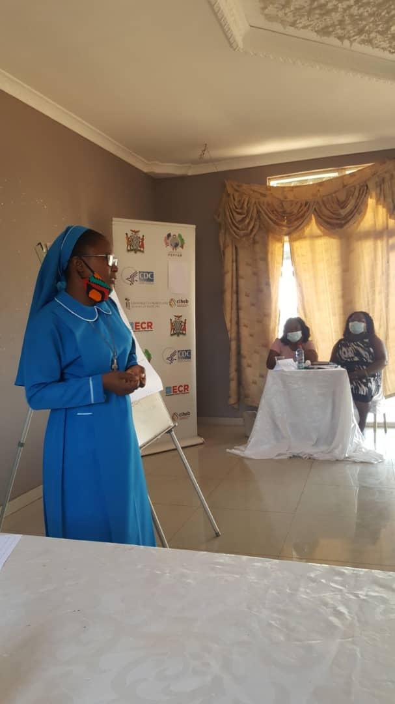
“SEA-CHANGE” AND FAITH MATTERS IN ZAMBIA (4)
“I was not sure that the Faith Matters Toolkit would be of great help to me. I should confess that the material is well laid out and did indeed meet my expectations and has made my weekly Tuesday community visitations a lot easier and enjoyable as we engage our communities on stigma…
Many congregants are coming out in the open and embracing their situations, knowing that we as a community are becoming more supportive and accommodating towards people living with HIV…”
Sr. Marleen Phiri, St. Oscar’s Parish, PETAUKE

Slide 11
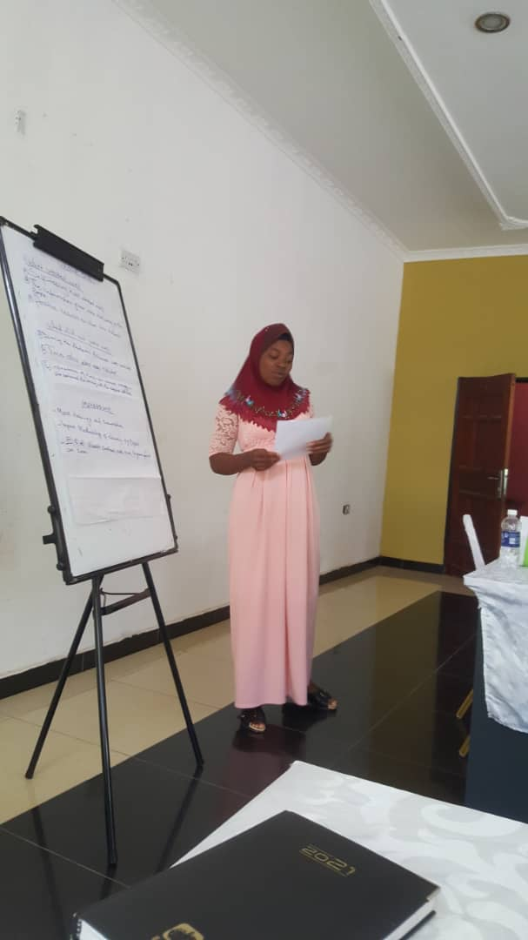
SEA-CHANGE IMPACT OF FAITH MATTERS IN ZAMBIA (5)
“In my faith [Islam], it is very difficult for a female to come out in the open and say that they are HIV positive. You are condemned and perceived to be immoral. Because of that, many of our sisters lead a secret life and can not allow themselves to seek medication so defaulting on medication is common among us…
But when ECR came to us, the Faith Matters training helped our Imams to spread the good news of knowing one’s HIV status and those positive are encouraged to seek medication without shame or fear…people are now more tolerant and supportive ”
Sr. Hildah Banda, Jame Masjid, LUNDAZI

Slide 12
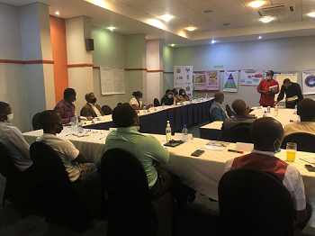
SEA-CHANGE IMPACT OF FAITH MATTERS IN ZAMBIA (6)
“The Faith Matters training was an eye opener to us in tackling issues of stigma & discrimination. So many have been encouraged to adhere to medication and it is working”
Rev. Mwanza, RCZ, Chipata
“We have counselled so far, over 100 members, tackling stigma, fear and discrimination and we have spoken to them about a health life through accessing PEP, and PrEP for the discordant couples, adhere to ART and praising the Lord for the science and the medicine that God’s people have been able to discover”
Fr. Moses, Anglican Presbyterian, PEATUKE

Slide 13
SEA-CHANGE STORIES ON STIGMA & DISCRIMINATION
FAITH MATTERS
“The Faith Matters tool kit has been a blessing to us, especially as used, with the student clergy in our congregation – an opportunity that I personally did not have. The students [Clergy] are very appreciative of this initiative and it is believed that there approach to these matters when ordained, will be better than in our time”. Rev. Phiri, Council of Churches in Zambia, LUSAKA
“With this knowledge we have acquired and the optional referral addresses for the different service providers, it will be easier for us to report cases of abuse quickly. We did not have more information, but now our eyes are open and cases will be reported immediately as it will just take a phone call.” Elder Grace, Methodist Church, MAZABUKA
“I used to live an unhappy life, but our pastor talked to me about an adolescent ART group where HIV positive adolescents meet and encourage each other. I am now committed finding my mates and also knowing that the church membership and leadership have continued addressing stigma & discrimination” Young Female, aged 14, MONZE
“Many of the cases of HIV testing we have done in the past month or two, have had clients stating that they came because of this or that church. When we inquired further, we were able to establish that many churches are working with an organization called ECR which explained an increase in numbers clients turning up for HIV testing from the churches…” Facility-In-Charge, Mwase Clinic, LUNDAZI

Slide 14
Thank You!!!

