Slide 1
Adolescent HIV Self –Testing (HIVST) in Nigeria

Slide 2
Outline
Background
Service delivery channels
How HIVST services work
Achievement
Recommendation
Conclusion
Notes:
Planned activities for the next quarter
Recommendations

Slide 3
Background
The prevalence of HIV in Nigeria among children 0-14 years is <1%.
An estimated 100,000 Children and Adolescents Living With HIV (CALHIV) are yet to be identified.
Adolescents miss HIV testing opportunities due to barriers associated with conventional community and facility testing models.
An approach that shows promising testing outcomes is the HIV Self-Testing (HIVST) strategy.
It is a non-invasive oral fluid-based test and is convenient for users.
Government of Nigeria (GoN) gave approval to FASTER to rollout of HIVST services in 7+1 States in Nigeria including FASTER Project procured and distributed 100,000 HIVST kits to service delivery points in collaboration with CDC IPs and GoN.
Health Care Workers/ HIVST Focal Persons were trained on HIVST services, tracking, linkage of confirmed positives and reporting.
Conducted demand creation for HIVST services through pastoral messaging and faith-based radio talk shows

Slide 4
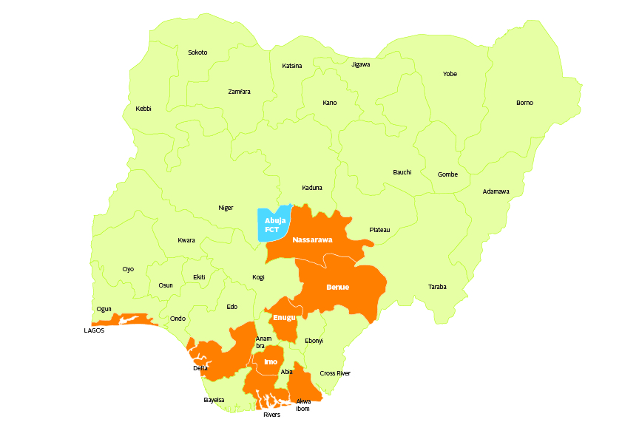
FASTER Supported States in Nigeria Lagos, Benue, Nasarawa, Enugu, Imo, Rivers, Delta and the Federal Capital Territory Abuja.
Creating demand for HIVST services using pastoral messaging at
St Patrick’s Catholic Church Issele-Ukwu, Delta State, Nigeria

Slide 5
HIVST Service Delivery Channels
How channels were identified
Health facilities owned by Faith Based Organizations (FBOs)
Public health facilities
Youth friendly centers
FBOs working in the community
Community Pharmacies
Community Based Organizations targeting adolescents and young persons
Use of Local Government Area HIV prevalence
HIV positivity hot spot mapping
Adolescent population density
Youth centers

Slide 6
How HIV Self Testing works
At the health facilities, identified HIV positive adolescents are counseled and a list of their partners is taken.
They are then given HIVST kits to give to their partners
Their partners are tracked within 48hrs for result of test, confirmation of HIV positive results and linkage of confirmed positives to treatment by escorting them.
In a community setting, adolescents are screened for HIV risk using a standard screening tool and eligible ones are offered HIVST kits.
HIV positive adolescents are counseled and given HIVST kits to give to their partners.
The are tracked within 48hrs for result of test, confirmation of HIV positive results and linkage of confirmed positives to treatment by escorting them.
In both the health facility and community setting, younger adolescents may be assisted by a health care worker or caregiver (parent/guardian) to carry out the test.
Older adolescents can also conduct the test on themselves without assistance.

Slide 7
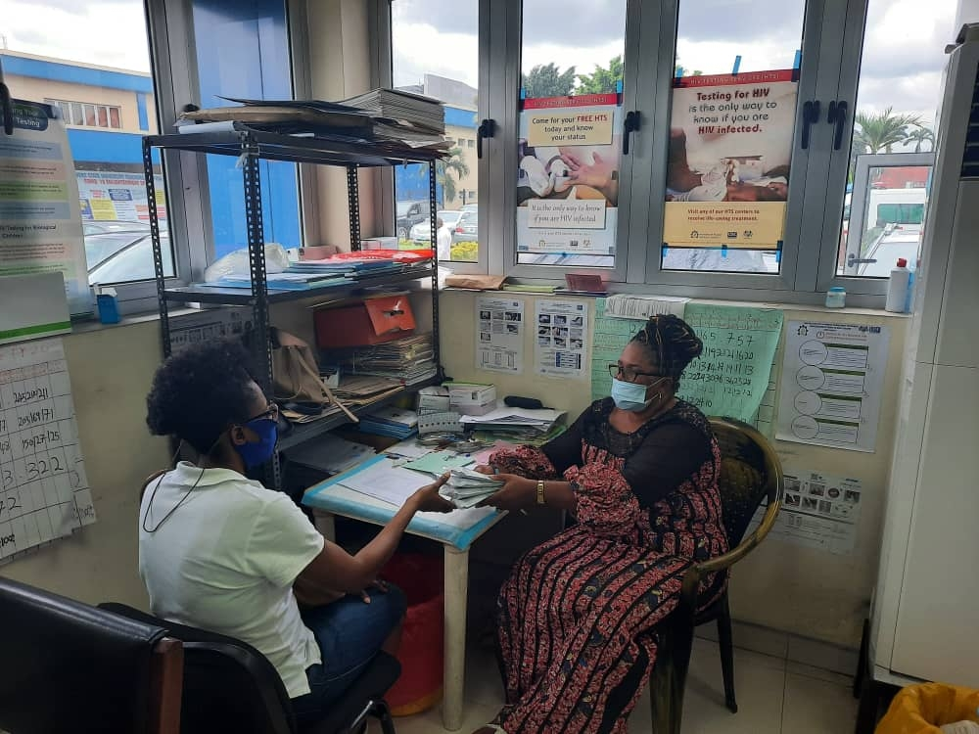
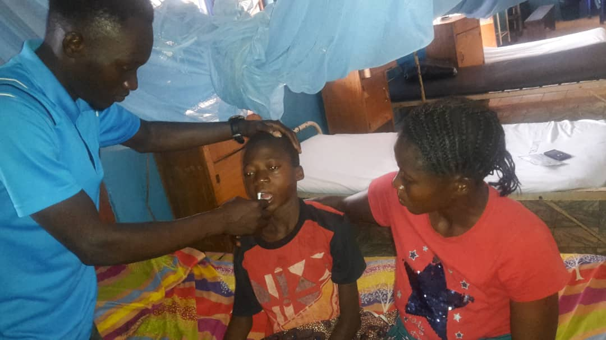
FASTER Community Volunteer conducting assisted
HIV self testing on an adolescent at a vulnerable
Children shelter at Benue State Nigeria
HIV positive Adolescent receiving HIVST kits for her partners at a
Health facility in Port Harcourt Nigeria

Slide 8
HIVST among adolescents 10-19 years old performed effectively across several states in Nigeria (October 2020 – April 2021)
Younger Adolescents
99.9% results returned
1.2% yield (POS screen)
95.0% confirmatory testing
Older Adolescents
99.9% results returned
5.4% yield
99.3% confirmatory testing

Slide 9
Recommendations
The implementation of HIVST should be prioritized as a means of ensuring that 95% of adolescents living with HIV know their HIV status and are linked to treatment, care and support services.
FBOs can support adolescents to know their HIV status by including faith-based HIV prevention messaging and demand creation for HIV self testing in pastoral sermons.
Following pastoral demand creation messaging, FBOs should conduct HIV risk screening amongst adolescents and distribute HIV self test kits to the adolescents eligible for testing.
Adolescents should be tracked for test results and those that are reactive to HIVST should be referred to health care facilities for further follow up.

Slide 10
Conclusion
FASTER Project Nigeria demonstrated the considerable potential of HIVST as a novel, non-invasive intervention in improving HIV case finding in the underserved adolescent population using faith based and non faith based models.

