Slide 1
Programmatic implementation of caregiver-assisted HIV self-testing
Zambia
20th Oct 2021

Slide 2
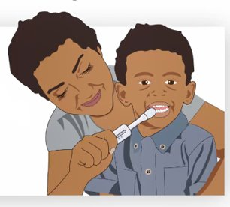
Background
World Health Organization approved the use of Ora Quick oral HIV test for children 2-11 years of age in November 2019.
During the COVID-19 outbreak, PEPFAR, advised countries to provide parents with HIV (index clients) oral screening kits to screen their biological children >2 years of age at home.
In Zambia, based on WHO and PEPFAR guidance, we compiled evidence from Kenya and Zimbabwe to seek approval on the use of caregiver assisted HIV self testing in children.

Slide 3
In Kenya and Zimbabwe, OraQuick performed just as well as blood based HIV testing in children and adolescents when administered by lay HIV testing providers
Countries
Chikwari C. Journal of AIDS, 2019
Study Purpose: Comparison of a saliva based self test to the blood based test for children
Intervention:
Ora Quick Antibody Test was performed by lay providers
Blood-based HIV testing was used to confirm the result
Results:
In Zimbabwe, all the 28 children identified positive by blood test were also positive using Ora quick saliva-based test
In Kenya, among the 43 children with HIV positive oral tests at 20 minutes, all of them still had positive results at 40 minutes indicating stability of visual results
Impact:
The results from this study have resulted in OraQuick being used by providers for testing children 24 months or older
Ora Quick revised the package insert for Ora Quick to include administration by HCWs for children 2-11 years of age, in addition to the previous guidance of HIVST for children ≥12 years of age.
Zimbabwe
Kenya
Target Population
Children Aged 18 months – 18 years
Results
100 % Sensitivity in all 71 children and was able to detect HIV

Slide 4
Caregivers interviewed in Zimbabwe reported that caregiver-provided oral HIV self-testing (HIVST) could be preferable and help overcome current barriers to pediatric testing
Country
Rainer C. AIDS Care, 2020
Study Purpose: Investigate caregivers and adolescents’ knowledge and attitudes towards HIV Self Testing using oral saliva based test
Methods:
Evaluated children aged 2–18 years in health facilities and communities in Zimbabwe
Research assistants interviewed caregivers of children aged 2–15 years and adolescents aged 16–18 years
Results:
Caregivers fear their children being recognized at the health facility linking recognition at the health facility with stigma.
Caregiver-provided testing and HIV Self Testing could address these barriers through increased privacy.
Adolescents reported the desire for support during the HIVST process.
Impact:
Findings demonstrate HIV Self Testing could increase the uptake of HIV testing.
Expand the use of directly assisted HIVST models for adolescents
Zimbabwe
Target Population
Caregivers & Adolescents
Results
Participants felt caregiver-provided HIVST could reduce HIV testing barriers by increasing privacy and reducing stigma.

Slide 5
Implementation of HIVST in Zambia
Discussions with the Ministry of Health (MoH) and the HIV Technical Working Group, resulted in caregiver assisted HIV Self Testing approval for use for children during COVID-19
Temporary measure is intended to counter the effects of COVID-19 on identifying children with HIV so that they can be put on treatment.
MoH selected the facilities to implement the HIV Self Testing, Health Care Workers trained.
Job aids and training materials including a video showing caregivers how to perform self testing developed and used

Slide 6
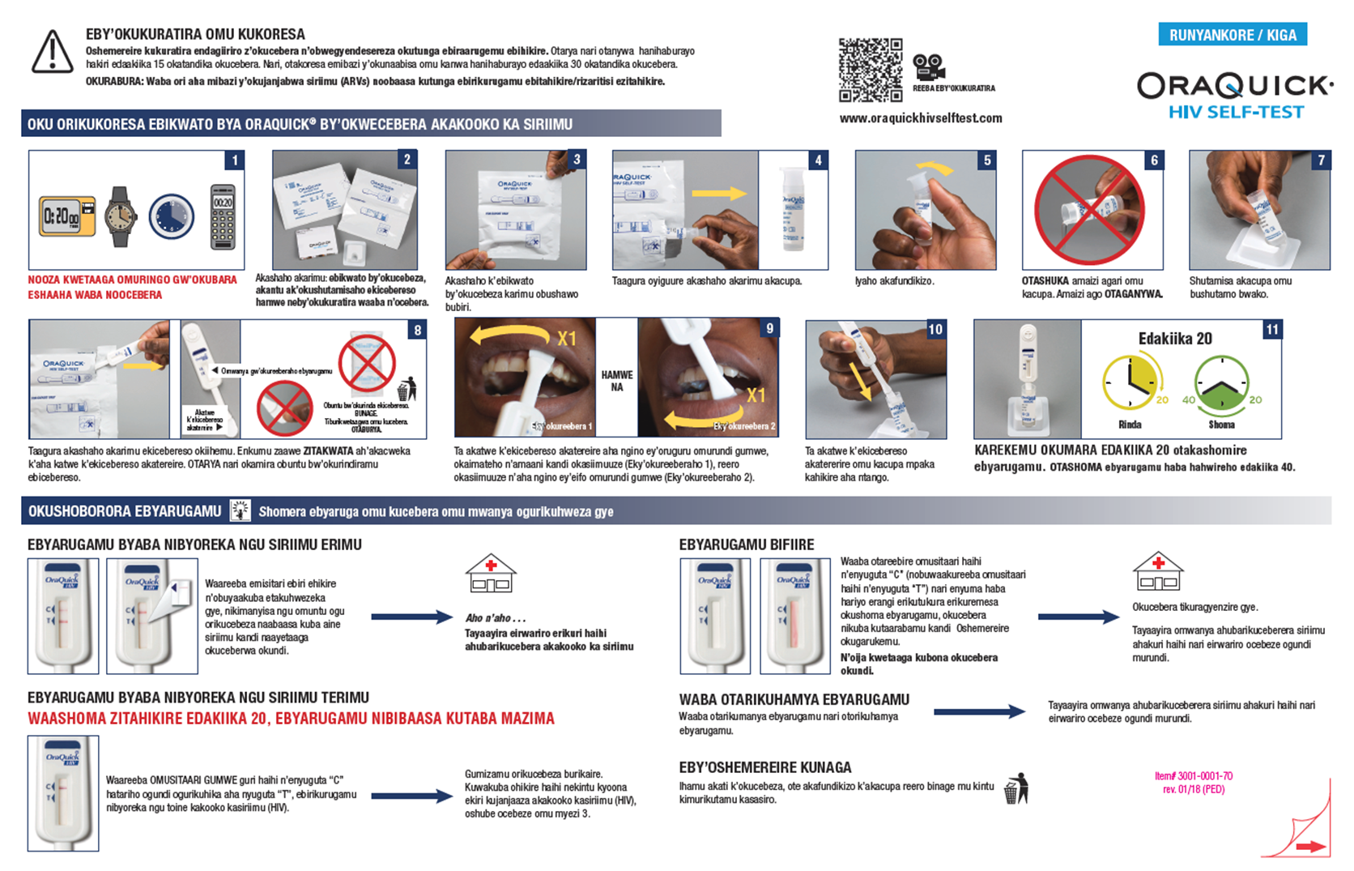
Implementation of HIVST in Zambia
Procured 2,500 test kits to kick start the implementation.
Progress to date
5 facilities (not faith-based facilities) have started the implementation of care giver assisted HIV Self Testing in children
134 children have been indexed through their care givers using HIV Self Testing since implementation (August 30th 2020)
So far, 83 of the 134 kits (62%) have been returned from caregivers with a positivity rate of 1%.

Slide 7
Lessons learned, Recommendations and Conclusions
Caregiver assisted HIV self testing is easy to perform by caregivers
Caregivers may prefer this modality for privacy
During the Covid pandemic assisted HIV self testing in children can help provide testing options in children
Follow up is needed on distributed test kits so that HIV positive children can be linked to confirmatory testing and treatment as indicated

Slide 8
Lessons learned, Recommendations and Conclusions
More than 70% of Zambians profess to be aligned to a particular faith.
Faith leaders/communities play a very important role in advocating for HIV testing in children, including linking to treatment and encouraging staying in care and treatment.
HIVST information can be shared within faith communities as a scientifically proven testing option that allows for privacy and can be supported by health care workers.

Slide 9
THANK YOU!

