Slide 2
Mission:
End sexual violence against
women and children globally
Notes:
No Means No Worldwide (NMNW) is an international non-governmental organization whose mission is to end sexual and gender-based violence against women and children globally. NMNW trains instructors in high-risk environments to deliver the evidence based and evidence informed No Means No curricula.
We are facing a pandemic inside of a pandemic. COVID + SGBV
Need for this work now more than ever

Slide 3
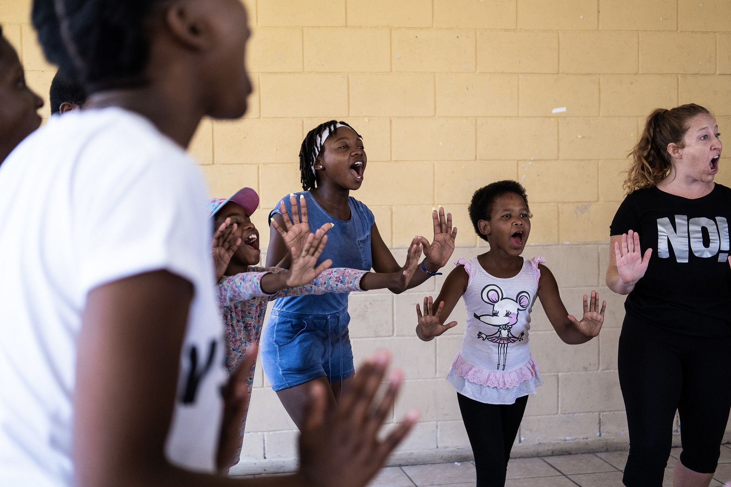
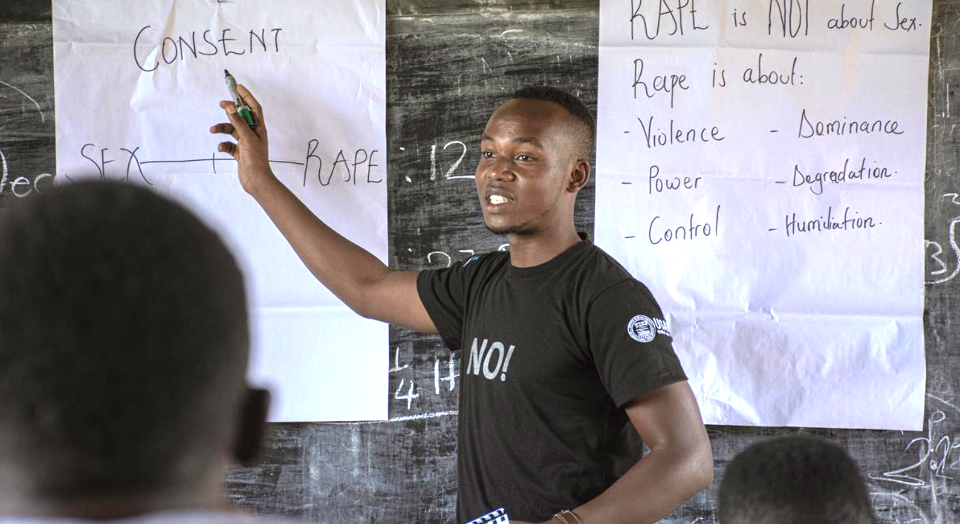
No Means No Curriculum
Girls aged 10 - 20
Boys aged 10 - 20
Awareness
Personal safety
Positive masculinity
Redefining gender roles
Debunking rape myths & culture
Cycle of force
Consent
Bystander intervention
Self-efficacy
Empowerment
Assertiveness
Boundary setting
Saying “NO”
Role of voice
Physical self-defense
Notes:
NMNW adopts a comprehensive approach that aims to put a stop to the cycle of violence and to inspire community-wide generational change.
We teach both girls and boys because we firmly believe the key to ending the global rape epidemic is to empower both genders to create a culture of mutual respect.
NMNW has dual gender, skills-based programs for boys and girls ages 10-20.
For boys the (10-13)
Boys (14-20).
NMN Girls curriculum (10-20)
Boys learn to challenge harmful gender norms and rape myths
They are also educated on their role and responsibility in preventing violence in their lives and communities and are equipped with bystander intervention skills to interrupt harmful behavior when they witness it or anticipate it.

Slide 4
EMPOWERMENT SELF-DEFENSE
ESD is a holistic self-defense approach that teaches mental, verbal, and physical skills
to prevent and respond to all types of violence.
ESD Principles: trauma informed approach
Repudiating victim-blaming
Honoring anything anyone has done or is doing to survive
Consent: Emphasizing Voice and Choice and giving students agency over what they want to do and not do in class for ex: asking for consent before touching.
Notes:
Builds resilience, self-efficacy and assertive models of femininity in girls
Builds critical thinking around socialisation of girls and women into being passive, subservient, e.g. that women and girls should not ‘say no’ but should please others / men and put others’ needs before their own, or accept abuse rather than demand respect.
ESD promotes finding power in one’s body rather than the disempowering narrative that men are physically superior and if a man is committed to rape it is inevitable.
Creating a safe space where all opinions are valued and respected
Accommodating all learning styles and abilities
Repudiating victim-blaming, and honoring anything anyone has done or is doing
to survive
Success-based learning: building skills one step at a time
Collaborative approach: Partnering and leveling power differences between Trainer and Trainee and honoring the students’ knowledge and experiences
Emphasizing Voice and Choice and giving students agency over what they want to do and not do in class for ex: asking for consent before touching.

Slide 5
Long-term Partnership Vision
Program Design and Adaptation
Intensive Training of Instructors + 8 wk technical assistance
Establish MEAL framework
Identify top Instructors
Initial Program Launch
Program adaptations based on MEAL
Certification of local Master Trainers
Ongoing business development / Fundraising
Local Partner Ownership
Partner trains new Instructors in-country (own org, local implementing partners)
Partner leads scale up / integration with government
Local Scale Up
Vision:
A Global Network of Partners Scaling IMpower
Instructor / Master Trainer Refresher Training and Resources
Research, MEAL
Comms, Advocacy, Business Development
Conferences / Workshops
Ongoing Technical Support
Notes:
Our model for scale is built on partnerships. We are a tech assistance provider, and we partner with local Implementing Partners.
Our goal is to support IPs to sustain and amplify the impact of their own IMpower program over the long term. We work closely with partners to monitor the fidelity of their IMpower programs, but also offer technical guidance and support along the way.
Timeline for these phases varies depending on the partner capacity, funding availability, etc.
Our ultimate intent is to build a community of practice where all partners will benefit and learn from one another.
To date NMNW has worked with IPs in:
South Africa
Nigeria
Uganda
Ethiopia
United States
In 2021 NMNW is working with new IPs in:
Zimbabwe
Zambia
Malawi
Lesotho
Namibia
Tanzania

Slide 6
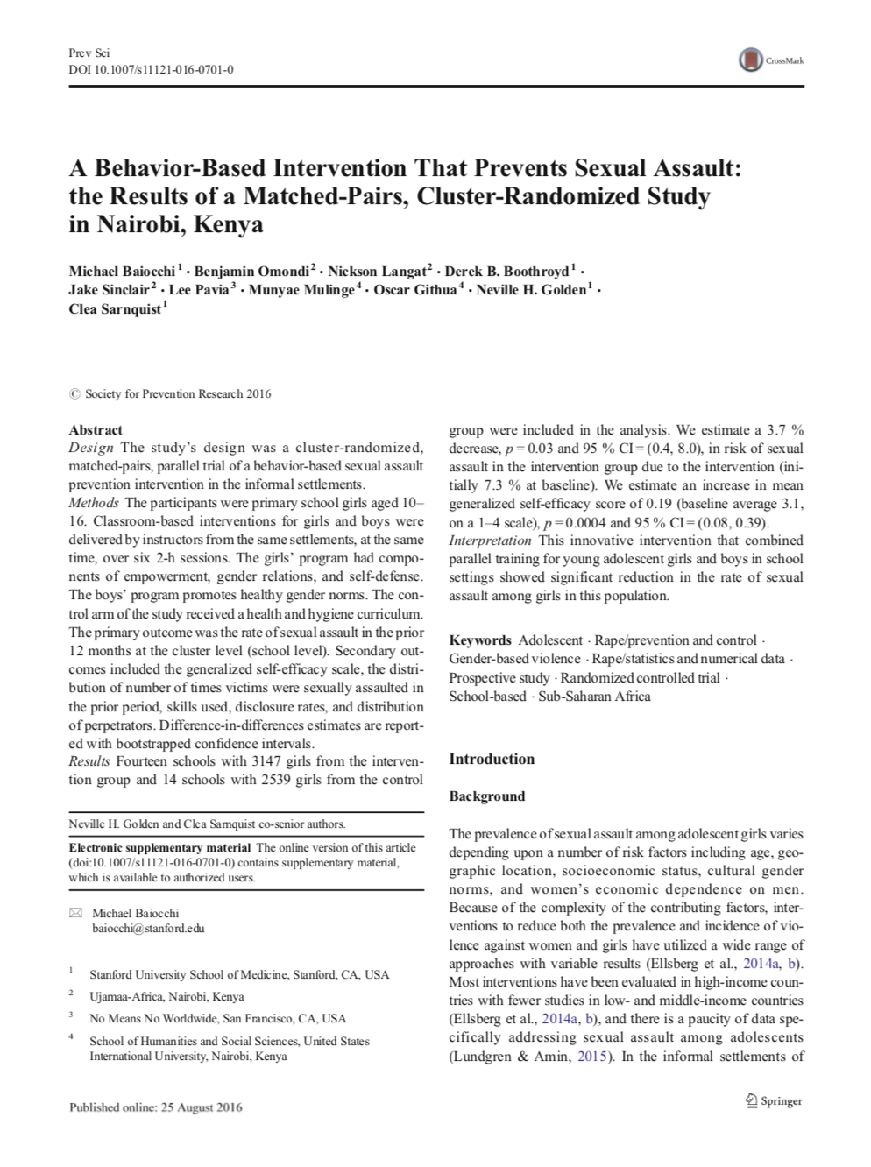
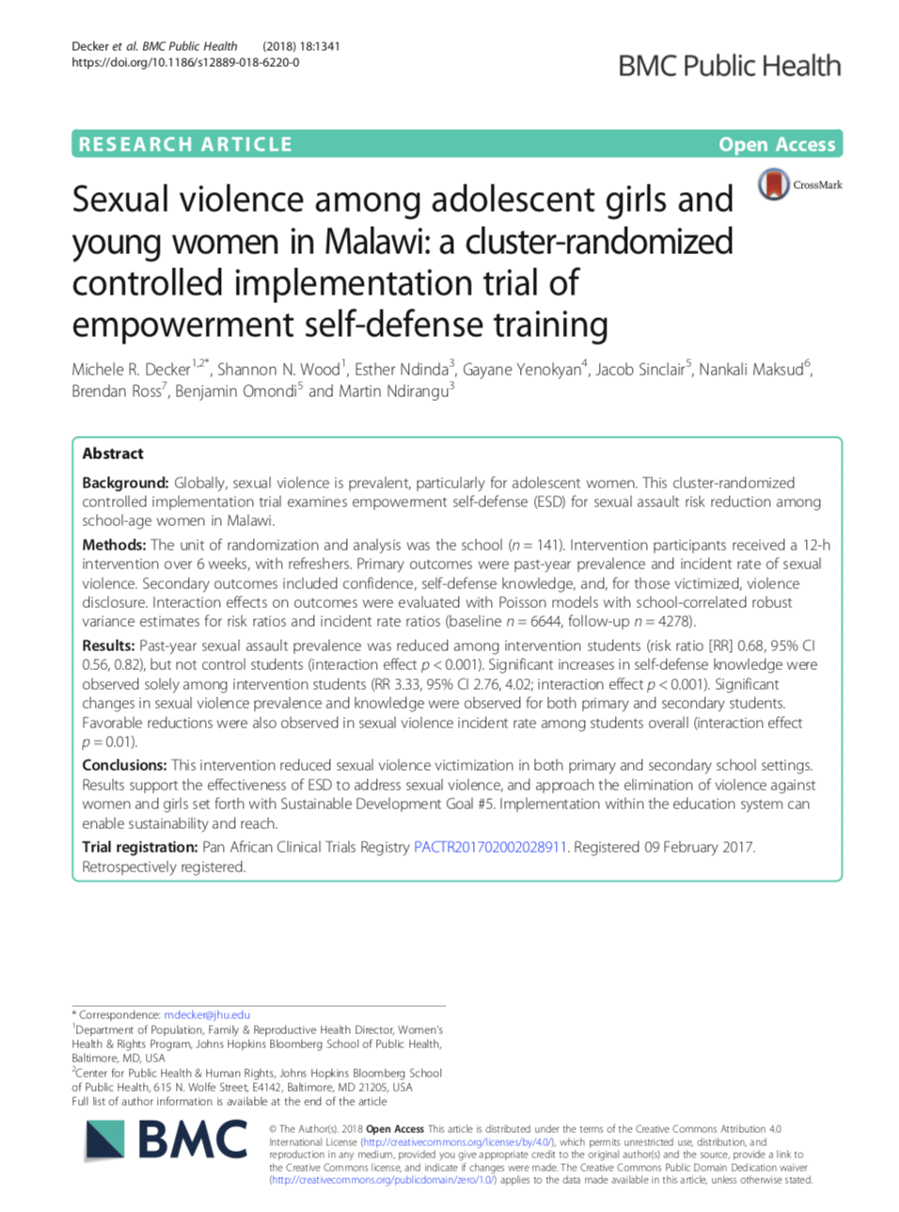
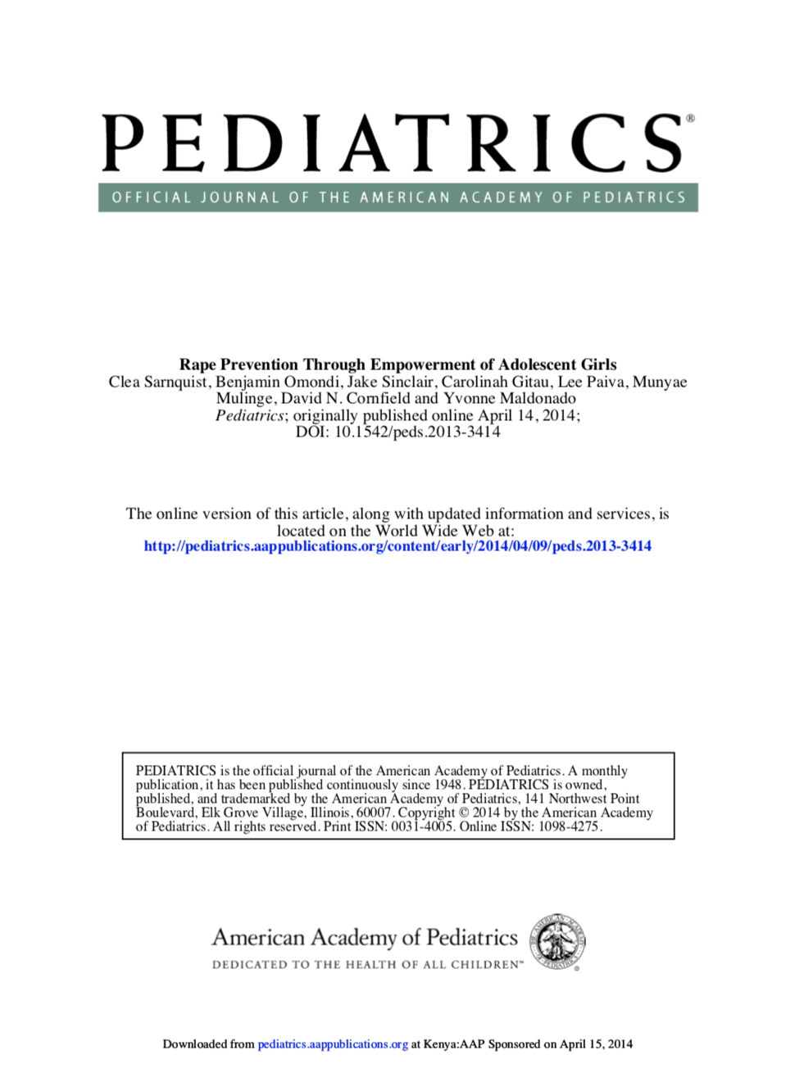
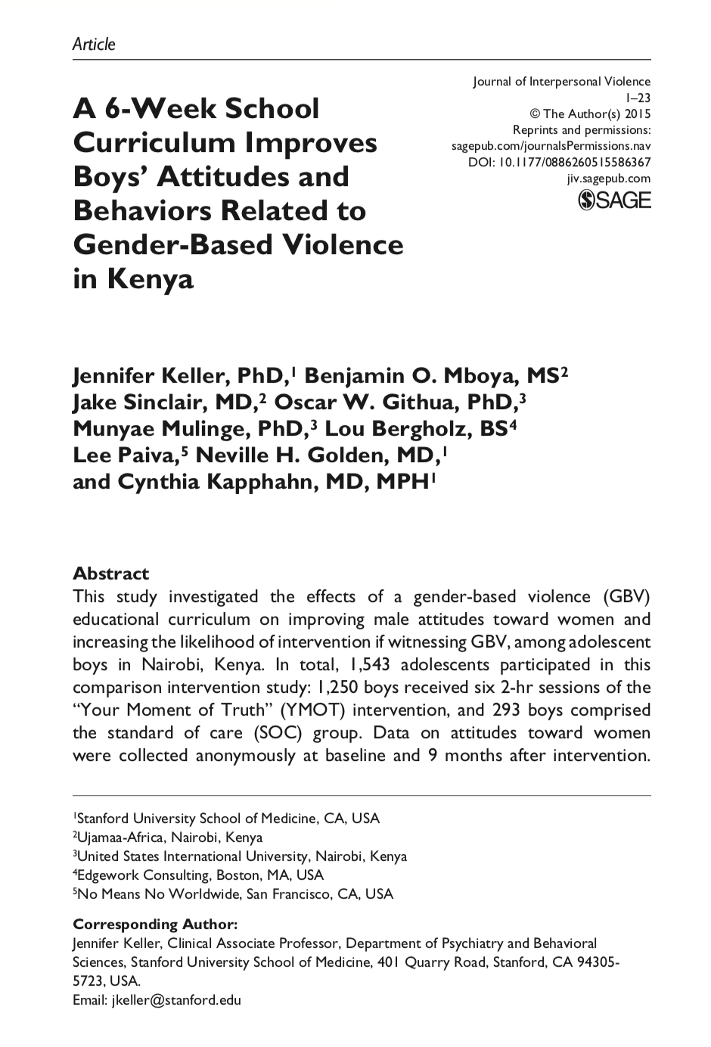
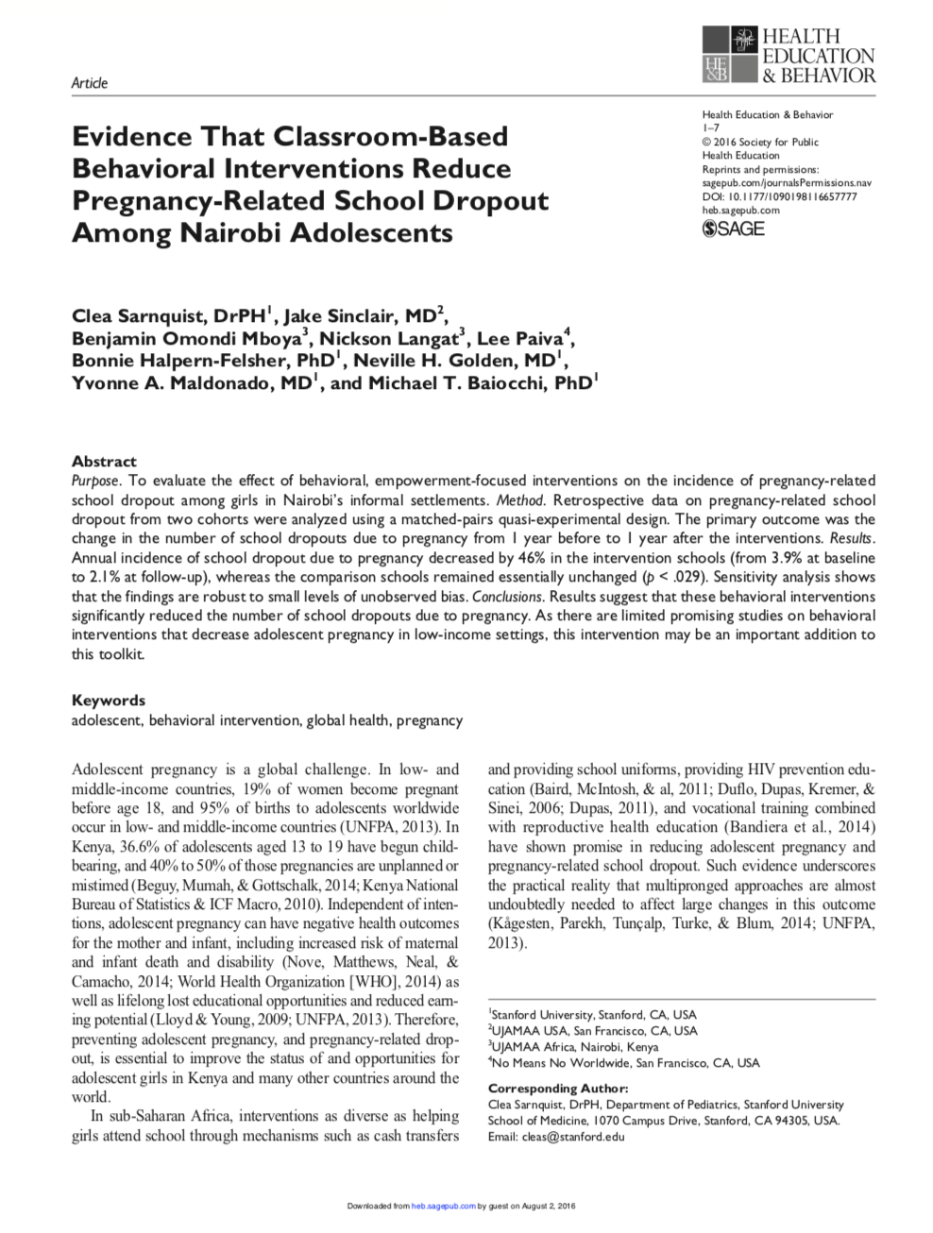
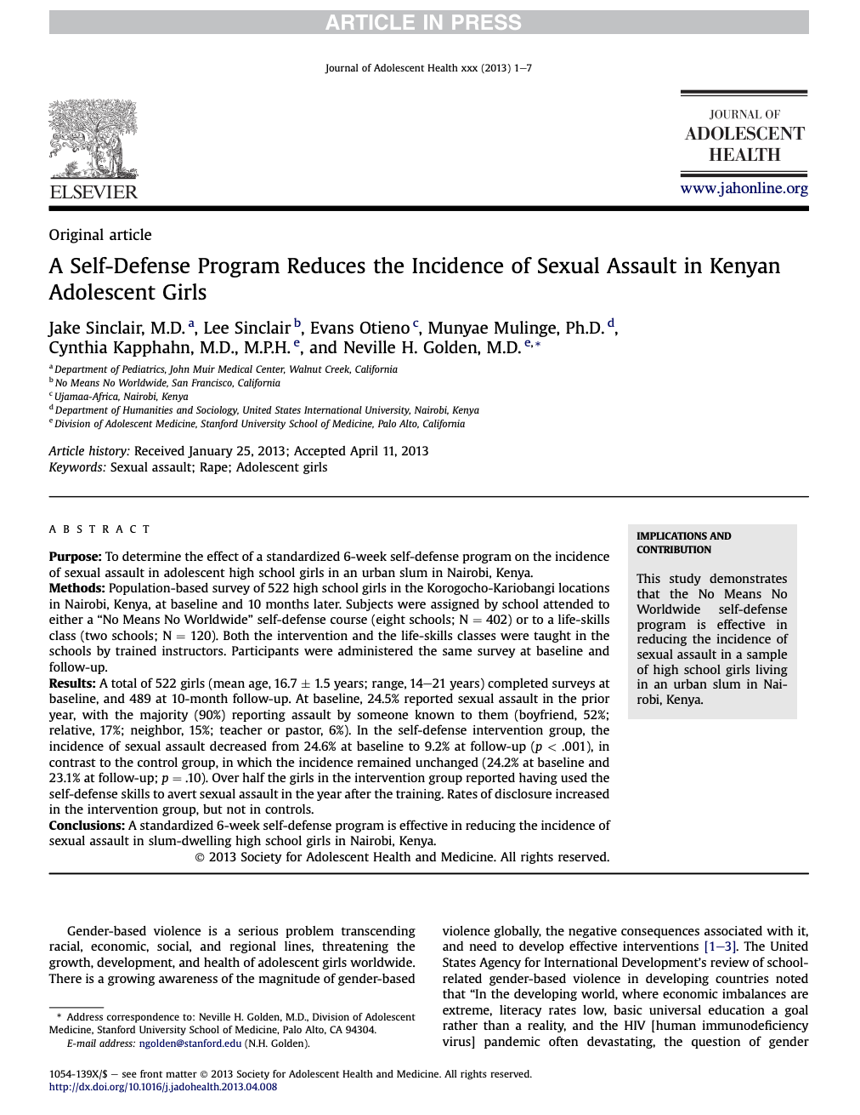
Notes:
We invested in academic, peer reviewed research from the beginning. We have 8 papers published in major scientific journals with Stanford University and Johns Hopkins and each one tells the same story.
You can find them all on our website, but I’ll highlight some of the key findings today.

Slide 7
At least 50% of female participants use NMNW skills to stop a rapist in the year following the training.
79% of boys who witnessed physical or sexually assaultive behavior successfully intervened to stop it.
PROVEN
IMPACT
46% decrease in teen pregnancy related school dropouts among program participants.
47% decrease in the overall incidence of rape among female participants.
Based on data collected by the GBV Prevention Collaborative at Stanford University and reported in six scientific articles.
Notes:
To date, 8 peer-reviewed research studies in top journals have been published that review the No Means No approach
Based on data collected by the GBV Prevention Collaborative at Stanford University and reported in six scientific articles.

Slide 8
SECONDARY OUTCOMES
Significant increase of the number of girls disclosing violence
50%+ of girls used skills learned in class to defend against assault
Boys who completed the program had more positive attitudes towards women
Intervention cost was as low as $1.75 USD/person, compared to $86/person for immediate aftercare services in the same community

Slide 9
NMNW’s work with FCI
Zambia
2 prime partners: Expanded Church Response, Pact (2 sub-partners: Catholic Medical Mission Board, Copperbelt Health Education Program)
Programming in Lusaka and Copperbelt
Start Date: May 31, 2021
32 certified female Instructors
Zimbabwe
1 prime partner: FACT Zimbabwe
Programming in Manicaland Province
Start Date: August 23, 2021
20 female Instructors currently being trained
Tanzania
3 prime partners: Amref Health Africa, Henry M. Jackson Medical Research International (1 sub-partner: Caritas), Pact
Programming in Songwe and Tanga
Anticipated training date: Q1 FY22
Expect to certify up to 32 Instructors

Slide 10
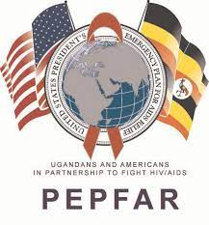
NMN EXPERIENCE IN MUBENDE DISTRICT
15/09/2021

Slide 11
NMN Program Implementation_MILDMAY UGANDA
NMNW Rollout
NMNW Program Rollout in April 2021 in Mubende District
16 instructors Trained in NMN Girls (8-Hour)
Roll out in sub counties in Mubende District
Targeting AGYWs in the community, OVC and DREAMS
NMN Delivery Method
In school (Intervention given at a school during official school hours)
After of school (Intervention given at a school outside of official school hours)
Out school (The intervention was given at a venue that was not a school.)
Survivors in Recovery Anonymous
23 Girls disclosed during the April-June 2021

Slide 12
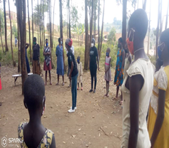
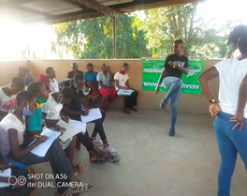
Mildmay goal vs. Achievement
Highlights
Target is to empower 3000 AGYWs (10-20 Years) in 5 Months (May 2021 to September 2021) in Mubende District
In May-August 2021, 44% (1331) Achievement against the 6 month Target.
Targets distributed at Sub-county Level
COVID Restrictions affected Progress (Total Lockdown)
AGYW-1331
Not attended 6-8 Hours-38
(97%) 1293
Graduated
Field Experiences with the Girls in Photos

Slide 13
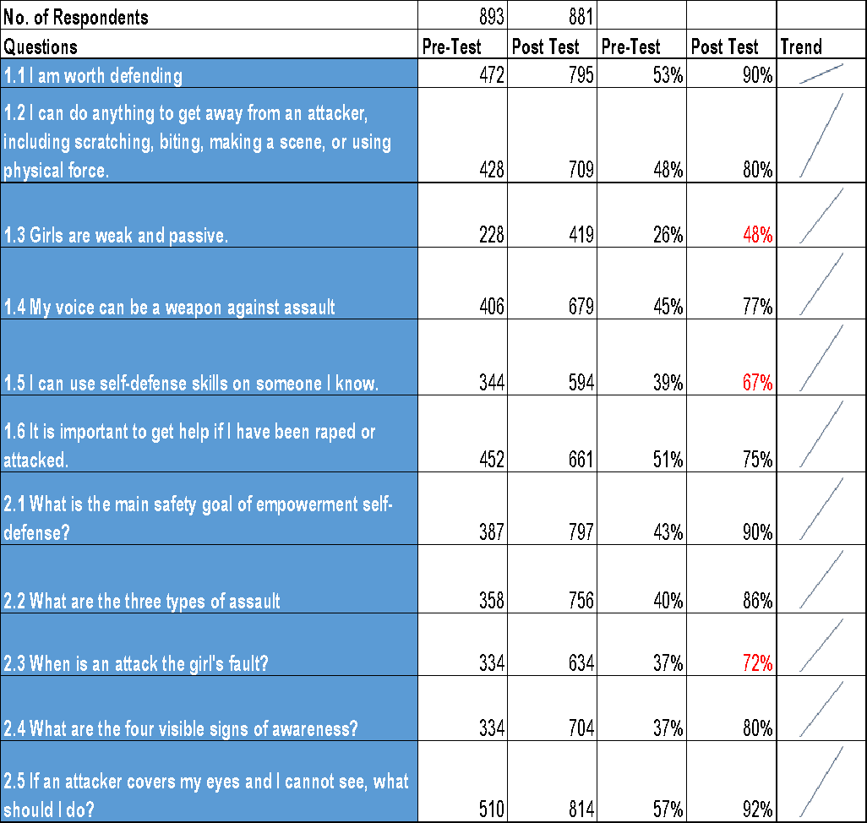
Pre-Post Analysis and Findings- Field Experiences (April-June 2021)
Areas to focus on
Girls are weak and passive.
I can use self-defense skills on someone I know.
When is an attack the girl's fault?

Slide 14
Experiences
Positive
Program embraced by the community, district and AGYW
AGYW reported autonomy and confidence
AGYW are in place and willing to be trained in NMNW.
Convenience of the 8hr program
Church Youth peer leaders mobilizing AGYW to participate and cascade
Negative
Advance effects COVID 19- School closure;
AGYW-Slow learners;
Geographical scope and road terrain;
Language Barrier

Slide 15
Experiences
Positive
Negative
AGYW are in place and willing to be trained in NMNW.
Caregivers in the community do appreciate the program on empowerment & Self-defense (SGBV issues).
AGYW feel they can now defend themselves once attacked.
Caregivers and the school administrators are requesting for the involvement of the boys in the NMNW program since they also need the awareness (NMNW for Boys in Mubende).
Sub-county leadership welcomed the program and supported the program by providing masks to the AGYW during Trainings.
NMN Program well appreciated in schools and community
The In school delivery method seems the best in terms of mobilization & retention of AGYWs. The instructors are sure the girls will attend all the 8 Hours
Change in Attitude for Girls
Advance effects COVID 19- School closure; Adolescent Girls aged 10-11 Years face a challenge of writing and some are not able to write their names well. They reported having forgotten how to write, thus a few AGYW trained had challenges in answering the pre-test and post-test.
AGYW-Slow learners; found time limited, they needed more time.
Geographical scope and road terrain;
Transport to reach the community was so difficult since sometimes the social workers had a busy work schedule and were not able to transport the instructors to the training venue on time, in addition COVID19 restrictions of not carrying people other than cargo . Long distances and Bad roads especially Madudu. Mildmay Uganda has resorted to give transport refunds to the instructors to hire transport of motor bikes to and fro the communities
Language Barrier in some communities; some girls do not understand Luganda yet it is the local language in the community

Slide 16
Visit www.nomeansnoworldwide.org
Follow us
@NomeansNoworldwide
@NMNWorldwide

