Slide 1
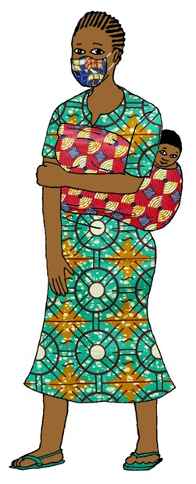

https://www.faithandcommunityinitiative.org/

Slide 2
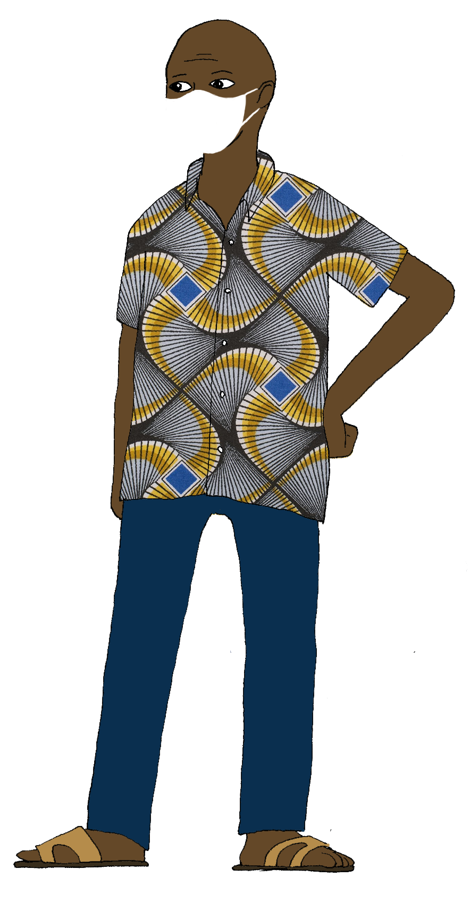
LIFE
We can have real hope in the face of COVID-19! Most cases of COVID-19 are mild; most people who contract COVID-19 recover; and every person can contribute to preventing new cases by taking simple steps like physical distancing, hand hygiene, covering the mouth and nose when coughing or sneezing, and wearing a face mask.
Life is a gift of God that we have the privilege to share, protect and celebrate with and for our brothers and sisters.

Slide 3
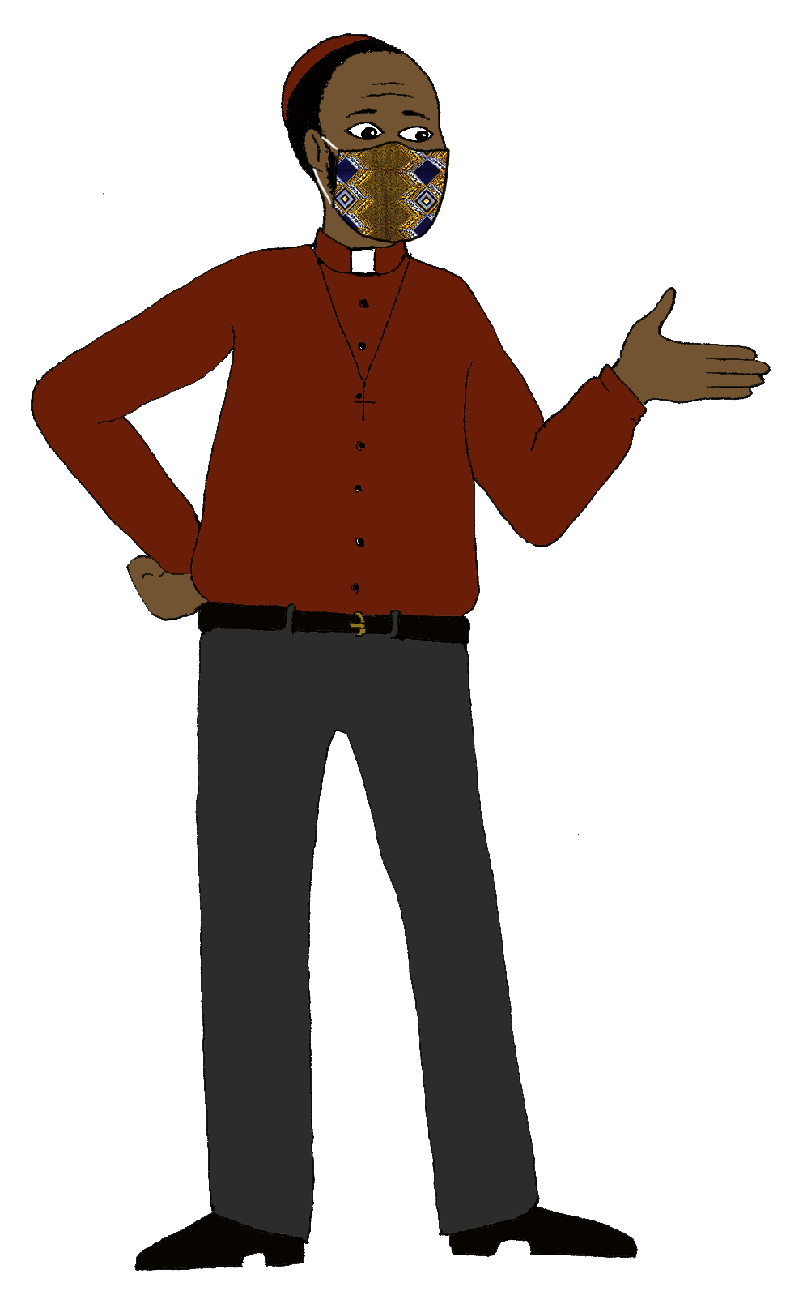
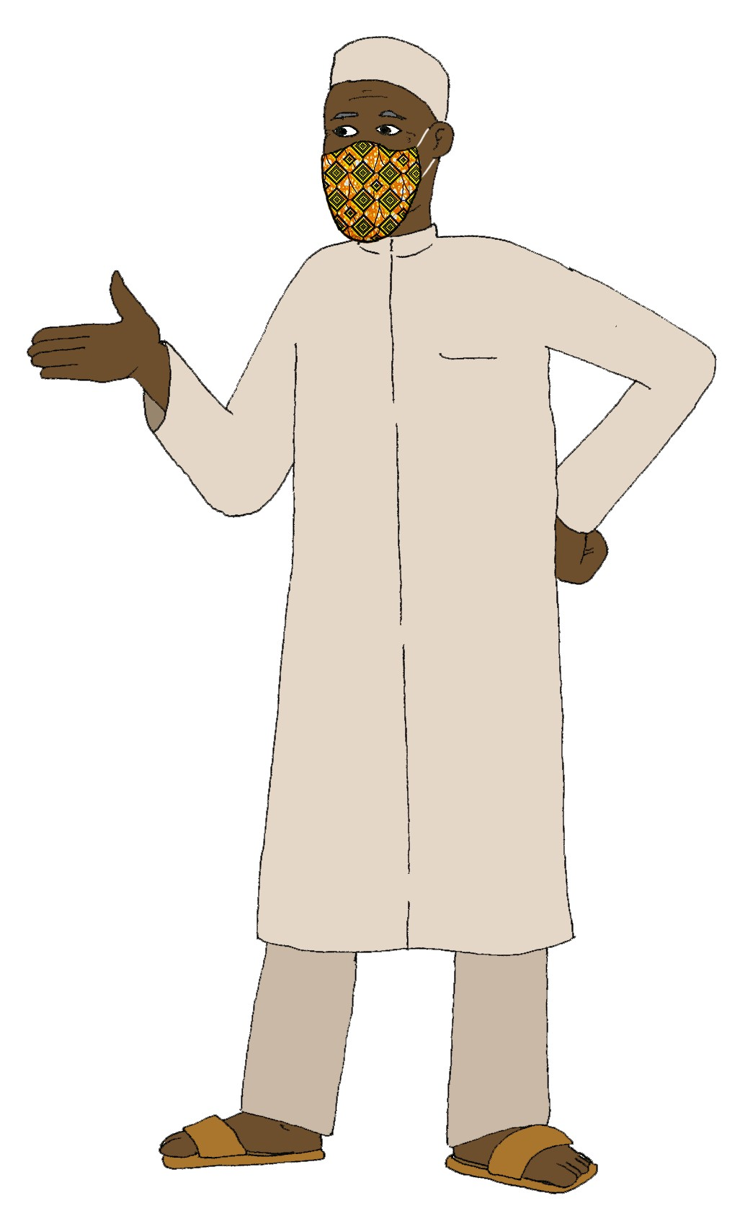
INFLUENCE
We faith leaders are sharing prevention messages to stop the spread of COVID19. Let’s live, hope, connect, care and celebrate together!!!
Lead from the front!

