Slide 1
REACT, RESPOND & REBUILD HBC during Covid-19
Ms. Anupama Silas - Founder/Executive Director, Vanitashray
and
Mr Gary Kamaal – National Director for VIVA India
www.viva-india.org www.vanitashray.com

Slide 2
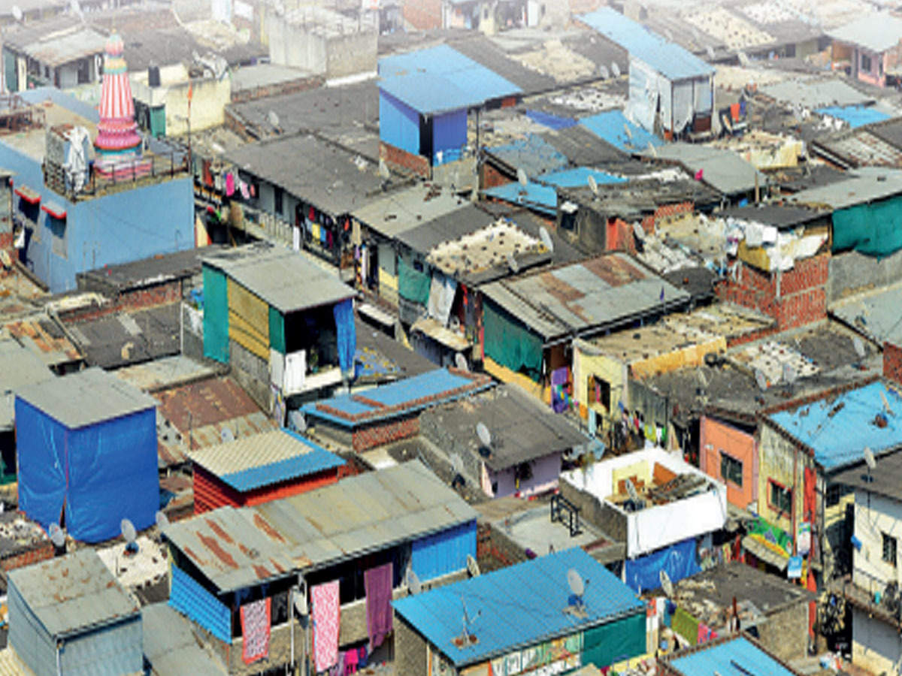
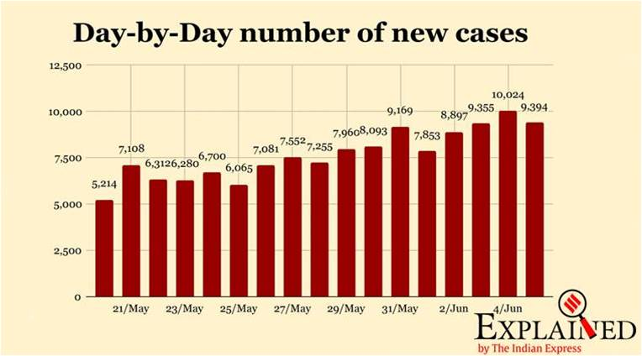
Population- 13 Million
47% Living in Slums
PUNE

Slide 3
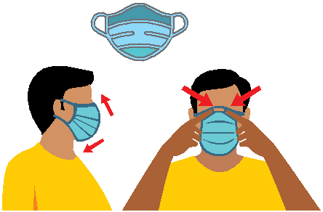
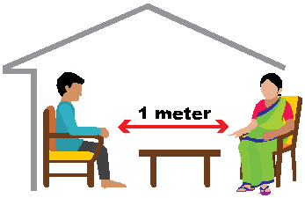
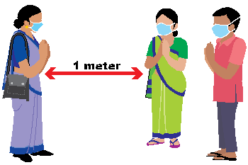
WHAT ARE THE SAFE PRACTICES AT HOME FOR QUARANTINED INDIVIDUALS?
Seek health care and notify
• If suffering from fever, cough, or having difficulty in breathing, wear a mask to protect others and immediately get in touch with your nearest health
facility or ASHA or ANM.
Stay away from others
•• Stay in a specific room and
away from other people in
your home. Maintain distance
of at least 1 meter. Restrict all
movement so that others in the
house stay safe from infection.
•• If available, use a separate
bathroom.
Wear a mask
•When you are around other
people and before you enter a
healthcare provider’s clinic.
•If sick person is unable to wear
it, then other family members
should wear it when they enter
the sick person’s room.
Avoid going to public areas
•Do not go to work, school, or
public areas.
• If you are infected, you could
transmit infection to others.
Avoid visitors or support staff
coming to the house
•You may likely pass infection unknowingly.
•Support staff like maids, drivers,
etc. should be asked to stay away.
www.viva-india.org www.vanitashray.com

Slide 4
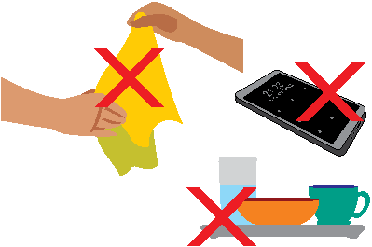
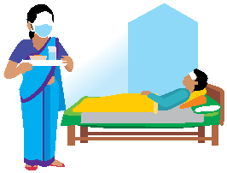
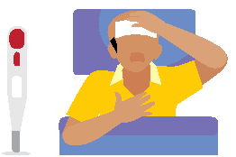
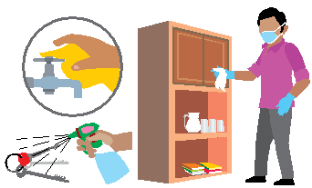
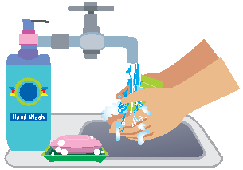
HOW TO SUPPORT HOME QUARANTINE?
2. Monitor Symptoms:
Fever and breathing must be monitored regularly and reported immediately in case there is breathing difficulty or very high fever.
3. Protective Hygiene:
Avoid sharing household items like dishes, drinking glasses, cups, eating utensils, towels, bedding with the suspected person. Throw used tissues in a lined closed trash can.
Wash and disinfect linen in warm water and soap, dry in sun.
Washing machine: use disinfectant, soap, warm water, dry in sun.
Linen can be soaked in hot water and soap in a large drum, using a stick to stir, avoiding splashing (soak linen in 0.05% chlorine for approximately 30 minutes. Finally, rinse with clean water and let linen dry fully in the sunlight.
1. Support:
Assigned family member to take care of person suspected of infection helping them follow doctor’s instructions for medication(s) and care.
4. Clean and disinfect:
All “high-touch” surfaces, such as table tops, doorknobs, bathroom fixtures, toilets, bedside tables, every day. Also, clean any surfaces that may have blood, stool, or body fluids on them.
5. Wash hands
with soap and water for at least 20 seconds or, if soap and water are not available, clean your hands with a 70% alcohol-based hand sanitizer. Wash often and especially after touching.
www.viva-india.org www.vanitashray.com

Slide 5
HOME BASED CARE
COVID-associated vulnerabilities, including violence and hunger
-Indian women have filed more domestic violence cases during this lockdown phase than in the last 10 years. (Source: The Hindu)
HOME-BASED CARE, and COVID-19 SECOND ORDER IMPACTS
The government's helpline for children (1098) receives 4.6 lakh calls during the first phase of a nationwide lockdown, intervention calls to CHILD HELPLINE – with 30% COVID-related
Majority of such interventions were simply pleas for food. However, 9,385 of these calls were cries for help from children who were being subjected to physical, emotional or sexual abuse, or being trafficked,
or abandoned.
So, the Government is approaching us
NGOs to help the PDS reach the last mile.
Hence we are engaged in cooking meals everyday
for the communities.
India also has ‘invisible children’
– estimated 2 million
www.viva-india.org www.vanitashray.com
Notes:
Feeding Centres providing Meals for 1500 + Families
Medical Camps conducting for communities
Community Health Care workers daily visiting Children at risk
Stitching and providing of masks by community women
Distribution of Ration to Single mothers’ and widows
National Help lines for Child Abuse and Domestic violence- Counselling and legal help
Training Community Health Workers
Training for crisis management Teams
Working with Government Authority and civil society
Teacher Training for Community Home based education- kits provision
Practicing social distancing, sanitization and hand washing

Slide 6
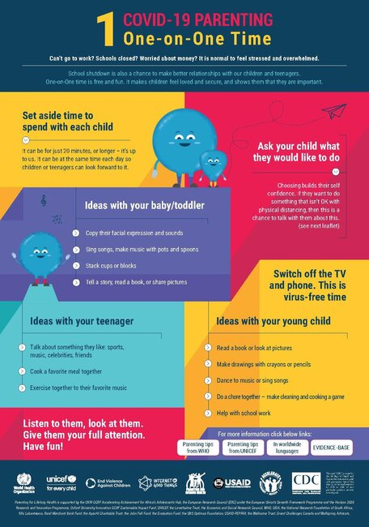
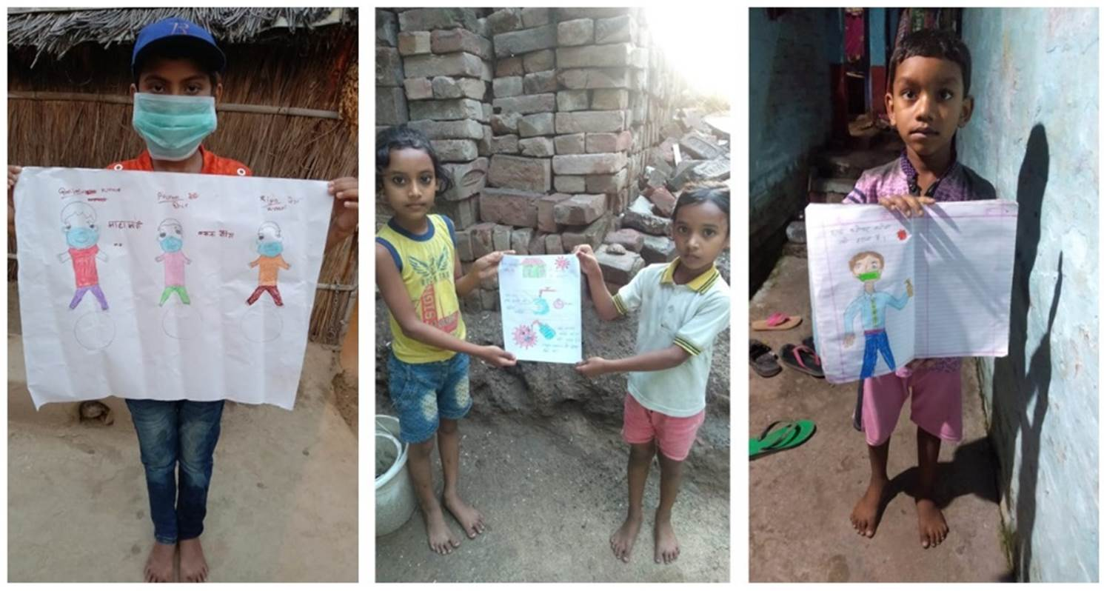
COVID-19 Parenting Keeping it Positive
Set aside time to spend with your children
www.viva-india.org www.vanitashray.com

Slide 7
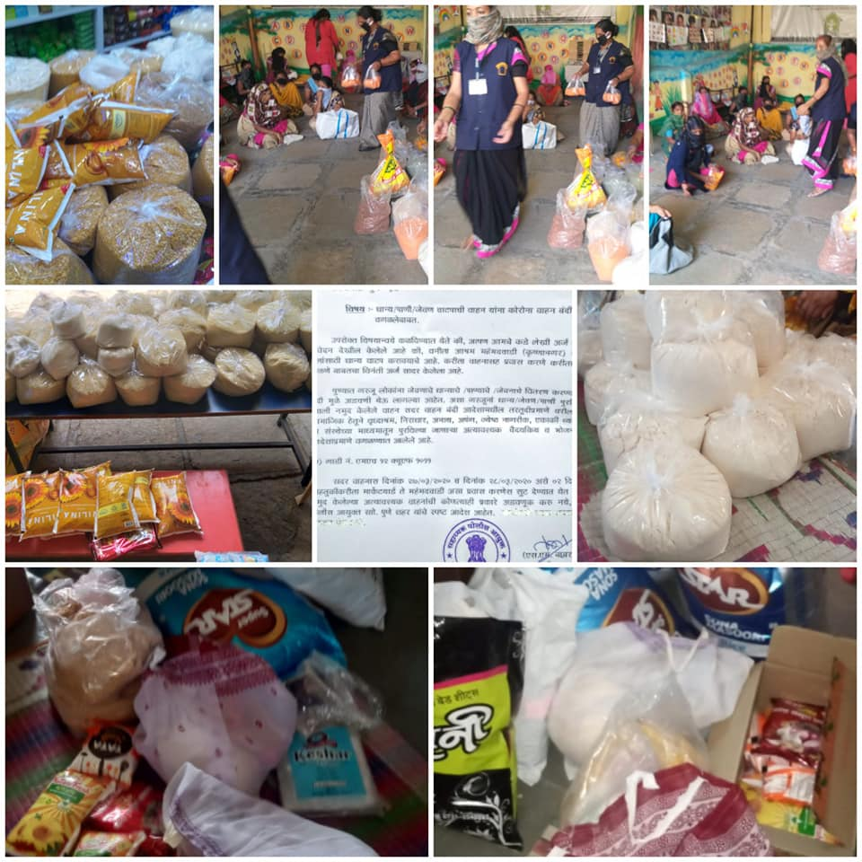
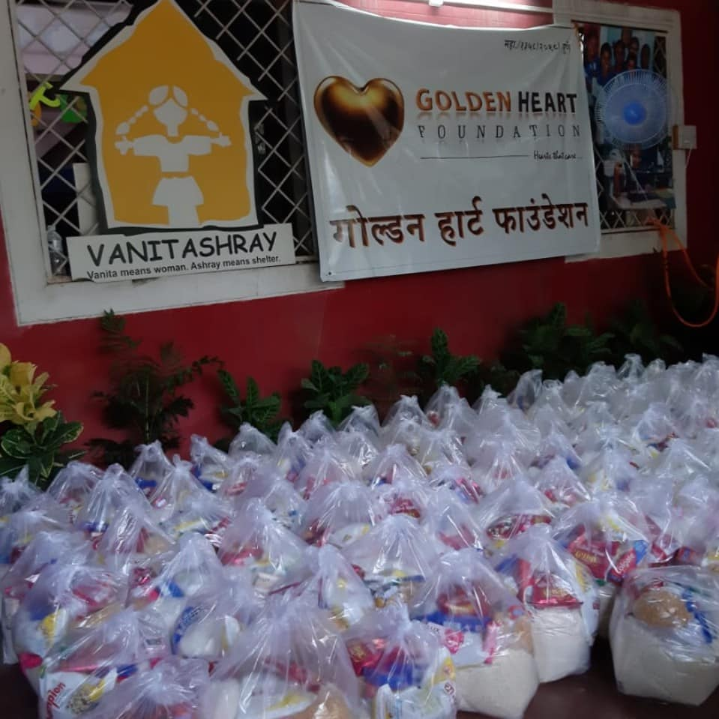
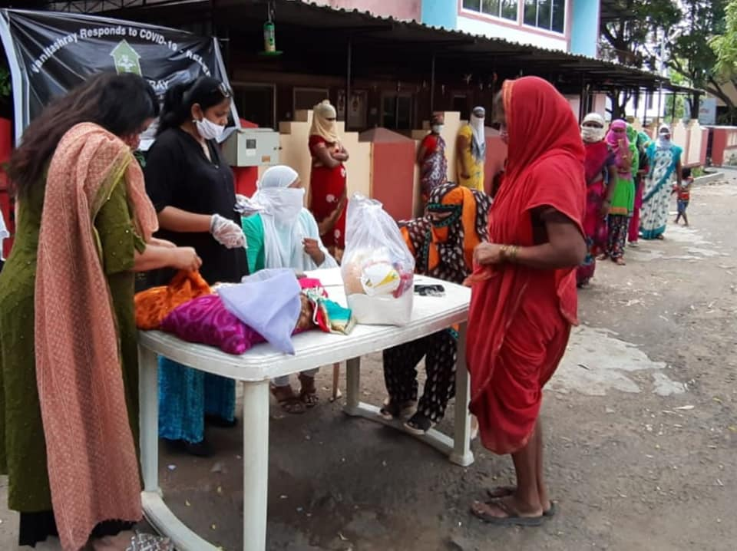
www.viva-india.org www.vanitashray.com

