Slide 1
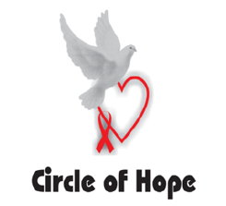
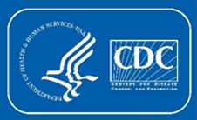
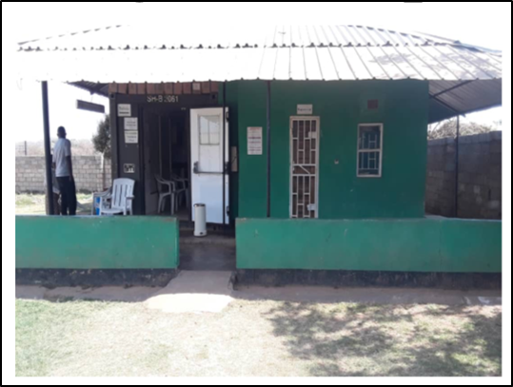
Increased HIV case finding and efficiency through faith-engaged community posts: Catholic Relief Services Circle of Hope, Zambia (March 2018–September 2019)
See also AIDS2020 Abstract PDE0302
Minesh Shah¹, Gibstar Makangila², Albert Mwango³, Olufunlola Adedeji³, Susan Hillis⁴, Nzali Kancheya⁵, Kennedy Nkwemu⁵, Idongiset Essiet-Gibson¹, Lauren Erickson Mamane¹, Isaac Zulu¹, Amy Medley¹, Kazadi Jean-Claude Mwayabo³, Simon Agolory⁵
1. Division of Global HIV & Tuberculosis, Center for Global Health, Centers for Disease Control and Prevention, Atlanta, GA USA; 2. Circle of Hope, Lusaka, Zambia; 3. Catholic Relief Services, Lusaka, Zambia; 4. Office of the Global AIDS Coordinator, Washington, DC USA; 5. Center for Global Health, Centers for Disease Control and Prevention, Lusaka, Zambia
Background
UNAIDS estimates that in 2018, Zambia had approximately 1,200,000 people living with HIV, 87% of whom knew their status, and 78% were receiving antiretroviral therapy (ART). Some subpopulations had lower case identification and lower ART coverage, including men and children.
To close the ART coverage gap in these populations, Catholic Relief Services (CRS) Circle of Hope expanded access to HIV services by introducing four decentralized faith-engaged community posts (CPs) in Lusaka, the capital of Zambia.
CPs are designed to reach men and other populations often missed by conventional healthcare settings. They are staffed by multidisciplinary teams from local faith communities and provide confidential, comprehensive HIV services in areas of high commercial activity, such as marketplaces, that are frequented by men. Testing strategies include risk-based testing and index testing of sexual contacts and biological children.
Methods
HIV test results reported to PEPFAR were analyzed for the 17 months before CP introduction (October 2016–February 2018) and the 19 months following introduction (March 2018–September 2019). Testing yield was defined as the number of HIV-positive results as a percentage of total HIV tests. A proxy measure of linkage to treatment was calculated as the number of people initiating ART divided by the total number of positive tests. Index testing data was available for the period from October 2018 – September 2019.
Contact: Gibstar Makangila, Circle of Hope, Lusaka, Zambia (gibstarm@cohzambia.org)
Results
Figure. People living with HIV newly identified by CRS Circle of Hope before and after the introduction of faith-engaged community posts (March 2018)
Faith-Engaged Community Posts Introduced
Conclusions
Acceptability
HIV services provided in faith-engaged CPs were highly accessed and resulted in greater uptake of HIV testing services. This was especially for men and children – populations that do not typically access conventional healthcare settings.
Efficiency
Identification of PLHIV through HIV testing services was highly efficient in faith-engaged CPs, with testing yields exceeding historic performance and PEPFAR program benchmarks.
Sustainability
The number of PLHIV identified increased monthly with expansion of additional CPs and refinement of testing strategies including risk-based screening and index testing.
Characteristics of CRS Circle of Hope Faith-Engaged Community Posts
Faith and community organization involvement in HIV programs may help close critical gaps in HIV case finding
Near communities – areas frequented by men and without traditional health care services, including markets, bus stations, church grounds, fishing camps
Trusted health staff from local faith communities offer quality HIV services – testing, ART initiation and continuation, routine HIV laboratory tests, with referrals to affiliated parent facilities as needed
Staff trained in core values of RECIPE and in customer-centered care
RECIPE = Respect, Empathy, Compassion, Integrity, Passion, Ethics
Table. HIV test results and yield for clients served by CRS Circle of Hope
 | Before Community Posts (Oct 2016 - Feb 2018) | After Community Posts (Mar 2018 - Sep 2019)
Months Observed | 17 | 19
Tested (N, Col % by age/sex) | 3,902 | 43,402
Children (<15) | 127 (3%) | 5,173 (12%)
Adult Males (≥15) | 1,500 (38%) | 18,402 (42%)
Adult Females (≥15) | 2,275 (58%) | 19,827 (46%)
Identified (N, Col % by age/sex) | 866 | 11,457
Children (<15) | 15 (2%) | 284 (2%)
Adult Males (≥15) | 292 (34%) | 4,960 (43%)
Adult Females (≥15) | 559 (65%) | 6,213 (54%)
Testing Yield (All) | 22% | 26%
Children (<15) | 12% | 6%
Adult Males (≥15) | 19% | 27%
Adult Females (≥15) | 25% | 31%
Index testing
From October 2018 – September 2019, 2,418 adults and 149 children were identified through index testing services (28% of all adults and 65% of all children identified)
Linkage to ART
From March 2018 – September 2019, 11,851 individuals started ART, resulting in a linkage proxy of 103%
HIV Testing Strategies
Risk-Based Testing
Risk screening tools
Expert clients
Index Testing
Sexual contacts
Biological children
Limitations
Results are from observational data, and may not account for confounding factors that may affect program results. Small sample sizes may have affected the high testing yield observed in children before CP introduction.
PRESENTED AT THE 23RD INTERNATIONAL AIDS CONFERENCE (AIDS 2020) | 6-10 JULY 2020

