Slide 1
Parenting for Lifelong Health (Furaha) Program in Tanzania
USAID Kizazi Kipya Project
Pact Tanzania
Gender and Youth Integration Advisor
Esther V. Ndyetabura
February 24th 2021

Slide 2
Presentation Outline:
Background
Parenting for Lifelong Health (Furaha) Program in Tanzania
Coverage and sub-partners involved
Outcomes of Furaha Program
Approach taken in relation to COVID-19 pandemic in Tanzania

Slide 3
Background
VAC in Tanzania
Measures to Address
More than a third of orphaned females reported experiences of childhood sexual violence compared to a quarter of females who were not orphaned (1)
Various measures taken by the United Republic of Tanzania to address reported VAC issues.
Kizazi Kipya implemented Parenting Program to address violence within family setting.
Kizazi Kipya used the evidence-based Parenting for Lifelong program
1. VIOLENCE_AGAINST_CHILDREN_IN_TANZANIA_REPORT.pdf [Internet]. [cited 2021 Feb 19]. Available from: https://www.unicef.org/media/files/VIOLENCE_AGAINST_CHILDREN_IN_TANZANIA_REPORT.pdf
Notes:
Measures by Tanzania Government:
The enactment of the Tanzania Law of Child Act (2009),
National Parenting Education Manual for Families (2015) and the
National Plan of Action to End Violence against Women and Children(NPA-VAWC 2017/18-2021/22).
2. Measures by Kizazi Kipya:
Kizazi Kipya project in response to NPA-VAWC, implements Thematic Area 4 Parenting, Family Supports and Relationships by scaling-up the PLH (Furaha Caring for Families Program).
Kizazi Kipya used PLH program as its surveys provided evidence in an African context that a parenting programme can improve a range of family, caregiver, adolescent and household economic outcomes.

Slide 4
Parenting for Lifelong Health (Furaha) Program in Tanzania
Scaling Up
Community Context: 2018-2021- was scaled up to 17 councils
Mining Context: In 2019, adapted to 3 additional CIM councils.
It is an evidence-based violence prevention and parenting intervention program for caregivers and adolescents adapted to fit Tanzania context.
AIM:
At reducing the risk of violence against adolescents by improving positive parenting and communication between caregiver and adolescent.
Pilot
04
Community Context: In 2017, the program was piloted in 5 councils.
Findings were shared with government and program was endorsed for scale up.
03
Adaptation Process
In 2017, Program was adapted to Tanzania local context and translated into Kiswahili.
02
01
Introduction
In 2017, Introduced to the Director for Children Development and National Parenting Task Force.
Notes:
Furaha Program:
Adapted from the evidence-based Sinovuyo Teens package-South Africa to fit into the Tanzania context. Has been renamed to Furaha Caring for Families for Parents and Teens.
The program is HIV enhanced to meet both the positive parenting and the HIV related needs of Kizazi Kipya Beneficiaries.

Slide 5
Program Results
Coverage and sub-partners involved
Furaha has been implemented in 20 SNUs (2)
Through a partnership with 11 local implementing partners (2 FBOs and 9 CSOs)
Involving over 401 primary schools
Fiscal Year | Targets | # of AGYW and their caregivers reached with Furaha | % of AGYW and their caregivers reached with Furaha
FY17 | 540 | 522 | 97%
FY18 | 4,000 | 3,311 | 83%
FY19 | 15,752 | 3,748 | 25%
FY20 | 40,000 | 28,713 | 72%
2. Temeke MC, Morogoro MC, Mvomero DC and Kilosa DC, Iringa MC and Iringa DC, Bukombe DC
Songwe DC and Chunya DC, Kyela DC and Rungwe DC, Mbeya CC, Kahama TC, Ushetu DC and Msalala DC, Shinyanga DC and Shinyanga MC, Muleba DC
Notes:
In FY19, Furaha program commenced in DREAMS Councils. Considering, Furaha program was starting and there were limited trainers who were also responsible with supervising the program facilitators, Pact had to start small and scale up in phases. In FY20, Pact was able to kick off and have more supervisors and facilitators to reach more beneficiaries and the program is aiming at reaching more FY19 and FY20 beneficiaries in FY21.
To implement Furaha with fidelity below are some drivers:
Delivery of 14 sessions
Enough number of facilitators
Facilitators need to be training by TOTs which at the beginning they are from CWBSA
Engagement of external consultant - CWBSA

Slide 6
Outcomes of Furaha Program
Furaha Results Reported by Caregivers (%)
Furaha Results Reported by Adolescent Girls (%)
Notes:
These reported data represent improvement in communications between caregivers and adolescents on difficult topics around sexual relationships. And we can see remarkable changed from the pre-test to the post tests conducted. All these results are statistically significant.
One of the key reported risk in Tanzania is risk of violence to adolescent girl, hence Furaha program improved parent-adolescent communication on sexual relationship and sexual violence which protected girls from more risks.

Slide 7
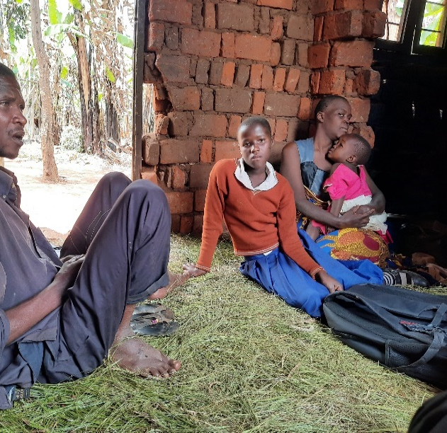
Success Story: Happier Again!!!
I thank FURAHA program to return happiness in our family (Anitha)
We are happy now at home, everything that touches my children’s I must find enough time and speak with them and I allow everyone to have a say on matter hence we reach the agreements by deciding together. (Anitha’s Stepmother)

Slide 8
Approach taken in relation to COVID-19 Situation in Tanzania.
During COVID-19 lockdown, Furaha Program was implemented only through school platform.
Since Tanzania schools were open in June 2020, classes were progressing as usual therefore Furaha sessions resumed as normal.
Precautions Taken:
Sessions were done in open spaces i.e. school playgrounds.
Project supported schools with buckets for water and soap.
Families were advised to wear mask (such as handmade masks).
All beneficiaries were reached with WASH and COVID-19 Prevention Education.
All families were provided with leaflets which guide on “Steps to wash your hands”
Notes:
Tracking during school closure due to COVID-19 pandemic:
During the 3 months school closure in Tanzania (March-June), the project tracked beneficiaries’ well-being through phone calls;

Slide 9
Approach taken in relation to COVID-19 Situation in Tanzania
COVID_19 Prevention and WASH Guide
Steps to wash your hands
Notes:
Pact didn’t use the COVID-19 Parenting Tips considering the content was more appropriate for families affected by confinement/ lockdown while in Tanzania schools and business continued, thus Pact opted at educating families on COVID 19 Prevention and Steps to washing hands.
At the same time introducing new materials to be used at school requires some sort of endorsement from the LGA, therefore – the use of material developed by MoHCDGEC was an option.

Slide 10
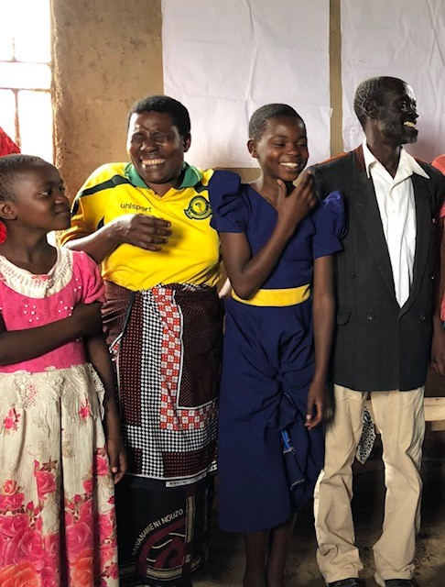
Asante sana! Thank you!

