Slide 1
Spiritual Health as one of the WHO’s Four Components of Health
Rev. Richard W. Bauer, MM, BCC, MSW
George Washington University
Institute for Spirituality and Health
Faith and Community Initiative Webinar
24 August 2022

Slide 2
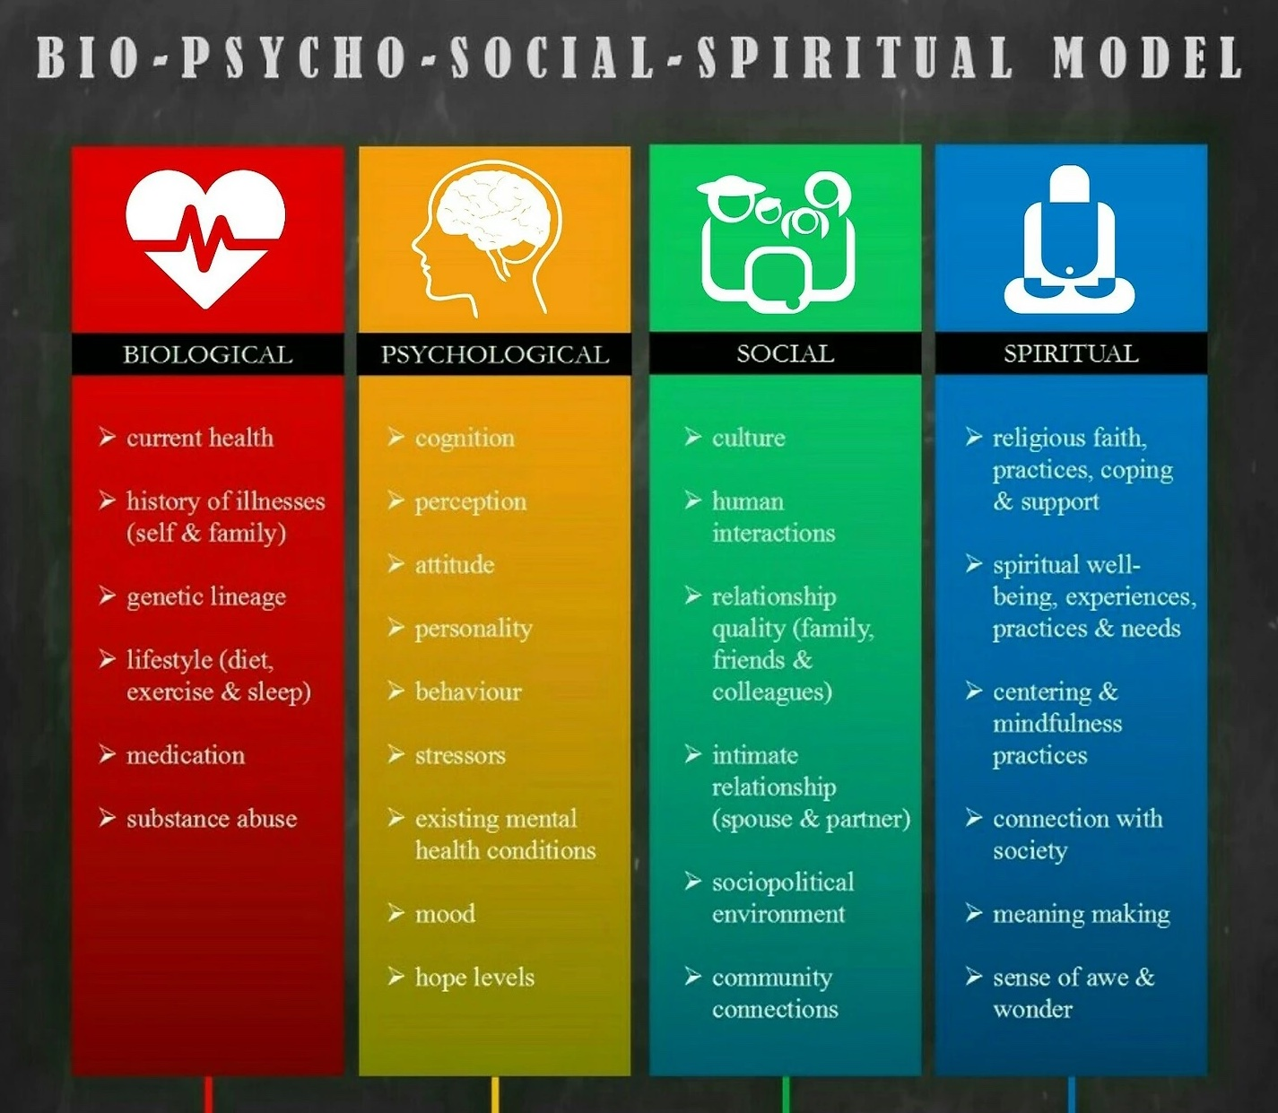
Spiritual health: one of the four components
Notes:
There is a growing consensus that if we are not assessing and providing care and treatment in all FOUR domains, this is not quality, comprehensive care.

Slide 3
Spiritual health: one of the four components
An international consensus definition for spirituality:
“Spirituality is a dynamic and intrinsic aspect of humanity through which persons seek ultimate meaning, purpose and transcendence and experience relationship to self, family, others, community, society, nature and the significant or sacred. Spirituality is expressed through beliefs, values, traditions and practices.”
Puchalski, C. M., Vitillo, R., Hull, S. K., & Reller, N. (2014). Improving the Spiritual Dimension of Whole Person Care: Reaching National and International Consensus. Journal of Palliative Medicine, 17(6), 642–656. https://doi.org/10.1089/jpm.2014.9427

Slide 4
Spiritual health: one of the four components
Importance of Spirituality
Addressing spiritual issues can have a positive impact on the patient’s emotional, social and physical well-being.
Understanding a patient’s spirituality is crucial to understanding them and how they deal with illness and health, death and bereavement. We know this is more than rituals and praying with patients.
Addressing spiritual issues, both the generalist and the specialist helps empower patients and facilitates communication and quality treatment planning that meets the individual’s needs and well-being
Copyright © George Washington University, ISPEC

Slide 5
Spiritual Health: one of the four components
Witness to Suffering: A Spiritual Practice of Love and Compassion
Calling us to form deeply meaningful relationships with our patients and their families and loved ones
We become witnesses to suffering, to joy, to disappointments, to hopes and aspirations
There is a transformation that can occur between the health care professionals and patient/family if we are open to relationship—to the sacred and compassionate in that professional relationship
Copyright © George Washington University, ISPEC

Slide 6
Spiritual health: one of the four components
Reflections and Questions:
How can we better integrate and advocate for treatment in all four domains?
What are the challenges you experience in the holistic provision of care and support?
How can we better integrate a Generalist- (everyone on the multidisciplinary team has a basic understanding and competence in each of the domains) -Specialist (one member of the MDT has advanced training and education in each specific domain of care) model of care?

Slide 7
Spiritual health: one of the four components
Resources:
Dhar, N., Chaturvedi, S., & Nandan, D. (2013). Spiritual health, the fourth dimension: A public health perspective. WHO South-East Asia Journal of Public Health, 2(1), 3. https://doi.org/10.4103/2224-3151.115826
Engel GL. The need for a new medical model: a challenge for biomedicine. Science. 1977 Apr 8;196(4286):129-36.
Puchalski, C. M., Vitillo, R., Hull, S. K., & Reller, N. (2014). Improving the Spiritual Dimension of Whole Person Care: Reaching National and International Consensus. Journal of Palliative Medicine, 17(6), 642–656. https://doi.org/10.1089/jpm.2014.9427
Sarmiento, P. J. D. (2021). Wounded healers: A call for spiritual care towards healthcare professionals in time of COVID-19 pandemic. Journal of Public Health, 43(2), e273–e274. https://doi.org/10.1093/pubmed/fdaa232
Sulmasy, D. P. (2002). A Biopsychosocial-Spiritual Model for the Care of Patients at the End of Life. The Gerontologist, 42(suppl_3), 24–33. https://doi.org/10.1093/geront/42.suppl_3.24
Tan, H., Holmes, C., Flynn, E., & Karimi, L. (2021). Essential Not Optional: Spiritual Care in Australia during a Pandemic. Journal of Pastoral Care & Counseling: Advancing Theory and Professional Practice through Scholarly and Reflective Publications, 75(1_suppl), 41–45. https://doi.org/10.1177/1542305020985071

Slide 8
Spiritual health: one of the four components
Thank you! ¡Gracias! Merci! Asante Sana!
Some slides courtesy of the Interprofessional Spiritual Care Education Curriculum (ISPEC) ©
https://smhs.gwu.edu/gwish/interprofessional-spiritual-care-education-curriculum-ispec
Join (free) the Global Network for Spirituality and Health
www.gnsah.org
Rev. Richard W. Bauer, MM, BCC, MSW
richardbauerbcc@email.gwu.edu
Twitter: @nvrflycoach

