Slide 1
Improving HIV Testing Yield among Children and Adolescents using Validated HIV Risk Screening Tool in Uganda
20th October 2021
By Dr. Damalie Bajunga

Slide 2
Presentation Outline
Rationale of HIV Risk Screening
Overview CALHIV
The HIV Risk Screening Tool
Operationalization of Tool
Results
Challenges
Lessons learnt

Slide 3
Rationale of HIV Risk Screening
Risk screening increases;
HIV testing for children and adolescents in Outpatient settings and community settings
Improves HIV testing yield
Facilitates immediate linkage to care and treatment.

Slide 4
Overview on Pediatric and Adolescent HIV Care in Uganda
HIV prevalence among children < 15years in Uganda: 0.5%
Children 0 -9years living with HIV: 43,854
Children 10 –19years living with HIV: 87,659
Estimated children and adolescents in Uganda unidentified: 28,997
(Data source: COP21)

Slide 5
Ped & Adol HIV care Vs Adult HIV care in Uganda – the 95, 95, 95
Only 68% of children and 57% of adolescents know their status compared to 93% of adults
Linkage to treatment among children and adolescents is as high as among the adults (97%)
Viral load suppression among children and adolescents is 55% and 61%, respectively, compared to >80% for adults
These gaps in CALHIV care are pulling down national efforts towards epidemic control.
(Source: MoH quarterly HIV Care and Treatment Report Oct-Dec 2020)

Slide 6
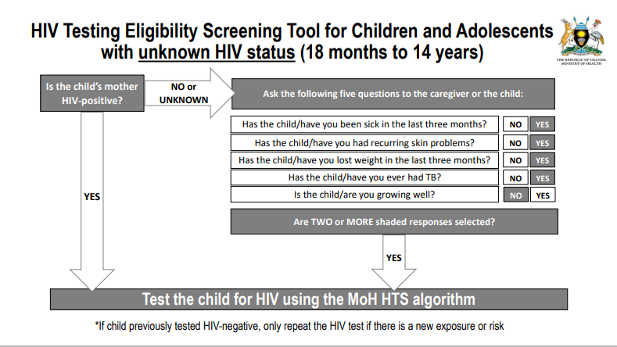
The Validated Pediatric & Adolescent HIV Risk Screening Tool
Rationale for the HIV Screening Tool
The HIV Risk Screening Tool
The HIV screening tool was developed to;
  Improve testing efficiency by reducing the number of children needed to test to find one HIV positive child (NNT)
  Improve HIV testing yield at OPD and community setting
  Identify children most at risk for HIV and refer them for HIV testing
  Optimize HIV testing resources

Slide 7
Developing and operationalizing the HIV Risk Screening Tool
Risk screening tool was developed and validated - by MOH, CDC, EGPAF
-MOH revised HIV care guidelines, included validated screening tool
-Initial roll out in 5 HF to learn lessons
- Conducted by FASTER
National roll out
- Integrated with the roll out of 2020 HIV care & treatment guidelines
-Conducted by IPs in collaboration with MOH (TOTs and HF based trainings)
-
Jan 2021–June 2021
November 2020
FASTER HFs
Capacity building M&E
- Conducted by QI coaches in collaboration with IPs and FASTER
September 2020
FASTER HFs
SS/Mentorship
- Conducted by FASTER in collaboration with MOH
June 2020
March 2016 - March 2020

Slide 8
FASTER supported Health Facilities
FASTER supported 86 health facilities with the highest unmet need in CALHIV care from 5 regions.
13 of the FASTER supported health facilities are Private not for profit health facilities ( PNFP) owned by FBOs and 73 GOU
FASTER supported regions and facilities are;
Mubende Region 18 HF (3 FBO)
Mukono Region 18HF (8 FBO)
Masaka Region 35 HF (4 FBO)
East Central Region 10 HF (0 FBO)
North-Acholi Region 5 HF (0 FBO)

Slide 9
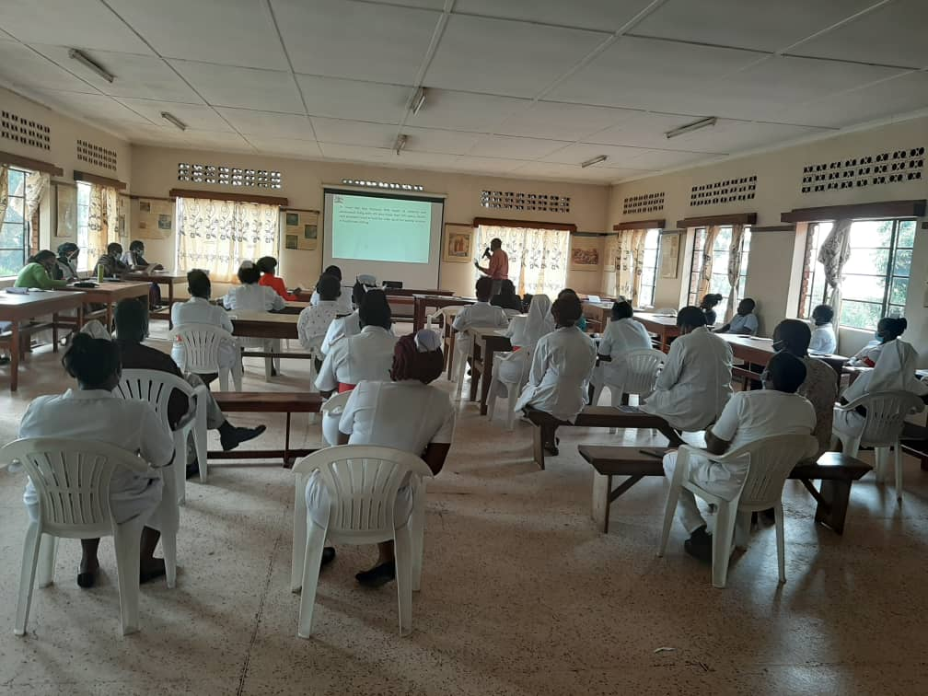
Factors that enabled the health workers use the HIV Risk Screening Tool
Simplicity of the tool
Orientation, support supervision/mentorship of health care workers
Teamwork and peer supervision
Availability of copies of the tool at entry points
Availability of HIV test kits
Integrating HIV screening in routine care
FASTER/MoH team orienting Health Care Workers at Rubaga Hospital on the HIV screening tool
From support supervision/mentorship reports

Slide 10
HIV risk screening for children and adolescents in FASTER supported FBO health facilities (Mukono Region)
All CALHIV identified linked to care

Slide 11
Challenges and Corrective actions
Challenges
Corrective actions
Not all children were screened.
Human resource constraints
Lack space where HIV screening could be done in privacy to ensure confidentiality.
Positivity did not increase across all FASTER supported facilities
Health education talks and support supervision
Assigning staff to oversee screening and documentation
Improvising space
Assigning staff to screen/ over see screening and documentation

Slide 12
Lessons Learned
Risk screening increased HIV testing for children in outpatient settings, improves testing yield , and facilitates immediate linkage to care and treatment.
The tool can be integrated into routine patient care and administered by all cadres
Assigning specific staff to over see HIV screening, documentation enhances routine use of the tool.
Training HCWs to ask the question on maternal HIV status later during the course of administering the tool improves mothers/caregivers’ response to HIV screening.

