Slide 1
Enhancing HIV prevention in faith communities: what is PrEP, why it is important and how to better promote it in faith settings
New Foundations of Hope Webinar Series
July 28, 2021

Slide 2
Part 3: Focused Discussion
What are some challenges you have identified in transitioning PrEP from a key population intervention to a general population intervention?
How can these challenges be addressed?
What further information or resources do you need to address these challenges?

Slide 3
Part 3: Focused Discussion cont.
What additional questions do you have on how to better promote PrEP in faith settings?
Based on these presentations and in your experience, what are the best ways to promote PrEP within the communities we serve?

Slide 4
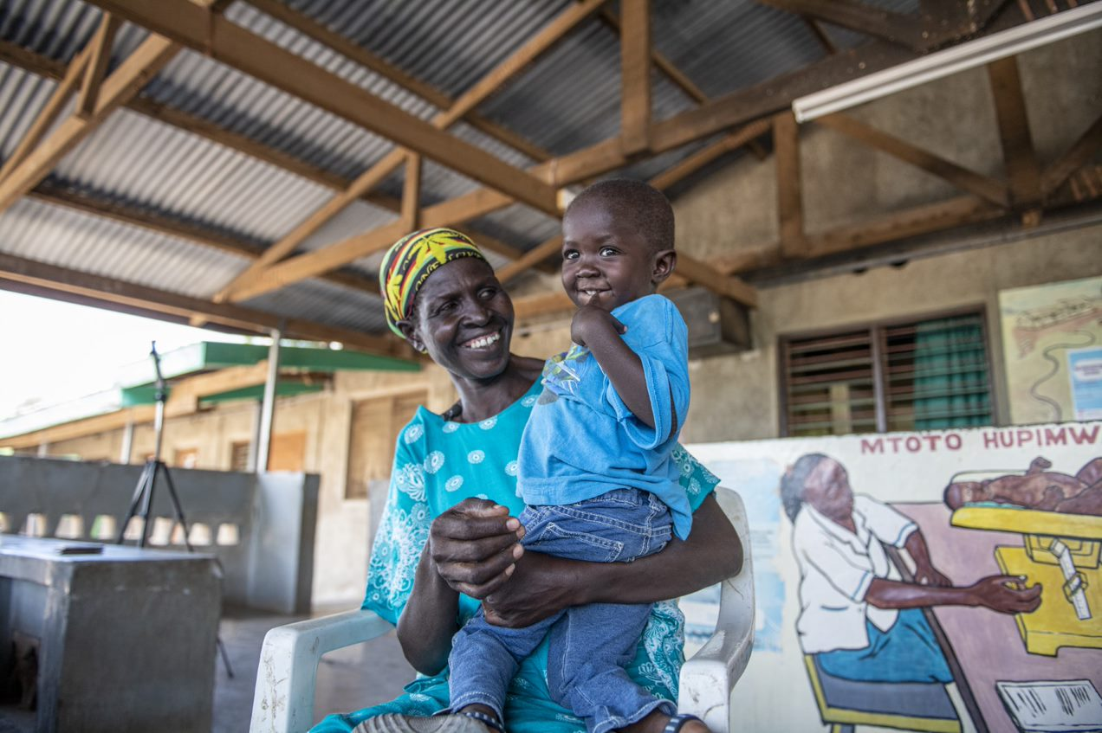
Thank you for your participation!

