Slide 1
Reaching Communities with Sustained COVID 19 messages Through Social Media Platforms
Christian Health Association of Kenya
Bramwel Siku
Date: 18th May 2022

Slide 2
Introduction and Scope
Engaged Inter-Faith parent bodies (EAK, NCCK, SUPKEM, SDA and COPTIC Church) country-wide ( i.e. 47 counties)
Why Religious leaders?
Influential/Trust
Critical masses
Rich coverage
Very reliable for messaging and advocacy
Utilizing Curriculum focusing on 6 key thematic areas-trained 3,204 Inter-Faith Leaders as advocates /ambassadors
IEC material distribution to places of worship
Church/Mosque platforms were used to disseminate messages on COVID-19.
Messaging was by Inter-Faith Leaders, their faith networks and leveraged on opportunities of gathering and social media platforms
Monitoring and documenting of best practice
Inter-Faith Council to continuously engage
Utilized google form to track progress through periodic feedback
Notes:
In this slide, we share the key gaps that are based on site performance against the 33 questions as previously presented. Key gaps are in the informed consent, confidentiality, IPV risk assessment and adverse events.as detailed.
In informed consent thematic area, the key gap was on availability of Communication materials creating awareness on patient rights and reporting violations
The second is confidentiality with key gaps noted in signing of confidentiality agreement by providers; confidentiality protection on data shared with other organizations; and SOPs for provision of provider referral as an ICT approach.
The third thematic area is IPV risk assessment with key gaps including SOPs on ensuring client safety for clients who screen positive for IPV; lack of list of supportive services for IPV services; and HCPs training on adverse events monitoring, reporting and response.
Lastly, is adverse events including tracking system for all reported adverse events; anonymous reporting of adverse events by clients; as well as SOPs for identifying, investigating and responding to adverse events.

Slide 3
Why Social Media Platforms?
Simplest cheapest effective and efficient way of dissemination of COVID-19 messages.
Biggest driver for behavior change in COVID-19 response
Myths and misconceptions - serious predicament to health service seeking
Bridge to knowledge gap – vernacular
The magnitude of COVID-19 > illness (insecurity, tribal clashes, lack of access to basic needs, services and information)
Infrastructural dimensions – remote Counties, poor road network
Notes:
In this slide, we share the key gaps that are based on site performance against the 33 questions as previously presented. Key gaps are in the informed consent, confidentiality, IPV risk assessment and adverse events.as detailed.
In informed consent thematic area, the key gap was on availability of Communication materials creating awareness on patient rights and reporting violations
The second is confidentiality with key gaps noted in signing of confidentiality agreement by providers; confidentiality protection on data shared with other organizations; and SOPs for provision of provider referral as an ICT approach.
The third thematic area is IPV risk assessment with key gaps including SOPs on ensuring client safety for clients who screen positive for IPV; lack of list of supportive services for IPV services; and HCPs training on adverse events monitoring, reporting and response.
Lastly, is adverse events including tracking system for all reported adverse events; anonymous reporting of adverse events by clients; as well as SOPs for identifying, investigating and responding to adverse events.

Slide 4
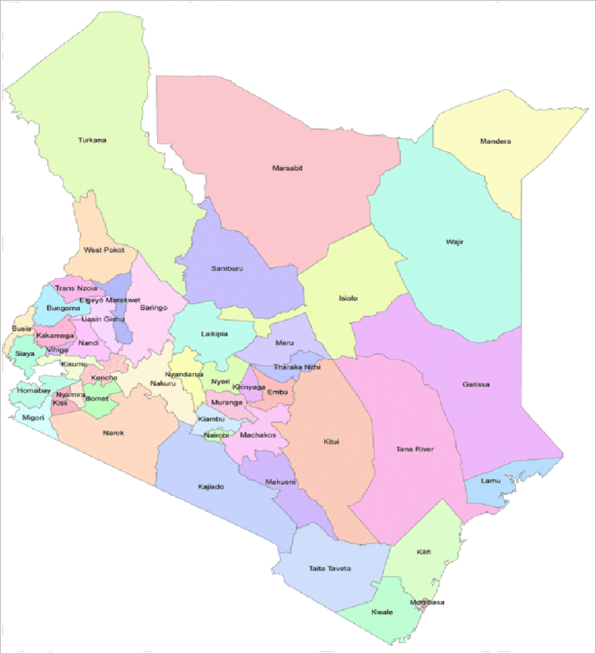
Social Media Platforms Utilized
Notes:
In this slide, we share the key gaps that are based on site performance against the 33 questions as previously presented. Key gaps are in the informed consent, confidentiality, IPV risk assessment and adverse events.as detailed.
In informed consent thematic area, the key gap was on availability of Communication materials creating awareness on patient rights and reporting violations
The second is confidentiality with key gaps noted in signing of confidentiality agreement by providers; confidentiality protection on data shared with other organizations; and SOPs for provision of provider referral as an ICT approach.
The third thematic area is IPV risk assessment with key gaps including SOPs on ensuring client safety for clients who screen positive for IPV; lack of list of supportive services for IPV services; and HCPs training on adverse events monitoring, reporting and response.
Lastly, is adverse events including tracking system for all reported adverse events; anonymous reporting of adverse events by clients; as well as SOPs for identifying, investigating and responding to adverse events.

Slide 5
Progress Update for Messages of Hope
Enhanced knowledge and skills
Increased awareness at congregational level (Est 11.6M people reached).
Installation/improvement of sanitation and handwashing facilities at places of worship improved
Myths and misconceptions demystified
Notes:
In this slide, we share the key gaps that are based on site performance against the 33 questions as previously presented. Key gaps are in the informed consent, confidentiality, IPV risk assessment and adverse events.as detailed.
In informed consent thematic area, the key gap was on availability of Communication materials creating awareness on patient rights and reporting violations
The second is confidentiality with key gaps noted in signing of confidentiality agreement by providers; confidentiality protection on data shared with other organizations; and SOPs for provision of provider referral as an ICT approach.
The third thematic area is IPV risk assessment with key gaps including SOPs on ensuring client safety for clients who screen positive for IPV; lack of list of supportive services for IPV services; and HCPs training on adverse events monitoring, reporting and response.
Lastly, is adverse events including tracking system for all reported adverse events; anonymous reporting of adverse events by clients; as well as SOPs for identifying, investigating and responding to adverse events.

Slide 6
Progress Update on Messages of Hope
Notes:
In this slide, we share the key gaps that are based on site performance against the 33 questions as previously presented. Key gaps are in the informed consent, confidentiality, IPV risk assessment and adverse events.as detailed.
In informed consent thematic area, the key gap was on availability of Communication materials creating awareness on patient rights and reporting violations
The second is confidentiality with key gaps noted in signing of confidentiality agreement by providers; confidentiality protection on data shared with other organizations; and SOPs for provision of provider referral as an ICT approach.
The third thematic area is IPV risk assessment with key gaps including SOPs on ensuring client safety for clients who screen positive for IPV; lack of list of supportive services for IPV services; and HCPs training on adverse events monitoring, reporting and response.
Lastly, is adverse events including tracking system for all reported adverse events; anonymous reporting of adverse events by clients; as well as SOPs for identifying, investigating and responding to adverse events.

Slide 7
Outcome of Social Media Metrics and Sustained Practice
Acceptance and behavior change
Optimal knowledge dissemination
Remarkable reduction of airborne/waterborne/hygiene related diseases
Role modelling by Inter-Faith Leaders in IPC
Remarkable resource mobilization
Use of Social Media Platforms maintained
Shared Updates from Government
Continued Vaccine Uptake
Notes:
In this slide, we share the key gaps that are based on site performance against the 33 questions as previously presented. Key gaps are in the informed consent, confidentiality, IPV risk assessment and adverse events.as detailed.
In informed consent thematic area, the key gap was on availability of Communication materials creating awareness on patient rights and reporting violations
The second is confidentiality with key gaps noted in signing of confidentiality agreement by providers; confidentiality protection on data shared with other organizations; and SOPs for provision of provider referral as an ICT approach.
The third thematic area is IPV risk assessment with key gaps including SOPs on ensuring client safety for clients who screen positive for IPV; lack of list of supportive services for IPV services; and HCPs training on adverse events monitoring, reporting and response.
Lastly, is adverse events including tracking system for all reported adverse events; anonymous reporting of adverse events by clients; as well as SOPs for identifying, investigating and responding to adverse events.

Slide 8
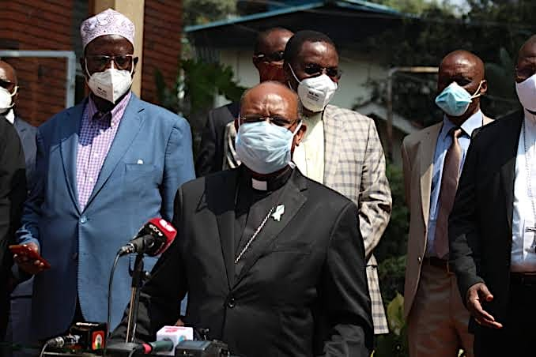
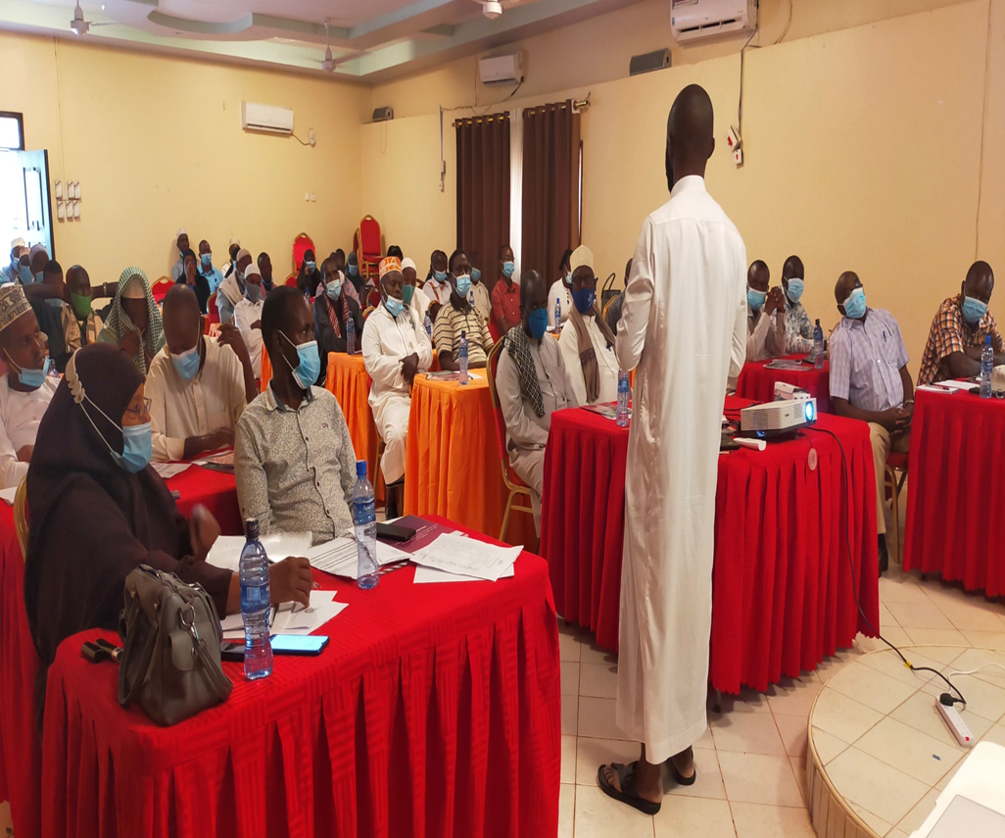
Pictorials
Notes:
In this slide, we share the key gaps that are based on site performance against the 33 questions as previously presented. Key gaps are in the informed consent, confidentiality, IPV risk assessment and adverse events.as detailed.
In informed consent thematic area, the key gap was on availability of Communication materials creating awareness on patient rights and reporting violations
The second is confidentiality with key gaps noted in signing of confidentiality agreement by providers; confidentiality protection on data shared with other organizations; and SOPs for provision of provider referral as an ICT approach.
The third thematic area is IPV risk assessment with key gaps including SOPs on ensuring client safety for clients who screen positive for IPV; lack of list of supportive services for IPV services; and HCPs training on adverse events monitoring, reporting and response.
Lastly, is adverse events including tracking system for all reported adverse events; anonymous reporting of adverse events by clients; as well as SOPs for identifying, investigating and responding to adverse events.

Slide 9
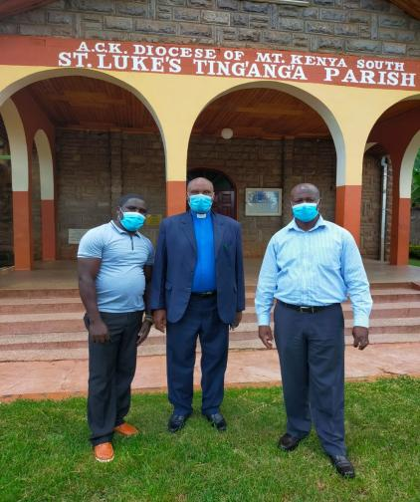
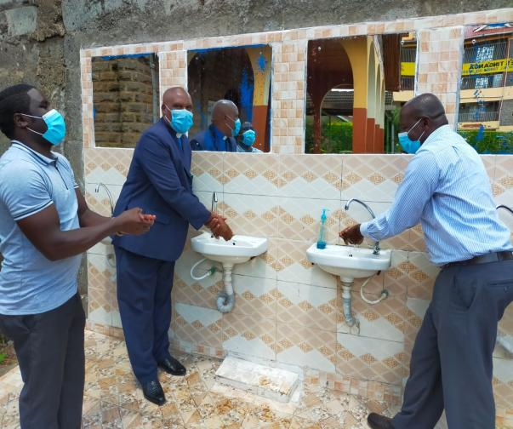
Pictorials on Covid 19
Notes:
In this slide, we share the key gaps that are based on site performance against the 33 questions as previously presented. Key gaps are in the informed consent, confidentiality, IPV risk assessment and adverse events.as detailed.
In informed consent thematic area, the key gap was on availability of Communication materials creating awareness on patient rights and reporting violations
The second is confidentiality with key gaps noted in signing of confidentiality agreement by providers; confidentiality protection on data shared with other organizations; and SOPs for provision of provider referral as an ICT approach.
The third thematic area is IPV risk assessment with key gaps including SOPs on ensuring client safety for clients who screen positive for IPV; lack of list of supportive services for IPV services; and HCPs training on adverse events monitoring, reporting and response.
Lastly, is adverse events including tracking system for all reported adverse events; anonymous reporting of adverse events by clients; as well as SOPs for identifying, investigating and responding to adverse events.

Slide 10
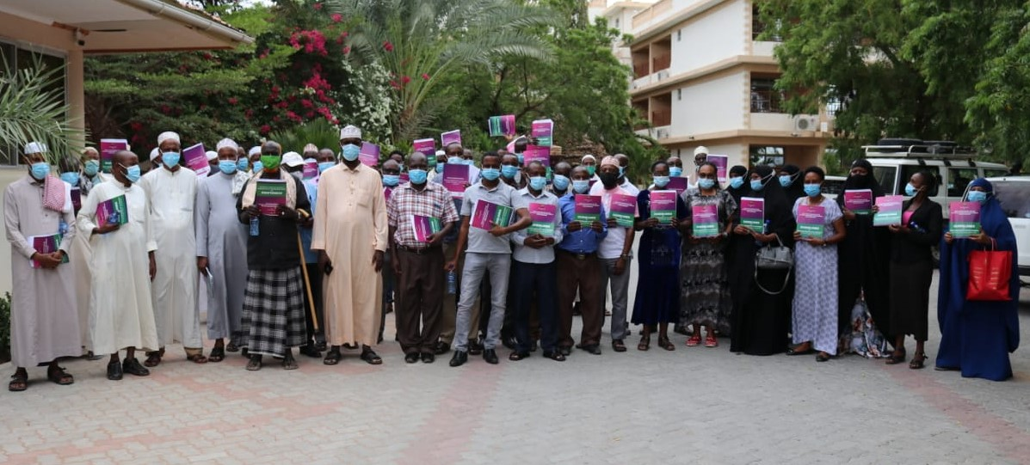
Pictorials
Inter-Faith Leaders After Covid 19 Sensitization from Mandera County
Notes:
In this slide, we share the key gaps that are based on site performance against the 33 questions as previously presented. Key gaps are in the informed consent, confidentiality, IPV risk assessment and adverse events.as detailed.
In informed consent thematic area, the key gap was on availability of Communication materials creating awareness on patient rights and reporting violations
The second is confidentiality with key gaps noted in signing of confidentiality agreement by providers; confidentiality protection on data shared with other organizations; and SOPs for provision of provider referral as an ICT approach.
The third thematic area is IPV risk assessment with key gaps including SOPs on ensuring client safety for clients who screen positive for IPV; lack of list of supportive services for IPV services; and HCPs training on adverse events monitoring, reporting and response.
Lastly, is adverse events including tracking system for all reported adverse events; anonymous reporting of adverse events by clients; as well as SOPs for identifying, investigating and responding to adverse events.

Slide 11
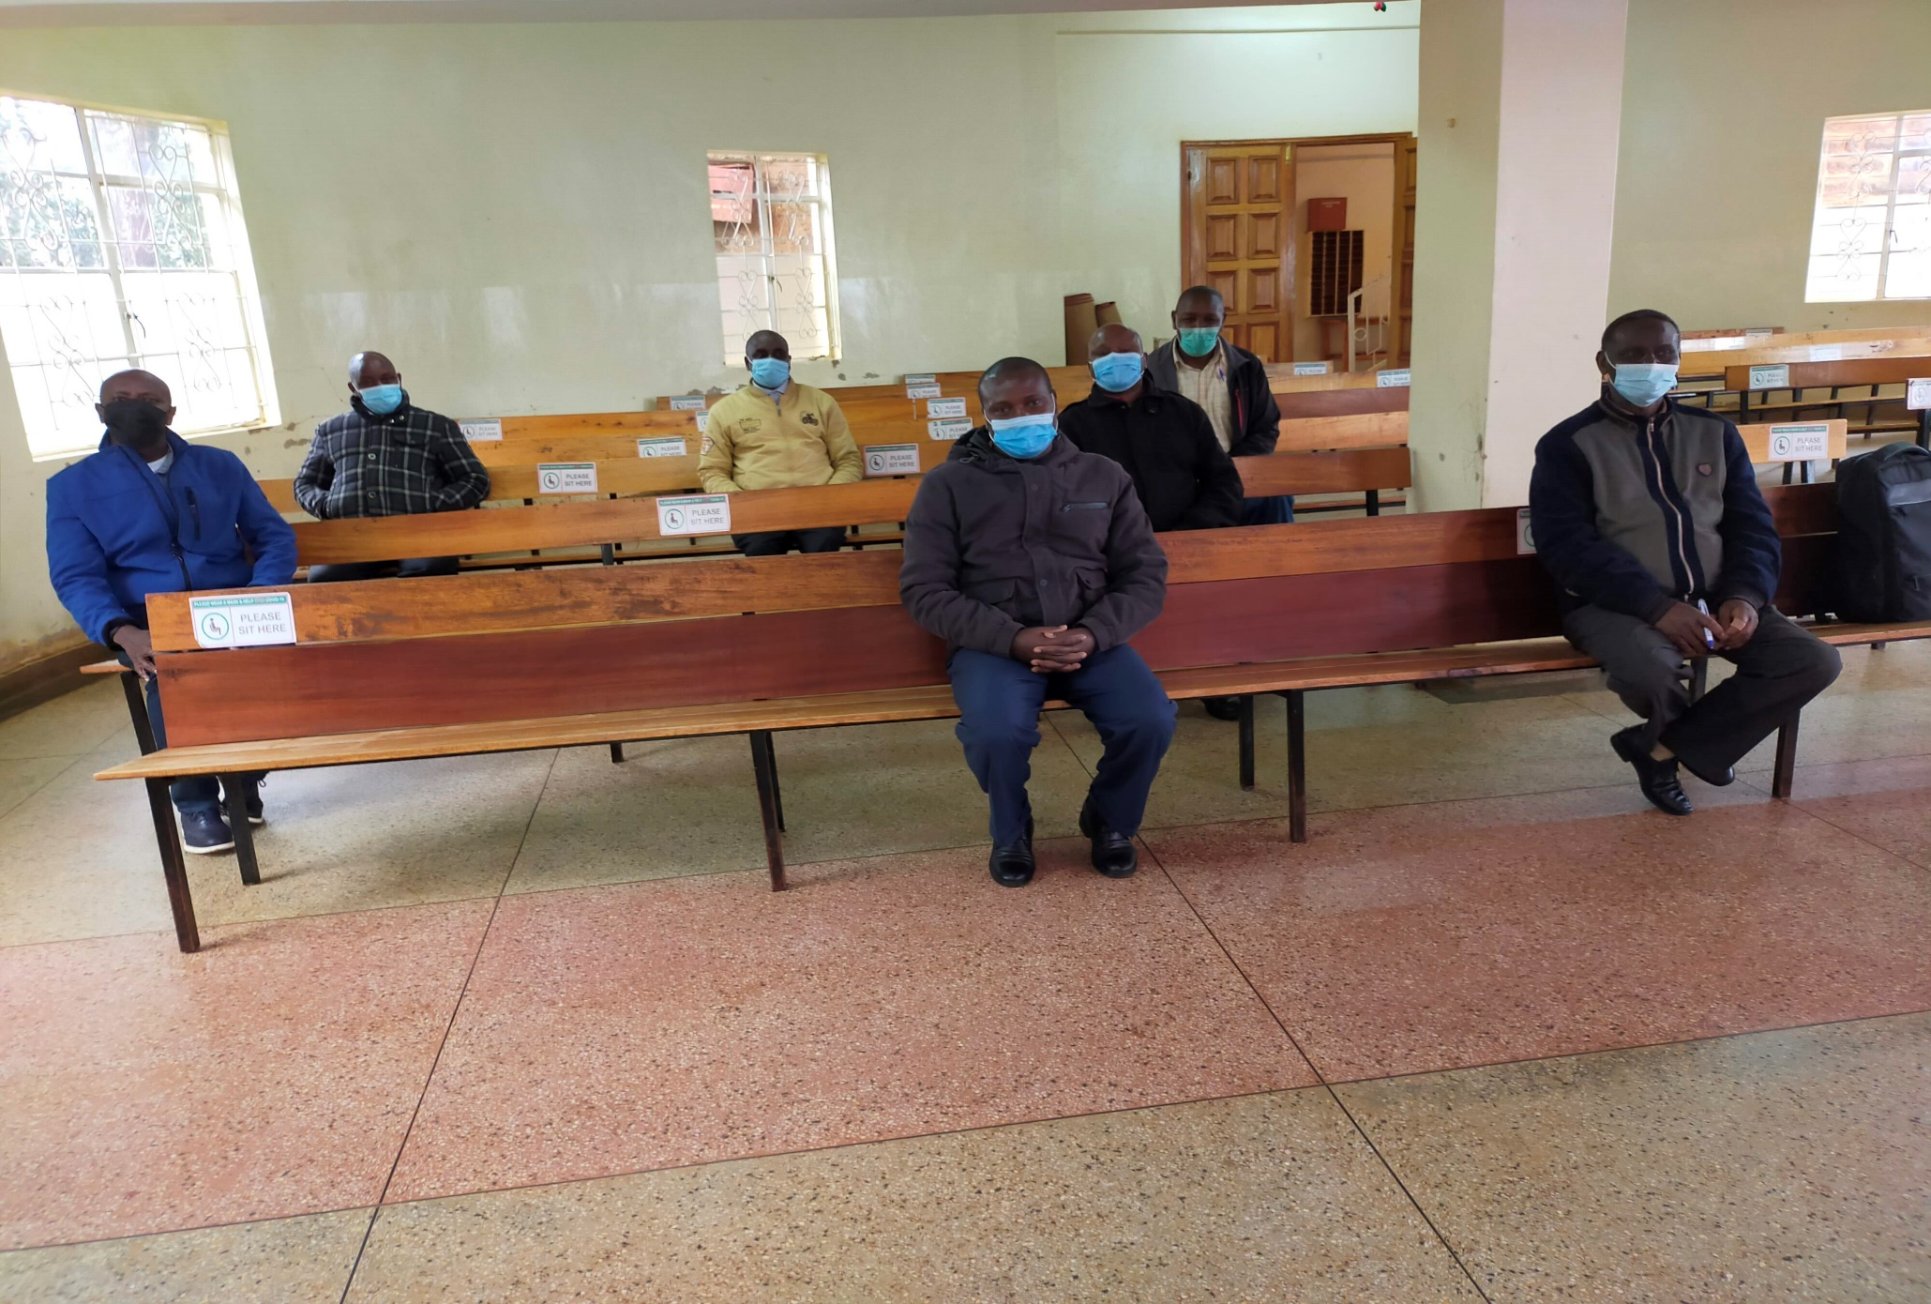
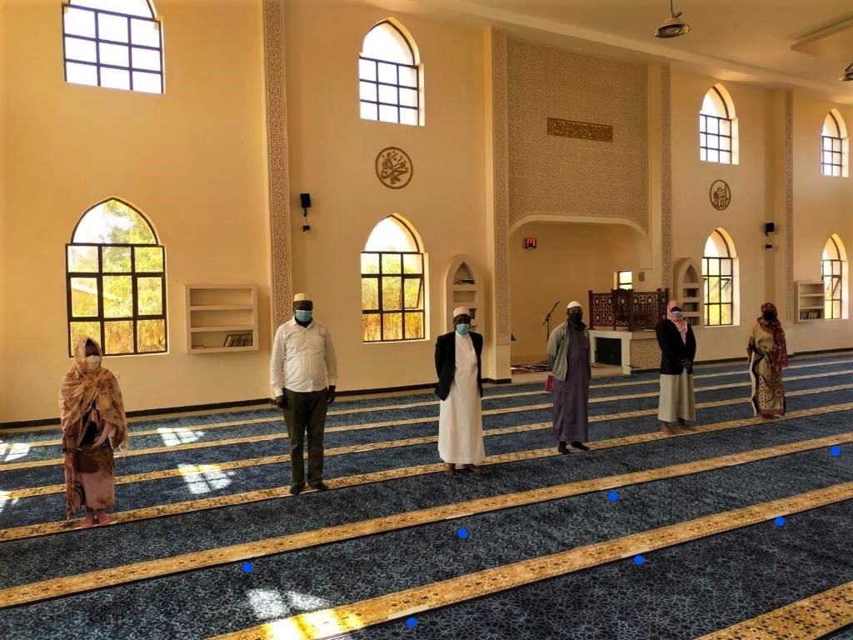
Pictorials
Spacing labels for social distance in a Mosque Marsabit County
Labelling for seats in Kiambu County
Covid 19 Sensitization session in Wajir County
Notes:
In this slide, we share the key gaps that are based on site performance against the 33 questions as previously presented. Key gaps are in the informed consent, confidentiality, IPV risk assessment and adverse events.as detailed.
In informed consent thematic area, the key gap was on availability of Communication materials creating awareness on patient rights and reporting violations
The second is confidentiality with key gaps noted in signing of confidentiality agreement by providers; confidentiality protection on data shared with other organizations; and SOPs for provision of provider referral as an ICT approach.
The third thematic area is IPV risk assessment with key gaps including SOPs on ensuring client safety for clients who screen positive for IPV; lack of list of supportive services for IPV services; and HCPs training on adverse events monitoring, reporting and response.
Lastly, is adverse events including tracking system for all reported adverse events; anonymous reporting of adverse events by clients; as well as SOPs for identifying, investigating and responding to adverse events.

Slide 12
Acknowledgements
Inter-Faith Leaders
Parent Bodies (SUPKEM, NCCK, EAK, SDA and COPTIC).
CHAK
CDC
PEPFAR
Notes:
In this slide, we share the key gaps that are based on site performance against the 33 questions as previously presented. Key gaps are in the informed consent, confidentiality, IPV risk assessment and adverse events.as detailed.
In informed consent thematic area, the key gap was on availability of Communication materials creating awareness on patient rights and reporting violations
The second is confidentiality with key gaps noted in signing of confidentiality agreement by providers; confidentiality protection on data shared with other organizations; and SOPs for provision of provider referral as an ICT approach.
The third thematic area is IPV risk assessment with key gaps including SOPs on ensuring client safety for clients who screen positive for IPV; lack of list of supportive services for IPV services; and HCPs training on adverse events monitoring, reporting and response.
Lastly, is adverse events including tracking system for all reported adverse events; anonymous reporting of adverse events by clients; as well as SOPs for identifying, investigating and responding to adverse events.

Slide 13
Thank You!

