Slide 1
HIV Prevention 2025 Roadmap Priorities
Strengthening Combination Prevention and Addressing Societal Enablers to End Stigma
New Foundations of Hope Webinar, May 24, 2023

Slide 2
Estimated new HIV infections by region, 2010-2020, and projected new infections if 2025 targets are met

Slide 3
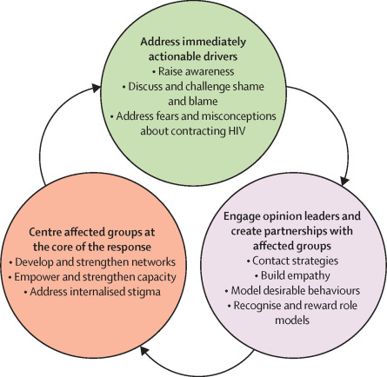
The Lancet HIV - Stigma reduction: an essential ingredient to ending AIDS
as a Public Health Threat – and the 3 evidence-based necessary components
https://pubmed.ncbi.nlm.nih.gov/33539757

Slide 4
A status neutral approach to HIV testing services
New Foundations of Hope Webinar: Following the Roadmap to HIV Prevention- The 4th 95: Combination Prevention and Ending Stigma
24 May 2023
Dr. Rachel Golin, S/GAC Senior HIV Testing Services Advisor

Slide 5
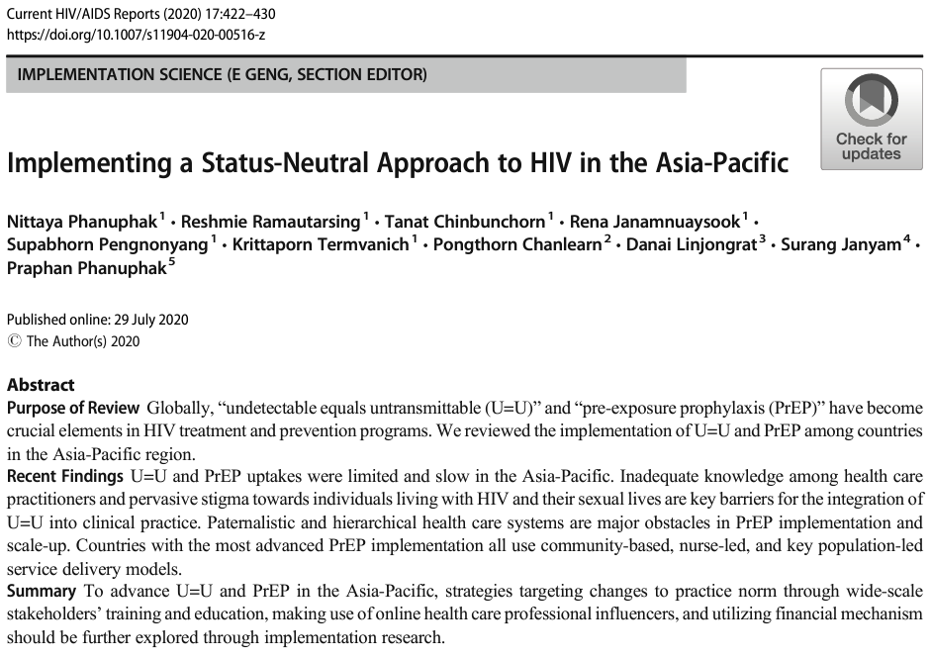
A status neutral approach keeps individuals at the center of care
“The status-neutral approach begins with an HIV test which is followed by active engagement of that person regardless of their HIV status…visualizing that the clinical, programmatic, or social “HIV” divide is nonexistent.”
“Both HIV-positive and HIV-negative individuals end at a common final stage of being continuously engaged in clinical care with negligible risk of either transmitting or acquiring HIV.”
Phanuphak N, Ramautarsing R, Chinbunchorn T, Janamnuaysook R, Pengnonyang S, Termvanich K, Chanlearn P, Linjongrat D, Janyam S, Phanuphak P. Implementing a Status-Neutral Approach to HIV in the Asia-Pacific. Curr HIV/AIDS Rep. 2020 Oct;17(5):422-430. doi: 10.1007/s11904-020-00516-z. PMID: 32725317; PMCID: PMC7497381.

Slide 6
Implementing a status neutral approach to HIV testing services
An example of offering HIV testing services within a universal test-and-connect approach¹
3 purposes of HTS:
Case finding
Reengagement
Linkage to prevention services
A status neutral approach to HTS is not synonymous with universal testing; rather, it is ensuring individuals in need of HTS, receive safe and ethical HTS and support to ensure timely linkage to appropriate prevention and/or treatment services based on the individual’s needs.
¹Grimsrud A, Wilkinson L, Ehrenkranz P, Behel S, Chidarikire T, Chisenga T, Golin R, Johnson CC, Milanga M, Onyekwena O, Sundaram M, Wong V, Baggaley R. The future of HIV testing in eastern and southern Africa: Broader scope, targeted services. PLoS Med. 2023 Mar 14;20(3):e1004182. doi: 10.1371/journal.pmed.1004182. PMID: 36917570; PMCID: PMC10013883.

Slide 7
Summary of implementation considerations for HIV testing modalities for case finding
HIV Testing Modality | Primary Purpose of Modality | Priority for Plan & Budget | Comments
Facility-Based Index Testing for Older Adolescents and Adults (≥15y) | Case finding | Universal offer required | Emphasis to remain on offering coverage over testing positivity.
Community-Based Index Testing for Older Adolescents and Adults (≥15y) | Case finding | Universal offer required | Emphasis to remain on offering coverage over testing positivity.
Index testing of Biologic Children and Adolescents (<19 years of age) of persons living with HIV | Case finding | Universal offer required. Implementation catch-up plan required. | Emphasis to remain on offering coverage over testing positivity.
Social Network Testing | Case finding | Strategic use for case finding | See Section 6.5.1.2 for additional information on Social Network Testing.
HIV Self-Testing (HIVST) | 1) Case finding 2)Prevention Monitoring | Strategic use for case finding; some prevention applications | HIVST is currently used for screening and not for HIV diagnosis. All positive HIVST results require confirmatory HTS. Comprehensive monitoring requires use of IP-provided program data to complement MER data. Data triangulation is needed to assess relationship between HIVST distribution for case-finding and HTS positivity and number of diagnoses by SNU. Successful implementation should be showing increases in other HTS modalities.
OtherPITC for Older Adolescents and Adults (≥ 15 years) | Case finding | Based on estimated case finding by subpopulation. | OtherPITC positivity of ≥ 10% may indicate insufficient testing coverage. See Sections 6.3.2 and 6.3.3 for important considerations for PITC for children and adolescents.
TB Clinics | Case finding | Universal offer required | Emphasis to remain on testing coverage over testing positivity.
STI Clinics | Case finding | Universal offer required | Emphasis to remain on testing coverage over testing positivity.
Source: PEPFAR’s FY24 Technical Considerations

Slide 8
Summary of implementation considerations for HIV testing modalities within prevention programs
HIV Testing Modality | Primary Purpose of Modality | Priority for Plan & Budget | Comments
HIV Self-Testing (HIVST) | 1) Case finding 2)Prevention Monitoring | Strategic use for case finding; some prevention applications | HIVST is currently used for screening and not for HIV diagnosis. All positive HIVST results require confirmatory HTS. Comprehensive monitoring requires use of IP-provided program data to complement MER data. Data triangulation is needed to assess relationship between HIVST distribution for case-finding and HTS positivity and number of diagnoses by SNU. Successful implementation should be showing increases in other HTS modalities.
ANC and Post ANC for PMTCT | Prevention monitoring | Universal required | See Section 6.2.4 for additional guidance on PMTCT.
FP Clinics | Prevention monitoring | Context-specific, high incidence settings only | Focus on high incidence settings as part of AGYW programming and PrEP. Additional WHO guidance may be found here.
PrEP | Prevention monitoring | Based on PrEP targets | Seroconversion while on PrEP should lead to further investigation.
VMMC | Prevention monitoring | Based on VMMC targets | Though HIV testing is not required (i.e., remains optional) prior to receiving VMMC services, programs are encouraged to systematically offer HTS to individuals (especially men 15 – 35 years of age) seeking VMMC services. All HTS must remain aligned with the WHO’s 5 Cs (https://apps.who.int/iris/handle/10665/179870)
Source: PEPFAR’s FY24 Technical Considerations

Slide 9
Thank You

Slide 10
Combination Prevention and
Ending Stigma
Overview based on the 2025 Targets
And Prevention Roadmap
Francesca Merico
PEPFAR New Foundations of Hope; PEPFAR – UNAIDS Faith Initiative

Slide 11
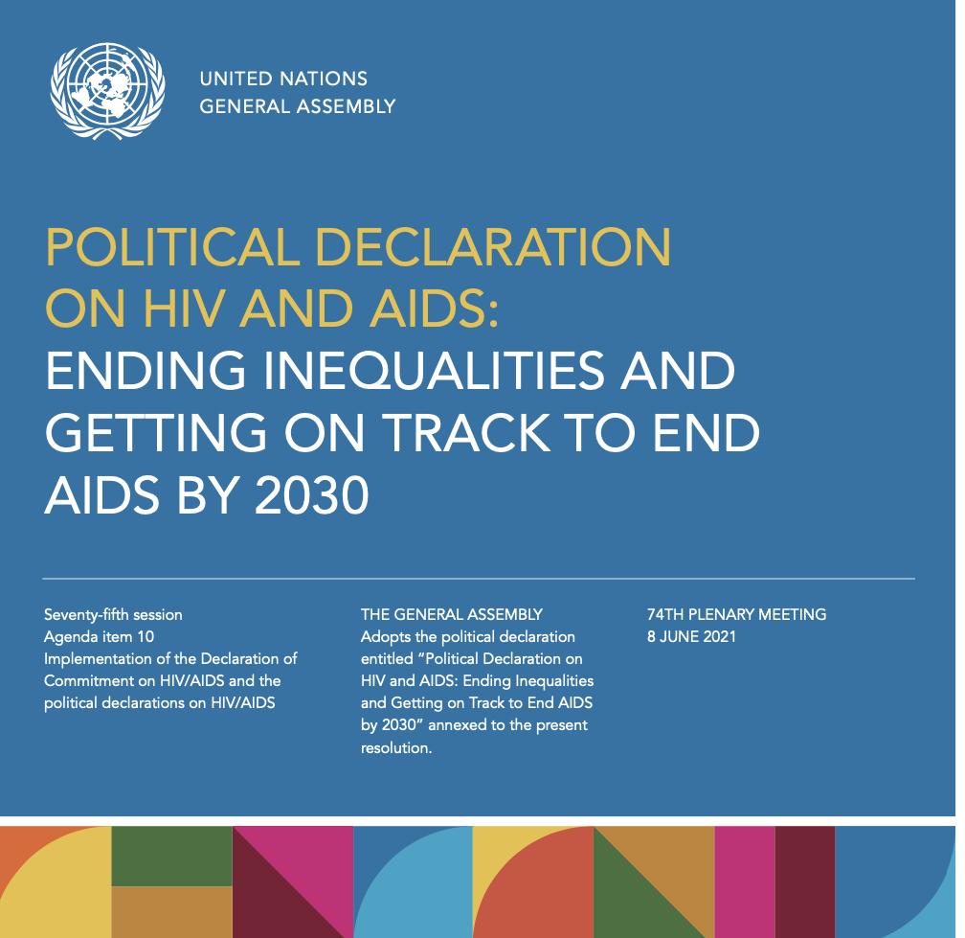
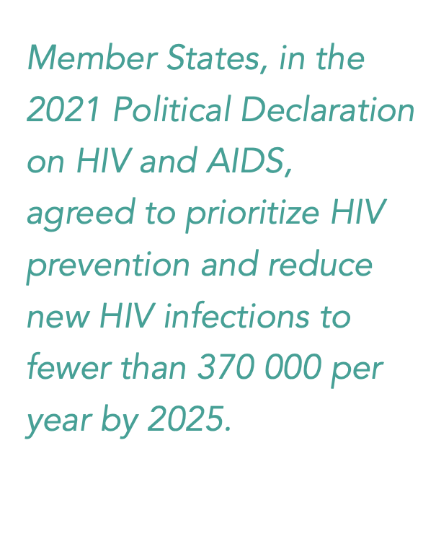
GLOBAL AIDS STRATEGY
2021 - 2026
Confronting stigma and discrimination is a prerequisite for effective prevention and care.
Discrimination on the grounds of one’s HIV status is a violation of human rights.
Notes:
Global consensus on the importance of tackling AIDS-related stigma and discrimination is highlighted by the Global AIDS Strategy 2021 – 2026 and by The Political Declaration on HIV & AIDS – adopted by all UN member states in 2021. Both these docs affirm that confronting stigma and discrimination is a prerequisite for effective prevention and care, and reaffirms that discrimination on the grounds of one’s HIV status is a violation of human rights.

Slide 14
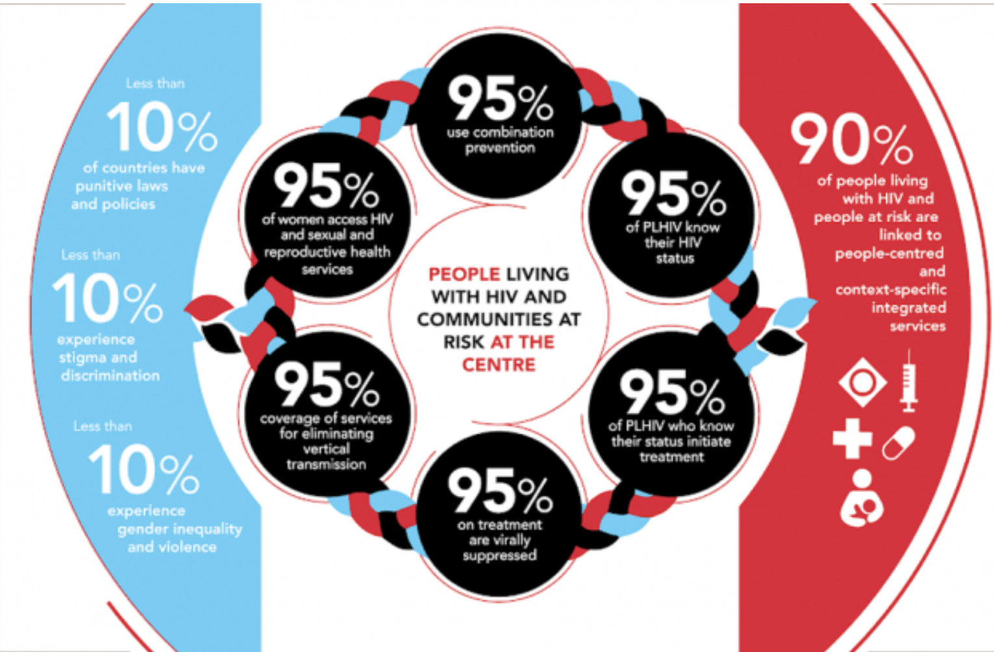

Slide 16
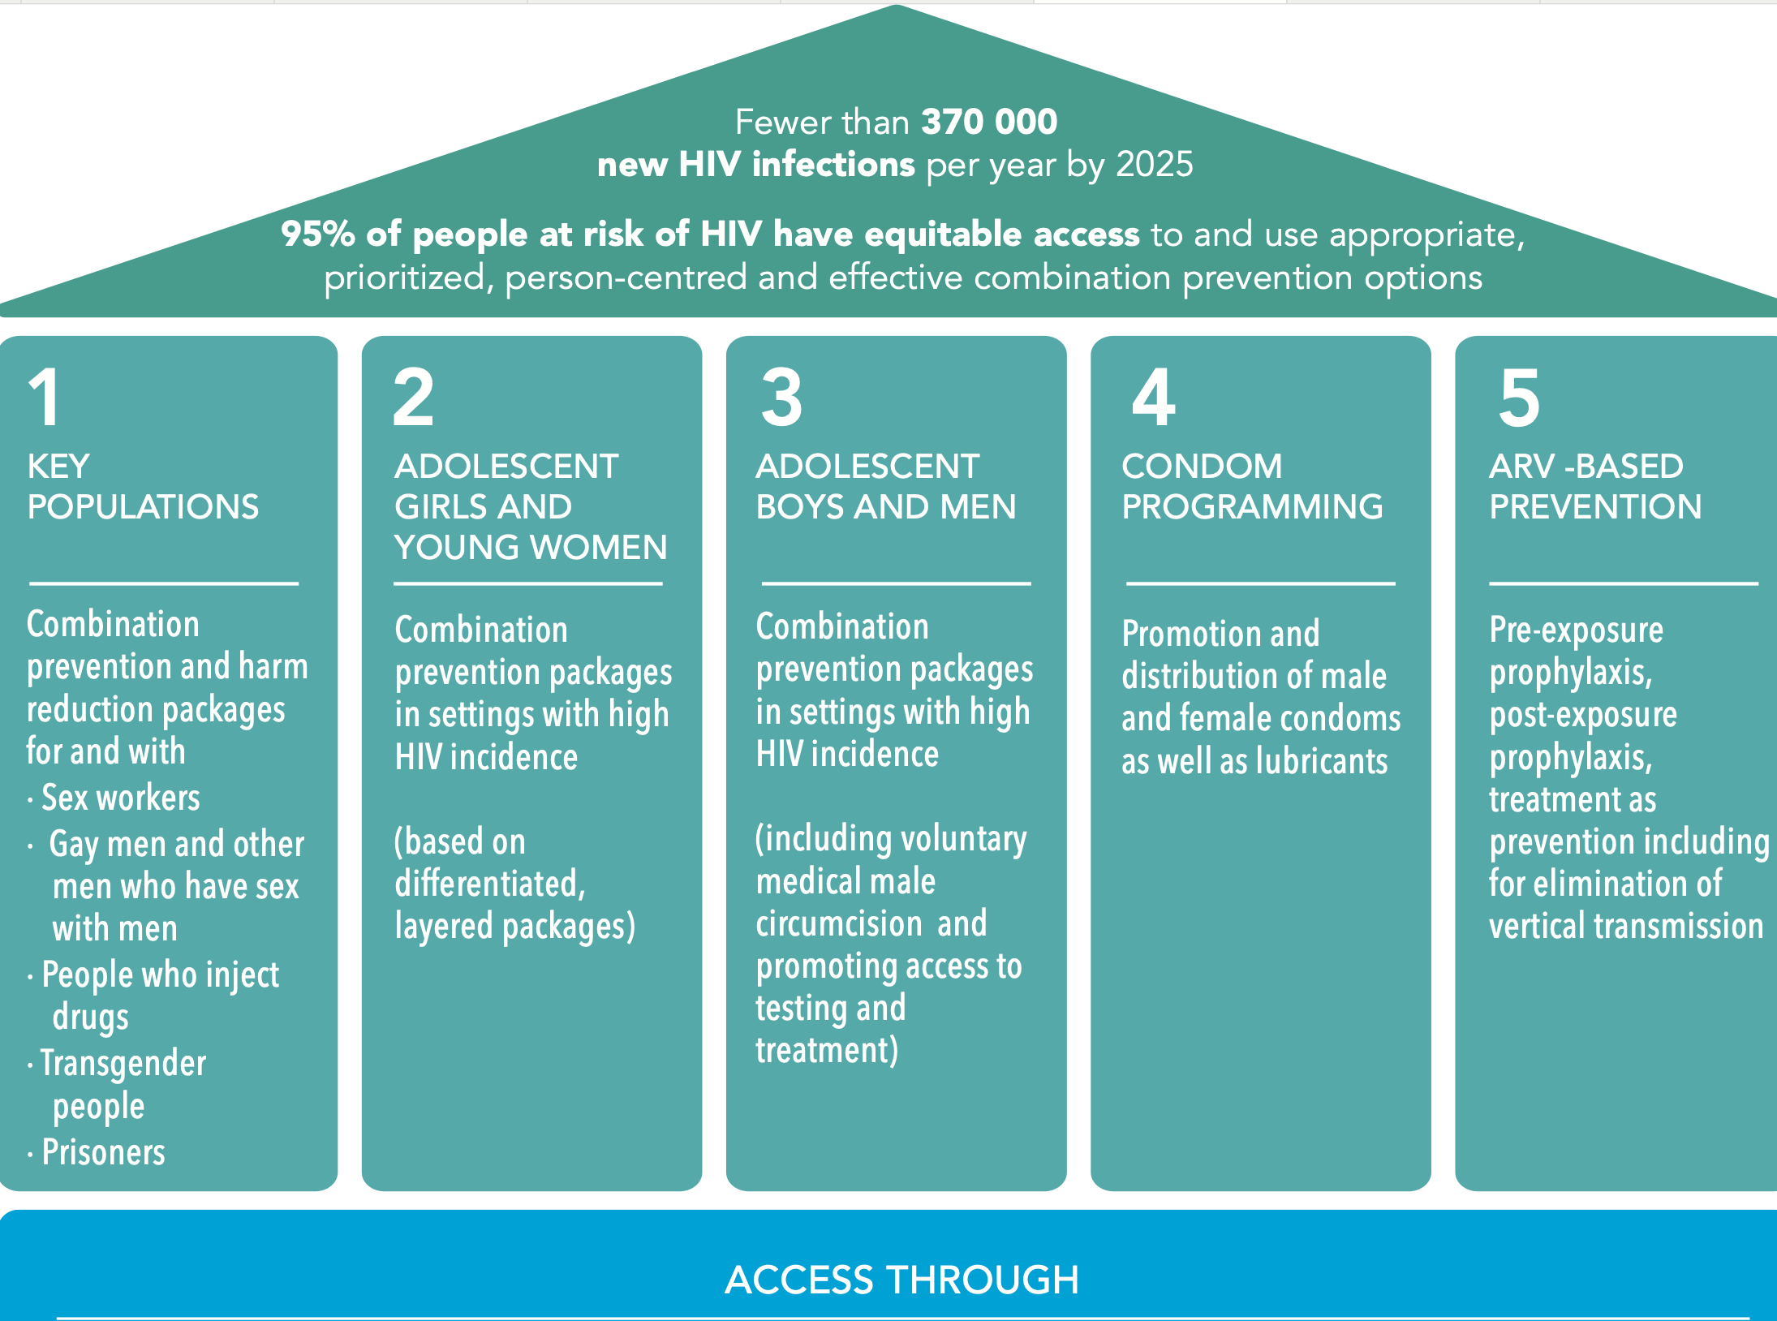

Slide 17
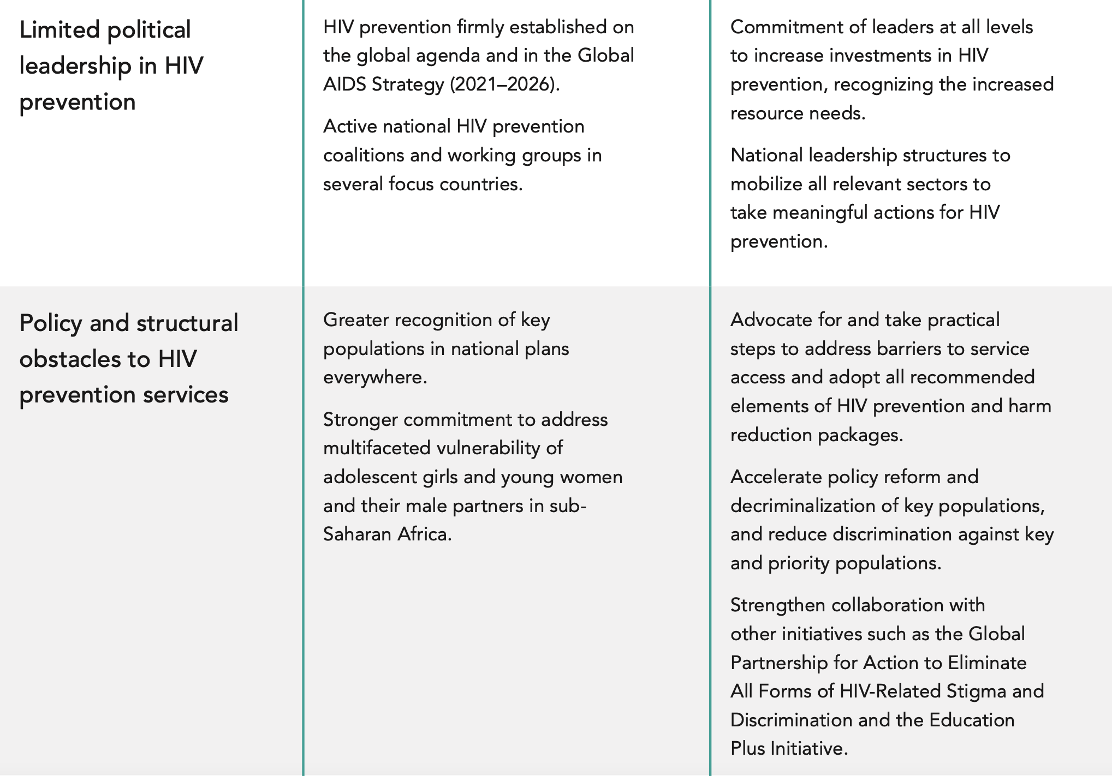

Slide 18
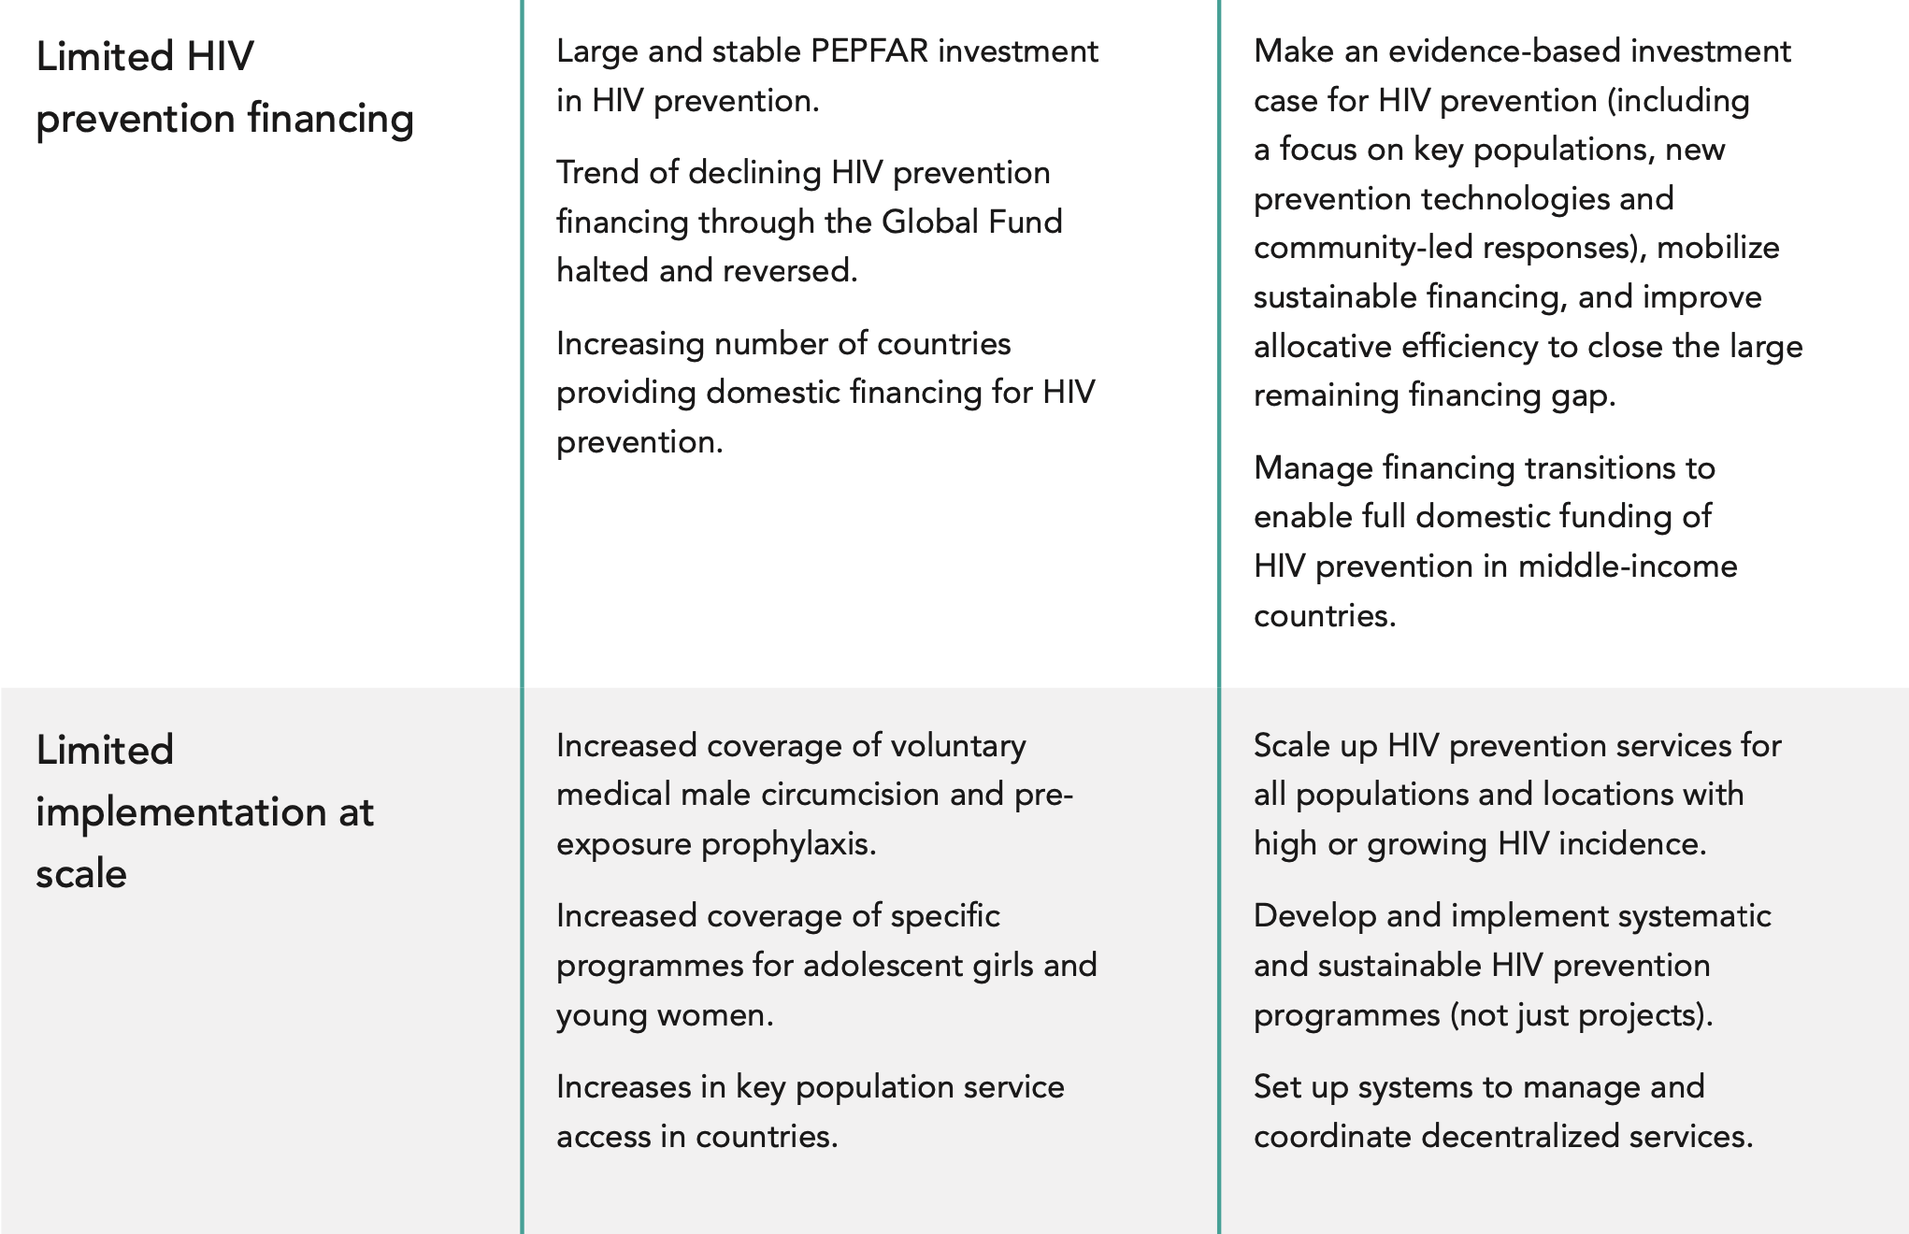

Slide 20
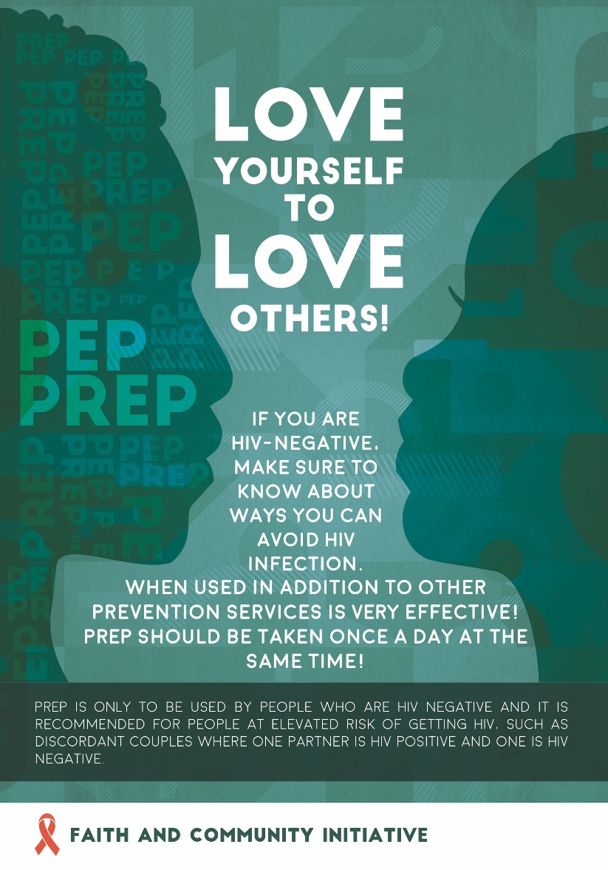
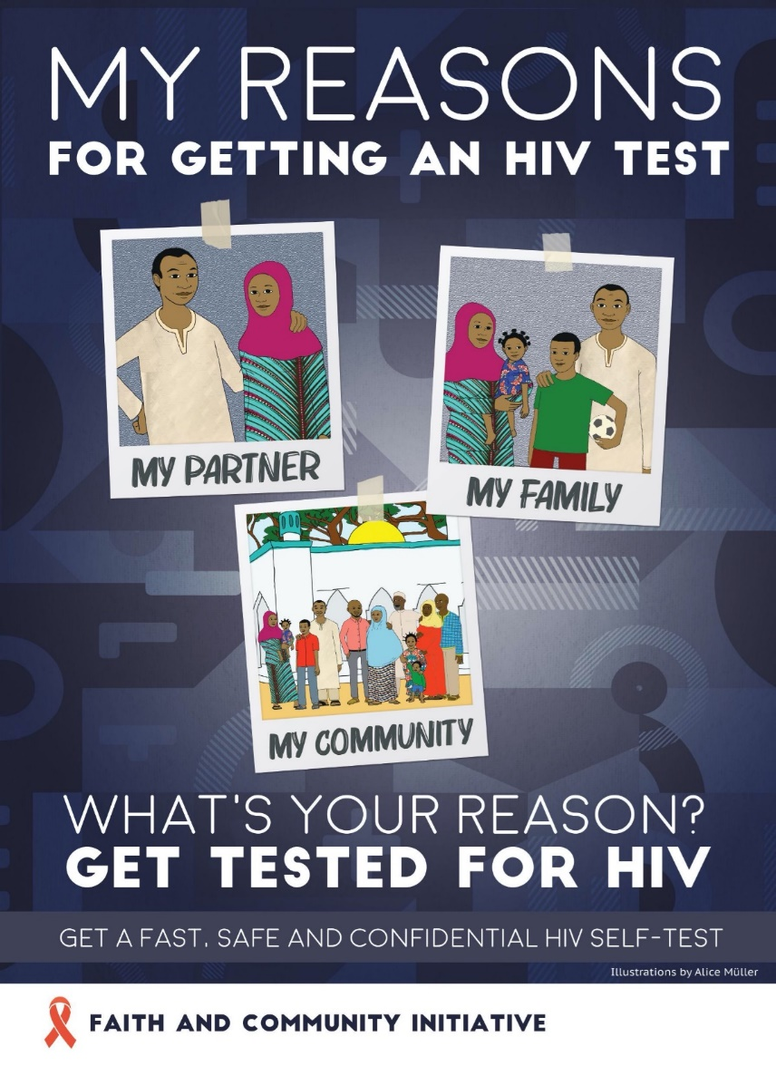
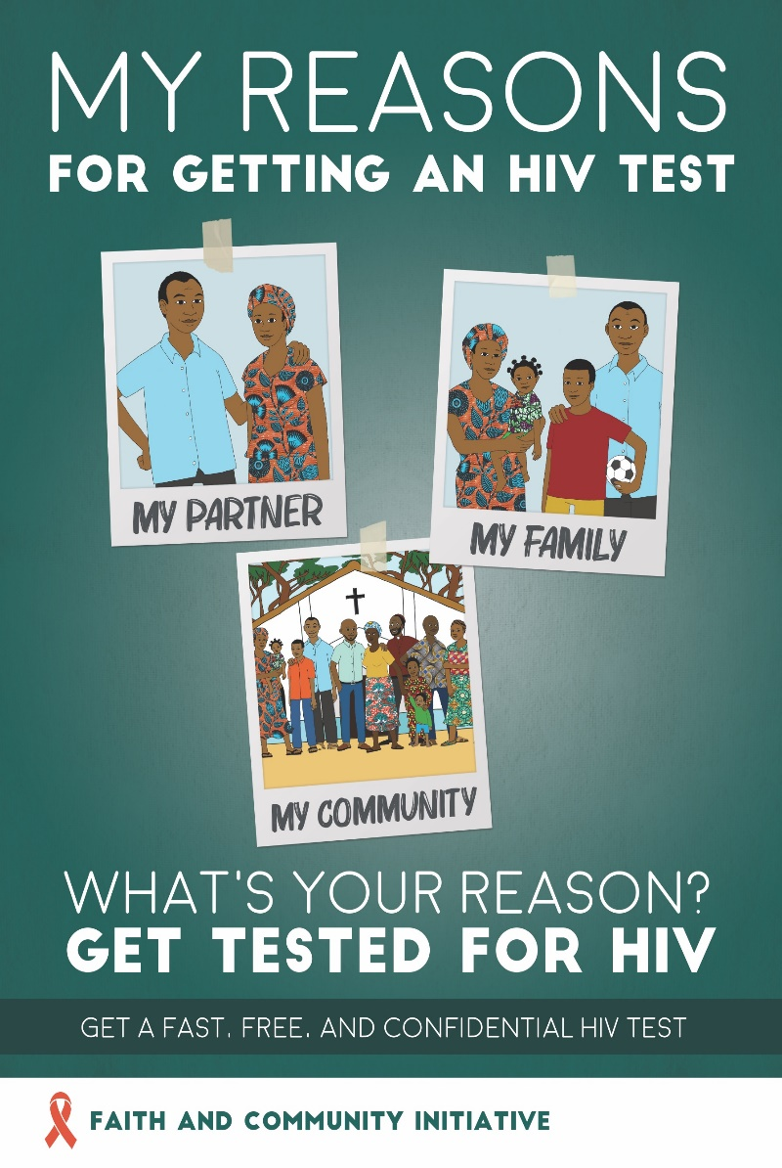
THANK YOU https://www.faithandcommunityinitiative.org

Slide 21
The PrEP Basics – what it is and why it’s an important HIV prevention option
Robyn Eakle, Senior Advisor on PrEP and Prevention
S/GAC
May 2023

Slide 22
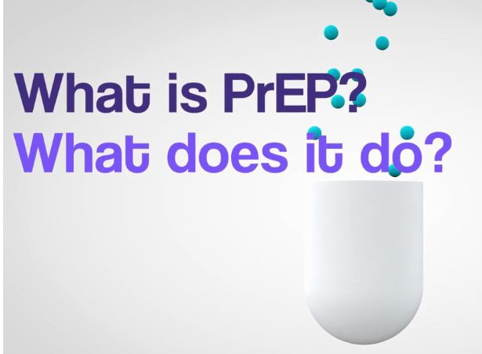
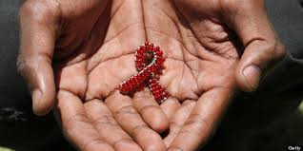
​ What is pre-exposure prophylaxis (PrEP)?
PrEP is medication that is taken to prevent HIV before exposure
PEP is taken after a suspected exposure to HIV; and,
Treatment is taken after someone is infected.
Cool videos: http://www.whatisprep.org/
Zambia ending AIDS – PrEP: https://www.youtube.com/watch?v=jhYyNcKWg6I (clients)
https://www.youtube.com/watch?v=GSZgTTpW3VM&t=8s (providers)

Slide 23
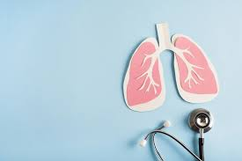
PrEP is not a new concept!
Other infectious diseases can also be prevented with medication
Examples:
Safe and effective medications have been recommended to prevent malaria for visitors to malaria endemic regions for decades.
Medications are also used to prevent progression of latent tuberculosis to active tuberculosis.

Slide 24
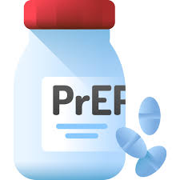
Why take PrEP?
PrEP tablets can reduce the risk of getting HIV from sex by about 99% when taken as prescribed.
[Note: new PrEP products will have different levels of protection]
https://www.cdc.gov/hiv/basics/prep/prep-effectiveness.html

Slide 25
How does PrEP compare to other interventions?
Intervention | Estimated effectiveness
Test and treat/immediate treatment/U=U (prevention effect for MSM, heterosexual men & women)¹ | 100%
Daily oral PrEP (MSM, heterosexual men & women) | 99%
Daily oral PrEP (PWID) | 74-84%
Always use condoms (heterosexual men & women)² | 80%
Always use condoms (MSM) ² | 63-91%
1. Taking ART daily as prescribed and achieving and maintaining viral suppression; 2. Based on self-report, https://www.cdc.gov/hiv/risk/estimates/preventionstrategies.html

Slide 26
PrEP is safe!
A minority of people may have stomach upset or headache when starting PrEP but this goes away within the first couple of weeks
The medication in oral PrEP has an established track record of safety, as it has been used to treat other infectious diseases for years including in pregnant women & children
There is very little risk of HIV drug resistance from oral PrEP because it does not remain in the body for very long.
Main risk can come from when someone with HIV is missed during testing

Slide 27
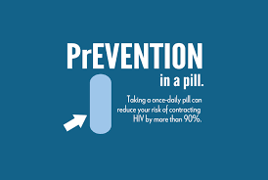
Who is PrEP for and how is it used?
PrEP is for anyone who needs it or requests it – this should be decided between clients and providers
Oral PrEP containing tenofovir should be offered as an additional prevention choice as part of combination HIV prevention approaches (WHO 2015)
NEW monthly dapivirine vaginal ring recommended as an additional prevention choice for women (WHO 2021)
NEW long-acting injectable cabotegravir (CAB LA) recommended for people >35 kg (WHO 2022)
Can help couples safely conceive babies where one partner may have HIV and other does not
Can provide an extra layer of protection in case condom breaks

Slide 28
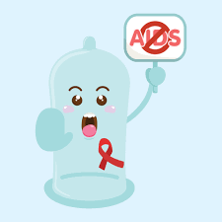
What about condoms?
PrEP does not replace condom use.
In fact, PrEP counseling specifically emphasizes that condoms are still needed for STI and pregnancy prevention.
PrEP is beneficial because condoms may break or people may forget to use a condom every time.

Slide 29
PrEP does not result in increased sexual "risk behaviors" or STIs
In a review of studies compiling data from 15 studies and 25,000 participants. . .
https://bmjopen.bmj.com/content/12/5/e048478.long

Slide 30
PrEP is not forever!
PrEP may be stopped when there are no longer benefits from taking the medication.
PrEP is NOT like ART. It can be taken for a month, a year, or however long this protection is needed.
PrEP could be stopped if the client decides to use other forms of prevention (like condoms) consistently.

Slide 31
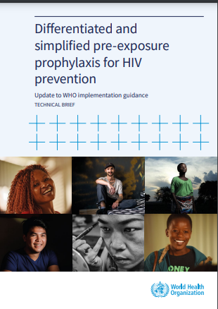
WHO Recommendations and need for scale-up
PrEP services should be client-centered and accessible – where will it be easiest for people to get PrEP?
The majority of people still do not know what PrEP is and that it exists.
Faith–based leaders play an important role by raising awareness about this new prevention option and even where to access it which can help curb new HIV infections in the communities they serve.

Slide 32
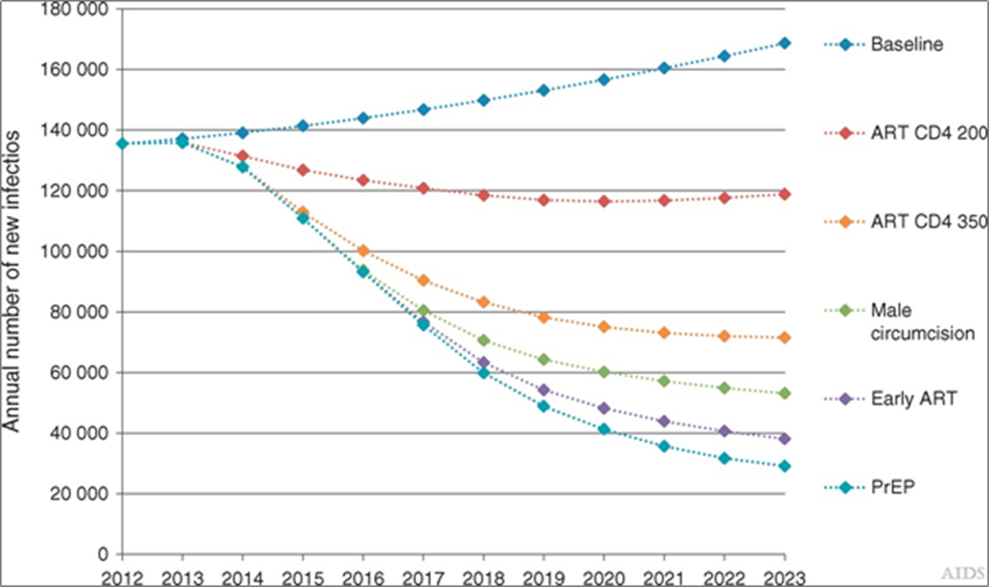
PrEP is a powerful intervention needed to end new infections and end HIV as a public health threat (shown over time)
PrEP and other primary prevention needed to reduce new HIV infections (from 2013)
Primary prevention is still needed to reduce new HIV infections beyond what is achievable with ART scale-up
Primary prevention can decrease new HIV infections by an additional 70–75%
Oral PrEP is a key component of primary prevention
https://pubmed.ncbi.nlm.nih.gov/35310517/
The new role of antiretrovirals in combination HIV prevention: a mathematical modelling analysis Cremin, Ide; Alsallaq, Ramzi; Dybul, Mark; Piot, Peter; Garnett, Geoffrey; Hallett, Timothy B. AIDS27(3):447-458, January 28th, 2013. doi: 10.1097/QAD.0b013e32835ca2dd

Slide 33
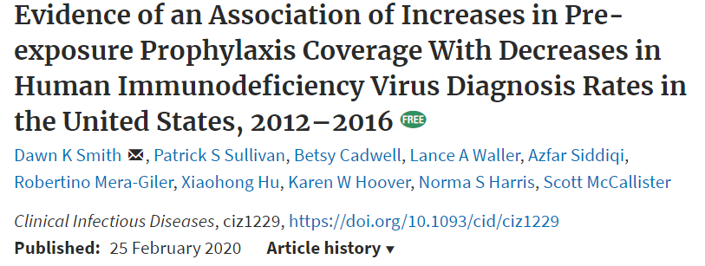
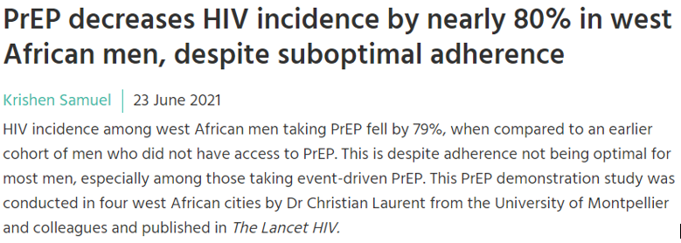
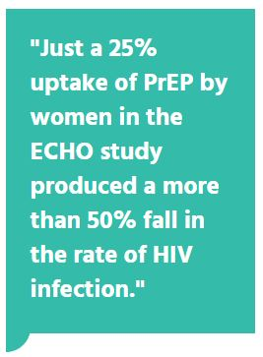
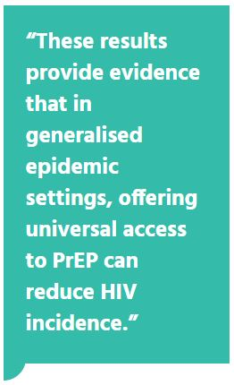
When scaled-up, studies show that PrEP has a high impact - but it is not yet widely accessible
Includes women
All studies found results despite imperfect adherence
33

Slide 34
Take home message: what to tell your congregation
PrEP is safe and 99% effective at preventing HIV if taken as prescribed.
It is a responsible choice for a person’s health if they think they may be at risk for HIV.
It can help protect and support families to grow.
Talking to a provider about PrEP can help someone decide if it is right for them.
Communities are important in spreading the word about PrEP!

Slide 35
THANK YOU!

