Slide 1



PROMISES TO KEEP:
IMPACT OF COVID-19 ON
ADOLESCENTS IN KENYA
September 15, 2021

Slide 2
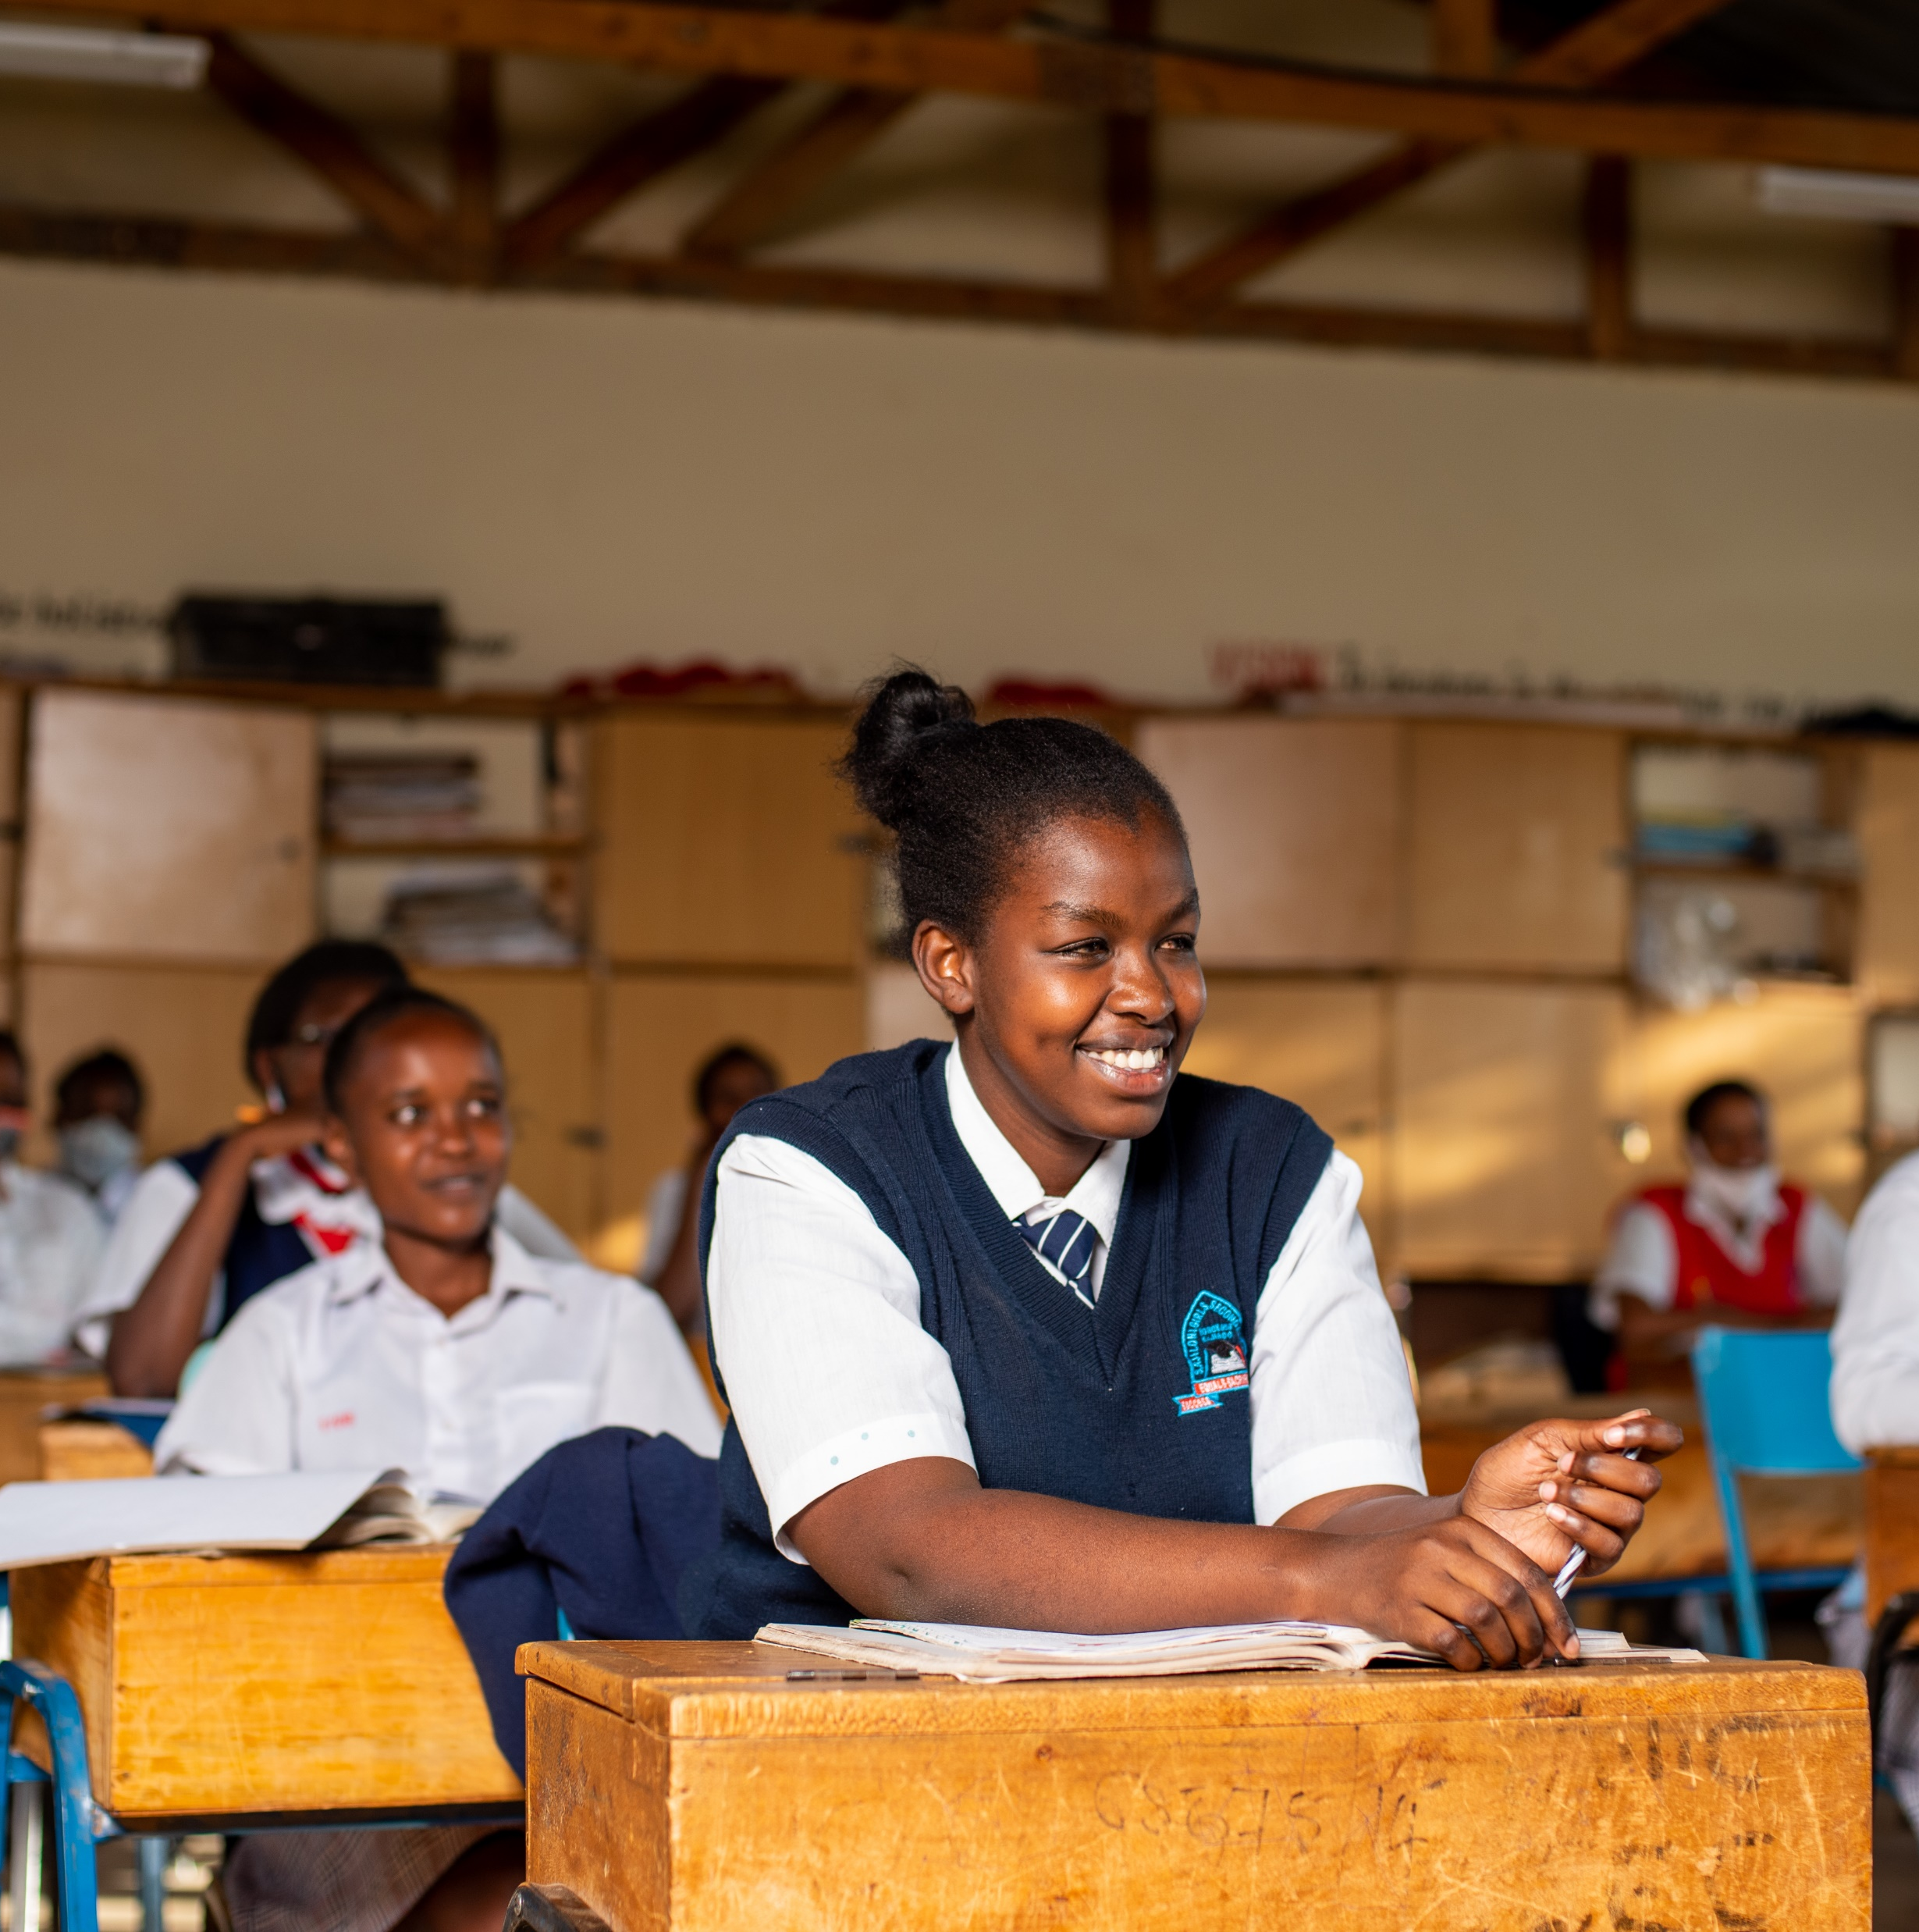
Objectives of the study
Understand the social, education, health and economic effects of COVID-19 on Kenyan adolescents
Include gender disaggregated data to effectively identify the gendered impacts
Generate data to guide post-COVID-19 adolescent programming and policy in Kenya
1
2
3
2

Slide 3






The Study Focus Areas
Focus areas
Education
Mental health
Economic effects
GBV and safety
Teen pregnancy and early marriage
3
Notes:
Assessed the state of remote-learning during school closures and the level of re-enrolment after re-opening of schools
Investigated the mental health status of adolescents and the sources of depression
Analyzed how the overall economic downturn affected the wellbeing of adolescents
Collected information on teen pregnancy and early marriage, and the drivers of these among adolescents
Assessed the tension and violence experienced by adolescents

Slide 4

Study timeline
Quantitative Data (Two rounds in June-August 2020 & February 2021
  (~4000 adolescents, 75% girls, 25% boys)
  Kilifi, Kisumu, Nairobi, Wajir
Qualitative data (November 2020) – girls, boys, parents, teachers, key stakeholders
  Kajiado, Kilifi, Kisumu, Makueni, Muranga, Nairobi, Wajir
Adolescent Validation Meetings
Capturing of voices
Progress
4
Notes:
Phone surveys (quantitative – two rounds in June-August 2020 & February 2021 (~4000 adolescents, 75% girls, 25% boys)
Kilifi, Kisumu, Nairobi, Wajir
Qualitative data (November 2020) – girls, boys, parents, teachers, key stakeholders
Kajiado, Kilifi, Kisumu, Makueni, Muranga, Nairobi, Wajir
Adolescent Validation Meetings
Technical Advisory Committee Meetings
Video & photography work

Slide 5
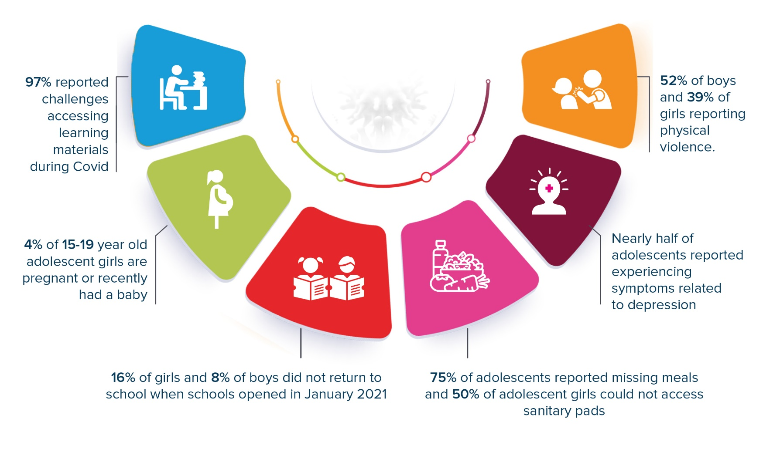
Key findings
5
Notes:
Basic descriptives, comparing sites/age groups
Working on a few papers that are more sophisticated analyses

Slide 6




Remote learning: During school closures, adolescents were unable to effectively engage in remote learning due to multiple factors
Remote learning
85% of the interviewed students accessed some form of remote learning during the school closures but faced multiple constraints. These include:
Limited access to reading materials:
68% of interviewed students reported that they only read the books they had during the school closures
Adolescents in low-income settings could not access additional reading materials in schools or public libraries
Limited time to engage with education:
Adolescents reported that they spent on average 2.5 – 3 hours on education per day
This is compared to the average 7 hours spent in school
Limited connectivity and access to online resources:
Many cited inability to access phones for online learning – only 32% of interviewees reported accessing phones
Even with access to mobile phones, issues such as lack of internet connectivity and electricity limited use
6

Slide 7

Re-enrolment: 16% of adolescent girls and 8% of boys did not re-enrol due to school fees, teen pregnancies and work
School re-enrolment
Proportion of adolescent girls and boys who were in school in March 2020 and re-enrolled in February 2021
%; 2020 - 2021
91%
94%
94%
94%
91%
87%
83%
81%
Girls
Boys
Nairobi
Wajir
Kilifi
Kisumu
Girls reported lower re-enrolment rates, with 84% re-enrolling back to school compared with 92% of boys. These figures highlight that over 250k girls and 125k boys did not re-enrol in February 2021
The major barrier to re-enrolment was school fees which was cited by 47% of girls and 21% of boys. The second major reason amongst girls was pregnancy (10%) and work amongst boys (14%)
7
Notes:
Of those in school in March 2020,
-84% of girls, 92% of boys re-enrolled → translates into ~125k boys who did not re-enroll and 250k girls

Slide 8


Mental health and food security: Adolescents reported experiencing depressive symptoms and skipping meals due to reduced family income
Mental health
Proportion of adolescents reporting depressive symptoms and skipping meals
%; 2020 - 2021
Economic
effects
70%
53%
58%
Jun-Aug 2020
Feb-21
31%
% Experiencing depressive symptoms
% Skipping meals
8
Notes:
Situation is improving somewhat
Mental health assessed using the patient health questionnaire that is globally used to diagnose depression
-mental health improvements are likely due to return to school. Among those who did not re-enroll, 50% still exhibiting depressive symptoms, which is similar to how it was when schools were closed

Slide 9
Economic effects: The economic impact of COVID-19 limited girls’ access to menstrual hygiene products
Economic
effects
Proportion of adolescent girls reporting to have accessed to menstrual and other reproductive health products
%; 2020 - 2021
The large proportion of adolescent girls (45% +) reporting lack of access to menstrual hygiene products after school re-enrolment indicates there are limitations in the schools’ sanitary towels programme
57%
54%
55%
55%
51%
45%
Jun-Aug 2020
Feb-21
Nairobi
Kilifi
Kisumu
9
Notes:
(among menstruating girls)
Over half of menstruating girls had trouble getting MHM products since COVID-19 started – has not changed much between Jun and February
NOTE: Most girls NOT getting their pads at school (point to the school pads program) – likely why a change hasn’t been seen
Nairobi – 20% given pads at school
Wajir – 50% given pads at school
Kilifi – 14% given pads at school
Kisumu 28% given pads at school

Slide 10

Economic effects: Adolescents also skipped health care services when sick primarily due to cost
Economic
effects
Proportion of adolescents reporting skipping health care in the past month
%; 2020 - 2021
Girls
18%
Boys
12%
11%
9%
The primary reason for skipping health care services was the cost of medical care followed by the health workers’ strike and the fear of contracting COVID-19
Jun-Aug 2020
Feb-21
10
Notes:
Main reason for skipping is COST, followed by either lack of services/medicines or fear of COVID-19 infection
Highlight that this is in past 30 days, health care services aren't something you do every day, so these are actually quite high!

Slide 11
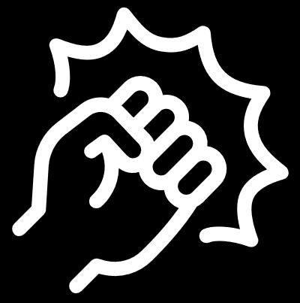
GBV and safety: Adolescents reported experiencing increasing emotional, physical and sexual violence acts
GBV and safety
Proportion of adolescents reporting emotional, physical or sexual violence in the past month
%; 2020 - 2021
10%
10%
9%
Jun-Aug 20
Feb-21
5%
2%
2%
Emotional violence
Physical violence
Sexual violence
For all reports of violence, half to three-quarters say it is happening now more than pre-COVID-19 era
11
Notes:
No gender gap for emotional violence.
Physical violence experienced more by boys.
Sexual violence was only reported by girls
Also highlight - this is past 30 days, so numbers are high!

Slide 12
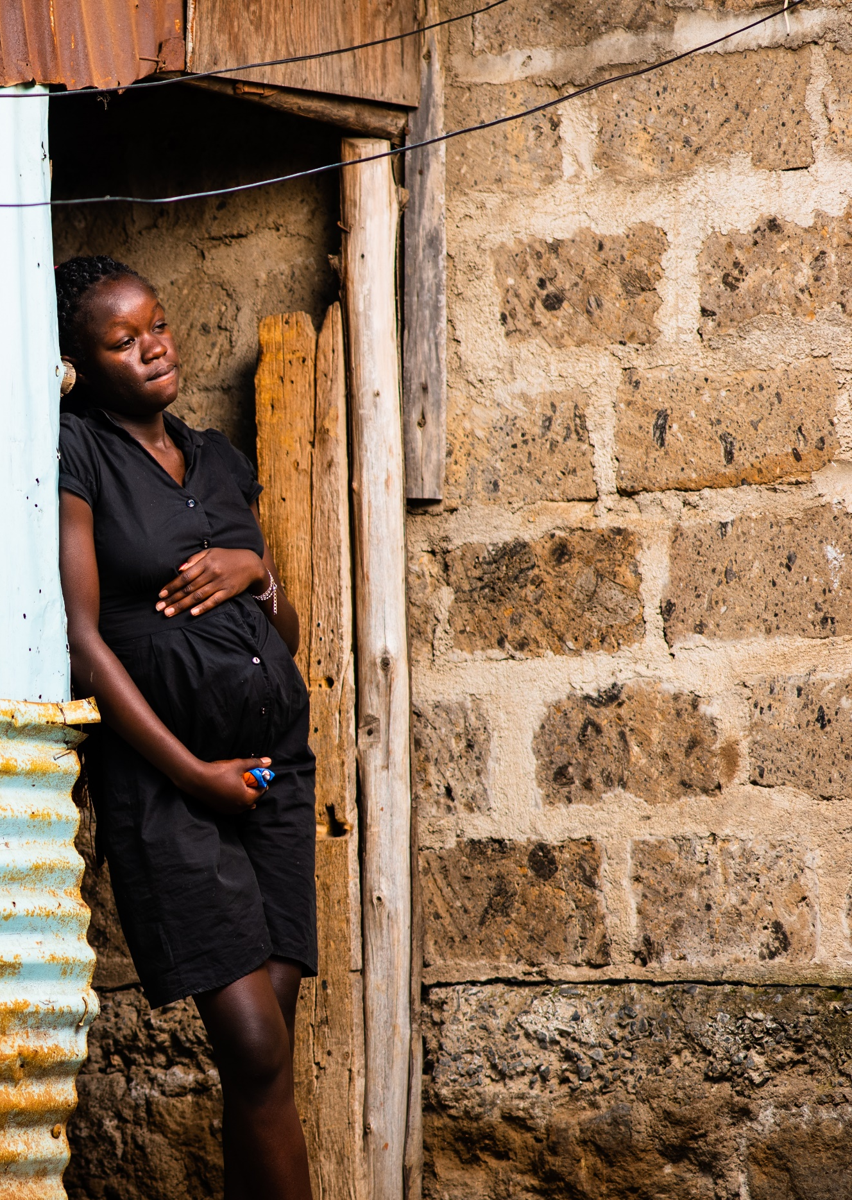
Pregnancy and early marriage: A noticeable proportion of adolescent girls are either pregnant or married
Proportion of adolescent girls reporting pregnancy and marriage status by county
%; 2020 - 2021
15%
13%
Nairobi
9%
9%
Wajir
7%
Kilifi
6%
Kisumu
5%
4%
3%
3%
0%
0%
Pregnant/recently had a baby
Married
Living with a partner
4% of 15–19-year-old girls are pregnant or recently had a baby
This translates to over 320k adolescent pregnancies
12

Slide 13
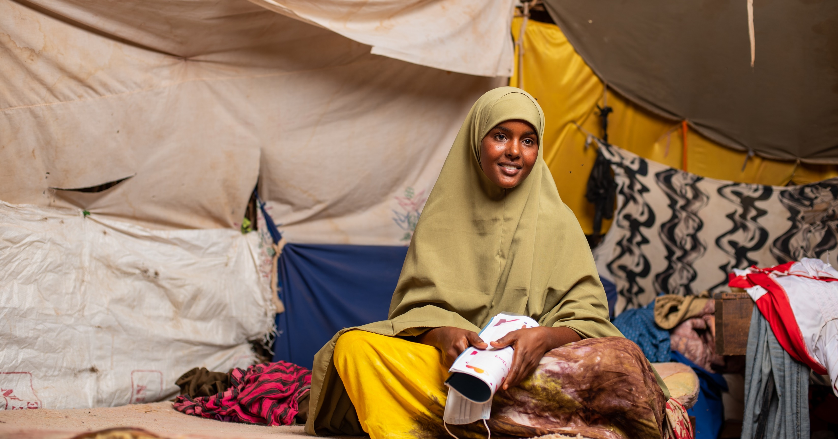
Recommendations and Next Steps
13

Slide 14



Recommendations: Summary of targeted solutions to address the identified adolescents’ challenges (1/5)
Recommendations
Adolescent Voices: Incorporate adolescents in programming
Entrench tangible and valid representation of Adolescents in the development of mitigation plans, in resource allocation and public participation forums.
Multisector Approach: Develop strong multisectoral, whole-of-government
policy approaches that address adolescent health and well-being
A multisectoral collaboration enables efficient use of resources, enhanced accountability, a sense of collective ownership and knowledge sharing.
Education: Provide additional financing and address the digital divide
Financing mechanisms such as the GPE campaign are required to ensure that adolescents access basic education. Additionally, digital learning initiatives such as the UNICEF giga initiative or that of digitruck could be scaled to reduce the digital divide and enhance remote learning.
14

Slide 15



Recommendations: Summary of targeted solutions to address the identified adolescents’ challenges (2/5)
Recommendations
Nutrition: Refine the school meal programme
The Ministry of Education to develop a sustainable plan to provide school lunch for all primary and secondary school children to ensure enrolment, retention, and good performance.
Menstrual hygiene programme: Review and enhance efficiencies in the supply chain
The State Department of Gender needs to review and refine the schools’ sanitary towels supply chain to ensure girls access the products in school and at home.
Teen pregnancy: Develop a bold, integrated approach that addresses root causes
The government and development sector actors need to design a bold approach that incorporates positive parenting, protection for young girls and risk mitigation while considering socio-cultural practices.
15

Slide 16


Recommendations: Summary of targeted solutions to address the identified adolescents’ challenges (3/5)
Recommendations
Teen pregnancy: Refine the return to school policy for pregnant teens
The policy needs to incorporate critical factors to ensure complete re-integration of pregnant girls. These factors include a psychological support system, access to antenatal care, nutrition and conducive breastfeeding environments.
Invest in data driven evidence and research findings to address adolescent’s challenges
Sufficient data and evidence at county and national levels exist to guide development and prioritisation of activities for adolescents.
Violence against children and adolescents: Community accountability structures
Institute community interventions including positive parenting, accountability structures to address violence. Moreover, screen for experience of GBV in schools and health centres, and scale existing safe shelters.
16

Slide 17



Recommendations: Summary of targeted solutions to address the identified adolescents’ challenges (4/5)
Recommendations
Safe hubs and skills building opportunities
Revitalize MoE’s Community Learning Platform to support the establishment of safe hubs for adolescents during school holidays, where skills building beyond academics, can be included throughout the school year.
Mental health: Joint interventions by the health and education sectors
Scale up implementation of MoE’s Mentorship Policy for Early Learning and Basic Education which imparts teachers with new counselling skills tailored for adolescents. Further, the health sector should guide MoE on school mental health responses.
Substance abuse: Institute community movements to address the latent threat
Establish community movements with appropriate linkages to health care services to address substance abuse among adolescents.
17

Slide 18

Recommendations: Summary of targeted solutions to address the identified adolescents’ challenges (5/5)
Recommendations
Adolescent boys: Link rite of passage programmes with comprehensive curriculums
Link the rites of passage programmes with comprehensive curriculums that cover value of all genders and mental health, among other life skills.
18

Slide 19

Thank You
19

