Slide 1
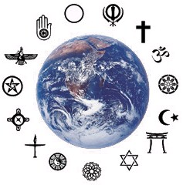
Spiritual and Psychosocial Self-Care for caregivers and communities
Rev. Richard W. Bauer, MM, BCC, LCSW
FCI New Foundations of Hope
17 March 2021

Slide 2
Spiritual and Psychosocial Self-Care
“The expectation that we can be immersed in suffering and loss daily, and not be touched by it, is as unrealistic as expecting to be able to walk through water without getting wet.”
Remen RN. Kitchen Table Wisdom: Stories That Heal. Sydney: Pan Macmillan, 2002.
Notes:
I know I have gone to many presentations and lectures on self-care, always thinking “it’s for my staff, or others.” But I’ve learned over the years, I cannot continue to do this ministry and work unless there is self care. I call this holy, selfishness. This is ESPECIALLY important as we work to identify and support those who have experienced GBV and children who have experienced abuse.

Slide 3
Spiritual and psychosocial self-care
Fr Rick’s Guide (Rules!)
Every day, spend time with God (however you understand that word and concept) This is individual time in prayer, meditation and or reflection.
Taking care of family and colleagues. Checking-in
Taking care of patients
Repeat, never change the order.
Notes:
So, in my 8 minutes today, I really want to focus on numbers ONE and TWO and what this means in terms of our own healthy self-care. Caring for what God has created in YOU, caring for the gifts, talents and abilities that God has given YOU.

Slide 4
Spiritual and Psychosocial Self-Care
What do our religious and spiritual traditions say about self care?
For Christians both Matthew (22,37-39) and Ephesians 5,29 talk about the importance of self care.
The Islamic tradition talks of praying 5 times a day properly and sincerely for true peace (Qur’an 13:28)
Buddhists and Hindu traditions speak of Namasté for peace and self care
Notes:
Jesus said to him, “You shall love the Lord, your God, with all your heart, with all your soul, and with all your mind. This is the greatest and the first commandment. The second is like it: You shall love your neighbor as yourself. (Matt 22, 37-39) For no one hates his own flesh but rather nourishes and cherishes it, even as Christ does the church (Ephesians 5,29) Praying 5 times a day ensures a constant daily connection with God, through times of both difficulty and ease. It guarantees that we will always have a relationship with Him, and a strong foundation for when we need to turn to Him for help. If we pray properly and sincerely, it can give us true peace. “Without doubt, in the remembrance of Allah do hearts find satisfaction.” (Qur’an 13:28) Namaste: My soul honors your soul. I honor the place in you where the entire universe resides. I honor the light, love, truth, beauty & peace within you, because it is also within me. In sharing these things, we are united, we are the same, we are one.
Even, with this, when I spend time in self-care, in my heart/gut, it always feels either “selfish” or just ”wasting time.” But my head knows it is absolute necessity. Even Jesus often ”went away to pray.”

Slide 5
Spiritual and psychosocial self-care
An international consensus definition for spirituality:
“Spirituality is a dynamic and intrinsic aspect of humanity through which persons seek ultimate meaning, purpose and transcendence and experience relationship to self, family, others, community, society, nature and the significant or sacred. Spirituality is expressed through beliefs, values, traditions and practices.”
Puchalski, C. M., Vitillo, R., Hull, S. K., & Reller, N. (2014). Improving the Spiritual Dimension of Whole Person Care: Reaching National and International Consensus. Journal of Palliative Medicine, 17(6), 642–656.
Notes:
Definitions are important, especially in new areas of understanding. Here is a suggestion from our palliative care colleagues as a place to begin

Slide 6
Spiritual and psychosocial self-care
WHO definition of mental Health:
Mental health is a state of well-being in which an individual realizes his or her own abilities, can cope with the normal stresses of life, can work productively and is able to make a contribution to his or her community.
Mental health is fundamental to our collective and individual ability as humans to think, emote, interact with each other, earn a living and enjoy life. On this basis, the promotion, protection and restoration of mental health can be regarded as a vital concern of individuals, communities and societies throughout the world.
https://www.who.int/news-room/fact-sheets/detail/mental-health-strengthening-our-response
Notes:
This is the WHO definition, but I don’t like the “earn a living” as it negatively impacts those with significant disabilities and perhaps the elderly. But, it is a place to start

Slide 7
Spiritual and Psychosocial Self-Care
Self-care is essential for managing stress, preventing burnout, and mitigating compassion fatigue—all common occupational hazards for individuals who care
Physical (the body) – to live, move, and breath
Emotional (heart) – to love, care, and be in relationship
Psychological (the mind) – to learn, think, grow and develop
Spiritual (the spirit) – to connect with meaning, purpose, connectedness and transcendence (God)
Notes:
Physical self-care involves ensuring an overall healthy lifestyle that includes eating healthy, drinking lots of water, and getting plenty of exercise. Take time away from computers, TV, and your smartphone Enjoy moments to rest and replenish. Emotional self-care might include setting clear boundaries on your time and energy. Emotional boundaries within helping/clinical relationships are healthy for both the clinician and patient. We need to be with people who affirm, support and inspire us. Emotional self care means addressing problems as they arise so that they don’t build up. We learn to both Give and receive love, kindness, and support and spend time with people you care about and who care about you. Psychological self-care activities include both personal and professional development. I keep learning through seminars and continuing education. I learn to take time for personal reflection and cultivate self-awareness through journaling, receiving feedback from others, counselling, and consultation or supervision. I avail myself for opportunities to grown, learn and reflect. Spiritual self-care might include religious practices and rituals, prayer or meditation. You may want to practice gratitude and forgiveness, spend time in nature, and be aware of the non-material aspects of your life. My purpose in life, gets me up in the morning. Meaning in life helps me sleep at night. Both of these are related to my connectedness with others and with God.

Slide 8
Spiritual and Psychosocial Self-Care
Spiritual self care
Spirituality has different meanings for different people, often influenced by the ideas and experiences that you grew up with. For many, we associate spirituality with our religious and cultural traditions and practices. Participating in and observing rituals, attending religious services or ceremonies, and studying religious texts can be types of spiritual self-care.
Notes:
Perhaps your concept of spirituality is experienced in nature, in one another, or within oneself. It could be through art, music, and dance. Ultimately, spirituality can be anything that enkindles meaning, purpose, connectedness and sacredness. A spiritual self-care practice is any ritual or practices that are are energizing and inspiriting.

Slide 9
Spiritual and Psychosocial Self-Care
Spiritual self care might include:
Participation in organized religion
Meditation
Connecting with your deepest self
Notes:
ORGANIZED RELIGION
Participate in church, mosque, temple or religious institutions
Praying and focusing on your concept/understanding of God
Reading religious and sacred texts
Talking and sharing with others who share similar beliefs
MEDIATATION
Deep breathing that focuses on the source of life
Mindfulness meditation that focuses on the moment in a non-judgmental way
Visualizations: imagining a peaceful, relaxed, hopeful, loving place
Repeating a mantra or sacred words or sounds
DEEPEST SELF:
Focusing on your goals, values and beliefs: What brings you hope, joy and comfort? What brings your life meaning and purpose?
Keeping a regular journal to express your deepest thoughts and feelings
Reading inspiring stories, essays, poetry or philosophies that can enrich your life
Being open to new experiences that can nurture your spirit, the deepest part of you, with nature, music, art and beauty.
Looking around at what is good in yourself, and in others. Be aware of the sacred and significant around you. Learning to practice gratitude and forgiveness on a daily basis. Focus on the positive.

Slide 10
Spiritual and Psychosocial Self-Care
1. Evaluating your coping skills
Examining your own habits is an important first step in developing a self-care plan. How do you typically deal with life’s demands? Can you identify when you need to take a break? When faced with challenges, we can use either positive coping strategies or negative coping strategies. Below are a few examples of each. Which strategies do you use?
Notes:
Positive Negative
Deep breathing Yelling
Stretching Acting aggressively
Prayer/meditation Overeating
Listening to music Drinking excessive alcohol
Exercising Smoking
Reading Pacing
Going for a walk Biting your fingernails
Sitting outside & relaxing Isolating from friends and family
Engaging in a hobby Planning revenge
So, it is easy to listen to all of the nice things said today, but, if you don’t actually DO self-care and practice this DAILY, you cannot benefit from this!

Slide 11
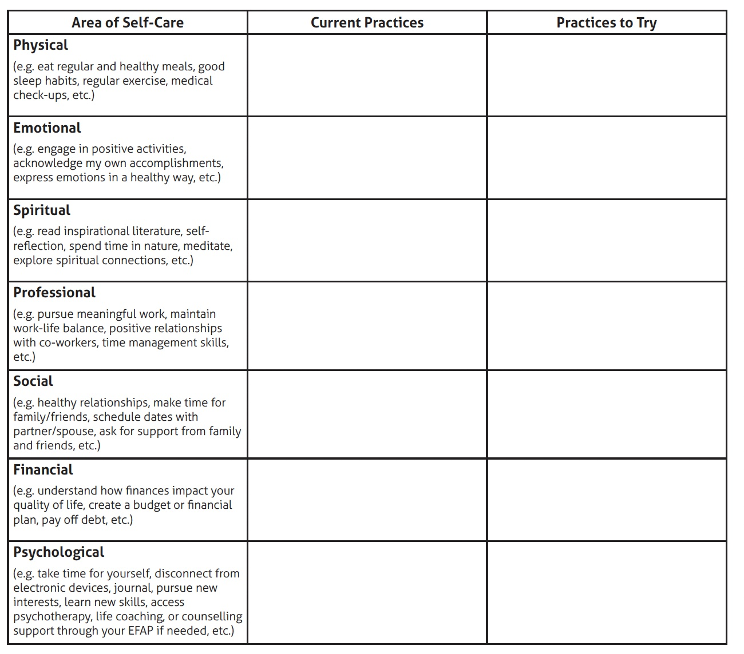
Spiritual and Psychosocial Self-Care
2. Identify YOUR self-care needs
Notes:
We are all faced with unique challenges and no two people have the same self-care needs. Take a moment to consider what you value and need in your everyday life (daily self-care needs) versus what you value and need in the event of a crisis (emergency self-care needs). Remember that self-care extends far beyond your basic physical needs: consider your psychological, emotional, spiritual, social, financial, and
workplace well-being.

Slide 12
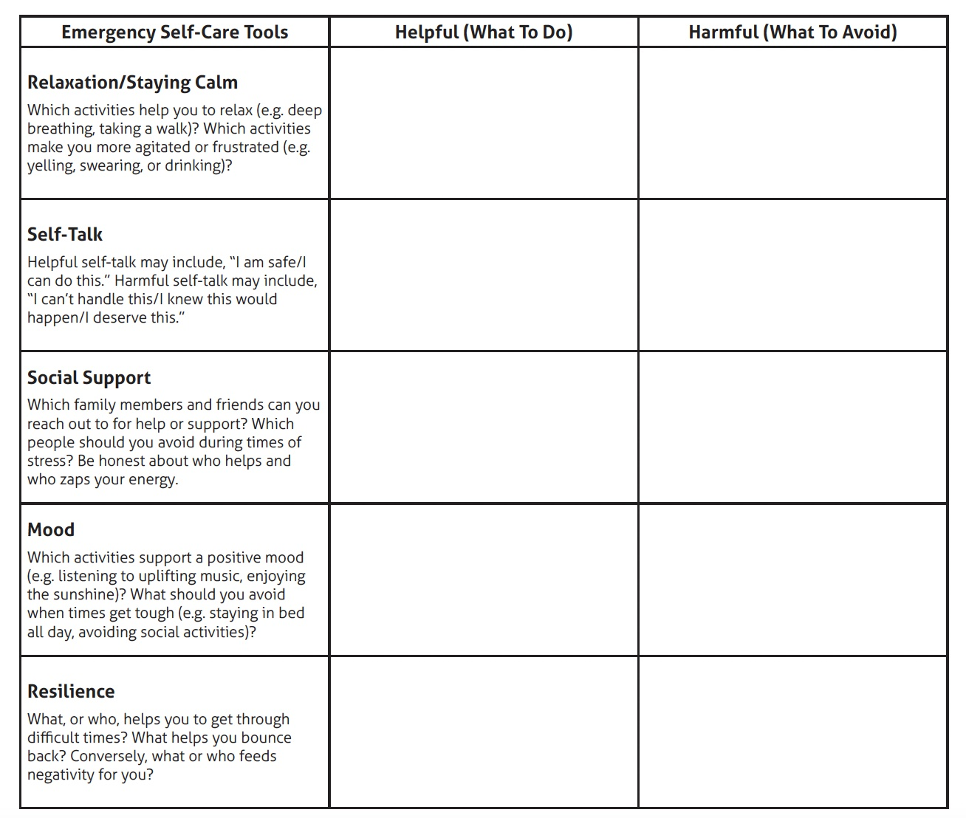
Spiritual and Psychosocial Self-Care
2. Identify YOUR self-care needs (con’t)
Notes:
When you are faced with a crisis, you likely won’t have time to create a coping strategy. Take time to develop a plan in advance so it’s there when you need it. Try completing the following table to help identify your unique self-care needs during times of distress.

Slide 13
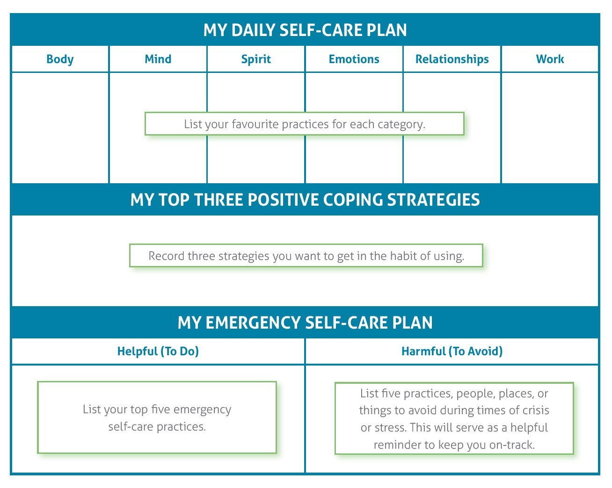
Spiritual and Psychosocial Self-Care
3. Create YOUR self-care plan
Notes:
Once you’ve determined your personal needs and strategy, write it down. Your self-care plan can be as simple or complex as you need it to be. You may choose to keep a detailed plan at home and carry a simplified version in your wallet, in your purse, or on your phone. Here is an example of how your simplified self-care plan might ook:

Slide 14
Spiritual and psychosocial self-care
Resources:
Aten, J. D., Shannonhouse, L, Davis, D. E., Davis, E. B., Hook, J. N., Van Tongeren, D. R., Hwang, J., McElroy-Heltzel, S. E., Schruba, A., & Annan, K. (2020). Spiritual first aid. Wheaton, IL: Humanitarian Disaster Institute
Basic Psychosocial Skills: A Guide for COVID-19 Responders https://www.who.int/news/item/01-06-2020-basic-psychosocial-skills-a-guide-for-covid-19-responders (accessed 10 Mar 2021)
Grief: The new normal. Offerings from the Chaplaincy Innovation Lab, for all who are grieving and those who love them. http://chaplaincyinnovation.org/resources/ebook-grief-new-normal (accessed 10 Mar 2021)
Mills, J., Ramachenderan, J., Chapman, M., Greenland, R., & Agar, M. (2020). Prioritising workforce wellbeing and resilience: What COVID-19 is reminding us about self-care and staff support. Palliative Medicine, 34(9), 1137–1139.
Osofsky, J. D. (2011). Vicarious traumatization and the need for self-care in working with traumatized young children. In Clinical Work with Traumatized Young Children (pp. 336-348). New York: The Guilford Press.

Slide 15
Spiritual and psychosocial self-care
Resources (con’t):
Psychological first aid: Guide for field workers https://www.who.int/publications/i/item/9789241548205 (accessed 10 Mar 2021)
Sanchez-Reilly, S., Morrison, L. J., Carey, E., Bernacki, R., O’Neill, L., Kapo, J., Periyakoil, V. S., & Thomas, J. deLima. (2013). Caring for oneself to care for others: Physicians and their self-care. The Journal of Supportive Oncology, 11(2), 75–81.
Sansó, N., Galiana, L., Oliver, A., Pascual, A., Sinclair, S., & Benito, E. (2015). Palliative Care Professionals’ Inner Life: Exploring the Relationships Among Awareness, Self-Care, and Compassion Satisfaction and Fatigue, Burnout, and Coping With Death. Journal of Pain and Symptom Management, 50(2), 200–207.
Stuart, R. M. (2012). Practicing Contemplation for Healthy Self-care. Chaplaincy Today, 28(1), 33–36.

Slide 16
spiritual and psychosocial self-care
Thank you! Asanta Sana! Merci! Obrigado!
Rev. Richard W. Bauer, MM, BCC, LCSW
richardbauermm@mac.com
@nvrflycoach

