Slide 1
PEPFAR Faith and Community Engagement – Where we are going

Slide 2
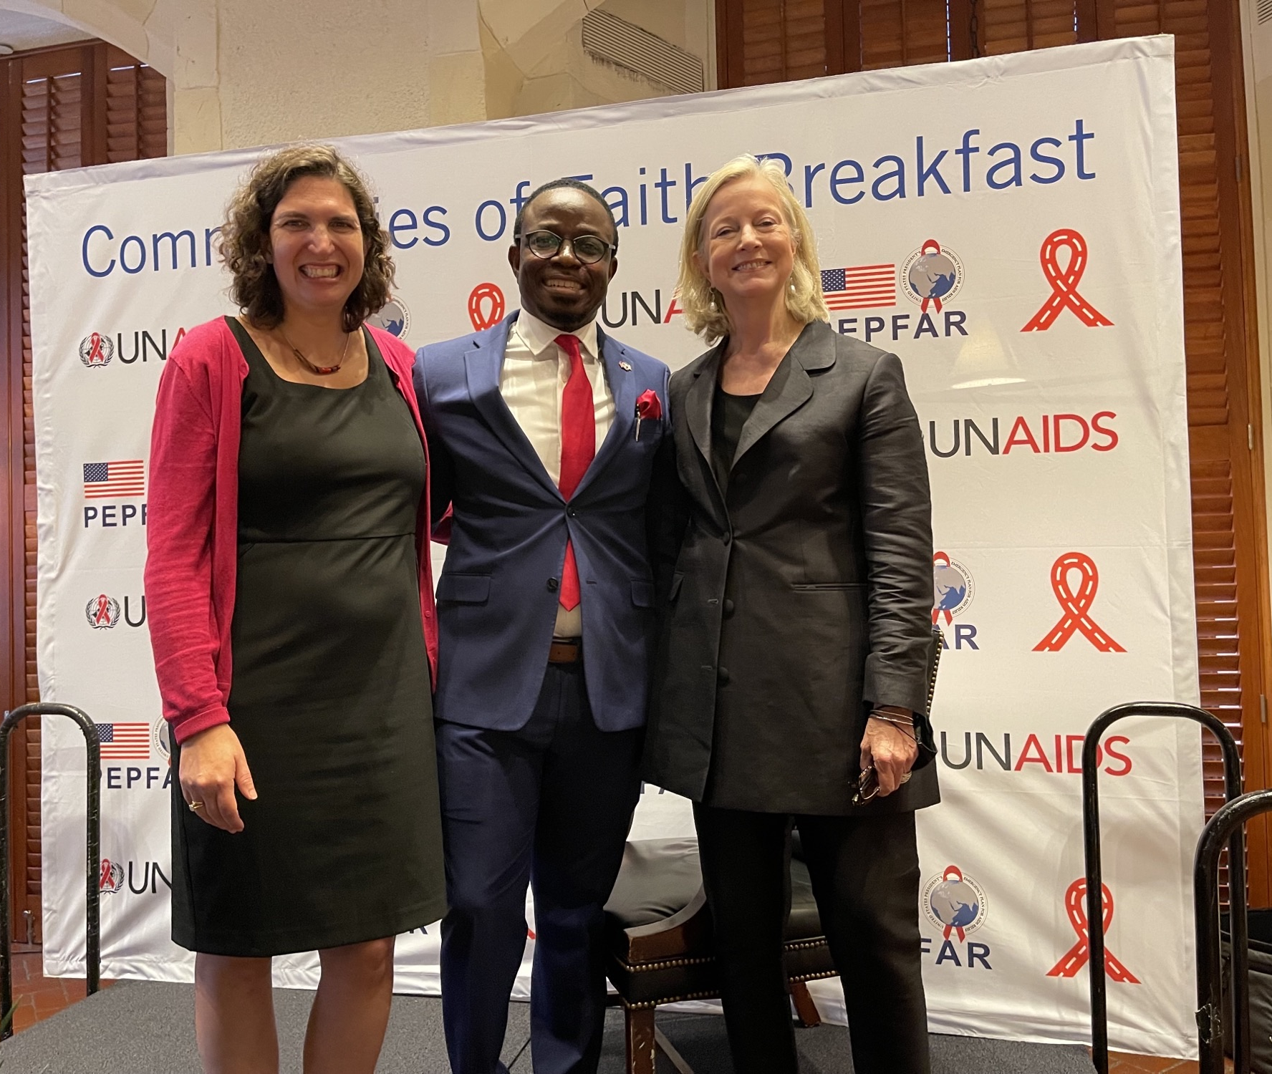
UNAIDS –PEPFAR Faith Leaders’ Breakfast, UNGA

Slide 4
What do data say about core challenges
And how do FBO models close EQUITY gaps?

Slide 5
Solutions for People -- Programs and Partnerships Led by Trusted Community Leaders Close These Gaps (COP22)
Faith- engaged Community Posts
Faith- engaged HIV Self-testing
*Not at Epidemic Control

Slide 6
Solutions for Children: Programs and Partnerships Led by Trusted Community Leaders Close These Gaps (COP22)
The Vatican Initiative
Baby Shower Model, COP22
Operation Triple Zero, CATS, Co-location Models COP22

Slide 7
What is PEPFAR's strategic SUSTAINABILITY response,
as reflected in COP guidance
or
other documents?

Slide 8
FCI Leverages Inter-Faith Community Platforms through People, Programs, and Partnerships to Sustain HIV Gains and Advance Global Health Security
Disseminate New Messages of Hope in each Parent [Mother] Body
Faith and Community
Initiative IPs Leads
Nazarenes,
Lutherans, Council of Churches
Episcopal/ Anglican/
Catholic Conference
Youth Faith Leaders
Islamic Supreme Council
Consortium of Concerned
Church
Leaders
SEMINARIES
Zionists
Churches
Churches
Churches
Mosques
Mosques
Congregations
Affiliated
Churches
Schools

Slide 9
What do PEPFAR FCI models strengthen
GLOBAL HEALTH SECURITY?

Slide 10
Leveraging Faith and Community Initiative Coordination Structure in COVID-19 to Advance Mitigation and Vaccination

Slide 11
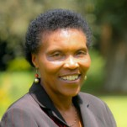
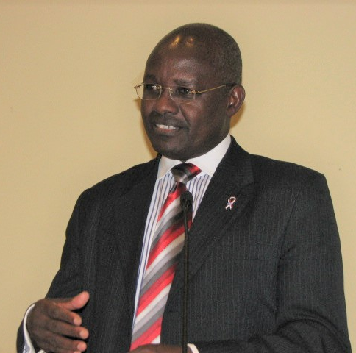
South-to-South Learning Platform: Collaboration of faith community leaders, governmental, bi-/multi-lateral, CSO, private partners leaders
South-to-South Faith & Community Partnerships
Faith Leaders & Alliances
FBOs & CSOs
Multilaterals
MOHs & National Governments
Private Sector
Bilaterals
Dr. Esther Mombo Co-Chair
Dr. Peter Okaalet
Co-Chair (the late)
Country-led, Participatory Design
Bi-directional information sharing and education
Facilitated Real-time collaborations
Identifying and Catalyzing actions

Slide 12
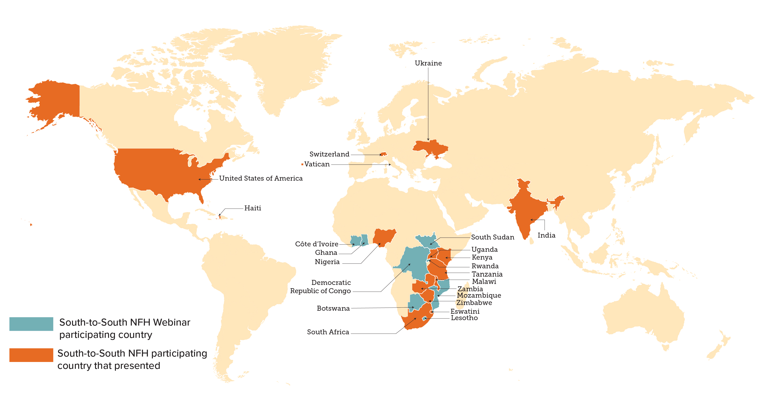
South-to-South Faith and Community Partnerships: Strategic for Sustaining Epidemic Control and Protecting Global Health Security Security
‘New Foundations of Hope’ (NFH) learning community through webinars
22 interactive monthly webinars since April 2020
425 faith and community leaders engaged – in faith infrastructures and media networks raising awareness for over 12 million people
23 countries represented
1,871 person-sessions total
Partnering across NGOs, FBOs, CSOs, UNAIDS, Faith Alliances, bilaterals, multilaterals, country governments
97% of participants used what they learned to improve programming
Notes:
For the 35 million people reached – broad media and faith networks/social media reach: 8 million in Malawi, 5 million in Zambia, 22 million in Kenya

Slide 13
PARTNERSHIPS:
How do we work with partners, including multilaterals, donors, faith and community leaders, private sector, beneficiaries, and others on responses?

Slide 14
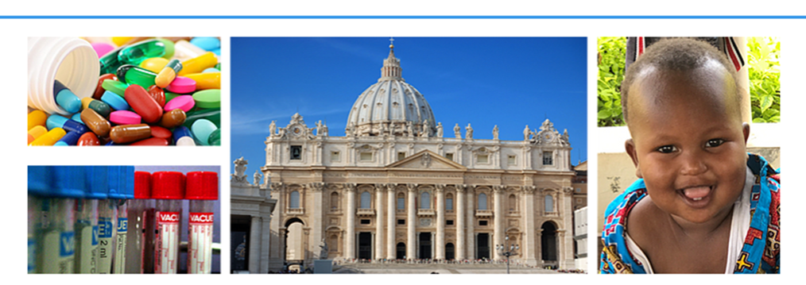
ROME PAEDIATRIC HIV & TB ACTION PLAN
The Academic Consortium of UNAIDS-PEPFAR Partnership to Advance Paediatric HIV & TB, 2016 - 2022

Slide 15
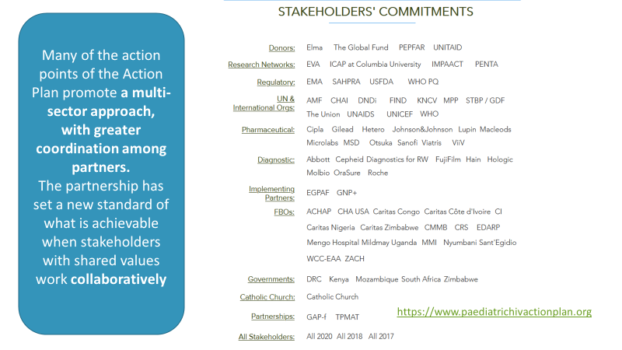
The Academic Consortium of UNAIDS - PEPFAR Partnership to Advance Paediatric HIV & TB: Rome Action Plan Stakeholders

Slide 16
SCIENCE:
What are examples of evidence-based models supported in COP22?

Slide 17
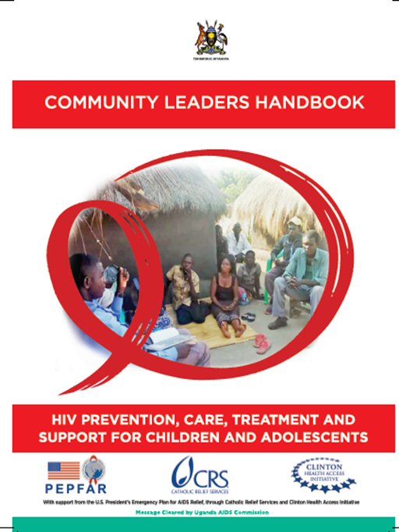
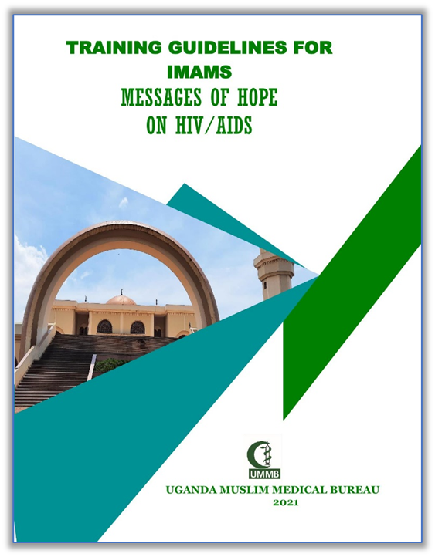
Uganda – Broad Partnerships to Close Gaps for Young Adults
Faith-based medical bureaux
Faith-based radio, newspaper, and other media
Civil society, including Key Population-led CSOs
Catholic Centre for Legal Aid Services
Regional implementing partners
Catholic Relief Services FASTER for pediatric case-finding
Ministry of Health

Slide 18
Uganda – FBOs Reaching Healthly Women and Men
Test Positivity
Tests to Identify One PLHIV

Slide 19
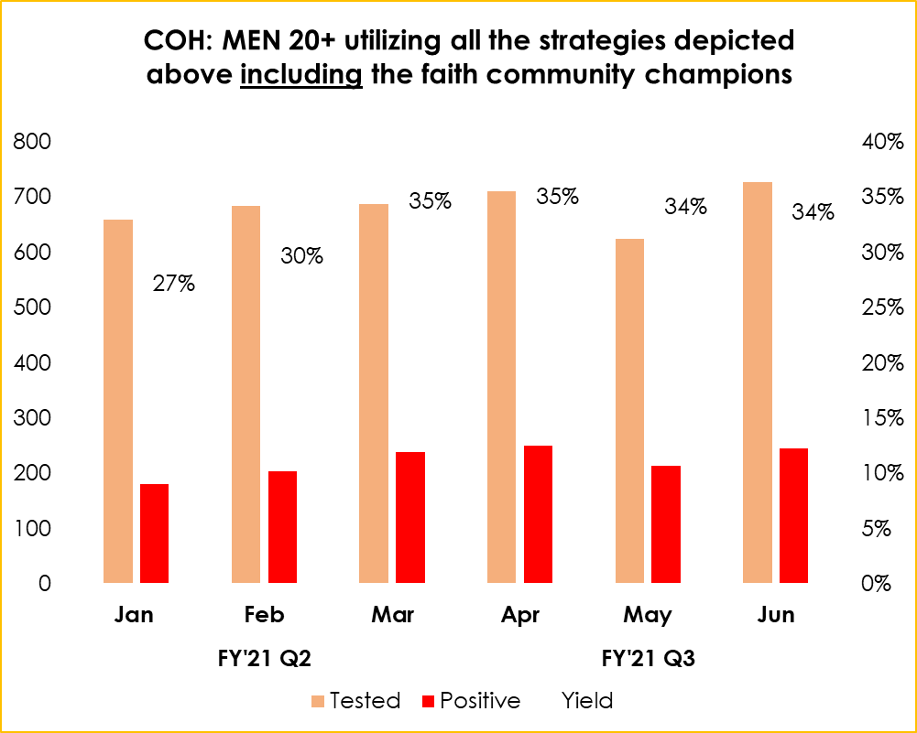
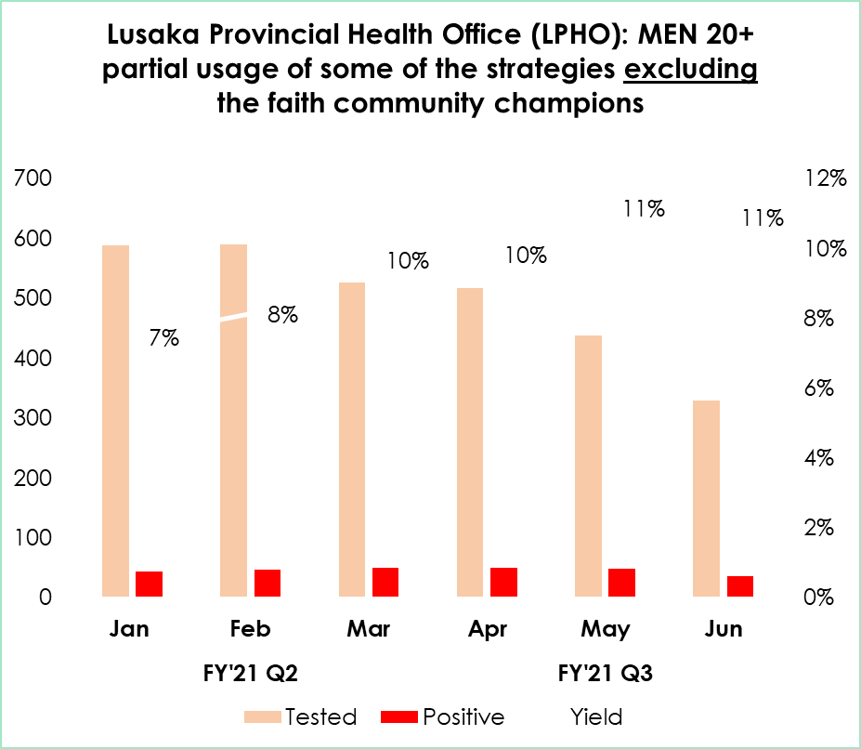
ZAMBIA Faith-Engaged Community Posts (CP): Higher Performance in Reaching Well Men, than Lusaka Provincial Health Office CPs - Targeted Testing Men, FY21Q2 & Q3 Q2

Slide 20
High distribution among men, lower reactivity when compared to women
Notes:
More males have been supplied with HIVST kits compared with females across all age groups, however, females have much higher reactivity rates across all age groups.
This trends on HIVST distribution numbers reflects on the location of the community posts where there is the presence of more men.
The higher reactivity among women is probably a reflection of the epidemic, which disproportionately affecting more women than men

Slide 21
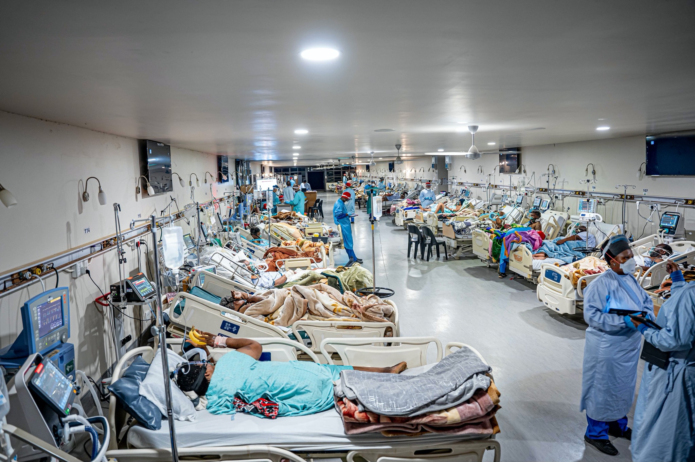
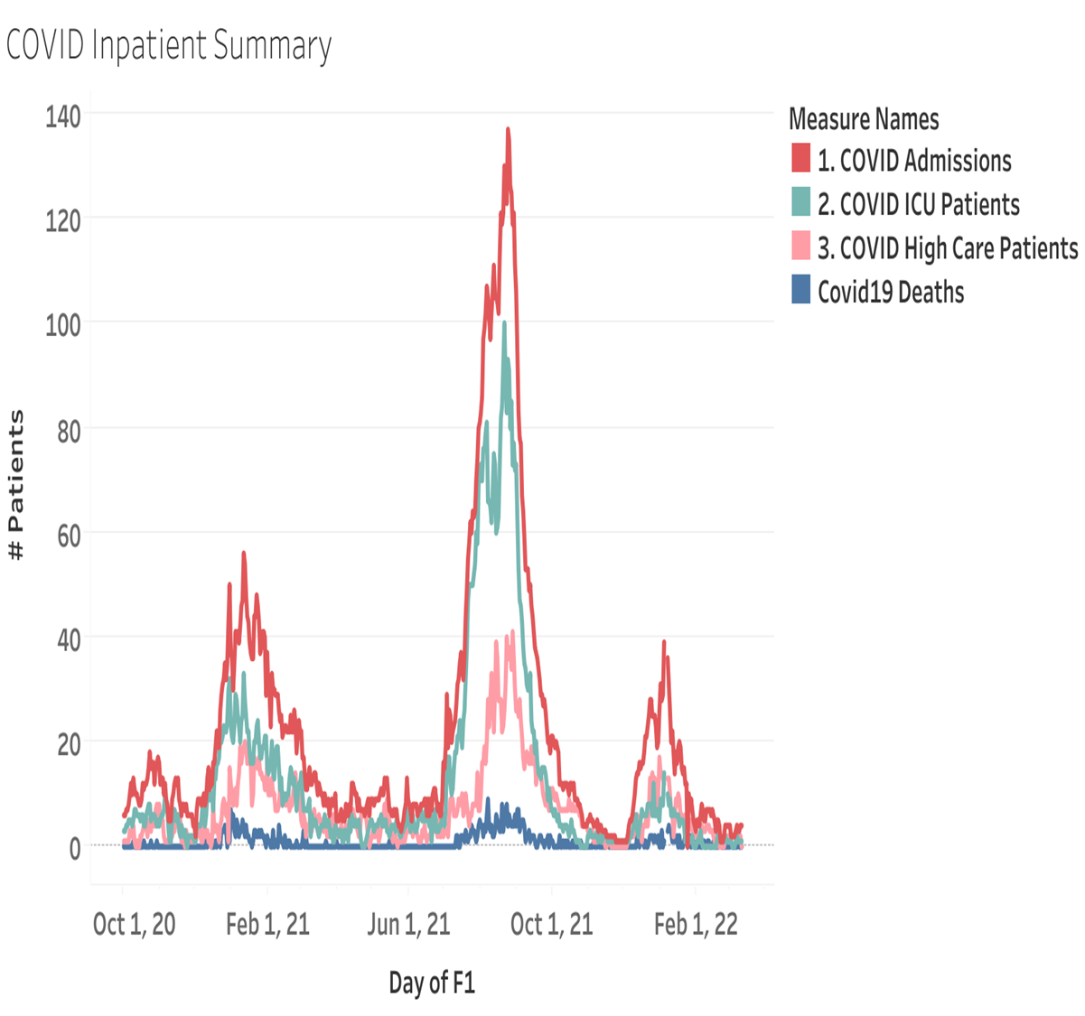
15 years of Mobile Community Outreach for HIV to every Region Laid Infra-structure for COVID Response

Slide 22
THANK YOU

