Slide 1
Maximizing ART & PrEP Initiation
New Foundations of Hope Webinar
Echo VanderWal / The Luke Commission
October 28, 2020

Slide 2
Background
The Luke Commission (TLC) provides compassionate, comprehensive, client-centered health care to underserved populations in Eswatini
HIV/AIDS prevalence in Eswatini: 27%
The TLC team delivers services from the fixed-site Miracle Campus and through mobile hospital outreaches
Motivated by faith, TLC seeks to treat every patient as a beloved father, mother, brother, sister, or child

Slide 3
Challenges & Solutions
Challenges
Solutions
Some patients are reluctant to test or go on treatment (ART or PrEP)
Some patients resist guidance from junior-level health care workers
Comprehensive health care platform
Escalation matrix
Community-level collaboration

Slide 4
Compassionate, Comprehensive Care
Comprehensive health care platform with 42 services
Male-friendly spaces
Open 24 hours a day, 365 days a year
24-hour hotline (+268 7613 8814)

Slide 5
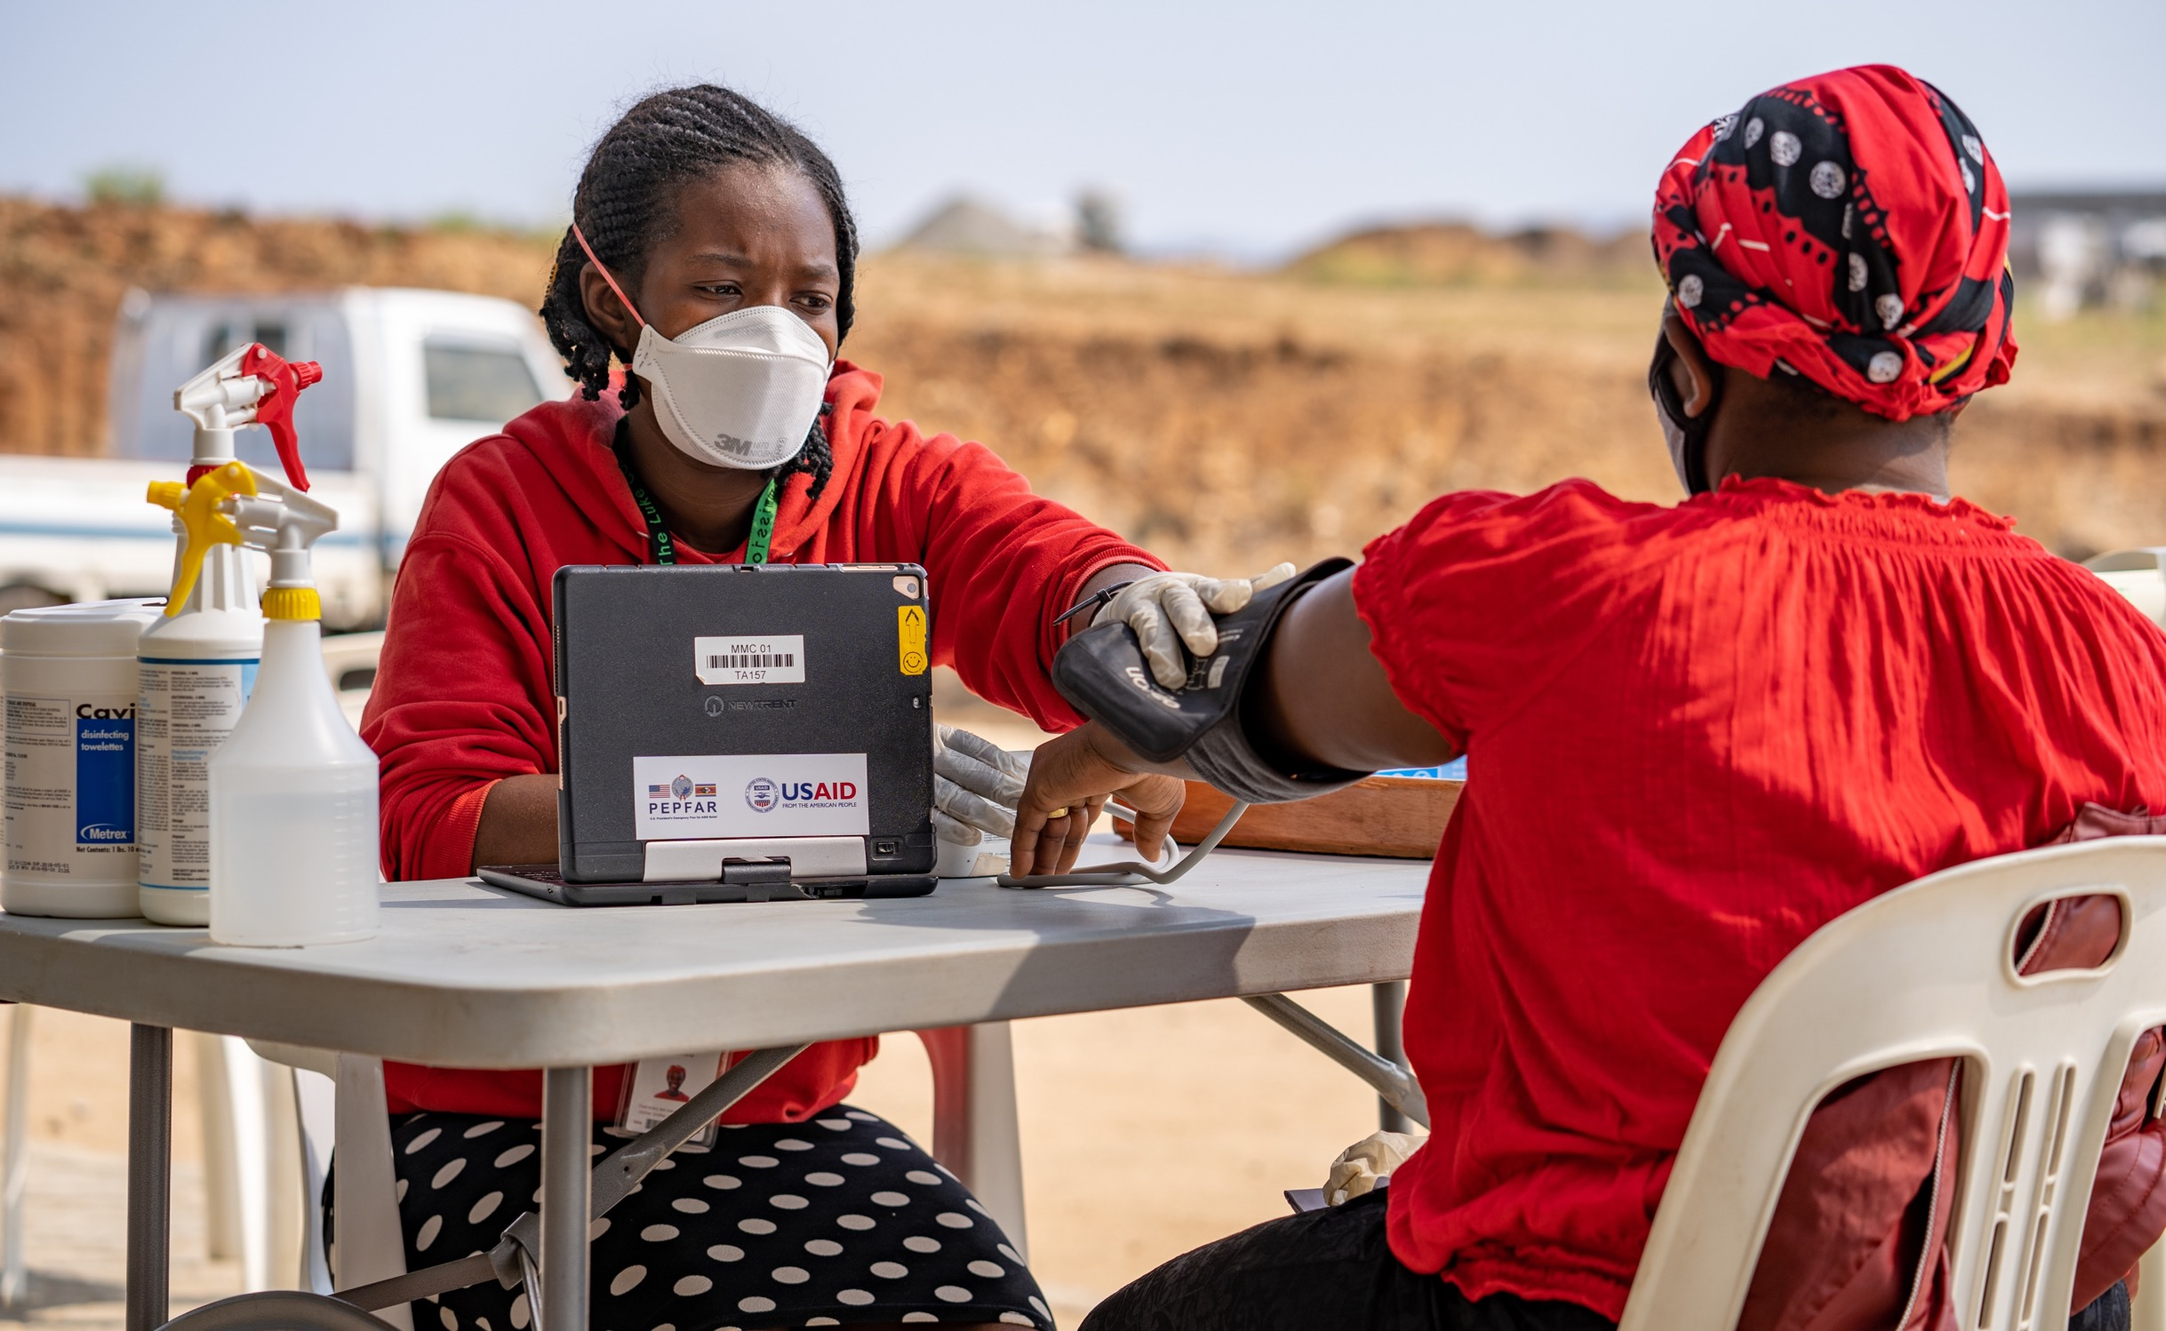

Slide 6
Escalation Matrix
Goal
To connect patients to senior-level staff at the first sign of resistance to testing, ART initiation, or PrEP initiation
Approach
Rapid escalation (under 5 minutes) to senior-level staff using EMR and Slack (secure messaging platform)
Personnel
Senior-level staff specially trained in motivating patients to test or to go on treatment

Slide 7
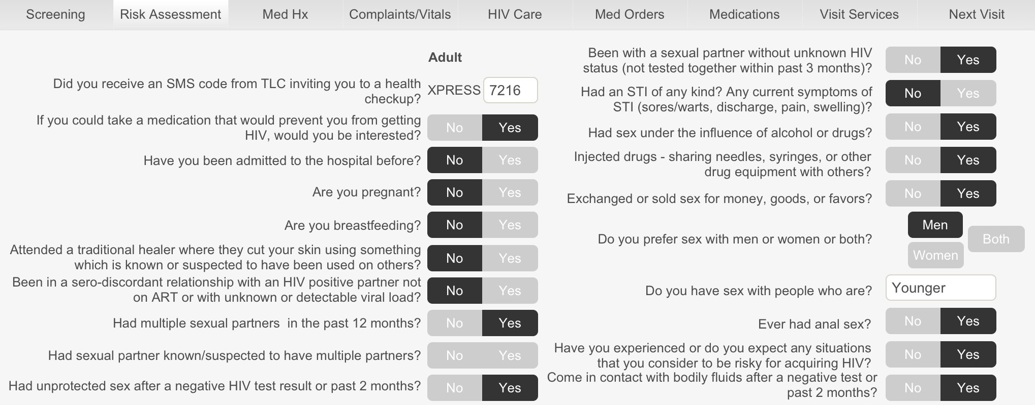

Slide 8
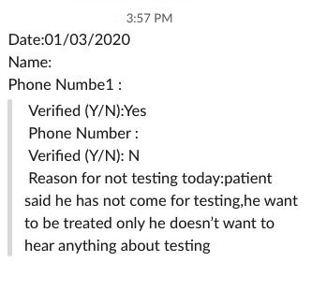
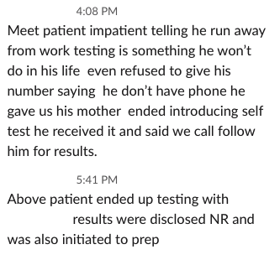

Slide 9
Community-Level Collaboration
Through the Faith and Communities Initiative (FCI), TLC has trained and now partners with over 300 faith leaders and community carers who advocate for health
every faith community can contribute to 95/95/95
HIVST distribution
PrEP referral
ART referral
Referral for other health services

Slide 10
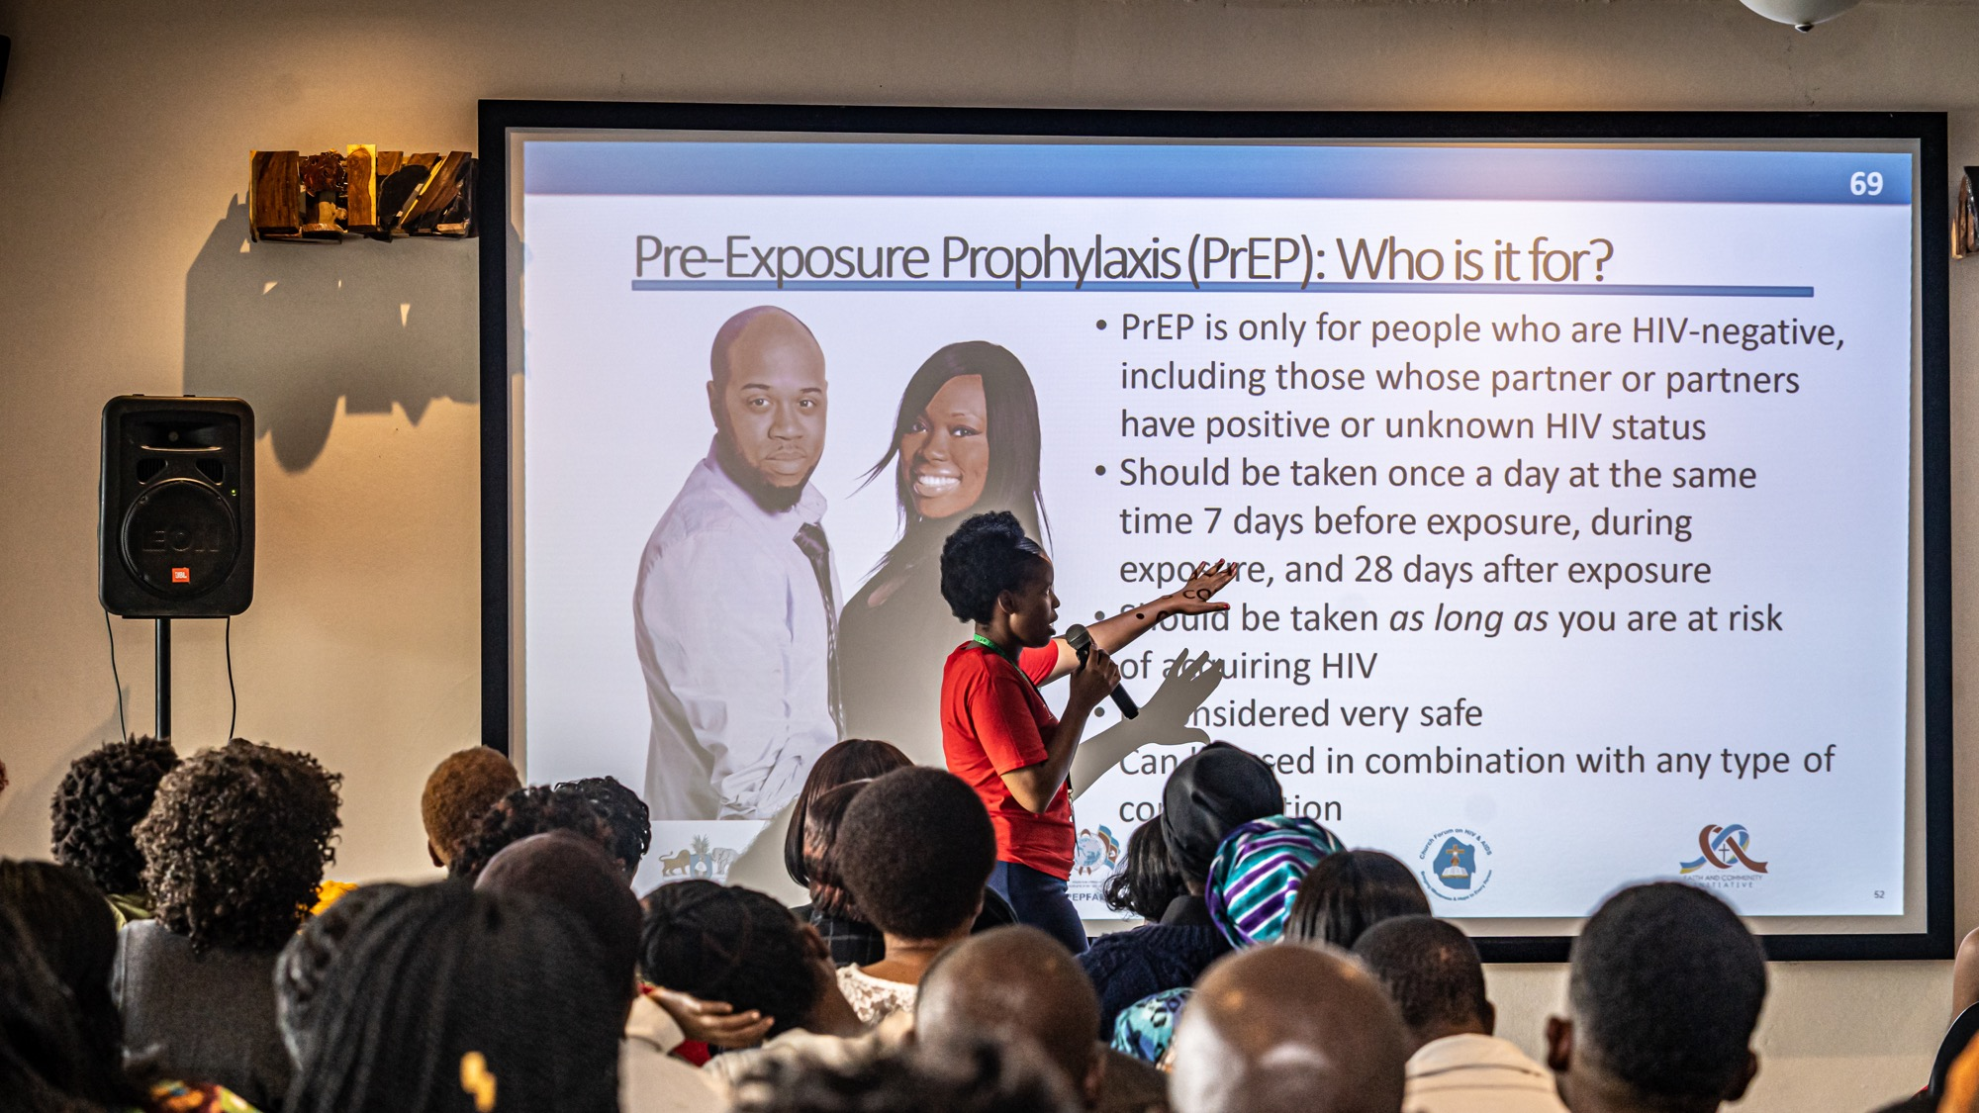

Slide 11
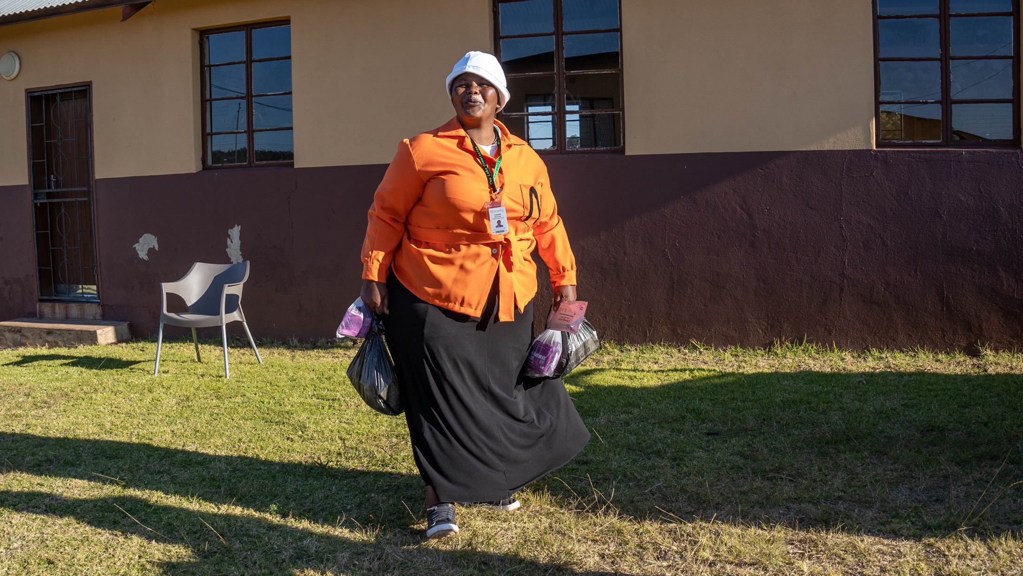
Notes:
Cebsile Nkonyane, FCI community carer
Referred over 100 people in a month for PrEP

Slide 12
Lessons Learned
Success hinges on building trust
Rapid response communicates value
Ongoing staff training builds sustainability
Continuous community collaboration extends reach

Slide 13
Reflections from the Field
“When patients come to us, we welcome them with love. We introduce all our services to them, including PrEP.
We work as a team. Everyone in our team is a motivator or an influencer. We share more about PrEP, give room for them to ask, and give the privilege to be initiated on PrEP.
We respect patients’ decisions. We allow a discussion with the patient to hear concerns. We give light about PrEP.”

Slide 14
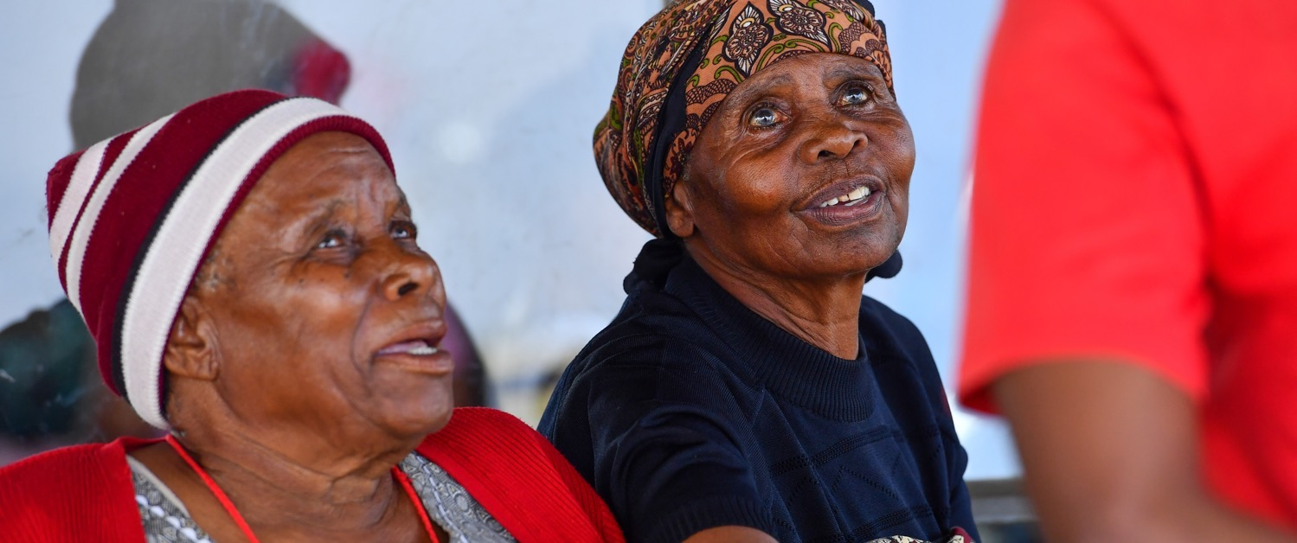
Questions?

