Slide 1
Anglican RELIEF & DEVELOPMENT IN ZIMBABWE
Linet Musasa
Hiv stigma reduction COORDINATOR
+263 779 840 163
linmusasa@gmail.com

Slide 2
Introduction
ARDeZ (Anglican Relief and Development Zimbabwe) is the relief and development wing of the Anglican Church in Zimbabwe. It comprises of the Dioceses of Manicaland, Matabeleland, Masvingo, Central Zimbabwe and Harare.
Endorsed by The Archbishop of York and the Archbishop of Canterbury, ARDeZ was established in 2008 at the peak of the Zimbabwean hardships to respond to the natural and manmade disasters. Through ARDeZ, the Anglican Church in Zimbabwe endeavours to fulfil its spiritual mandate and social obligation to minister to people holistically.
The HIV Stigma Reduction and Empowerment of PLHIV Phase 1 & 2 is being implemented by United Society Partners in the Gospel (USPG) and the Anglican Council of Zimbabwe

Slide 3
5 marks of mission
The work of the Anglican Church in Zimbabwe is guided by the 5 marks of mission:
To proclaim the Good News of the Kingdom
To teach, baptise and nurture new believers
To respond to human need by loving service
To transform unjust structures of society, to challenge violence of every kind, and pursue peace and reconciliation
To strive to safeguard the integrity of creation, and sustain and renew the life of the earth

Slide 4
Rationale
The intervention was designed following an extensive Zimbabwean Stigma Index research that was conducted in 2013/14. The research was undertaken with a view to understand the nature, experiences and rates of HIV–related stigma and discrimination at national level to provide evidence base to lead to implementation of more effective programs aimed at reducing HIV-related stigma and discrimination. The findings of the study informed the baseline of the programme.

Slide 5
HIV & AIDS Related Stigma in Zimbabwe
In 2014 the Zimbabwe People Living with HIV (PLHIV) Stigma Index was carried out to measure the level of stigma and discrimination facing PLHIV in Zimbabwe
  Findings show that 65.5% of the study respondents reported they had experienced one or more forms of HIV-related Stigma
  51.4% of the respondents reported that they had been gossiped about
  Mid Term (MTLR) & End of Term Programme Learning & Review (ETLR)
  There were 363 households in total who took part in the Mid Term & 370 in End Term Review

Slide 8
HIV Stigma Reduction Programme: Phase 1& 2
Project Goal
To envision an empowered Anglican Church in Zimbabwe and its surrounding communities, empowered to tackle issues of HIV stigma and discrimination affecting People Living with HIV and to realise improved wellbeing and welfare of PLHIV.
Outcomes
Increased comprehensive and accurate information on HIV&AIDS related stigma and discrimination, non-communicable diseases (NCDs)
Improved household incomes for PLHIV
Increased church leadership influence on HIV related stigma and discrimination
Increased climate change awareness

Slide 9
Strategies
Youth Seminars: In reaching out to young people we go where they are, for example Church Youth Conferences such as the Zimbabwe Anglican Youth Association (ZAYA) where Anglican youths from all the parts of the country come together to worship. These platforms are taken advantage of to reach out to young people and raise awareness on HIV-related issues. We take advantage of events to raise HIV stigma awareness.
Sports Galas: On the sports day, mobile clinics are made available for HIV testing.
Awareness Campaigns: Targeting young people to promote adherence to ART through giving testimonies.

Slide 10
Strategies (2)
Edutainment: Adolescents also participate in awareness raising activities. School-going children undertook awareness raising through poems, dramas and songs during commemorations such as World AIDS Day.
Income Generating Activities: The IGAs have motivated youth and men to participate in the HIV Stigma Reduction Programme. The Anglican Church engages all Churches and communities through IGAs Church and Communities they have a source of income to support their families
Clergy Sermons: Church leadership and priests are actively involved in the HIV stigma Reduction program. The Priests were trained in HIV & AIDS basic information and HIV related stigma and discrimination. They share information on HIV related stigma in their sermons as such reaching out to young people and men in the Church. A manual with scriptures of hope has been developed.
Clergy tournaments: Soccer tournaments have been done and these were successful in encouraging male participation in the HIV stigma programme.

Slide 11
Beneficiary analysis

Slide 12
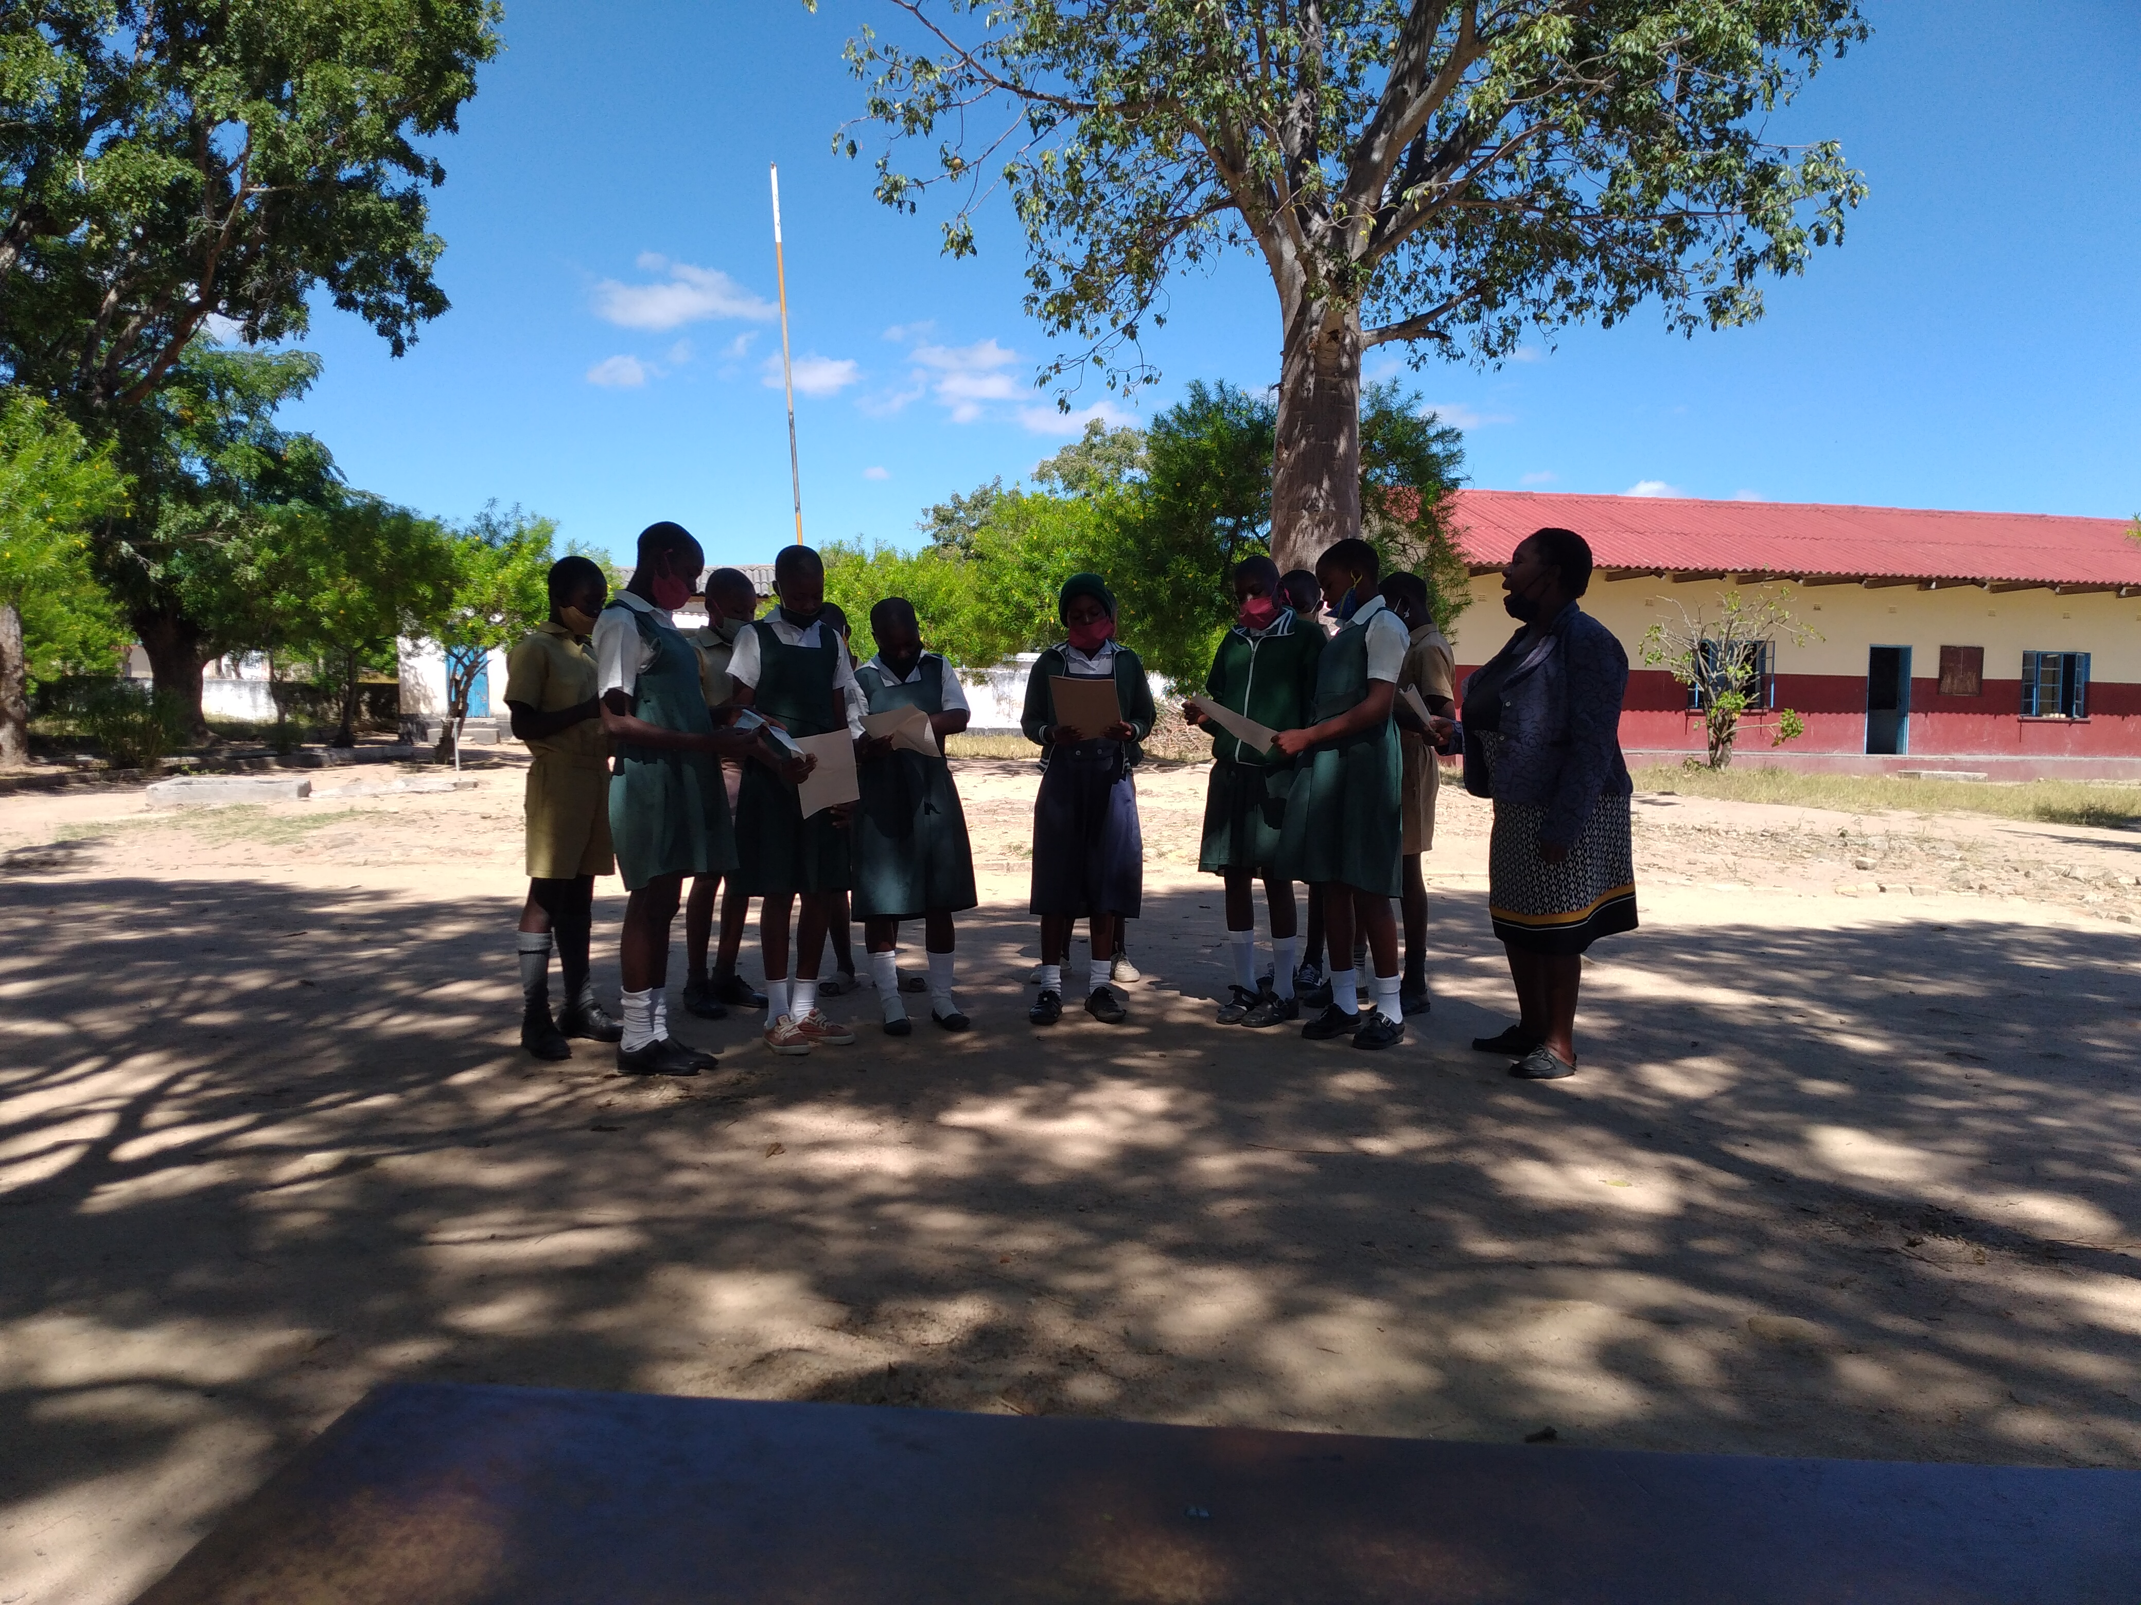

Slide 13
Success stories
The project contributed significantly to the reduction of stigma and discrimination from a high of 65.5% (Stigma Index study) in 2014 to about 35.5% (mid-term learning review or MTLR) in 2018 and to 21.4% at (end-term learning review or ETLR) in 2019.
The intervention was noted to have been effective in facilitating access and availability of HIV related information, awareness, participation and services, as well as providing PLHIV with livelihood options
Increased disclosure of HIV status
Livelihood projects improved self-esteem among PLHIV
Promoted uptake of HIV voluntary counselling and testing (VCT)
Establishment of wellness support groups
HIV-related messages in Church sermons
Involvement of school learners

Slide 14
Success stories (2)
Reduction of HIV-related stigma in Church institutions and communities
More PLHIV are now participating in public forums
Good support by the Church leadership- Church leadership commitment, coming together of the Bishops, personal initiative to speak in pubic meetings, priests’ participation at parish and church level
Meaningful involvement of PLHIV
Involvement of Church and traditional leaders

Slide 15
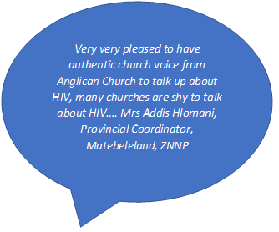
Success stories (3)
“HIV stigma reduction programme helped me in preaching the word I had been labelled for so long trying to teach. People began to accept me and their attitude towards me has changed significantly. People in my community now respect me, the programme helped in overcoming the stigma and discrimination I had faced from my community for many years” -Chitengo

Slide 16
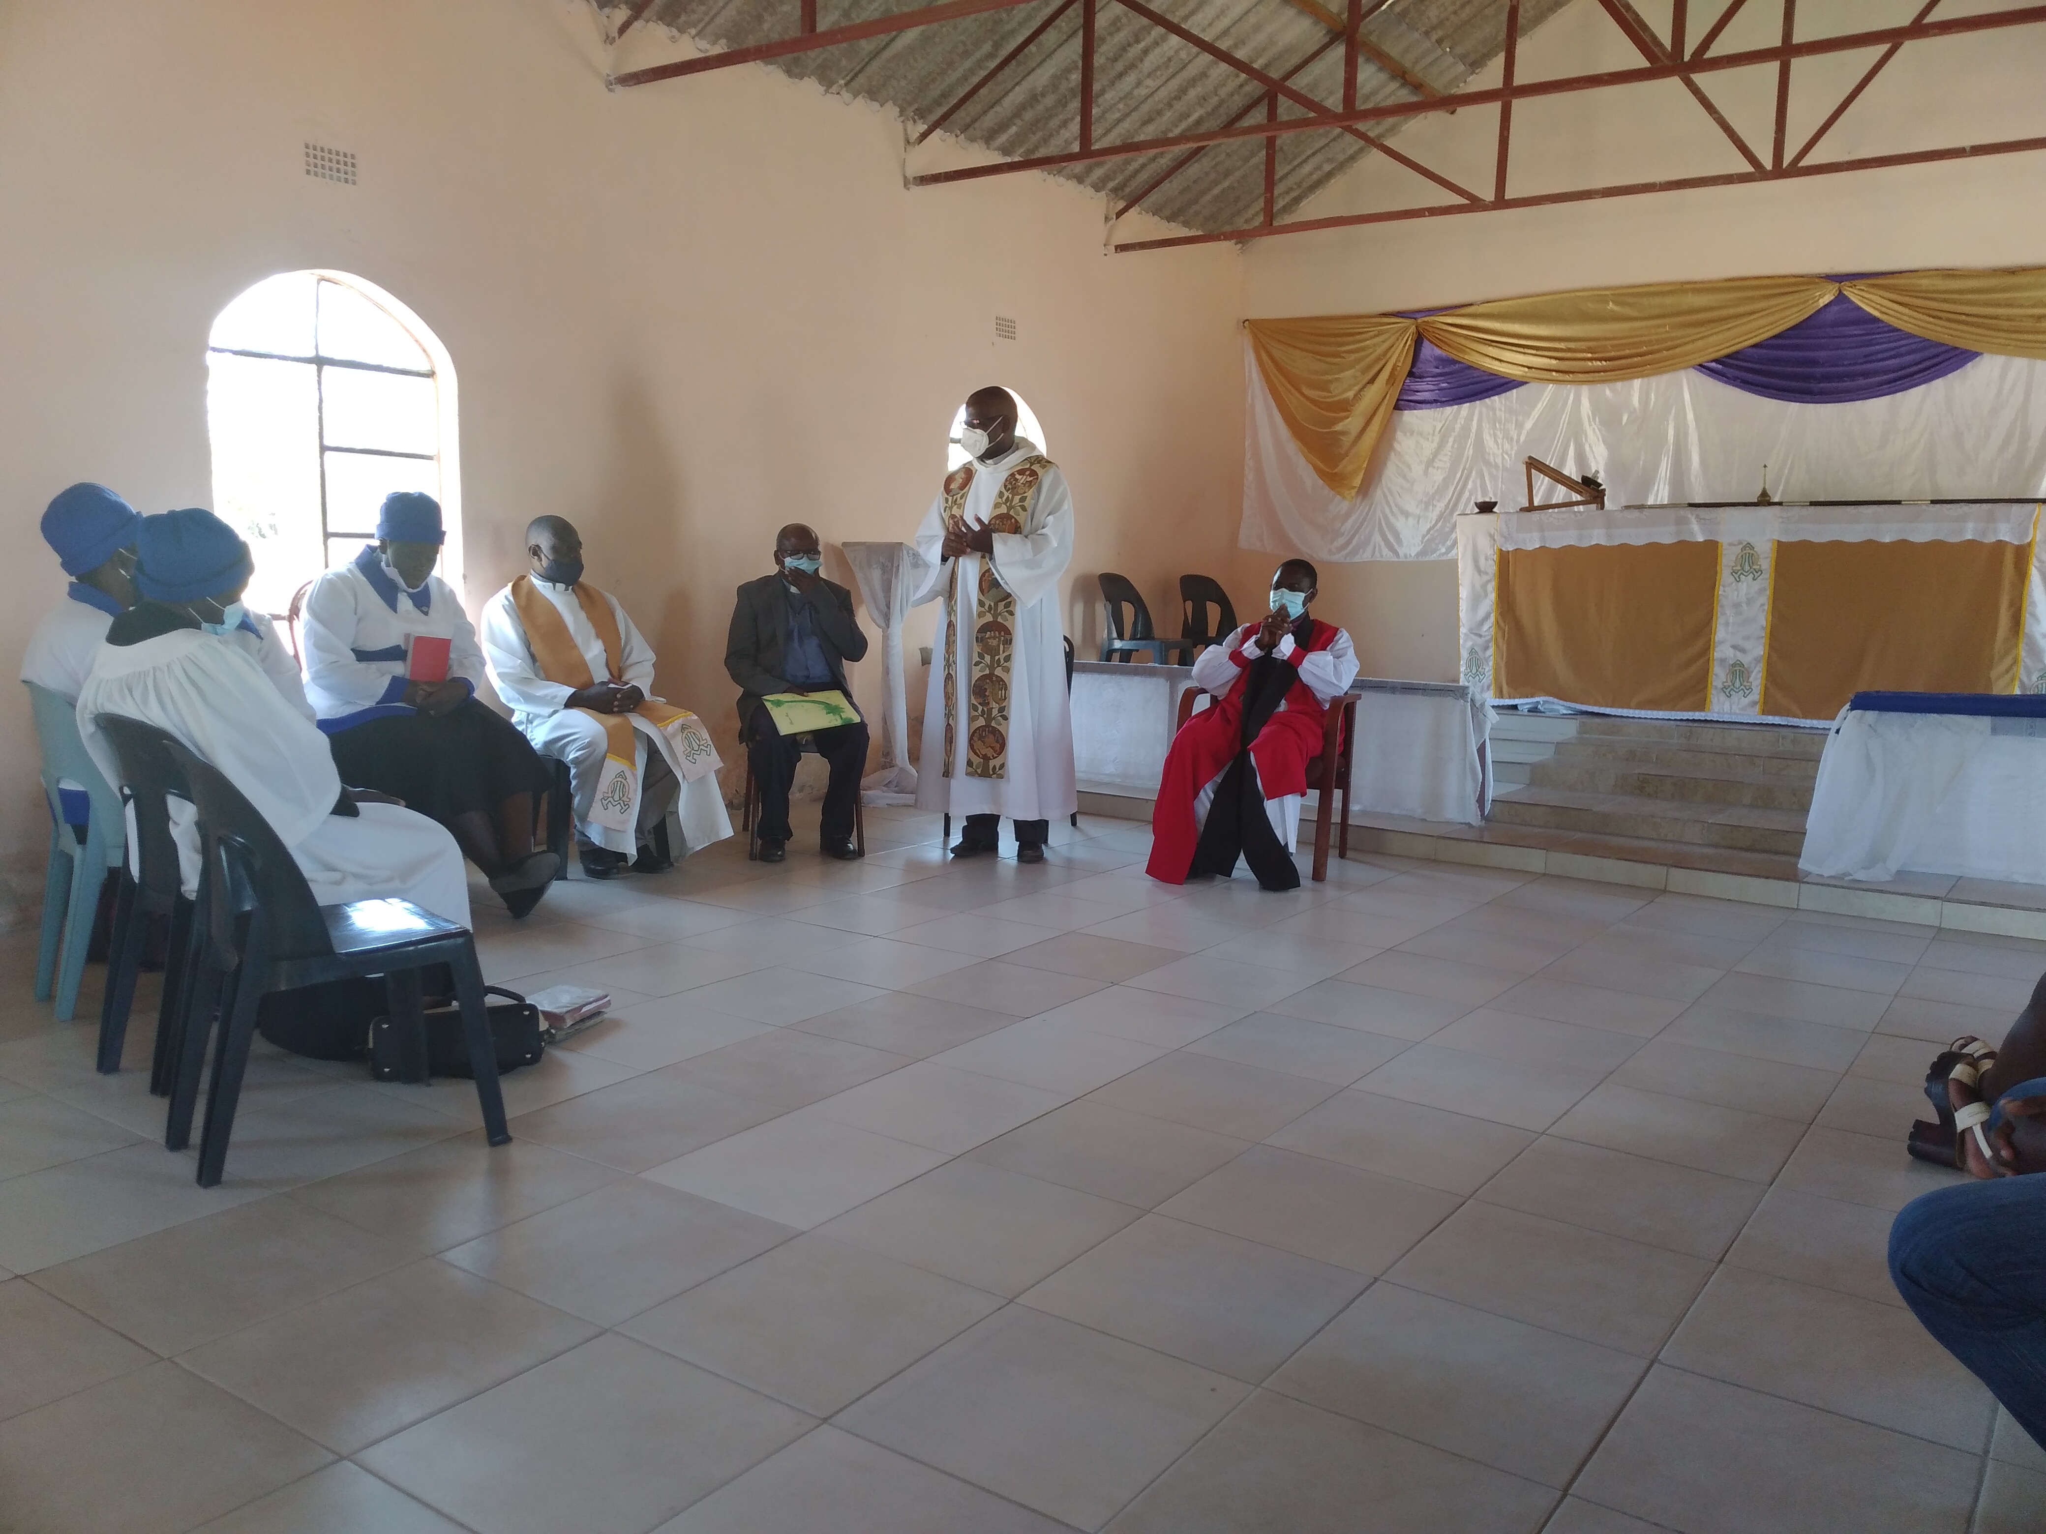
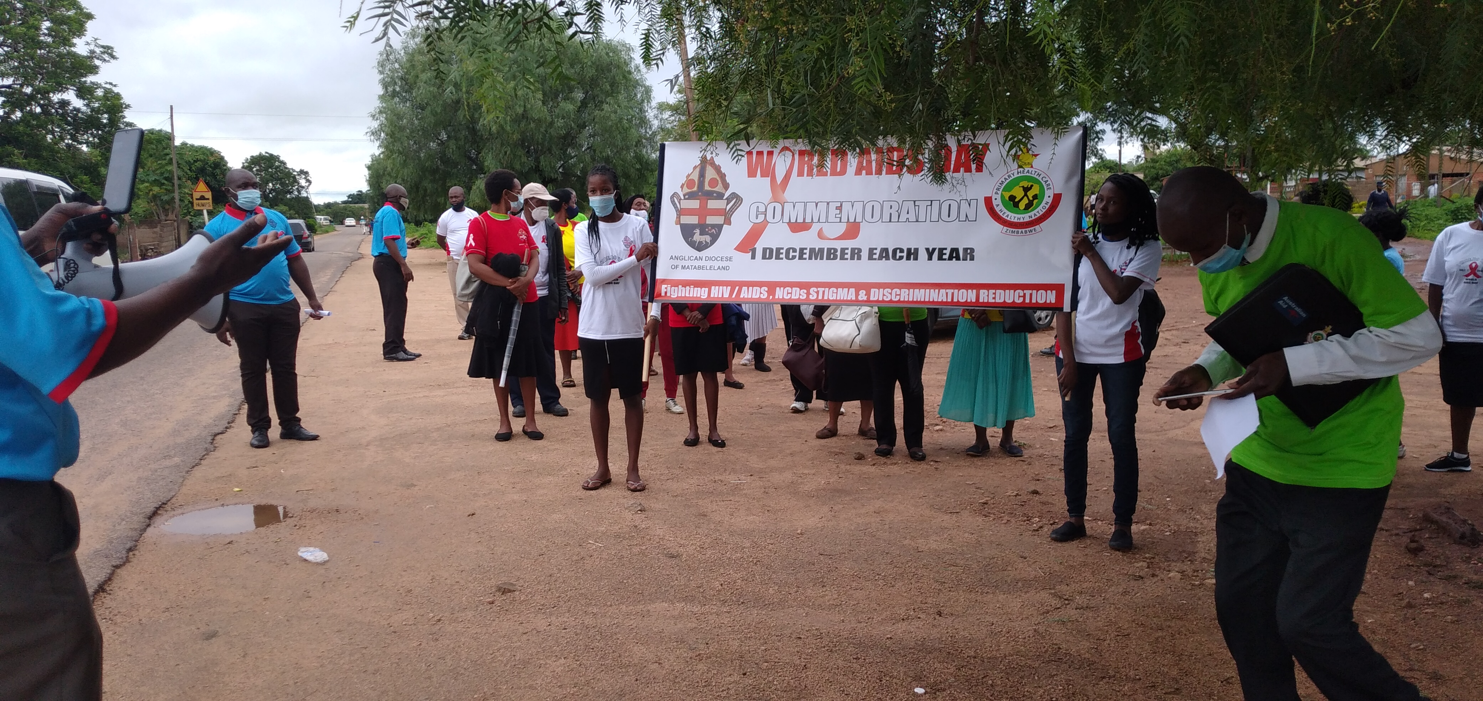

Slide 17
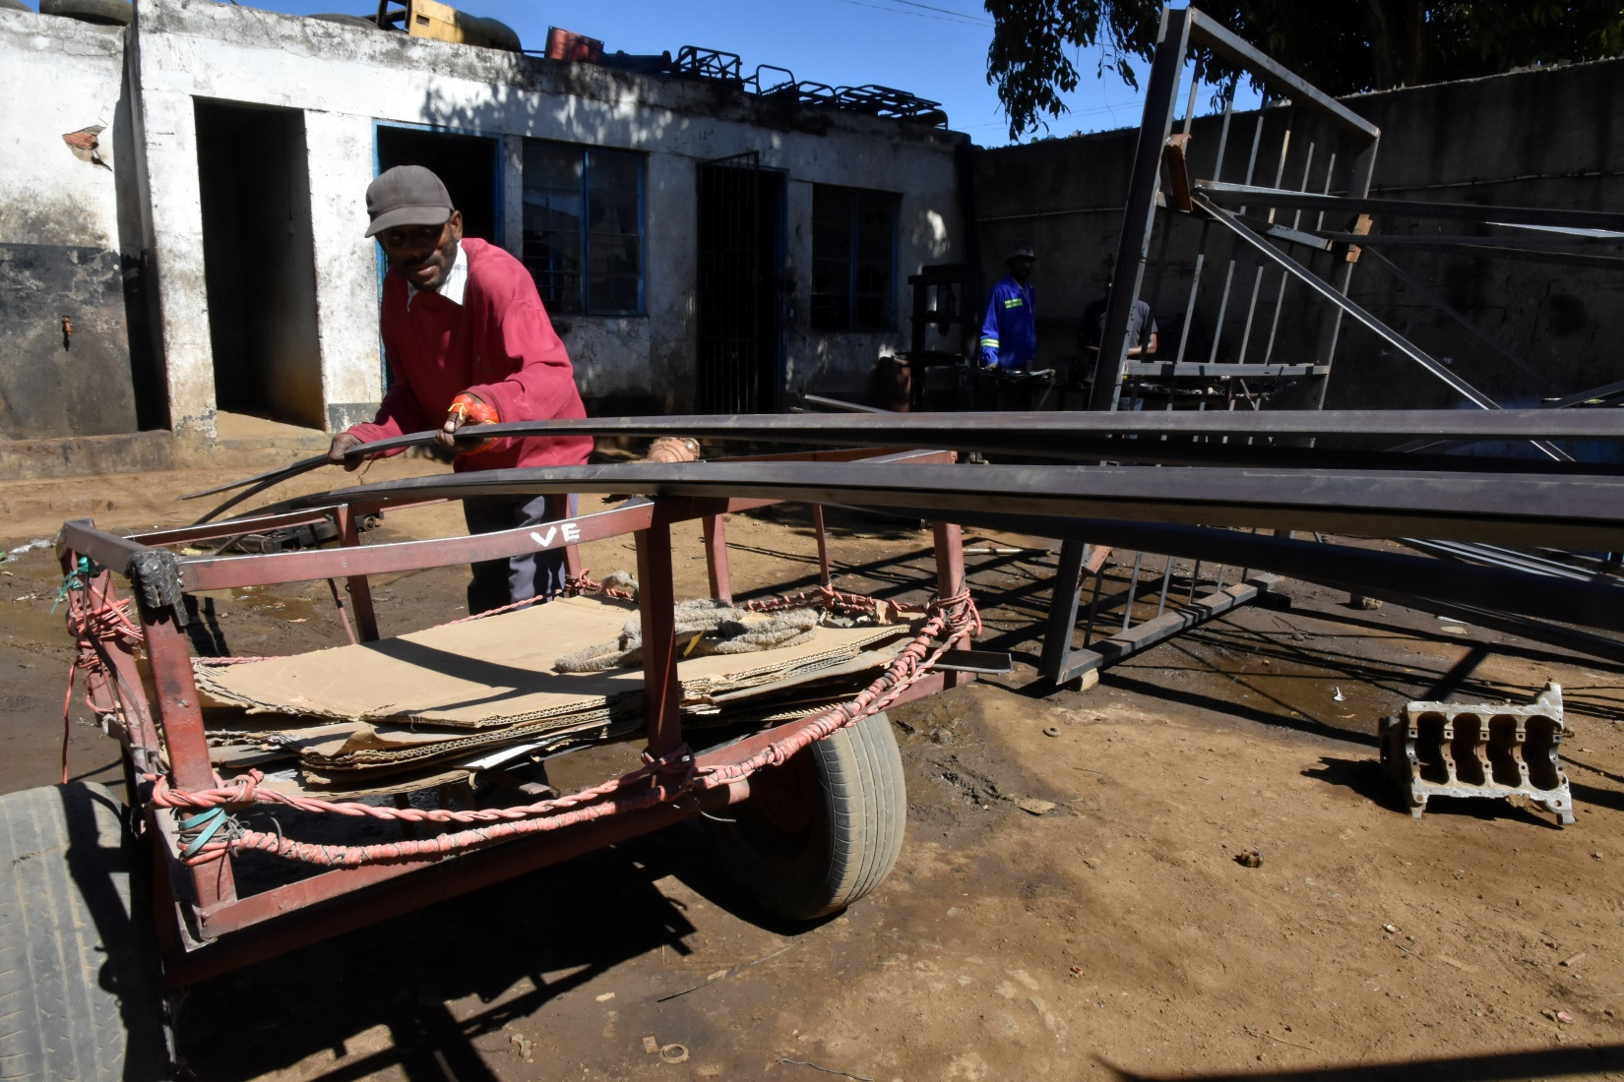
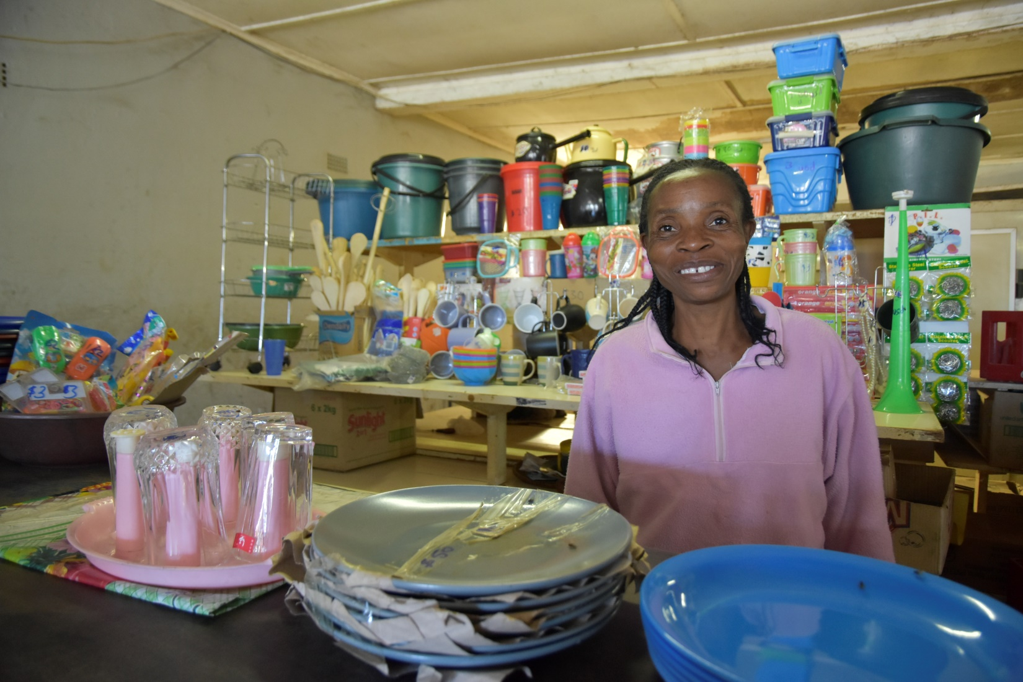
PLHIV in IGAs

Slide 18
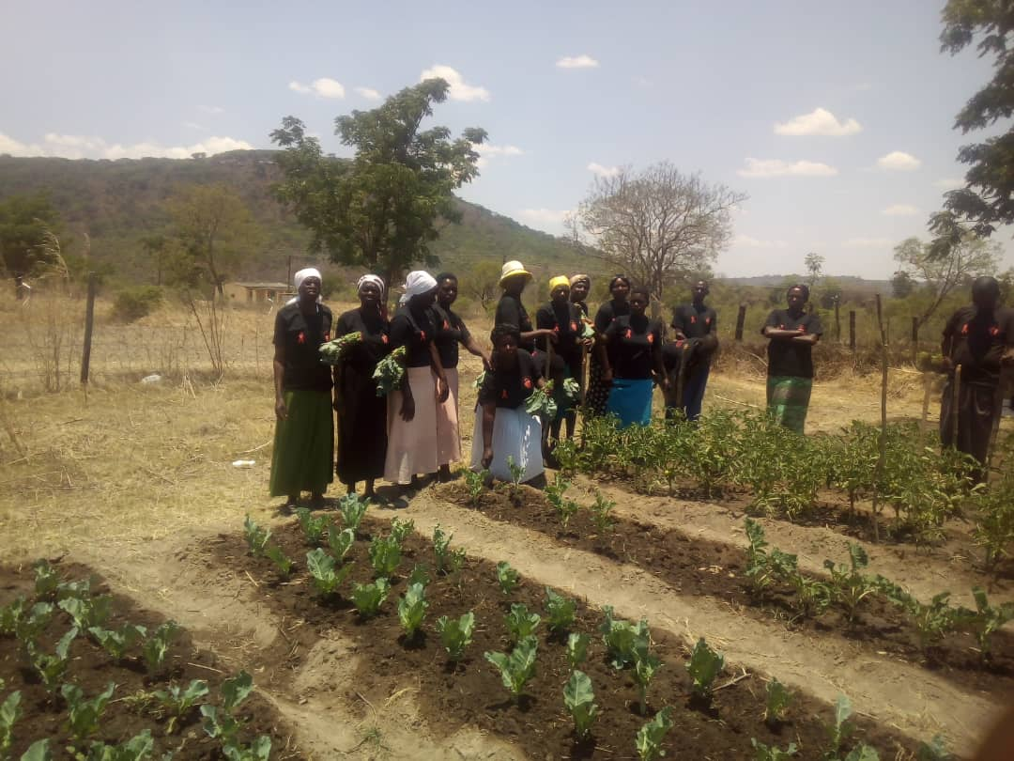
THANK YOU!

