Slide 1
RESOURCES:
Responding to the
Needs of Children Impacted by COVID-19
www.faithtoaction.org

Slide 2
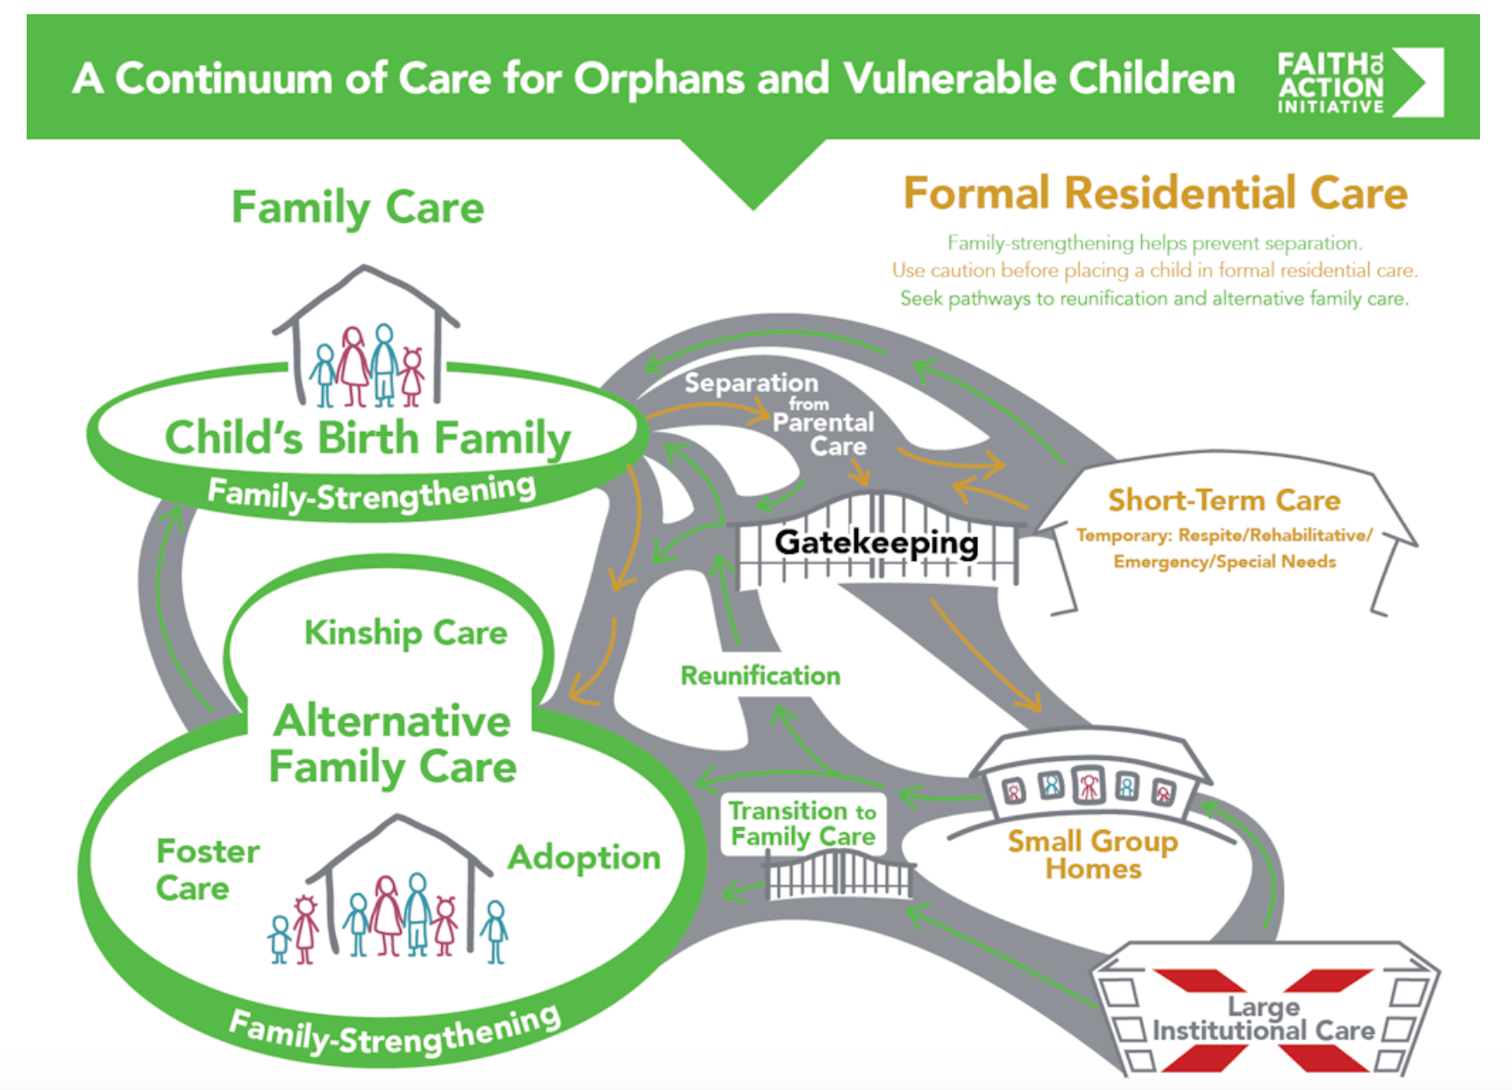
www.faithtoaction.org
Notes:
In this time of crisis for children, we need options to respond.
Continuum of Care- resources that allows you to go deeper in the different ways of supporting children
Highlight importance of family strengthening = family preservation

Slide 3
Faith communities can...
Identify children and families in crisis
Respond to immediate needs
Ensure children stay with surviving family
Address misconceptions and stigmas
Encourage action
Provide alternative family care (when necessary)
www.faithtoaction.org
Notes:
Faith communities are critical to ensuring children are safe and well cared for, and families in crisis receive the support they need. They are uniquely placed to...

Slide 4
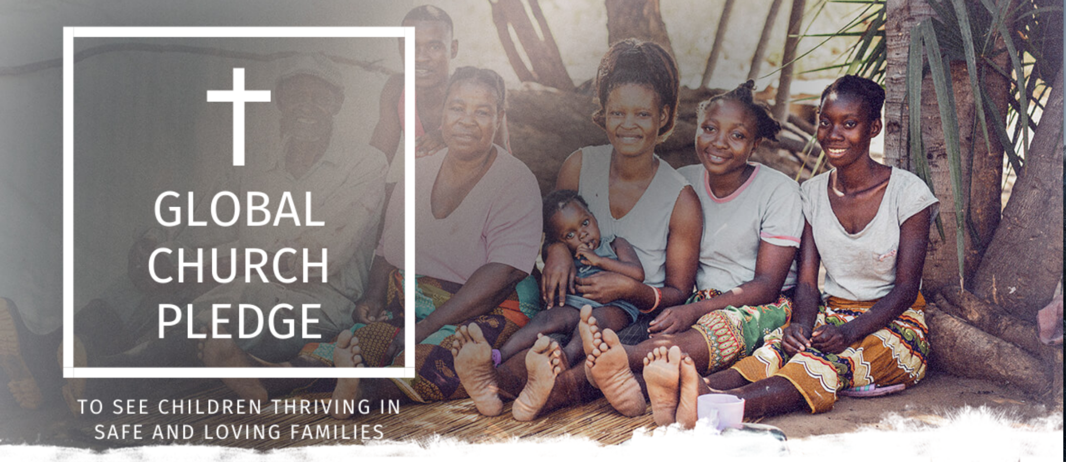
www.faithtoaction.org
Notes:
Example- rallying Christians to support children in families

Slide 5
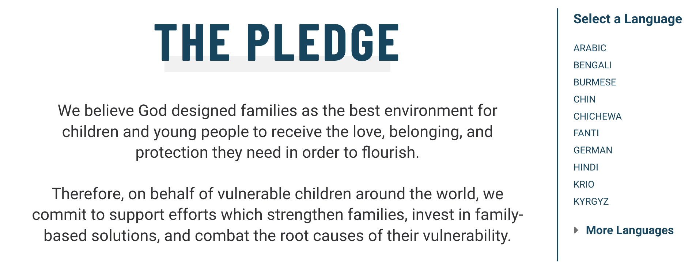
www.faithtoaction.org

Slide 6
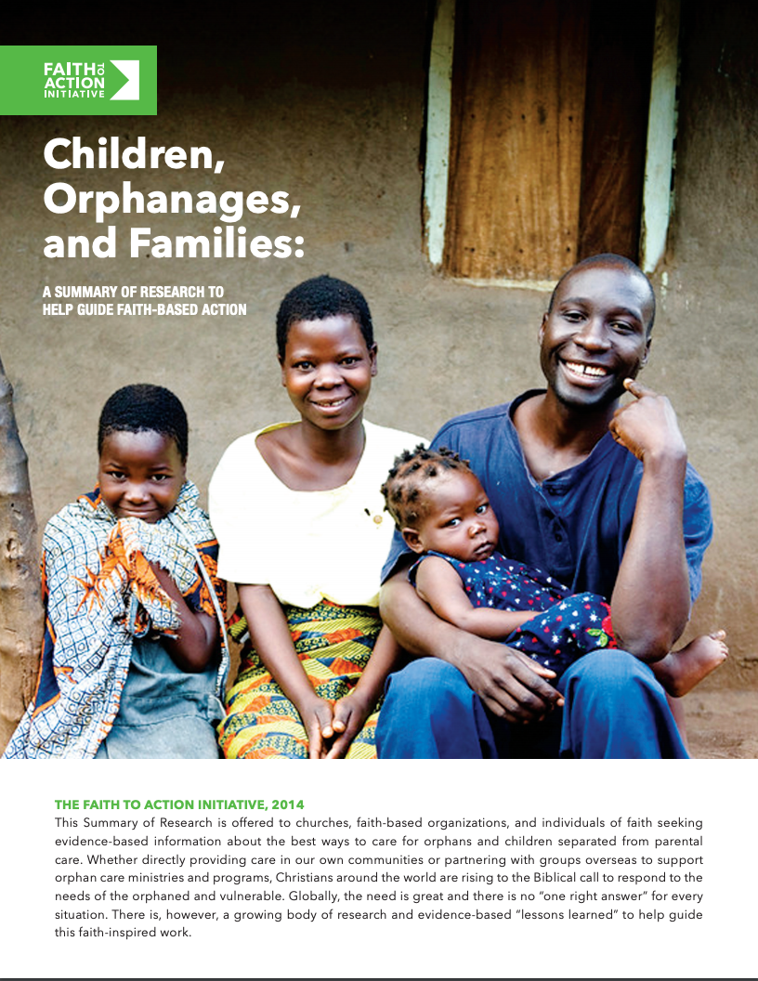
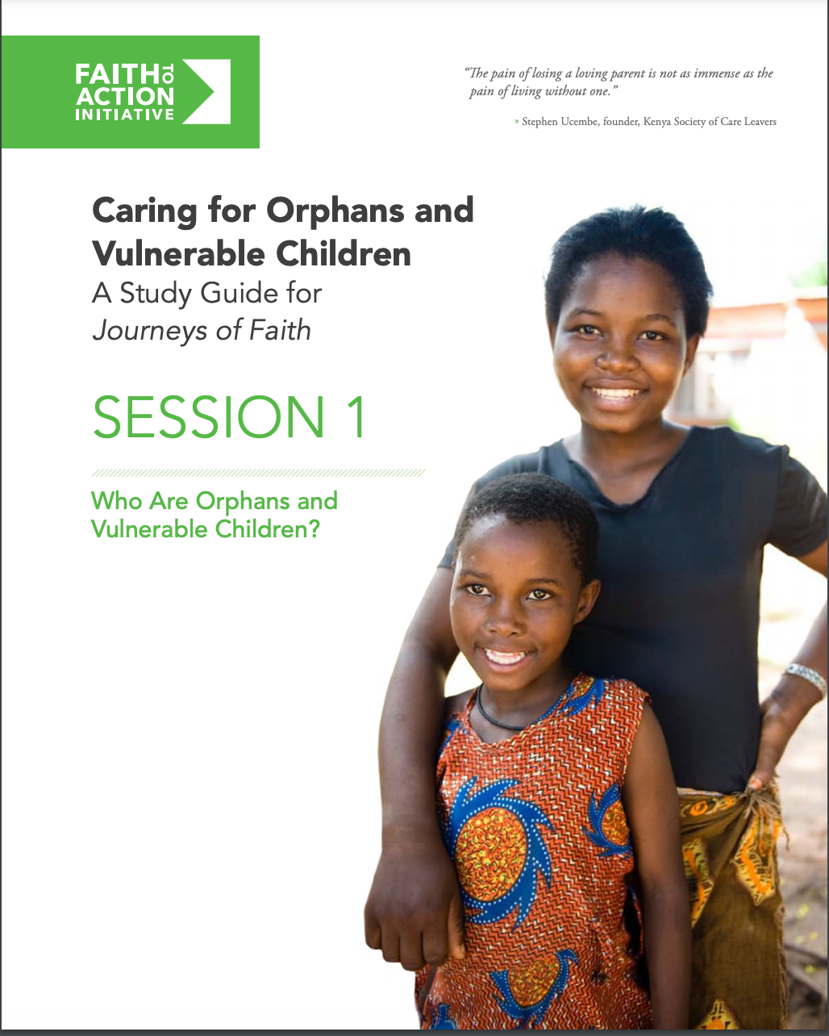
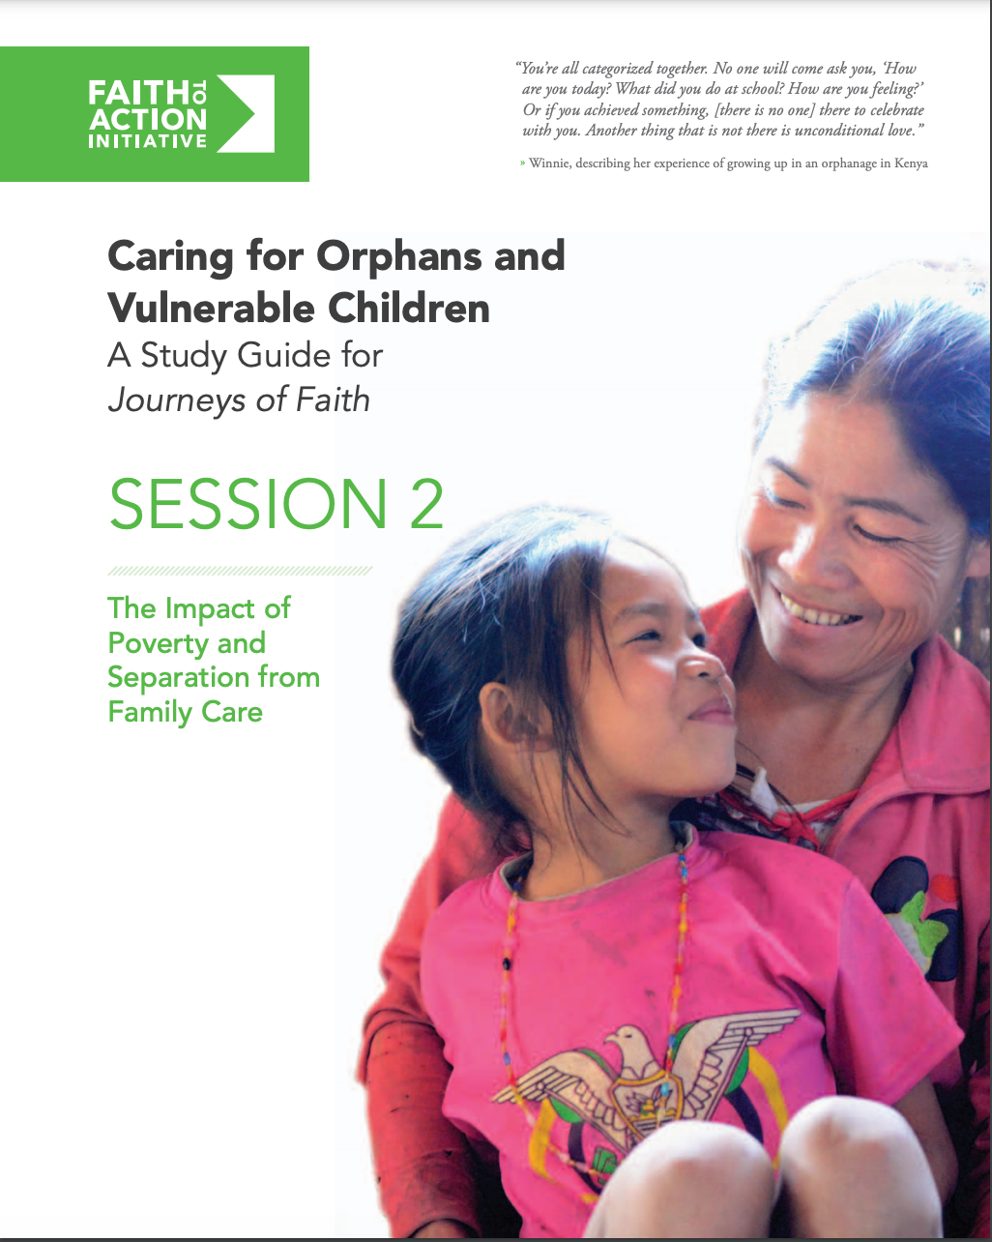
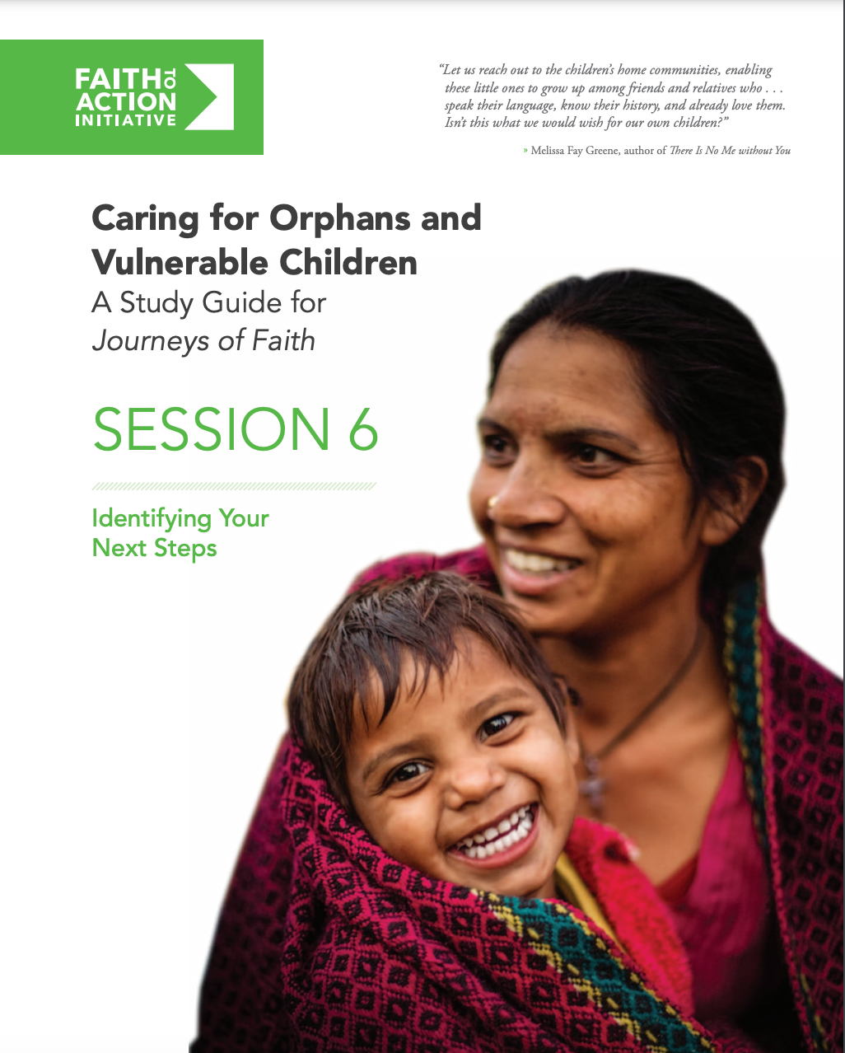
www.faithtoaction.org
Notes:
Make research accessible.
Give faith-communities tools they can use: Small group study, Sermon examples, Devotionals

Slide 7
www.faithtoaction.org
This presentation was made possible through the generous support of the American people through the U.S. Agency for International Development under Partnerships Plus cooperative agreement number 7200AA18CA00032, funded September 28, 2018, and implemented by JSI Research & Training Institute, Inc. The contents are the responsibility of the Faith to Action Initiative, a project of Tides, and do not necessarily reflect the views of USAID or the United States Government.

