Slide 1
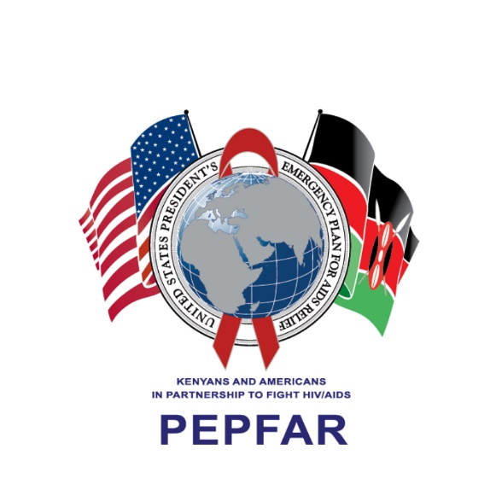
Navigating the Impact of COVID-19
Within CHAK OVC Programs

Slide 2
Introduction
Christian Health Association of Kenya
Supports 3 OVC Local Implementing Partners (LIPs) in 3 Counties (i.e. Nairobi, Machakos, and Kajiado) through its CDC-funded HIV Project
A total of 5,020 OVCs supported from 2,257 Households
The OVC living with HIV linked to a total of 98 Health Facilities for ART support
The OVC LIPs are affiliated with the Seventh Day Adventist, Catholic Church, and African Brotherhood Church

Slide 3
Adverse childhood experiences as a result of HIV and COVID-19
HIV and COVID-19 are a cause of orphan hood. Children’s lives are permanently changed by the loss of a primary caregiver. This as an adverse childhood experience is linked to:
HIV infection
Greater risk of dropping out of school
Lower self-esteem
sGBV including SVAC
Developed anxiety and depression

Slide 4
OVC Implementation Model and Approach
CHAK OVC programs employ a strengths-based case management approach and a participatory model that leverages on the unique strengths of every individual beneficiary in household in helping them to recognize their own strengths ,abilities and identifies and taps on existing opportunities for household economic empowerment and growth.
This provides an opportunity to engage and involve children and families in the design and monitoring of OVC programs.
There is focus on empowering girls and boys and their families to recognize, prevent and respond to adversities themselves

Slide 5
OVC Implementation Model and Approach
The beneficiaries have a say and their voice heard contributes to resilience. Families, including children, participates in decision-making as an important part of the recovery process that builds their sense of control over their lives and this helps them to develop resilience.
The end goal of the case management process is a child living within a strong, committed and stable family, with a supportive social network, who has education and health care, feels loved and is self-confident about their ability to live a positive life, including overcoming any challenges that they might face in the future
Four domains of case management include: Healthy, Safe, Schooled and Stable.

Slide 6
Case-management Approach
Key strengths of case-management approach to OVC programming
Timely delivery of quality and enhanced services to OVC and families
Addresses the gaps in continuum of sustained care and support beyond graduation
Delivers individualised context-specific child-focused and family-centred interventions
Builds active partnership with OVC families and key actors to identify, plan, and complete a series of actions for optimal service delivery

Slide 7
HIV and COVID-19 Impact in OVC Programs
HEALTHY DOMAIN
Negative Impact of HIV and COVID-19 | Magnitude of Impact | Strategies for Navigation
Poor hygiene due to limited resources at household level | Inadequate COVID 19 Infection Prevention and Control at household level | Sensitized caregivers to use locally-made liquid soap and improvise handwashing points using locally-available materials
Lockdowns and curfew posed a challenge in keeping appointments for routine services e.g. immunization, PMTCT, ARV re-fills, viral load testing | Increased interruption in treatment for OVCs that are CALHIV | Ensured MMD, virtual treatment adherence support, and extra-facility drug linkage
Food insecurity affecting ART adherence | Malnutrition Increased illness | Procured Care packs Linkage of needy households to church/individual - food support Close monitoring for CALHIVs
Due to poor nutrition and reduced income, caregivers couldn’t manage the costs of treating common ailments and COVID-19 | Increased demand to support medical costs by OVC LIPs for illness related to COVID-19 and its effects | LIPs encouraged to facilitate identified and reported cases to access treatment

Slide 8
SAFE DOMAIN
Negative Impact of HIV and COVID-19 | Magnitude of Impact | Strategies for Navigation
Increased cases of sGBV | Increased cases of teenage pregnancy due to incest/sGBV | OVC LIPs reported and liaised with Department of Children Services and rescued affected OVC and linked to safe spaces Bi-directional referrals for GBV services Counselling and caregivers’ forums to create awareness and educate on possible sources of support and conflict resolutions
Death of 10 OVC caregivers due to COVID-19 related complications | Total orphan hood for some households | Identification of responsible caregivers for affected households for continuum of care and support Update of case plans in the affected households to capture new needs after re-assessment

Slide 9
SCHOOLED DOMAIN
Negative Impact of HIV and COVID-19 | Magnitude of Impact | Strategies for Navigation
Prolonged period of school closure as a COVID-19 mitigation measure | Increased teenage pregnancies and sGBV cases | Through FCI Program invested in Evidence Based Interventions (EBIs) including SASA!FAITH, FMP and CBIM
Loss of livelihood by caregivers leading to lack of cash flow to support expenses like school fees etc. | Poor retention in school | Public Private Partnerships and Collaborations for education support and COVID-19 IPC items Lobbied for waivers for OVC 25 OVC re-enrolled in school 8 OVC receiving an economic strengthening approved intervention and received start up kits Continuous mentorship forums

Slide 10
Stable Domain
Resilience-oriented and builds families to care for themselves after graduation
Encouraged to have household Income Generating Activities (IGAs)
Activities – capacity building on business skills/record keeping/entrepreneurship, assets transfer/starter up kits, business boost, savings group

Slide 11
Saving group – Village Saving and Loaning Associations (VSLA)
A total of 38 VSLA groups supported
28 active VSLA groups with 420 active members
KES 800,278 net in circulation(Loans, Shares and Social Fund)
23 in cycle 3 and had successful share-out to members
Share-out utilized to pay school fees, buy food, transport to health facility, and to enhance household IGAs

Slide 12
STABLE DOMAIN
Negative Impact of HIV and COVID-19 | Magnitude of Impact | Strategies for Navigation
Reduced/diminished incomes among caregivers Loss of jobs for OVC caregivers (most casuals 90%) | Loss of livelihoods No active in-person meetings for saving groups like Village Savings and Loan Associations (VSLAs) | Encouraged caregivers to engage in locally-available casual jobs and join VSLAs Enroll caregivers to VSLA groups Train them on business skills Business Boost and Business start-up kits provided Linkage to Government OVC cash transfers

Slide 13
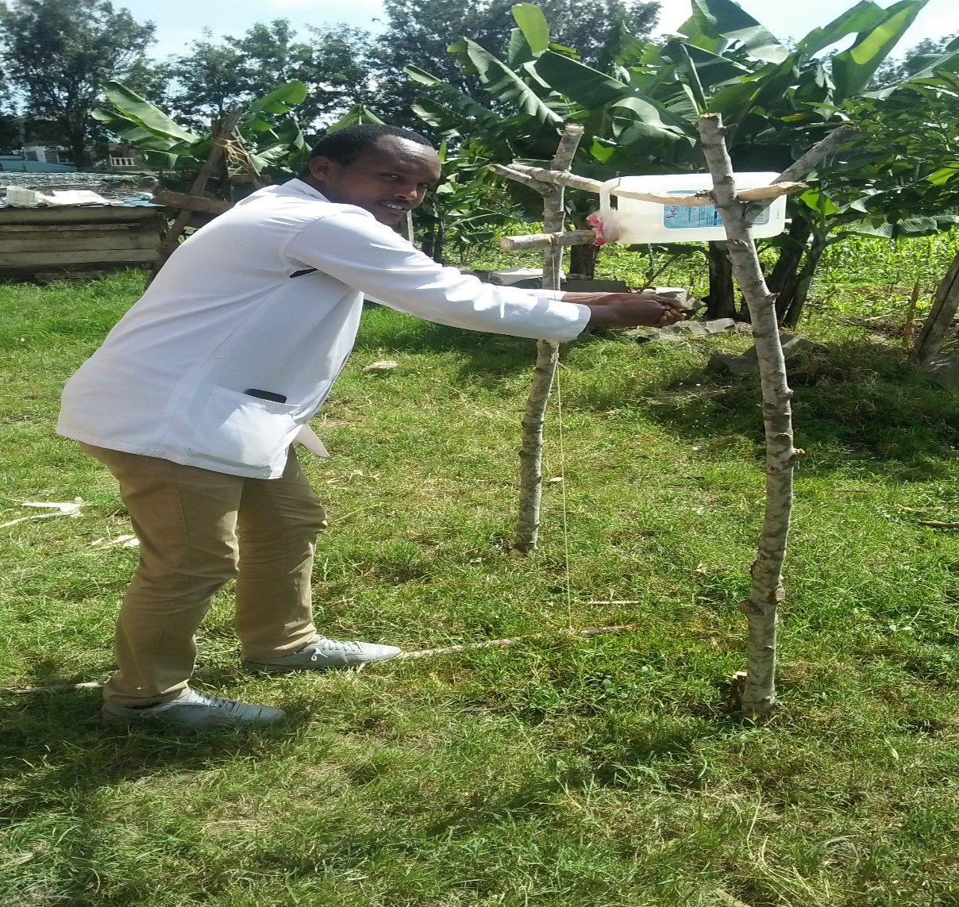
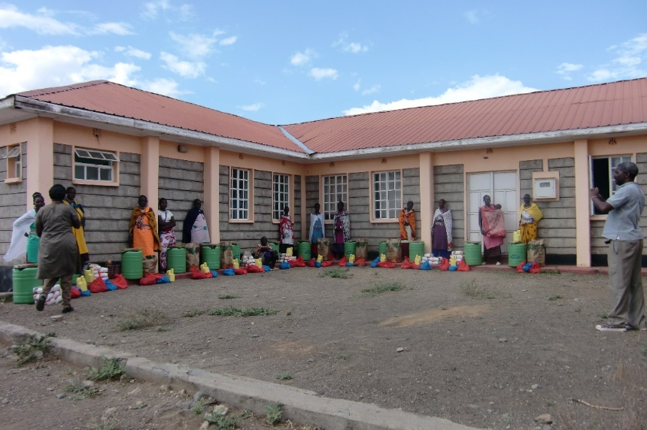
A health care provider demonstrating locally
assembled hand washing facility at household
Caregivers receiving food and water storage containers at Tinga and Oloonkuruman

Slide 14
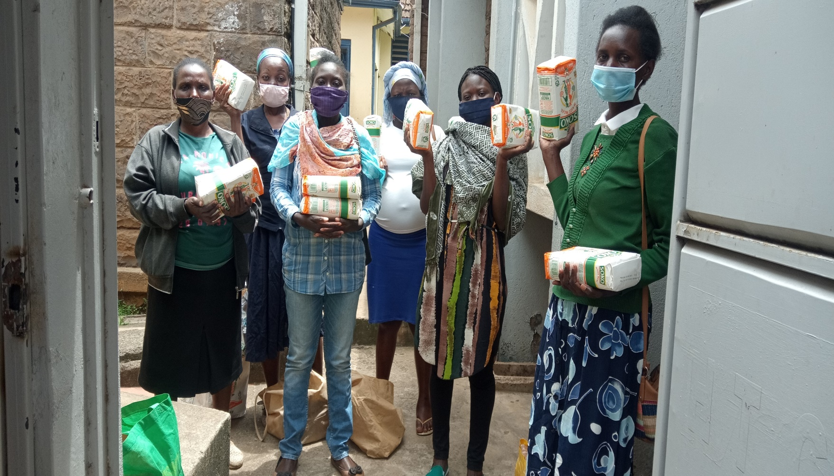
Food support provided for OVC caregivers

Slide 15
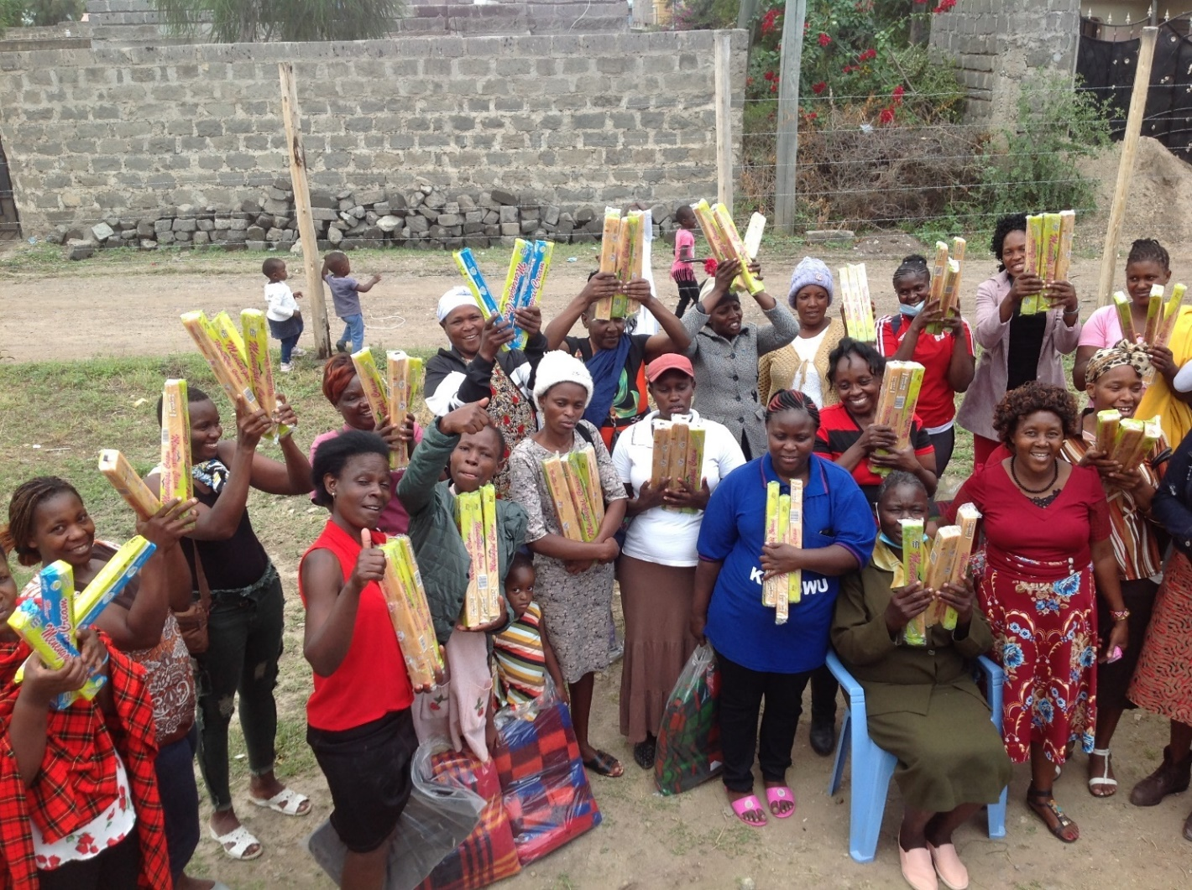
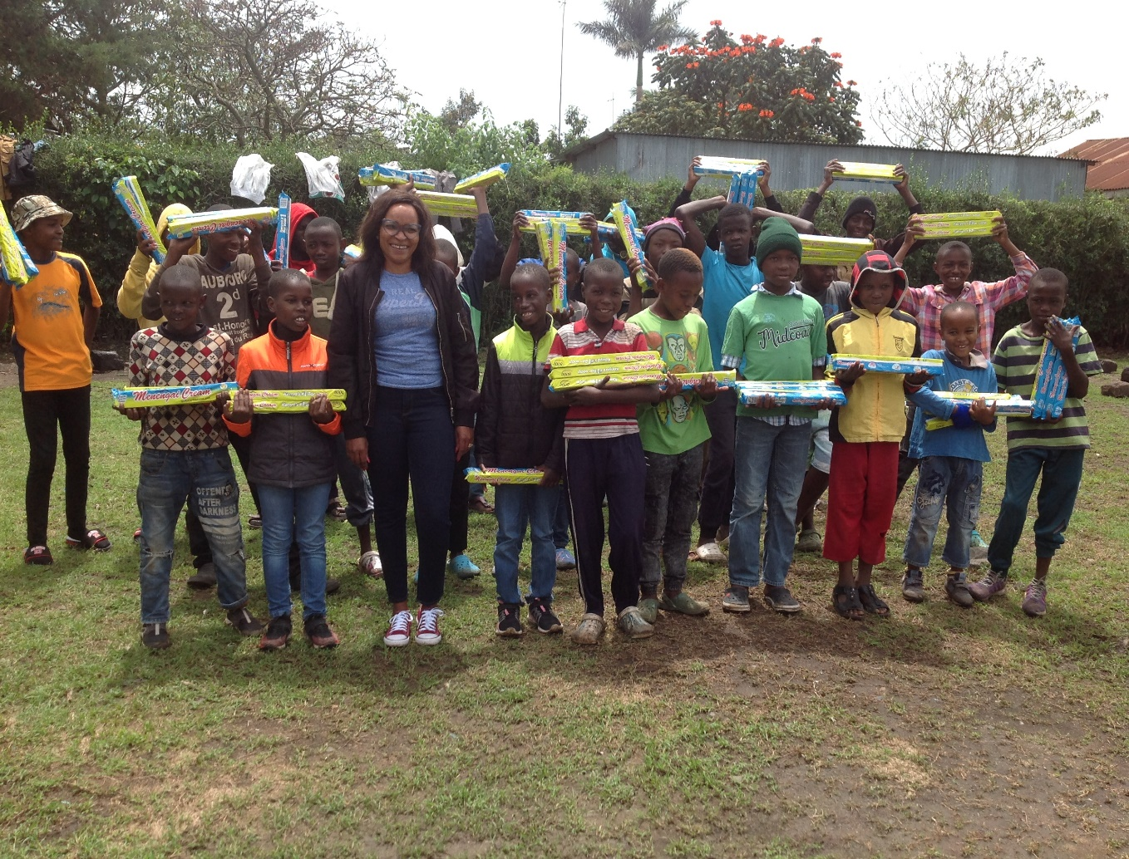
Caregivers and OVC Supported with bar soap to promote hygiene

Slide 16
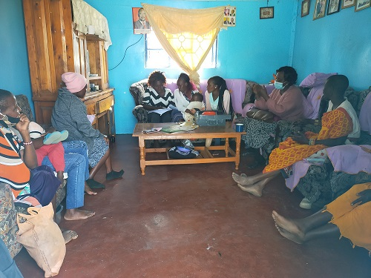
VSLA Session in progress

Slide 17
Summary
The Magnitude of COVID-19 was more than the illness (i.e. lack of access to basic needs, services and information)
The economic drain exacerbated the impact of COVID-19 on OVC and their households
Support to the OVC LIPs through CHAK and Faith Communities played a significant role in mitigation of COVID-19 through: food support, appropriate linkages and referrals for sGBV and treatment services, provision of COVID -19 IPC materials, business boosts and economic strengthening, school re-enrolment, and continued case-management support

Slide 18
Thank You

