Slide 1
CDC Zimbabwe COH Model: Community posts update
October 2020
Dr Talent Maphosa

Slide 2
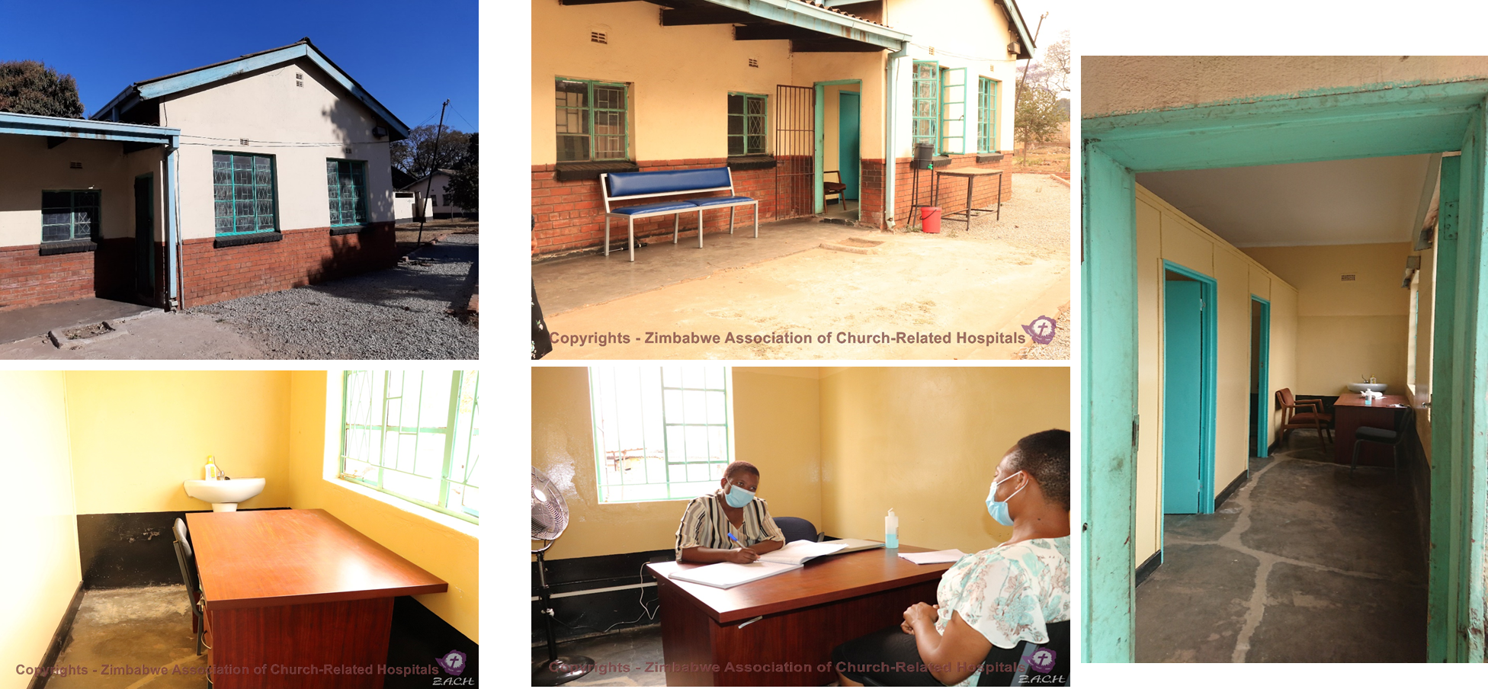
ZACH supported Mbare Methodist Church CP– Open
Notes:
Mbare is the oldest high-density suburb with a population of about 800,000 people. (Harare province population is 2,123,132)
Mbare has Mbare Musika, the largest farm produce market in Zimbabwe. Farmers deliver their fresh crops every morning and some travel from far away places >300km (Mutare, Masvingo and Kariba) to sell their produce.
It is befitting for us to set up three of the 6 community posts in Mbare, with one at the Methodist church being one of them.
Mbare has a four health facilities (namely Edith Oppermann Maternity Wing and Clinic, Mbare Flats Clinic, Matapi clinic and Beatrice Road Infectious Disease hospital)

Slide 3
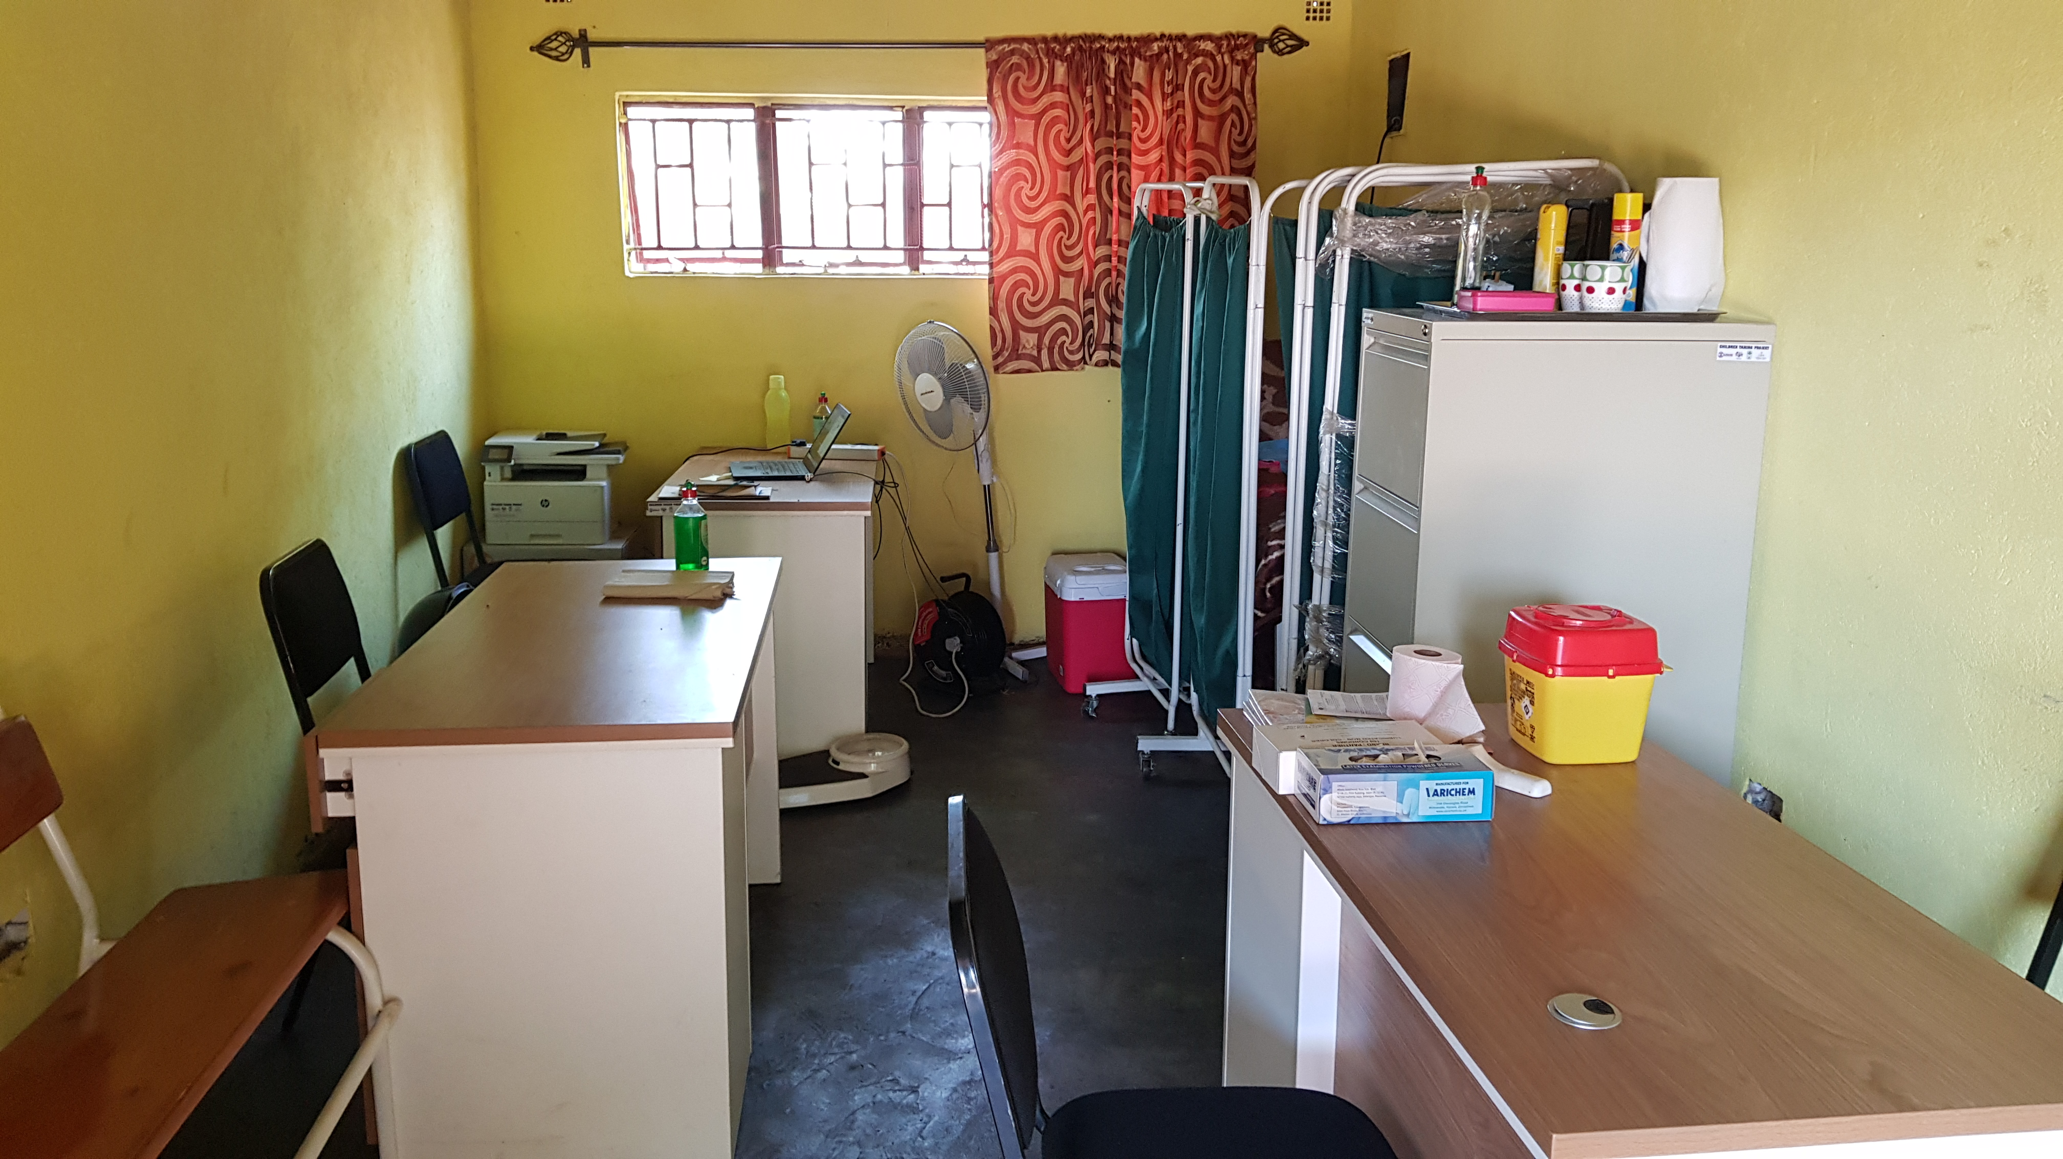
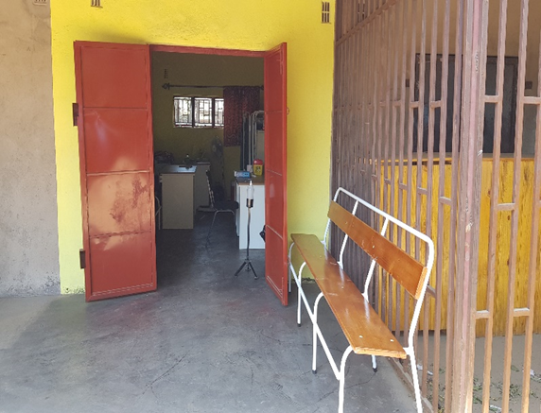
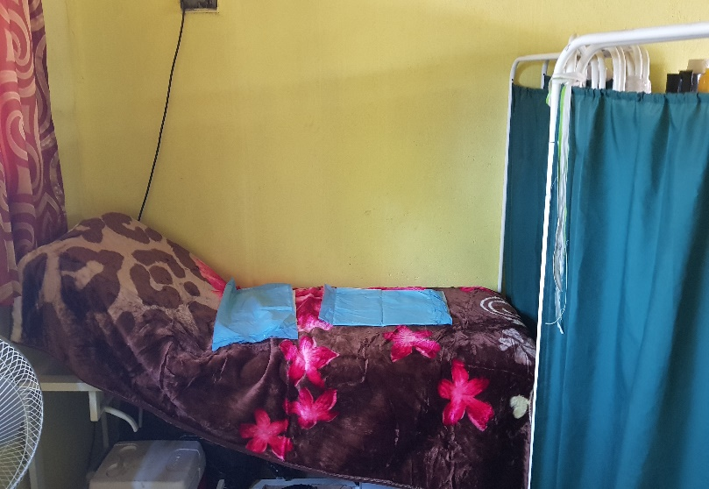
FACT supported Sakubva CP – Open
Notes:
Sakubva township is a high-density location which has a total population of 67 946. (Manicaland Province population is 1 752 698, Mutare population 262 126).
The catchment area of Sakubva has two health facilities namely Sakubva clinic serving out patients and Sakubva District Hospital for maternal and eye services.
The CP is situated at the Green market which was previously a vegetable market and now converted to be a Light industrial area in Sakubva.
The CP was activated on the 29th of June and is being manned by seven staff members comprising of 1 Team Leader, 1 Nurse Counsellor, 1 Data Clerk and 4 Community Health outreach. Workers who provide HIV and testing services to men who work in the market and general populace within the market.
All the CPs will have a staff complement indicated in the center blue box. Before assuming duty, the team is attached at the parent health facility for 2weeks. The objectives of the attachment is to familiarize oneself with the catchment population and build a working relationship with the parent health facility team. The community post team will be collecting their supplies from the parent health facility daily.

Slide 4
Overall cascade shows high HIVST kits utilization & optimal linkage
ZACH Program data, Oct 2020
Notes:
These are the results of the first 2 weeks of implementation at Mbare and Highfields community pasts.
The results have been encouraging, we expect to continue the trend. The overall HIVST cascade shows a high utilization of the distributed kits and an optimal linkage to ART of those confirmed to be HIV infected.
The five clients who tested positive by HIVST who have not had confirmatory tests done are still being followed up so that they have confirmatory tests done and can be linked to appropriate services and care
Of those that reported to the community posts (reactive by HIVST), 5 tested negative after the confirmatory test, these clients are being followed up so that testing can be repeated after 14 days

Slide 5
Reporting of HIVST results high, > 85%
ZACH Program data, Oct 2020
Notes:
Though its early days, generally reporting of HIVST results by clients has been high >85%.
The 2 graphs show variable performance of the 2 community posts

Slide 6
Week 1 – HTS Cascade (HIV Rapid test)
41.7% yield
31.8% yield
54.3% yield
ZACH Program data, Oct 2020
6
Notes:
Testing in the community posts has had a yield of 41.7%; with the yield better in the 2nd week (54.3%) than the first (31.8%). We expect the yield to improve in subsequent weeks as we improve our targeting for testing. High yield is attributed to index testing, screening before testing using HIVST and screening tool
Linkage to ART has also been optimal above 95%.
In order to achieve our COP20 targets, we have set weekly targets for each CP. This will also enable them to track their performance weekly. Performance in week one has been low but improved in week 2.

Slide 7
More males have been identified and linked to ART
58% yield
50% yield
82% Linkage
100% Linkage
ZACH Program data, Oct 2020
Notes:
So far, within the 2 community posts we have identified more males than females. And the yield is also higher among males. These are early days to be draw any conclusions.
As PEPFAR Zimbabwe we took up this strategy or model to improve HIV diagnosis among males and adolescents. The start has been encouraging and we expect it to be sustained.

Slide 8
Sakubva community post monthly data
214 HIV tests done
16 HIV infected diagnosed (11 male and 5 female)
HIV testing yield _ 7.48%
Optimal linkage to ART _ 94%
FACT Program data, Oct 2020
Notes:
Due to Covid-19 restrictions (movement restrictions, the market was partially closed hence low volumes of customers) the start has been slow as reflected by the results. However, we are now past the formative stages and we expect the results to improve.
As shown above, there is a deliberate targeting of men for testing and diagnosis.
HIVST distribution is being done in the community through AFRICAID.

Slide 9
Roll out experiences
Morning motivational talks at community post instead of parent health facility
Daily performance monitored and shared via WhatsApp
HTS focuses on high yield strategies (screening & index testing)
Community leaders participated in recruiting FCI champions
FCI champions WhatsApp group to share experiences
Retention strategies still evolving, emphasis on 6MMD
REC
I
PE
Notes:
Our IPs have replicated every aspect of the RECIPE (Responsibility Empathy Compassion etc.)

Slide 10
Lessons learnt in rolling out community posts
Policy
Human resources
Community participation
Continual TA by COH critical to blow winds in our sails
10
Notes:
Although Zimbabwe had a policy allowing implementation of community posts, we experienced a 5-month delay to get the necessary approvals and buy in from the different authorities. This was precious implementation time lost
Recruiting the right cadres is critical. Gibstar has emphasized this repeatedly. For us we did take our time to ensure we got the right cadres and the early results support.
With community participation we were able to identify community posts in highly strategic points. Due to changes in urban policies by the government we have had to change the other 2, but new ones were quickly identified and are close to opening.
We hope to share some of the experiences with the team as we implement.

Slide 11
End . . .

