Slide 1
Muslim Education And Welfare Association (MEWA)
MEWA’s Innovative Faith-based Model For Addressing Gaps In HIV Epidemic Control, And The Challenges And Opportunities For FBOs To Work With Key Populations
Presented By: Abdalla Badhrus
Program Manager- MEWA Health And Harm Reduction

Slide 2
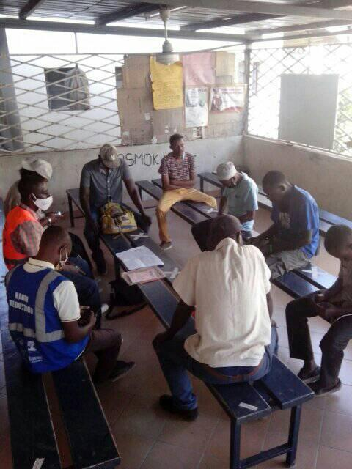
MEWA’s innovative faith-based model for addressing gaps in HIV epidemic control
Survey (typology, gender, education, needs assessment)
Detoxification centre
Residential and non-residential rehabilitation treatment
Female drug users rescue centre
Female drug users safe space
Street families rehabilitation
Methadone treatment
Harm Reduction
Paralegal work
SRHR

Slide 3
FBOs’ challenges working with PEOPLE WHO INJECT DRUGS (PWIDs)
Opportunities for FBOs to work with PWID
Criminalization of drug use
Stigma and discrimination
Sounds like encouraging drug use
No direct contact with PWIDs
FBOs are against drug use
Drug use SIN (the lack faith, criminals, dirty, they will not see have)
Myths on drug use
Respected by communities / PWIDs
Can make a change (decriminalization of drug use)
Donors, governments and communities trust FBOs
FBOs have resources
Opportunity to understand addiction as a disease
Near the community

Slide 4
Overview of supportive Services
Female Rescue Shelter: Free detoxification for female drug users (FDUs) and their children, adherence, parenting training, IGA, peer support, clothes and sanitary towels, shelter for women on methadone and in recovery
Support for children of FDUs – meals, diapers, clothes, medical care, psychosocial support, School Madrasa
Opioid Substitution Treatment (OST)/Medication-Assisted Treatment (MAT): Recruit, assess, shelter, and transport MAT clients; support MAT clinic, psychosocial, nutritional support
Street Family Support: Rescue street families, psychosocial support, basic medical services, legal services, rehabilitation, resocialization, family reintegration, financial education
Paralegal Services; issuance of national documents, human rights, advocacy
Female Safe Spaces: Formal space where FDUs feel comfortable to express themselves without fear of judgement or harm, receive social support, acquire skills, receive GBV services, information on women's rights, health and services.

Slide 5
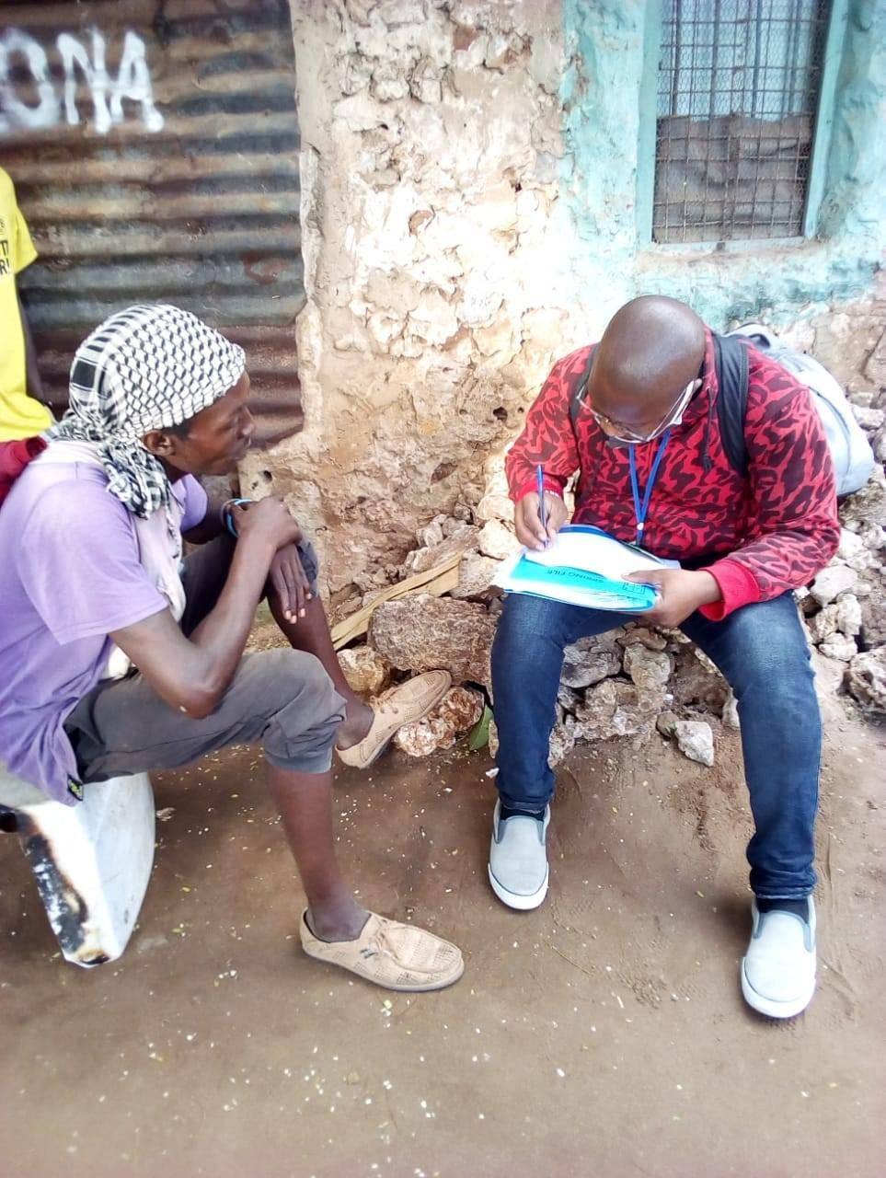
HARM REDUCTION/DICE SERVICES
Needle and Syringe Program
HIV counseling and testing
Antiretroviral therapy (for PWID who are living with HIV), including adherence counselling
Prevention and treatment of STIs
Condom programs targeted specifically PWID and their sexual partners
Targeted IEC materials and campaigns for PWID and their sexual partners
Prevention, diagnosis and treatment of tuberculosis and viral hepatitis

Slide 6
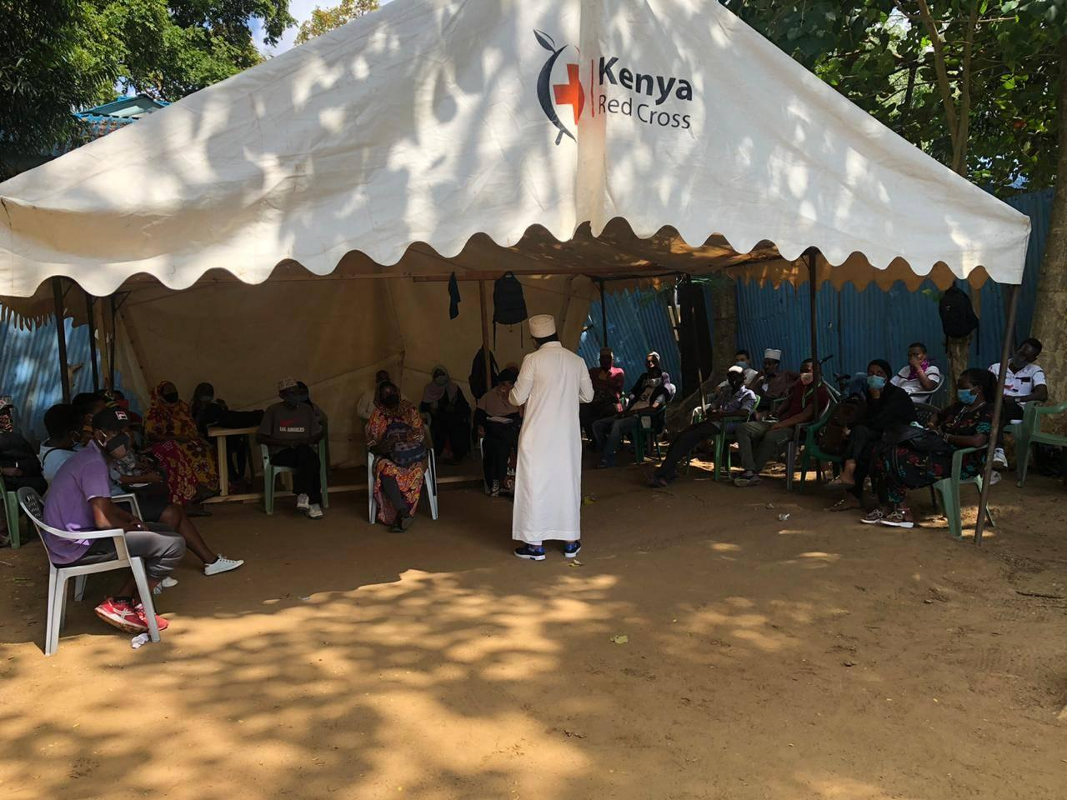
KP HIV Testing AND ART – the role of the faith community
Mobile HIV testing services
Stakeholder meetings (disseminating information to stakeholders on quarterly program achievements, challenges and way forward)
Cervical cancer screening

Slide 7
KP PrEP- the role of the faith community
PrEP is highly effective for preventing HIV from sex or injection drug use.
If you use PrEP consistently and correctly, it is 92%–99% effective in reducing your HIV risk, whether you use a condom or not.
Faith community should sensitize community on PrEP.
Prevention of HIV infection is achieved through a combination prevention approach.
Behavioral Interventions is used to increase knowledge and skills i.e. communication, negotiation and correct and consistent condom use, reduction of sexual partners in HIV prevention, change attitudes and motivate individuals as well to adopt healthier behaviors.
Substance use may hinder adoption of healthy behaviors.

Slide 8
HIV PREVENTION,CARE AND TREATMENT
 | Male | Female | Total
Clients on ART | 61 PWID: 45 PWUD: 16 | 54 PWID: 26 PWUD: 28 | 115 PWID: 71 PWUD: 44
Eligible for Viral Load | 40 | 36 | 76
Viral Load Results Received | 40 | 36 | 76 (100%)
Virally Suppressed |  |  | 98%
PrEP | 38 | 28 | 66 (with 100% adherence)

Slide 9
BEST PRACTICE
Shanzu Law Court: collaborated with magistrates to ensure cases of drug users are addressed fairly, petty offenders are released and those in need of treatment are linked for detox and counselling sessions
Police Stations: Met with police stations and discussed assisting in follow-up of client cases, and sensitized them on harm reduction program
Chiefs, Registrars and Local Elders: to facilitate the process of issuance of application of Kenya identification card and other legal documents
Probation and Prison Department: Probation officers in Shanzu court and prison commanders from different prisons ensure inmates with drug dependence receive sessions, and discuss matters of drug users, the progress of probation clients and how to make the program a success.

Slide 10
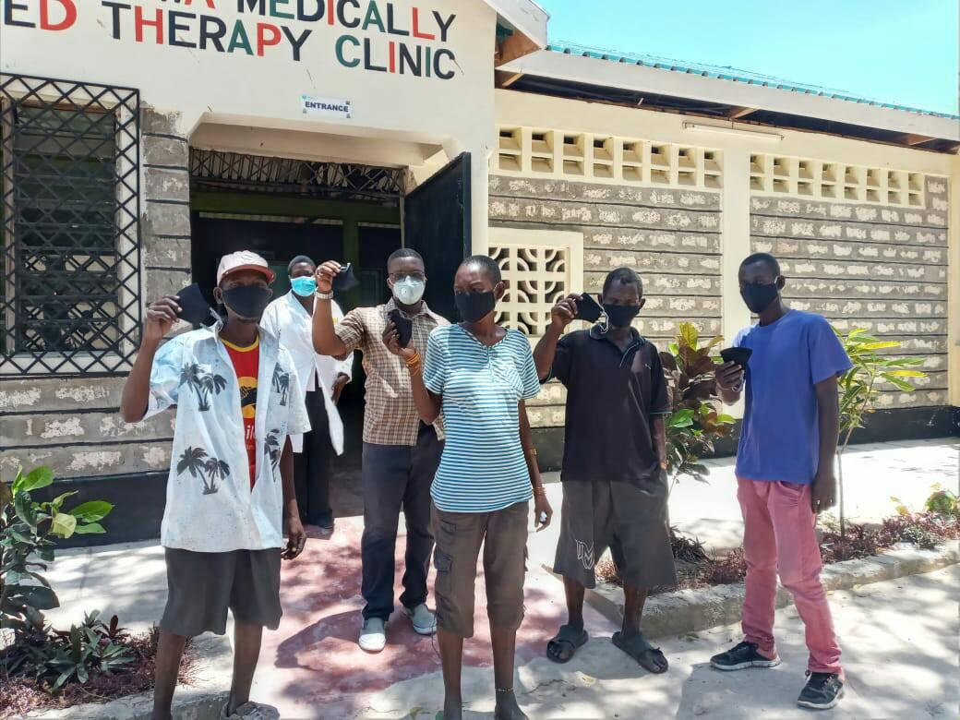
Thank you

