Slide 1
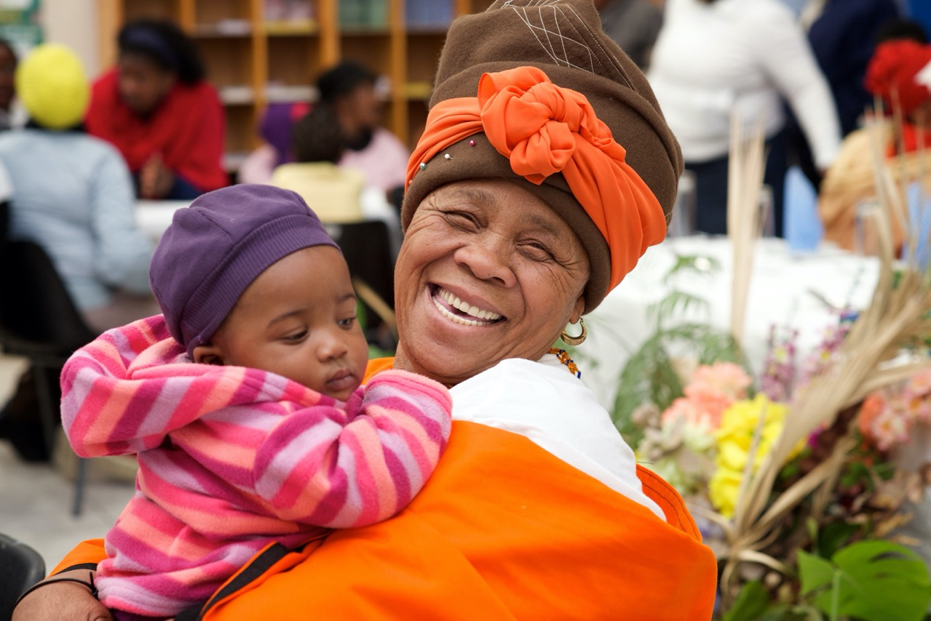
COVID-19 PLAYFUL PARENTING EMERGENCY RESPONSEGITAL
An inter-agency initiative
Jamie M. Lachman
and Lucie Cluver
© Gregor Rohrig

Slide 2
The COVID challenge
Stress, abuse, school closures
Economic crisis & government cuts
Every family needs parenting support

Slide 3
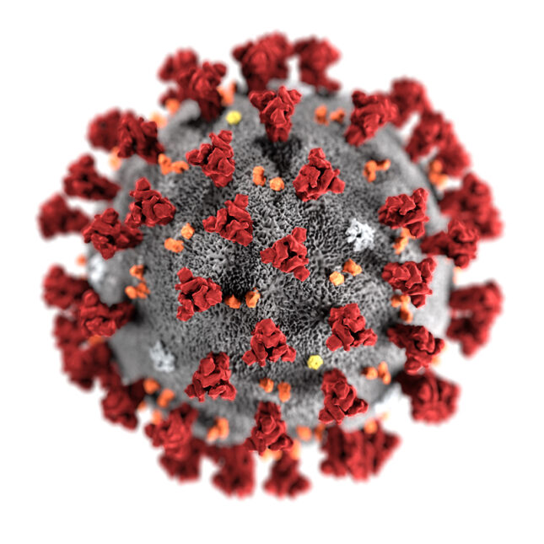
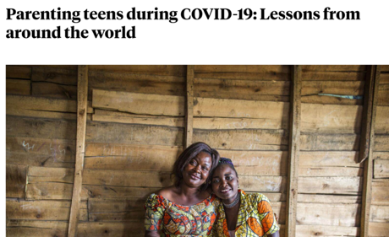
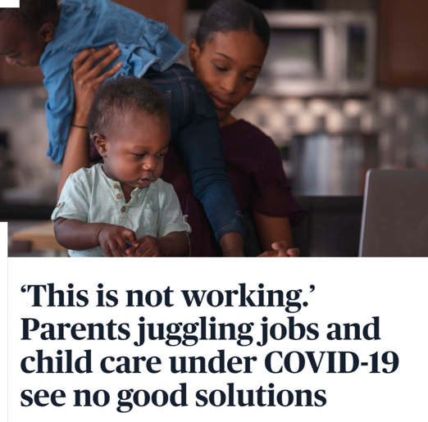
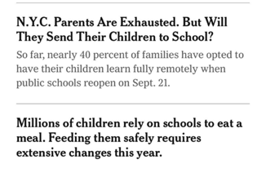
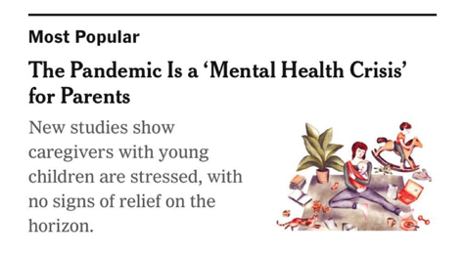
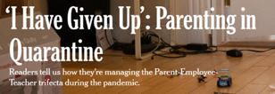
Notes:
- Why we are here today

Slide 4
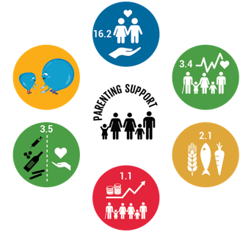
Evidence of Effectiveness
Child Abuse
Positive Parenting
Mental Health
Substance Abuse
Hunger
77 Systematic Reviews
Number of randomized controlled trials of parenting interventions in low- and middle-income countrries by year published
Poverty
WHO Parenting Guidelines 2021
Cluver, Orkin, Toska, Campeau, Webb, Carlqvist, Sherr, (2019) The Lancet Child & Adolescent Health
Notes:
Lucie:
- Abundant evidence of traditional models developed over the last 30 years
Add WHO guidelines on responsive caregiving – include review
For ECD parenting – evidence shows that effects are variable as they scale
Add frances review

Slide 5
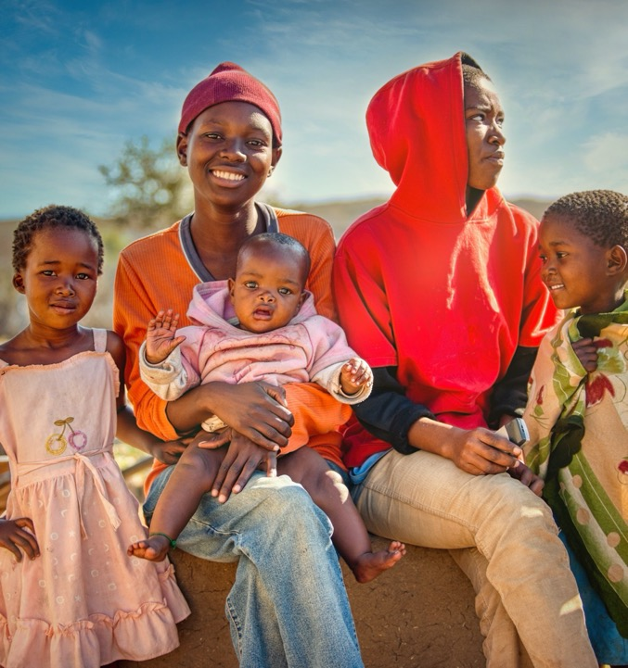
Parenting for Lifelong Health - Sinovuyo
Aim: Reduce the risk of child maltreatment and improve child wellbeing
10 randomised trials: South Africa (6), Philippines, El Salvador, Lesotho, and Thailand

Slide 6
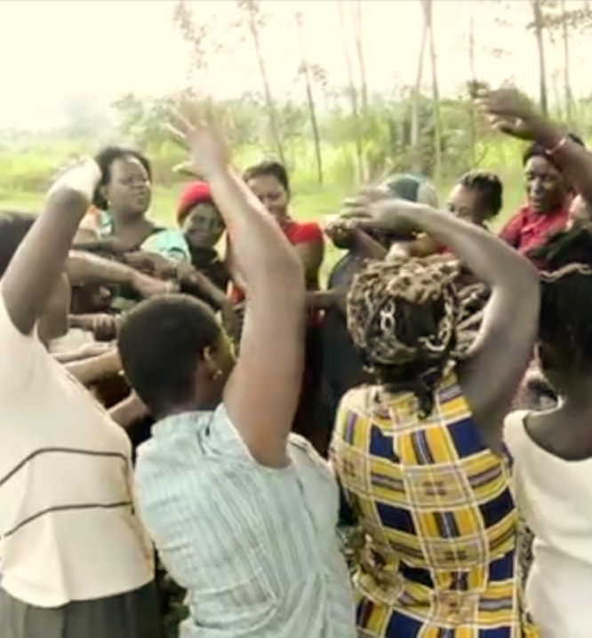
Parenting for Lifelong Health – Sinovuyo Teens
Developed and tested in South Africa, 14 sessions
Building relationships
Praise
Talking about emotions
Dealing with anger
Family problem-solving
Family budgeting
Cooling down conflict
Rules and Routines
Keeping safe outside
Responding to crisis

Slide 7
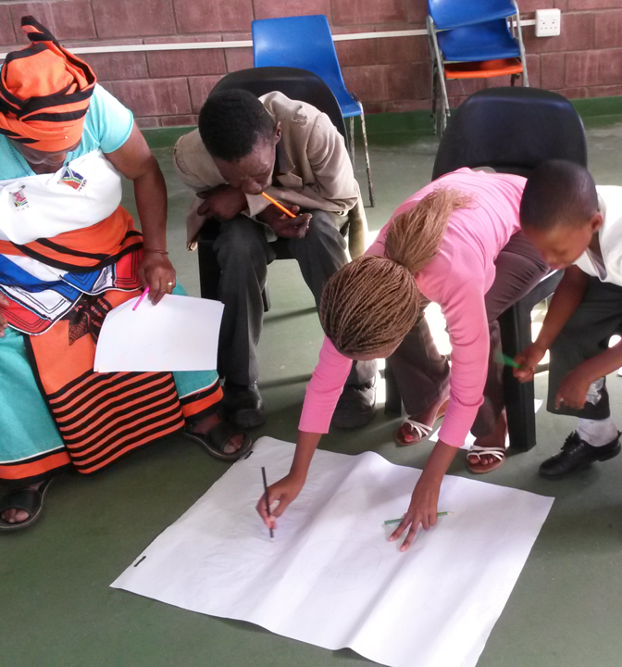
Parenting for Lifelong Health – Sinovuyo Teens
More parental supervision, More involved parenting,
More positive parenting, More social support,
More family protection, More family savings
Less violence, Less corporal punishment,
Less alcohol use, Less drug use
Less depression, Less parenting stress
Less borrowing money, Less shortfalls of food
Cost-effectiveness: R6 for every R1spent
Cluver et al (2018) BMJ Global Health. Redfern et al (2019) BMJ Global Health

Slide 8
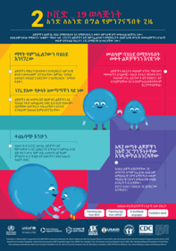
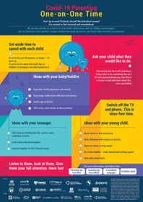
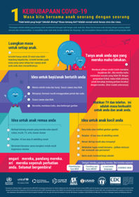
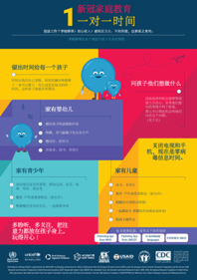
COVID-19 Playful Parenting Resources
Derived from rigorously tested evidence-based programme
Content adapted to fit COVID-19 context
Developed with and reviewed by UNICEF, WHO, CDC, USAID, and Global Partnership to End Violence
Simplified for transportability across cultures and contexts
Translated into over 100 languages

Slide 9
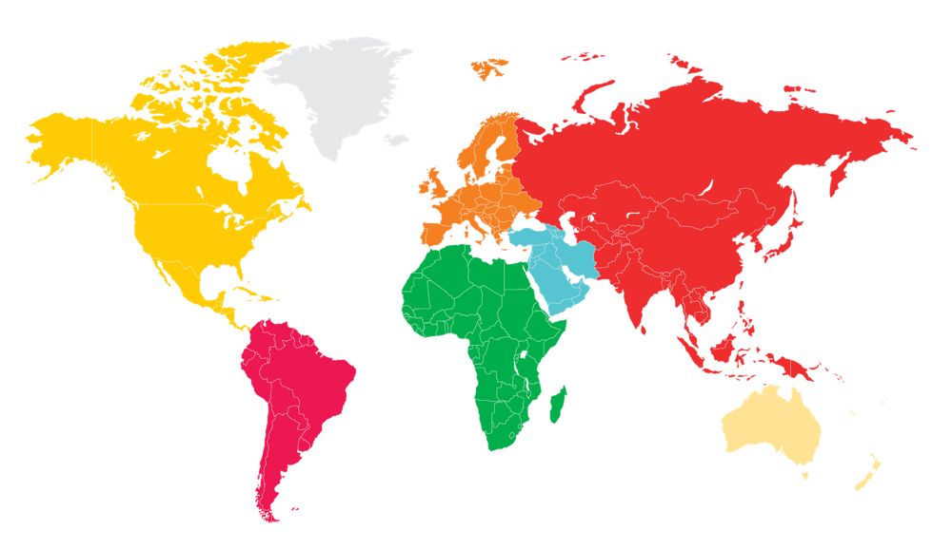
137.7 million reached
Moldova, Montenegro, North Macedonia: Developed online parenting support groups based on Parenting for Lifelong Health
Moldova, North Macedonia, Romania: Testing delivery of Parenting for Lifelong Health via Zoom (2021)
Pakistan: National television broadcast
Kyrgyzstan: Cartoon videos on national television reaching over 2 million people
Special Olympics:
in 130 countries
Thailand: Government distributed leaflets in Health Promotion hospitals throughout the country
Zimbabwe: Reached over 1million via national radio stations.
Jamaica: Shared audio tips on national radio
Laos: National Government and UNICEF speakers in 5,800 villages for 50% of population
South Africa: Reached over 6.8 million people through 50 different community radio stations
India: Created phone-call based family mentoring programme based on the parenting tips.
Sri Lanka, Cameroon India, Montenegro, Philippines & South Africa: Delivered with food packages
Philippines: National Government and UNICEF webinars for over 1500+ families
Paraguay: 1million reached online with the First Lady’s support
Kenya:
Safaricom ringtones of COVID-19 parenting song
Cameroon: Used tips in workshops presented to fathers in the community
Malawi & Zambia:
Blantyre Synod Radio broadcast reaching over 11 million people

Slide 10
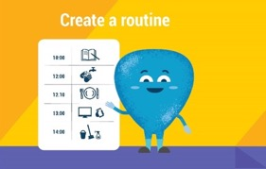
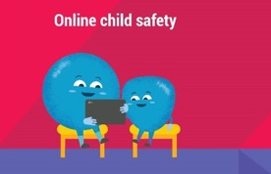
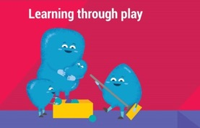
Evidence-Based Playful Parenting

Slide 11
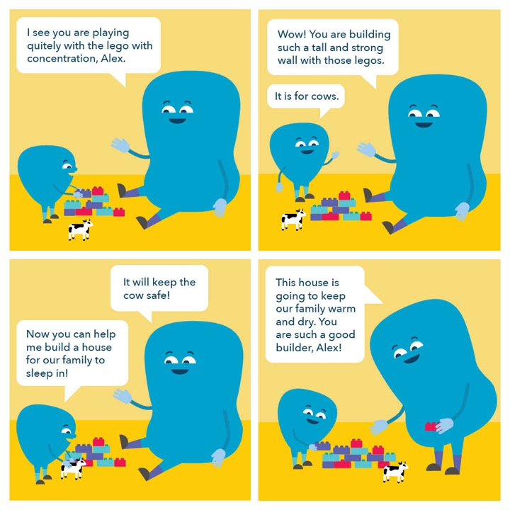
One-on-One Time
Positive relationship building
20 minutes a day
Child-led play
Switch off TV and phone

Slide 12
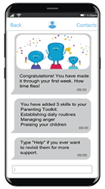
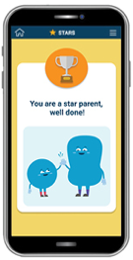
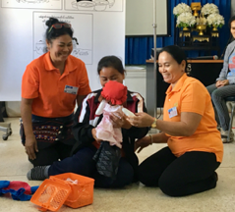
Parenting for Lifelong Health – People Plus Digital
PLH In-Person
ParentChat
ParentText
ParentApp
Parenting programs delivered by trained facilitators in-person or Zoom
5-14 s modules for groups of 10-15 participants
Strongest evidence for effectiveness across multiple outcomes
Delivered in over 25 countries for more than 300,000 families
Can be delivered via Zoom or other video conferencing
Online parent support groups based on PLH (ages 2-17)
8 weekly modules; 2 chat sessions per module (8-15 parents)
Weekly assignments and feedback sessions
Pilots in Malaysia, Moldova, Montenegro, North Macedonia, Philippines, South Africa
Interactive chatbot delivery to basic phones and smartphones (ages 0-17)
5-10 weeks of daily content depending on user-driven frequency
On-demand content (e.g., child behaviour, stress, services)
Reminders for practicing skills and reducing stress
Pilots in 2021 in India, Jamaica, Malaysia, Philippines, South Africa
App-based program for parents of adolescents (10-17)
Parenting support through joint activities and stories for parents
Reminders for practicing skills and reducing stress
Check-ins and reminders on parenting and emotional wellbeing
Piloting in 2021 in South Africa
Notes:
Lucie….

Slide 13
Core Principles
Evidence of Impact
Scalable & Low-Cost
Open Source & Non-Commercial
Adaptive & Locally Relevant
Playful & Empathetic
Policy Partnerships

Slide 14
THANK
YOU !
COVID-19 Playful Parenting Emergency Response
Dr Jamie M. Lachman & Professor Lucie Cluver
www.covid19parenting.com

