Slide 1
“Leveraging the Faith Community to accelerate Epidemic Control”
Learning and Actioning the gains from the FCI NFH
Gibstar Makangila
Executive Director
Circle of Hope, Lusaka Zambia
Learning and Actioning gains
from the FCI NFH
September 28, 2022

Slide 2
FAITH COMMUNITY INHERENT CAPACITY
“Learning from the past”
MANDATE – A DEEP SENSE OF RESPONSIBILTY
CALLING – THAT IS BEING ANSWERED
GOOD WILL – DRIVES THE RESPONSE
HOPE - GIVES ENCOURAGEMENT AND HOPE
LOCATION - IN ALL LOCAL COMMUNITIES
COMPOSITION – FAITH ENGAGED ACTIVE PRACTIONERS
SERVICE PROVISION - LOVE ANCHORED BY THE RECIPE

Slide 3
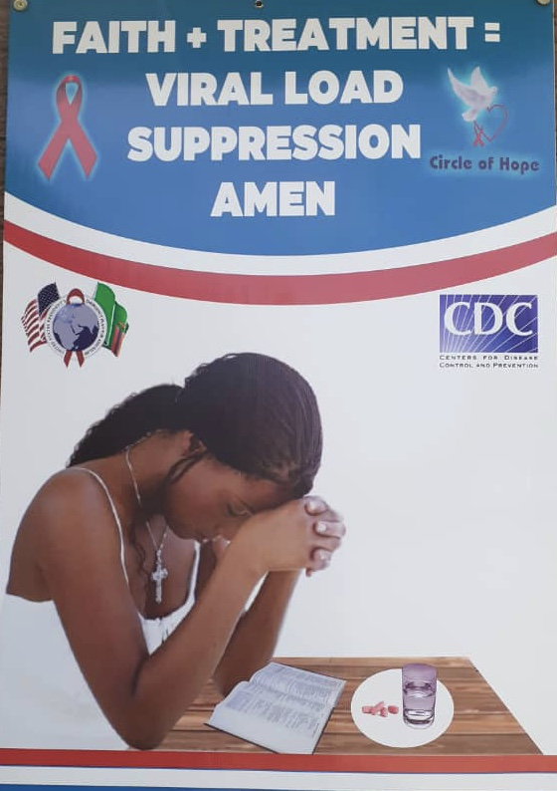
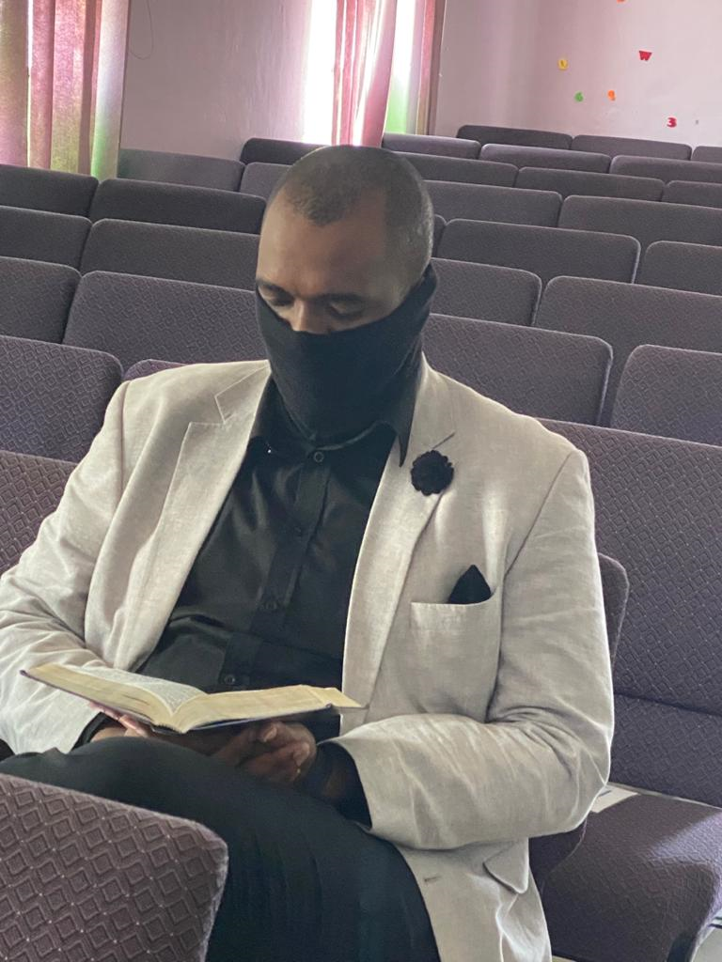
CRITICAL SUCCESS FACTORS
RELATIONSHIP CAPITAL
TRUST WORTHINESS
UNHINDERED ACCESS TO HOUSEHOLDS
INTRICATE KNOWLEDGE OF LOCAL COMMUNITIES
FIRST RESPONDERS
ADDRESSING WHOLE PERSON

Slide 4
“Obeying the present” by highlighting Successes and Opportunities
Unprecedented results in key indicators
Increased trust among community stakeholders
Transformative Innovations in program implementations
Effective deployment of impassioned HCWs and CHWs
Effective provision of influential community leadership
Demonstrable sustainability and longevity of presence in communities beyond project intervention
Insufficient tapping and usage of the WISDOM and experience in the faith communities

Slide 5
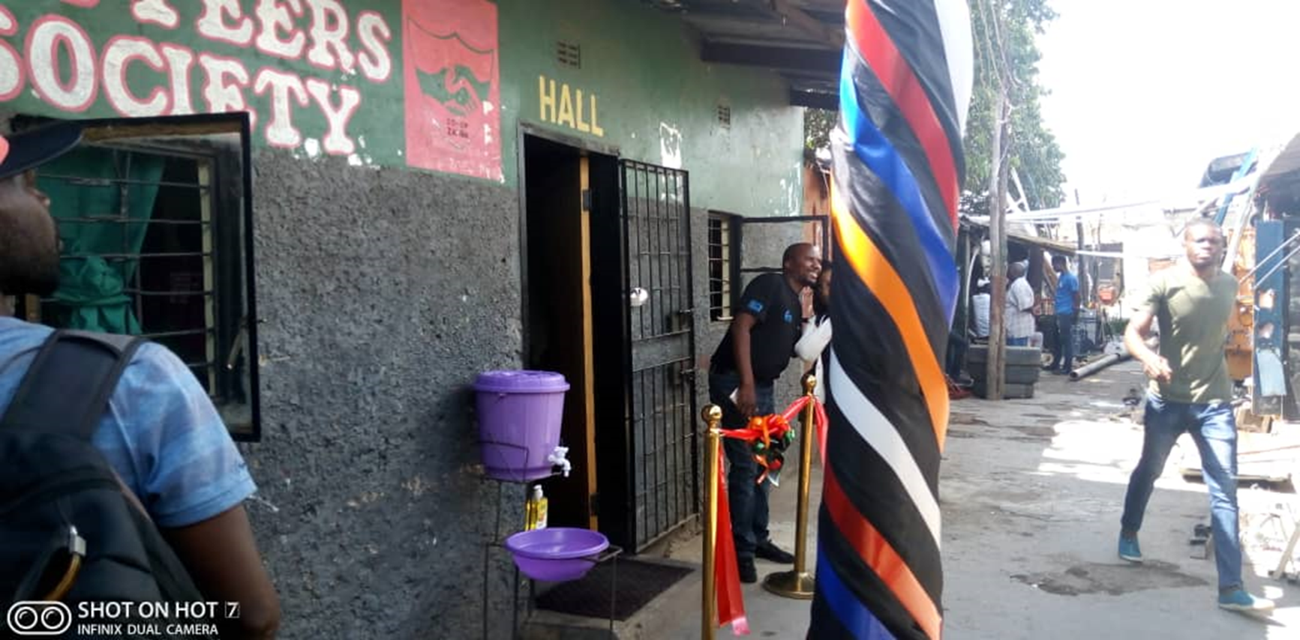
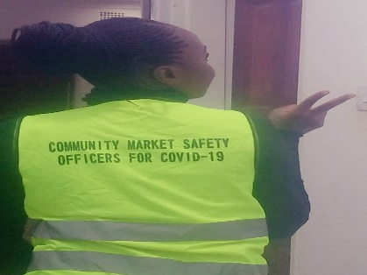



Zambia COH: Faith-engaged community posts led to >1,200% increase in case – finding for HIV

Slide 6
Zambia COH: More males being reached with testing, yield is higher among females, FY20Q1-FY21Q3

Slide 7



Zambia COH Faith Engaged CPs & Lusaka Health Provincial Health Office
CPs Targeted Testing Men- FY21 Q2 & Q3

Slide 8
Shaping the future by overcoming Weaknesses and Challenges
Poor documentation
Poor advocacy of its successes
Absent and inadequate presence on important Technical Health Committees
Inadequate presence and absent from policy formulating groupings
Diverse position and doctrine on some aspects e.g. faith healing
Inadequate collaborations among faith communities
Insufficient tapping and usage of the WISDOM and experience in the faith communities

