Slide 1
Serving & supporting Covid-19 orphans Forgotten Voices – Zambia, Summary Impact
Remmy Hamapande, Forgotten Voices Zambia

Slide 2
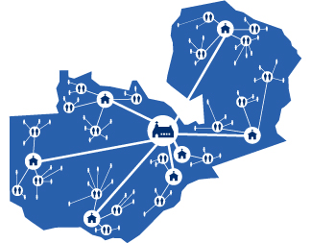
Zambia: Early situation of Covid-19
Characteristics of reports received from partners…
Trauma/panic,
Stress/anxiety
fear about uncertain future
loss of economic livelihood
Child abuse
GBV…
etc

Slide 3
The Challenge
HIV/AIDS decimated young vibrant parents
Leaving orphans mainly under care of grandparents (gogos)
Covid-19, grandmother caregivers highly susceptible
Orphan hood experienced for the 2nd/3rd …etc… time around.

Slide 4
The Challenge
It’s estimated that one child every 12 seconds is losing a primary caregiver (www.worldwithoutorphans.org/covid-19)
Increased child headed households
Increased child trafficking susceptibility

Slide 5
Organizational Response….phase 1
Relief food distribution & counseling for families, especially grandparent caregivers:
Bereaved families (1st phase – 170 families in Lusaka & Copperbelt [approx. 1,020 children])
Economically affected due to Covid-19
Trauma healing

Slide 6
Organizational Response….phase 2
Parenting Tips materials
In collaboration with WWO:
Parenting Tips materials roll out (https://www.covid19parenting.com/resources)

Slide 7
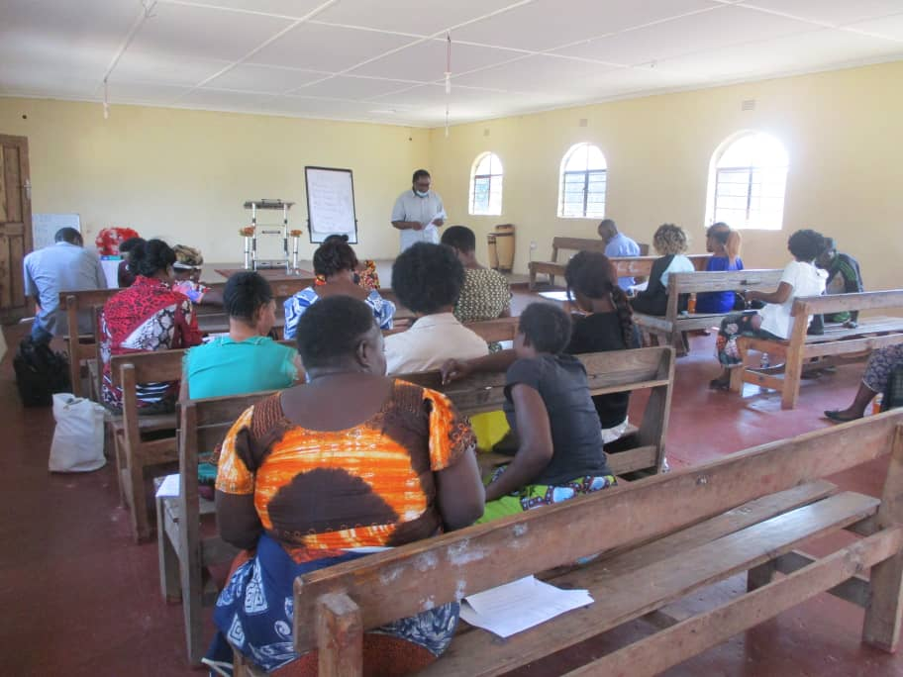
Organizational Response ….phase 2
Means of reaching out:
Through local churches
Online Platforms – WhatsApp
In person instruction
Radio
Telephone (in collaboration with Viva Child and Family Mentoring training)

Slide 8
Survey impact
Evaluation: Standard questionnaire from Parenting for Lifelong Health (Oxford University):
Reached out to:
23 partner churches reaching 5750 Households
3 million caregivers/parents
Random Sample of 267 Households

Slide 9
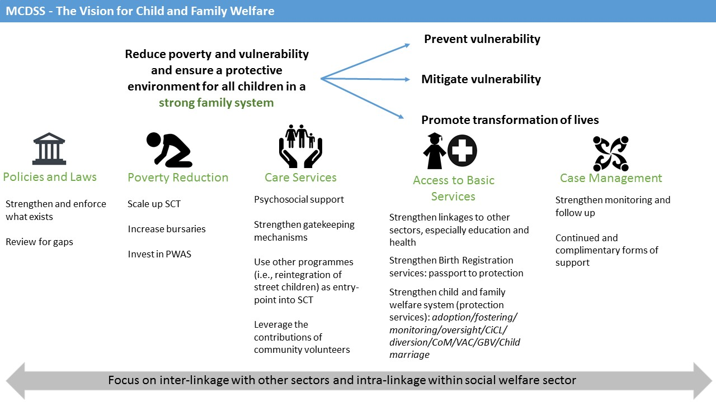
Ministry of Community Development & Social Services (Govt. of Zambia)

