Slide 1
HIV Stigma Reduction through CATS in Zimbabwe
FCI New Foundations of Hope webinar
20th March 2022
Notes:
Good morning / afternoon. I’m going to talk about Zvandiri and the CATS work on stigma reduction with young people living with HIV. CATS are community adolescent treatment supporters. ‘Zvandiri literally means ‘as I am’ – this name was chosen by adolescents living with HIV back in 2004. They wanted to say I may be HIV positive but accept me ‘as I am’. Way back then, their message to us was ‘we need to feel accepted and loved, despite our HIV status, because what they faced in their daily lives, was stigma’. They told us they need ‘more than the medicines’ if they were to thrive as young people living with HIV and this was very much the foundation and beginnings of Zvandiri – an evidence-based, peer-led approach to paediatric and adolescent HIV and mental health

Slide 2
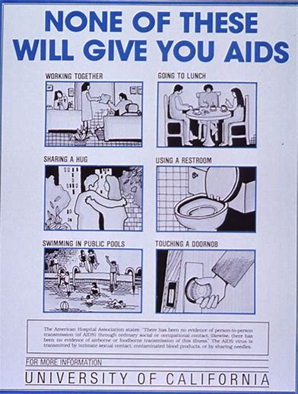
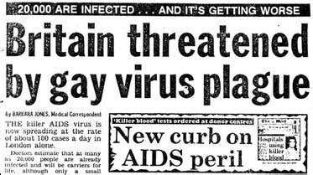
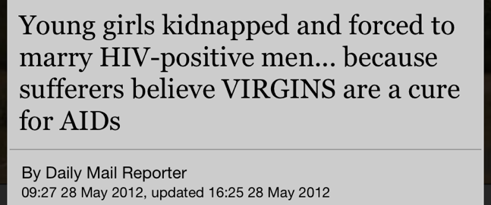
1980s
Notes:
I will start by taking us back to the 1980s. These were the messages back then
HIV = death. Pictures of Graves, skeletons
Messages emphasising that you can’t get HIV through sharing a glass
Reports of beliefs that having sex with a virgin can cure AIDS – from 2012
These were the messages 30 years and you may wonder why I’m taking us back there.
But in 2021, when we asked groups of people from faith communities about their understanding of HIV, this is what we heard…

Slide 3
2021
‘HIV is spread through sharing a towel, plate, cup, blanket with infected people’
‘HIV is spread by those who are promiscuous’
‘HIV can be cured if one sleeps with a virgin child’
‘HIV is not found among church members’
‘HIV positive people cannot have negative babies’
‘HIV will always lead to AIDS’
‘Children born with HIV will die before they reach 5 years’
‘People don’t want to be tested due to fear and stigma’
Not knowing my status is better than getting to know I am going to die’
Notes:
In 2021, through the FCI programme, when we met with faith communities to hear their questions and thoughts about HIV, this is what we heard. QUOTES
Despite the phenomenal advances in HIV care and treatment over the last 3-4 decades, these messages persist, demonstrating we have not moved far in other ways. We still have a very long way to go in addressing myths and misconceptions and the subsequent stigma experienced by people living with HIV

Slide 4
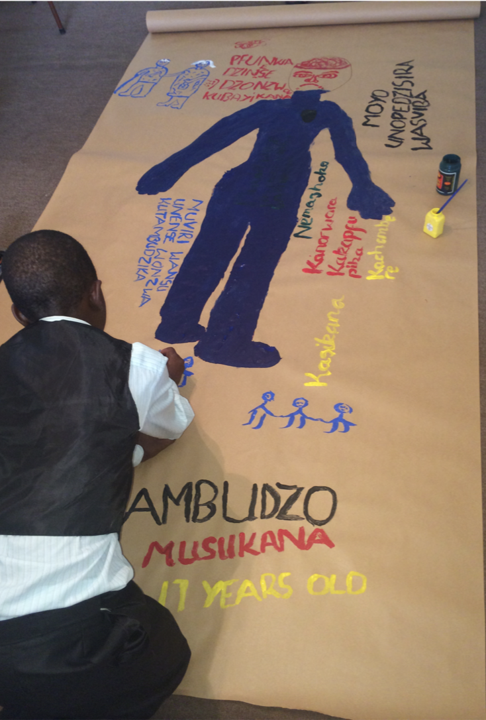
Adolescents living with HIV attribute their poor mental health to the words and behaviours of:
Peers
Families
Communities
Health Care Workers
Notes:
Now I’ll speak specifically about children and adolescents and the role of sigma in heir lives.. It is increasingly understood that ALHIV have increased risk of poor mental health and that this correlates with poor adherence and virological failure. We’ve conducted various studies with young people living with HIV with depression and anxiety. This photo is an example from some of our body mapping research. Our research shows over and over again that young people living with HIV attribute their poor mental health to the words and behaviours of their peers, families, communities and their health care workers. Stigma – experienced or perceived – is at the root of how they think, feel and behave and influences their mental health and subsequently, their adherence, viral suppression and quality of life

Slide 5
“When I was sick, some relatives would say I was to be left to die just the same way my mother died. I was moved from relative to relative” (Kudzanai, 17 years).
“I stay with my stepmother who is very cruel to me. She ill-treats me because she has her own child and so it is done on the basis that I am not her child” (Tanaka, 14 years)
“They will not play with me because if they touch me, they will be "infected". (Paradzai, 15 years).
“They hurt me when they say, 'This one drinks pills (for HIV), so there is no need to bother with him because he is not my child”. (Wangaa, 17 years).
“the pain that I go through each day I go to school is because of my body. . .It’s small so people always tease me” (Persevere, 18 years).
“You need that love, but you won’t get it. I cry myself to sleep every day. My mother died when l was three. I never knew her, l don’t have a picture of her” (Janet, 19 years).
Notes:
Here young people with depression describe how the words and behaviours of others affect them.

Slide 6
‘I have the medicines. I know I need them. But if my relatives find them, I will lose everything. So it is better to hide them. But this makes adherence difficult’
Notes:
We can have all the medications needed but adherence is determined by the realities of young people’s lives of which stigma is a daily, persistent, traumatising reality.
The recurring theme among young people we work with (and I’m sure same for many adults too?) is that they can have the medicines in their hands, the information in their heads, but what determines whether they take the medicines is whether someone else will find out their HIV status and the fear of those repercussions.

Slide 7
Notes:
Zvandiri connects young people living with HIV with trained mentored peer counsellors called Community Adolescent Treatment Supporters (or CATS) who understand and respond to their needs and experiences.

Slide 8
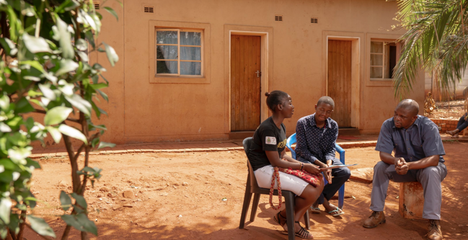
CLINIC
HOME
SUPPORT GROUP
DIGITAL
Notes:
This is Vimbai, a CATS– she connects with her young clients and their families in the clinic, in their homes, in support groups and through digital platforms, providing counselling and connecting them with he services they need.
Through the Faith Communities Initiative, we had the opportunity to take this peer-led model and apply it in Faith Communities

Slide 9
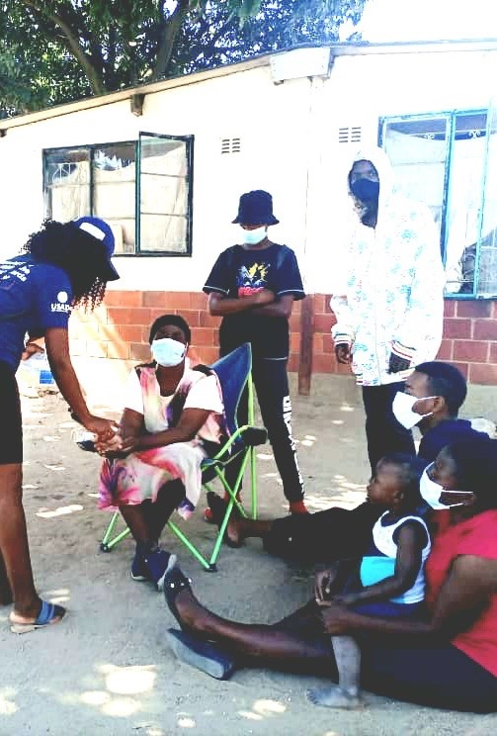
FCI Champions
82 young people from faith communities
53 (ZACH / CDC); 29 (USAID)
Supervised by MoHCC, attached to clinics and community posts
Engaged with faith communities through community events, homes, church gatherings, social media - with community leaders
Disseminated messages of hope
HIV testing; Stigma reduction
Engaging men
ART and Adherence, Viral load monitoring; Faith healing
COVID-19 prevention
Mobilisation for HIV testing
Index case finding; HIV self test kit distribution
Defaulter tracing
Notes:
Messages of Hope – how men feel, engaging men, men and clinics, how providers feel, mother’s voices, faith leaders for children and youth, covid-19 prevention

Slide 10
Results
Community Dialogues – 11,149 people reached
Messages of Hope – 285,545 people reached
Index Case Testing:
366 offered; 300 (82%) accepted; 344 contact elicited
307 (89%) contacts tested and received results
265 (86%) contacts tested negative
42 (14%) contacts tested positive; 33 (79%) linked to ART
HIV Self Testing:
10,541 kids distributed
10,461 (99%) kits utilized
735 (70%) reactive results
603 (82%) confirmed positive
589 (98%) linked and on ART
Defaulter tracing:
1.058 MoHCC identified defaulters
754 confirmed defaulters by Zvandiri
737 (98%) defaulters traced
Notes:
FC – apostolic, presbyterian, Adventist, catholic, Pentecostal, African tradition, islamic

Slide 11
“We thought children born with HIV will die. We didn’t know.
After talking with the CATS and seeing them, now we know differently.” Chief Representative
’In our church, when young couples come for marriage counselling, we would discourage marriage. This community dialogue has been an eye opener’ Pastor, Zvimba
Notes:
What have we learned?
CATS themselves are a stigma reduction intervention.
When families, caregivers and communities engage with CATS - confident, healthy, determined young people – this demystifies and transforms their pre-existing ideas and mis-conceptions

Slide 12
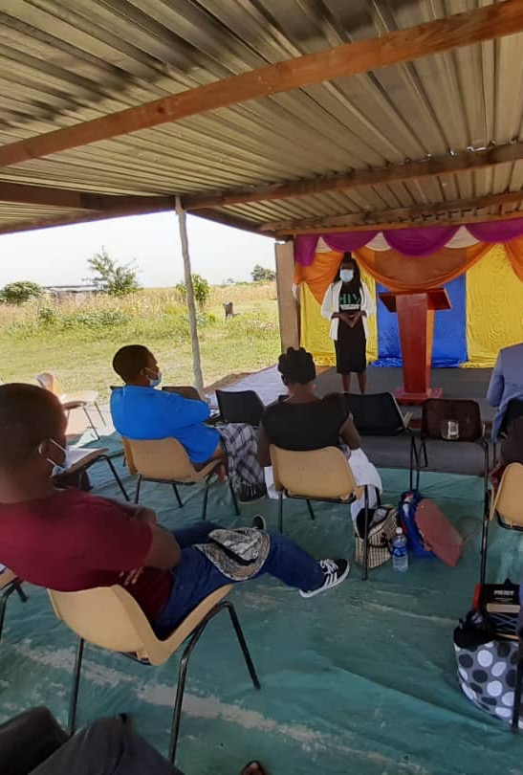
“Please make sure your messaging about HIV keeps coming as people are not aware of such updated information about HIV,’ Pastor, Mount Darwin
“We haven’t reached a stage of normalizing HIV and we rarely talk about it at church, hence this programme came at a good time for us to share such information about HIV that we were not aware of with congregates” – Pastor, Mazowe
Notes:
CATS shared information with faith communities, providing critical opportunities for sharing up to date information about HIV, testing, treatment. Promoted awareness of services available and the benefits of accessing services whilst respecting faith and religious beliefs.

Slide 13
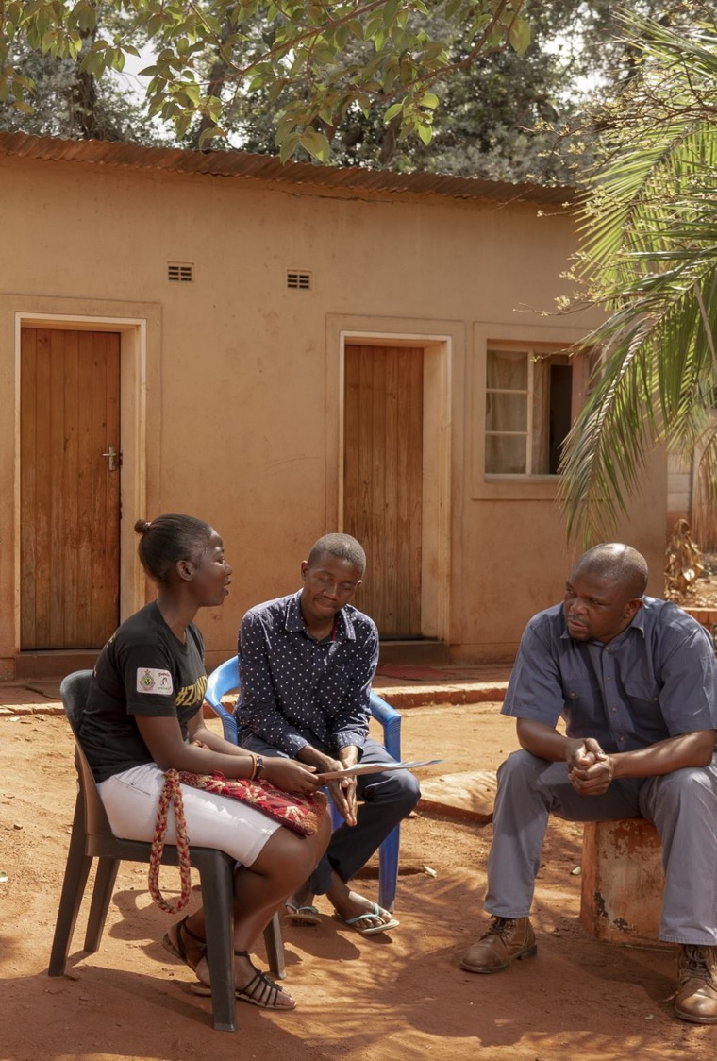
Adolescents supported by CATS report reduced stigma and more supportive environments compared with those receiving standard care alone (Willis et al, 2019)
’I used to have my own plate, cup and blanket. They were afraid of me. My CATS helped explain and now things are much better’ Child, 11 years
Notes:
This aligns with findings from the Gokwe Study, a RCT, which confirmed reduced stigma and more supportive environments. CATS provide information, counselling and support to families and caregivers, ensuring they have the right information and understanding to support their children.

Slide 14
‘It was hard for me to access testing because I didn’t want others in my community to find out (for HIV) but the CATS told me about HIV self testing and made sure I knew how to test’. Youth
‘In our church, we usually preach about HIV in a negative manner as HIV is associated with promiscuity. This discourages people from testing as they fear stigma and discrimination’ Church member

Slide 15
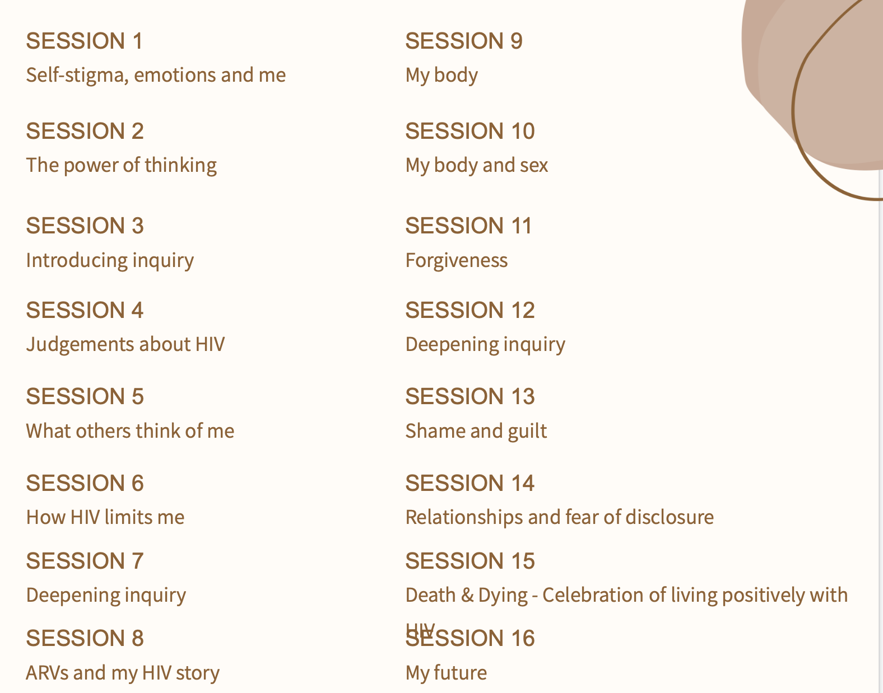
CATS-led self stigma intervention
Commenced August 2021
30 young people recruited
Baseline conducted
Ryff Scale
HIV Self Stigma Scale
Quality of Life Scale
16 x 3 hour sessions held
Inquiry Based Stress Reduction (IBSR), Music & Art
Weekly briefing of Coaches and ongoing mentoring
End line evaluation
Planning for scale up through CATS
Notes:
Self-stigma intervention developed last year in Zvandiri
Wakakosha – you’re worth it
Informed by formative research; on-going study to measure impact on self stigma and capacity of young people to deliver this intervention to their peers

Slide 16
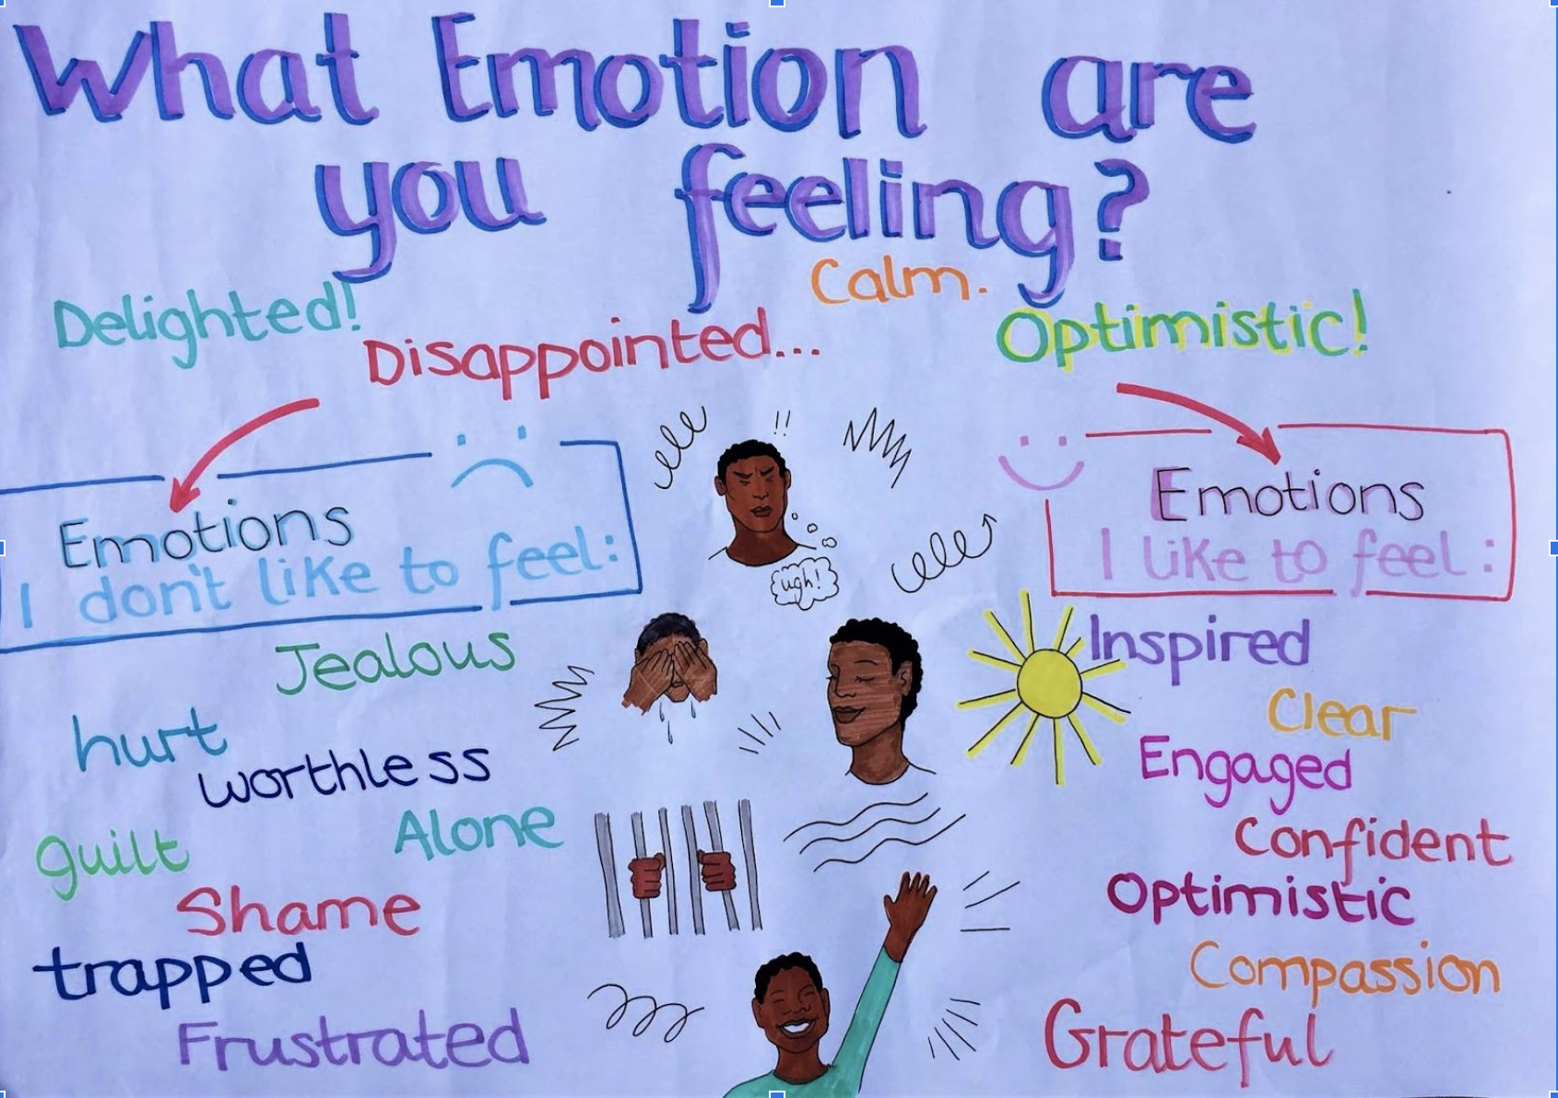
Notes:
We’re still analysing the data but this gives an indication of some of the baseline emotions expressed by the participants and the emotions they would like to feel instead.

Slide 17
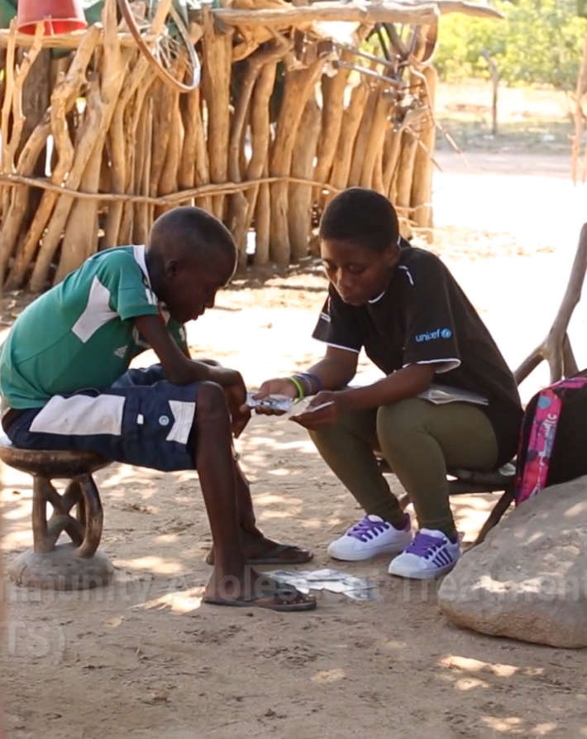
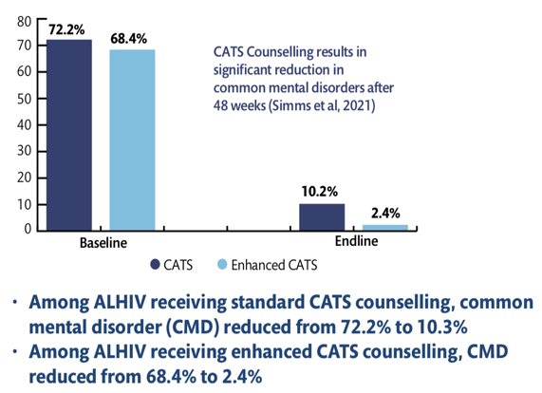
Results
Notes:
I want to tie all this together by emphasising the issue of mental health. We cannot separate stigma and mental health. When we provide effective mental health interventions, stigma is a key part of this.
These are the results from the Z-FB rial where 840 adolescents were randomised to standard CATS counselling or enhanced CATS counselling where CATS were trained in PST by FB. This counselling focused on the wide range of problems experienced by young people living with HIV, where stigma was a recurring theme. You can see both arms had significant improvements – among ALHIV receiving standard CATS counselling, CMD reduced from 72 to 10 % Among those receiving enhanced CATS counselling, CMD reduced from 68 – 2%. So in both arms, CATS were found to have a significant impact on young people’s mental health
As I mentioned at the beginning, experienced or perceived stigma is a key determinant of young people’s mental health. When CATS engage with their peers, they provide a safe, accepting space which helps to combat young people’s experience of stigma. So as mental health gains increasing attention worldwide, we need to be sure to include stigma within mental health interventions.

Slide 18
A message for us all from Zvandiri youth…..
Notes:
And to end, a few words from young people at Zvandiri. They produced this short film in response to a request from WHO and the international council of nurses so they are talking to nurses in particular, but their message is relevant for us all

Slide 19
Thank you

