Slide 1
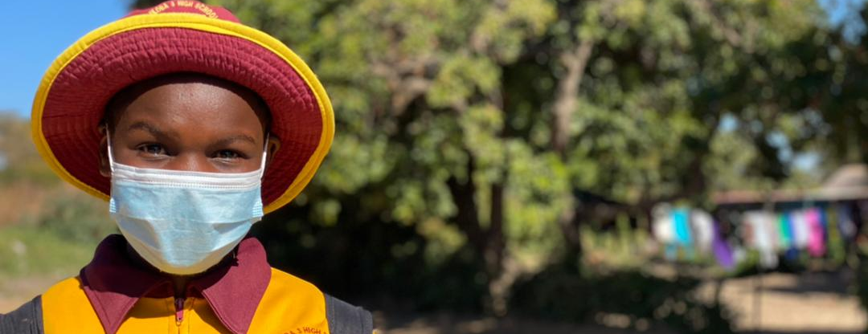
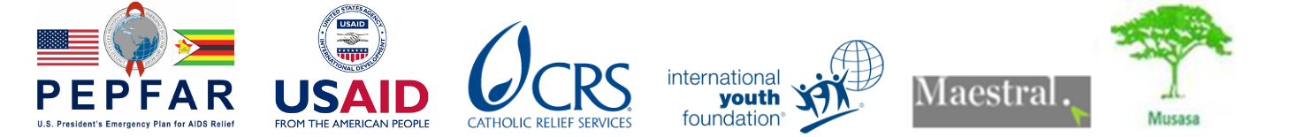
FCI New Foundations of Hope 2021 Webinar Series:
Children Affected by COVID-19
Dr. Farai Charasika
Chief of Party
Catholic Relief Services (CRS) Zimbabwe
25 August 2021
\

Slide 2





Project Overview
Pathways activities are implemented by 6 local implementing partners & 5 technical partners in 9 districts, across 4 technical domains and 1 cross cutting domain, resulting in a 62,481 clients served.
Educational subsidies (DREAMS) districts
Education stationery support
SCHOOLED
STABLE
Household Economic Strengthening
Savings & Internal Lending Communities
Child rights education
Gender based violence prevention & response
Positive parenting
SAFE
HIV Testing Services (referral)
HIV Care & Treatment including adherence
IMBC & Growth Monitoring (under 5s)
Social Behaviour Change (HIV prevention)
HEALTHY
CROSS CUTTING
Case Management
Local Organisations Capacity Building

Slide 3
Covid Patterns in Zimbabwe
Daily Positivity rate compared to SA
South Africa - Zimbabwe
3 waves to date (Jul 2020, Jan 2021, Jul 2021)
Total cumulative cases: 123,001
Total Recoveries: 107,759
Total deaths: 4,923
Case Fatality Rate: 3.5%
Total 1st vaccination: 2,345,343
Total 2nd vaccination: 1,483,048
Estimated Covid Orphans: 6,000¹
1. Based on modeling by LSHTM

Slide 4
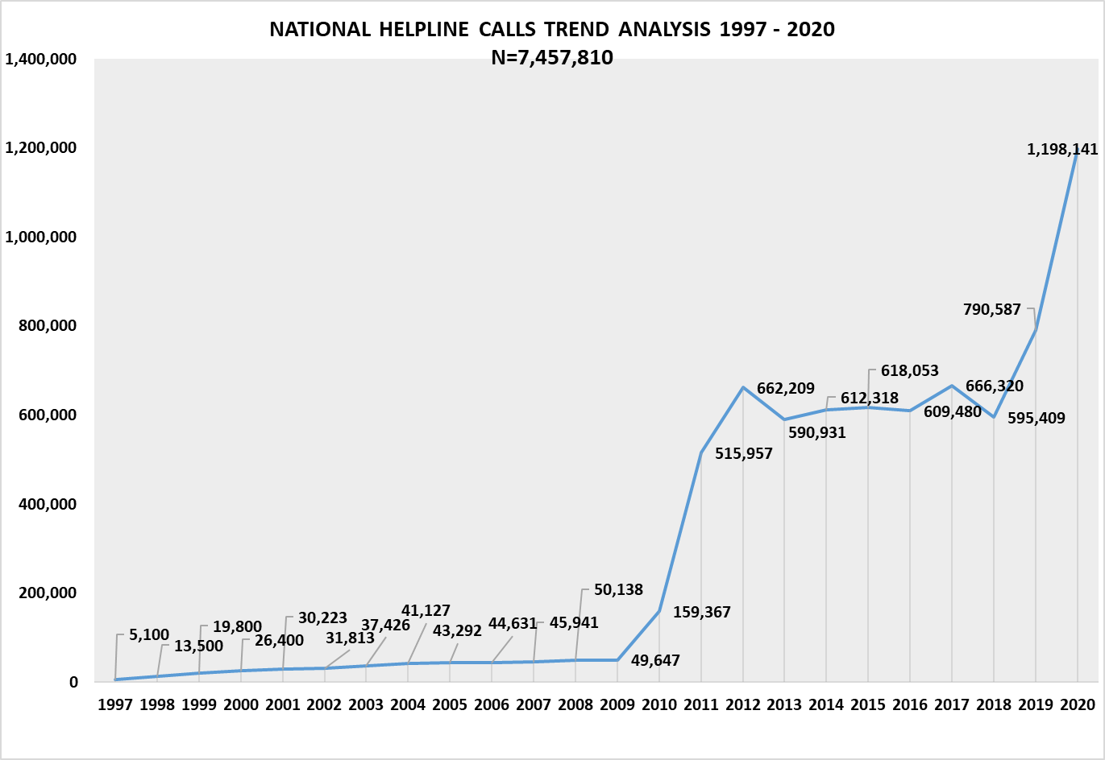
Through our partner Childline who runs a toll free 116 number, we have seen a major increase in the numbers of cases reported for GBV/VAC cases against children.
Gender Based Violence (GBV) and Violence against Children (VAC) Trends
Covid-19 has increased the extent to which children are exposed to Violence against children. The pandemic has created new risks for children, as well as increase the extent to which children are predisposed to existing risks. This has been due to the fact that the COVID-19 pandemic, has resulted in the shift in the socio-economic structure of most communities, with reduced incomes and also schools being closed during lock

Slide 5
Teenage Pregnancies, School Drop out & Child Marriages
Spike in teenage pregnancies during Covid period (data being collated but all programs have reported pregnancies in their cohorts of clients
Higher rates of school drop outs- children did not return after lockdowns lifted
Child marriage data still being collated (UNICEF)
National campaign against child marriages by all partners may have a mitigating effect
Greater media awareness on child marriages and the ongoing legislative reforms

Slide 6
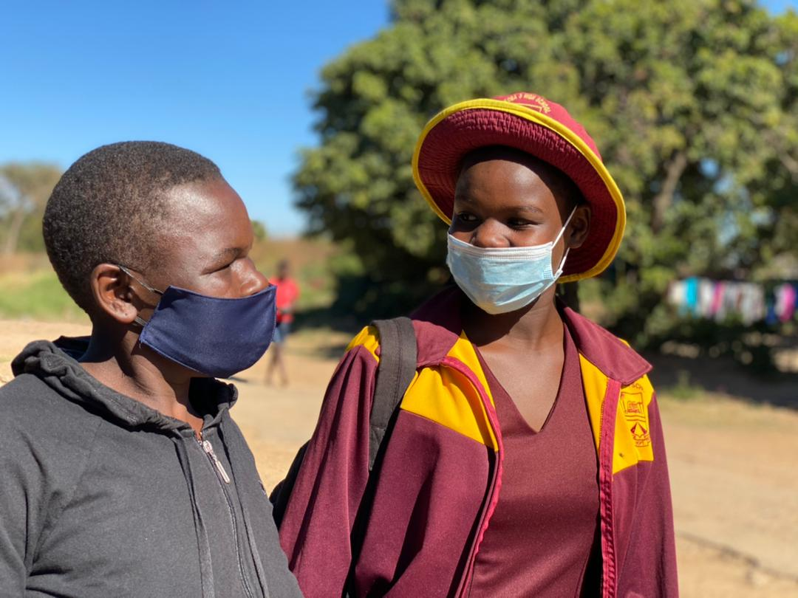
COVID Mitigation Strategies
Mitigating the Impact of Covid on Children & Families
We are working in 10 Districts where serve both OVC and DREAMS clients. Facilitators are supported by coaches virtually on a weekly basis.
Due to COVID-19 we are staying connected virtually with clients weekly through simple session format below.
Participants are being reached through phone calls, WhatsApp messaging and text messages have utilised their buddy system where there is erratic network. Some have formed WhatsApp groups.
At one-point fliers were sent out to hard-to-reach participants these were followed up by texts messages.
Facilitators buddy System for continuous capacity development of facilitators.
Weekly intensive virtual coaching session for facilitators and shadowing of coaches during coaching sessions.
Weekly updates on progress via WhatsApp groups to enhance monitoring.
Check in
Core Lesson principles
Home activity and Check out
Home activity Discussion

Slide 7
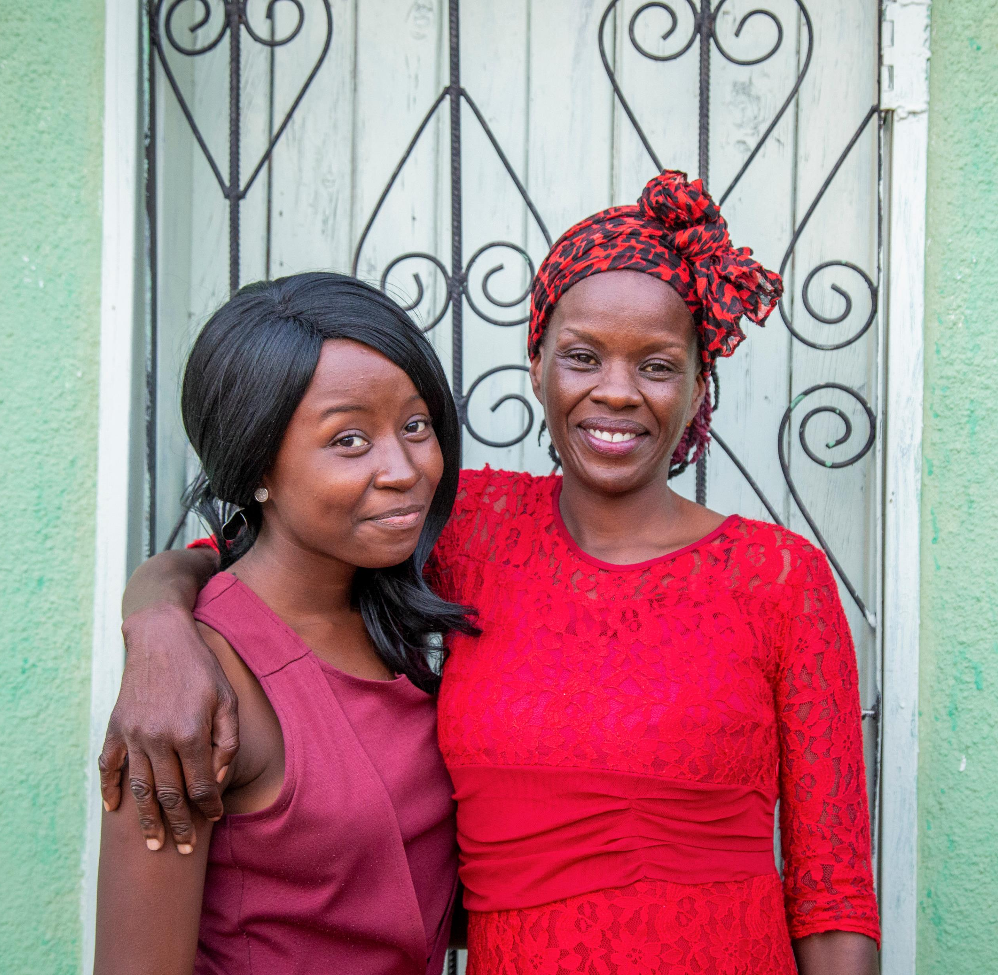
Gender Response and Prevention
Musasa is heavily relying on virtual counselling and legal service delivery with strict adherence to COVID-19 protocols for walk-in clients through the One Stop Centers and shelters: 14299 clients received post GBV services from March 2020 to July 2021
Shelter admissions are being done with a negative COVID-19 test result: 1 722 admitted in the 4 shelters from March 2020 to July 2021
GBV Prevention services
GBV Roadshows and Stop the bus campaigns were conducted in collaboration with the District Health and Ministry of Women Affairs authorities in all the districts: GBV Roadshows reach 3151 and Stop the Bus Campaigns reached 7776 from March 2020 to July 2021.
Community based GBV prevention activities including community dialogues and SASA! messaging were done with a limited number of people in smaller groups with strict adherence to COVID 19 regulations: Community dialogues reach 11 064 and SASA! Reach 11 797 from March 2020 to July 2021
Trainings and meetings
Some of the trainings and stakeholder meetings which were scheduled to be done physically were alternatively done virtually to protect both the participants and project staff.

Slide 8
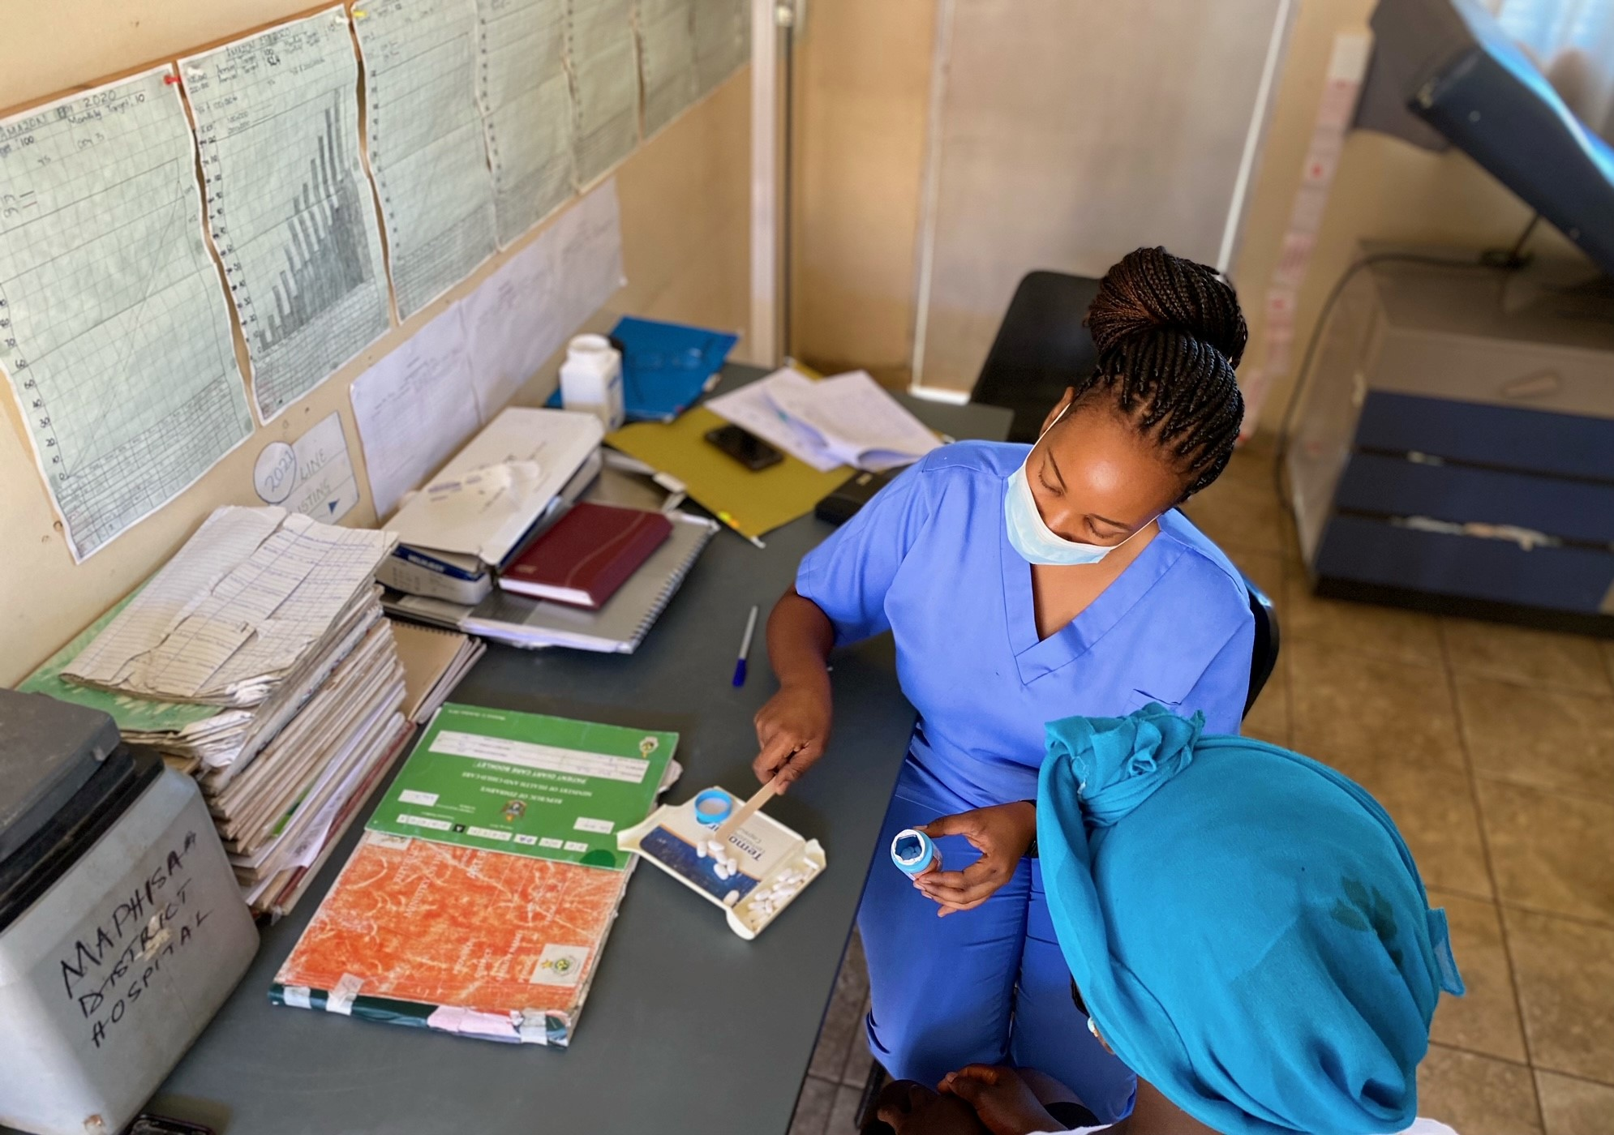
Health

Slide 9
Service Areas | Target Audience | Number of clients reached | Mode of Service delivery in COVID Context | Responsible persons
Adherence Support | PLHIV | CLHIV – 8825 ALHIV - 8097 | SMS, WhatsApp, HH visit, telephone calls | H.O., CCWs, VHW, POC, CMO
Treatment Literacy | PLHIV | CLHIV - 3956 | SMS, WhatsApp, HH visit, telephone call | H.O., CCWs, VHW, POC, CMO
Drug refill | PLHIV on ART | CLHIV – 8825 ALHIV - 8806 | Partnership with clinical partners & MoHCC to decongest HFs. MMD, FARGs, HH delivery of drugs, facilitate transport to HF for CARGs. | H.O., CCWs, VHW, POC, CMO
Disclosure Support | PLHIV with undisclosed HIV status | 609 CLHIV | Facilitate disclosure at HF, and HH visit by H.O, Zvandiri peer supporters | H.O., CCWs, VHW, POC, CMO
Facilitation to access VL bleeding | PLHIV | CLHIV – 8825 ALHIV - 8806 | SMS reminders, transport to HF | H.O., CCWs, VHW, POC, CMO
Facilitation to access HIV EID testing services | HIV exposed infants | HEI - 1333 | SMS and telephone call reminders, transport to HF | H.O., CCWs, VHW, POC, CMO
HIV risk assessment | Pathways clients at risk of HIV infection | 327 | Telephone calls, HH visit | H.O., CCWs, VHW, POC, CMO

Slide 10


