Slide 1
PEPFAR Faith and Community Engagement: Ending Stigma and
Discrimination
Susan Hillis, PhD, MS
Senior Technical Advisor, PEPFAR
Faith and Community Engagement
and Inter-agency Team

Slide 2
Faith-based Organizations (FBOs) and Faith Communities have been strong PEPFAR partners since 2003. The majority of populations in Southern and Eastern Africa – 75-93%, view faith leaders very influential. Ongoing engagement with faith and community leaders will become increasingly strategic in closing gaps in HIV epidemic control.

Slide 3
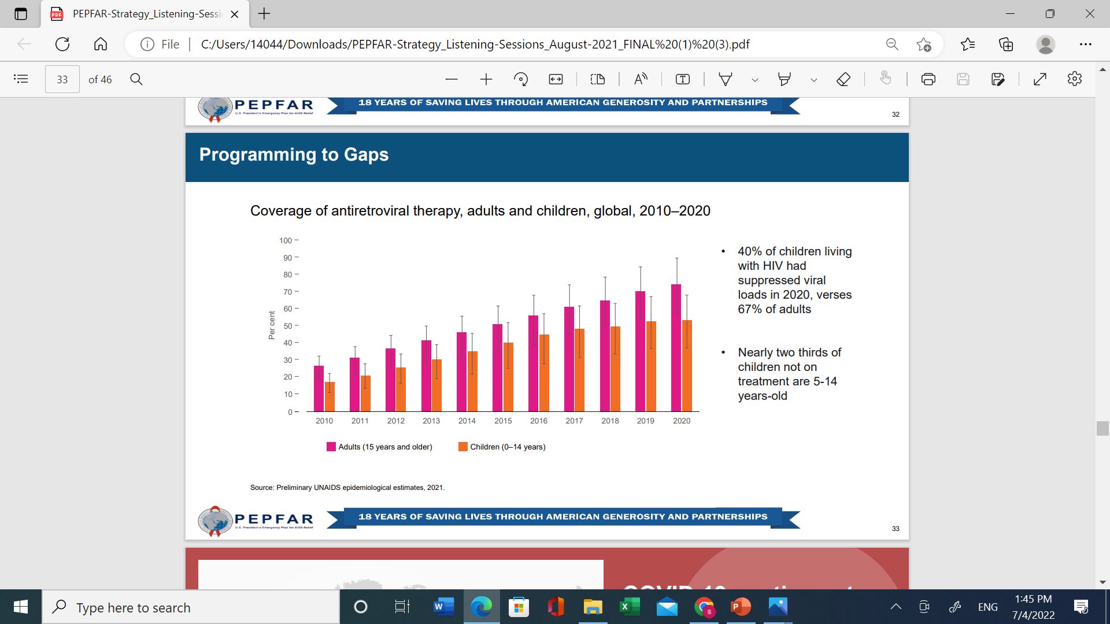
FBOs and Faith Community Leaders can Help Solve Challenges for Sustaining Epidemic Control: VLS gaps for men and children
Antiretroviral Therapy Coverage, Children Versus Adults
VLS: 40% in Children vs 67% in Adults, 2020
*Not at Epidemic Control

Slide 4
Faith communities and trusted leaders are vital assets, who shape community responses to HIV and other pandemics, because they have:
  expertise in combatting stigma
  trusted access to families and communities
  influential social capital
  expertise and venues for decentralized care

Slide 5
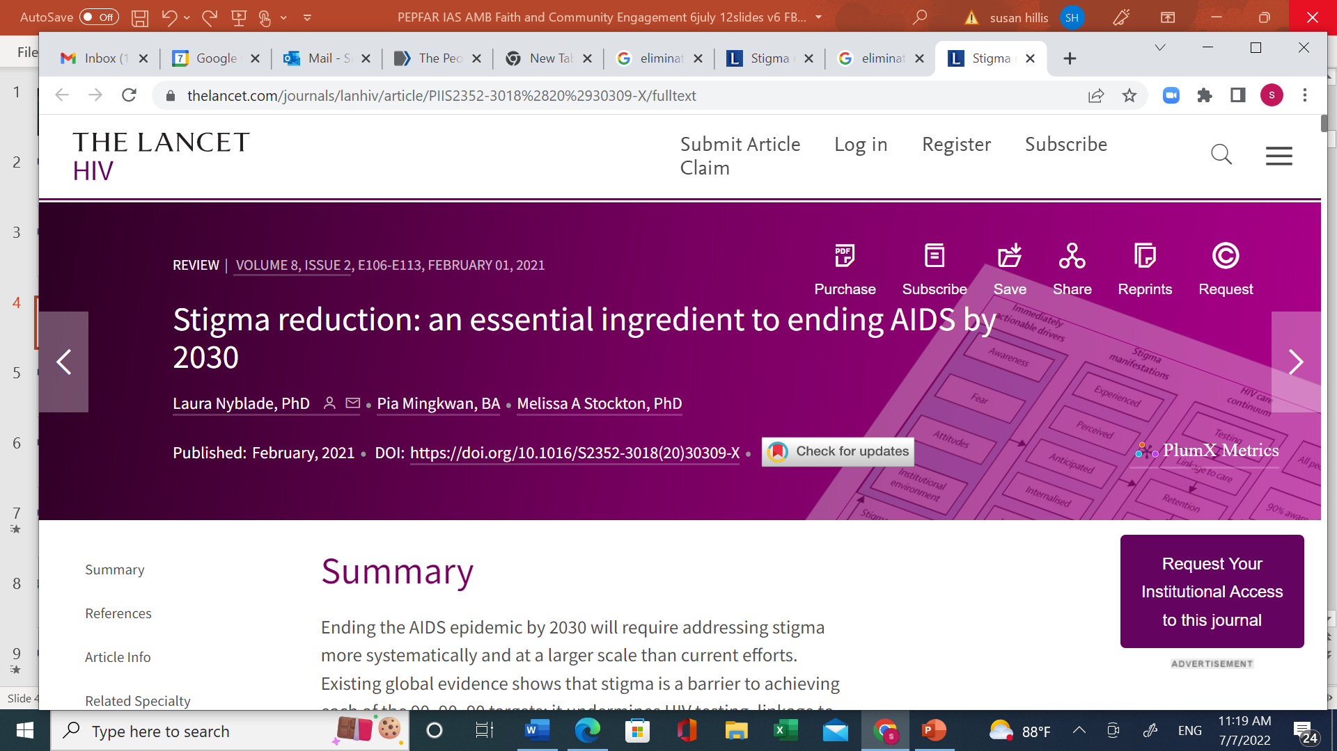

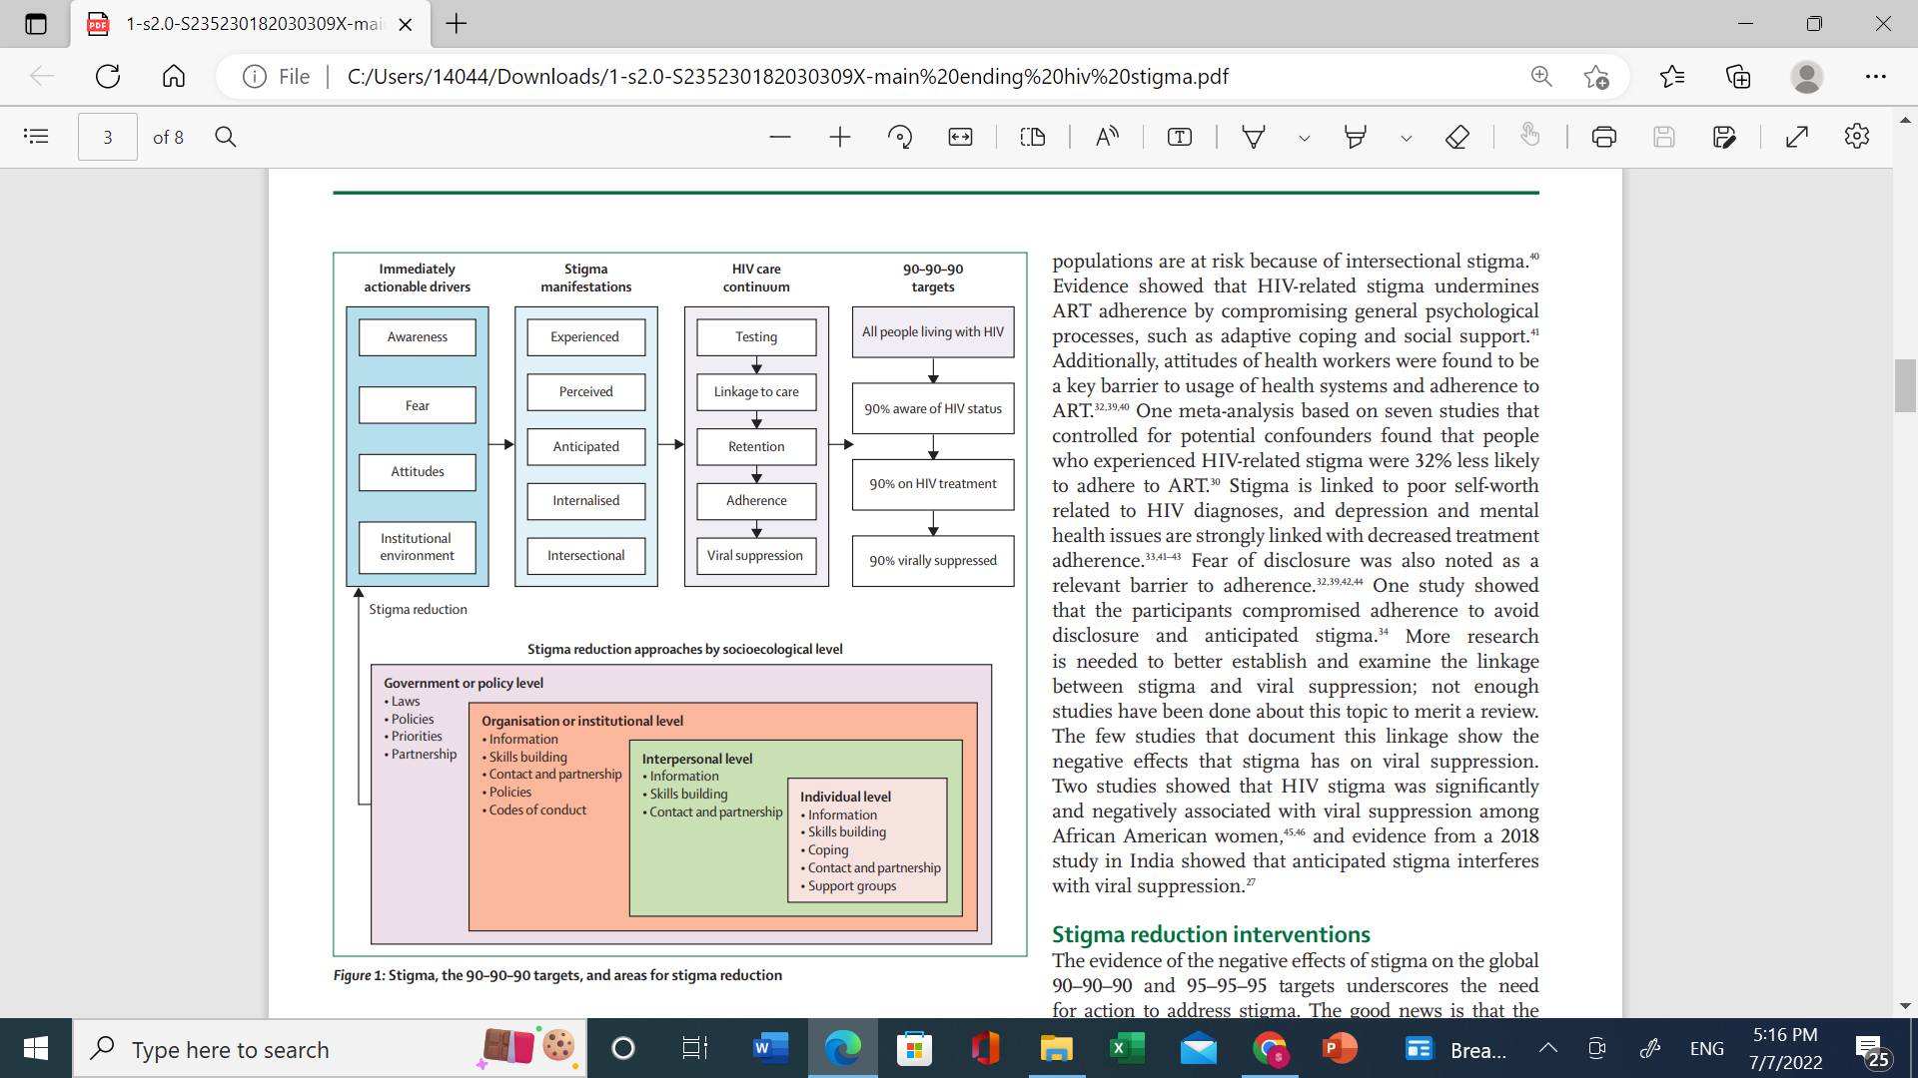
PEPFAR FBO Partners Support Interventions that Reduce Stigma:-
Links between Drivers, Stigma, HIV Care Continuum, and Targets
Information-based approaches
Skills building approaches
Counseling approaches
Contact and Partnership approach
Notes:
Panel 1: Types of stigma • Experienced stigma: actual experienced or enacted interpersonal acts of discrimination • Perceived stigma: perceptions of the prevalence of stigmatising attitudes in the community and among health-care providers • Witnessed stigma: hearing stories or witnessing events of how stigmatised individuals have been mistreated • Anticipated stigma: the fear or expectation that one will experience stigma • Internalised stigma: taking on (internalising) experienced or perceived stigma and accepting it as just and true • Intersectional stigma: convergence of multiple stigmatised identities within a person or group, or intersecting of stigmas experienced by individuals who are part of multiple marginalised group

Slide 6
The PEPFAR Faith and Community Initiative supports innovations for epidemic control by addressing stigma & discrimination against women, children, youth, young men, and key populations. Model COP22 FCI programs are:
  high-performing
  replicable
  scalable
  people-centered

Slide 7


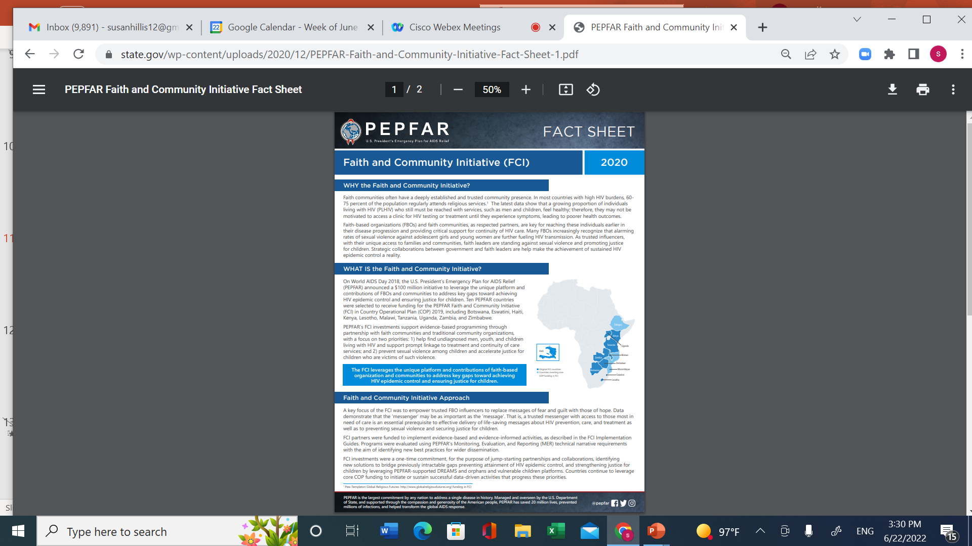
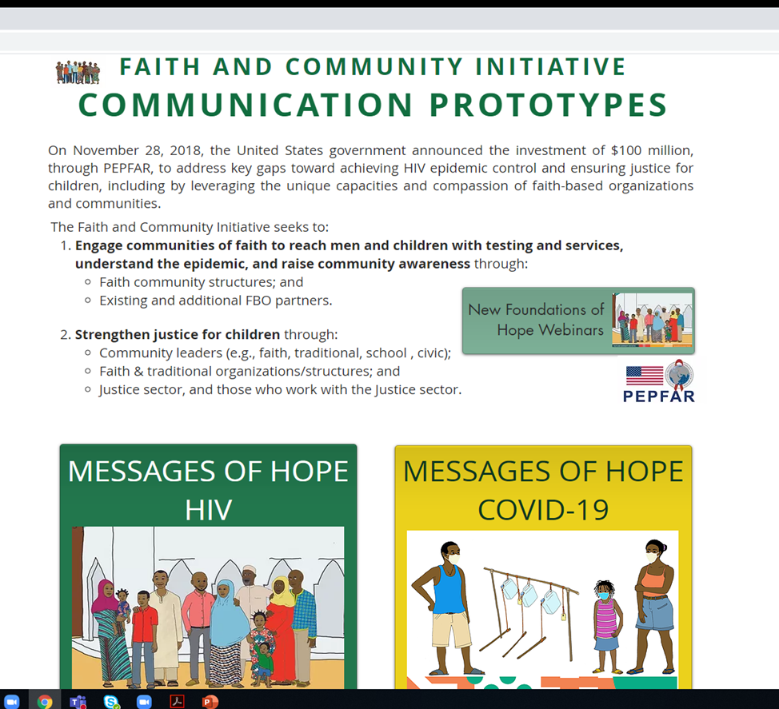
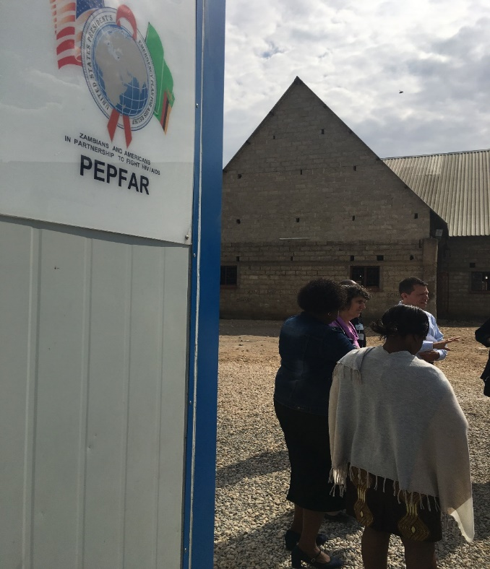
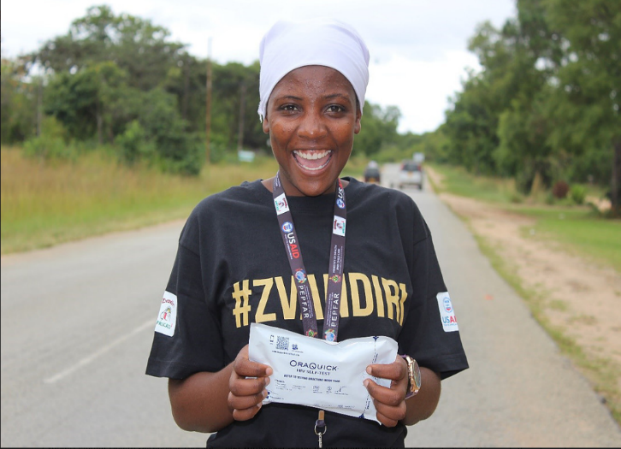
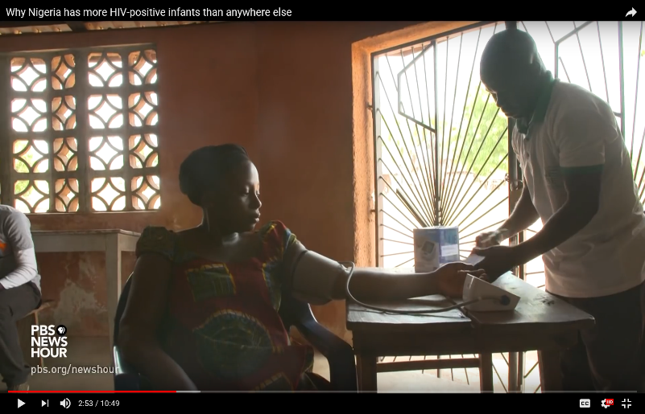
COP22 – PEPFAR Supports FBO Solutions for Linking Men & Children to Care, Strengthening Continuity, and Advancing COVID-19 Response
Faith-Engaged Community Posts
Faith-Engaged Highly Targeted HIV Self-Testing
Maximizing Same Day
Initiation
Colocation of Faith
Site and clinic
Community Adolescent Treatment Supporters
Baby-Shower
Initiative
Notes:
Tell Kenya story

Slide 8
Sustaining, replicating, and partnering for
effective FBO and community programming that eliminates stigma and discrimination,
will be essential for
sustaining epidemic control
and
protecting global health security

Slide 9
Leveraging Inter-Faith Community Structures for Messages, Models and Data to Sustain HIV Gains and Advance Global Health Security
Inter-Faith Steering Committees in 10 Countries Disseminate Messages of Hope for HIV and COVID-19, from National to Local Levels, 2019-2021
Faith and Community
Initiative Leads
Nazarenes,
Lutherans, Council of Churches
Episcopal/ Anglican/
Catholic Conference
Youth Faith Leaders
Islamic Supreme Council
Consortium of Concerned
Church
Leaders
SEMINARIES
Zionists
Churches
Churches
Churches
Mosques
Mosques
Congregations
Affiliated
Churches
Schools

Slide 10
THANK YOU

