Slide 1
PEPFAR Faith and Community Engagement: UNAIDS Prevention Roadmap
Susan Hillis, PhD, MS
Senior Technical Advisor, PEPFAR
Faith and Community Engagement
and Inter-agency Team

Slide 2
UNAIDS Global HIV/AIDS Targets for 2025

Slide 3
UNAIDS HIV Prevention Roadmap 2025

Slide 4
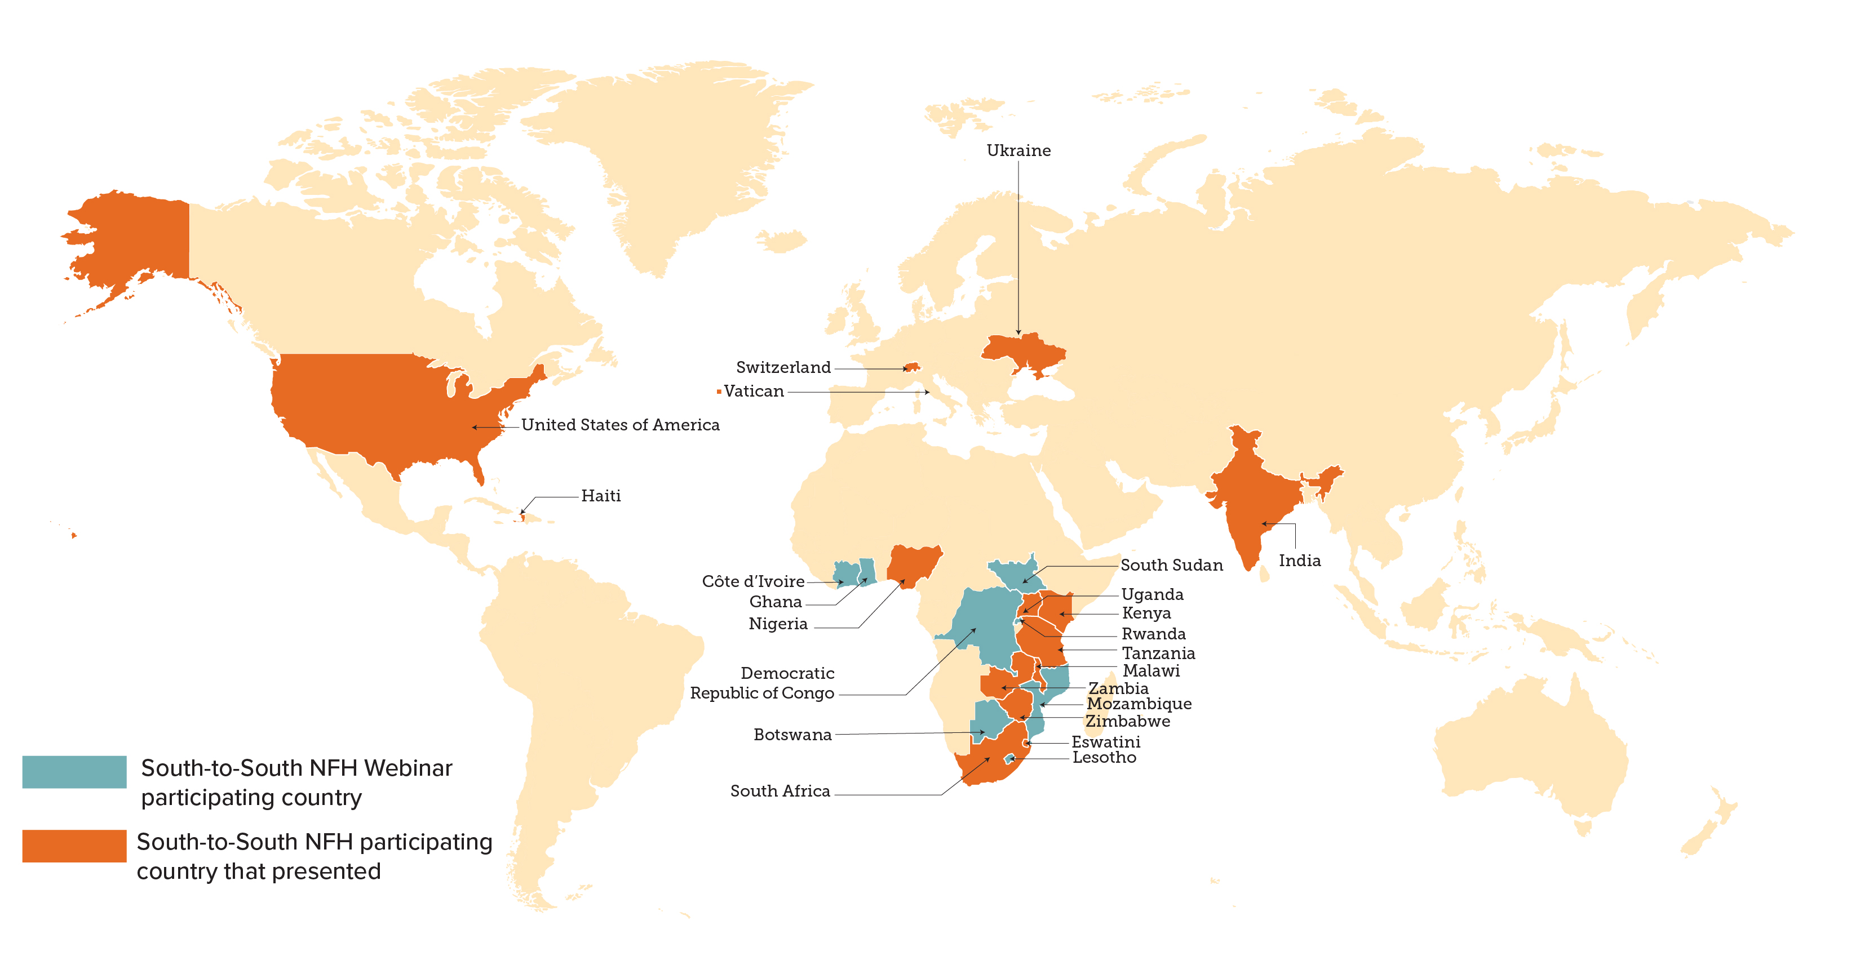
South-to-South Faith and Community Partnerships: Strategic for Sustaining Epidemic Control and Protecting Global Health Security Security
‘New Foundations of Hope’ (NFH) learning community through webinars
22 interactive monthly webinars since April 2020
425 faith and community leaders engaged – in faith infrastructures and media networks raising awareness for over 35 million people
23 countries represented
1,871 person-sessions total
Partnering across NGOs, FBOs, CSOs, UNAIDS, Faith Alliances, bilaterals, multilaterals, country governments
97% of participants used what they learned to improve programming

Slide 5
THANK YOU

