Slide 1
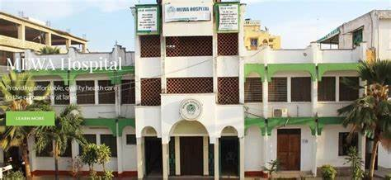
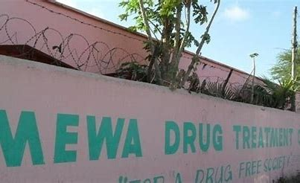
IMPROVING HIV CASCADE IN MEN USING DRUGS
Muslim Education And Welfare Association (MEWA)
Presented by: Abdalla Badhrus
Program Director MEWA Harm Reduction Programs
Mombasa, Kenya

Slide 2
EFFECTIVE TREATMENT CASCADE
MEWA’s first step in the treatment cascade for individuals who are living with HIV is to be diagnosed and made aware of their status.
MEWA’s effective testing programming enables those who are unaware of their status to test for HIV then be linked to HIV care and treatment.
It also enables those who are particularly at risk of HIV to test and be linked to treatment if they test positive, or prevention services.
HIV testing programmes focus on reaching people living with HIV who are unaware of their status, or those at a heightened risk of acquiring HIV, and are critical to an effective HIV response.

Slide 3
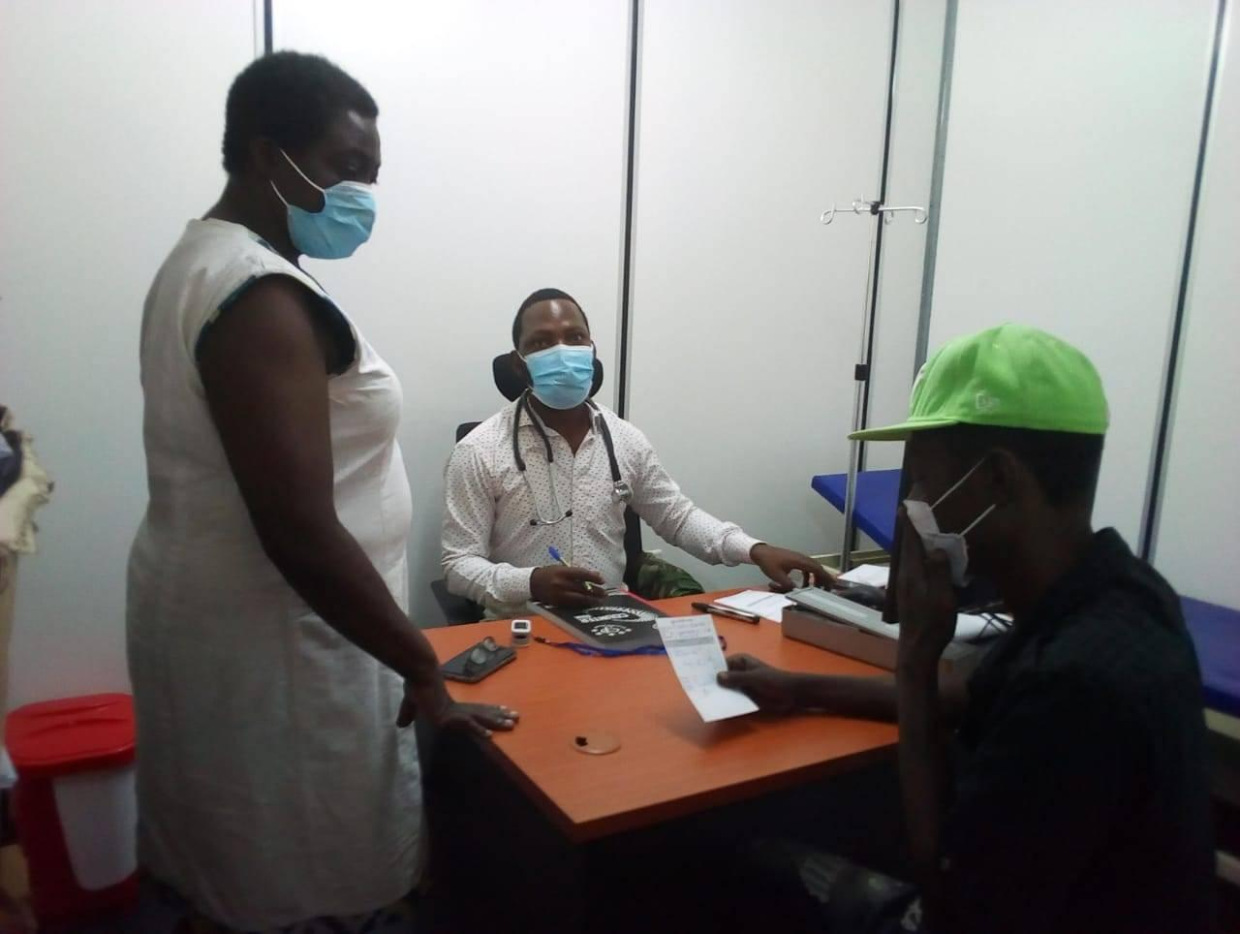
Strategies- 1st 90
Outreaches at the hotspot on daily basis i.e. provide health education, build rapport/trust, sensitize on importance HIV testing and prevention.
Using partner notification through spouses/partners.
Distributing HIV self-test kits both at the community and facility level, also distributing through partners.

Slide 4
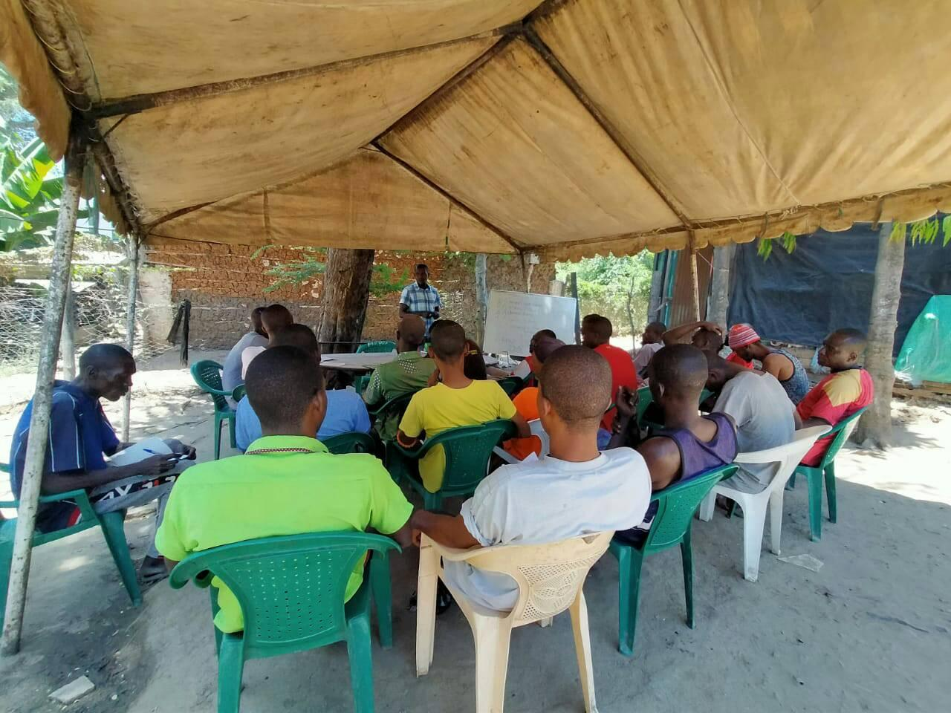
Strategies- 1st 90 cont.
Risk counseling on risk behavior and testing on quarterly basis.
HIV campaign at the community through dissemination of information and moonlight testing.

Slide 5
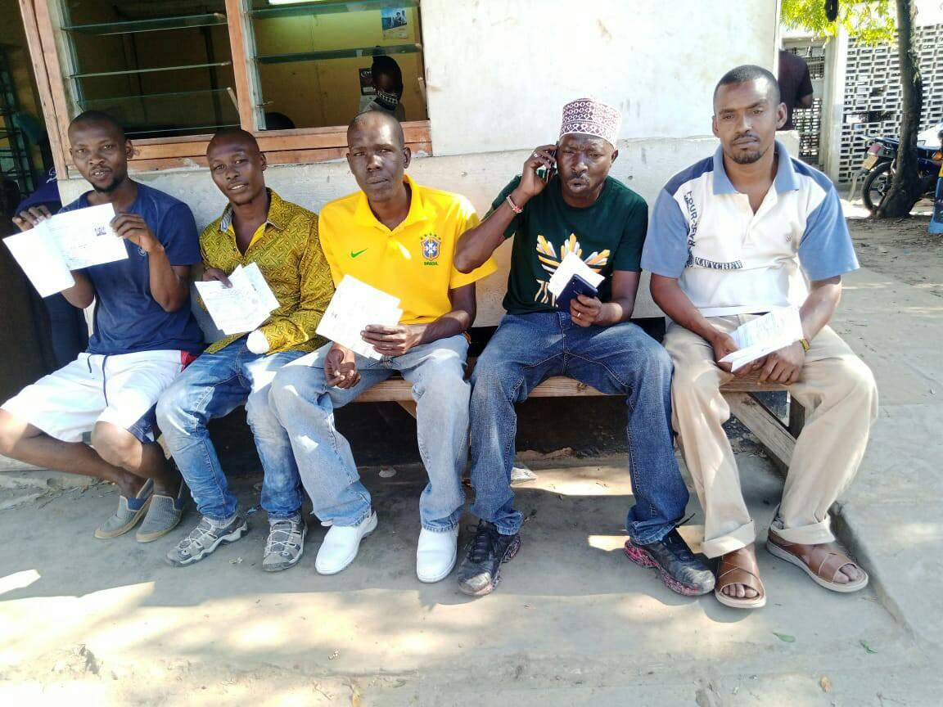
2nd 90
Adherence support counselling
ART
Viral load monitoring @ 6, 12 months
Couples counselling
Assisted partner notification services
Rehabilitation for those with poor adherence

Slide 6
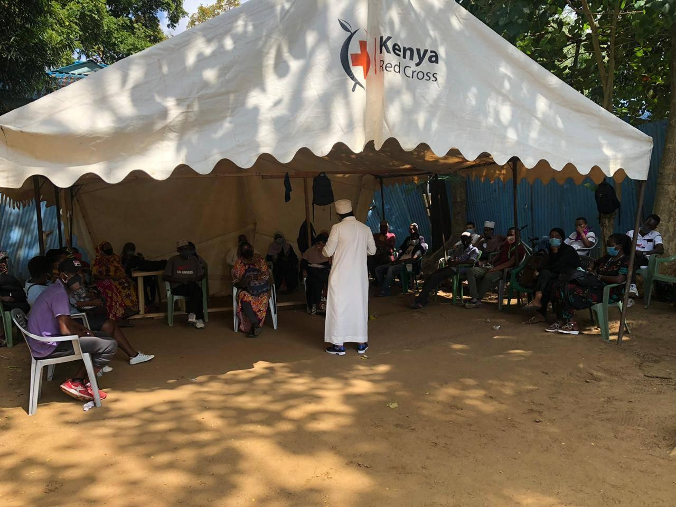
3rd 90
Multidisciplinary meeting for those with high viremia
Enhanced adherence counselling
Directly observed therapy for high viremia
Support group

Slide 7
ACHIEVEMENTS
Known HIV positive: 115 (M-61, F-54)
100% of clients known their HIV status.
100% discordant couples are on PrEP with good adherence.
98% PLHIV are on ART with good adherence.
98% have achieved viral suppression

Slide 8
CHALLENGES
Shortage of HIV testing kits
Shortage of viral load reagents
Clients change of hotspots
Clients not adherent to Covid-19 protocols

Slide 9
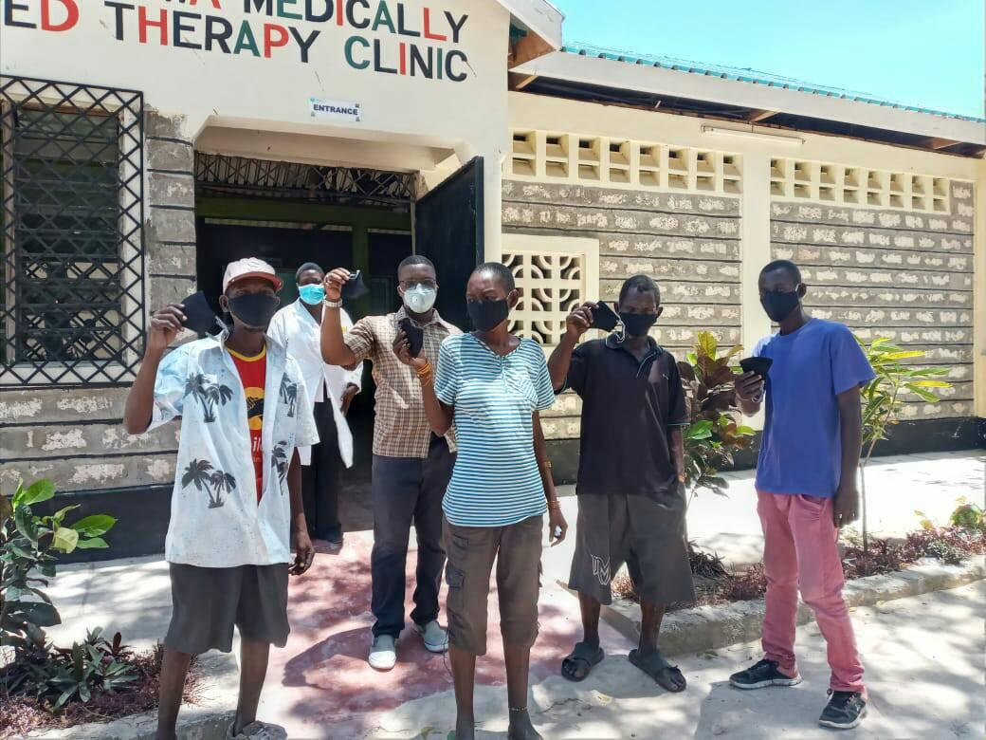
Thank you

