Slide 1
COVID-19 Parenting Tips Impact Zambia and Malawi Report
Remmy Hamapande, Zambia Country Director
Stephen Rodgers Modjeza, Malawi Country Director

Slide 2
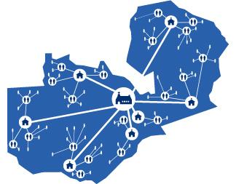
Zambia: Early situation of Covid-19
Panic, stress and fear about uncertain future, loss of employment, school closures, shortages of basic goods
Challenges and struggles of how to cope with stress and increased gender violence
Not knowing how to relate with children outside the normal routine

Slide 3
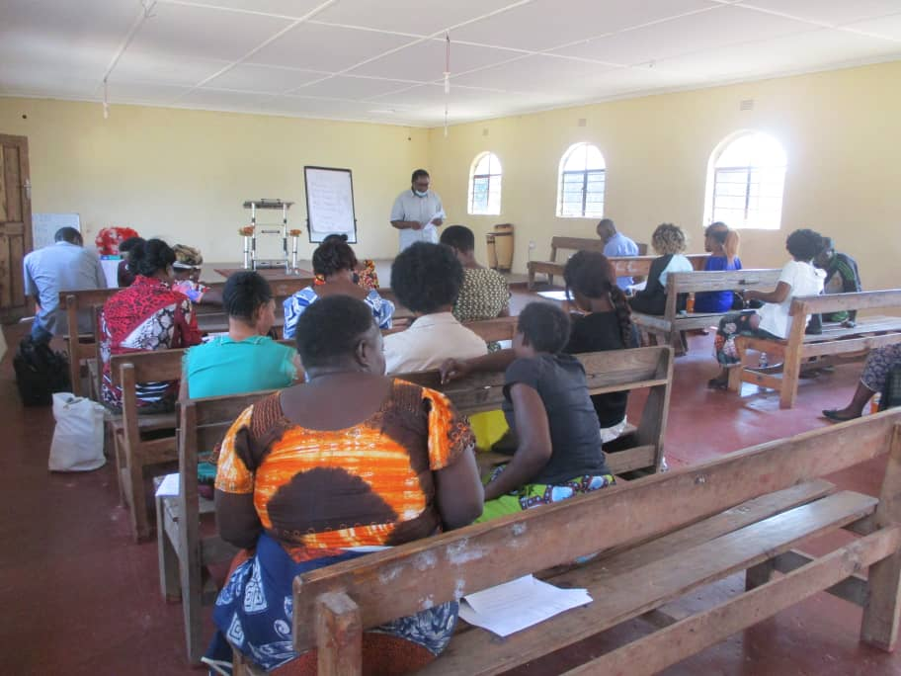
Zambia: Parenting Tips info dissemination
Through existing partner churches
Online Platforms – WhatsApp
In person instruction- hard copies
Radio

Slide 4
Zambia: Impact
Parenting Tips were shared with:
23 partner churches reaching 5750 Households (online, in-person)
3 million caregivers/parents via radio
Evaluation: Standard questionnaire from Parenting for Lifelong Health:
Random Sample of 267 Households

Slide 5
Zambia: Quotes from Caregivers
One parent testified to how it had been difficult for him to relate with his children on seemingly simple life issues. Now he starts the day engaging his children in conversation. Asking things like, ‘what do you have lined up for the day?’ to better connect with them.
Another conceded to how much time he had lost by not building a thriving relationship with his children and soon the couple will have an empty nest. He said, “I am enjoying every moment I am having with my children and I can’t imagine how time has gone, my babies will soon leave home”

Slide 6
Malawi: Situation on the Ground
Parents were not prepared for this crisis
Need to care for the caregiver
Gaps in parenting skills
Culture of silence
Increase in violence against children
Partner churches not equipped to support families

Slide 7
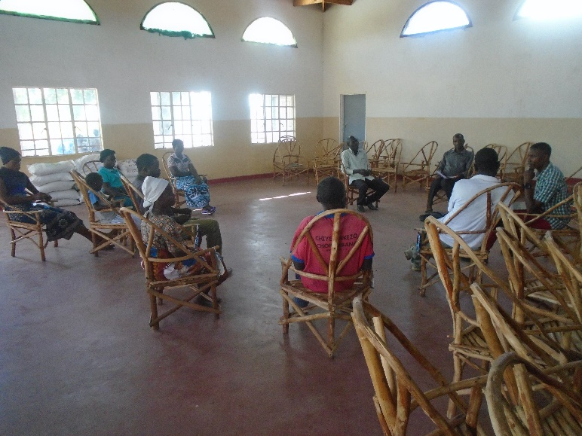
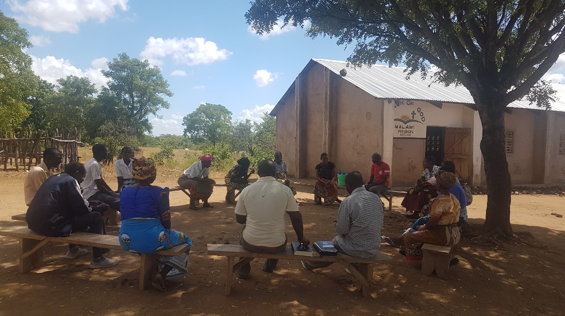
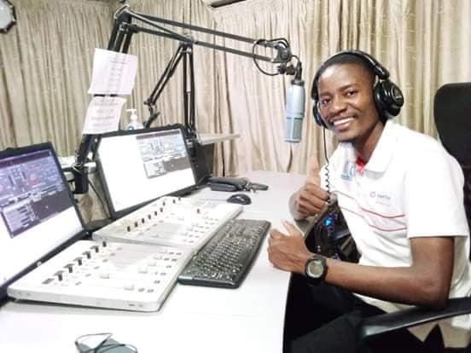
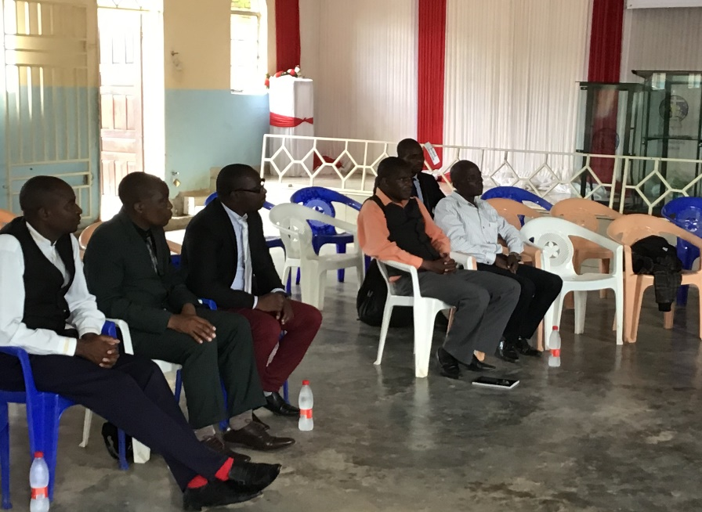
Malawi: How we used the Parenting Tips
Christian
Radio Station
Small groups
Church and community leaders
Pastors Fraternities
WhatsApp Groups
Home visits

Slide 8
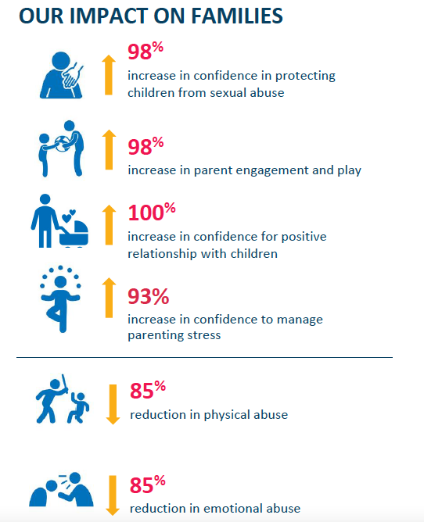
Malawi: Impact
Parenting Tips were shared with:
2 700 Households through local church partners (online, in-person)
8 million people via radio
Evaluation: Standard questionnaire from Parenting for Lifelong Health:
Random Sample of 40 households

Slide 9
Malawi: Quotes from Caregivers
“It's like I never knew how to parent. I could easily get disappointed, and charge at my children. As a result, they were failing to express themselves. But now, it is just coming naturally, the smiles and laughter- and a number of people have admired my style of parenting. To me, it has been this idea of not just reading them, but, being able to see- one by one, how the tips are making a difference in the life of my family. I really needed these tips."
"I feel what I learnt opened my eyes not just to apply it on my own biological children, but also to challenge members I am serving at church. As a parent, I have been able to sit down with my children, and they have noticed an improvement in my parenting and listening."

Slide 10
Looking to the Future
We will support the local church by continuing to share:
Parenting Tips: A guide for church leaders
COVID-19 Parenting Tips with other evidence-based tools to empower caregivers and parents so that every child will experience the love and security of a family, church and community through our ministry in southern Africa

