Slide 1
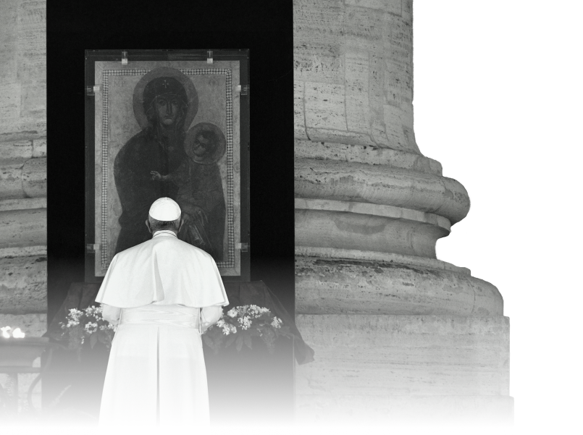
Prepare the Future: A Broader View
Vatican Efforts to Address COVID-19 and Ensure Equitable Access to Vaccines
by Mons. Robert J. Vitillo Member, Economy Task Force, Vatican COVID-19 Commission
at FCI-NFH Webinar 27 January 2021
Notes:
The above photo is emblematic of the Vatican’s handling of mass gatherings during the time of COVID-19 – the scene is in St. Peter’s Square 28 March 2020, when Pope Francis “An Extraordinary Prayer in the Time of Pandemic.” He appeared alone in the site where crowds numbering in many thousands normally gather for such events.
He took similar measures during the Easter and Christmas celebrations which had very limited participation at St. Peter’s Basilica (which again usually attracts thousands) and, on those occasions, delivered his “Urbi et Orbi” (“To the the City of Rome and to the World”) Addresses virtually, instead of from the Balcony of St.Peter’s Basilica.
During the summer, his weekly audiences in St. Peter’s Square also were transferred to virtual broadcasts from the Vatican Library with him appearing alone at a lectern. During July and August, he dedicated these broadcasts to COVID-19 and focused on the mutual caring expected from all believers and encouraged solidarity with those most in need and exemplified the social distancing and care through his own behaviour. He also focused a great deal on appealing for universal access to affordable treatment and vaccines. He stressed those same issues in his bilateral discussions with Heads of State and with the UN Secretary General and Heads of Multi-lateral Agencies who have sought his counsel during the these difficult times.

Slide 2
On 20 March 2020, Pope Francis asked the Dicastery for Promoting Integral Human Development (DPIHD) to create a Commission, in collaboration with other Vatican Offices and Catholic-inspired organizations, to express the Catholic Church’s care for the whole human family facing the COVID-19 pandemic, including analysis, reflection, and proposal of new approaches related to the new socio-economic and cultural future.
Five Working Groups were established to examine the following priority themes: acting now for the future; looking to the future with creativity; communicating hope; seeking common dialogue and reflections; supportive care.
Notes:
The above photo is emblematic of the Vatican’s handling of mass gatherings during the time of COVID-19 – the scene is in St. Peter’s Square 28 March 2020, when Pope Francis “An Extraordinary Prayer in the Time of Pandemic.” He appeared alone in the site where crowds numbering in many thousands normally gather for such events.
He took similar measures during the Easter and Christmas celebrations which had very limited participation at St. Peter’s Basilica (which again usually attracts thousands) and, on those occasions, delivered his “Urbi et Orbi” (“To the the City of Rome and to the World”) Addresses virtually, instead of from the Balcony of St.Peter’s Basilica.
During the summer, his weekly audiences in St. Peter’s Square also were transferred to virtual broadcasts from the Vatican Library with him appearing alone at a lectern. During July and August, he dedicated these broadcasts to COVID-19 and focused on the mutual caring expected from all believers and encouraged solidarity with those most in need and exemplified the social distancing and care through his own behaviour. He also focused a great deal on appealing for universal access to affordable treatment and vaccines. He stressed those same issues in his bilateral discussions with Heads of State and with the UN Secretary General and Heads of Multi-lateral Agencies who have sought his counsel during the these difficult times.

Slide 3
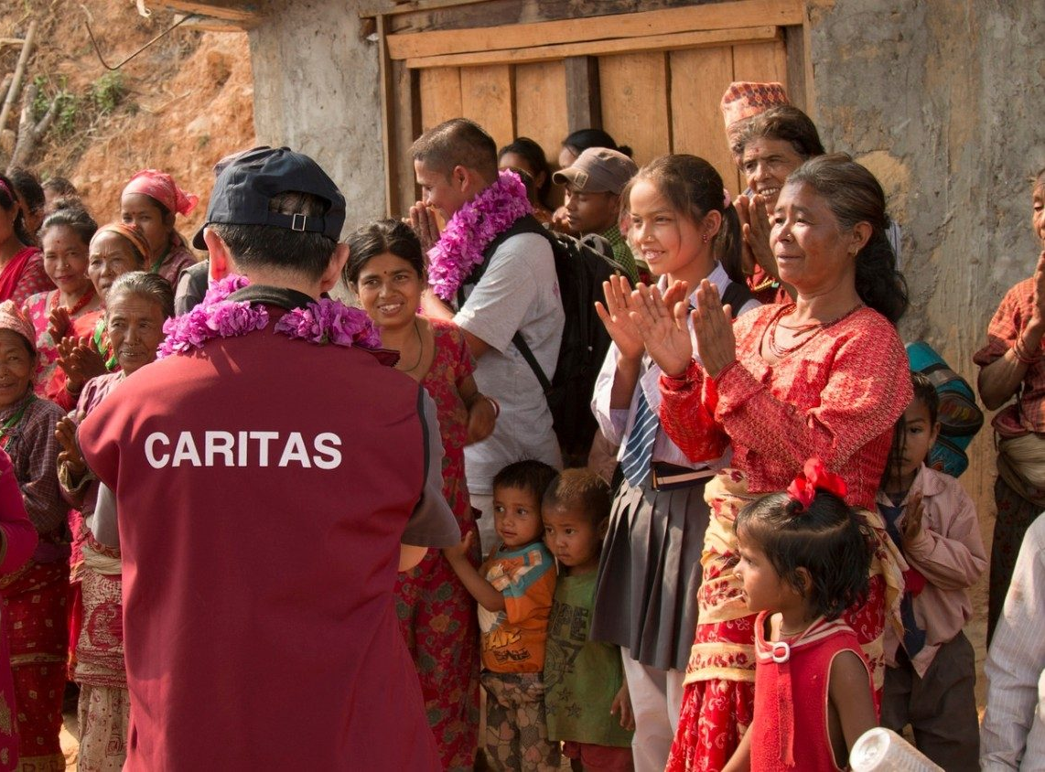
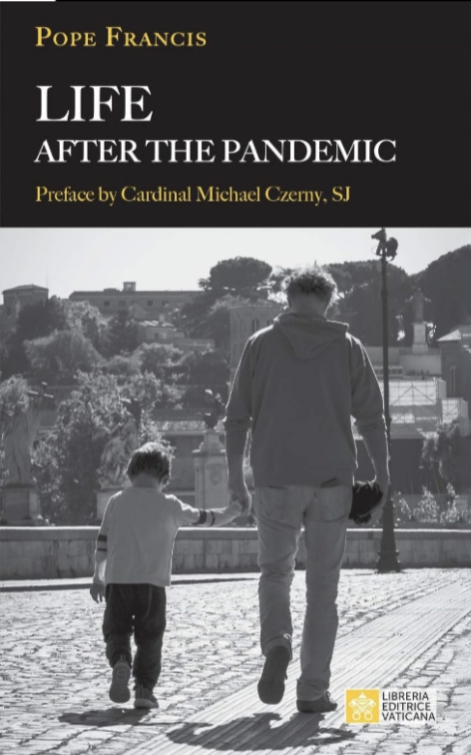
Sample 4
2020 annual report – a lot accomplished!
LISTENING AND RESPONDING TO LOCAL LEADERSHIP
200+ Reports from local voices
40+ projects funded around the world
525M reached
$6M mobilized
SUPPORTING DIPLOMACY AND GLOBAL RELATIONS
31 weekly, multi-language bulletins
Dozens of diplomatic inputs
Refreshed engagement for UNGA, G20, TED, and WEF
COCREATING INTEGRAL, CREATIVE SOLUTIONS
50+ External partners
150+ Analyses papers to inform local and global action
BUILDING A PIPELINE OF RESOURCES
7M Euro
1M US
2.4M € for local projects
SHINING A LIGHT ON GOOD WORKS
Hundreds of media outputs on multiple platforms
Dignity in work and the jobs of the future, today
From one to many, new structures for the common good
Governance, peace and security, at the heart of global solidarity
Rebalancing social systems with nature in the wake of COVID-19

Slide 4
Vatican’s 20 Points Document on COVID-19 Vaccines
In December 2020, the Vatican COVID-19 Commission and the Pontifical Academy for Life issued a joint paper addressing the issues and priorities arising at the various stages of the vaccine journey, from research and development to patents and commercial exploitation, including approval, distribution and administration.
The paper reiterates the critical role of vaccines to defeat the pandemic, not just for individual personal health but to protect the health of all.

Slide 5
Vatican’s 20 Points Document on COVID-19 Vaccines
World leaders are reminded that vaccines must be provided to all fairly and equitably, prioritizing those most in need.
Echoing Pope Francis’ recent Urbi et Orbi Christmas Message, it calls on world leaders to resist the temptation to participate in “vaccine nationalism”, urging nations and companies to cooperate – not compete – with each other.
Cardinal Turkson, head of the Dicastery for Promoting Integral Human Development (DPIHD), who also leads the Commission said, “We are grateful to the scientific community for developing the vaccine in record time. It is now up to us to ensure that it is available to all, especially the most vulnerable. It is a matter of justice. This is the time to show we are one human family.”

Slide 6
Vatican’s 20 Points Document on COVID-19 Vaccines
“The interconnectedness that binds humanity has been revealed by the COVID-19 pandemic. Together with the Commission, we are working with many partners to reveal lessons the human family can learn and to develop an ethics of risk and solidarity to protect the most vulnerable in society”. -Archbishop Vincenzo Paglia, President of the Pontifical Academy for Life
“We are at a turning point in the COVID-19 pandemic and have an opportunity to start to define the world we want to see post-pandemic.” -Mons. Bruno-Marie Duffe, Secretary, DPIHD
“The way in which vaccines are deployed - where, to whom, and for how much - is the first step for global leaders to take in committing to fairness and justice as the principles for building a better post- COVID world.”
Father Augusto Zampini, Adjunct Secretary, DPIHD

Slide 7
Vatican’s 20 Points Document on COVID-19 Vaccines: Some Special Issues
On the concern that cell lines of aborted babies were used in research and development of the vaccines, the document quoted previous teaching of the Vatican’s Congregation for the Doctrine of the Faith:
“We believe that all clinically recommended vaccinations can be used with a clear conscience and that the use of such vaccines does not signify some sort of cooperation with voluntary abortion. While the commitment to ensuring that every vaccine has no connection in its preparation to any material originating from an abortion, the moral responsibility to vaccinate is reiterated in order to avoid serious health risks for children and the general population.”

Slide 8
Vatican’s 20 Points Document on COVID-19 Vaccines: Some Special Issues
On the issue of Vaccine patents: “it is appropriate to consider the vaccine as a good to which everyone should have access, without discrimination, according to the principle of the universal destination of goods highlighted by Pope Francis”
On the moral responsibility of undergoing vaccination: ‘this issue also involves the relationship between personal health and public health, showing their close interdependence. In the light of this connection, we consider it important that a responsible decision be taken in this regard, since refusal of the vaccine may also constitute a risk to others.’

Slide 9
Vatican’s 20 Points Document on COVID-19 Vaccines: Some Special Issues
The Church at the service of “healing the world”:
“Leading by example in ways that are clear and contribute significantly, among other things, to achieving the goal of equitable distribution of vaccines and treatments ... Creatively use the voices of the Church worldwide to speak, exhort and contribute to assuring that quality vaccines and treatments are available to the global family, especially the vulnerable.”
NOTE: Pope Francis made it clear in a recent television interview that he had put his name on the list for vaccinations by the Vatican Health Service – both he and Pope Emeritus Benedict XVI were vaccinated already. Pope Francis also ordered the Health Service to begin vaccinations of homeless people receiving help in the area surrounding Vatican City.

