Slide 1
Africa cdc Vaccine strategy
COVID-19 STTT
Nicaise Ndembi, PhD
Head, Science Office
January 11, 2021

Slide 2
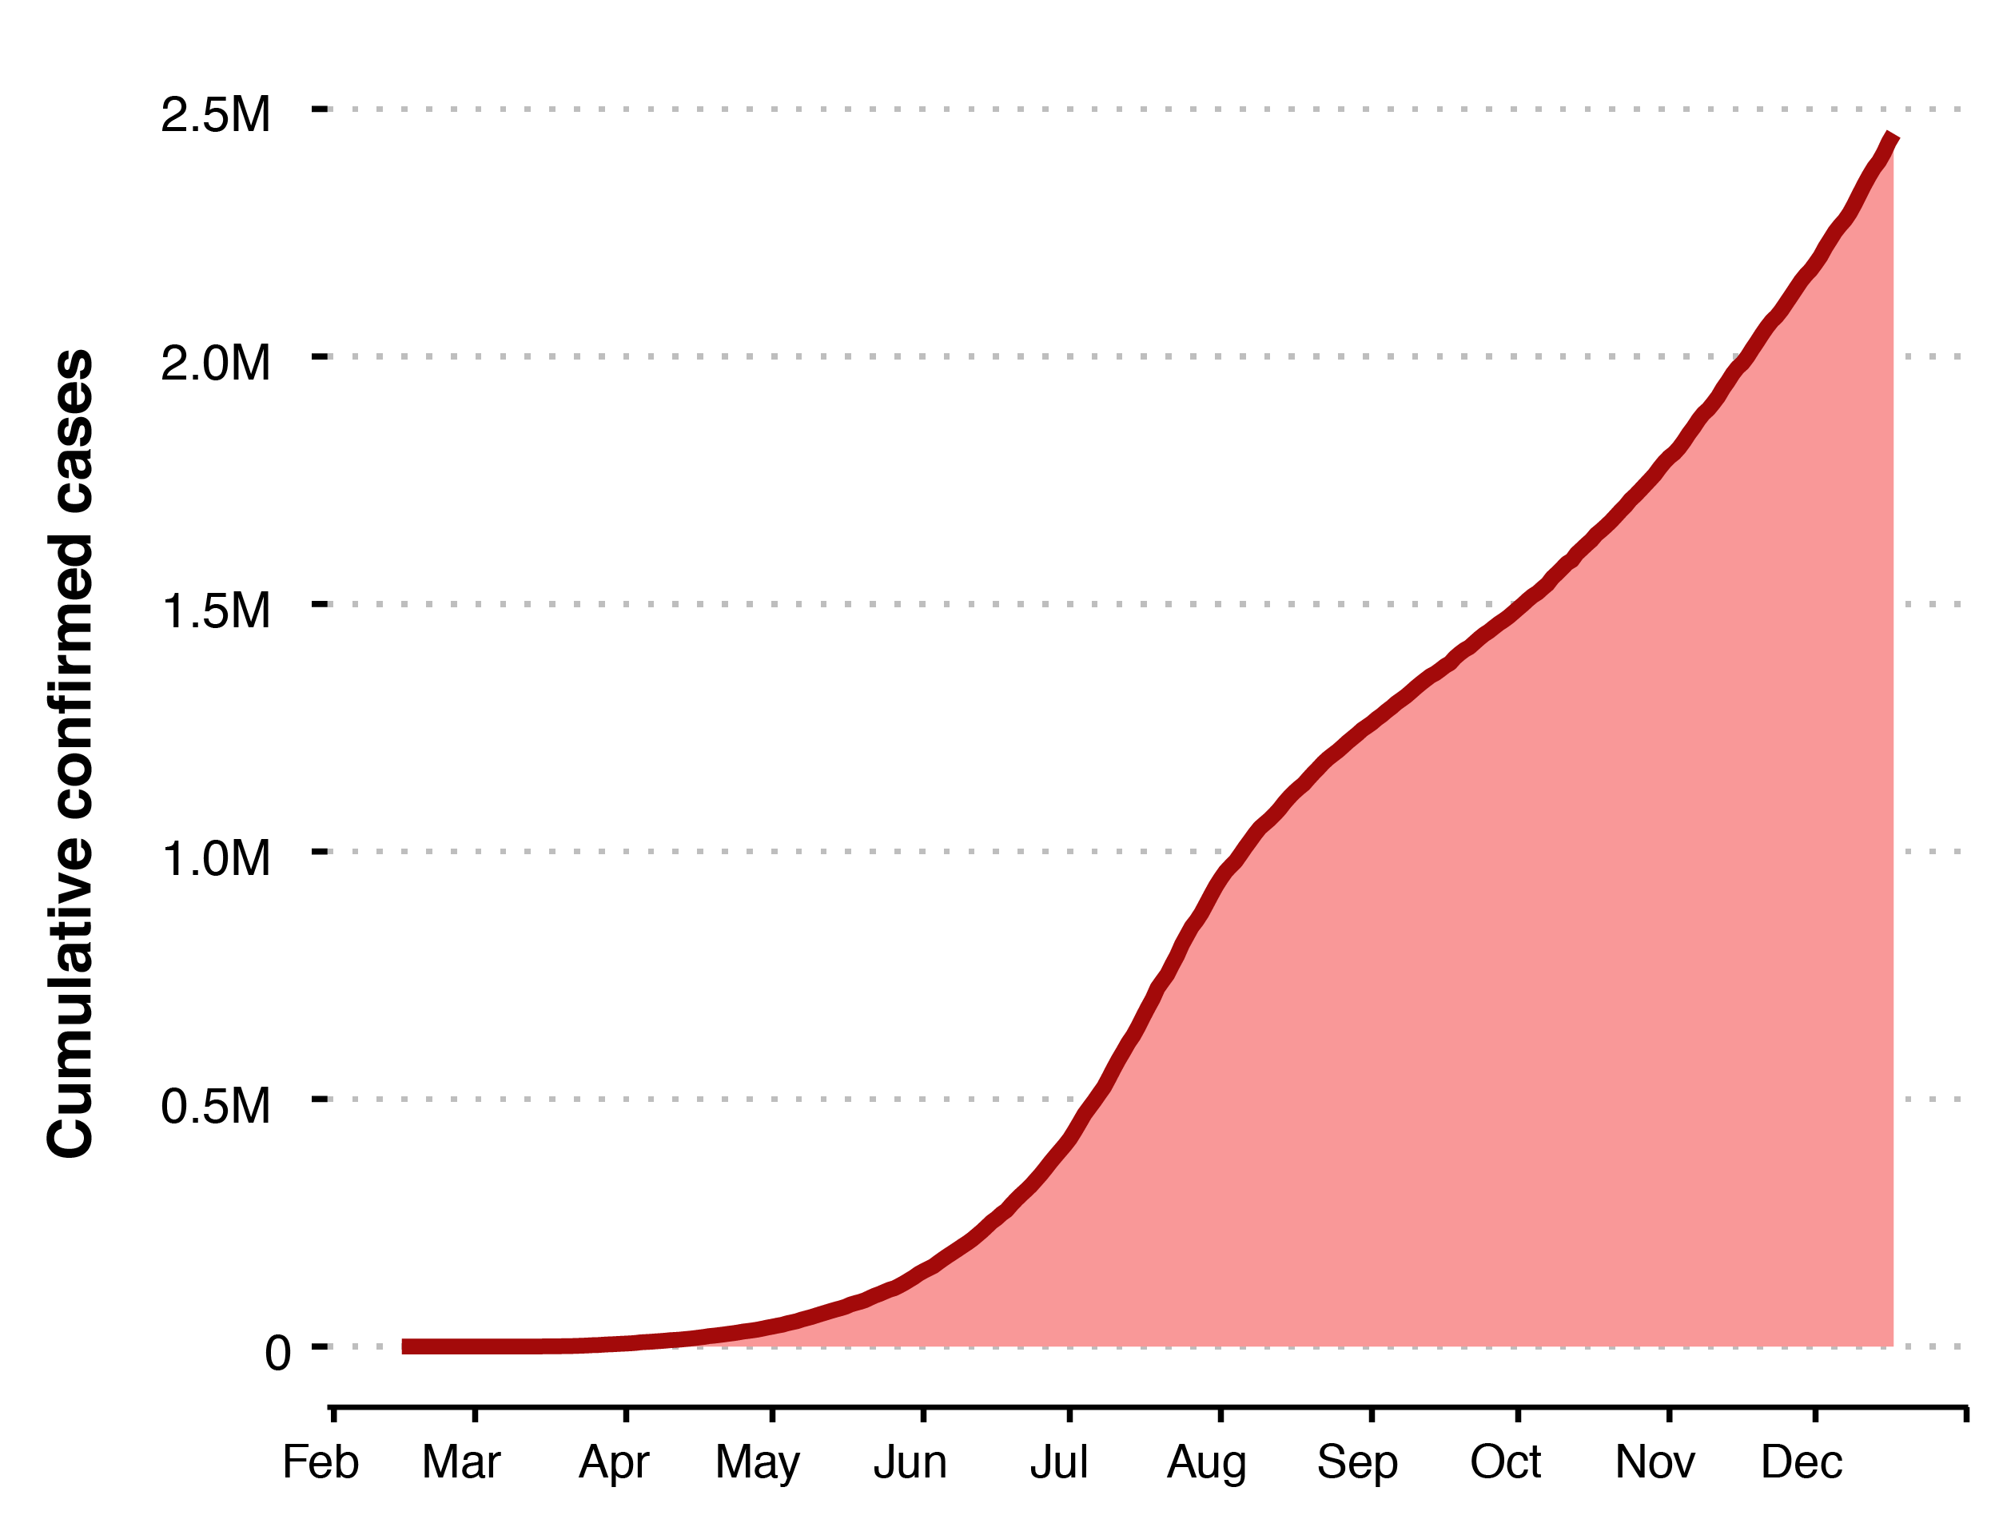
EPIDEMIOLOGICAL UPDATE IN AFRICA | TRENDS
as of 11 January 2021, 9:00 AM EAT
3.1M
>3.06M
cases
30 days
2M
47 days
>2.4M recoveries
(85%)
1.5M
58 days
1M
30 days
>78K
deaths
CFR: 2.4%
0.5M
133 days

Slide 3
Relevance of regulatory barriers in the Africa COVID-19 Vaccine Development and Access Strategy
1
Accelerate African involvement in clinical development
2
Ensure Africa’s access to sufficient vaccine supply
3
Remove barriers to widespread delivery and uptake of the vaccine across Africa
Consortium for COVID-19 Vaccine Clinical Trial (CONCVACT) – ensure Africa participates in COVID-19 vaccine clinical trials to test safety and efficacy, while strengthening Africa’s capacity for running high quality clinical trials
Access, financing and procurement – secure timely, sufficient and equitable doses for all Member States
Regulatory – enable rapid regulatory decisions and ongoing safety monitoring
Manufacturing – scale-up African vaccine manufacturing capacity to produce COVID-19 vaccines in the longer-term
Delivery – ensure effective supply chains and immunization activities
Uptake – engage communities to maximize vaccine acceptance and uptake

Slide 4




Vaccine candidates in clinical trials or with limited approval
AS OF 11 January 2020
Current status of new COVID-19 vaccine development
  COVID-19 vaccine development is progressing at an unprecedented rate: 20 vaccine candidate are in Phase III clinical trials and 10 vaccines have been granted limited or full approval
  Demand for approved vaccines will exceed supply in the medium term, with many manufacturers having already committed the majority of their capacity (e.g., AstraZeneca - 100% doses pre-committed, 1.3B for LMICs)
  Decisions on countries of distributions will likely be made based on overall readiness (esp. regulatory preparedness)
  It is therefore imperative that African countries ensure their regulatory processes are prepared to allow fast-tracked access to newly approved, safe and efficacious vaccines
Phase I
Phase II
Phase III
Limited approval¹
Approval²
Abandoned
43
20
20
7
3
1
Vaccines testing safety and dosage
Vaccines in expanded safety trials
Vaccines in large-scale efficacy tests
Vaccines approved for early or limited use
Vaccines
approved
for full use
Vaccines abandoned after trials
Released preliminary phase III data indicating 95% vaccine effectiveness
Preliminary analysis of phase III results showed 94.1% effectiveness against COVID-19 and 100% against severe COVID-19
Preliminary analysis of phase III results showed 62-90% effectiveness depending on dosage – but there is uncertainty around the results
1. Approved for early or limited use: CanSino Biologics (China); Gamaleya Research Institute (Russia); Vector Institute (Russia); Sinopharm/Wuhan Institute of Biological Products (UAE); Sinovac Biotech (China), AstraZeneca (India, Mexico, Argentina), Bharat Biotech (India) | 2. Approved: Pfizer/BioNTech (Canada, Saudi Arabia); Moderna (Canada), Sinopharm BBIBP-CorV (China, UAE)
SOURCE: New York Times Coronavirus Vaccine Tracker, Pfizer, Moderna and AstraZeneca press releases

Slide 5


Reaching the Africa COVID-19 vaccine strategy goal of vaccinating at least 60% of the African population is expected to cost ~$9-10 B
Cost to purchase vaccines
Goal:
Vaccinating at least 60% of the Continent’s population within 24 months – in pursuance of the decision taken by the AU Bureau of Heads of State in August to achieve herd immunity, taking the whole of Africa approach
Cost of vaccinate
Additional cost of climate-sensitive cold chain
Indicative total cost¹
$B
~780 million people to vaccinate
1B
1B
3.3B
9.1B
5.8B
Cost to purchase
Cost to vaccinate
Total cost
1 Assumptions: two-dose regimen at $3.5 per dose to procure ($7 per person); wastage rate of 5%; cost to vaccinate of $2/dose ($4 per person). Actual costs will depend on the characteristics of the specific vaccine (e.g., cold chain requirements, dosage, presentation, etc.)
5

Slide 6
Total financing need of ~$9-10B will be fulfilled through at least four sources – COVAX/donors, country self-financing, the World Bank, and Afreximbank
PRELIMINARY - BASED ON
CURRENT INFORMATION
Indicative total cost¹, $B
Cost to purchase vaccines
Expected funding sources, Estimates, $B
Cost to vaccinate
Both costs included
Country self-financing (minimum)
Additional cost of climate-sensitive cold chain
COVAX / donors
World Bank
Afreximbank
1B
USD 4-5B depending inclusion of cost of climate-sensitive cold chain²
0.5
Afreximbank finances remaining gap
Assuming the 46 AMC-eligible countries in Africa (LICs and LMICs) will receive dosage to immunize 20% of the population, with zero co-payment
Assuming at a minimum, countries are self-financing 15% of the cost to vaccinate (e.g., cold chain, logistics, health worker costs) – countries requiring support can leverage additional finances from Afreximbank
Part of the global $12B financing announced by the World Bank – amount for African countries to be confirmed
1 Assuming COVAX would cover the cost of doses for 20% of the population, assuming 5% wastage, and no co-payment for lower-middle and low income countries
2 Assuming cost of climate-sensitive cold-chain would be covered through World Bank Funds

Slide 7


Per the second pillar (financing and procurement) of the ACDC COVID-19 Vaccine Strategy, we will fully commit to COVAX while pursuing non-competing direct deals
Fully commit financial
and political support to
the COVAX Facility
Pursue non-competing
direct deals with
manufacturers
All direct deals with be made with COVAX-supported vaccine manufacturers – deals to be based on the same price per dose and terms as the COVAX Facility

Slide 8
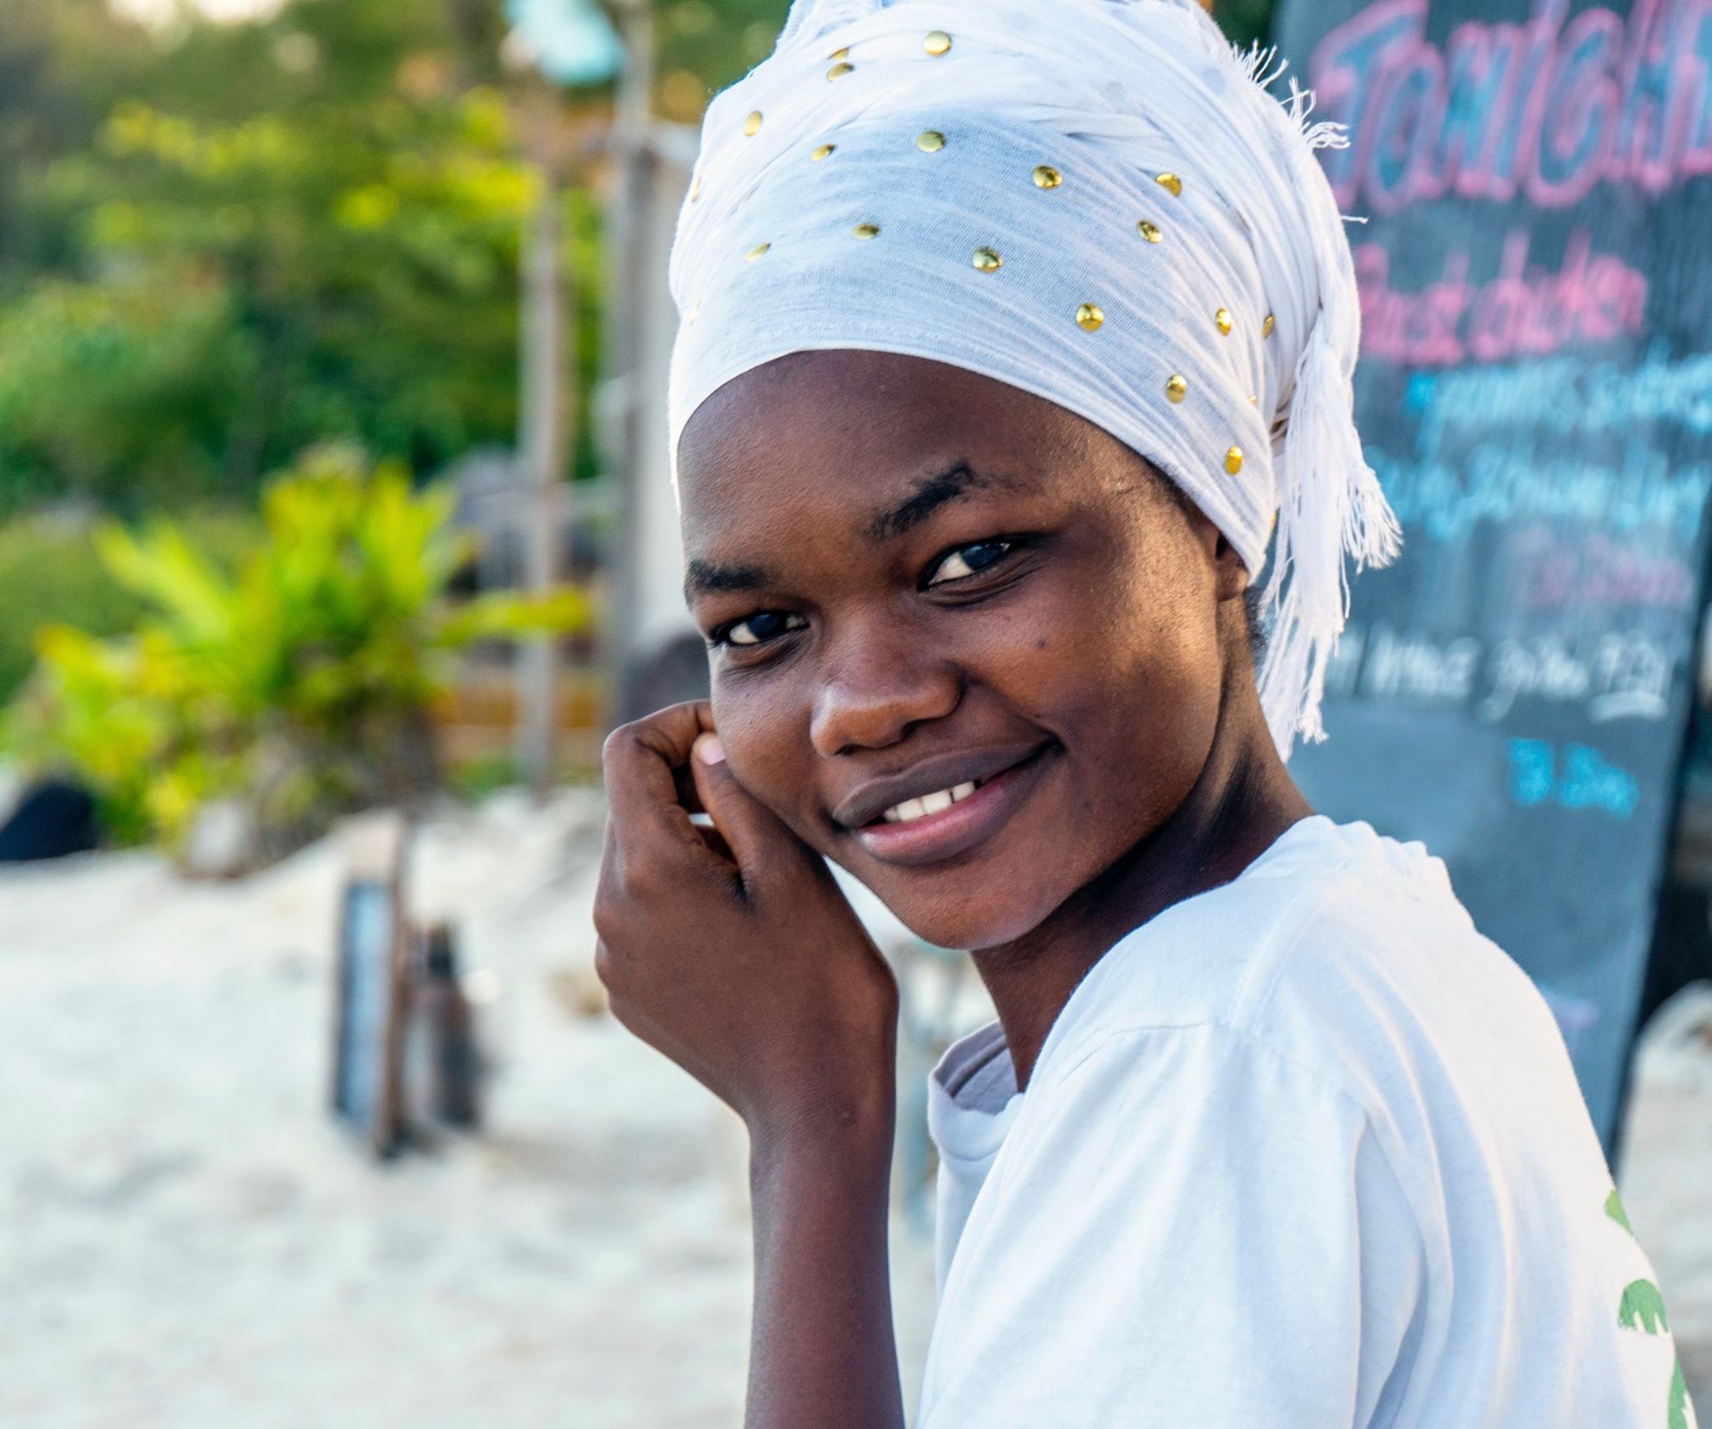

COVID-19 Vaccine Perceptions in Africa

Slide 9
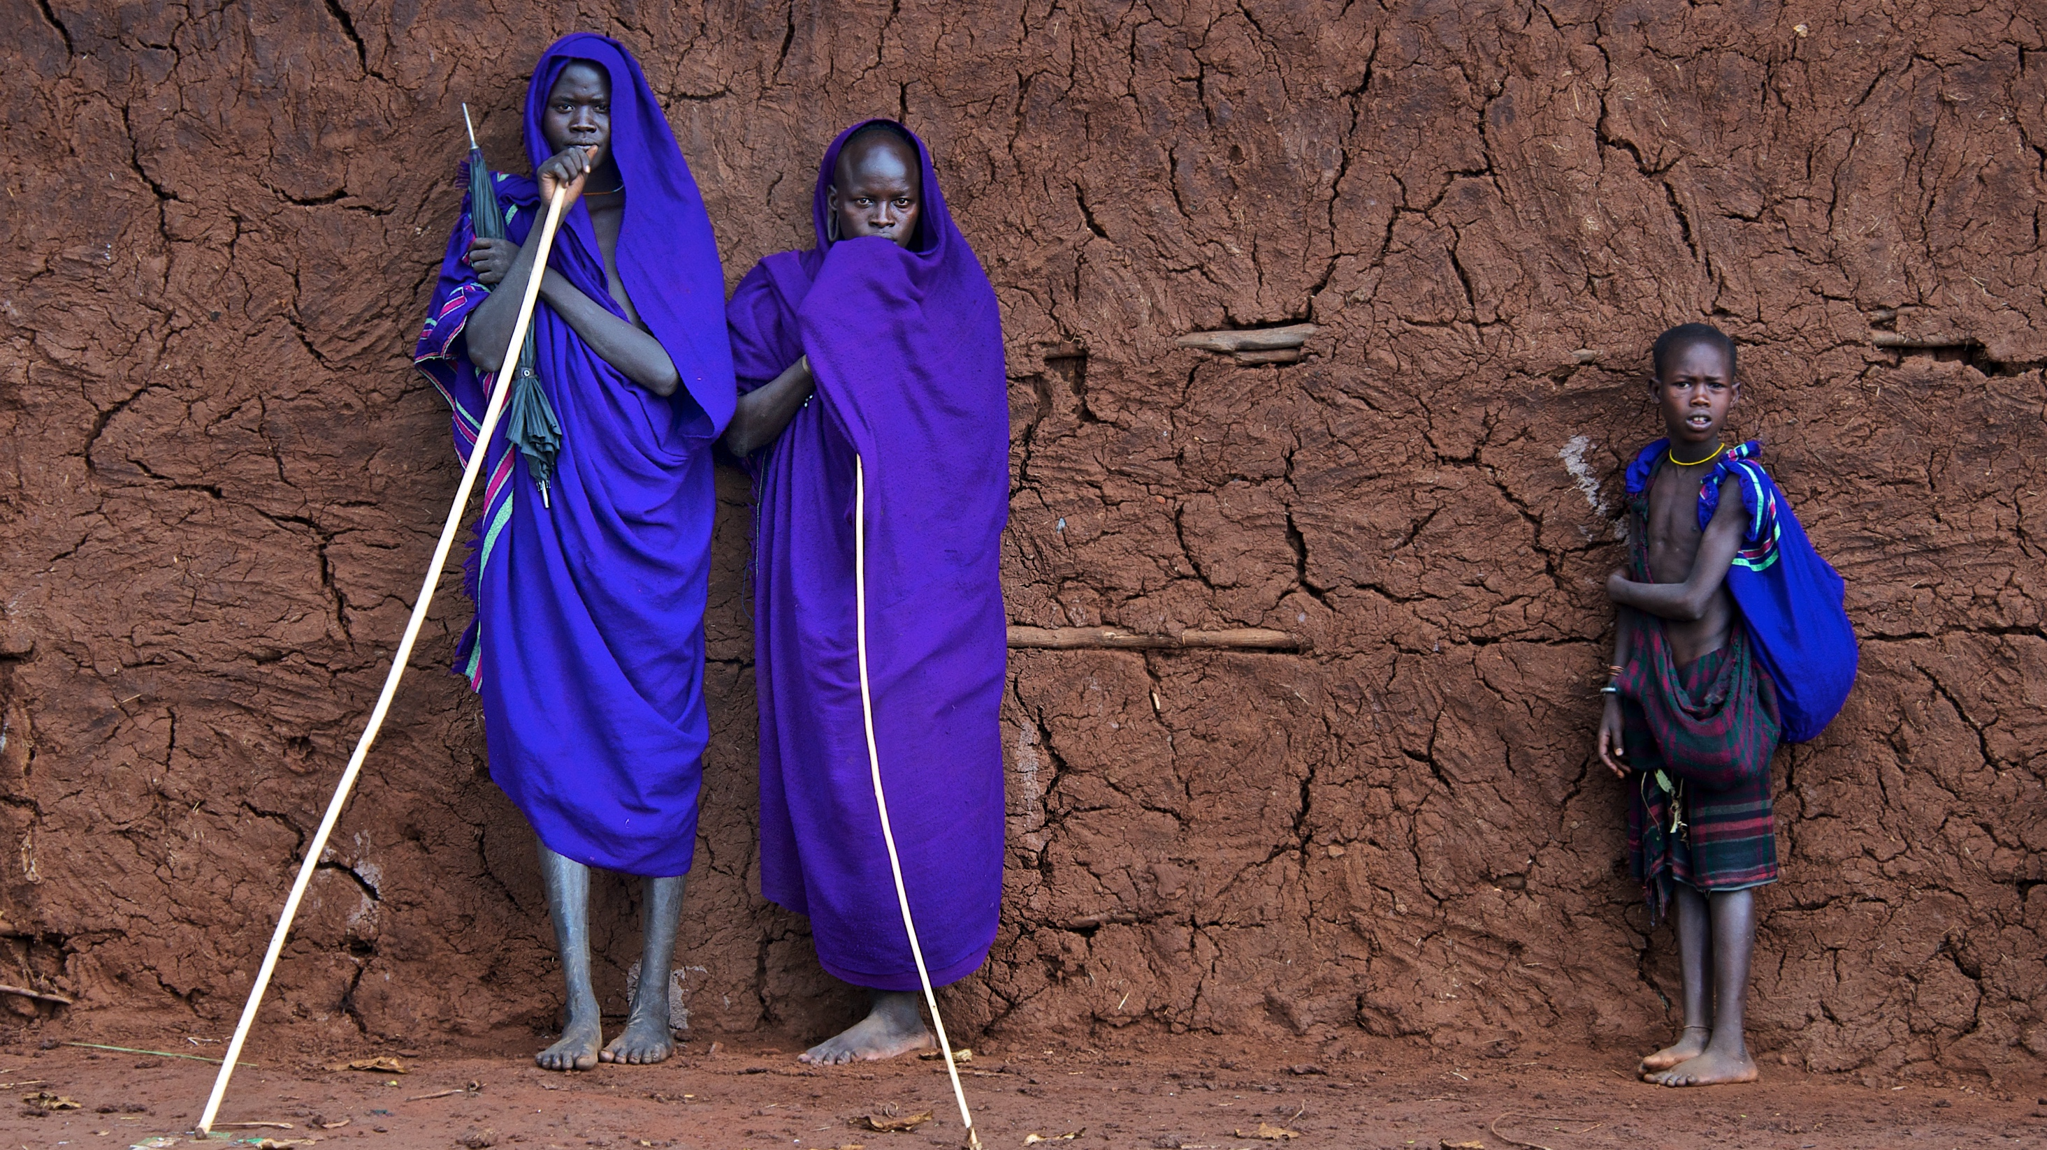

RESEARCH OVERVIEW
1. Research design
2. Fieldwork
3. Analysis
4. Outputs
Media habits
1. Preliminary topline from ORB
Implications for communication strategies
15
COVID awareness and understanding
Countries
AFRICA comparisons
Measures of vaccine uptake and hesitancy
QUESTIONNAIRE
RECOMMENDATIONS
2. LSHTM analysis and implications to follow
Country fact sheets
15,000+ respondents

Slide 10

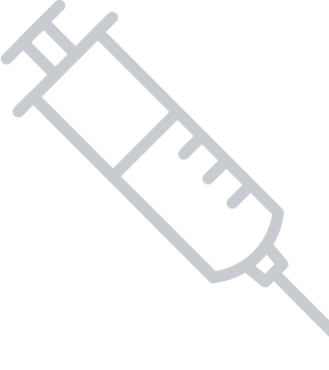
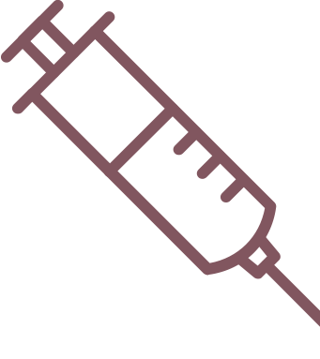
Uptake of COVID-19 vaccine
Q: If a new Coronavirus (COVID-19) vaccine became publicly available and was deemed safe and effective, do you think you would take it?
By country
          By country
Potential uptake of a COVID-19 vaccine in Africa is high, though there are significant regional differences. One in five respondents say they would not take the vaccine.
All respondents
Trend for countries in Janssen project* | Comparison – globally*
Ethiopia (91%) Nigeria (78%) DRC (47%) | UK (75%) South Korea (84%) Ecuador (73%)

Slide 11




Reluctance to take COVID-19 vaccine
Belief in conspiracy theories
Belief in
conspiracy theories
          Attitudinal groups
No belief in conspiracy theories
Those more likely to refuse COVID-19 vaccine
People who have seen COVID-related disinformation | People who think the threat of COVID-19 is exaggerated
People who trust social media for information | Those who do not know anyone who has had the virus
All Respondents: Yes = 5183, No = 7387
?
Vaccines are safe
All Respondents: Agree = 9786, Disagree = 2284

Slide 12


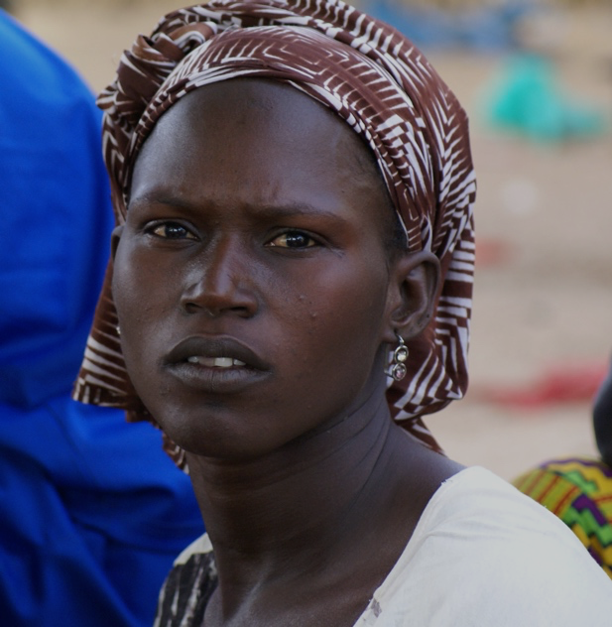

Reasons given for not taking a COVID-19 vaccine
“
”
It normally takes 15 years
to manufacture a vaccine so
how can a new vaccine be manufactured in just a year?
Respondent in the DRC
I don’t believe
there is Corona as
I have not seen it.
Respondent in Nigeria
“
”
Top reasons for not taking the vaccine: | Top reasons for not taking the vaccine:
 | I don’t trust the COVID-19 vaccine
 | I do not believe that the virus exists
 | I do not feel that I am at risk of catching the virus
 | I believe that vaccines can give you the disease they are designed to protect you against
1
“
”
2
The vaccine should be
tested in Europe first.
Respondent in Senegal
3
“
”
I would need to see
the effect it has
on people first.
Respondent in Kenya
4

Slide 13

Disinformation
Q: And finally, could you tell me for each of the following
statements, whether you believe them to be true or false?
A significant proportion believe in vaccine-related rumours. Those from North Africa, men, younger respondents and those who believe that the threat from COVID-19 is exaggerated are more likely to believe these disinformation stories.
COVID-19 is planned event by foreign actor
People in Africa are being used as guinea pigs in vaccine trials
Only poor people chosen for vaccine trials in Africa
Vaccine trials in Africa have led to the death of several children
The spread of COVID-19 is linked to 5G

Slide 14
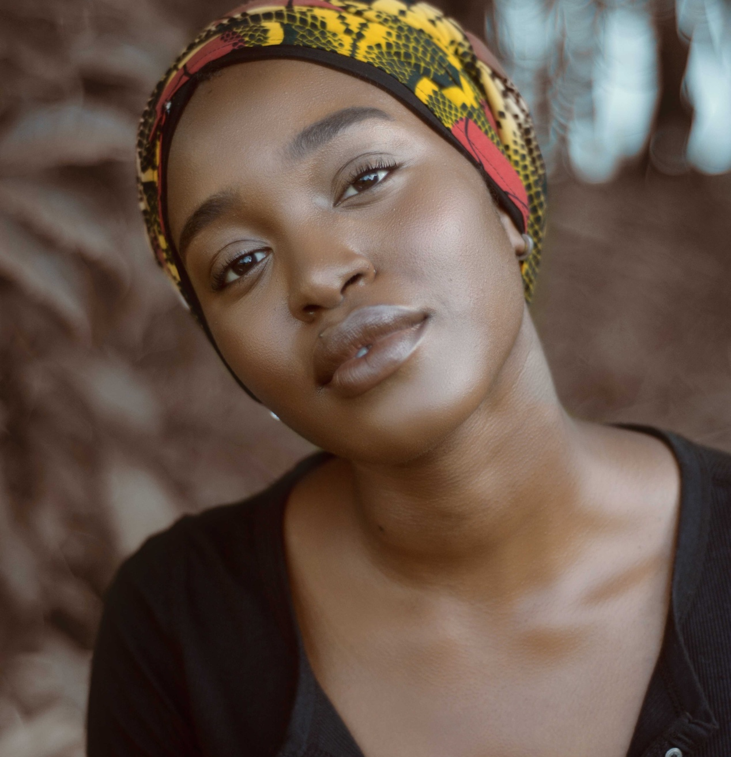
Advocacy for COVID-19 vaccine
Despite regional differences the World Health Organisation (WHO) and healthcare professionals are key sources that need to provide their seal of approval in order for respondents to trust in the safety and efficacy of a potential COVID-19 vaccine.

Slide 15
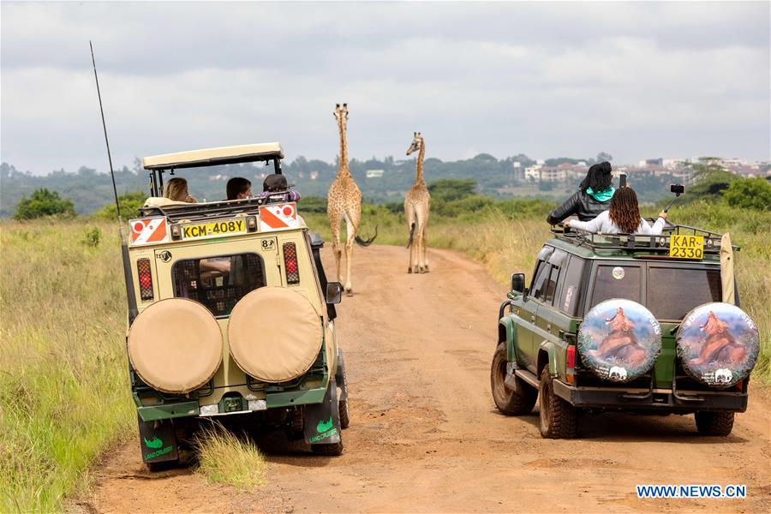

COVID-19 will cost global tourism at least $1.2 trillion
Vaccinating 60% of the population would allow Member States to
Timely return to the regional economic development agenda
Tourism
+

Slide 16
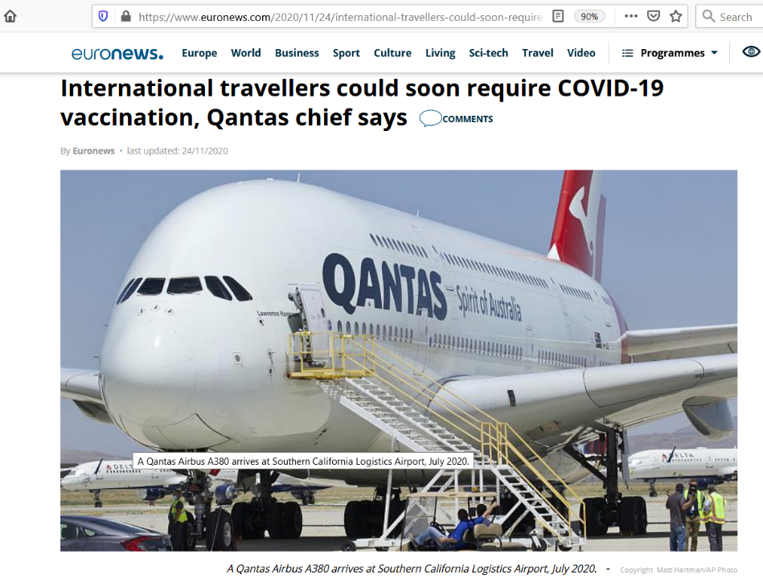
AIRLINES TO REQUIRE COVID19 VACCINATION CERTIFICATE SOON…
Qantas CEO Alan Joyce said the airline is planning to require passengers traveling internationally to prove they have been vaccinated against COVID-19 after the vaccinations become available to the public.
The company is looking to change its terms and conditions to ensure travelers get vaccinated before getting on the aircraft.
Other airlines across the world are looking to adopt similar measures.

Slide 17
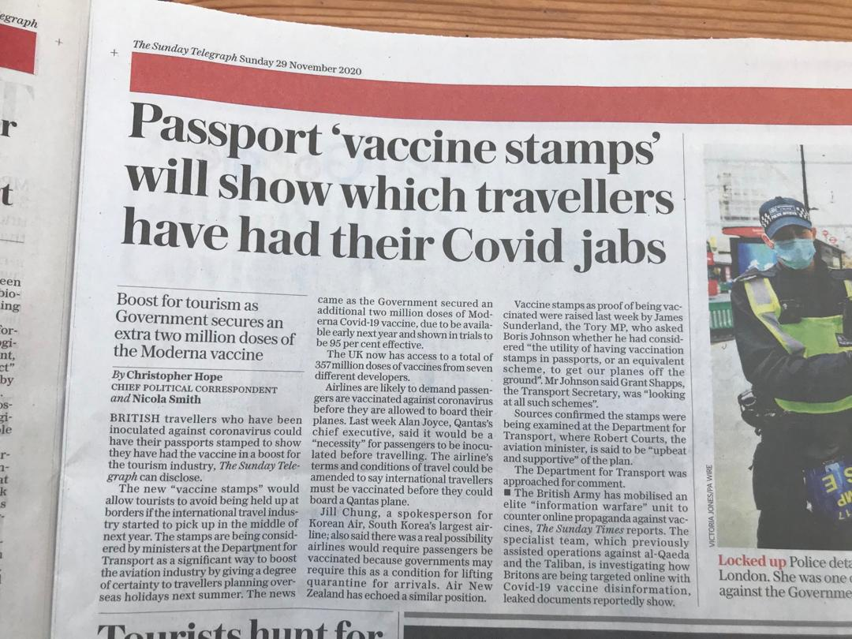
AIRLINES TO REQUIRE COVID19 VACCINATION CERTIFICATE SOON…

Slide 18



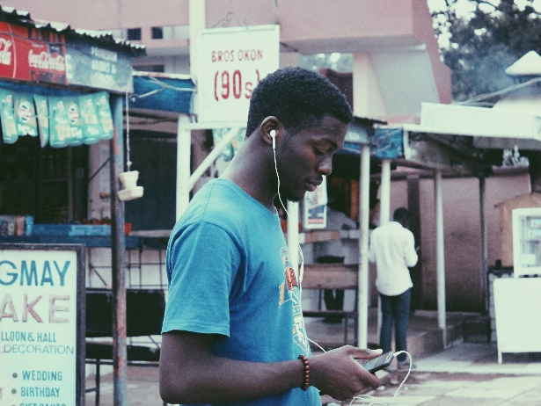
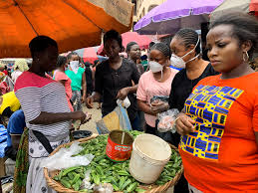

The reality of COVID-19 on the African continent
>90% of infections in sub-Saharan Africa in persons under 60
>80% of cases asymptomatic
Young people remain a reservoir of the virus
>80 of employment in the informal economy
Loosen Public Health Social Measures (PHSM)
Lockdowns have a devastating effect on livelihoods
Multi-generation homes, large areas with high population density
Limited facilities for remote education
Limited ability to enforce social distancing
1 https://www.devex.com/news/data-suggests-the-pandemic-is-playing-out-differently-in-africa-98204

Slide 19


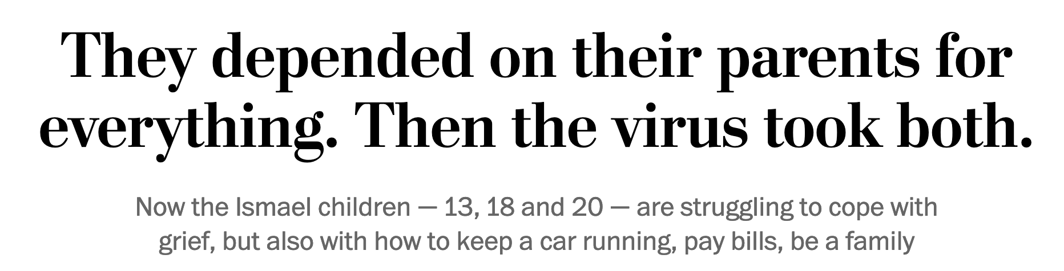
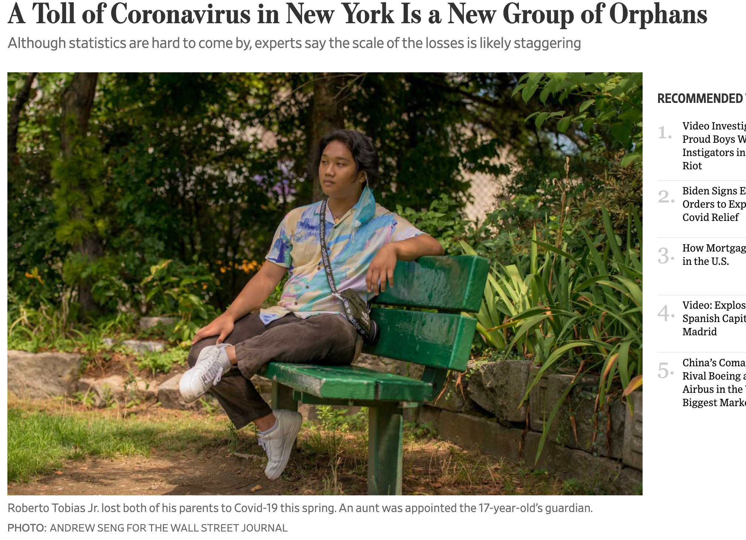
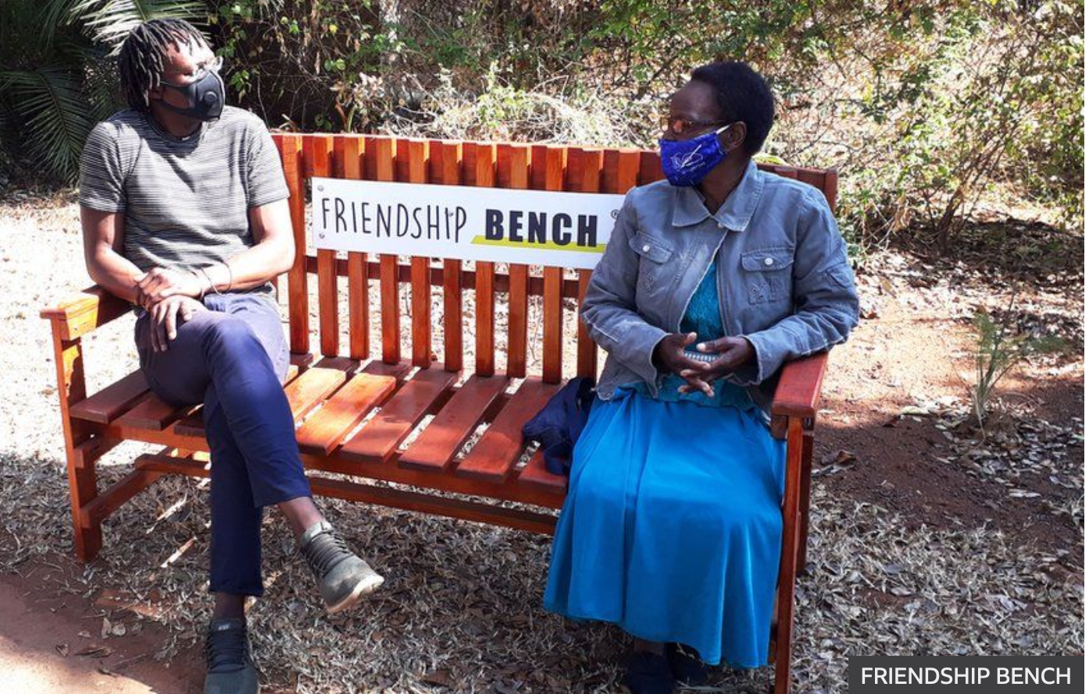

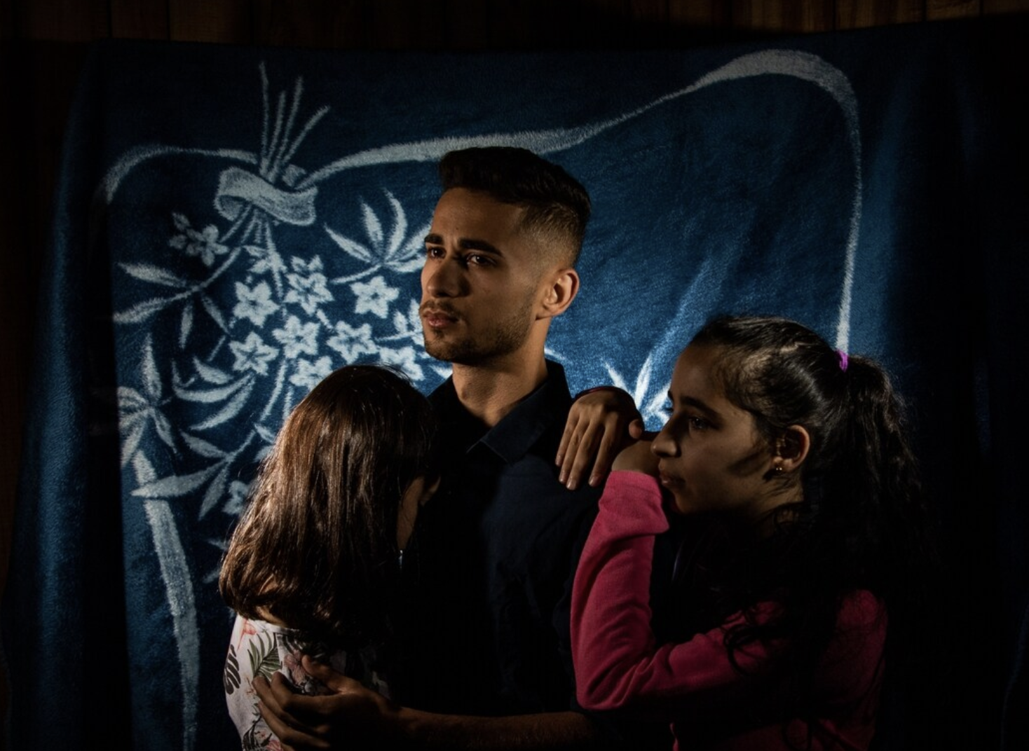
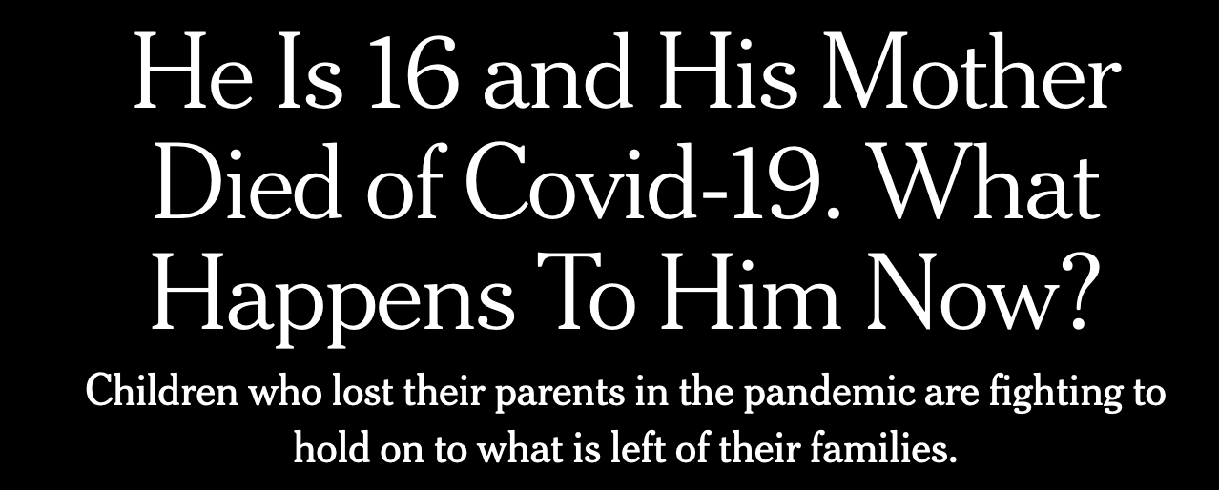
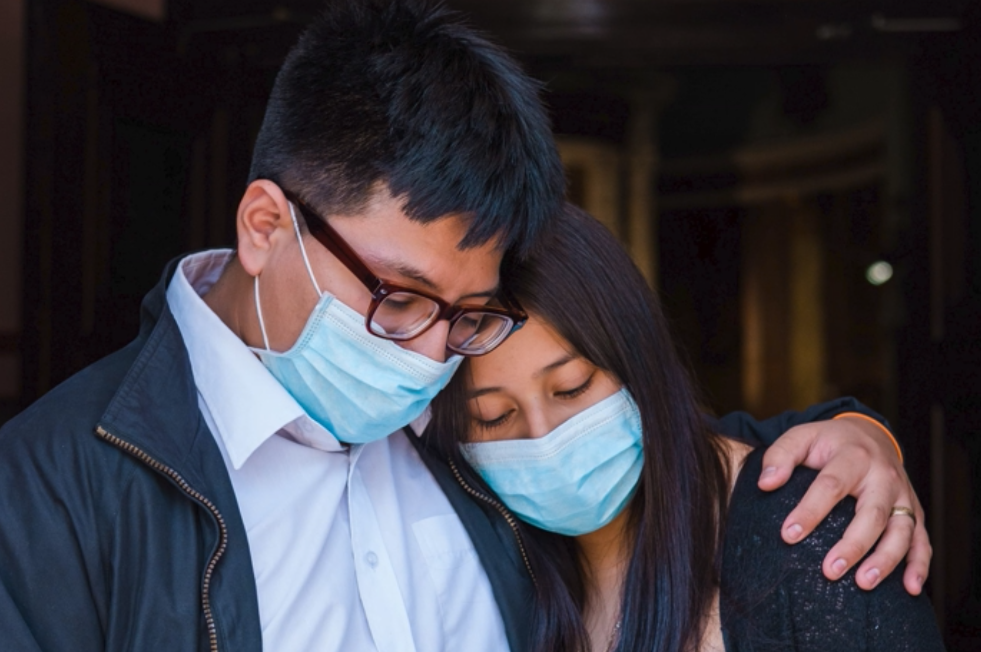
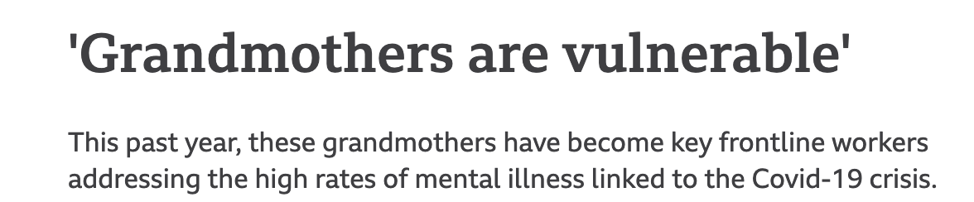
Global impact of COVID-19-associated deaths on orphans and caregivers

