Slide 1


Targeted HIV Testing for Children, Adolescents & Men in the context of Covid-19
Gibstar Makangila
Executive Director
Circle of Hope, Lusaka Zambia
FCI NEW FOUNDATIONS OF HOPE WEBINAR

Slide 2
TARGETED HIV TESTING IS PREMISED ON THE APPROACH OF LEVERAGING THE RELATIONSHIP CAPITAL INHERENT IN THE FAITH & LOCAL COMMUNITIES
OVERALL STRATEGY:
Decentralize service delivery to community level where community influencers have direct impact on community decisions and individual behavioral change.
SPECIFIC STRATEGIES:
Identify, segment and map the faith community and local community in specific catchment areas within 2-3 km radius surrounding a facility or community post.
Foster & strengthen collaboration with community influencers by including them throughout the value chain of planning, execution, review, feedback and performance assessments.
Notes:
By leveraging community gate keepers, faith-engaged community CHWs and community relationships COH has enjoyed community trust, relationships and unhindered household access.

Slide 3
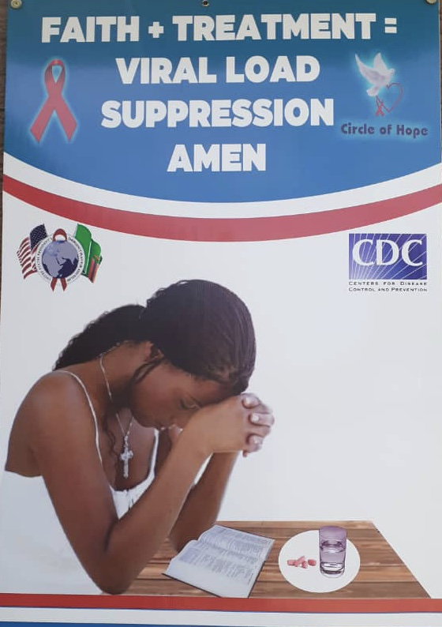
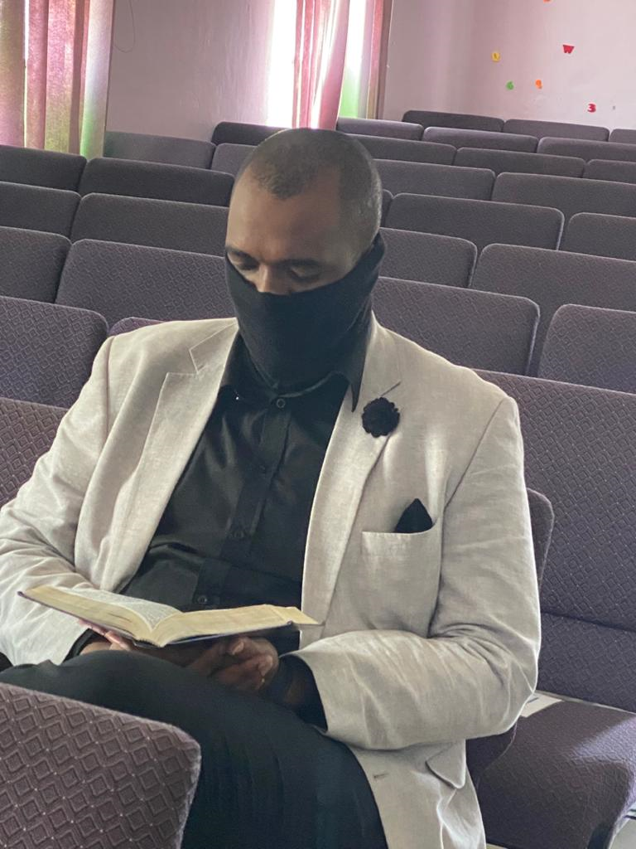
Faith champions have continued to:
develop and deploy support interventions for linkage and retention
provide education about sexual violence against children for community leaders (faith, traditional, school, civic)

Slide 4
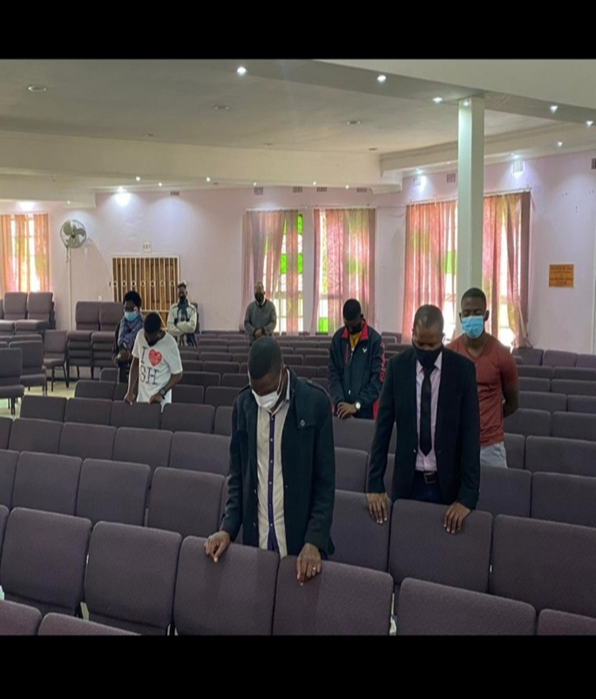
Challenges in the covid-19 era
COVID-19 restrictions in April-June ‘21: Government of Zambia announced that the country entered its 3rd wave of COVID-19 which negatively affected community activities - including closure of hotspots; CHWs could not sufficiently reach or test the elicited contacts due to COVID-19 restrictions.
COVID-19 & HIV stigma among men to visit health facilities was brought to the fore
Restricted movements meant both clients and CHWs spent more time in their local communities
Congregation observing Covid-19 guidelines

Slide 5
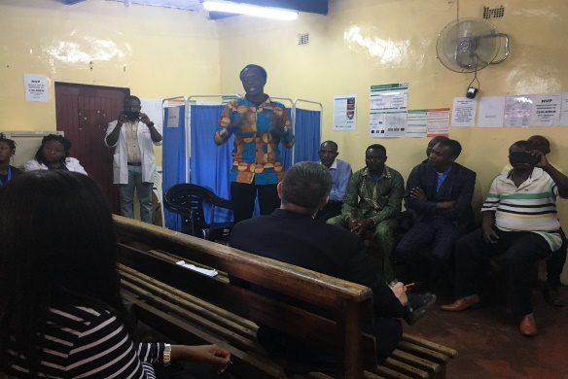
BARRIERS AND STRATEGIES IN FINDING MEN

Slide 6
CRITICAL BARRIERS OVERCOME THROUGH STRATEGIES USED TO FIND MEN
Time - attracted by the quick turn around time – 20-30 min
(client waiting time and time to reach services)
Cost of access (transport) - situated right where the men live, work and socialize
Stigma – the CP blends into the environment where it is situated, no branding
Good Customer Care among Community Health Workers (CHWs)

Slide 7
Strategies used to find the Men cont….
Social networks – expert male clients link their friends to test for HIV
Usage of male leadership to promote HIV sensitization activities
Female sex workers refer their male sexual partners (approx. 3-4) for HIV testing services
Provide private health talks in social places, encouraging men who are ready to test go to the CP for testing

Slide 8
A 34yr man accessing HIV services at
COH-Misisi CP

Slide 9



COH & LPHO CPs TARGETED TESTING men- fy21 q2 & q3

Slide 10
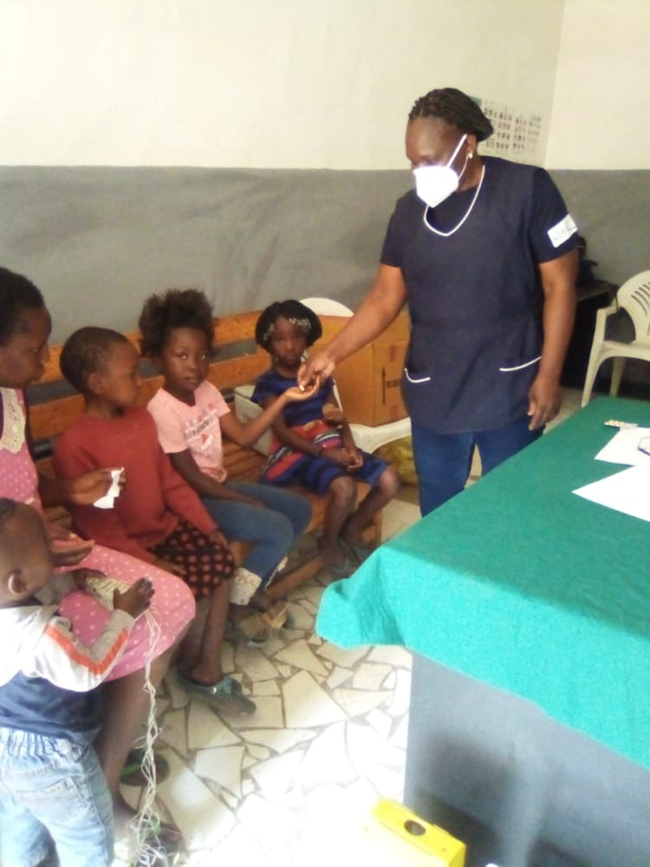
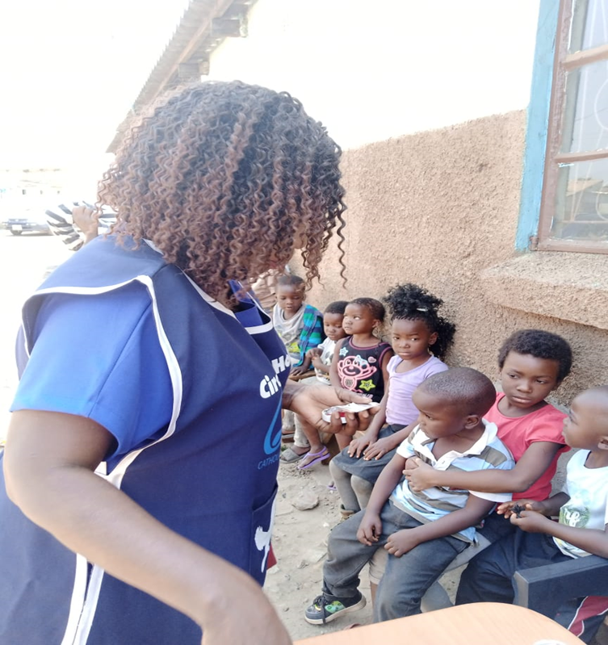
BARRIERS & STRATEGIES IN FINDING CHILDREN & ADOLESCENTS

Slide 11
BARRIERS EXPERIENCED BY CHILDREN & ADOLESCENTS IN ACCESSING HIV SERVICES
Conflicting times – School/College Vs Facility/CP opening times
Custody conflicts and/or change in Guardian/Child Carer
Low level of treatment acceptability by adolescents (“Why am I the only one who drinks medicine daily?”) - self STIGMA
Treatment fatigue – “How long will I continue drinking medicines”
Low household incomes leading to food shortages at home level

Slide 12
BARRIERS EXPERIENCED BY CHILDREN & ADOLESCENTS IN ACCESSING HIV SERVICES CONT….
Communication barriers – Guardian/Parents unreachable for follow up client visits or reminders
Late disclosure to children or adolescents by Parent/Guardian
Low number of fellow/peer adolescents in the forefront of providing the HIV services in facilities
Absence of Child/Youth friendly services in facilities
Misinformation from fellow adolescents about HIV

Slide 13
Strategies used to find children & adolescents
Prevention from Mother To Child Transmission (PMTCT) : During faith gatherings the women are encouraged to ensure they know their HIV status for the wellness of the baby.
INDEX TESTING: The CHWs stationed in the faith communities ensure they reach and test the children below 19 yrs whose parents are identified HIV positive.
CHILD IMMUNIZATION DAYS: During child health week, the health facilities have set base at faith premises & at CPs to encourage congregants to have their children under-5 immunized and tested for HIV.

Slide 14
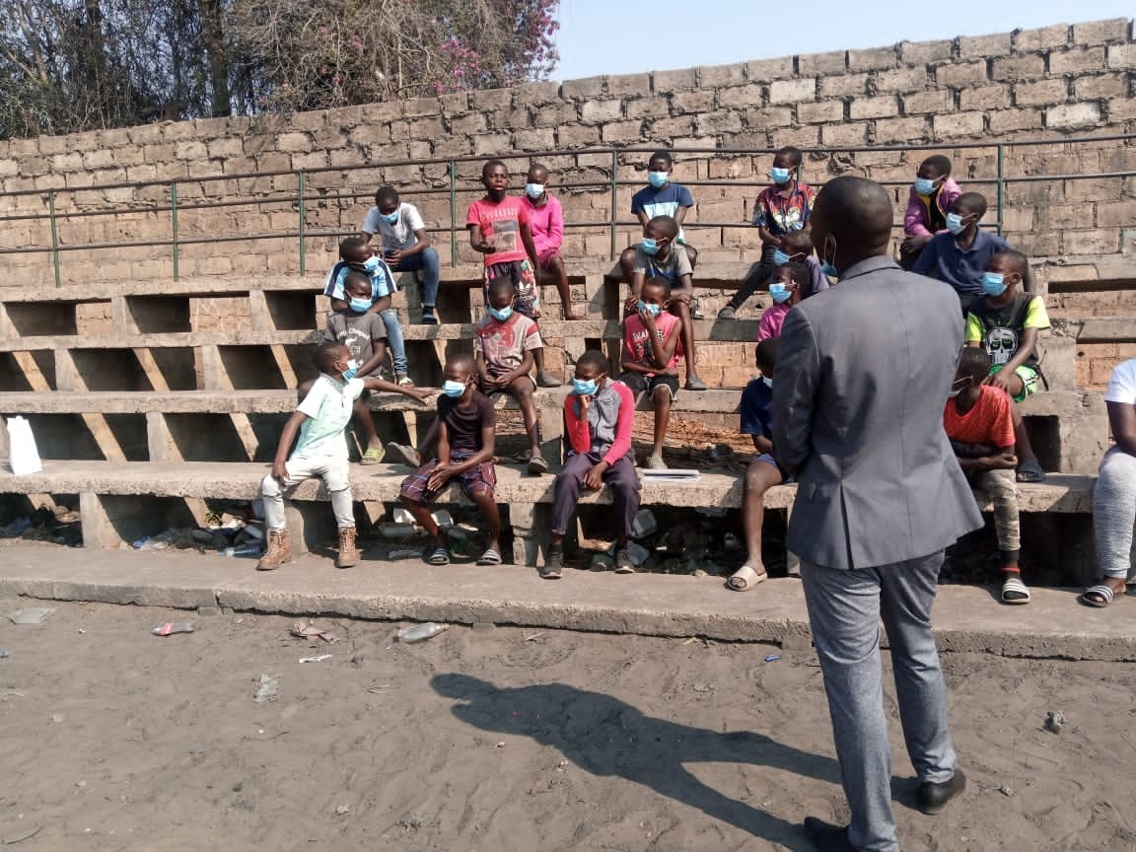
Strategies used to find children & adolescents cont….
Know Your Child’s HIV Status (KYCHS): For those children who may have been missed during PMTCT (0-19), mothers are encouraged to bring their children for testing – elicitation is conducted upon every visit anchored on pediatric screening tool.
Sunday/Youth Meetings: Children are provided with age-appropriate HIV messages during Sunday school for their knowledge. The youths (18-24) are provided with assisted Oral Quick HIV self test kit as a way of knowing their HIV status by the life coaches.
CBIM: Children (6-19) are mentored by Faith leaders, provided with HIV information and with the consent from their parents tested for HIV.
A faith leader coaching boys into men (CBIM) - Mandevu

Slide 15

WHERE ARE THE CHILDREN…?
High-prevalence settings: Testing infants and children at immunization, outpatient settings, or under-5 clinics.
Routine HIV screening for all infants attending immunization or under-5 clinics yields more results for identification of HIV-exposed and HIV-infected infants in high-burden areas with insufficient PMTCT, or for those children whose mothers seroconverted late in pregnancy or during breastfeeding.

Slide 16
COH: TARGETED TESTING FOR CHILDREN & ADOLESCENTS- JAN-JUN 2021

Slide 17
HIV Case Identification Modalities Results JULY-SEPT 2021

Slide 18
CHALLENGES & SOLUTIONS IN IDENTIFYING CHILDREN & ADOLESCENT - LESSONS LEARNT FROM FINDING MEN
Conflicting time – Flexibility to accommodate them after school
Custody challenges – Educate guardians on benefits of early child/adolescent adherence
Lack of safe spaces at facilities – Practice child/adolescent focused Customer Care
Lack of child/adolescent role models – Use of expert child/adolescent clients to reach out and encourage others (Including Child Client Guardian pairing)

Slide 19
CHALLENGES & SOLUTIONS IN IDENTIFYING CHILDREN & ADOLESCENT - LESSONS LEARNT FROM FINDING MEN CONT…
Late disclosure – encourage early disclosure to child/adolescent clients by parents/guardians
Low household income – design programs to include nutritional support packages to vulnerable children & adolescents LWHIV (including child-headed homes)
Congestion at facilities – have separate days, times & queues for children & adolescents. DSD to include home deliveries.
Treatment Fatigue – continuous education on the importance of treatment & adherence (Direct Observed Treatment)

