Slide 1



COH Faith-engaged Community Posts (CPs) improving HIV case Finding, Retention, Suppression for men
Gibstar Makangila
Executive Director
Circle of Hope, Lusaka Zambia
FCI New Foundations of Hope
Webinar. May 19, 2021
Notes:
Today I want to talk for 5 minutes about (read slide).

Slide 2
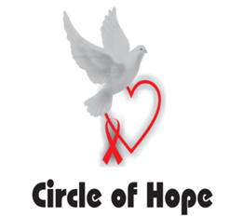


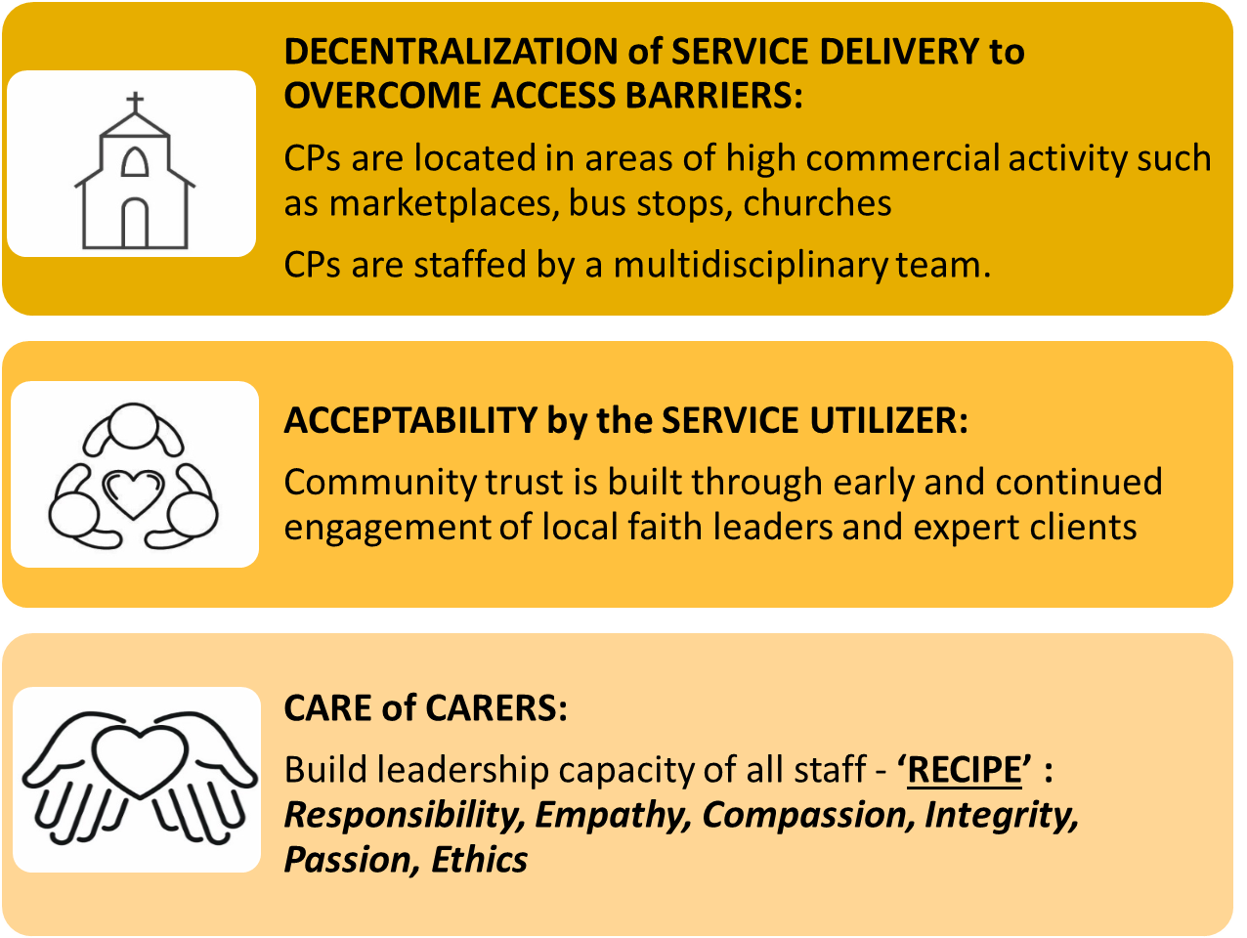
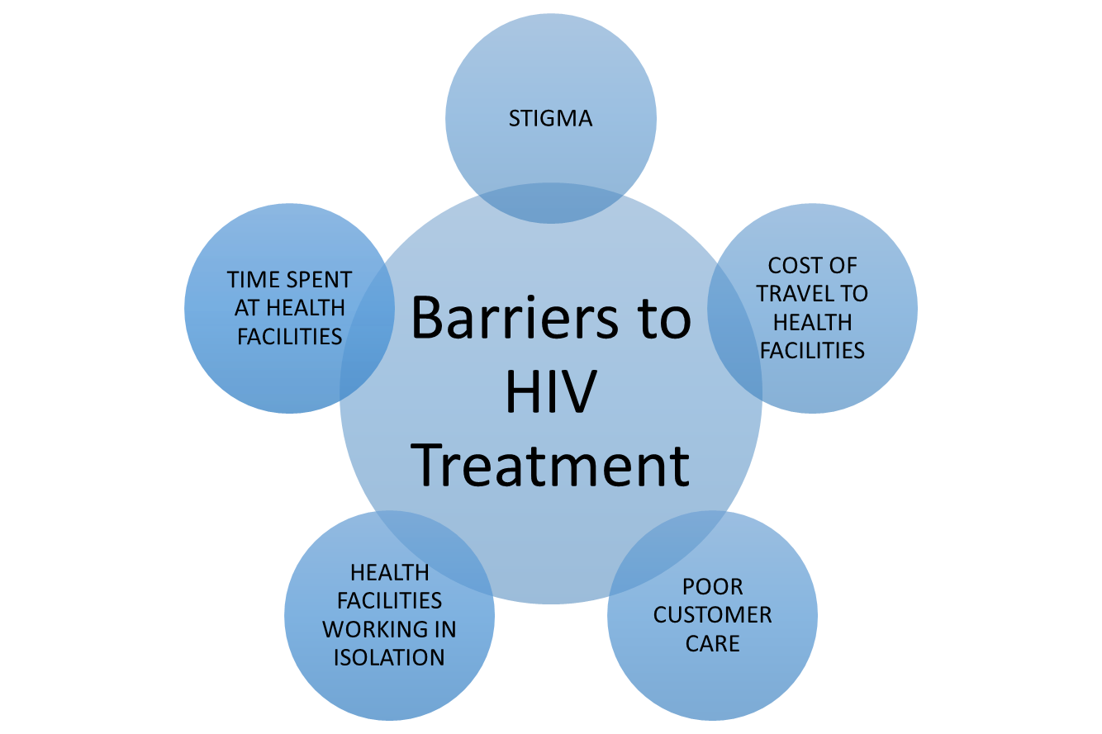
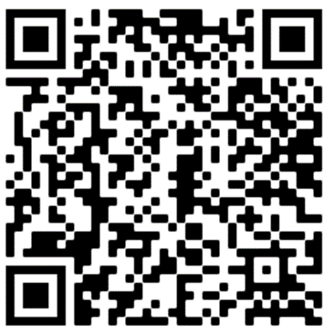
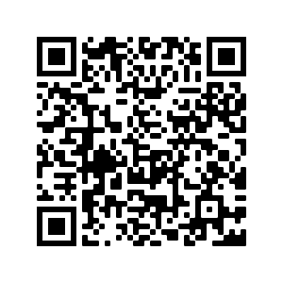
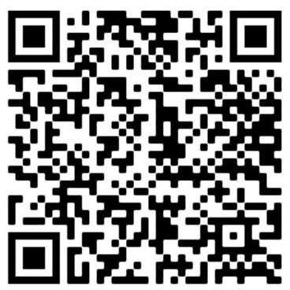

Faith-engaged community posts associated with over 1200% increase in new HIV case ascertainment, with high linkage and retention, Zambia
Gibstar Makangila¹, Albert Mwango², Minesh Shah³, Nzali Kancheya⁴, Kennedy Nkwemu⁴, Isaac Zulu³, Idongesit Essiet-Gibson³, Lauren Erickson Mamane³, Simon Agolory⁴, Susan Hillis⁵ 1 Circle of Hope (COH), Lusaka, Zambia; 2 Catholic Relief Services (CRS), Lusaka Zambia; 3 CDC, Atlanta, GA, USA; 4 CDC, Lusaka, Zambia; 5 Office of the Global AIDS Coordinator, Washington, DC, USA
BACKGROUND & DESCRIPTION
Circle of Hope is a Faith-Based Organization based in Lusaka, Zambia. In March 2018, to increase HIV case-finding, linkage, and retention particularly among men and children, Circle of Hope (CoH) started engaging faith leaders and deploying faith community members to de-centralized community posts (CPs) for effective service delivery.
BARRIERS TO ACCESS HIV TREATMENT OVERCOME BY THE COH CP MODEL
Same barriers for COVID-19

Slide 3
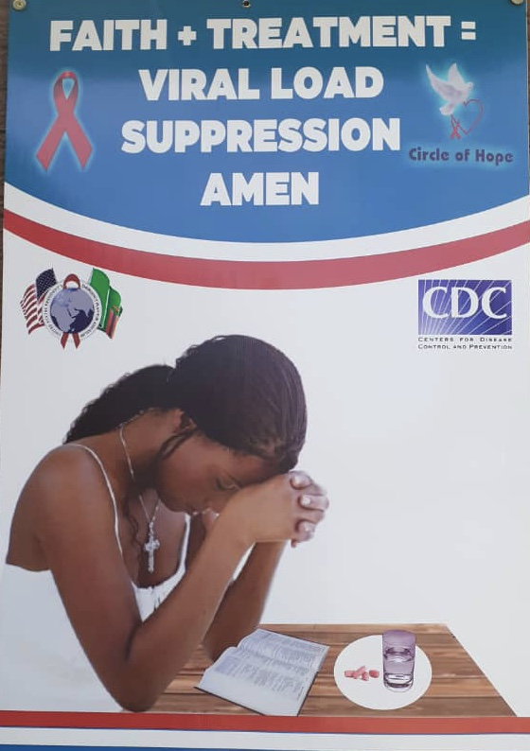



Faith-engaged community posts led to >1,200% increase in case – finding for HIV
Local COH CHWs & FCI Champions go daily from community posts into their own communities, to care for those with HIV, and address COVID-19
By leveraging Community Gate Keepers, Faith Engaged Community CHWs and Community Relationships COH has enjoyed Community Trust, relationships and household access. This has helped in our seamless integration of Covid 19 awareness and screening into our HIV services that has included case finding, contact tracing (leveraging CoH’s index testing skills)
Circle of Hope has grown its its Tx Curr from 3,500 to >23,000 in 2 yrs 8 months through its 35 Community Posts.
COH has scaled up the CP model and replicated and opened over 100 CPs for its partners in the four CDC supported Provinces and in Nigeria (CDC) and Zimbabwe(CDC and USAID) with more Countries to follow.

Slide 4
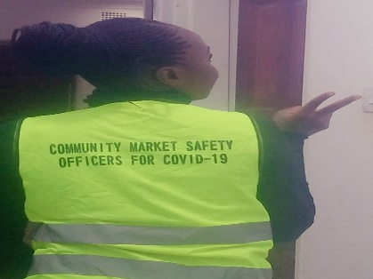
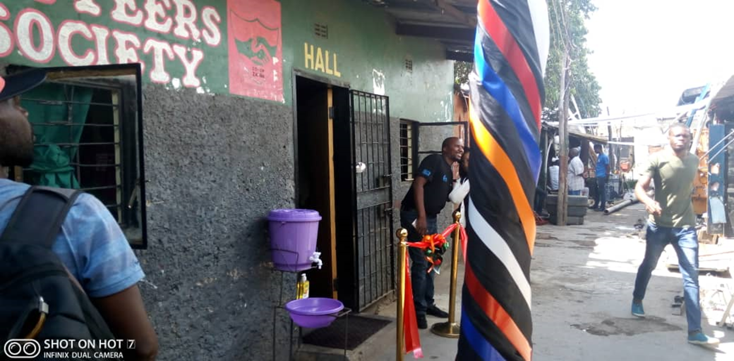
COH: Faith-engaged community posts led to >1,200% increase in case – finding for HIV

Slide 5
COH: More males being reached with testing, yield is higher among females
FY20Q1 TO FY20Q4
HTS Cascade by Gender

Slide 6
COH: Faith – Engaged Community Post Data –Tx_Curr Trend
FY20Q1
FY20Q2
FY20Q3
FY20Q4
FY21Q1

Slide 7

COH: Faith – Engaged Community Post Data – Viral Load Suppression (%)
COVID-19 Surge

Slide 8
COH Faith-Engaged Community Post Sustains Exceptional Performance on Index Testing Cascade during COVID-19 Surge : FY2021 Q1
Index Pos contribution = 60%
100%
Linkage
Notes:
Index Pos contribution = 60%

Slide 9
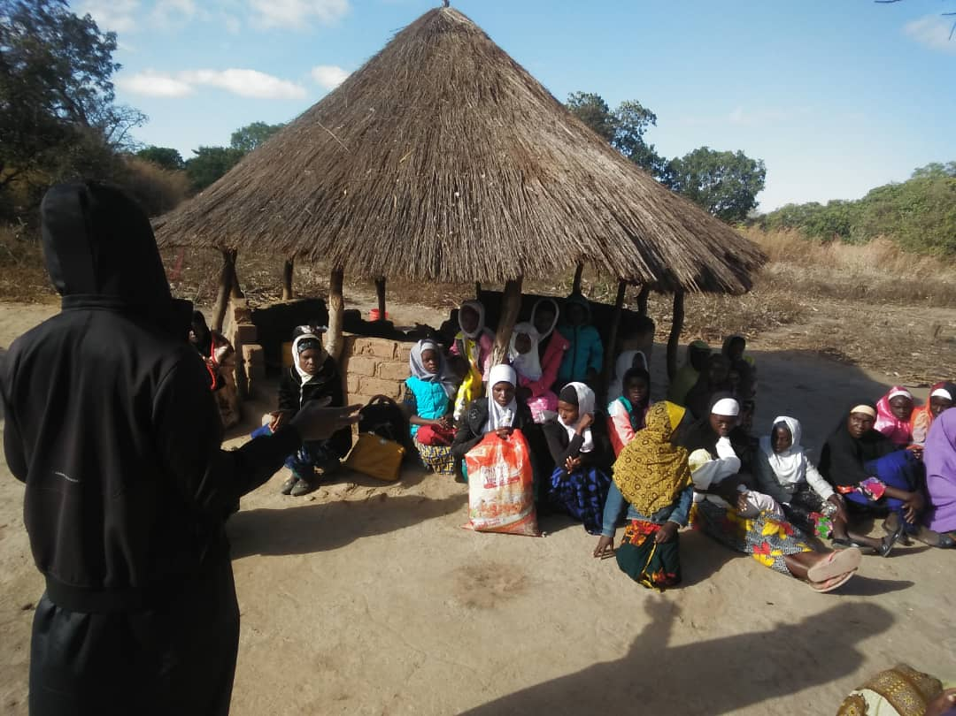
Faith-engaged community posts case – finding for HIV and linkage:
Lusaka Province
Southern Province
Eastern Province
Western Province
A Faith champion disseminating messages of hope to his congregation

Slide 10
Faith –Engaged Community Post Data – HTS_Pos, Tx_New and True Linkage (%) – Lusaka Province – FY21Q1

Slide 11
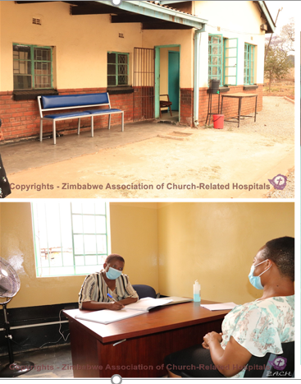
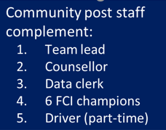
Circle of Hope model replication in Zimbabwe
Priority 1: Engaging communities of faith to understand the epidemic, raise community awareness, and bring critical prevention and treatment interventions to reach men and children with testing and treatment services
Success in engaging faith communities
  Their participation critical in identification of CPs
  FCI champions are from the faith communities
  Dissemination of messages of hope
Notes:
Priority 1: Engaging communities of faith to understand the epidemic, raise community awareness, and bring critical prevention and treatment interventions to reach men and children with testing and services
We chose to replicate the COH model in order to reach more men and adolescents with HIV testing and treatment services
We have had success in both replicating the COH model and engaging faith communities.
I will present briefly results of 6 CPs that started operating last year in October; 2 of these are set up with in Christian faith communities or buildings.

Slide 12
Yield 14% higher than health facilities, optimum linkage to linkage ART
99% shared results
14% reactive
94% confirmed at CP
98% confirmed HIV positive
97% initiated on ART
Notes:
Through the community posts, 3337 HIVST kits have so far been distributed and 99% have so far shared their test results
The reactivity rate and proportion of those reporting for confirmatory tests is at 14% and 94% respectively
For those reporting to the community posts, 98% were confirmed positive and of these 97% were initiated on ART – follow up continues for the remaining 3%

Slide 13
More males being reached with testing, yield is higher among females
Notes:
The key goal of opening community posts and engaging faith communities was to reach more men and close the HIV diagnosis gap. With this model we are reaching more men with testing than we do with women. This has been a star model during COVID-19 to help identify men who are positive and linking them to care and initiating them on treatment
Based on these results we have closed the gap in HIV diagnosis between males and females.
Overall, among those identified as HIV positive, there were more men (52%) compared to females (48%)

Slide 14
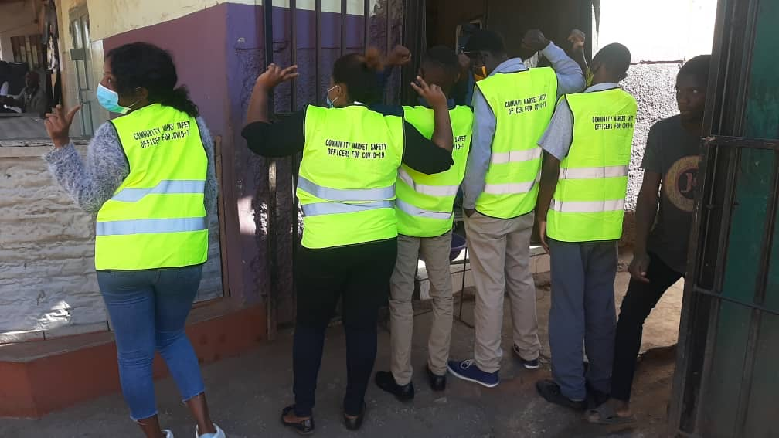

Thank You!

