Slide 1
COVID-19-Associated Orphanhood and Deaths among Grandparent Caregivers: The Far-reaching Impact of Pandemic Disparities
Susan Hillis, Ph.D., M.S.
Co-Chair, Global Reference Group on Children Affected by COVID-19 and Crisis: Joint Estimates and Action
Gretchen Bachman, M.B.A.
United States Agency for International Development (USAID)
June 13, 2022
On behalf of Global Reference Group on Children Affected by COVID-19
www.cdc.gov/coronavirus/2019-ncov/global-covid-19/index.html

Slide 2
Global minimum estimates of children affected by COVID-19-associated orphanhood and caregiver death, Feb 26,2020 – Feb 14, 2022
Sources: Imperial COVID-19 Orphanhood Calculator available at: https://imperialcollegelondon.github.io/orphanhood_trends/

Slide 3
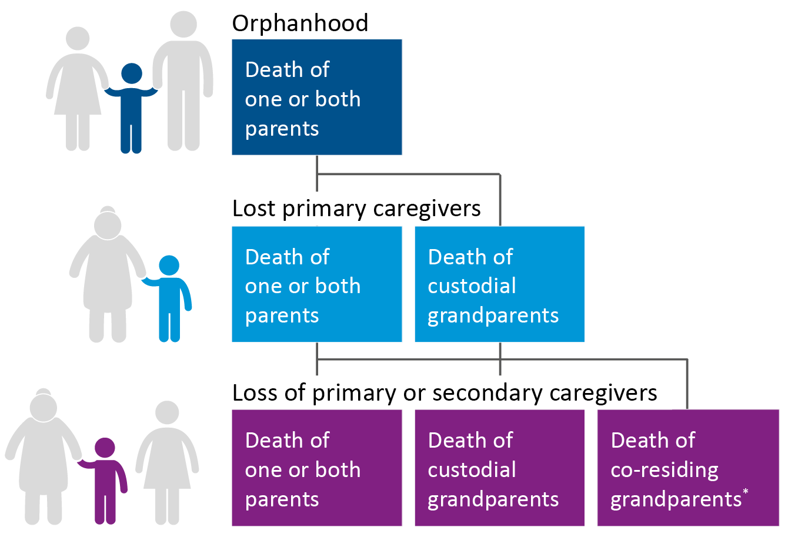
Global minimum estimates of children affected by COVID-19-associated orphanhood and caregiver death, update for May 12, 2022
7.5 million children
Loss of primary caregivers
8.0 million children
10.4 million children
Source: Cumulative numbers Real-time COVID-19 Orphanhood Calculator https://imperialcollegelondon.github.io/orphanhood_calculator/

Slide 4
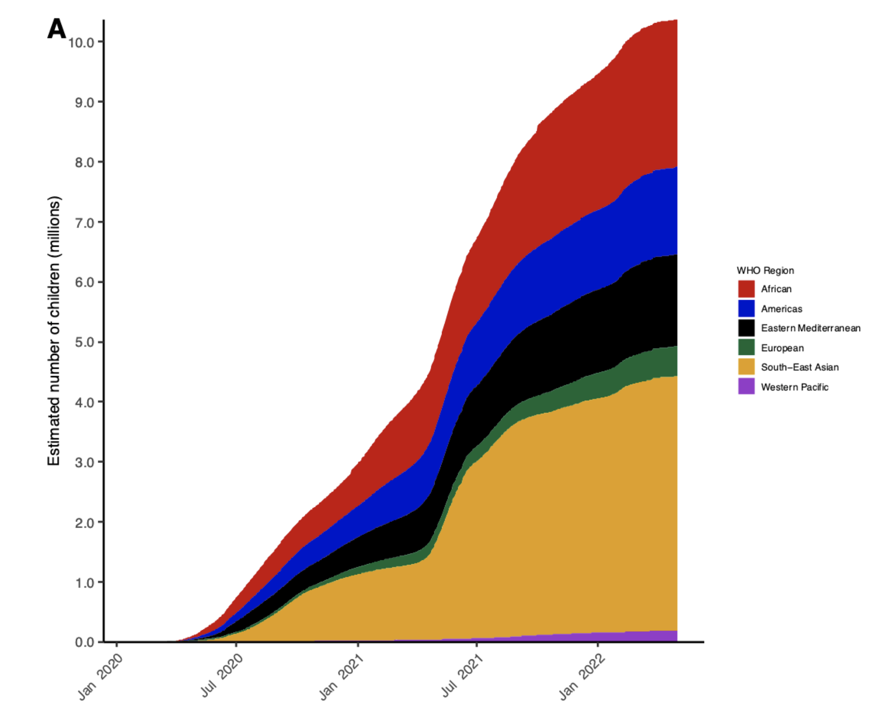
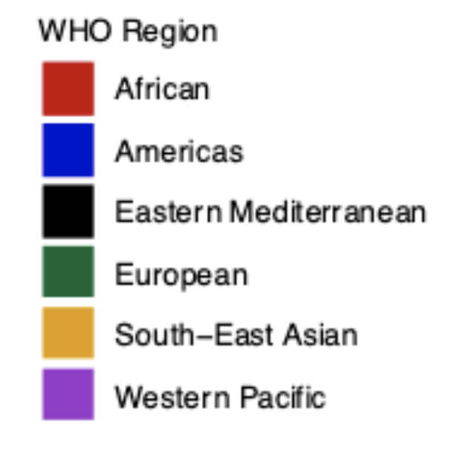
Regional trends in minimum estimates of COVID-19-associated orphanhood​ and caregiver death, March 1 – May 1, 2022
Source: 10.4 Million Children Affected by COVID-19-associated Orphanhood and Caregiver Death: An Imperative for Action available at: https://www.medrxiv.org/content/10.1101/2022.05.08.22274788v1.full.pdf

Slide 5
3 of every 4 COVID-19 orphans worldwide have lost their fathers, and are therefore at increased risk of exploitation, abuse, poverty, and vulnerability to violent extremism *, Feb 2022
Sex of deceased parent
*BWIRE: Battle against violent extremism can be won (citizen.digital), Developmental Predictors of Violent Extremist Attitudes: A Test of General Strain Theory - Amy Nivette, Manuel Eisner, Denis Ribeaud, 2017 (sagepub.com),
Updated estimates from source :5.2 Million Children Affected by Global Surges in COVID-19-Associated Orphanhood and Caregiver Death (2022) The Lancet CAH https://www.thelancet.com/journals/lanchi/article/PIIS2352-4642(22)00005-0/fulltext

Slide 6
2 of every 3 COVID-19 orphans worldwide are adolescents, and are hence at increased risk of sexual violence, incident HIV, mental health problems, adolescent pregnancy, severe distress, Feb 2022
Age (years)
Updated estimates from source :5.2 Million Children Affected by Global Surges in COVID-19-Associated Orphanhood and Caregiver Death (2022) The Lancet CAH https://www.thelancet.com/journals/lanchi/article/PIIS2352-4642(22)00005-0/fulltext

Slide 7
Care for COVID-19-Affected Children: Incremental Extension of United States Agency for International Development (USAID) and the U.S. President’s Emergency Plan for AIDS Relief (PEPFAR) investments, low cost and high return
Children reach their full potential
in Safe & Loving Families
PREVENT
COVID-19-deaths of caregivers
PROTECT
children from poverty, adversity and violence
PREPARE
family-based support, avoid institutionalization

Slide 8
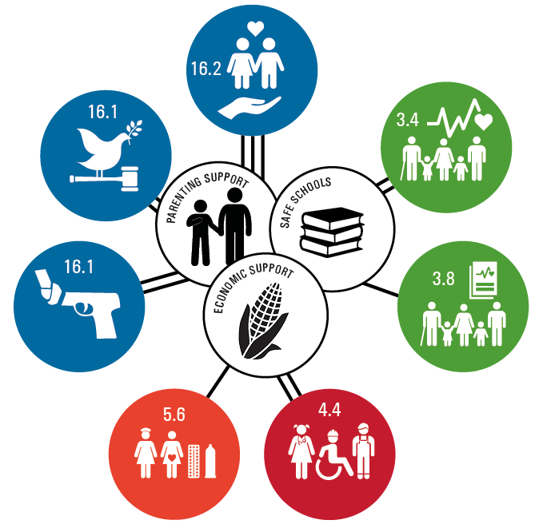
Protect children: Support evidence-based cost-effective strategies linked to multiple protective impacts for children
Abuse
Parenting support
Economic support
Educational support
Community violence
Mental Health
Perpetration of violence
HIV Care retention
High-risk sexual behaviors
School progression
Source: Cluver, Orkin, Toska, Campeau, Webb, Carlqvist, Sherr, (2019) Lancet CAH AIDS, South Africa, with circles representing 2030 Sustainable Development Goals for health, peace, education, and gender equality

