Slide 1
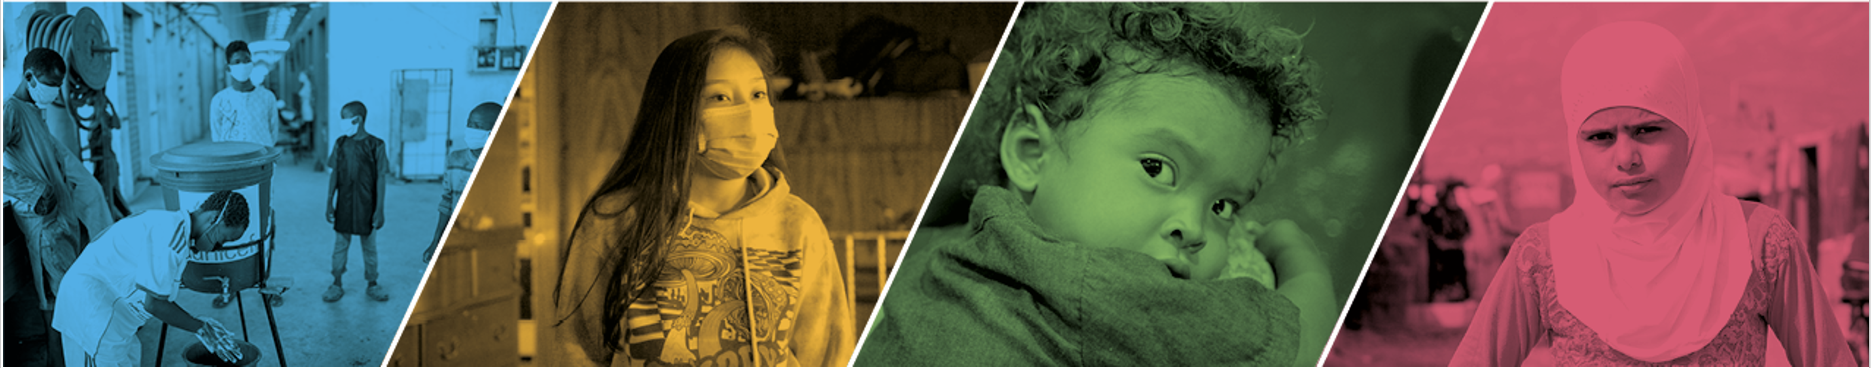
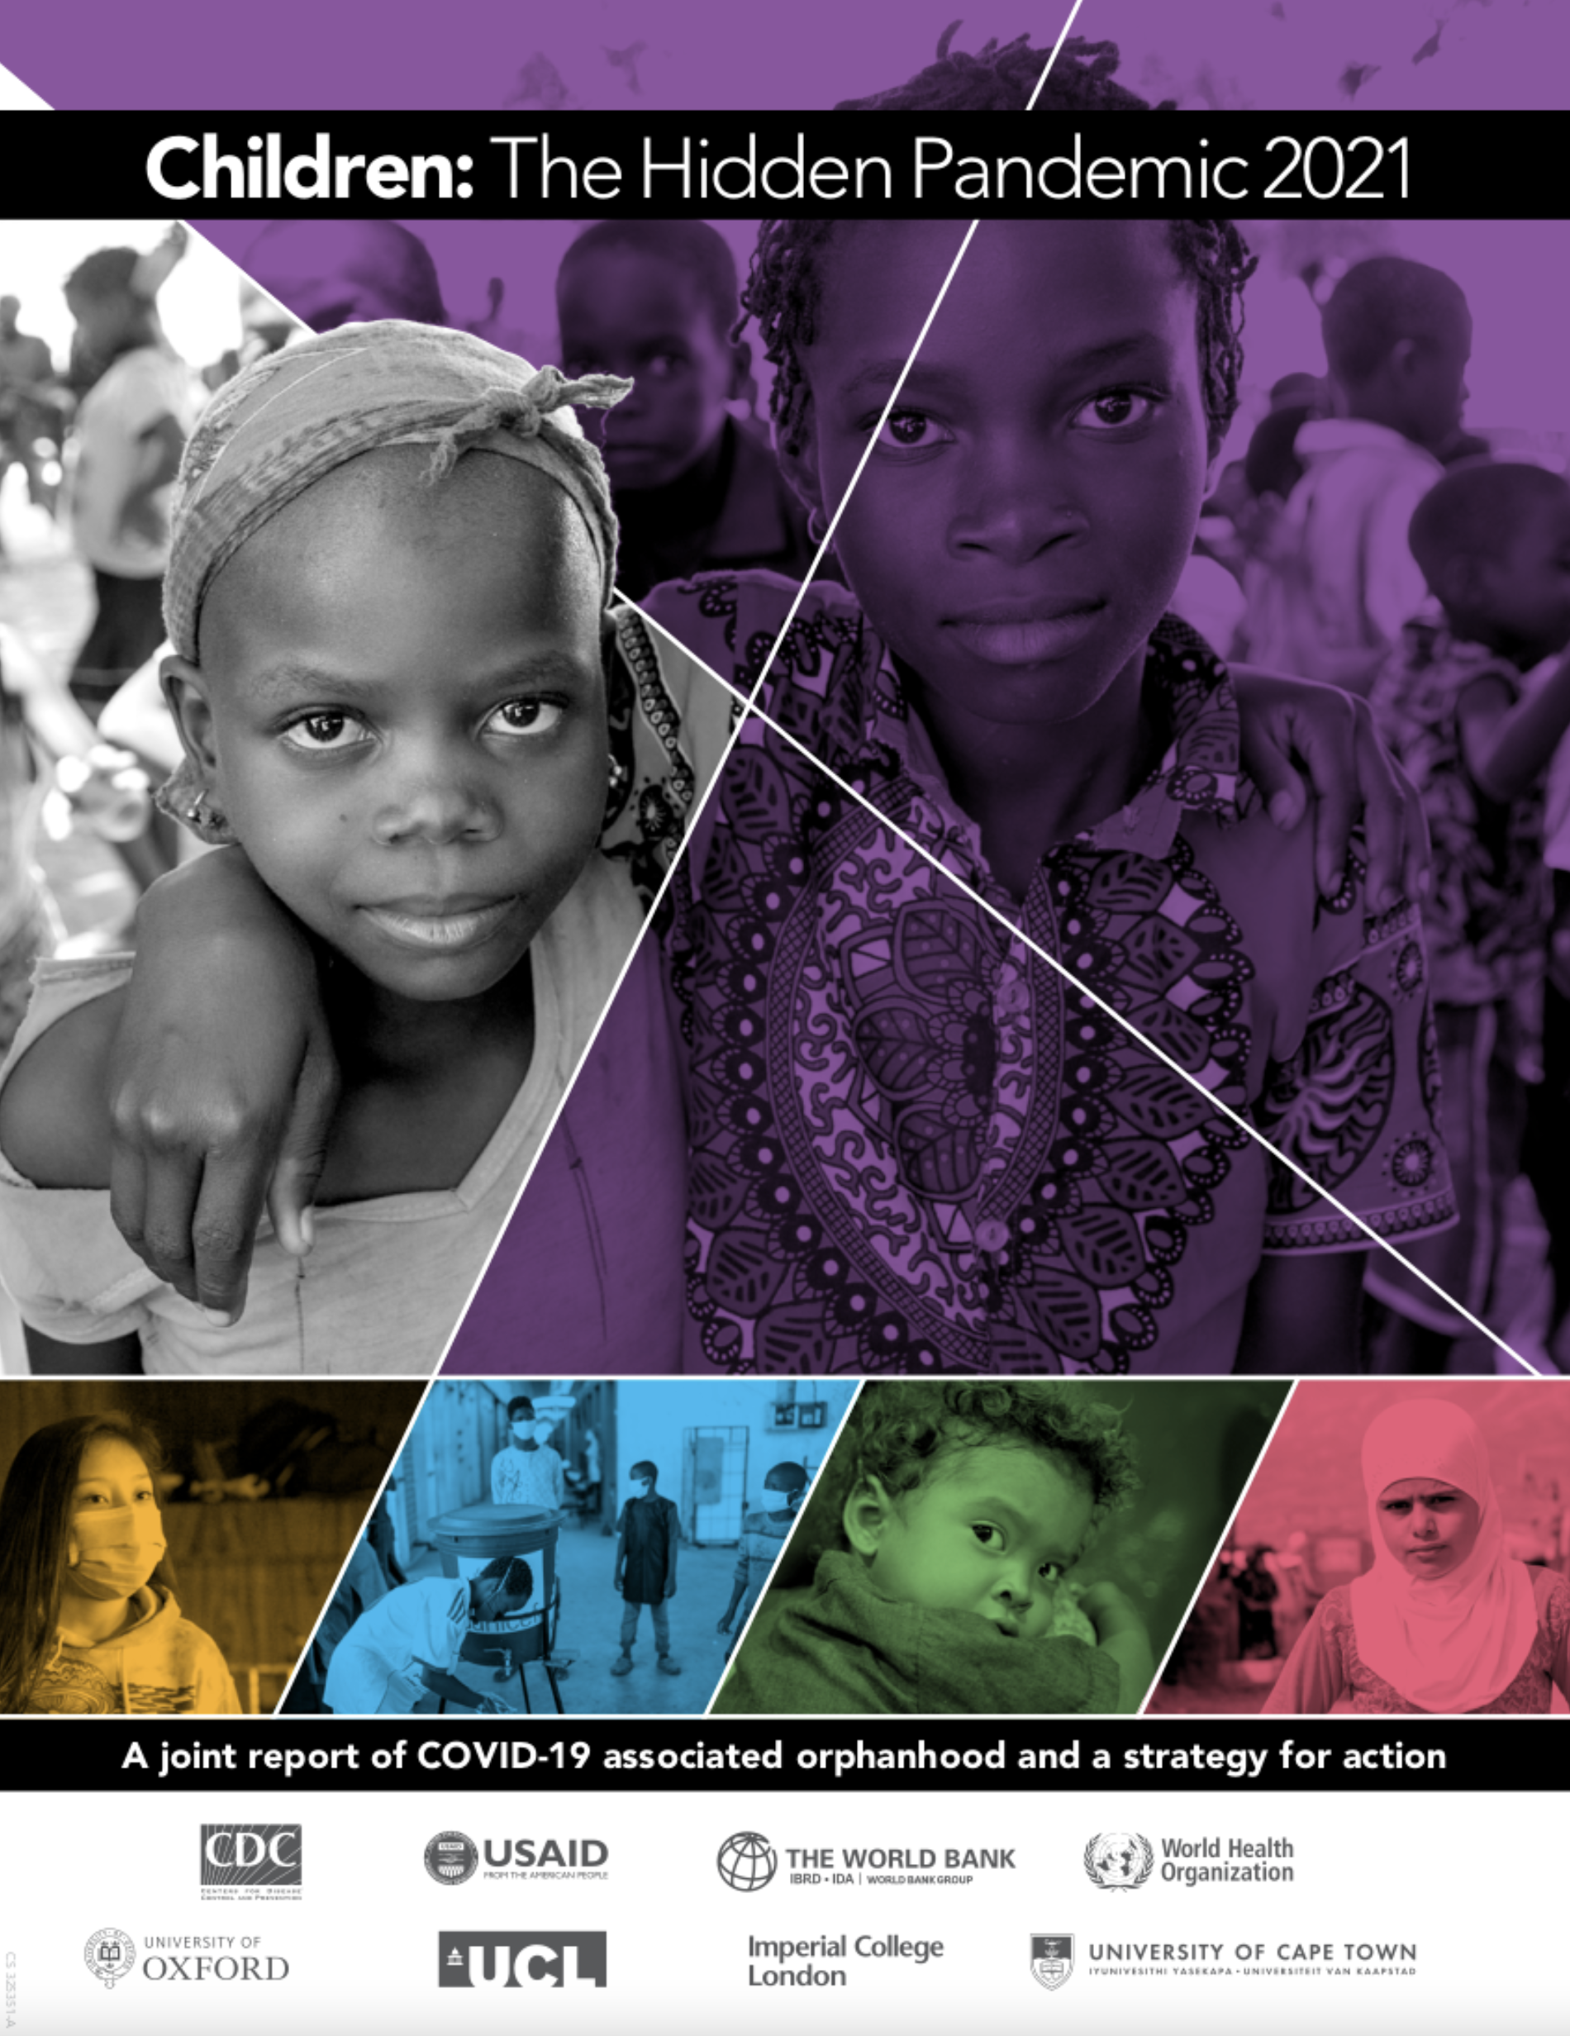

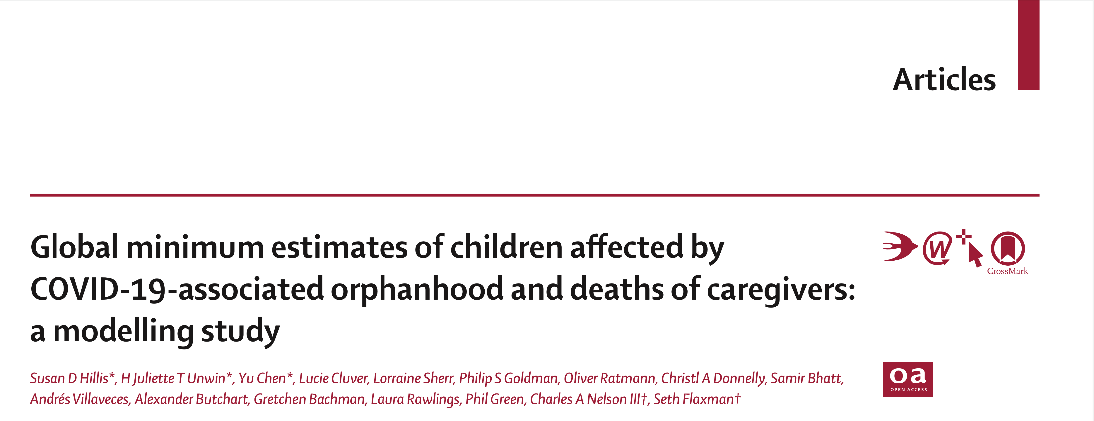

Slide 2
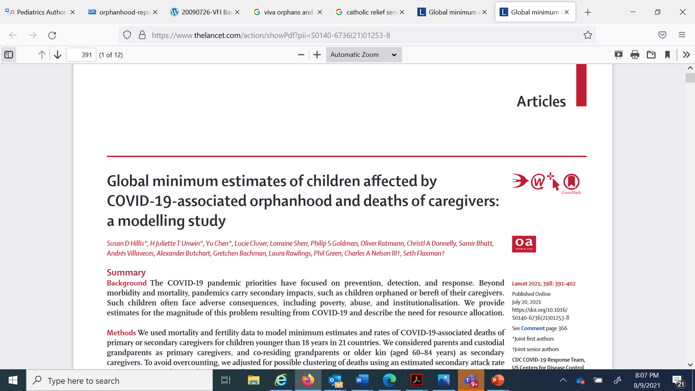
-- First estimates show over 3 million deaths left over 1.5 children affected by deaths of their parents and caregivers – for every 2 COVID-19 deaths, 1 child faces orphanhood.
-- Published July 20, 2021, with coverage of over 120 media outlets in 21 countries and 9 languages

Slide 3
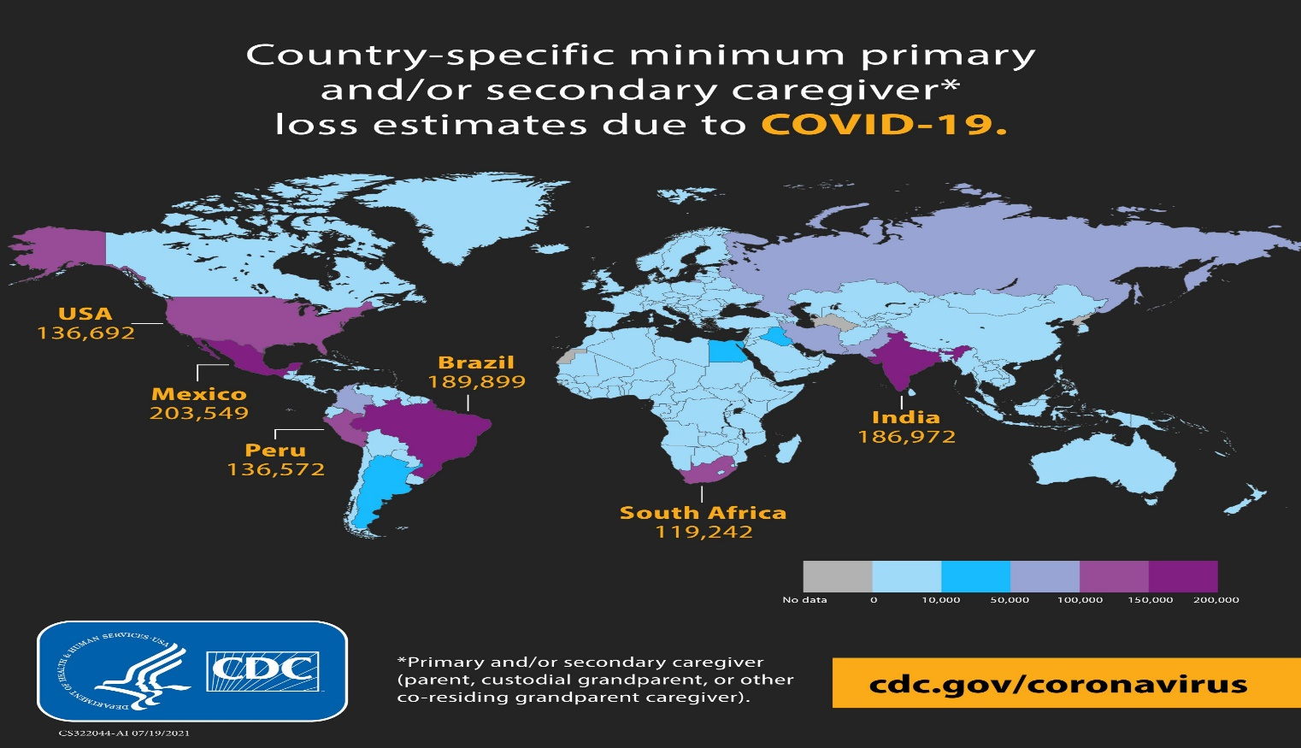
Findings
All regions affected
Countries of concern
Dynamic process

Slide 4
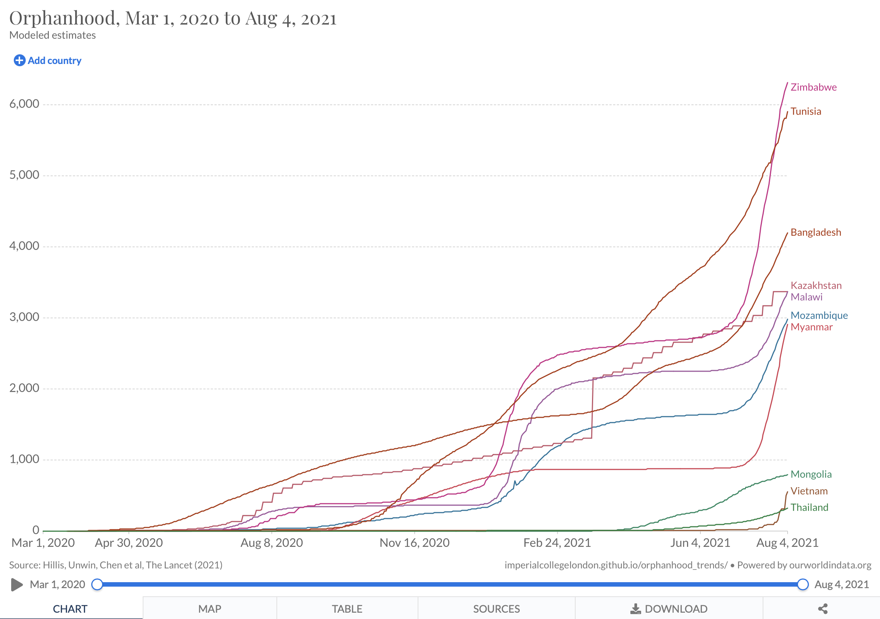
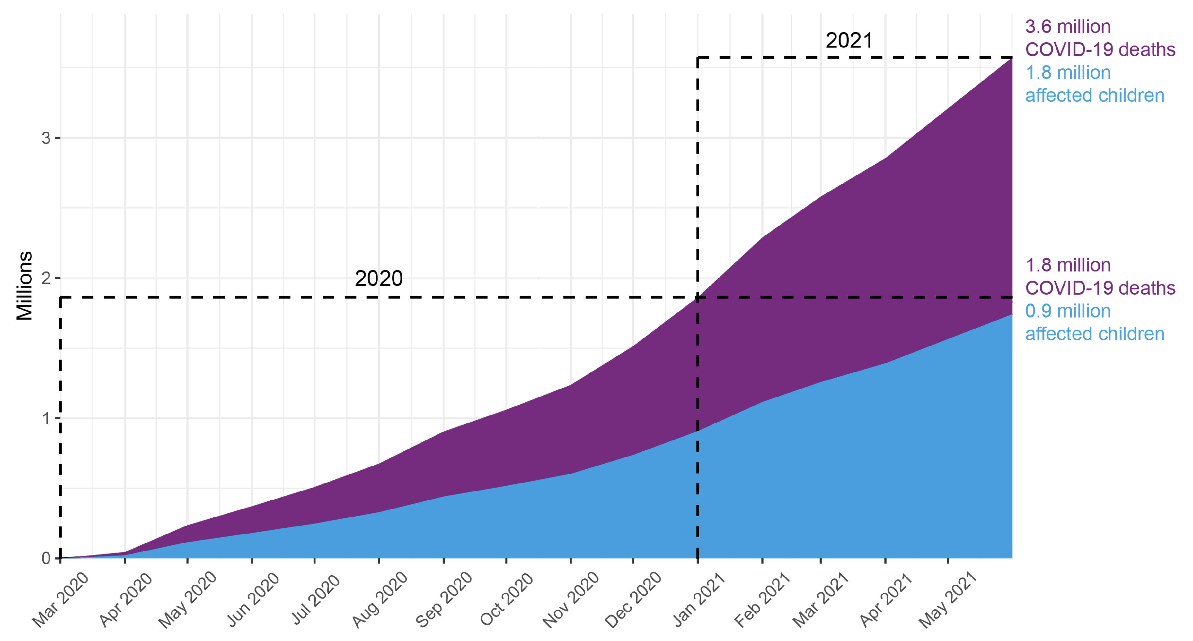
COVID-19 deaths and children affected by orphanhood and death of caregivers: Comparison of trends between March 1 – Dec 30, 2020, and Jan 1 – May 31, 2021 AND ‘Real Time COVID Calculator’
Real Time COVID Calculator
Recent months
Countries of concern

Slide 5
During April 2021, due to COVID-19, every 12 seconds
1 child was orphaned or faced death of a grandparent or caregiver
These numbers will continue to increase and persist for years

Slide 6



A call to action
PREVENT loss: Support vaccine equity and public health mitigation
PREPARE families: Support kinship, fostering, or adoption for children in need of alternative care
PROTECT children: Against violence by supporting evidence-based interventions to strengthen positive parenting, economic support, and educational growth

Slide 7
Source: https://data.unicef.org/resources/covid-19-confirmed-cases-and-deaths-dashboard/
Notes:
To shed light on the situation, UNICEF created the COVerAGE database (COVerAGE-DB), an open-access database compiled by the Max Planck Institute for Demographic Research (MPIDR). It provides insights into how children and adolescents have been directly impacted by COVID-19. To compile the database, MPIDR collates available age- or age- and sex-disaggregated COVID-19 cases and death based on data that were extracted from reports published by official governmental institutions in a variety of formats (COVID reports, dashboards, health systems, etc.,). As of 1 August 2021, data had been collected from 108 countries from January 2020. Country data were updated on different dates from February 2020 to July 2021.
Although the MPIDR COVerAGE database is recompiled every day, its sources for age-disaggregated data are updated less frequently. Among the countries in the database, the data of 78 nations (72 per cent) were updated after October 2020, while the rest were done earlier.
The map below illustrates that even if a country has data available, low counts of age-specific cases or death indicate that a lack of completeness exists. This means that not all cases and deaths of COVID-19 are being captured. Completeness of COVID-19 cases and deaths may be even more limited in certain age groups, making interpreting data for some age ranges even more difficult. Comparing the proportions of COVID-19 cases and deaths captured by the MPIDR COVerAge database versus the JHU COVID-19 database, the coverage could be lower than 1 per cent as the country only has limited or outdated records of age-disaggregated data.
Note: The ratio of cases and deaths in the MPIDR COVerAGE database versus the JHU COVID-19 database is labelled on the top of the bar representing the MPIDR COVerAGE database.
Source: The MPIDR COVerAGE database and the JHU COVID-19 database.
Note: The bar represents the total number of COVID-19 cases and deaths from the MPIDR COVerAGE database and the JHU COVID-19 database by income group. The solid circle represents the ratio of the MPIDR COVerAGE database versus the JHU COVID-19 database. National income classification follows the World Bank income classification, 2020.
Source: The MPIDR COVerAGE database and the JHU COVID-19 database.
Low availability of data by age in low- and lower-middle-income countries
Drawing definitive conclusions from the available COVID-19 case and death data can be difficult for many reasons. These reasons include the availability of detailed disaggregated data, coverage of testing and death reporting, and regional disparities all limit the interpretability of data. Data submitted and included in the database may not be fully representative of the true state of COVID-19 cases and deaths within a country, and cannot be generalized to other countries where little or no data are available. Therefore, these data should be interpreted with caution, and can only provide an estimate of the true number of cases and deaths among children and adolescents.
Compared to many publicly available COVID-19 databases, a unique and useful property of the Max Planck Institute for Demographic Research (MPIDR) COVerAGE database (COVerAGE-DB) is the availability of age- and sex-disaggregated information. Even so, not all countries reporting COVID-19 data are able to report such disaggregated data. For this reason, COVerAGE-DB contains fewer reported cases and deaths compared to other global, publicly available datasets, such as those produced by Johns Hopkins University (JHU). Additionally, to develop standardized age-disaggregated data some redistribution and recalculation methods are applied, which can contribute to some uncertainty in these numbers. See the COVerAGE project page for full details on database construction.
Moreover, as is the case with any COVID-19 related dataset, data provided by countries on COVID-19 cases and deaths may be incomplete. Available data on COVID-19 cases and deaths inherently depends on testing strategies and the availability of resources. During the early stage of the pandemic, only hospitalized or most severe cases were tested in some countries, meaning data can only provide an underestimate of the true number of national COVID-19. Comparatively, reporting of COVID-19 deaths may be high in countries that required detailed reporting and registration of deaths.
As shown in the above figure, the MPIDR COVerAGE database contains only 49 per cent of cases and 67 per cent of the deaths captured in the JHU database, due to limited information on the age of confirmed COVID-19 cases and deaths in some countries. When considering by both age and sex, the MPIDR COVerAge database contains even fewer reported COVID-19 cases and deaths compared to the John Hopkins University database: 30 per cent of global total cases and 64 per cent of global total deaths.
Age-disaggregated data from the COVerAGE database captures 49 per cent of the global COVID-19 confirmed cases and 67 per cent of the global COVID-19 deaths
Note: Please select to compare cases or deaths. The colour scale indicates the ratio of the MPIDR COVerAGE database versus the JHU COVID-19 database. Red indicates a low ratio while blue indicates a high ratio. The ratio exceeds 100 per cent as some countries in the MPIDR COVerAGE database have higher case or death counts than the JHU COVID-19 database.
These maps do not reflect UNICEF's position on the legal status of any country or territory or the delimitation of any frontiers.
Source: The MPIDR COVerAGE database and the JHU COVID-19 database.
The ratios of cases and deaths captured by the COVerAGE database could be very low in some countries
Finally, it is important to consider the availability of resources and health data systems capacities when drawing comparisons between countries. Many resource-limited settings may be unable to test, record, or provide data to the extent of other countries. As data become more detailed, as with age- and sex-disaggregated data, low-income countries, in particular, have fewer data and worse coverage in the MPIDR COVerAGE database.
The next two page tabs present age-disaggregated results and age- and sex-disaggregated results.
© 2021 Mapbox© OpenStreetMap
Filter Select
Inclusive
Cases
Deaths
Ratio (%)
0
117
Disaggregated data
Global
The decline in mortality over the last three decades has meant the survival of millions of children, adolescents and young people, but these lives are now under threat from the global COVID-19 crisis. The global COVID-19 data on the number of cases or deaths among children or adolescents are limited. This makes it challenging to understand the many ways in which children and young people are being affected by the pandemic.
Cases
Deaths
Ratio of cases and deaths in the MPIDR COVerAGE database to cases and deaths in the JHU COVID-19 database
Number of countries with data disaggregated by age by income group
Cases
Note: National income classification follows the World Bank income classification, 2020.
Source: The MPIDR COVerAGE database.
Countries with no data
Countries with data by age
Deaths
Total number of disaggregated COVID-19 confirmed cases and deaths versus the global
Download data for charts on this page
Data availability on age-disaggregated COVID-19 cases and deaths, by country
© 2021 Mapbox© OpenStreetMap
Cases and deaths with age disaggregation
Only cases with age disaggregation
Only deaths with age disaggregation
No data
The COVerAGE database includes 98 million confirmed COVID-19 cases by age from 103 countries and 2.8 million deaths by age from 79 countries, in which 74 countries have data by age for both cases and deaths

Slide 8
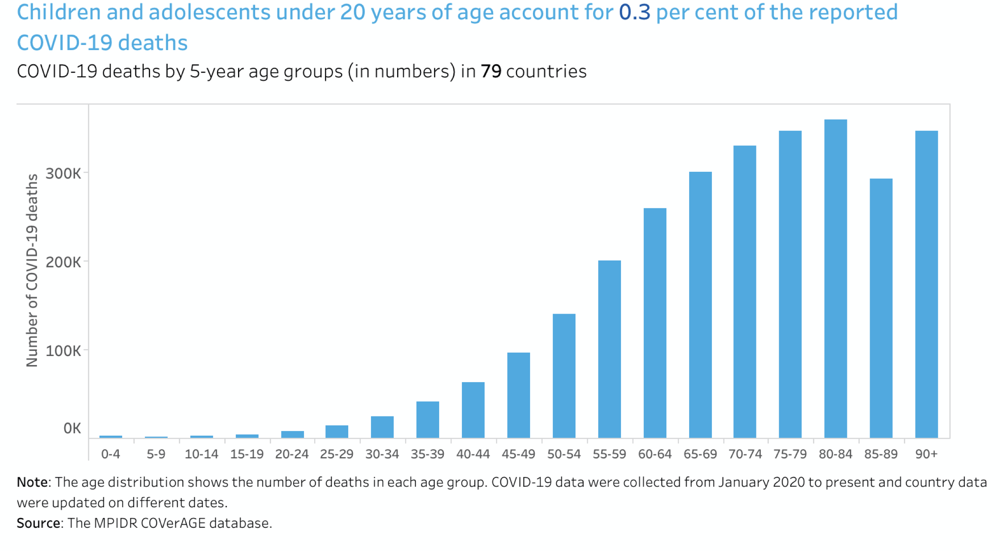
Source: https://data.unicef.org/resources/covid-19-confirmed-cases-and-deaths-dashboard/

