Slide 1
Faith Community Engagement to Mitigate COVID-19 Transmission Associated with a Religious Mass Gathering in Uman, Ukraine
PEPFAR Faith and Community Initiative
New Foundations of Hope Webinar Series
December 8, 2021
Notes:
CDC ITF was requested by US Mission, CDC/Ukraine, and the Ministry of Health to assist with COVID-19 mitigation measures for a religious mass gathering in Uman Ukraine

Slide 2
Presenters
Lauren Erickson-Mamane, Centers for Disease Control and Prevention (CDC)
Rabbi David Katz, Rabbinical Alliance of America (RAA)
Rabbi Dr. Aaron Glatt, Mount Sinai South Nassau & RAA
Rabbi Zvi Gluck, Amudim
Dr. Ezra Barzilay, CDC Ukraine
Olga Gvozdetska, Public Health Center of the MOH of Ukraine (UPHC)

Slide 3
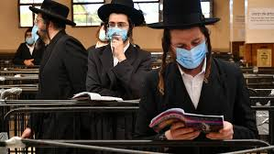
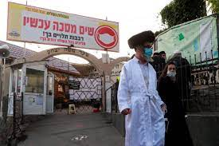
Uman Pilgrimage
Notes:
2020 COVID-19 travel restrictions, ~3,000 pilgrims at border between Belarus and Ukraine¹
CDC was requested to assist with mitigation measures among 2021 pilgrims

Slide 4
Uman, Ukraine Pilgrimage
Annual pilgrimage of approximately 30,000 Hassidic and Orthodox Jews to Uman, Ukraine during Rosh Hashanah (Jewish New Year)
Pilgrims come to pray at the burial place of Rabbi Nachman
Bulk of pilgrims who come from the US are from the northeast region, particularly NYC
In 2021, Rosh Hashanah began at sundown Sunday September 6th and lasted until sundown September 8th.
On Ukraine’s Border, the Coronavirus Ends a Hasidic Pilgrimage - The New York Times (nytimes.com)
Notes:
Each year approximately 30,000 Hasidic and other Jews travel to Uman, Ukraine during Rosh Hashanah (Jewish New Year) to daven (pray)at the burial place of Rabbi Nachman, an 18th-century luminary who founded the Breslov Hasidic movement. In 2021, Rosh Hashanah begins at Sundown Sunday September 6 and goes through September 8. The bulk of pilgrims who come from the US, are particularly from the northeast region.

Slide 5
COVID-19 Outreach to Hasidic & Orthodox Jewish Communities: Challenges and Opportunities
Rabbi Aaron E. Glatt, MD, MACP, FIDSA, FSHEA
Department of Medicine
Chief, Infectious Diseases & Hospital Epidemiologist
Mount Sinai South Nassau
Professor of Medicine
Icahn School of Medicine at Mount Sinai

Slide 6
COVID-19:
A Most Difficult year...
But hopefully with a happy ending!

Slide 7
Major Educational Opportunities
Different types of COVID-19 vaccines
Efficacy of these vaccines
Safety of these vaccines, including in selected subgroups
Pregnant, nursing and women trying to get pregnant;
People with underlying medical conditions or allergies;
People who have antibodies to COVID-19
Do the variants change things?
What are “booster shots”?
I had COVID-19 - why should I get vaccinated?

Slide 8
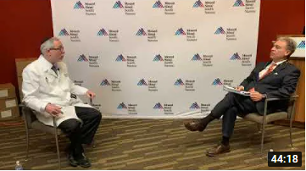
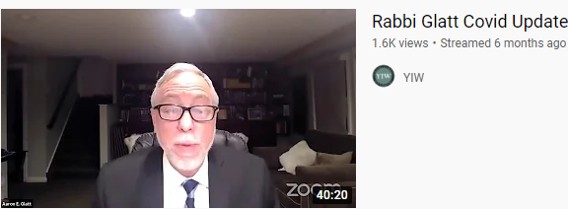
Educational Activities
Education for different Jewish communities
Education for major Rabbinical organizations
Joint public messaging from these groups
Written weekly “COVID-19 Updates”
Mailed out by many groups
Weekly Zoom meetings to large audiences
YouTube Recordings of these sessions
Available online

Slide 9
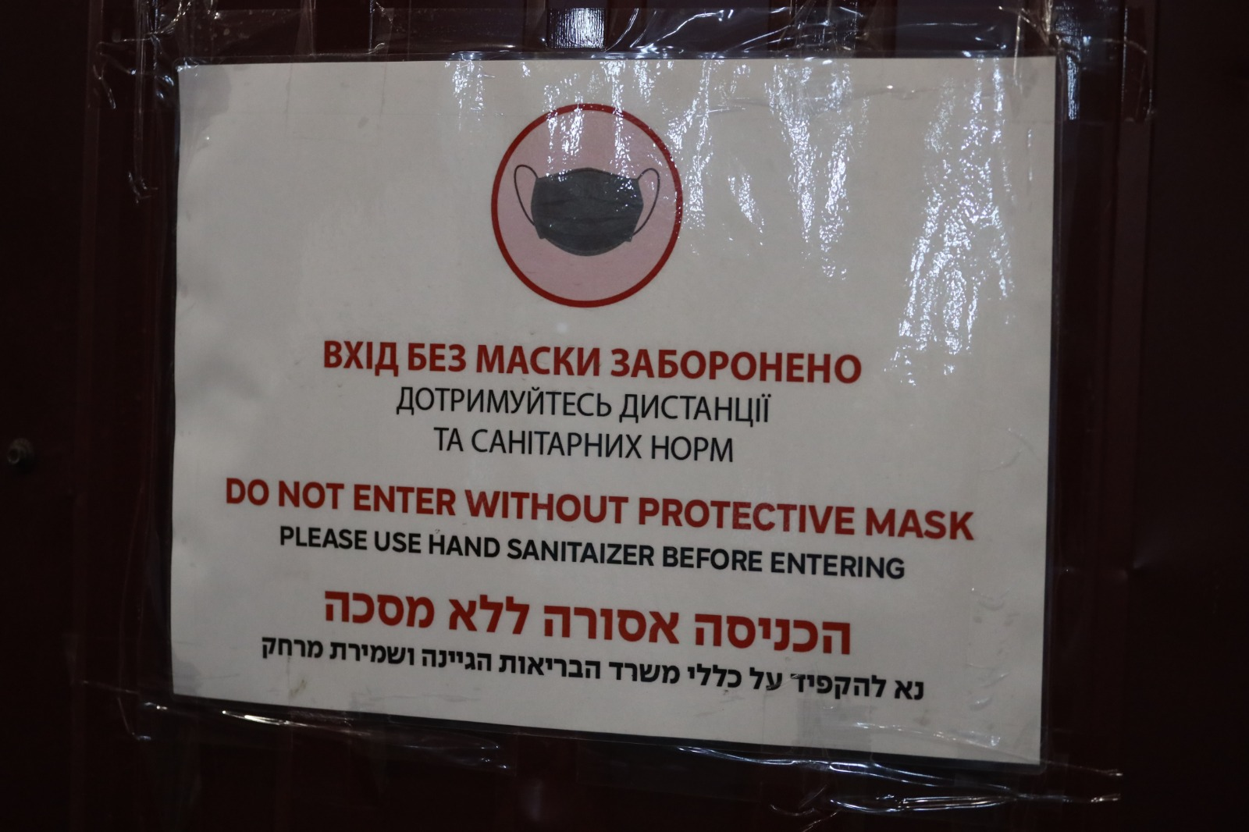
Challenges to COVID-19 Mitigation Strategies Among those Partaking in Pilgrimage
Ukraine did not restrict number of travelers or require vaccination of travelers in 2021
Motivation to undertake pilgrimage under adversity, restrictions might have actually provided more incentive to travel
Majority of pilgrims come from Breslov community from NYC and Israel
No grand Rabbi, no centralized leadership
Adherence to non-pharmaceutical interventions (masks and physical distancing) variable
Belief of herd immunity in the community given prior COVID-19 prevalence raised questions of the need for COVID-19 vaccination

Slide 10
Potential Super-spreader Event?
2019 Measles Outbreak in Israel linked to Uman Pilgrimage
Subsequent outbreak of Measles in Brooklyn, NY
Index case, child who traveled to Israel in October, 2019
Clark County, Washington measles outbreak
A child brought the virus back from Ukraine
Spread to 74 other people
McDonald R, Ruppert PS, Souto M, Johns D, McKay L, Bessette N, et al. Notes from the Field: Measles Outbreaks from Imported Cases in Orthodox Jewish Communities — New York and New Jersey, 2018–2019. MMWR Morb Mortal Wkly Rep 2019;68:444–445. DOI: http://dx.doi.org/10.15585/mmwr.mm6819a4external icon.
Oster M.. Jewish Telegraphic Agency. 2019. https://www.jta.org/quick-reads/israels-measles-outbreak-began-in-uman-ukraine
Gold M., Pager T. New York Times. 2019. New York Suburb Declares Measles Emergency, Barring Unvaccinated Children From Public - The New York Times (nytimes.com)
Notes:
In late September, following Rosh Hashanah and the annual Uman pilgrimage, measles cases exploded in Israel, to 949 in October
Meanwhile, a measles outbreak in New York began in October with a child in the Bensonhurst section of Brooklyn who had visited Israel
In Clark County, Washington, the measles outbreak is concentrated among a Russian-speaking community.
A child brought the virus back from Ukraine in December and it spread to 74 other people, mostly children, through schools, supermarkets and a bowling alley.

Slide 11
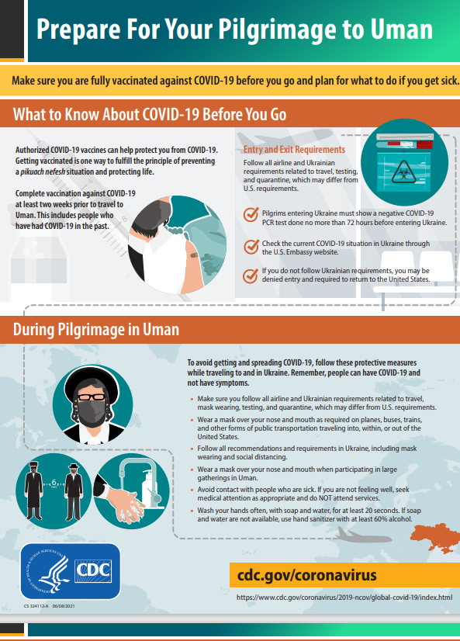
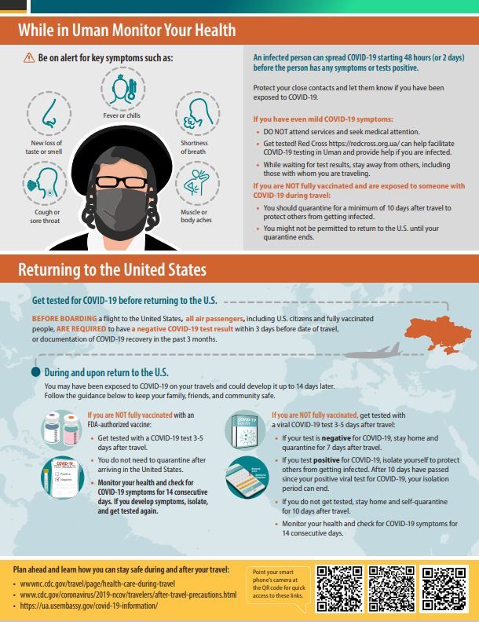
Multi-faceted Mitigation Strategy
Close collaboration with key advisors/partners and domestic task forces
Multi-faceted communications strategy:
Fact sheet in US Orthodox newspapers and Uman
WhatsApp blasts
Messages via Orthodox/Yiddish news hotline
Rabbinical Alliance of America YouTube show with Orthodox Rabbi/Medical Epidemiologist
Coronavirus Aid, Relief, and Economic Security Act (CARES) funding for the Public Health Center of the MOH of Ukraine supported activities in Uman City

Slide 12
2021
Uman COVID-19
debrief

Slide 13
The Challenge
Safety and Security First
As a provider of meals for pilgrims, Amudim was tasked to guard over the safety and security of thousands of pilgrims that rely on the largest event-based soup-kitchen in the Ukraine every year. These are some of the many challenges we faced:
40,000 pilgrims
20+ countries
Rapidly changing profile of COVID-19 in the world
Food is the most hygiene sensitive component of the pilgrimage
People often lower their guard (masks) while waiting for the meals
All measures need to be well-coordinated with multiple governments
At peak, more than two meals served per second

Slide 14
Core Prevention
Physical distancing throughout the compound
50% capacity in seating areas
6-8 seated at tables of 14
Crowd control at entrances and walkway
Ushers deployed throughout, supported by CCTV and a dispatcher
2m
keeping two meters (six feet)
Keeping people out who look sick, even if symptoms are mild

Slide 15
Investing in Safety
Over 500,000 Safety Items Distributed
01
02
03
Safety Stations
Personal Safety
Signage
Strategically and visibly deployed throughout the compound and in other key public locations in Uman
250,000 Uman-branded and disposable masks
25,000 personal sanitizer bags
and other items provided to facilitate compliance
120 Banners and posters
250,000 Personal information cards
and other information provided in English and Hebrew

Slide 16
Knowledge Center
Continuous monitoring of global conditions while making no assumptions: measures are based on worst-case scenarios (all red)
Daily Testing
MONITORING
All staff in the dining halls were required to wear masks and gloves and were tested daily (rapid antigen) from one week prior to the pilgrimage until one week after with additional PCR tests conducted every three days.
Zero Tolerance Enforcement
Over 20 ushers deployed to enforce the rules, supported by CCTV monitoring and two-way radios for instant response to non-compliance

Slide 17
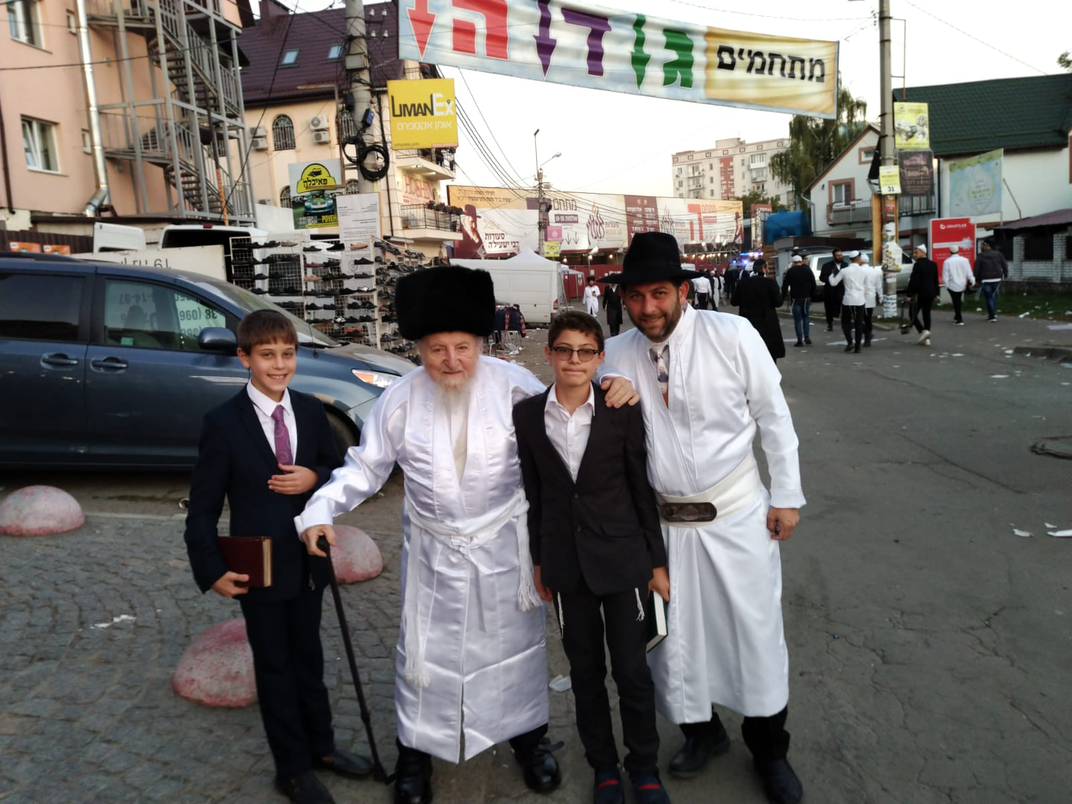
Protecting Our Families
Together. Thank you.

Slide 18
CDC Ukraine
Dr. Ezra Barzilay
CDC Ukraine Country Director

Slide 19
Helping Pilgrims Stay Safe During Rosh Hashanah in Uman
Public Health Center of the MOH of Ukraine

Slide 20
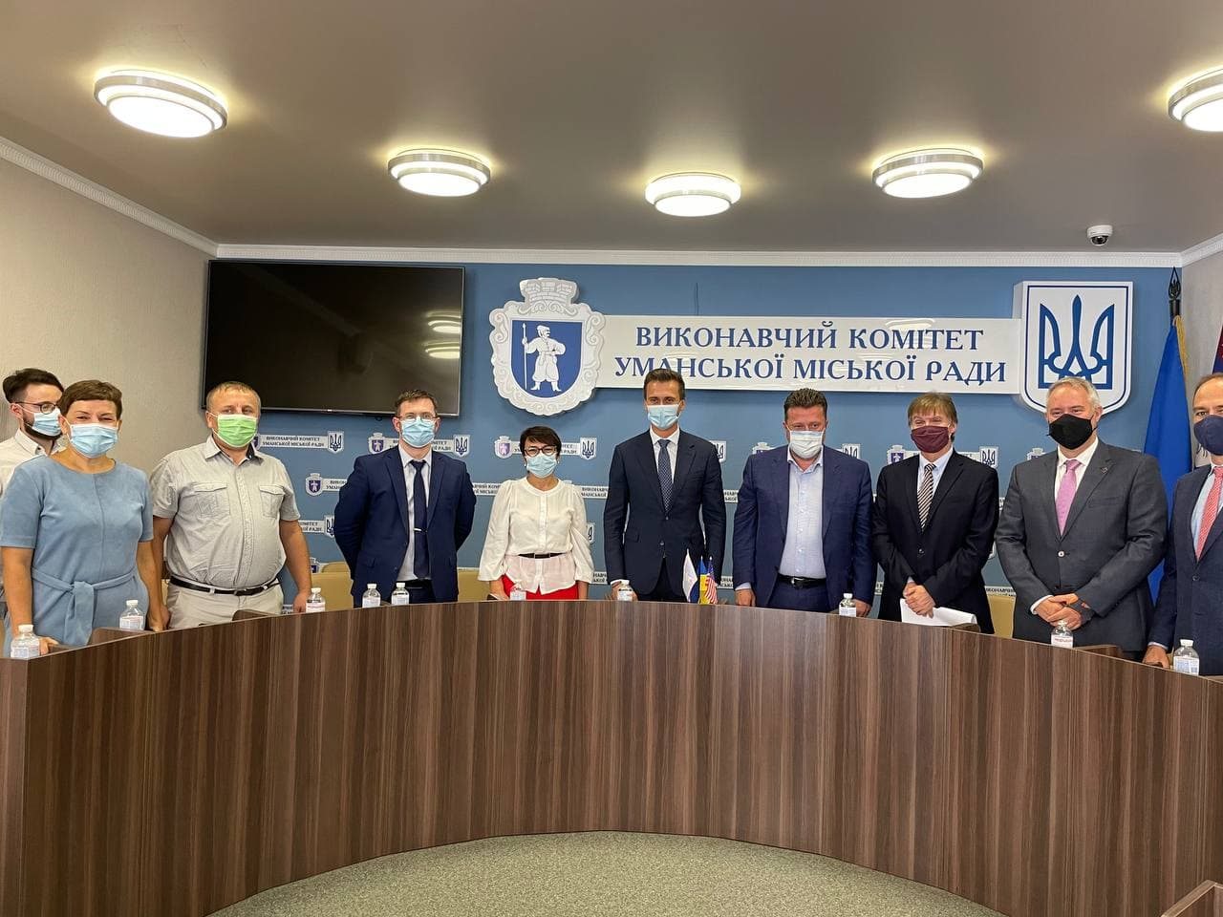
A Few Months Before Rosh Hashanah 2021
40,000 Hasidic pilgrims were expected to arrive in Uman in September 2021
In July-August, preparation meetings were held with the:
Ukrainian Red Cross
Rabbi Nachman of Breslov International Charitable Foundation
Federation of Jewish Communities of Ukraine
City administration of Uman and local organizations involved in preparing for the arrival of pilgrims.

Slide 21
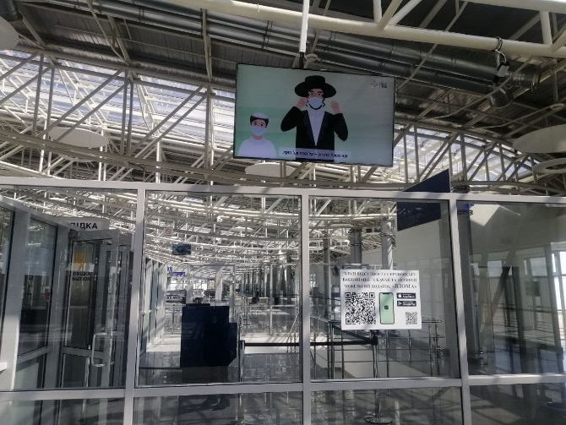
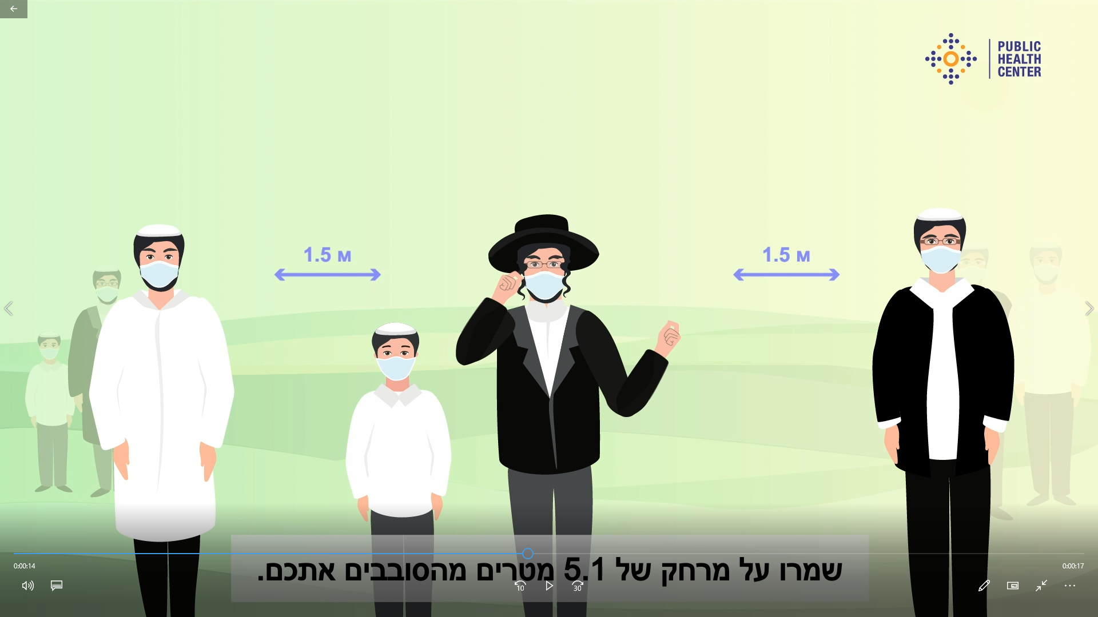
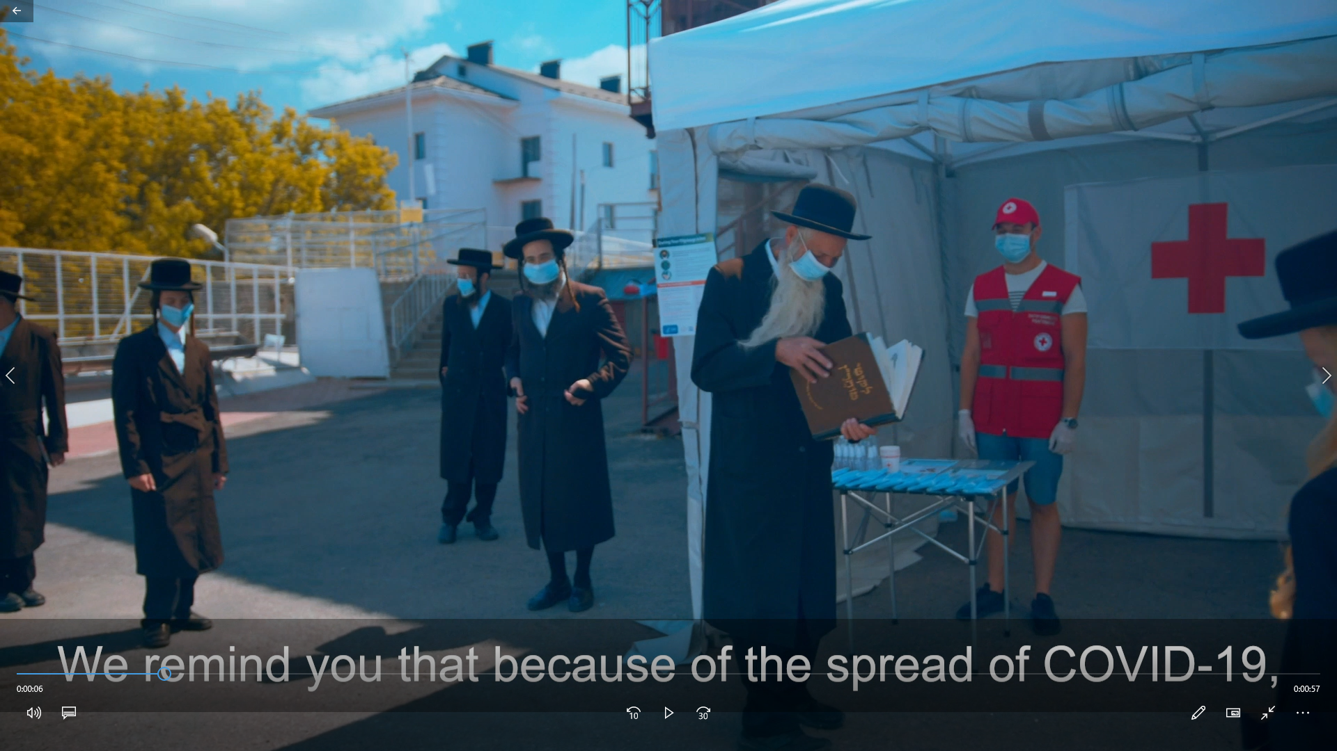
Videos for the Hasidic Jewish Community
Two videos with recommendations for the safe celebration of Rosh Hashanah, specifically targeting the Hasidic Jewish community were produced by Ukrainian Public Health Center (UPHC).
One broadcasted at the three international airports:
The second broadcasted in Uman, close to the pilgrimage site.

Slide 22
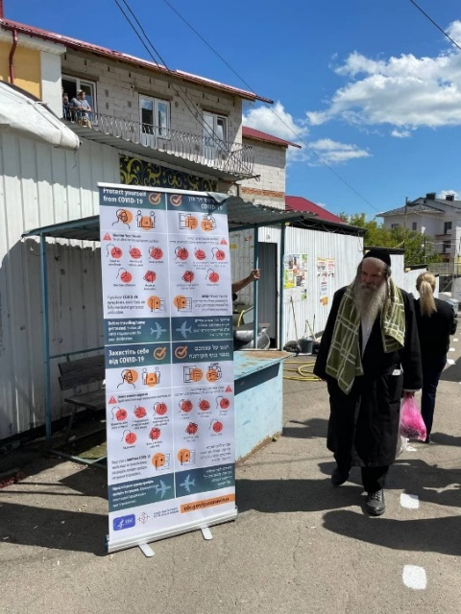
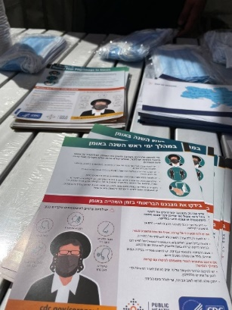
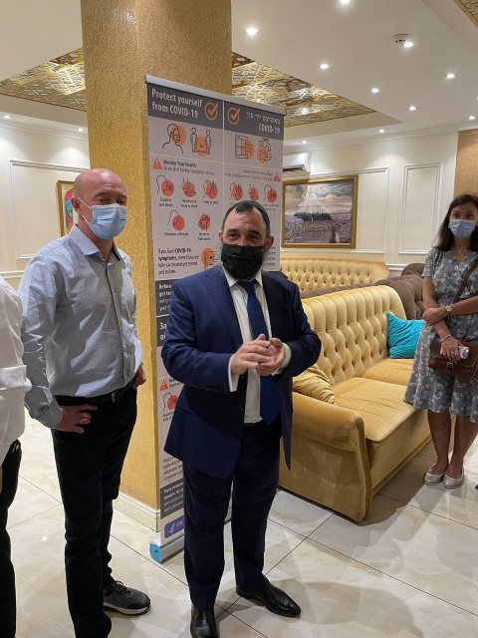
Printed Materials
14,000 CDC-developed fact sheets were delivered to the Rabbi Nachman of Breslov International Charitable Foundation for further distribution to pilgrims.
30 poster versions of the fact sheets were placed in hotel lobbies, Red Cross tents, local synagogues and near Rabbi Nachman’s burial place.

Slide 23
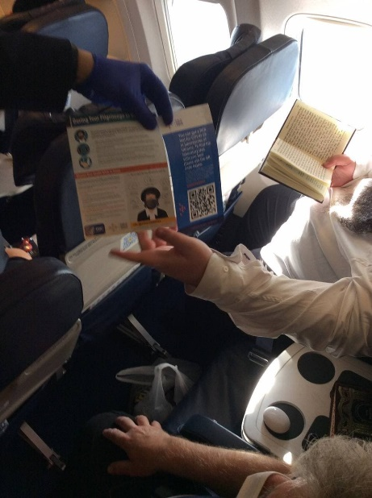
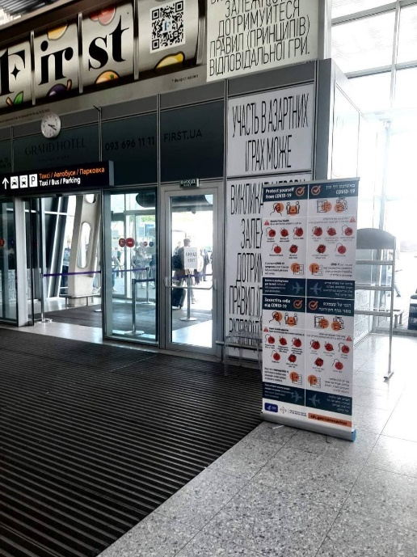
Collaboration with Airports and Airlines
10 poster versions of the fact sheets were placed at each airport in Boryspil, Zhuliany (Kyiv) and Lviv
Collaboration with Ukraine International Airlines
5,000 fact sheets were disseminated to pilgrims on the flights

Slide 24
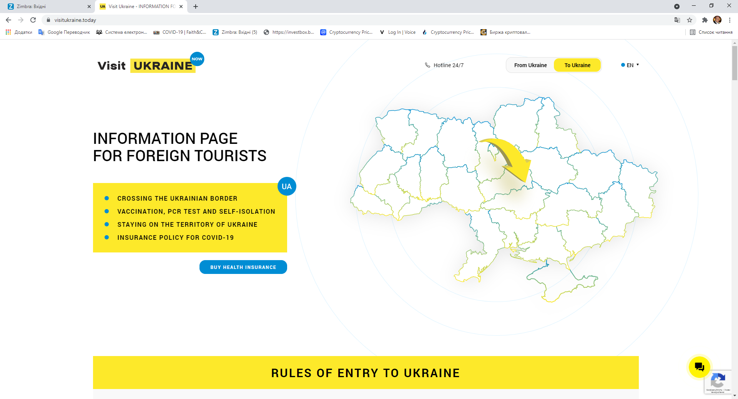
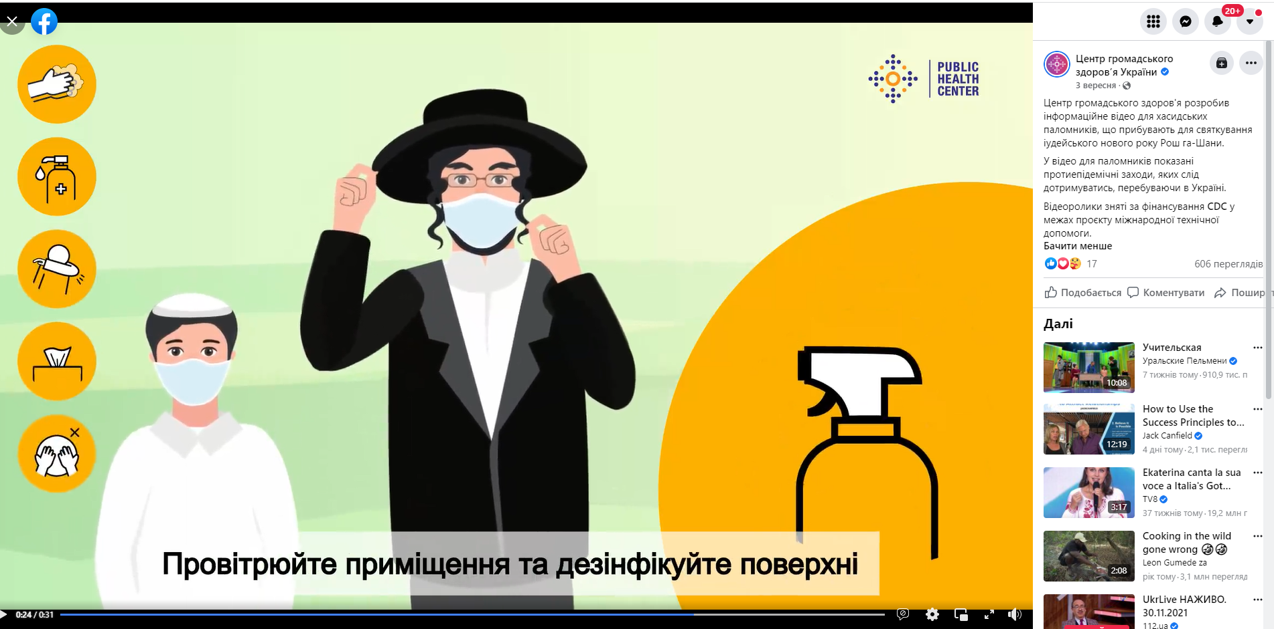
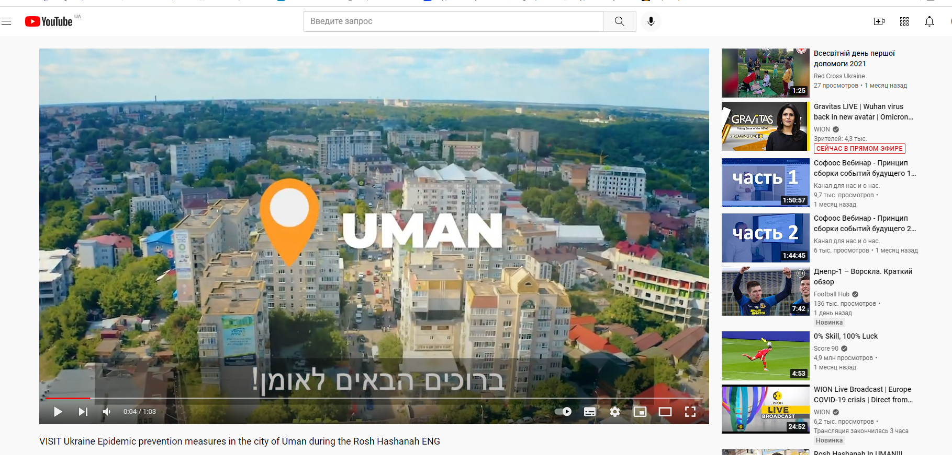
Sharing of Information
“Safe Celebration of the Jewish High Holidays” web content was posted on various social media outlets and the following websites:
UPHC
Visit Ukraine
Rabbi Nachman of Breslov International Charitable Foundation
Federation of Jewish Communities of Ukraine

Slide 25
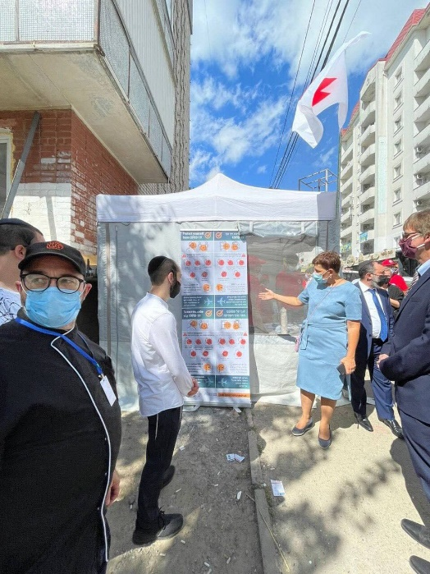
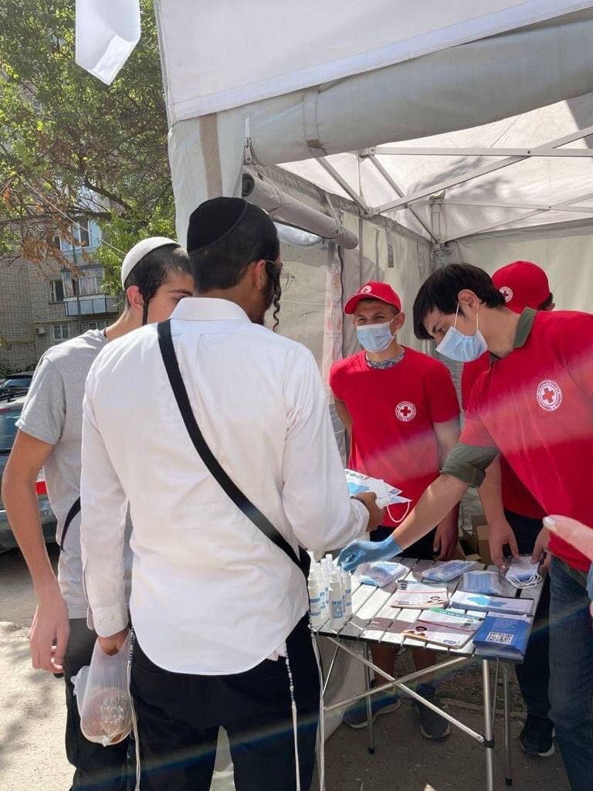
Collaboration with Ukrainian Red Cross
Three (3) information tents were placed in Uman.
30 Red Cross volunteers were trained jointly with the Rabbi Nachman of Breslov International Charitable Foundation.
19,000 bottles of hand sanitizer and 190,000 masks along with leaflets and posters were distributed to pilgrims.

Slide 26
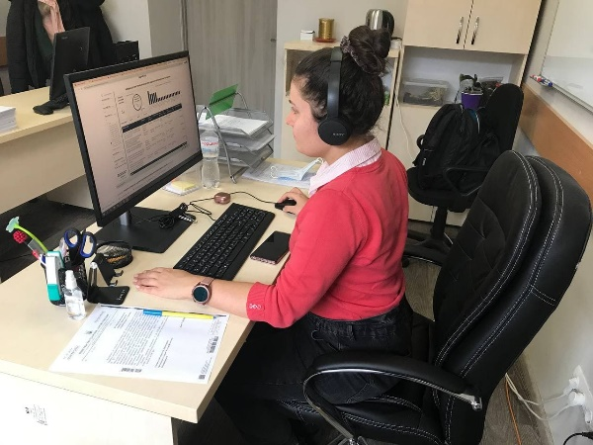
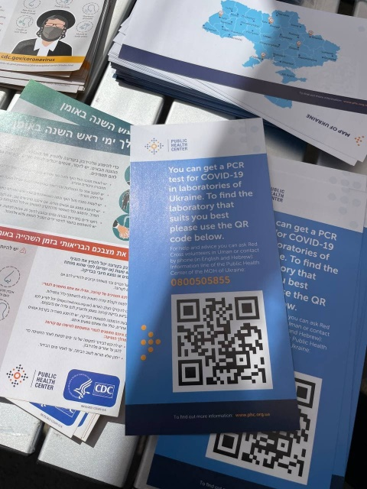
COVID-19 Hotline for Hebrew & English-speaking Pilgrims
UPHC added Hebrew and English-speaking operators to the PHC COVID-19 Hotline to address any COVID-19 related inquiries by pilgrims.
The number of the hotline was printed on the leaflets.
UPHC developed and disseminated leaflets carrying QR-codes with information and location of local laboratories that perform COVID-19 testing.

Slide 27
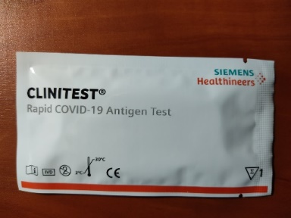
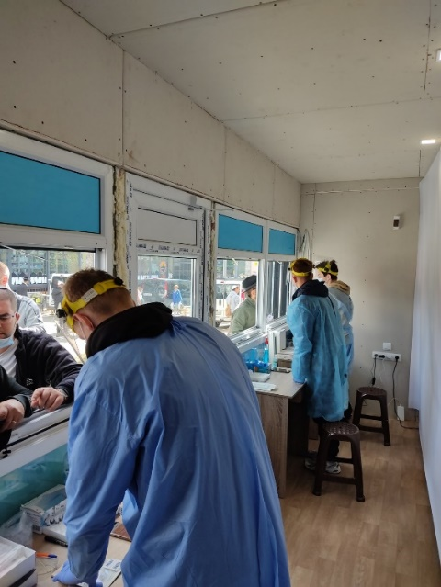
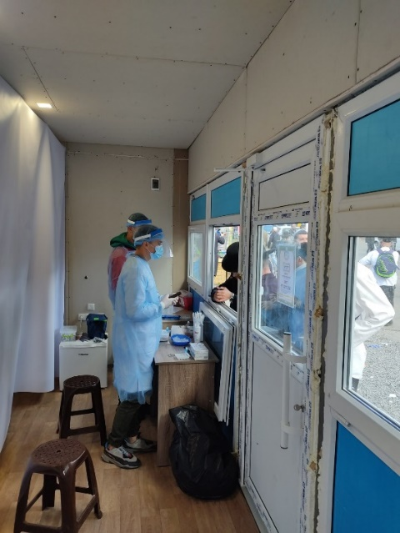
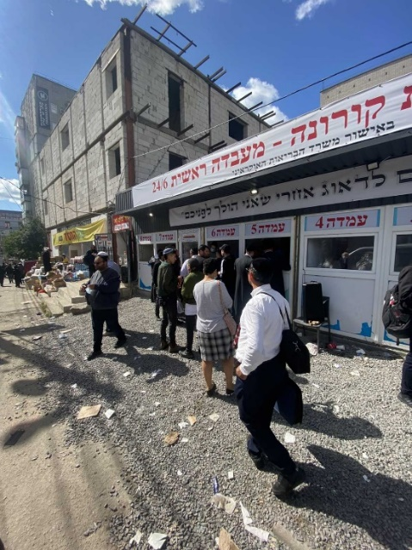
COVID-19 Testing
UPHC provided 50,000 antigen tests to Uman as part of their humanitarian assistance efforts.

Slide 28
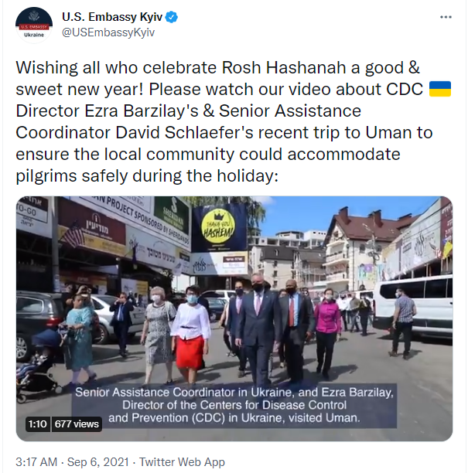
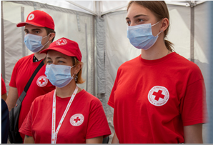
Extensive Surveillance Conducted Among Pilgrims
Over 34,000 pilgrims over three days
13,267 PCR tests conducted over four days with 0.7% positivity
Approximately 3,500 rapid tests with 0% positivity*
104 COVID-19 cases among pilgrims
93 PCR confirmed cases in Uman
11 PCR confirmed cases at airport during departure
Cases recommended to isolate
No cases among service workers
*According to the information provided by the Uman District Department of the Cherkasy Central Committee of the Ministry of Health.

Slide 29
A Successful Campaign!
UPHC became main interlocutor for the Rosh Hashanah Pilgrimage
UPHC continues to be the main contact for other organizations as it pertains to disease prevention
UPHC demonstrated ability to deal with the challenges presented by a mass gathering
Unique communications campaign (videos, hotline) appreciated by community
Support of airport administration for broadcast of video onboard all international flights
Financial support and resources
Continued and close collaboration between UPHC and CDC

Slide 30
US Data
Lauren Erickson-Mamane, MPH
CDC COVID-19 International Task Force

Slide 31
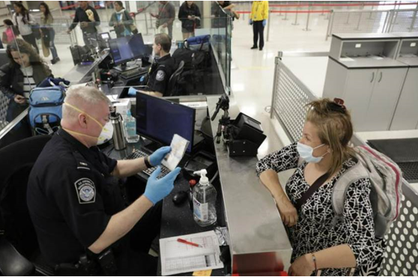
Limited Data Available on Returned Pilgrims to United States
Approximately 10,000 people traveled from Ukraine to the United States in the week following the pilgrimage (September 8-15, 2021)¹
Between September 8-October 10, 2021, NYC identified 15 COVID-19 cases reporting travel to Ukraine²
Clusters identified in two Hasidic neighborhoods
Difficult to determine if cases linked to Uman
1 U.S. Customs and Border Protection. Enterprise and Reporting Data Systems. U.S. Customs and Border Protection. Washington, D.C.; 202
2 New York City Department of Health and Mental Hygiene Integrated Data Team

Slide 32
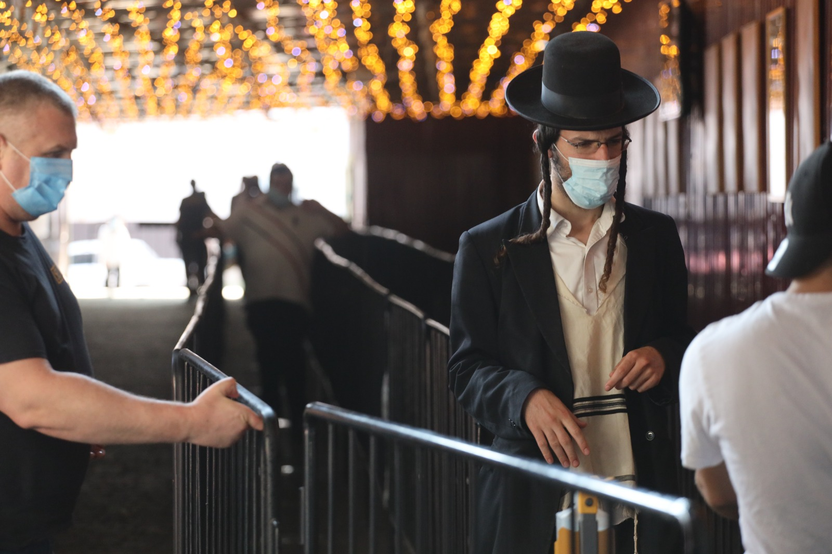
Lessons Learned for Future Mass Gatherings
Should plan early
Need improved methods for tracking people returning to the United States
Cannot focus only on vaccines in a public health campaign
Consider the use of a holistic approach that includes - vaccination, contact tracing, testing (before, during, after) mass gatherings
Reliable means for verification of vaccination status and negative test results that cannot be forged
Relationships are everything!

Slide 33
Thank You!

