Slide 1
Connecting with Faith Communities on COVID-19 Vaccination
Folake Olayinka MBChB, MPH
Immunization Team Leader
MCHN Office/Global Health Bureau
27 January 2021

Slide 2
Objectives
Provide update on COVID-19 vaccine landscape and sentiments
Provide overview of USAID technical assistance
Share relevance of faith community and promising practices to increase trust, acceptability, and uptake of COVID-19 vaccines

Slide 3
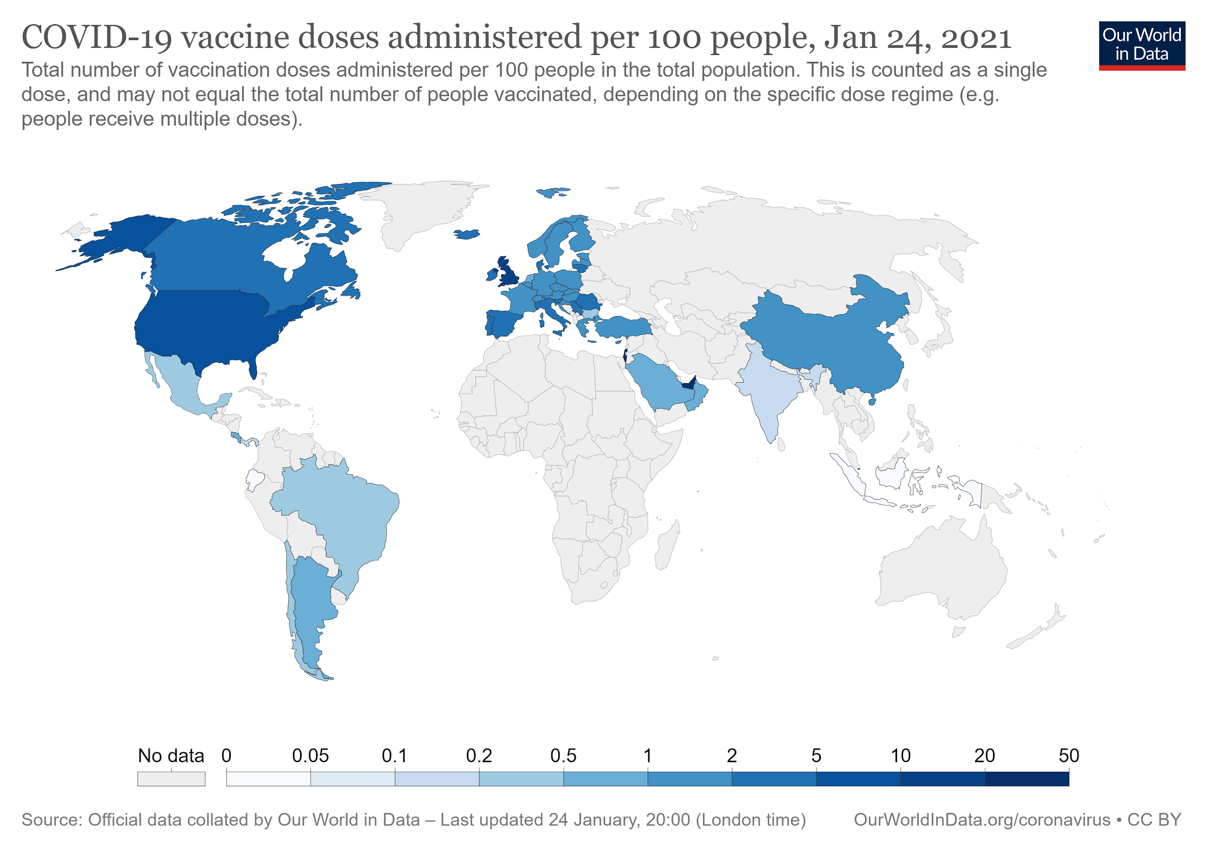
COVID-19 vaccine doses administered (as of Jan 24, 2021)
Coronavirus (COVID-19) Vaccinations - Statistics and Research - Our World in Data

Slide 4
COVAX consolidates global demand and facilitates equitable allocation of vaccines
COVAX Facility
~80 upper-middle and high-income economies given access to procure vaccines 10-50% of their population
COVAX Advanced Market Commitment
92 low and lower-middle income and IDA-eligible economies supported to procure doses for 20% of their population
Humanitarian Buffer
likely 5% of supply; terms still under discussion

Slide 5
$4 billion USG Contribution to COVAX underscores importance of country readiness for vaccine delivery
On December 27, Congress appropriated $4 billion to be made available through the end of fiscal year 2022 to prevent, prepare for, and respond to COVID-19, including for vaccine procurement and delivery through a contribution to Gavi.
These funds will support Gavi’s efforts to provide access to vaccines for 92 low and lower-middle income and World Bank International Development Association (IDA)-eligible economies that are part of the Gavi COVAX Advance Market Commitment (AMC).
To complement this funding, USAID is in the process of identifying additional resources to support bilateral technical assistance.

Slide 6
Public perceptions around COVID-19 vaccines globally
In an October 2020 Ipsos conducted a survey in partnership with WEF of more than 18,000 adults from 15 countries, 73% participants say they would get a vaccine if available. This is 4 percentage points less than 3 months earlier.
34% worry about side effects
33% worry that vaccine is moving through clinical trials too fast
10% have doubts about its effectiveness
8% perceive they are not enough at risk from COVID-19
COVID-19 vaccination intent is decreasing globally | Ipsos The survey was conducted by Ipsos on its Global Advisor online platform, October 8-13, 2020, with a sample of 18,526 adults aged 18-74 in the United States, Canada, and South Africa, and 16-74 in Australia, Brazil, China (mainland), France, Germany, India, Italy, Japan, Mexico, South Korea, Spain, and the United Kingdom.

Slide 7
USAID Technical Assistance to COVID-19 vaccine deployment and delivery
Technical assistance will be multi- pronged, targeted and catalytic
Complementary and in coordination with COVAX, other TA partners, and in support of NVDP
Leverage and strengthen long standing bilateral relationships with countries
8 key areas of USAID technical assistance

Slide 8
Examples of USAID Technical Assistance
Community engagement and acceptance: Bilateral Technical Assistance
Generate confidence, acceptance, and demand for COVID-19 vaccines, including:
Gathering and use local data: behavioral and social data, digital listening and media monitoring, and other relevant sources to inform design and evaluation of interventions
Risk/safety communication
Community engagement, and training, monitoring and responding to misinformation and rumors
Build on lessons learned from other vaccine introductions to address hesitancy/refusals
Use opportunity to increase demand for COVID-19 vaccines and other vaccines in the national schedule
Communications and media engagement for public information, including key messages by target group

Slide 9
Faith community and COVID-19 Vaccines
Faith community, opinion leaders, community leaders, and civil society are important stakeholders in COVID-19 vaccine delivery and uptake
Play an important role in health including polio eradication, HIV/AIDS, and malaria and have built trust with communities
Leveraging these experiences and lessons will be important to enhance COVID-19 service delivery, vaccine uptake and acceptance
Key role in addressing hesitancy and misinformation

Slide 10
Promising Practices to increase COVID-19 vaccine uptake
Engaging with local communities including faith leaders in developing and implementing tailored strategies to support vaccination delivery and uptake
Creating an enabling environment – making vaccination easy, quick, and affordable, in all relevant respects
Working in partnership with communities, building trust and ensuring that messages come from trusted endorsers are key to successful strategies. through open and transparent dialogue and communication
Monitoring and responding to changes in drivers of people’s behavior in a timely a manner
Amplifying endorsements from trusted community members who can connect with the group’s identity and self-understanding, share similar values and characteristics with the relevant group

Slide 11
Dr. Folake Olayinka
Immunization Team Leader
MCHN Office/Global Health Bureau

