Slide 1
COVID-19 Resources
New Foundations of Hope Webinar
July 15, 2020

Slide 2
COVID-19 Messages of Hope
Life – not death; focus in COVID-19 must change to survival
Hope – not fear; physical distancing works to reduce COVID-19 spread
Connection – not isolation; calls, texts, WhatsApp, for quarantined
Positive Role model – general prevention, avoid large gatherings
Caring – safely; for those affected by COVID-19, in our homes, congregations, and community
Celebration – not stigma; for those who improve, recover
Influence – builds hope, gratitude, compassion; as faith leaders can use virtual sermons/meetings, messages/radio/TV
For more information, contact Susan Hillis at shillis@cdc.gov

Slide 3
EGPAF Slides from Faith and Community Initiative Communication Prototypes

Slide 4
COVID-19 Resources for Non-US Settings
https://www.cdc.gov/coronavirus/2019-ncov/global-covid-19/index.html
COVID-19 presentation for Global Faith and Community Leaders
Making a Handwashing Solution
Guidance on Home-Based Care
Available in English, Arabic, French, Hindi, Portuguese, Russian, Swahili, and Urdu
Home Based Care Materials
Available in English, Arabic, French, Hindi, Portuguese, Russian, Swahili, and Urdu
Preventing Violence Against Children - Parenting Tips - available in 90 languages

Slide 5
Coronavirus Disease 2019 (COVID-19)
for Global Faith and Community Leaders

Slide 6
Notes:
Presentation broken down into three steps: Step One: Know the facts to help you and your community stay safe
Step Two: Use your voice to change the course of COVID-19, by using on-line, digital, virtual, radio and other media options to reach congregations and communities with important prevention messages
Step Three: Raise your voice to change the course of violence and abuse of children in your community!

Slide 8
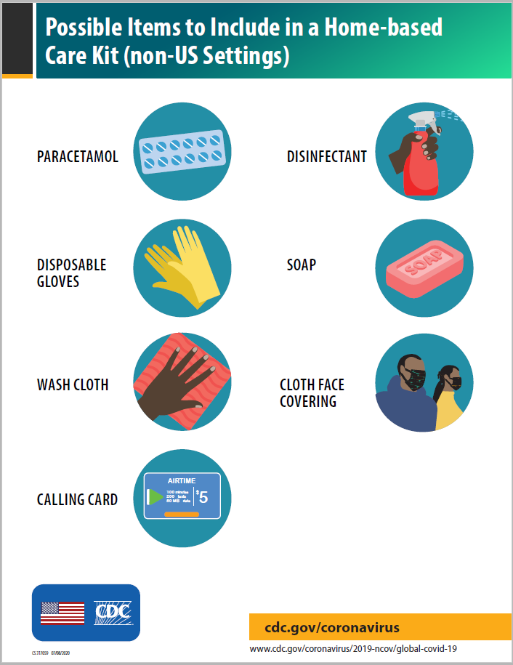
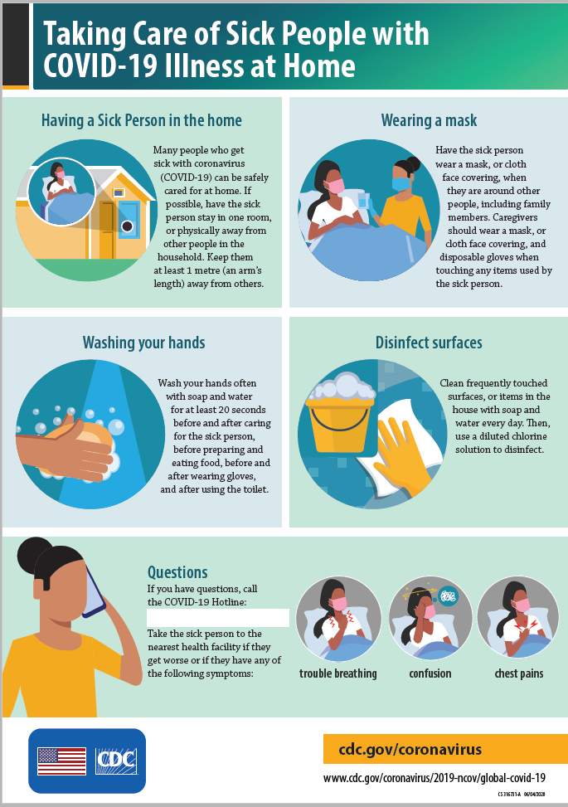

Slide 9
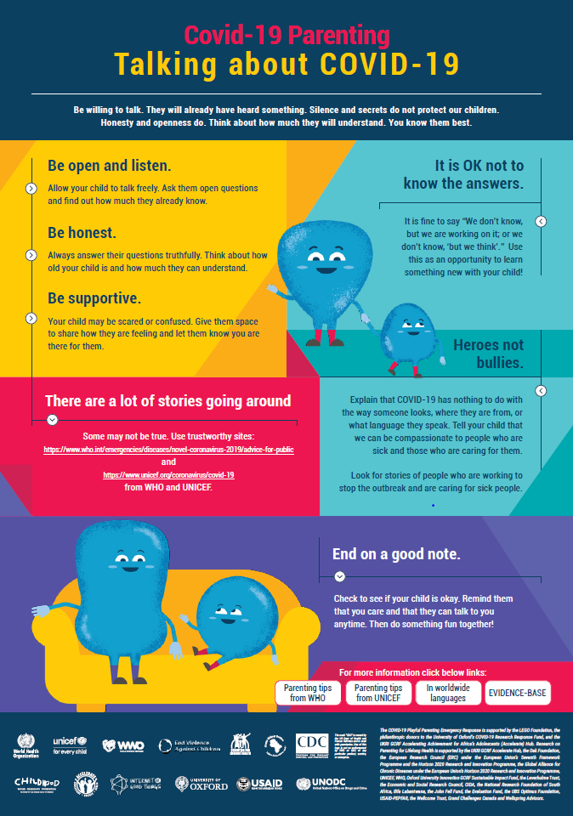
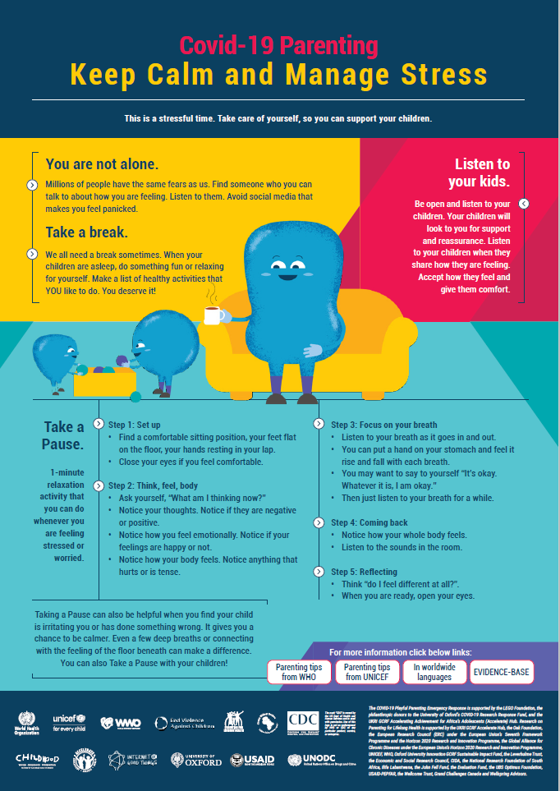
Notes:
The World Health Organization, UNICEF, the Global Partnership to End Violence Against Children, USAID, CDC and Parenting for Lifelong Health collaborated to provide open-access online parenting resources during COVID-19.
Importantly, these parenting resources use robust evidence from randomised controlled trials in low- and middle-income countries.

Slide 10
COVID-19 Resources for Non-US Setting
Notes:
SHOW VIDEO

