Slide 1
Keeping Children Safe and Child Safeguarding Faith and Community Initiative (FCI) New Foundations of Hope (NFH) 15 September 2021

Slide 2
Some of our members
+100 members around the world
Notes:
+100 members
18 FBOs
Reciprocal members: CHS, WeProtect, Consortium for Street children
Certified members: compassion int, Tearfund, Terres des hommes, United World Schools
Certified FBOs, last quarter 4 FBOs in LatinAmerica and Europe

Slide 3
Child Safeguarding and Child Protection
Child Protection In an international context, it must be understood as all the legal frameworks, policies and systems each country has in place to preventing and responding to violence, exploitation and abuse against children.
Child Safeguarding
The responsibility which organizations have to make sure their staff, operations, and programs do no harm to children.

Slide 4
Definition of Child Abuse
Child abuse and neglect, sometimes also referred to as child maltreatment, is defined in the World Report on Violence and Health as all forms of physical and/or emotional ill-treatment, sexual abuse, neglect or negligent treatment or commercial or other exploitation resulting in actual or potential harm to the child’s health, survival, development or dignity in the context of a relationship of responsibility, trust, or power.
(WHO, 1999 & 2002)

Slide 5
What are the types of abuse?
Physical Abuse: Actual or potential physical harm caused by another person’s actions e.g. hitting, shaking, poisoning, drowning and burning.
Emotional abuse: Maltreatment that impacts on a child or vulnerable person’s emotional development e.g. degrading, humiliating, bullying (including cyber bullying), and threatening, scaring, forms of treatment.
Sexual abuse: Forcing or enticing a child or vulnerable person to take part in sexual activities e.g. rape, oral sex, penetration, or non-penetrative acts such as masturbation, kissing, rubbing and touching. It may also include involving children or vulnerable persons in looking at or producing sexual abuse images.
Neglect: Failure to meet a child’s or vulnerable person’s basic physical and /or psychological needs, which is likely to result in serious impairment of a person’s healthy physical, spiritual, moral and mental development e.g. failure to properly supervise and protect children or vulnerable persons, provide for nutrition, shelter and safe living/working conditions.
Includes
Abuse online
Bullying
Harassment
Physical punishment
Spiritual abuse
Child sexual exploitation
Commercial exploitation, child labour

Slide 6
Faith-based organizations need to know:
Where, when and how it affects children
What policies and procedures are needed
Who is the designated safeguarding person/s
What safeguarding induction and training is needed
Its code of conduct
Abuse may still take place within a faith-based organization. At that point, it is how it responds that is crucial for the child, vulnerable adult and the organization.

Slide 7
Organizational Contact with Children
In a faith-based organization it can take place by means of
People (staff, faith leaders, volunteers, consultants, visitors, etc.)
Programs/Projects
Operations

Slide 8
How to include safeguarding into your work as a faith-based organization?
Identify the different ways in which your organization comes into contact with children.
Identify who in your organization has contact with, access to, or has an impact on children.
Know how contact with children can be made via the internet, and other forms of social media, through letters, and by phone. It does not always involve personal contact.
Carry out child safeguarding risk assessments

Slide 9
International Child Safeguarding Standards

Slide 10
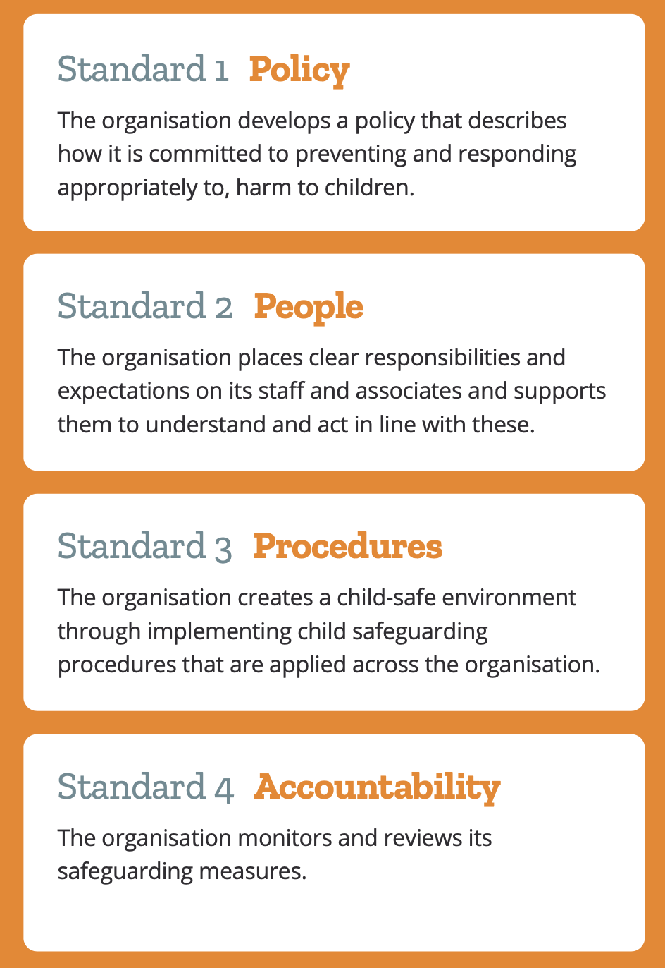
The Standards
Recognized internationally: USAID, European Commission, UKFCDO, United Nations, among others.
Applicable to any kind of organization
Protect children, staff and the organization
Offer a proper response to abuse

Slide 11
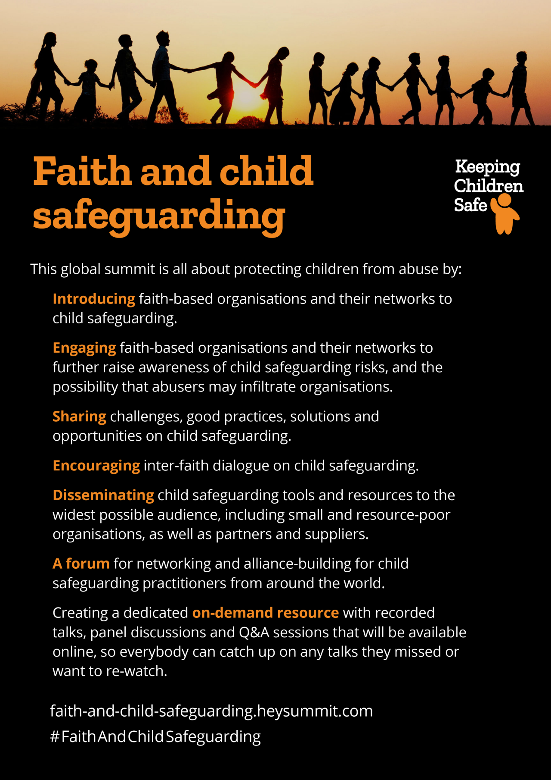
A global summit
8-11 November 2021
A global online conference on child safeguarding for faith-based organizations.
Free and open to all
Speaking and partnering opportunities available. Get in touch at valentina.mirabolanokeepingchildrensafe.global

Slide 12
Thank you! Get in touch at Valentina.Mirabolano@keepingchildrensafe.global Our website https://www.keepingchildrensafe.global #FaithAndChildSafeguarding https://faith-and-child-safeguarding.heysummit.com/

