Slide 1


USAID DISCOVER-Health
Life of Project:
12/2015 – 12/2021
FCI Partners Meeting
05.19.21

Slide 2
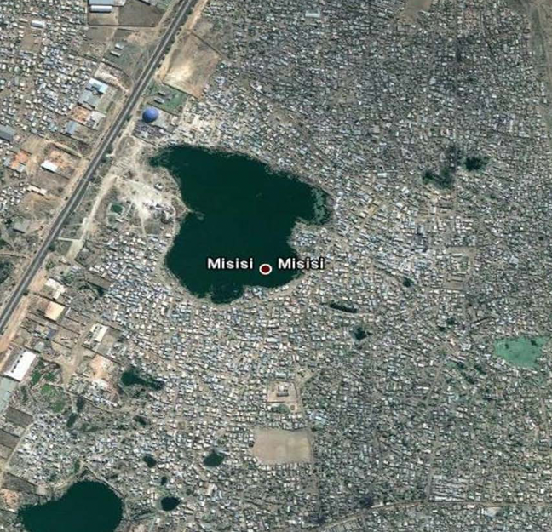
What was the challenge?
JSI/USAID DISCOVER-Health: FCI program overview
Informal settlements are unplanned
Most lack accessible health and other social infrastructure and services
There is often no designated space (land) for health and other social services…
…and then a bathroom break led us to the United Church of Zambia’s St Luke’s parish Church in Kuku neighborhood.

Slide 3
JSI/USAID DISCOVER-Health: FCI program overview
Approach: Leverages the reach and influence of faith community partners in Zambia’s under-served high-density urban informal settlements, providing comprehensive HIV services centered around newly established FBO health posts co-located in host-church premises.
Quality and dignity: Access to respectful, client-centered HTS in catchment areas, linked to project-supported health posts and other health facilities.
Focus: Addresses a gap in pediatric (<15 years) and young male (15-34 years) case-finding and ART access/utilization, but also has child protection, HIV prevention and FP/MCH benefits.
Full FBO involvement: Eight FBO partners (29 FBO health posts) receive technical support to strengthen organizational systems to manage health programs and donor funds; and grants, training and mentorship to expand targeted HTS and linkage to ART and other HIV preventive services.
Health infrastructure expansion: Seven FBO health posts operating from tents will receive medium-sized prefabricated clinics (completion Sept 2021) from FCI support.
New UCZ St Luke’s health post established in 2016 in partnership with USAID DISCOVER-Health.

Slide 4
FBO Facilities: Footprint and contribution to TX_NEW for Males 15-34
FY21 Data
FBO footprint: 20 FBO health posts represent 11% of JSI/USAID DISCOVER-Health’s service footprint.
Average contribution to males 15-34 years old TX_NEW during last four quarters: Above expectation at 22% (n=312).

Slide 5
FBO Facilities: Finding the missing young men 15-34 years
FY21 HTS yield and linkage to ART
FBO facilities
Qtr
non-FBO facilities
Indexing case-finding has been scaled-up in all project sites.
Overall HTS yield rates were on average higher in the FBO (12%) compared to the non-FBO (6%) health posts, for the FY21 semi-annual period, contributing to the higher performance of FBO sites in case-identification.
Indexing yield rates were also on average higher in the FBO (47%) compared to the non-FBO (33%) health posts, for the FY21 semi-annual period.
Both FBO and non-FBO linkage rates were 98% and above for the two quarters, averaging 103% and 100% respectively for the semi annual period.
FY21 Q1
106%
11.5%
5.8%
98%
FY21 Q2
101%
12.4%
5.6%
102%
FY21 Q3
FY21 Q4
KEY
# Tested
# Tested positive
% Yield
# Treatment (New)
% Linked
FY21 Indexing Yield
FBO non-FBO
47% 33%

Slide 6
FBO and Non-FBO Facilities: Continuity in treatment and Viral Suppression

Slide 7
FBO Facilities: Footprint and contribution to PREP_NEW for Males 15-34
FY21 Data
FBO footprint: 29 FBO health posts represent 11% of JSI/USAID DISCOVER-Health’s service footprint.
Average contribution to males 15-34 years old PREP_NEW during last four quarters: Above expectation at 18% (n=766).

Slide 8
Finding and Engaging Men: Using country data to inform programming
Insights from the 2017/18 DISCOVER-led Zambia Male Characterization Study (MCS) informs our FCI programming for men.
Two major themes emerged as key barriers to men’s HIV service access and utilization:
(more @ AIDS 2020 Oral Presentation: 0AD02 Zambia Male Characterization Study; Insights to inform HIV Programming to Increase Men’s HIV Service Utilization)
  Fear of/apprehension about: positive HIV diagnosis and living with HIV; pain; being disrespected, stigma and discrimination; death
  Health system shut-out: perceived negative health staff attitudes; health system set up for women and children; female providers; real or perceived lack of confidentiality and privacy; long wait-times in public health facilities; inflexible service timing/location.
  With limited contact with the health system, the men have limited access to reliable health and HIV information to inform their health choices and behaviors.
  Peers, who are often equally ill-informed, are the primary source of HIV and health opinions that shape individual health-seeking choices and behaviors.

Slide 9
Finding and Engaging Men 15-24: Who will be their Brother’s Keeper?
Health system fixes open up access and increase male HIV service utilization:
  Provided choice of male providers; differentiated service delivery; addressed staff attitudes; established male-friendly services; provided integrated health services to de-stigmatize HIV services; and reconfigured space for privacy.
Fairly low-cost fixes, that led to sustained increase in men’s HIV service utilization across all facilities.
Spiritual and health mentorship to addresses young men’s fears and life issues, while providing reliable health and HIV information:
Pilgrim Wesleyan Church (PWC) Example
Gap: During the MCS focus-group discussions young men told us that they have limited access to credible health information and that a DREAMS-like program for them would be beneficial.
Intervention: The young male pastor at PWC’s John Howard health post is implementing a ‘big brother’ mentorship program for catchment area young men that also provides HIV/health information.
Result: a significant increase in young men accessing and utilizing HIV services, and equally important for the FCI partner, an increase in the number of young males who have become active in their faith.
The FCI partners’ ability to provide spiritual and health mentorship to young men, a natural fit for them, is the difference maker in the FBO sites’ superior performance in finding men and linking them to HIV services.

Slide 10
Finding the Missing Men: Pivoting HIV services during COVID-19 for both FBO and non-FBO Sites
Strengthened Case Management
    Provided additional phone data and talk-time to case-managers to reach clients virtually.
    Trained case managers to undertake outreach safely, and provided infection control supplies.
Index case testing scaled-up, while ensuring safeguards to prevent IPV
  Placed the client’s preferences at the centre of the process, and continued to perform well at case-finding despite periodic lock-downs/restrictions due to COVID-19
Provision of client-centred HTS and ART initiation
  Provided ART initiation at the clinic or community – as preferred by the client.
  Provided 6MMD (even at ART initiation), where ARV supplies permitted, to reduce chance of exposure to COVID-19 at facility.
FBO Facilities Standout
Faith platforms/networks continued to operate (with permission from MOH and within guidelines) and remained available even during COVID-19 restrictions. FBO partner community health workers scaled-up use of these platforms for continued targeted case-finding outreach.
Church Platforms Case-finding
During COVID-19 The FBO partners .

Slide 11
FBO Facilities: Conclusion
Health system fixes: Use of Zambia data to make the health system more accessible to men.
Scale-up of proven approaches: Targeted testing/indexing and case management to increase program efficiency in HTS and program effectiveness effectiveness in continuity in treatment.
Client-centered care: Taking services to where the client is and tailoring service delivery to the client’s needs
Maximizing opportunities for HIV epidemic control: The program also provides HIV-negative males at substantial risk of HIV with PrEP, VMMC and other HIV prevention interventions.
Spiritual and health mentorship: Addressing the needs of the whole person not just their HIV vulnerability, is important in our context.
FBO Facilities: Ministering to the Whole Man
Providing spiritual and health mentorship to address the whole person not just their HIV vulnerability, is important in our context. Finding men and linking them to HIV services and retaining them in care are added benefits of this holistic approach.

Slide 12




Thank You!
Thank You!
This presentation is made possible by the support of the American People through the United States Agency for International Development (USAID). The contents of this presentation are the responsibility of JSI Research & Training Institute, Inc. (JSI) and do not necessarily reflect the views of USAID or the United States Government.

