Slide 1
Faith and Community Initiative (FCI) New Foundations of Hope (NFH) webinar ‘Programmatic approaches to preventing GBV, VAC and adolescent pregnancy’ ‘Implementation of Coaching Boys into Men programming in Malawi’ by Lilongwe Catholic Health Commission Maggie Kuchonde, OVC Program Manager. 15th September, 2021

Slide 2
Basic Overview
Lilongwe Catholic Health Commission (LCHC) is a Faith-based local organisation in Malawi implementing a 5-year PEPFAR funded OVC program as a prime partner
One key priority for OVC programming is to reduce risk for boys and girls 9-14 through primary prevention of HIV and violence
Under its HIV prevention activities, LCHC is implementing an evidence based curriculum by Futures Without Violence (FUTURES) called Coaching Boys into Men (CBIM) in partnership with World Vision (WV) Malawi

Slide 3
Basic Overview
Roles of WV in CBIM
Capacity building to LCHC staff
Monitoring of CBIM sessions
Goal of CBIM
Goal of CBIM: alter social/cultural norms that foster gender based violence by equipping boys (called athletes) with necessary skills and knowledge on gender
Why boys?
800 adolescent boys (called athletes) aged 9-14
Minimal inclusion of boys’ efforts in GBC interventions
Instill a respectful behavior in boys to avoid perpetuating the violence
As role models in promoting gender equality
Target

Slide 4
Delivery Method
Mobilization and facilitation
Athletes mobilized from already existing religious, school and community football clubs
Topics & graduation
12 sessions on integrity; non-violence; communication boundaries; personal responsibility; modeling respect
Impact
Graduated athletes are linked with school, community youth groups and SASA Faith leaders to advocate for a change in GBV cases
Trained coaches facilitate a 15 minute CBIM sessions of 20 athletes per session once a week
Athletes graduate and become certified role models in their religious and community gatherings to advocate for an end in GBV cases
They identify GBV cases together with athletes and refer cases to relevant service providers
These SASA Faith leaders come from Anglican, Catholic, presbytery, Pentecostal churches, Islamic religion

Slide 5
Activities done under CBIM
TOT training by WV to LCHC staff
Training of 80 coaches by LCHC to facilitate CBIM sessions
Production of CBIM manuals and card series
Community awareness and mobilization campaigns
LCHC actual delivery of CBIM session
WV monitoring CBIM sessions
Athletes role modelling
Refresher training for CBIM by WV to LCHC staff

Slide 6
CBIM Achievement
Target Vs Achievement
Since October,2020-June,2021; 1,160 athletes from 70 clubs have graduated from CBIM program representing 145% achievement against the annual target of 800 athletes
Contributing Factors to the success
Athletes willingness and understanding of CBIM goals
Layering CBIM in already existing football clubs
Reduced time for CBIM sessions
Continuation of CBIM sessions during COVID 19 in religious circles
Good coordination with relevant Ministries and WV Malawi

Slide 7
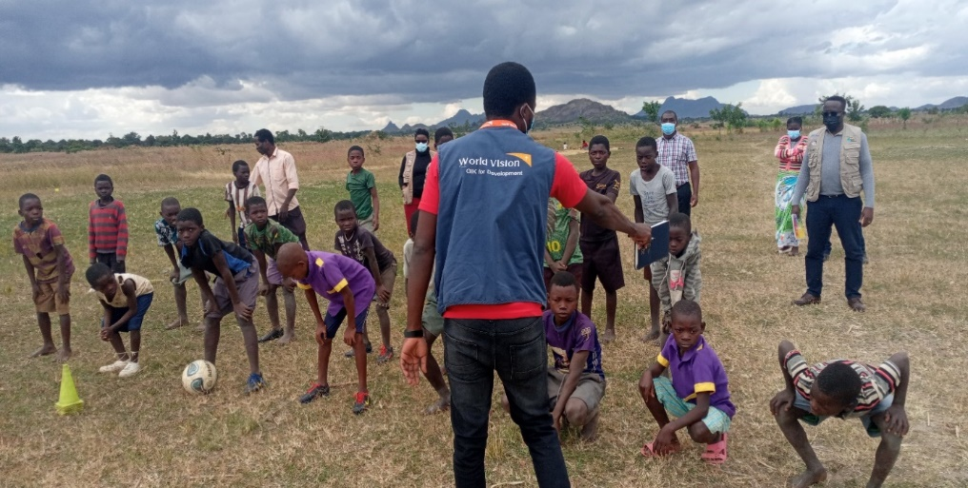
CBIM Supportive field visit with World Vision Malawi

Slide 8
Implications /observations of implementing CBIM in the faith-based setting
Cultivating open spaces for discussing GBV/HIV issues among young people in religious circles
Youth as active agents of their decisions in religious circles
Integrating acceptable cultural norms and religious teachings for a meaningful youthful life
Good collaboration with faith communities enhances the quality of service provision

Slide 9
Challenges and solutions
Challenges | Solutions
1.Coaches demotivated due to lack of incentives like stipends, allowances, ICT materials. Leading to 30 coaches resigning | LCHC and WV Malawi to engage coaches in other program activities like community review meetings, sensitization campaigns to boost motivation Lobby for religious leaders to engage the coaches in other relevant church activities for motivation
2.Lack of sports materials like footballs, jerseys, corns, whistles affecting athletes participation | CHC to include cost effective sports materials in the upcoming COP21 to increase participation Involve religious leaders to support any of the required sports materials through church fundraising activities
3. COVID-19 pandemic affecting session delivery in schools during its onset | LCHC prioritized CBIM session in religious platforms and provided PPES during session delivery
4. Less funding allocated for the program | Layering the service and implementing other CBIM activities together with other OVC interventions

Slide 10
Lessons Learnt
Layering CBIM in already existing youth interventions minimizes the costs and ease mobilization of athletes
Availability of incentives and sports materials are equally important to improve the quality of the program
As a prime local partner, proactive strategies for continuation of service delivery amidst COVID-19 are crucial to achieve program goals

Slide 11
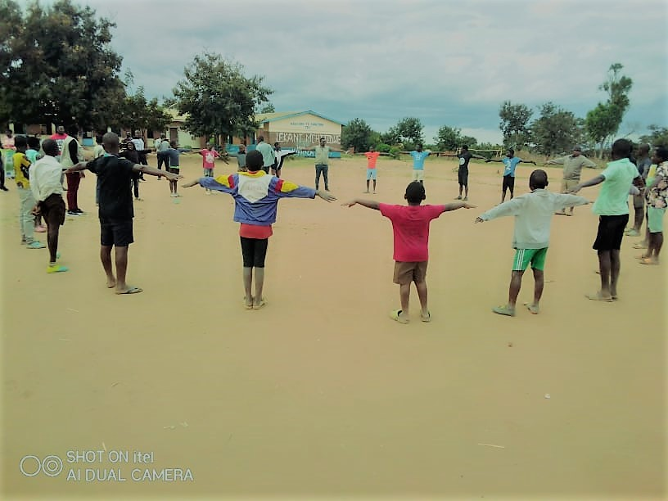
END!

