Slide 1
Recent recommendations and guidance from PEPFAR and APCCA: Programming for children affected by COVID-19
Gretchen Bachman, Sr. Advisor, Orphans and Vulnerable Children
The Office of the U.S. Global AIDS Coordinator and Global Health Diplomacy
8/25/21

Slide 2
USG Guidance

Slide 3
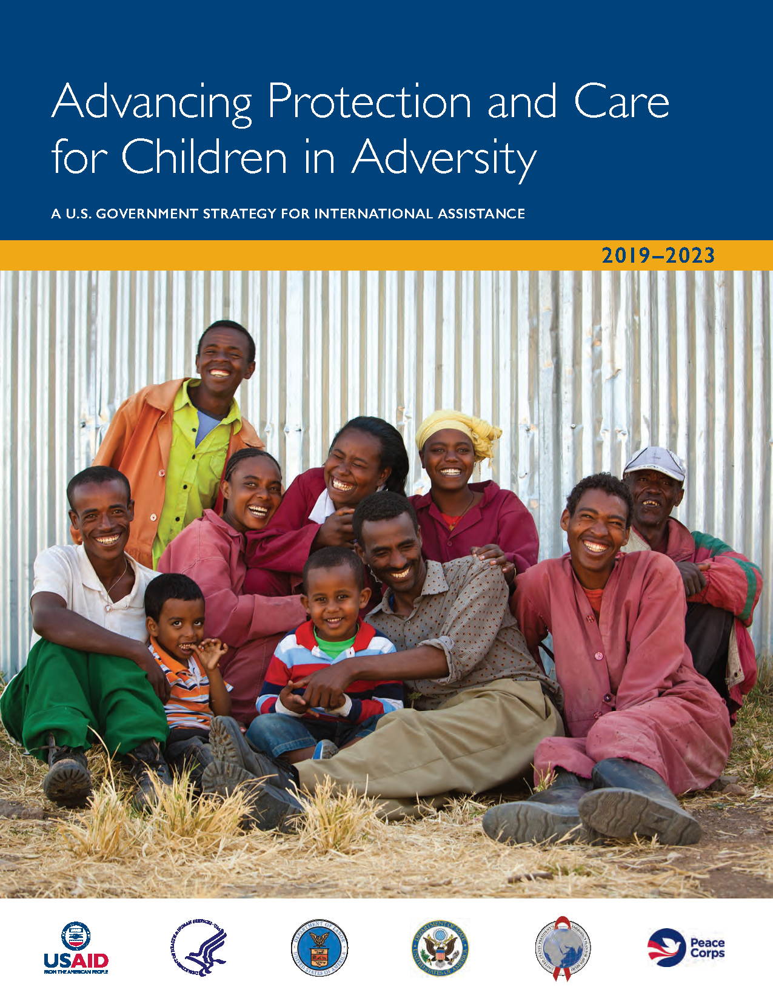
Advancing Protection and Care for Children in Adversity
Whole-of-government commitment and approach to investing in the development, care, and safety of the world's most-vulnerable children and their families.
USG Partners: U.S. Departments of Health and Human Services, Labor, and State, USAID, and the Peace Corps.
Responds to Public Law 109-95.
https://www.childreninadversity.gov/docs/default-source/default-document-library/apcca-strategy-final-web.pdf?sfvrsn=4
Notes:
Comprehensive
Coordinated
Effective

Slide 4
Notes:
APCCA’s 3 Objectives
Interrelated, interdependent, and mutually reinforcing, evidence-based strategic objectives.
(1) Build Strong Beginnings; (2) Put Family First; and (3) Protect Children from Violence.

Slide 5
Critical Action for the Protection and Care of Children in Adversity During the COVID-19 Pandemic
APCCA USG Guidance Note
Key points include:
Identify children who have lost caregivers and support family-based care, not institutional care
Strengthen the parenting and caregiving environment to prevent and respond to violence, and support psychosocial wellbeing of children
Provide economic support
https://www.usaid.gov/documents/us-government-guidance-note-critical-action-protection-and-care-children-adversity-0
I
Notes:
The guidance focuses on protection concerns for all children, not solely children who have lost caregivers - - but I’m highlighting key supports and interventions for children who have lost caregivers, to provide some concrete examples.
These activities should be integrated within health, education, and economic sector responses -we don’t need stand-alone child project projects.
1: Identify children who have lost caregivers and support them to remain in families:
Child protection workers in hospitals, clinics, and COVID-19 response/quarantine centers to identify and respond to protection needs;
Support hospitals and treatment centers to develop Standard Operating Procedures for immediate documentation of children accompanying infected adults who require treatment or quarantine.
Work with religious and community leaders help communities have “eyes on children” and train them to identify and refer at-risk children.
Identifying and supporting persons who can care for children separated from their families.
2: Provide parenting support and strengthening caregiving environment to prevent and respond to violence, and support psychosocial needs of children
3: Provide economic support:

Slide 6
Populations of concern
Children with no change in care, but who face protection risks/violations (violence/neglect; mental health and psychosocial distress; child labor, child marriage)
Children who experience caregiver loss, but who have surviving adult caregiver(s)
Children with no adult caregiver who require a family-based placement (i.e., kinship care, adoption, fostering, etc.)

Slide 7
USG Policy: Strengthen and Promote Family Care
In response to emergencies and epidemics (i.e., HIV/AIDS, Ebola) a proliferation of orphanages as a response to loss of caregivers
Numerous studies of children’s long term well-being and developmental outcomes support the critical importance of family care over institutional care.
Strengthening families includes supporting families to–
Meet their basic material needs for shelter, food, health care, safety, etc.
Maintain social connections and support
Adapt to new family situations and process trauma – such as taking in a child, losing a parent or grandparent
Gain parenting/child development knowledge and skills

Slide 8
PEPFAR-specific Guidance

Slide 9
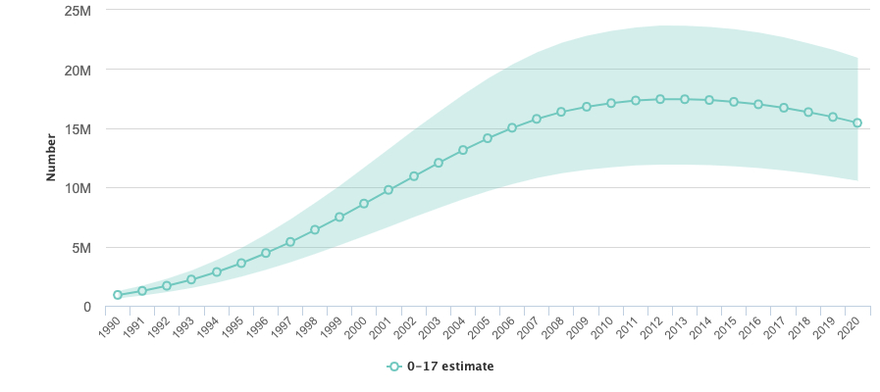
Guidance on PEPFAR’s role in responding to children who lose caregivers to COVID-19
Utilize PEPFAR infrastructure, but resource COVID-funding for COVID-specific activities
Stay focused on PEPFAR’s mandate to serve children infected, affected, and at risk of HIV.
Coordinate with USG-COVID responders (e.g. S/PRM, USAID/BHA) and with the Child Protection Cluster to maximize resources.
An Estimated 15.4 Million Children Had Lost One or Both Parents to AIDS as of 2020
Source: UNAIDS AIDS Info 2021

Slide 10
Illustrative Examples of PEPFAR-funded vs. COVID-funded Activities to Support Children
PEPFAR
Non-PEPFAR USG, other donors (Existing & Potential)
Ensuring that COVID-19 prevention information is part of OVC case management and home visits.
Arranging for children to access multi-month supplies of antiretroviral therapy (ART).
Facilitating referrals to COVID-19 vaccinations especially for those at highest risk such as elderly caregivers.
Serving as referral coordinators between health facilities and surrounding social services for children who have ill or deceased parents or guardians.
Advocating that child welfare and protection services remain operational and able to help children in need (e.g., child helplines, child and gender desks at police stations).
Continuing evidenced-based parenting and HIV and sexual violence prevention programming under FCI, DREAMS and OVC.
Providing cash transfers or other economic support to children who have lost caregivers due to COVID-19.
Enrolling children orphaned by COVID-19 into ongoing case management programs.
Developing community-wide detection and referral mechanisms for COVID-19-affected children and families requiring additional support, with special attention to children remaining in the home after the death of a parent or caregiver.
Ensuring children separated by COVID-19 receive appropriate family care, including family-based alternative care.
Arranging COVID-19 testing, if appropriate, for any child unaccompanied due to caregiver hospitalization with COVID-19. Initiate a case file to record family information, including name and treatment location of the parent(s).
Funding legal assistance to ensure and protect guardianship and inheritance rights for children orphaned by COVID-19.

Slide 11
Resources Available for Supporting Children who are Grieving
Regional Psycho-social Support Network (REPSSI) - https://repssi.org/
The Dougy Center - https://www.dougy.org/about/our-work/our-publications
”Bereavement Tip Sheets” - Parenting for Lifelong Health - https://www.covid19parenting.com/home - Coming Soon!

