Slide 1
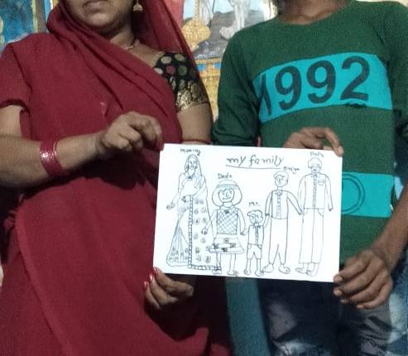
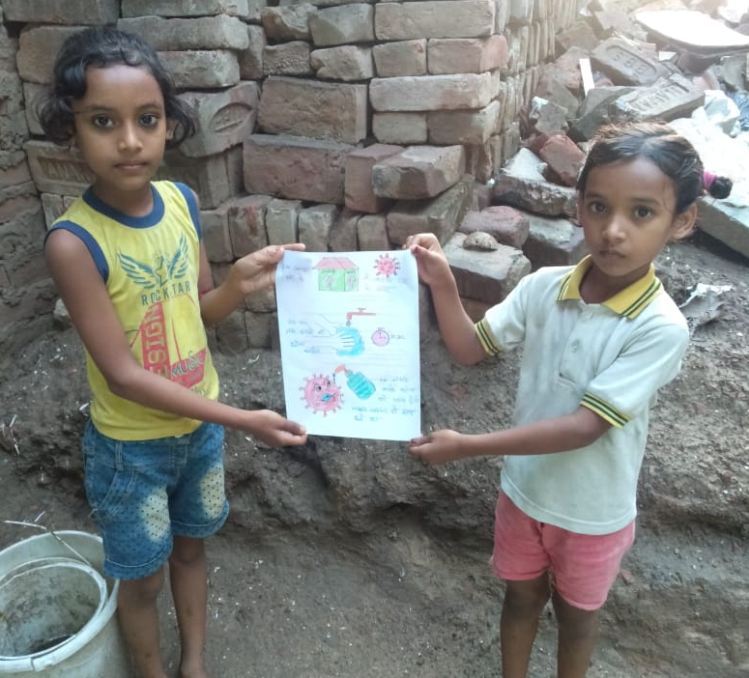
Providing Virtual Support for Vulnerable Families and Children During COVID-19:
Successful Adaptation and Use of
COVID-19 Parenting Tips for Caseworkers
Gary Kamaal - Country Director for Viva India

Slide 2

Viva uses COVID-19 Parenting Tips Caseworker’s Tool to Train Faith Leaders in Reaching Vulnerable Families
Advertise opportunity within congregations
Then provides training for those interested, including training in Child Safeguarding and in the COVID Parenting Tips
Vetting of participants who complete training, to assure they are well-suited to provide support for vulnerable families and children

Slide 3
Programme Resources and Training
http://covid19parenting.com
For each theme we have:
A script outline for phone conversations with parents and children www.childreninemergencies.org/2020/05/27/mentoring (Viva)
Images or posters type information using WhatsApp or suggested material for printing www.covid19parenting.com
Games or activities that unpack or demonstrate the theme www.covid19parenting.com
Messages, Radio spots, Social Media Messages using Faith Leaders Resources Packs www.worldwithoutorphans.org/covid-19 or Viva
Call Log by the mentor Kobo forms by Viva

Slide 4
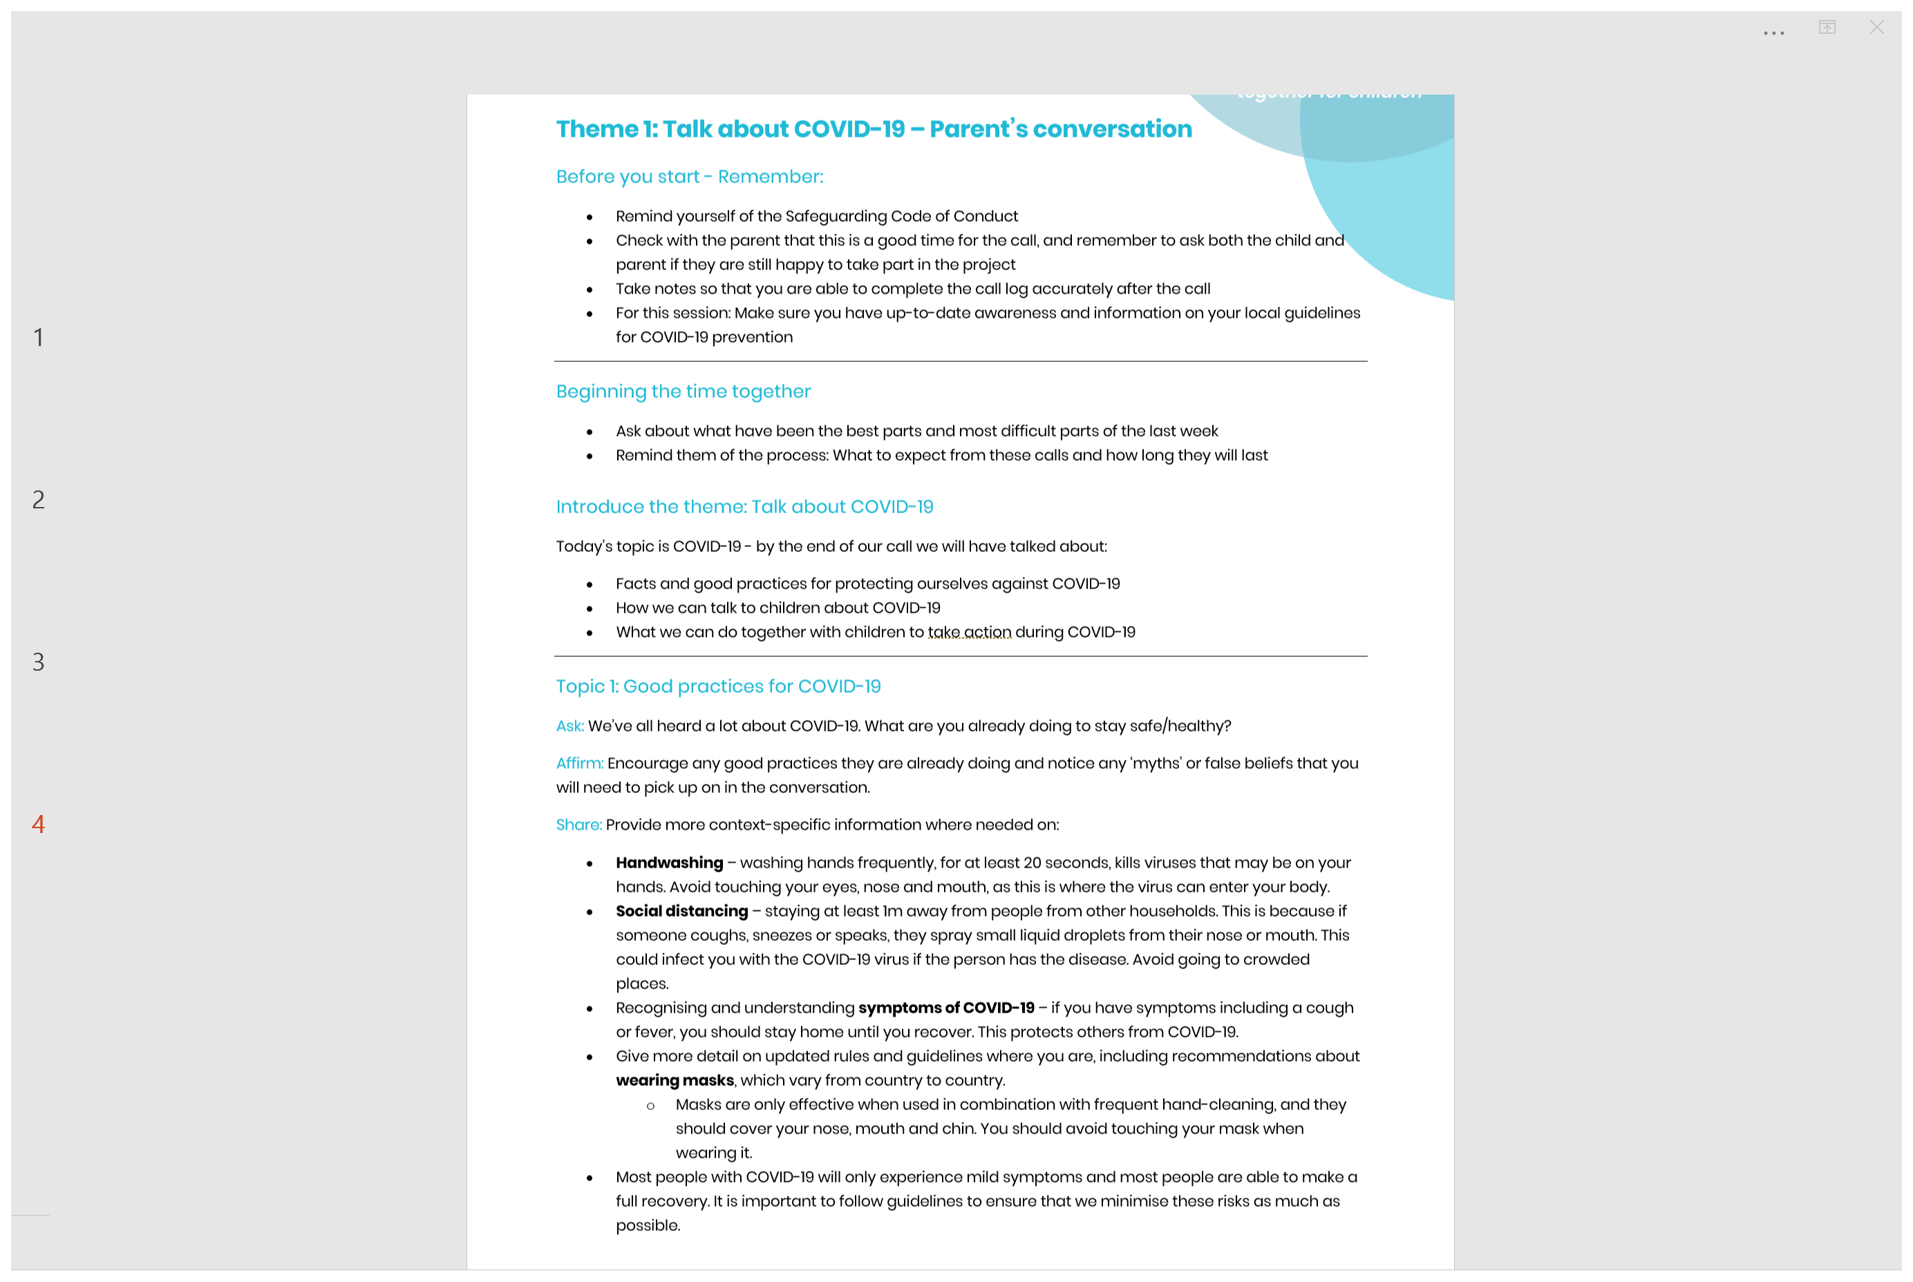
Mentor’s call script for parents on the theme

Slide 5
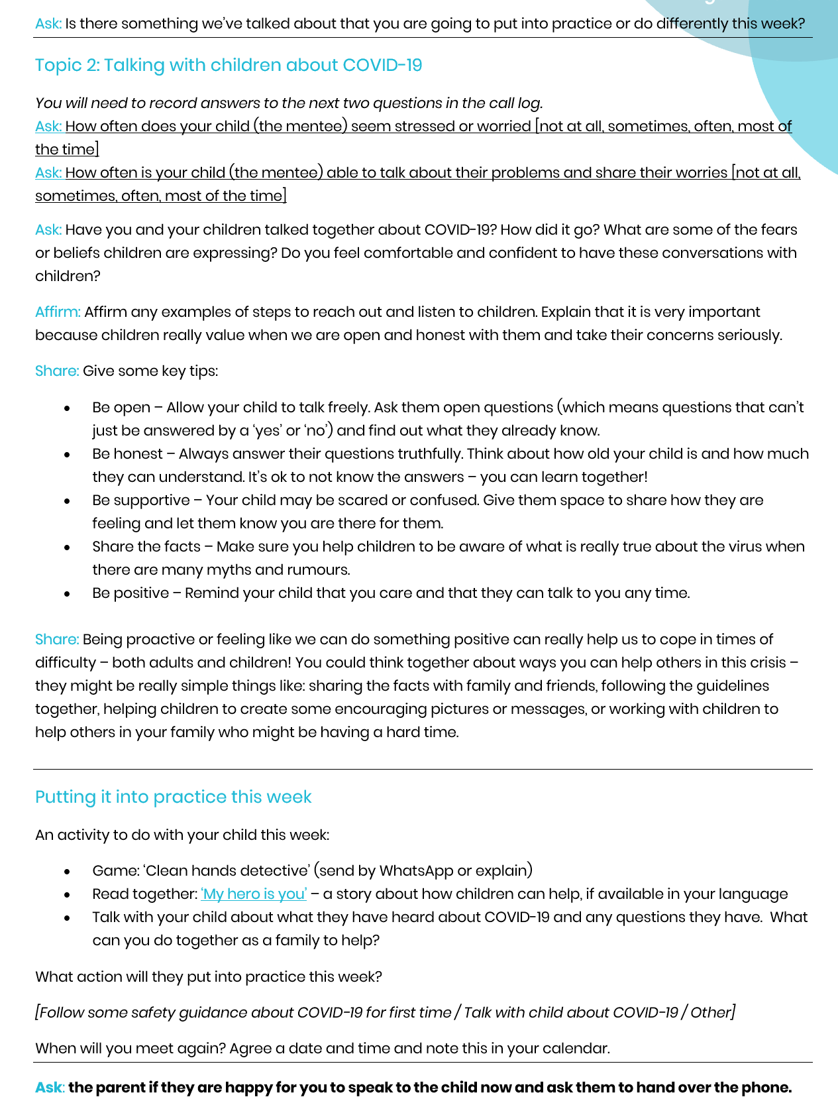

Slide 6
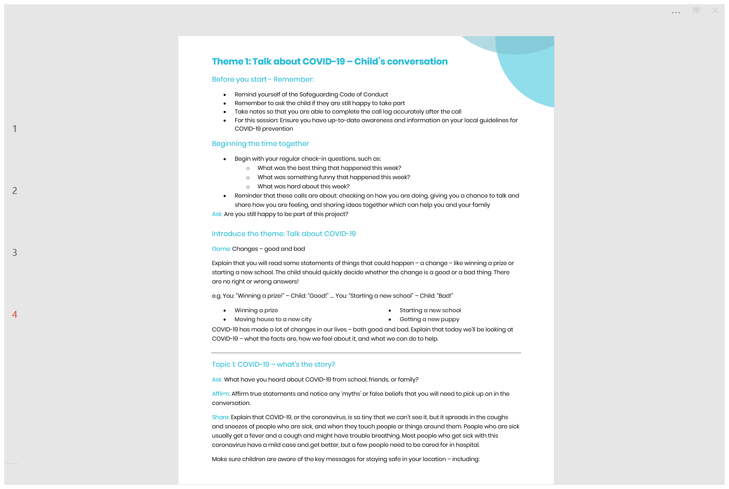
Mentor’s call script for children on the theme

Slide 7
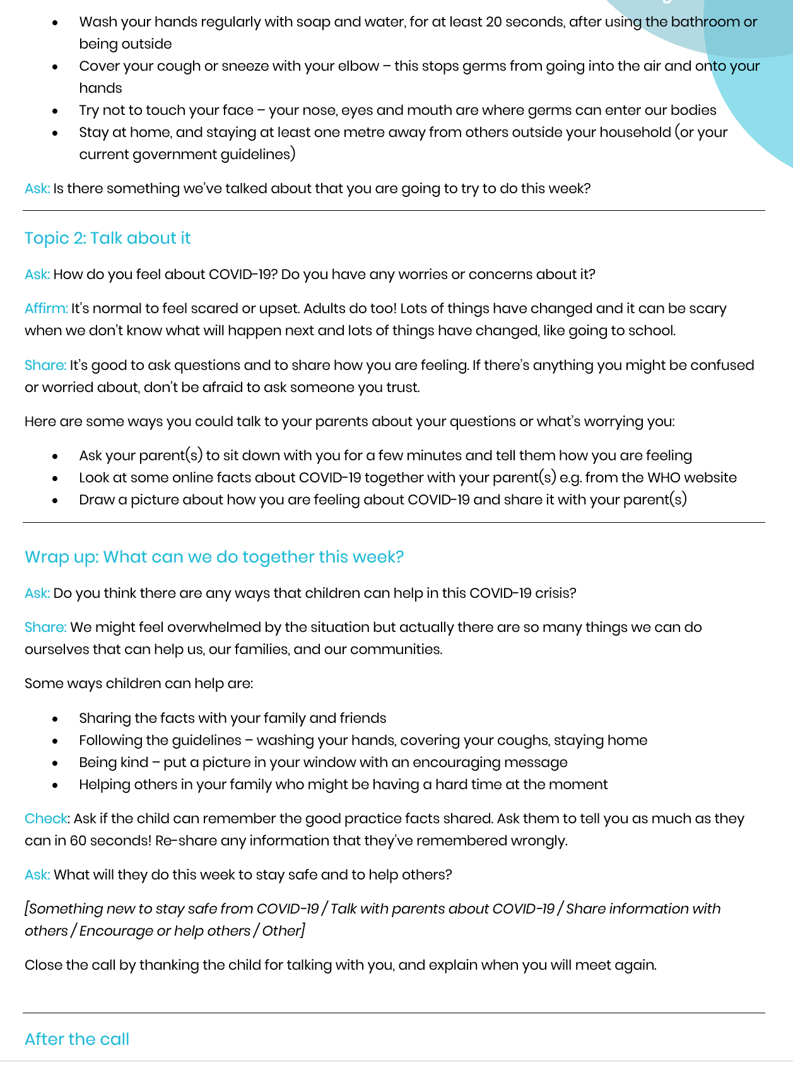

Slide 8
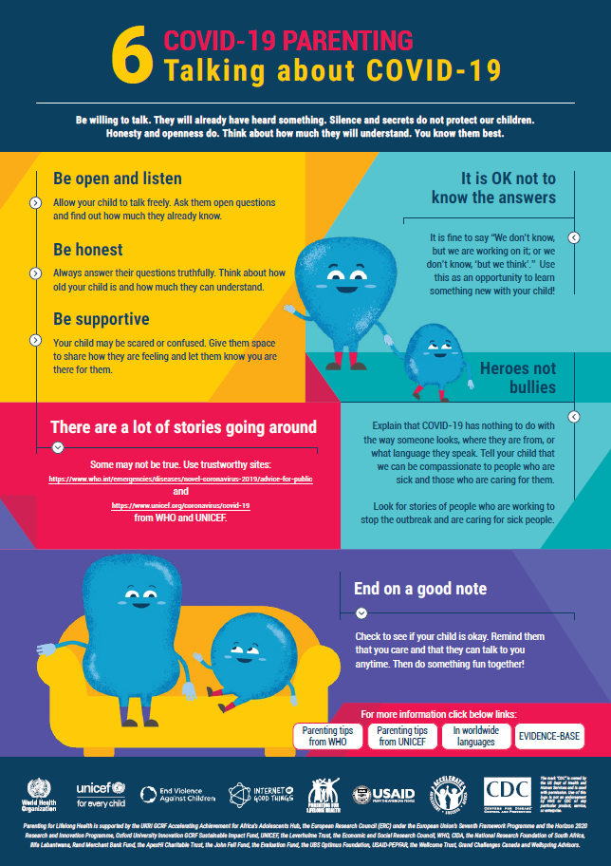
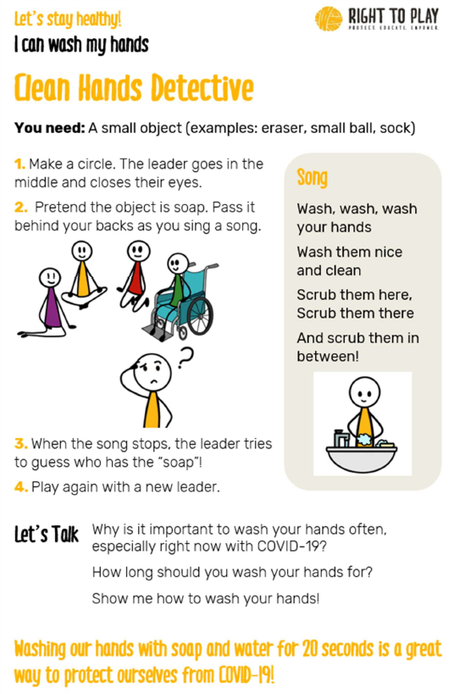

Posters and Activities Shared by the Mentor

Slide 9
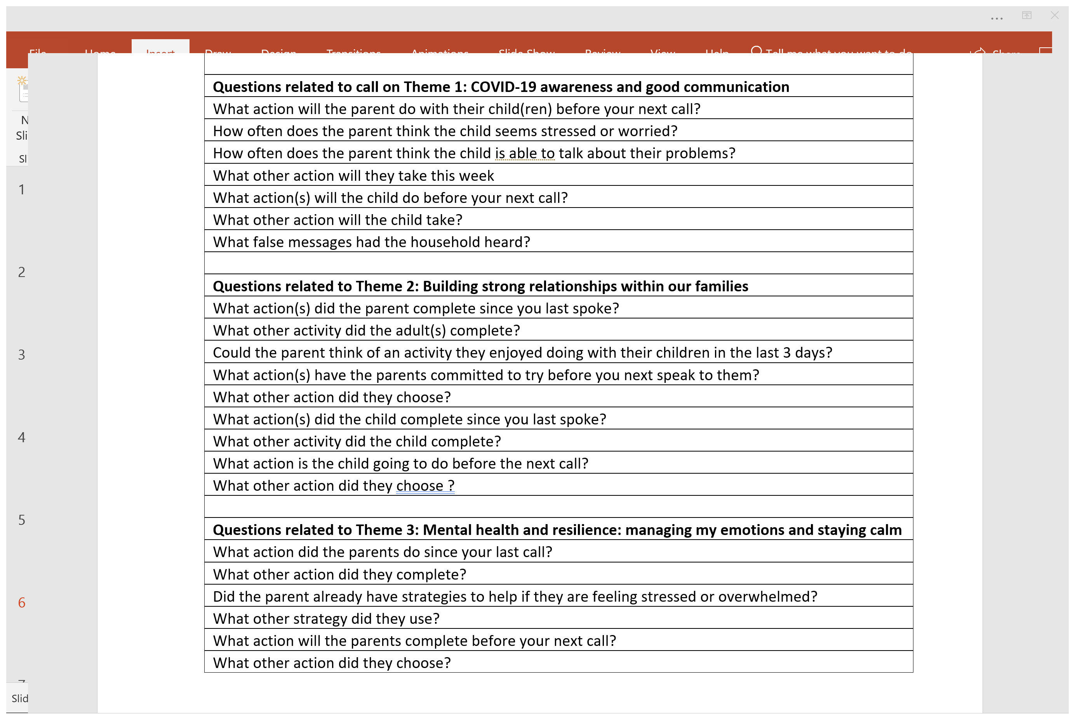
Programme Monitoring of COVID-19 Parenting Tips for Caseworkers
Call Log Questions
1
2
3
4
5
6
7
1
2
3
4
5
6
7
8
9

Slide 10
Call Log
Reports

Slide 11
Call Log
Reports

Slide 12
Call Log
Reports

Slide 13
Call Log
Reports

Slide 14
Call Log
Reports

Slide 15
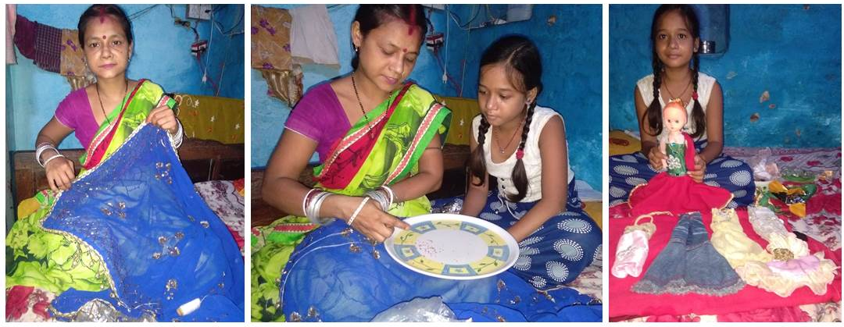
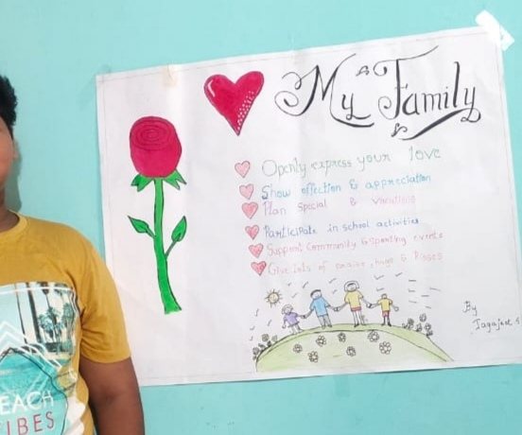
Programme Outcomes
Improved relationship between children and parents
Parents monitor their child’s online activity
Parents are engaged in their child’s learning
Covid safety awareness
Emotional support for vulnerable families
Churches and projects helping vulnerable families to cope with the challenges of the covid pandemic

Slide 16
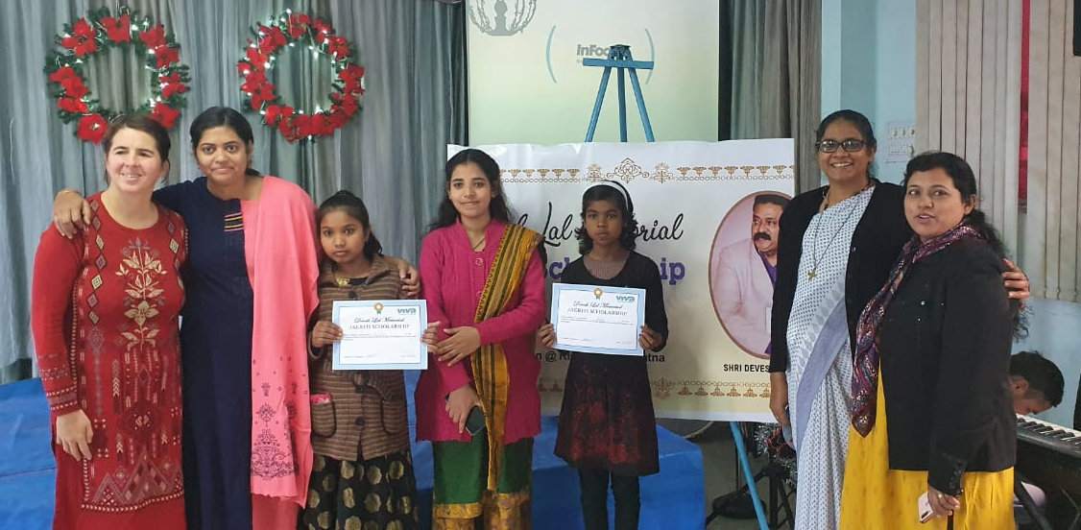
A video recorded in the field at Patna, India
Link to the (2 minute 44 second) video https://youtu.be/gVvAVKdhiP8

