Slide 1
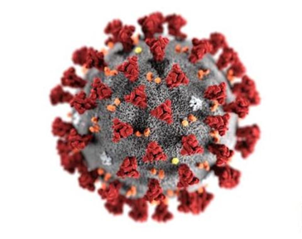
Faith and Community Initiative
New Foundations of Hope Webinar:
HIV Model Programs- How to Replicate
28 OCTOBER 2020

Slide 2
SESSION OUTLINE
Zvandiri Overview
Integration of FCI
Progress to Date
Lesson Learned for Replication

Slide 3
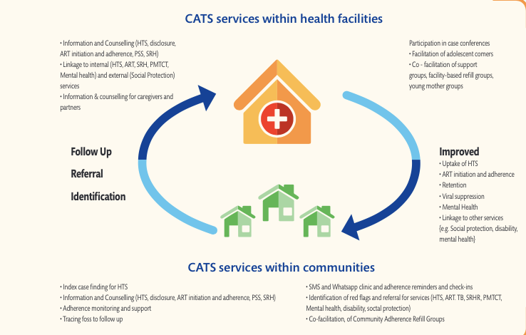
ZVANDIRI OVERVIEW
Notes:
Overview of the Zvandiri programme, highlighting the role of CATS (peer counsellors) across the HIV cascade, integrated within national HIV services and managing case loads between the Health Facility and Community

Slide 4
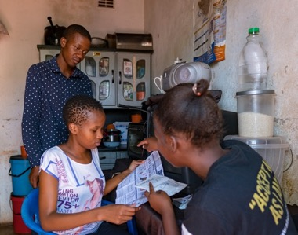
Zvandiri APPROACH TO HIV Testing, TREATMENT, CARE & SUPPORT
PEERS
Personal experience of HIV testing, living and growing up with HIV
Established relationships
TRAINED
Equipped with the skills to provide peer-led HIV and ART information, counselling and support and index case testing
MENTORED and SUPERVISED
CATS have essential HIV and ART information, counselling, monitoring and support
They are mentored to ensure high-quality service provision within the best interest of the child
CATS support a range of services and information within communities
Notes:
Notes to highlight:
PEERS
Personal experience of HIV testing, living and growing up with HIV
Established relationships to identify contacts and link between the home and clinics
TRAINED
Equipped with the skills to provide peer-led HIV and ART information, counselling and support and index case testing
Trained by Zimbabwe MOHCC and Africaid
MENTORED and SUPERVISED
CATS have essential HIV and ART information, counselling, monitoring and support
They are mentored to ensure high-quality service provision within the best interest of the child
CATS support home visits, support groups, adolescent clinic days, MHealth
CATS provide information on caregiver interventions, economic strengthening
Screening, identification, referral and support for protection, sexual and reproductive health services, disability, mental health, TB, post-test counselling and support, including disclosure support.

Slide 5
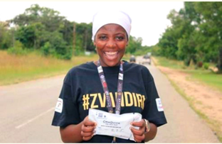
Integrating fci WITHIN ZVANDIRI
What is the role of
FCI Champions and CATS?
Distribute HIVST kits
Dissemination of Messages of Hope
Community Post
Referral and linkage to services
Linkage to CATS
Data collection
Coaching Boys to Men and Faith Matters
Facilitate Group sessions
Purpose: Improve on the number of HIV positive individuals tested and supported to start on treatment, especially among children and men aged 25-35 in 10 districts of Zimbabwe.
Community cadres: 98 CATS and 80 FCI champions
Notes:
FCI has been integrated within the Zvandiri programme, drawing on the same principle of community-based, peer-to-peer service delivery to promote the identification of HIV positive individuals and linkage to treatment, especially among children and men aged, 25-35.
The programme is being supported by 80 Faith and Community initiative cadres who lead the dissemination of Messages of hope as well as supporting linkage to HIV testing services
Additionally the program is being supported by 98 Community Adolescent Treatment Supporters(CATS)
The programme is currently supporting 6 active community posts in a partnership with a clinical partner but also in the process of opening another community post fully supported by Africaid

Slide 6
FCI testing services
Key Highlights:
- A total of 197,024 clients reached

Slide 7
FCI testing services

Slide 8
MESSAGES OF HOPE AND COVID-19
-”When I engage in visiting people who are sick, I make sure to wash my hands before and after the visit, and to keep physical distance, even when praying for others. National guidance for facial coverings are essential and we all must follow them”
“I wear a mask, as an act of LOVE, to protect the elders in my community who are especially at risk”
“Take your ARVs and believe − starting ART early does not take away your faith”.
“HIV haisarudze unopinda uriku Church ipi . Get Tested & Treated Early!”
Notes:
- Kushandisa HIV self-test zvine style!

Slide 9
KEY LESSONS LEARNED for REPLICATION
Government Leadership and coordination
Government critical in planning and coordination of FCI at national, provincial and district level
Mapping and selection of districts, facilities and faith communities
Standardised selection criteria and processes for recruitment of FCI cadres
Community engagement
Meaningful partnership, engagement and leadership from faith communities
Co-creation of messages of hope; feedback on messages of hope
Engagement of community in selection of FCI cadres
Documentation of motivating factors for HIV_ST among young people
Documentation of reasons for abstaining from confirmatory tests and ART initiation
Feedback from communities of faith on messages of hope

Slide 10
KEY LESSONS LEARNED
Youth leadership
Young people at the forefront of design, planning and implementation
Co-creation of messages of hope
Sustained supervision and mentorship
Standardised, integrated training, supervision and mentorship
Joint development of training curricula, implementation tools
Joint training of FCI Champions and CATS with MoHCC

Slide 11
Thank
you
This is My Miracle

