Slide 1
Children and HIV Faith Communities Taking Action to End AIDS in Children New Foundation Of Hope, FCI Tiffiany Aholou, Francesca Merico 24 August 2022 Data & Tables: UNAIDS July 2022 Global AIDS Report – In Danger

Slide 2
Only 59% of children (aged 0-14) living with HIV know their status
compared with 86% of adults
Only 52% of children living with HIV are on treatment compared with 76% of adults
Only 41% of children living with HIV are virally suppressed compared with 70% of adults

Slide 3
Global estimates for children (<15 years)  2021
Children living with HIV 1.7 million [1.3 million–2.1 million]
New HIV infections in 2021 160 000 [110 000–230 000]
Deaths due to AIDS in 2021 98 000 [67 000–140 000]

Slide 4
Children are often left behind: The gap in HIV treatment coverage between children and adults is increasing rather than narrowing
In 2021, an estimated 800 000 [640 000– 990 000] children living with HIV were still not receiving HIV treatment
Children comprised 4% of people living with HIV in 2021 but 15% of AIDS-related deaths

Slide 5
The HIV response is failing to meet the needs of children. In 2021, 41% [33–51%] of children living with HIV globally received antiretroviral therapy, compared to 70% [61–80%] of adults living with HIV and well short of the global target of 95% treatment coverage

Slide 6
Antiretroviral Therapy in children
The slow pace of progress in closing this gap in many regions is concerning. In eastern and southern Africa, Latin America, the Caribbean, and the Middle East and North Africa, the treatment coverage deficit for children appears to have increased in recent years. Given the profound gaps in testing and treatment for children, the world is not currently within reach of the target of 75% viral suppression among children living with HIV in 2023 and 86% viral suppression in 2025. In 2021, only 41% of children living with HIV had a suppressed viral load
Notes:
An estimated 800 000 [640 000–990 000] children living with HIV are still not receiving HIV treatment, with child antiretroviral therapy coverage especially low in western and central Africa (35% [28–41%]) and eastern and southern Africa (56% [45–71%]. This is mainly due to a failure to test all children who have been exposed to HIV and link those who have acquired HIV to treatment and care. Representative data from seven countries in eastern and southern Africa from 2015–2017 show that 10% of children diagnosed with HIV were not on treatment, and that 48% were not virally suppressed (114). Ensuring point-of-care testing, lowering the cost of test kits and simplifying screening procedures can improve the chances of I dentifying undiagnosed children living with HIV and ensuring that they receive life-saving treatment

Slide 8
In 2021, 160 000 children newly infected by HIV
The number of new HIV infections among children has declined by 52% since 2010. However, despite years of high-level pledges of urgent action to eliminate vertical transmission of HIV and close children’s HIV testing and treatment gaps, children continue to experience some of the most serious HIV-related inequalities.
In 2021, 160 000 [110 000–230 000] children were newly infected with HIV. Almost 85% of new vertical infections occurred in sub-Saharan Africa. Although dozens of countries of all income levels have demonstrated the feasibility of eliminating new HIV infections among children, progress in preventing vertical transmission has slowed, with only a 22% decline in new infections from 2016 to 2021

Slide 9
WHY SO MANY CHILDREN ARE STILL ACQUIRING HIV?
Almost half of new HIV infections in children are due to HIV-positive women not receiving antiretroviral therapy
More than 34 000 new child HIV infections occur when mothers are not able to remain on treatment during pregnancy or breastfeeding
A further 35 000 new infections occur when programmes miss women and girls who newly acquire HIV during pregnancy or breastfeeding periods
he remaining 13 000 vertical infections occurred because the mother was receiving treatment but was not virally suppressed
STIGMA & DISCRIMINATION
LIMITED ACCESS TO FACILITIES, COSTS,
USERS FEES
DRUGS SIDE EFFECTS & DIFFICULTIES ADHERING
Notes:
A clearer picture is emerging about why so many children are still acquiring HIV. Analysis of data from HIV programmes and modeling shows that almost half of new HIV infections in children (75 000 of an estimated 160 000 infections) are due to HIV-positive women not receiving antiretroviral therapy. HIV services are missing these women, many of whom avoid HIV services for fear of stigma and discrimination. Legal barriers (such as age-of-consent regulations and laws that criminalize key populations) also make it difficult for them be tested for HIV and start antiretroviral therapy before pregnancy. This leads to more undiagnosed cases and more onward transmission. Those legal obstacles should be removed.
Almost half of new HIV infections in children are due to HIV-positive women not receiving antiretroviral therapy.
In addition, more than 34 000 new child HIV infections occur when mothers are not able to remain on treatment during pregnancy or breastfeeding. Limited access to facilities, unexpected costs (including user fees), HIV-related stigma and discrimination, drug side effects and difficulties adhering to treatment all contribute to poor retention. Removing user fees (see the Cameroon feature story in Chapter 5) and improving the quality of treatment and care (including the use of optimized treatment regimens and trusted support from mentor mothers and other peers) can help remove those hindrances (115). A further 35 000 new infections occur when programmes miss women and girls who newly acquire HIV during pregnancy or breastfeeding periods. This is a major driver of vertical HIV transmission in eastern and southern Africa, where almost half of new child infections are occurring.
Proven HIV prevention choices, including PrEP, should be promoted for pregnant and lactating women and their partners in areas with high HIV incidence. Pregnant and breastfeeding women who do not know their HIV status should be encouraged and supported to access testing and, if needed, rapidly start treatment. Finally, the remaining 13 000 vertical infections occurred because the mother was receiving treatment but was not virally suppressed

Slide 11
Eastern and southern Africa remains the region most heavily affected by HIV
The region has also made notable progress in reducing new HIV infections among children: a 61% decline since 2010
Nonetheless, the rate of vertical HIV transmission after breastfeeding is still estimated to be 8.6%

Slide 12
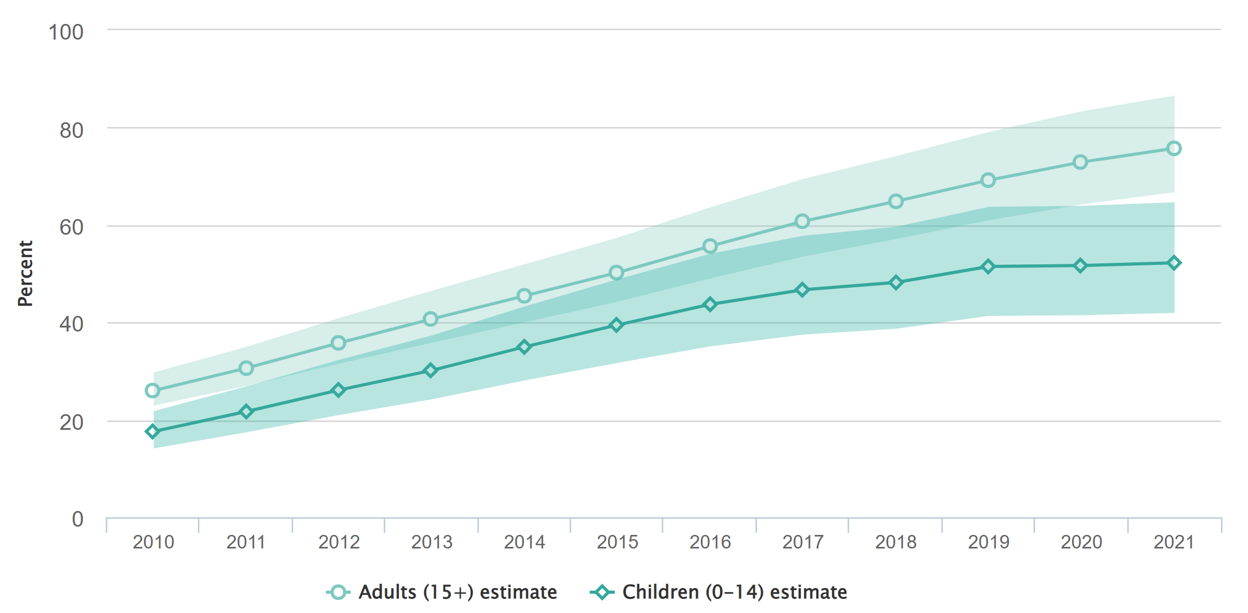
Consistently Lower ART Coverage in Children vs Adults (Mahy, Plenary Pediatric Workshop)
ART Coverage in Children in 2021 Has Not Improved;
ART coverage in children 0-14 years remain 52%, consistently lower than in adults which increased to 76%
60% of children not on ART are aged 5-14 years
ART Coverage, Adults vs Children
Implications:
Ensure robust early infant diagnosis (EID) systems
Strategies needed to identify older children and adolescents living with HIV (CALHIV)
76%
52%
Source: UNAIDS epidemiological estimates 2022: aidsinfo.unaids.org
Notes:
At the affiliated pediatric workshop, Mary Mahy from UNAIDS highlighted the consistently lower ART coverage in children (52%) compared to adults (76%). Despite continued increases in adult ART coverage, pediatric ART coverage has flatlined, highlighting increasing inequities for children. She also noted that 60% of children not on ART are aged 5-14 years. Implications for PEPFAR include that pediatric case finding strategies need to ensure robust EID systems but also implement effective and innovative strategies to reach older children.

Slide 13
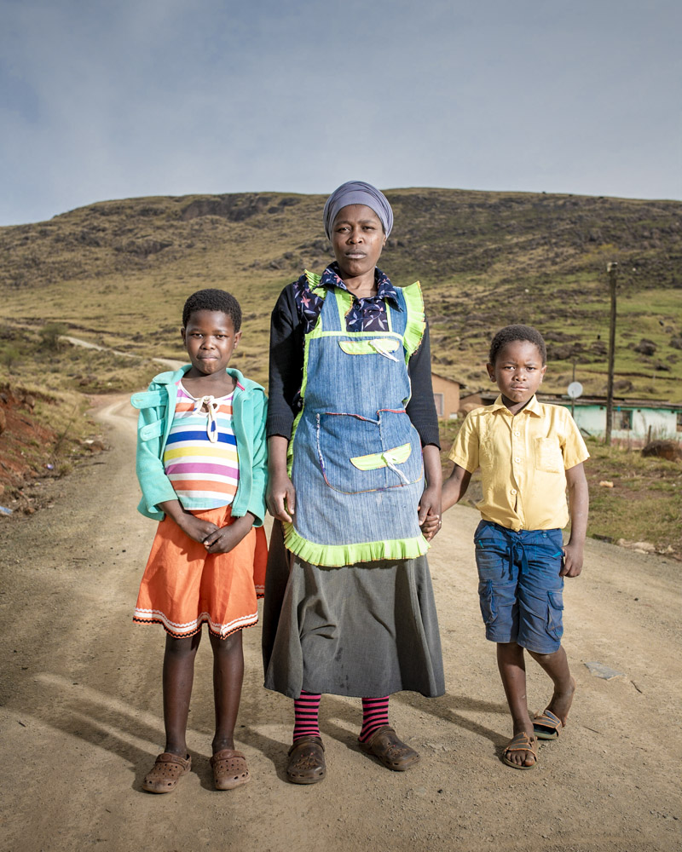
Equity in Maternal and Child Health Outcomes
Multiple satellite sessions highlighted the inequities in women and children, and provided strategies and commitment to reduce these inequities
No Time to Lose: Action to diagnose and treat the missing 800,000 children (co-organized by CDC and UNICEF)
Reducing inequalities, advancing equity: What will it take to achieve sustained epidemic control of HIV
Launch of the Global Alliance Initiative to end AIDS in children by 2030: Building partnerships, communities, and innovation
Photo credit: © Thom Pierce for the Division of Global HIV and TB, CDC
Notes:
Finally, there were a number of non-abstract driven satellite sessions highlighting the inequities in women and children, and provided strategies and commitment to reduce these inequities. CDC and UNICEF co-organized a satellite on pediatric case finding, several sessions at the PAM and IAS around reducing inequities included MCH presentations, and the Global Alliance to end AIDS in children by 2030 was launched. There was much more MCH-related content, and we encourage you all to attend the upcoming UNICEF webinar where Lynne Mofenson will provide a more comprehensive MCH overview.

Slide 14
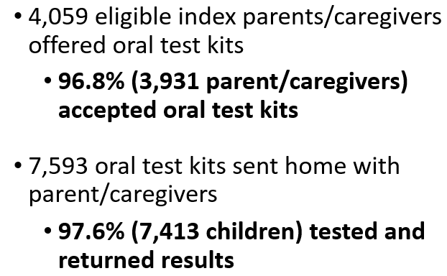
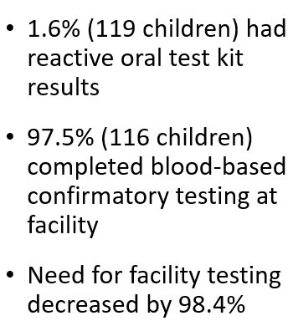
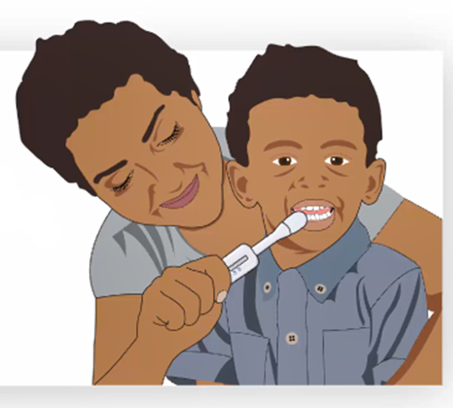
Adding to the HIV Testing Services Toolkit! Caregiver-Assisted Oral HIV Screening of Children 18 Months – 14 Years in Uganda and Zambia (Stecker, Oral Abstract 18, Pediatric Workshop)
Pediatric HIVST had High Acceptability among Caregivers
Key Findings:
High Feasibility
High Effectiveness
Implications for PEPFAR: Data sets from Uganda and Zambia to be shared with WHO to inform the 2023 HIVST guidelines, including guidance for caregiver-assisted HIV oral screening, and OraSure to submit regulatory packet to WHO PQ to revise the information for use (IFU) package insert to include caregiver administration.
Unresolved issues: Cost of oral HIVST kits remains at $2/kit, indicating the need for targeted programming (e.g., children of FSWs, children of index clients living geographically distant from their parents, transport challenges).

Slide 15
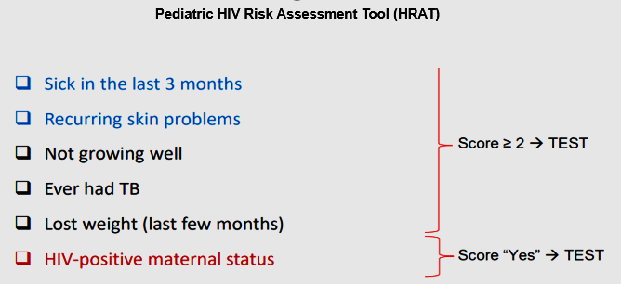
National Implementation of a Validated HIV Testing Eligibility Screening Tool and Expansion of Index Testing Improved Pediatric Case Finding in Uganda (Mabirizi, Abstract 16, Pediatric HIV Workshop)
Key Findings:
National implementation of a validated pediatric HIV risk assessment tool (HRAT) and increased index testing in Uganda increased the number of children diagnosed through testing in outpatient and index services
Use of the HRAT reduced the number needed to test (NNT) to identify one new child with HIV in outpatient to an NNT comparable to index testing
Unresolved issues: Validated tools typically perform better yet require an investment of time and money to conduct validation which may not be possible in all countries.
Implications for PEPFAR: Use of validated HRATs can be incorporated into routine use in outpatient settings, especially for countries with large pediatric treatment gaps, to ensure high-risk children are screened in for HIV testing services.
This study was conducted through the CDC-supported FASTER mechanism
Notes:
Another presentation shared results from national implementation of a validated pediatric HIV risk assessment tool (HRAT) and index testing in Uganda, which increased the number of children diagnosed in both outpatient and index testing settings. Use of the HRAT reduced the number needed to test in outpatient (40) to a number comparable to index testing (46). Unresolved issues include that validated tools perform better, but require investments to conduct validation studies. Implications for PEPFAR include that validated HRATs should be included in pediatric case finding strategies.

Slide 16
Testing non-biological or geographically distant children of PLHIV
Children Accompanied by Caregivers in Research to Validate a Paediatric Screening Tool in South Africa
Dunlop et al. International Workshop on Pediatrics and HIV, Poster 109, 2022.
8% (675) of the 8,278 children were non-biological
HIV prevalence in children with their mother was 0.5% (30 CLHIV) vs. 3.1% in maternal-orphaned children with a caregiver (6 CLHIV)
Est. 21 non-biological CLHIV went undiagnosed
Leaving no child behind: Experiences with Pediatric HIV Index Case Finding in Burundi
Vrazo et al. International Workshop on Pediatrics and HIV, Poster 114, 2022.
6.2% HIV positivity (1,663) among 26,952 tested
6% (1,746) of 28,698 pediatric contacts not tested
Est. 108 CLHIV went undiagnosed
Barriers
disclosure status of WLHIV to their families, and
difficulty following up with indexed children living away from home

Slide 17
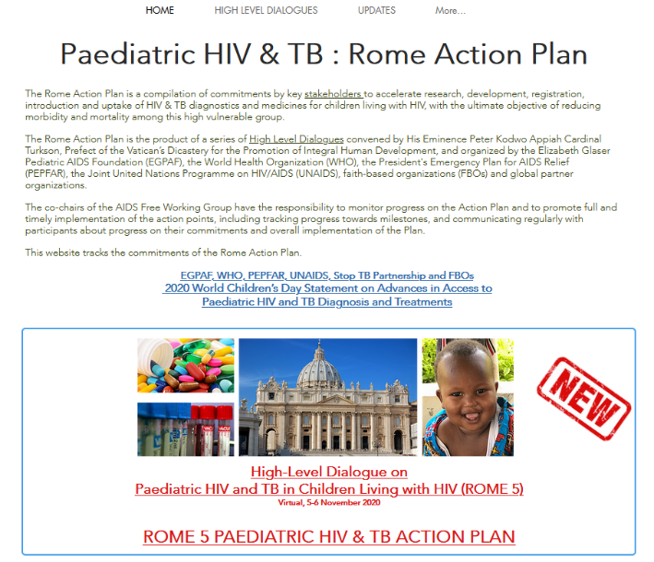
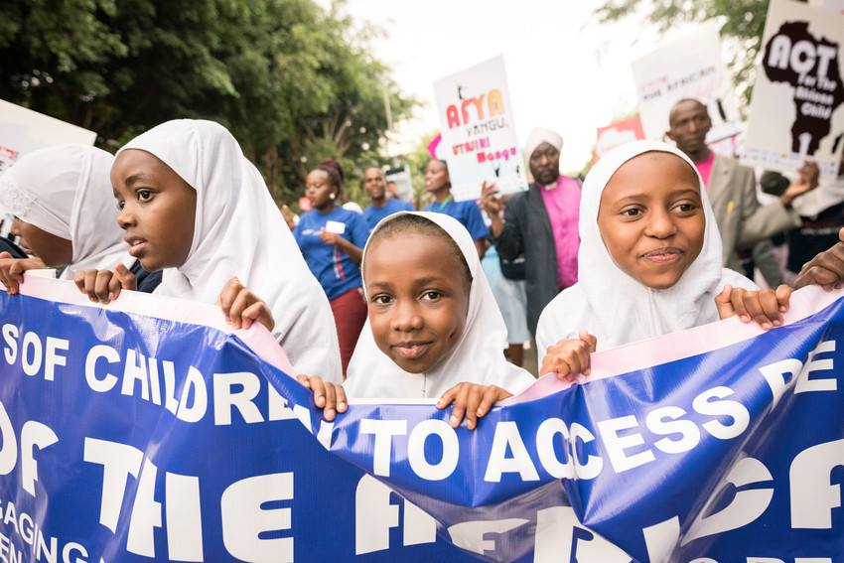
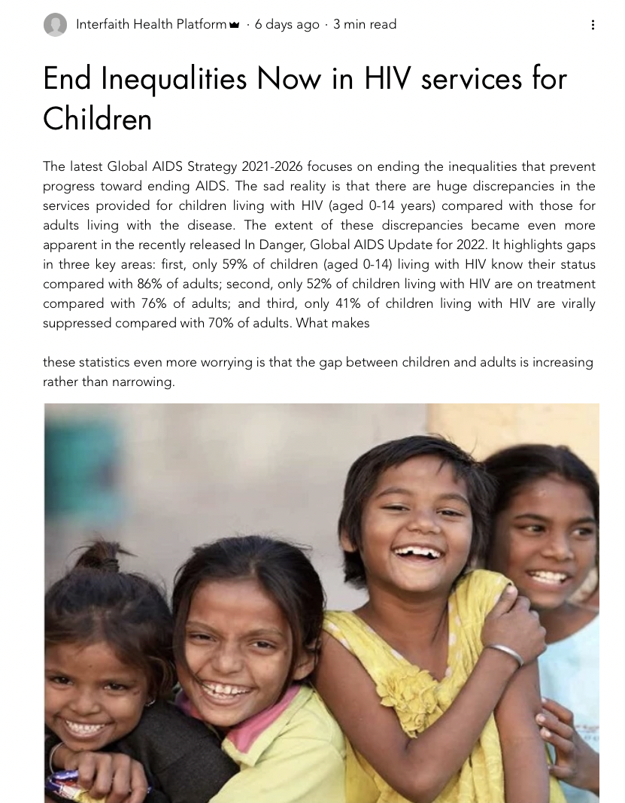
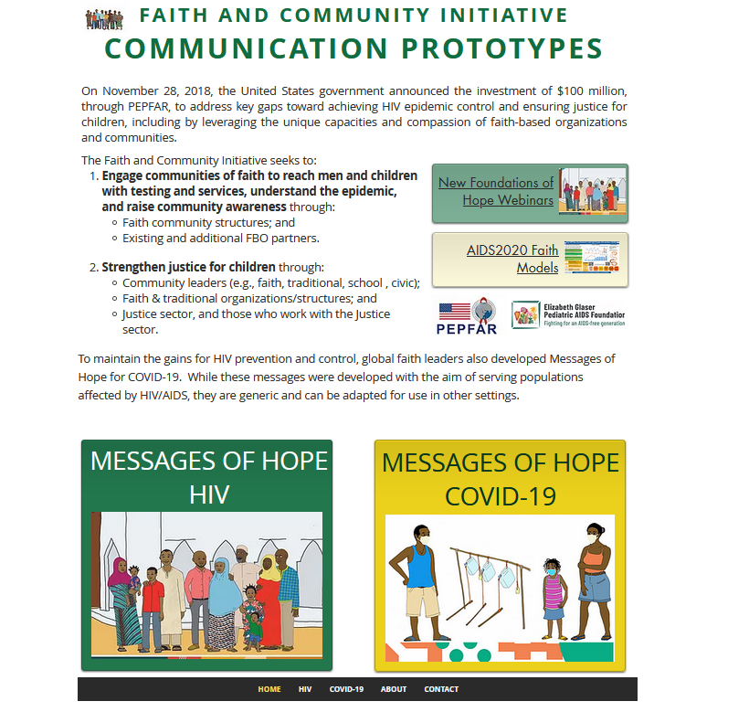
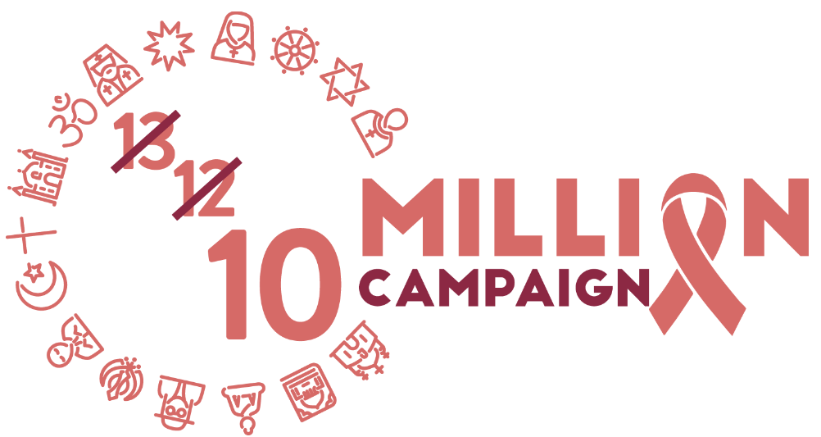
FAITH COMMUNITIES TAKING ACTION TO END AIDS IN CHILDREN

Slide 19
Compendium of Promising Practices on Paediatric & Adolesceents HIV by Faith Health Platforms and Communities
SERVICE DELIVERY THROUGH FAITH INSPIRED HEALTH PROVIDERS
OUTREACH THROUGH FAITH COMMUNITY GROUPS & COMMUNITY VOLUNTEERS
PLACES OF WORSHIP & RELIGIOUS SCHOOLS-
INSTITUTIONS to CREATE AWARENESS, ADDRESS STIGMA & DISCRIMINATION, AND DEMAND FOR HIV SERVICES
ADVOCACY BY RELIGIOUS LEADERS AND FBOs
Notes:
Urges the world to address the inequalities that are slowing progress Inequalities are the key reason why the 2020 global targets were missed. By ending inequalities, transformative outcomes can be achieved for people living with HIV, communities and countries. it requires bold political leadership to challenge and address the social injustices and inequalities that continue to make certain groups of people and entire communities highly vulnerable to HIV infection. Community-led service delivery pioneered by the HIV response is helping to overcome the extraordinary impediments created by COVID-19. Addressing social and structural factors that perpetuate inequalities is key
HIV and AIDS has largely been influenced by politics and victims of ideologies. One key reason is the prejudice and discomfort around the ways HIV is transmitted.
But also, another important factor is that the AIDS epidemic is fuelled by injustices, inequalities and human rights violations
AIDS both exposes and exacerbates multiple fault lines of social and economic inequality and injustice, which in themselves are very political.
An expanding AIDS epidemic reveals a political system’s weak points, whether at the national or the community level.
Politics has been the main driver of action as well as inaction and denial regarding AIDS.
On the one hand, positive political action at both the grassroots and governmental levels has greatly enhanced the global response to AIDS.
Political action on AIDS has also been an opportunity to correct underlying injustices and mobilize positive political momentum around issues such as key population rights.
On the other hand, politics has been a negative force at times, blocking important policy developments and evidence-informed action on AIDS, particularly prevention of sexual transmission of HIV, and harm reduction among injection drug users. Inaction reflects a political denial, an unwillingness to engage in sensitive issues, such as those inextricably linked to HIV transmission.
Community-led service delivery pioneered by the HIV response is helping to overcome the extraordinary impediments created by COVID-19. Addressing social and structural factors that perpetuate inequalities is key
.

Slide 20
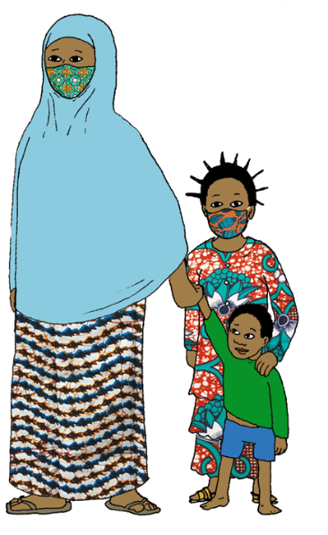
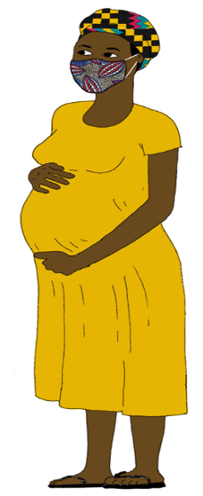
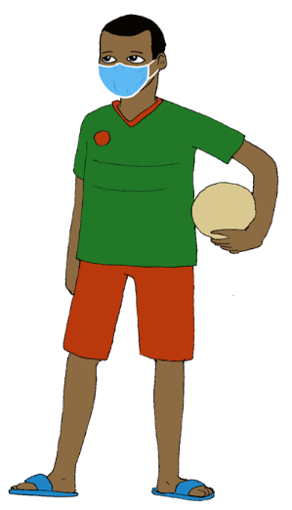
Thank you !

Slide 21
2025 TARGETS
ENSURE THAT 75% OF ALL CHILDREN LIVING WITH HIV HAVE SUPPRESSED VIRAL LOADS BY 2023 AND 86% BY 2025, IN LINE WITH THE 95– 95 – 95 HIV TREATMENT TARGETS

