Slide 1
Bolstering COVID-19 Vaccine Confidence
Chelsea Toledo, MA, MPH
Sr. Health Communications Advisor (Contractor – ASRT)
Adult Immunization Office, Immunization Services Division
FCI New Foundations of Hope Webinar
January 19, 2022
Notes:
Hello, everyone, and thank you for having me today.
My name is Chelsea Toledo, and I’m here on behalf of the Adult Immunization Office within CDC’s Immunization Services Division to provide some examples on what the agency is doing to bolster vaccine confidence through partnerships with faith-based organizations.

Slide 2
Defining Vaccine Confidence
Vaccine confidence is the belief that vaccines work, are safe, and are part of a trustworthy medical system.
Source: https://www.cdc.gov/vaccines/covid-19/vaccinate-with-confidence/building-trust.html
Notes:
Now my presentation was originally entitled “Addressing COVID-19 Vaccine Hesitancy,” but what I really aim to talk about is increasing vaccine confidence. We don’t like to use the word “hesitancy,” because it becomes self-fulfilling. The more we say it, the more it reinforces the ideas that there is a reason to hesitate in taking vaccines. So our communications and outreach tend to flip the script and talk about vaccine confidence.
Vaccine confidence is the belief that vaccines work, are safe, and are part of a trustworthy medical system.
Trust is an important foundation of vaccine confidence, whether that’s trust in the medical establishment, public health departments, the government, pharmaceutical companies, employers, or local leaders like those in faith-based organizations.
A key component of this trust exists outside of the scope of CDC and even modern medicine/public health. It involves leaning on trusted messengers, leaders in communities disproportionately affected by COVID-19. This also extends out to other vaccine-preventable diseases beyond COVID-19.

Slide 3
The Role of Partners in Building Vaccine Confidence
CDC works with a diverse array of partners to instill vaccine confidence in communities
Faith-based organizations and their networks are key, as they serve as trusted messengers
Levin J, Idler EL, VanderWeele TJ. Faith-Based Organizations and SARS-CoV-2 Vaccination: Challenges and Recommendations. Public Health Reports. 2022;137(1):11-16. doi:10.1177/00333549211054079
Notes:
To build vaccine confidence, CDC works closely with a wide variety of partners, and faith-based organizations and their networks are very important leaders in this effort.
In fact, a recent article in Public Health Reports touted faith-based organizations as “key players historically in public health outreach in the United States and globally,” with examples of their contributions to malaria control, HIV/AIDS relief, and other efforts.

Slide 4
Source: University of Kentucky, https://youtu.be/uAWyqMLNVXU
Notes:
To drive home the point of how important faith-based organizations are in increasing vaccine confidence among communities, I'd like to share a short video clip shared with us by the University of Kentucky, which partners with faith-based organizations for its community health days. This work was supported by the Health Resources and Services Administration of the US Department for Health and Human Services.

Slide 5
Examples of CDC’s Partnerships with Faith-Based Organizations (FBOs) to Increase Vaccine Confidence
Supporting jurisdictions which partner with faith communities for vaccination sites and volunteers at vaccination events
Offering Vaccine Confidence Bootcamps to community leaders and organizations, including faith-based groups, to promote vaccine confidence
Development of State of Vaccine Confidence Insights Reports identifying threats to vaccine confidence and ways organizations can act
Funding Prevention Research Centers to create a rural vaccination task force, including FBOs
Funding land grant universities (with USDA) who partner with FBOs via the Extension COVID Immunization Training and Education (EXCITE) program
Funding national, local, and community-based partnerships via the Partnering for Vaccine Equity program
Notes:
On this slide, I have listed a few of the areas in which CDC has partnered with faith-based organizations to increase vaccine confidence. Note, however, that CDC is a large agency, so this is not a fully representative list.
Some of this work includes… [read the slide]

Slide 6
Partnering for Vaccine Equity (P4VE)
Through the Partnering for Vaccine Equity program, CDC aims to improve equity in adult immunization across disproportionately affected populations, including racial and ethnic minority groups, through partnerships with faith-based organizations and other groups to drive community-level action.
Funded Partnerships
Funding to partners on the ground: CDC has provided $6.7B to jurisdictions and over $156M* million to 500+ partners across national, state, and community levels working in racial and ethnic minority communities, including faith-based organizations
Technical Assistance
Technical assistance for partners to accelerate their efforts: CDC provides hands-on support through peer-learning sessions, expert and 1:1 coaching, materials sharing, and data analytics support
Guidance & Communications
Guidance and communications for funded partners, Immunization Awardees, and other stakeholders: CDC develops guidance, communications, and resources to share vaccine information, best practices, and strategies
*This does not include an additional $150M to fund other partners supporting vaccine equity for other disproportionately affected adult populations
https://www.cdc.gov/vaccines/health-equity/index.html
Notes:
While CDC supports a variety of partnerships with faith-based organizations, I’m going to focus on those supported by the Partnering for Vaccine Equity program, as that is the program I support.
Program Overview
The Partnering for Vaccine Equity program supports efforts to increase influenza and COVID-19 vaccination coverage for adults in racial and/or ethnic populations experiencing disparities in the United States. This includes funding national organizations who partner with faith-based organizations at the community level to equip influential messengers by providing trainings and materials, increase vaccination opportunities and enhance provider partnerships, and establish partnerships with state and local health departments
Partners of the program receive hands-on technical assistance from CDC and other partners, as well as guidance on using data to inform their outreach efforts.
CDC is also providing partners, immunization awardees, and other stakeholders with communications and resources that share best practices and strategies.

Slide 7
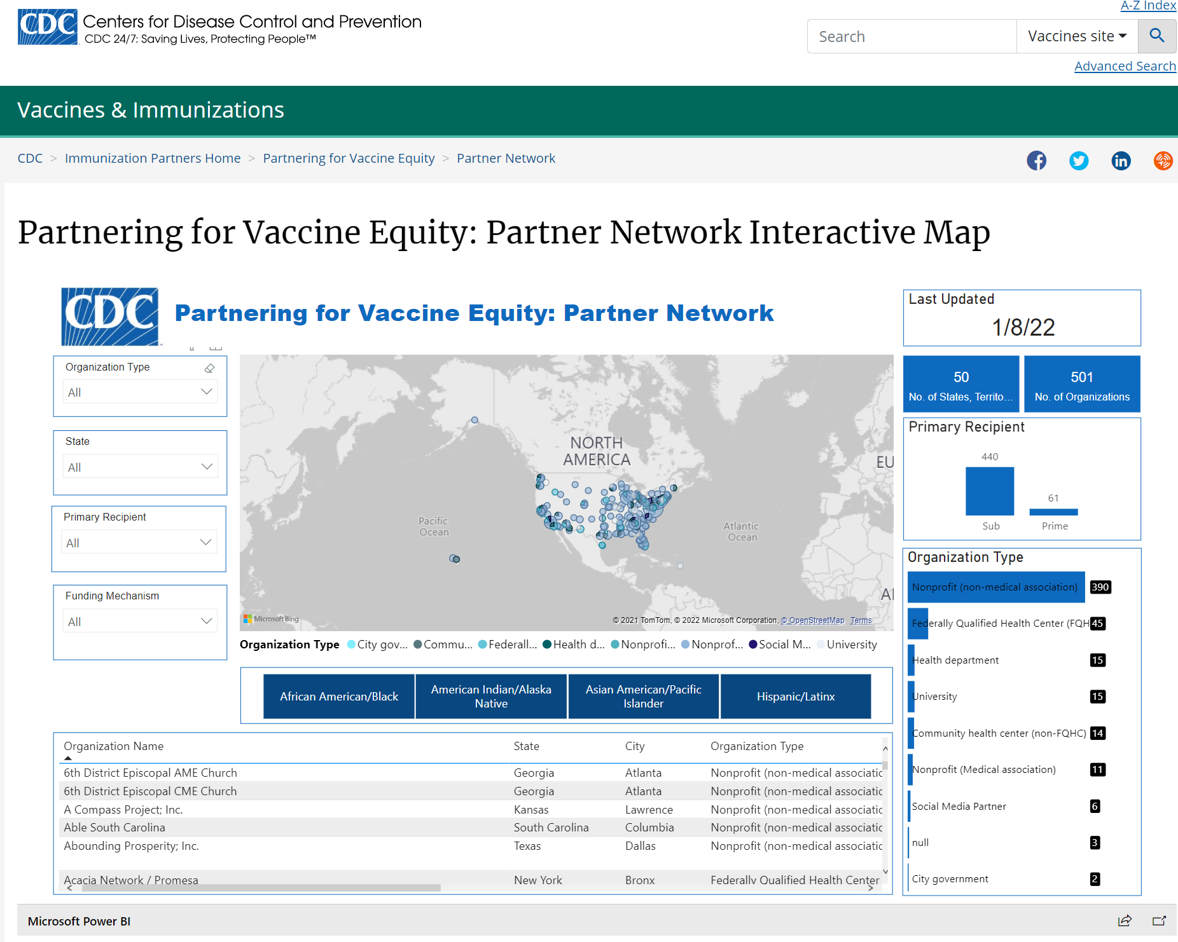
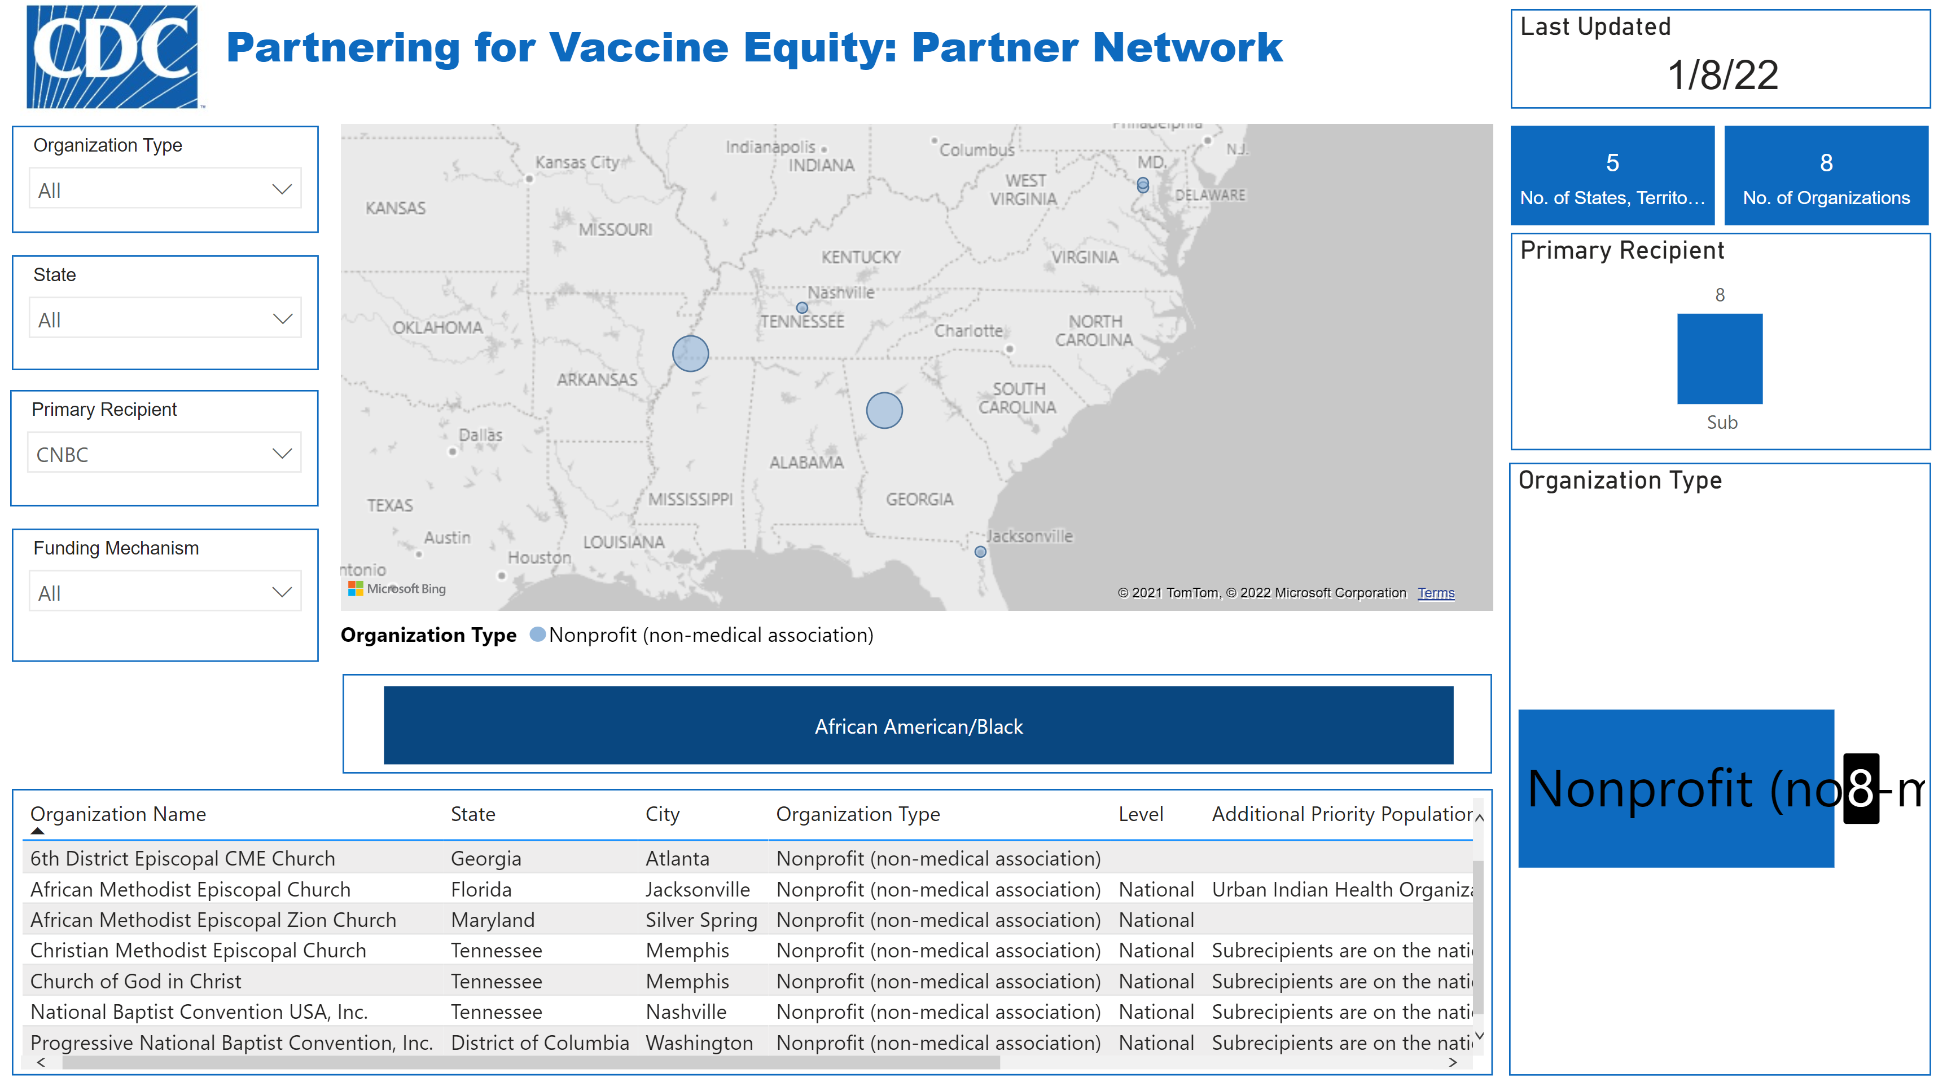
https://bit.ly/P4VEPartners
Notes:
I’m going to expand a bit on what the peer learning and one-on-one technical assistance looks like, but first I thought it would be helpful to give you an idea of who the funded partners are.
In November, CDC published an interactive map of the more than 500 organizations funded through Partnering for Vaccine Equity. If you look at this screenshot, where it says “Organization Name,” you can see a church right at the top of the list.
If you’d like to explore this map for yourself, I have created a shortened link for you, which you can see at the bottom of the screen. It’s bit.ly/P4VEPartners. Just go to your browser and type in bit dot L Y, slash capital P, number 4, capital V, capital E, then partners with a capital P.
Once you get there, you can scroll through the entire list, or sort by Organization Type, State, or Primary Recipient.
For instance, if you search by Primary Recipient (CLICK FOR ANIMATION) and then select “CNBC,” which stands for the Conference of National Black Churches (CLICK AGAIN), you’ll see a list of churches which are sub-recipients of the funding to CNBC, and where they are located. This is just one example of how to use this resource, which of course is returning churches. However, I should also note that we partner with many faith-based organizations, including the Buddhist Tzu Chi Medical Foundation in California, the Dar Al-Hijrah Islamic Center in Virginia, the Jewish Vocational Service Bureau of Kansas City, Missouri, and many more.

Slide 8
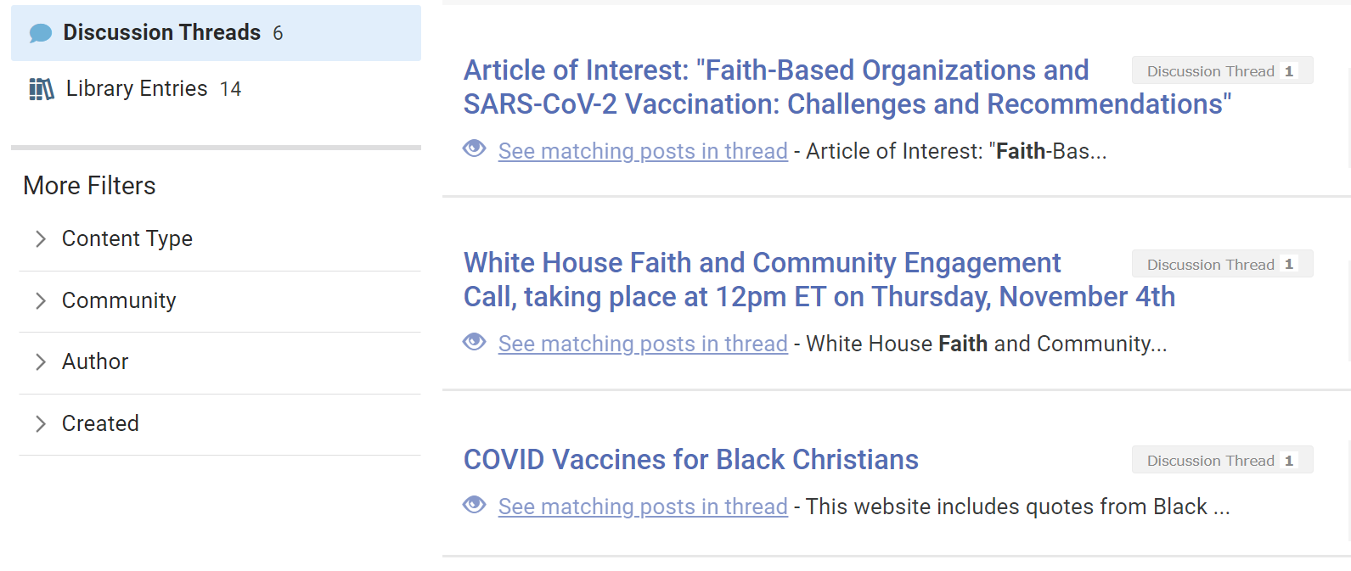
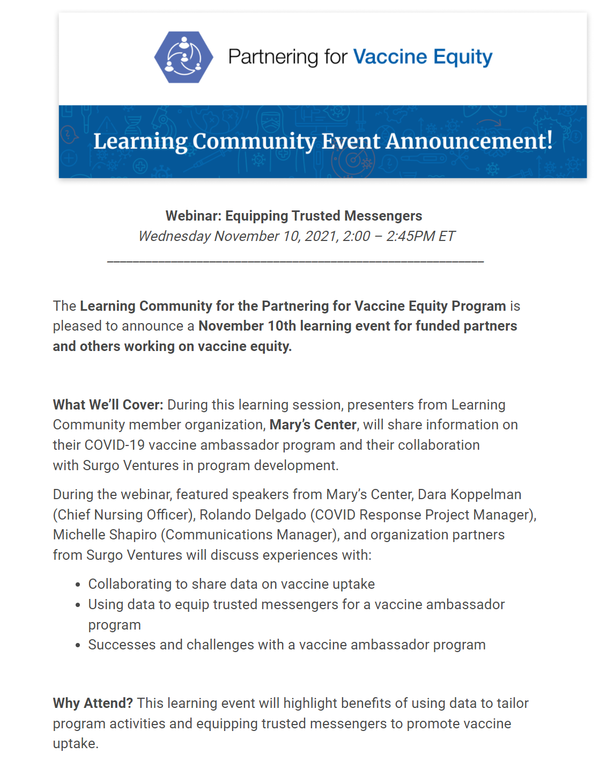
Support for P4VE Partners
Notes:
On a previous slide, I mentioned that CDC provides hands-on support through peer-learning sessions, expert and 1:1 coaching, materials sharing, and data analytics support. So what does that actually look like?
(CLICK MOUSE) One of the ways in which CDC supports its partners, including faith-based organizations, is through its Learning Community. This provide opportunities for peer-learning, including through webinars at which funded partners share their best practices. I’ve displayed an example of a past webinar on the topic of equipping trusted messengers.
(CLICK MOUSE) In addition to these bigger events, funded partners also have the opportunity to attend smaller “Office Hours” events, where they can ask the experts their questions directly. One-one-one support is also provided through CDC’s project officers, who serve as points of contact and provide technical assistance along the way.
(CLICK MOUSE) In terms of Materials Sharing, CDC has funded the development of a Learning Community website where funded partners can share and access information relevant to increasing vaccine confidence and vaccine uptake at the community level. Here, I’ve included a screenshot showing discussion board posts related to faith-based organizations.
(CLICK MOUSE) Finally, Partnering for Vaccine Equity provides data-informed technical assistance to its funded partners. That can take the form of analyses of populations within a given geographic boundary, looking for members of a priority population with given health risks, such as diabetes. These data can inform vaccination campaigns and allow partners to tailor their outreach to specific populations.

Slide 9
Impact of Partnership: Conference of National Black Churches (CNBC)
CNBC is comprised of the national leadership of the seven largest historically Black denominations in America, representing more than 80% of African American Christians with a combined membership of over 20 million people and 30,000 congregations.
Recent Activities (October - November 2021)
Success Story
Expanded national campaign to promote COVID-19 vaccination and broaden their reach to address disparities in adult vaccination by including additional predominantly White denominations with significant African American membership
Reported adding 35 new churches as vaccination sites, training over 2100 pastors, and administering nearly 300,000 vaccines cumulatively
Trained around 30 of Disciples of Christ pastors in CNBC’s vaccine education webinars and more are expected through the end of 2021
Launched new partnership with NAACP (non-religious, non-partisan civil rights organization) to help equip pastors and ministers of Black churches with training and messaging to overcome vaccine hesitancy among their membership
St. Phillip AME Church in Decatur, Georgia
Holds vaccine clinics every Thursday and gave 499 vaccines in October, 90% of them boosters
Conducted two separate 4-day events with the capacity to vaccinate 1,000+ people a day in November (data forthcoming)
CNBC’s Lessons Learned
People involved in the communities are very influential
It’s important to be patient and keep going little by little because changing attitudes, overcoming hesitancy, and building and rebuilding trust takes time
Listen and don’t assume – have discussions and don’t shy away from opposition or differing voices
Notes:
So what are the results of this partnership? Let’s take a look at one of our funded partners, the Conference of National Black Churches, or CNBC.
Background
CNBC is comprised of the national leadership of the seven largest historically Black denominations in America. The organization represents more than 80% of African American Christians across this nation that have a combined membership of over 20 million people and 30,000 congregations. Their mission is to speak with a unified voice of black religious bodies that seeks to improve the quality of life for African Americans as they seek to reach their full potential in American society.
Recent Activities
CNBC’s national campaign to promote COVID-19 vaccination and broaden their denominational and extra-denominational reach to address disparities in adult vaccination began in September and was expanded in October to include additional predominantly White denominations with significant African American membership, including: Disciples of Christ, United Methodist, United Church of Christ, and Presbyterian USA.
Over the past months, CNBC reported adding 35 new churches as vaccination sites, training over 2100 pastors, and administering nearly 300,000 vaccines cumulatively.
In partnership with Rev. Dr. Terri Hord Owens, the first African American and first female president in the history of a predominantly White denomination, Disciples of Christ, CNBC trained around 30 of their pastors through the organization’s vaccine education webinars during the month of October and more are expected through the end of 2021.
Additionally, CNBC launched a new partnership with NAACP, a non-religious, non-partisan civil rights organization, to help equip pastors and ministers of Black churches with training and messaging to overcome vaccine hesitancy among their membership.
Success Story
An example of a success story of one of CNBC’s partners is St. Phillip AME Church in Decatur, Georgia, who holds vaccine clinics every Thursday.
In October, they gave a total of 499 Vaccines, 90% of them boosters. Individuals can choose what vaccine they would like to have, within CDC guidelines of mixing and matching vaccine with booster.
St Phillip also planned to conduct two separate 4-day events in which they expected to vaccinate over 1,000 people a day in November.
Lessons Learned
People involved in the communities are very influential.
Changing attitudes and overcoming hesitancy takes time. Building and rebuilding trust takes time. It’s important to be patient and keep going little by little.
Listen and don’t assume – it’s important to have discussions and not shy away from opposition and differing voices.

Slide 10
Other Faith-Based Organizations’ Successes
Faith-based organizations are among the more than 250 community-based organizations (CBOs) receiving tools and technical assistance from CDC and three partners: CDC Foundation, Urban Institute, and Community Catalyst. Faith-based organizations and other CBOs are equipping influential messengers with trainings and materials, increasing vaccination opportunities, and establishing partnerships with state and local health departments.
Dar Al-Hijrah Islamic Center
Jewish Vocational Service Bureau of Kansas City
“Our major success [in October] was through our online video messaging. We posted these 9 short videos by community leaders and health professionals in 5 different languages, approximately reaching 82,000 people. These videos were viewed by 19,400 people.”
“[Our] new Refugee Medical Case Manager (RMCM) was able to help over 50 Swahili, Kinyarwanda, and Kibembe speakers register for the COVID vaccine and answer their questions at a vaccine clinic hosted by a local health department [in October].”
Notes:
Spotlights
Here are two success stories from faith-based organizations working in the P4VE program.
Dar Al-Hijrah Islamic Center was able to reach 82,000 people through 9 short videos by community leaders and health professionals in 5 different languages and these videos were viewed by 19,400 people.
Jewish Vocational Service Bureau of Kansas City was able to help over 50 Swahili, Kinyarwanda, and Kibembe speakers register for the COVID vaccine and answer their questions at a vaccine clinic hosted by a local health department.

Slide 11
Thank you!
ctoledo2@cdc.gov
Notes:
With that, I believe my time is coming to an end. If there is one message I can leave you with, it’s this – Vaccine Confidence is rarely instilled directly by government authorities. It’s crucial that we partner with the institutions and messengers that communities trust. Faith-based organizations are among the most trusted entities among many communities – especially those who are at the greatest risk of COVID-19. The work that you all do in reaching people is invaluable, and I’d like to thank you personally for your perseverance during these trying times.
Thank you for your time and attention today. We appreciate your participation and all you do.

