Slide 1
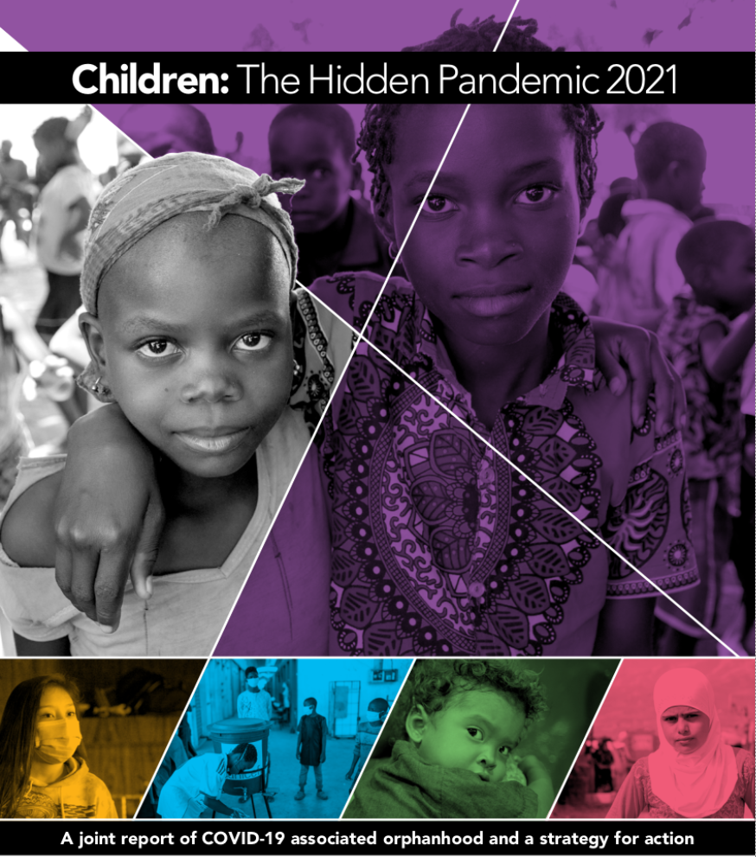









Overcoming COVID-19 Threats to Children:
Susan Hillis, PhD, MS, Centers for Disease Control and Prevention, December 17, 2021

Slide 2
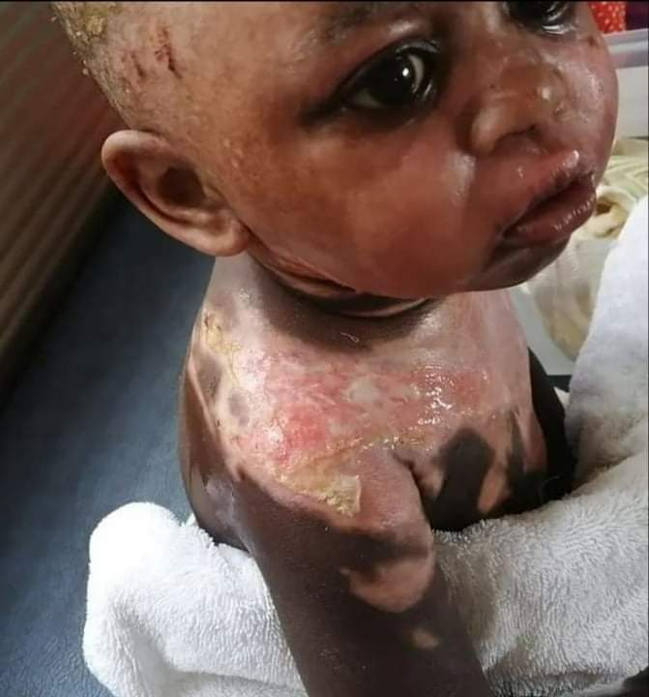
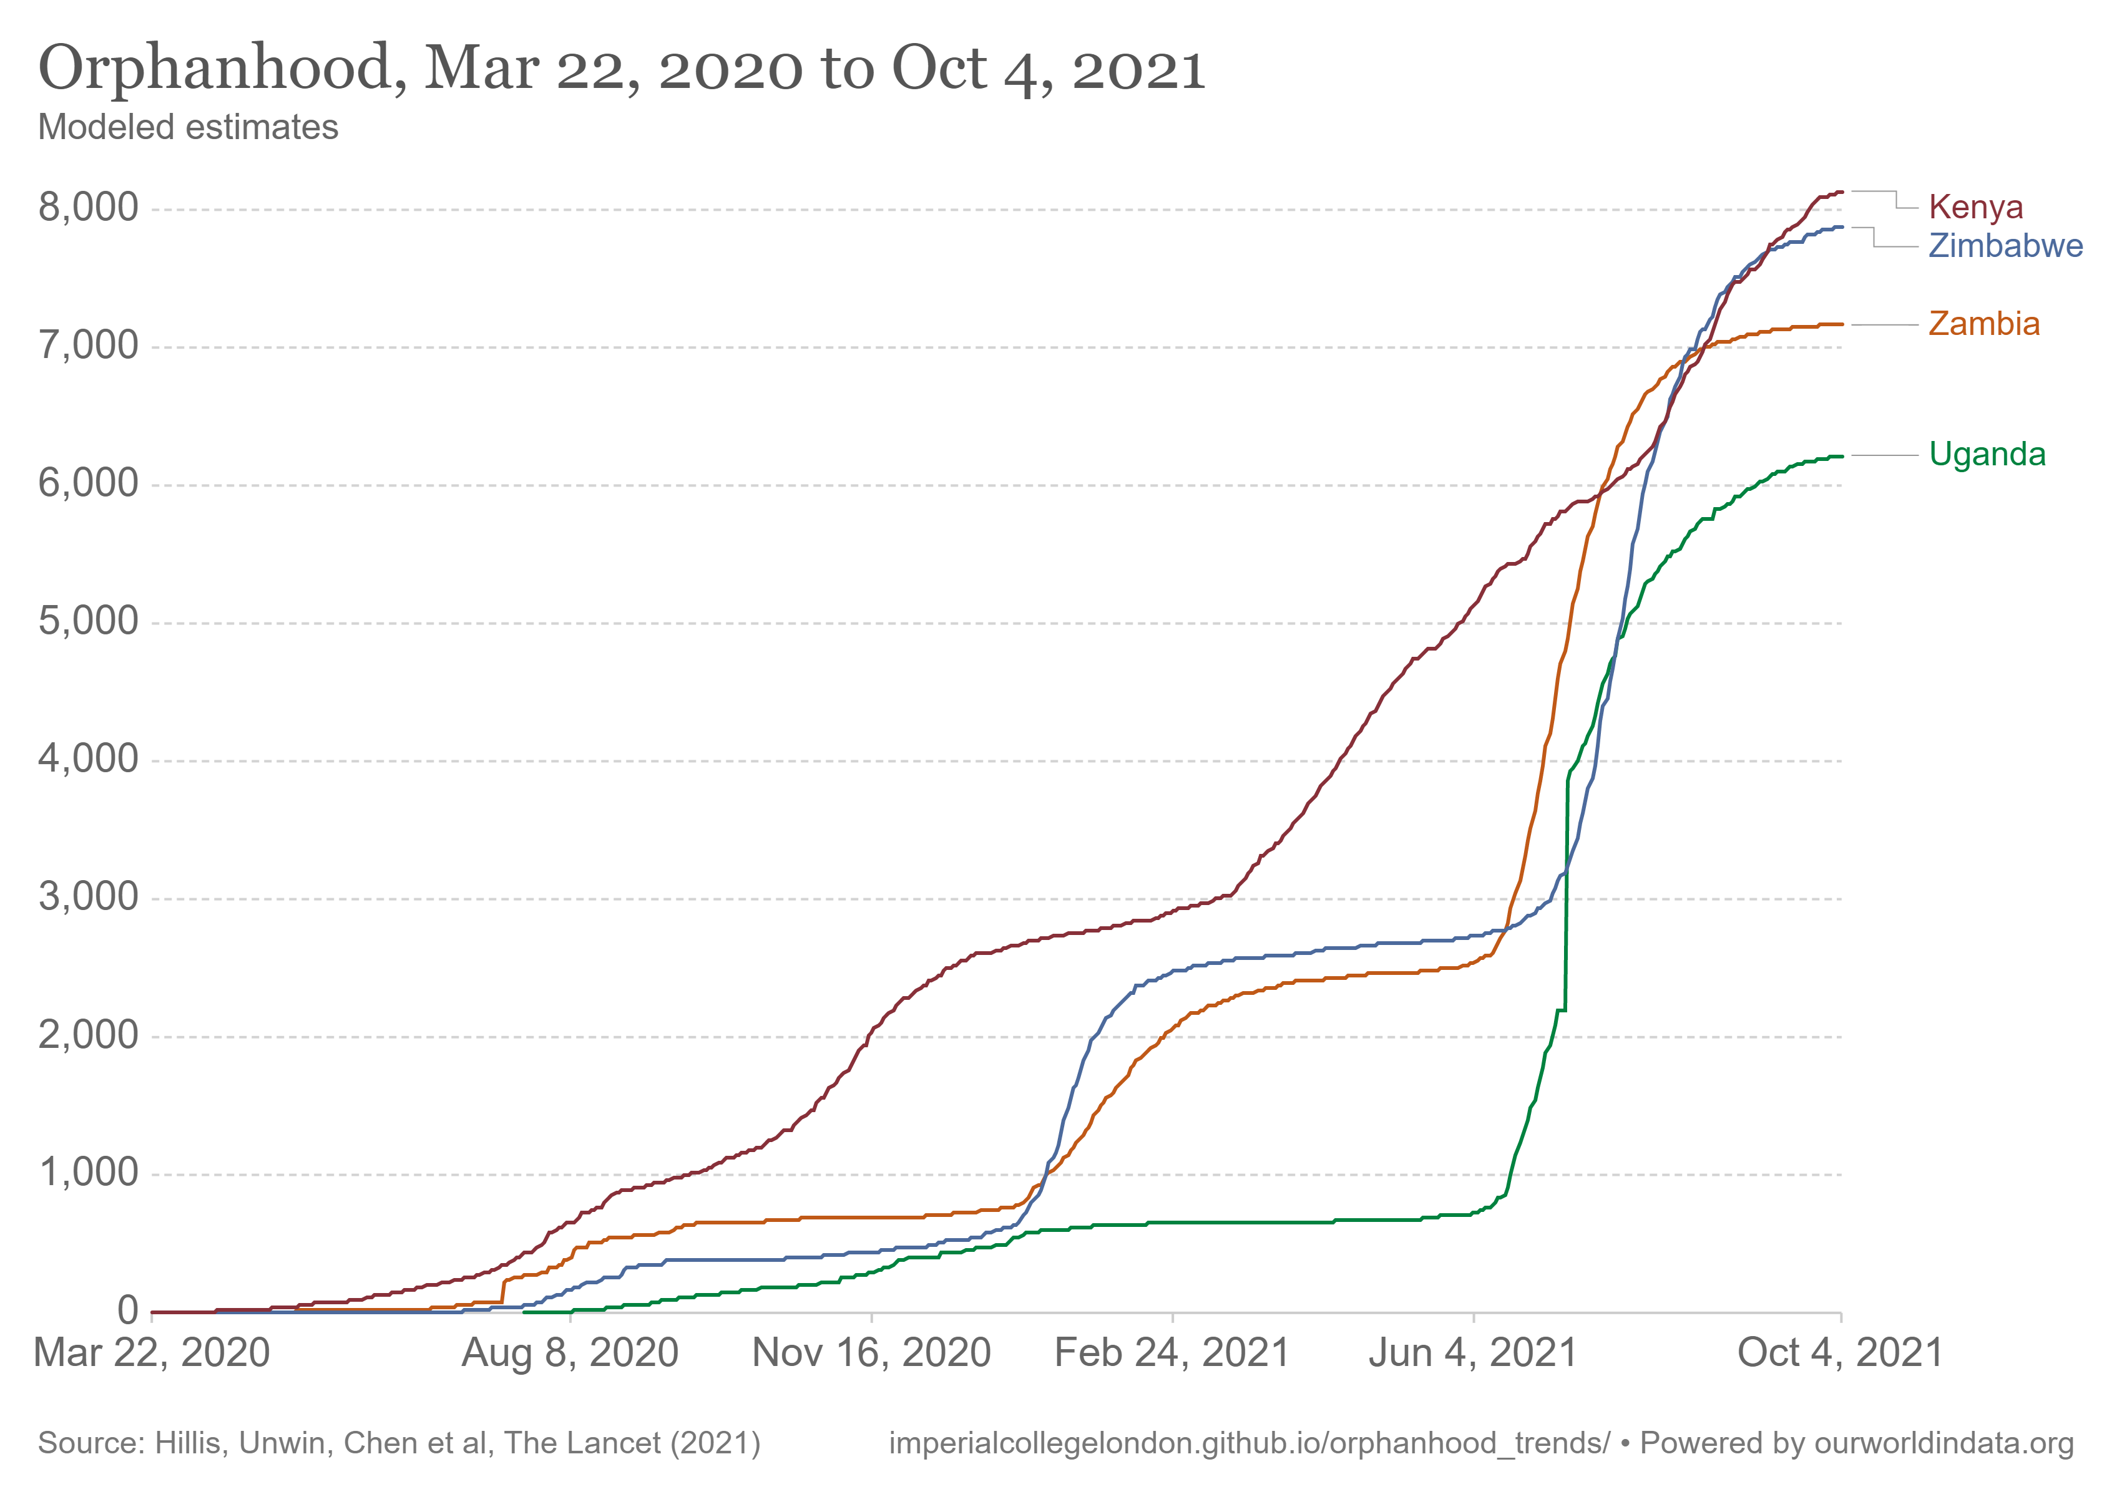
Data Meets Care: Every surge is comprised of faces
This little girl dumped boiling water on herself, alone after her grannie died at home from COVID
Used with permission, Rev Biliiance Chondwe, Kapiri Mposhi, Central Province, Zambia
covid19orphans-widget (imperialcollegelondon.github.io)

Slide 3
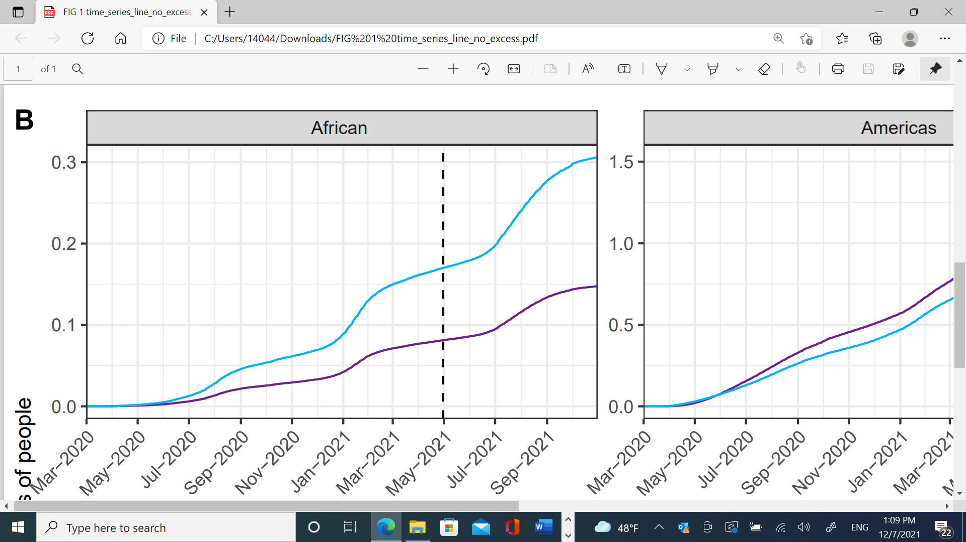
AFRICAN REGION: Number of children affected by COVID-19-associated orphanhood and caregiver death double the number of COVID-19 deaths, Oct 31, 2021
COVID-19 associated orphanhood and caregiver death
COVID-19 deaths
Millions of people
Source:5.2 Million Children Affected by Global Surges in COVID-19-Associated Orphanhood and Caregiver Death, pre-print, The Lancet Child and Adolescent Health https://papers.ssrn.com/sol3/papers.cfm?abstract_id=3971556

Slide 4
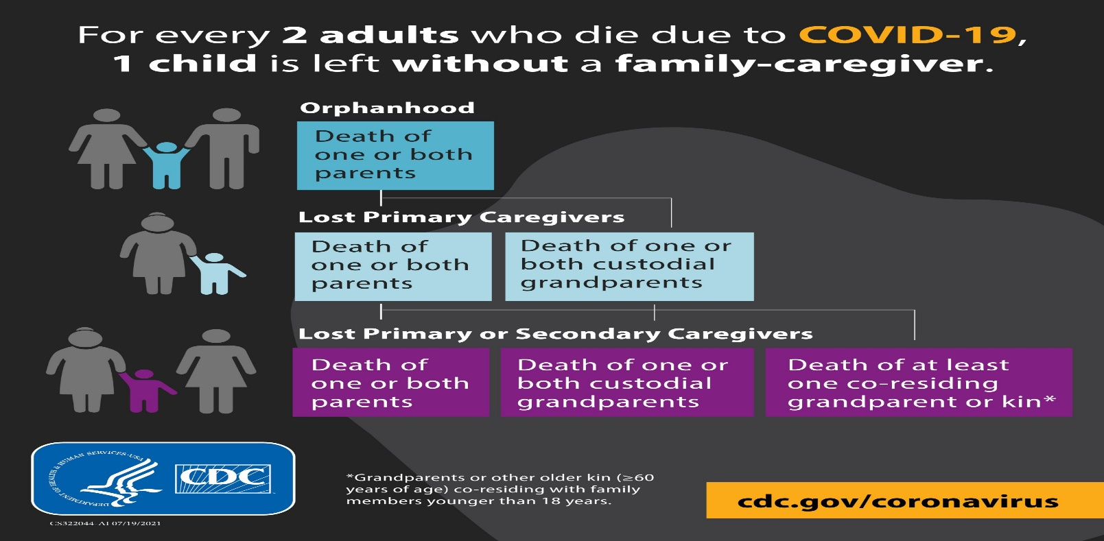
Global minimum estimates of children affected by COVID-19-associated orphanhood and caregiver death, from new mortality data, Oct 31, ’21
3.3 million
children
3.5 million
children
5.2 million
children
Cumulative numbers
by 31st October 2021

Slide 5
Our updated estimates using new available data show that a minimum of 5.2 million children have experienced death of a mother, a father, or a grandparent caregiver. As big as these numbers are, they are only global minimum estimates.
This means over the past 6 months,
1 child has been affected every 6 seconds.
Addressing the loss these children have experienced – and continue to experience, must be a top priority for emergency response both now and in the future.

Slide 6
CARE for COVID-19-Affected Children: ‘3 P’s’ Logic model
Accelerated equitable vaccine uptake
Children Reach their
Full Potential
in Safe & Loving Families
PREVENT COVID-19-deaths of caregivers
PROTECT children from poverty, adversity and violence
PREPARE family-based support, avoid institutionalization
CASH + CARE:
Economic + Parenting Support
Public health
Safe and timely clinical care
Kinship care,
fostering, adoption
Case management
EDUCATION: Safe schools & life skills

Slide 7
Together, we can ensure children affected by COVID-19-associated orphanhood do not remain hidden
Photo courtesy of Vanitashray NGO, India.
Sources: A Joint Report on Orphan Estimates and Program Strategies. Appendix 1. Available at: https://data.unaids.org/topics/young-people/childrenonthebrink_en.pdf and
Hillis S, Unwin HJT, Chen Y, et. al. Global minimum estimates of children affected by COVID-19-associated orphanhood and deaths of caregivers: a modelling study. Lancet. 2021 Jul 31;398(10298):391-402. doi: 10.1016/S0140-6736(21)01253-8. Epub 2021 Jul 21; data updated https://papers.ssrn.com/sol3/papers.cfm?abstract_id=3971556 .

Slide 8
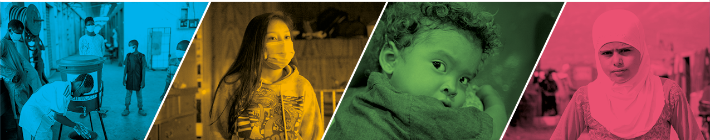
DISCLAIMERS
World Bank Group and World Health Organization:
This work is a product of authors working across various institutions. The findings, interpretations, and conclusions expressed in this work are entirely those of the authors. They do not necessarily reflect the views of the authors’ employers, their boards, or the governments they represent.
U.S. Government:
The views, findings, and conclusions in this article are those of the authors and do not necessarily represent the views or official position of the U. S. Centers for Disease Control and Prevention (CDC),
USAID, PEPFAR, or the U. S. Government.

