Slide 1
Combination Prevention and
Ending Stigma
Overview based on the 2025 Targets
And Prevention Roadmap
Francesca Merico
PEPFAR New Foundations of Hope; PEPFAR – UNAIDS Faith Initiative

Slide 2
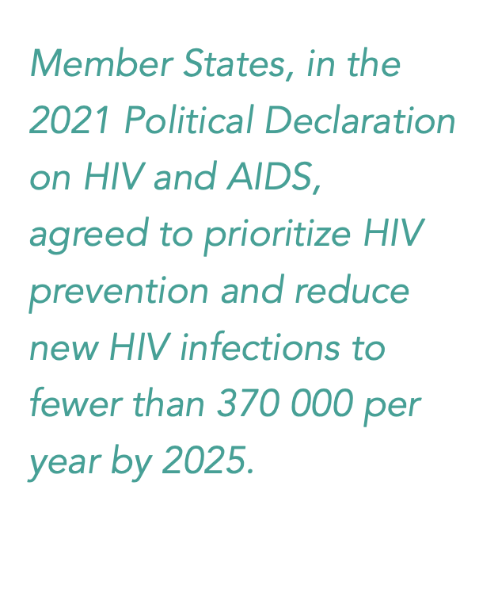
GLOBAL AIDS STRATEGY
2021 - 2026
Confronting stigma and discrimination is a prerequisite for effective prevention and care.
Discrimination on the grounds of one’s HIV status is a violation of human rights.
Notes:
Global consensus on the importance of tackling AIDS-related stigma and discrimination is highlighted by the Global AIDS Strategy 2021 – 2026 and by The Political Declaration on HIV & AIDS – adopted by all UN member states in 2021. Both these docs affirm that confronting stigma and discrimination is a prerequisite for effective prevention and care, and reaffirms that discrimination on the grounds of one’s HIV status is a violation of human rights.

Slide 5
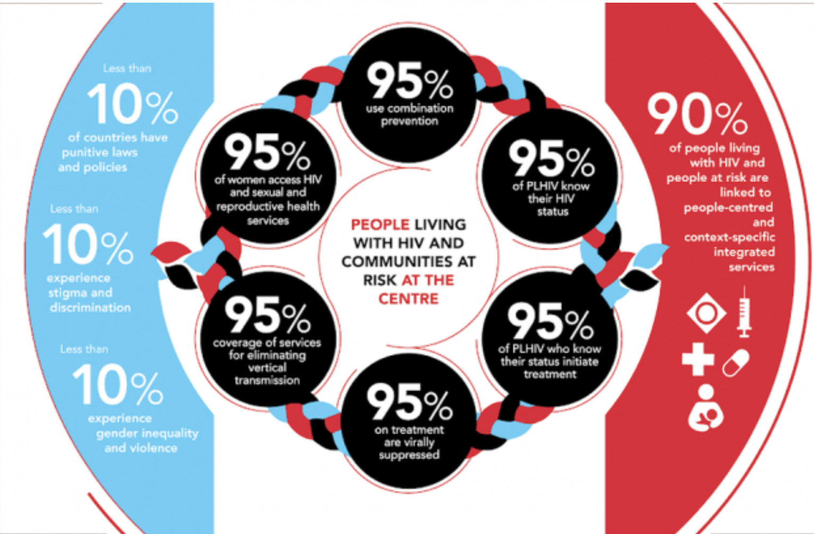

Slide 7
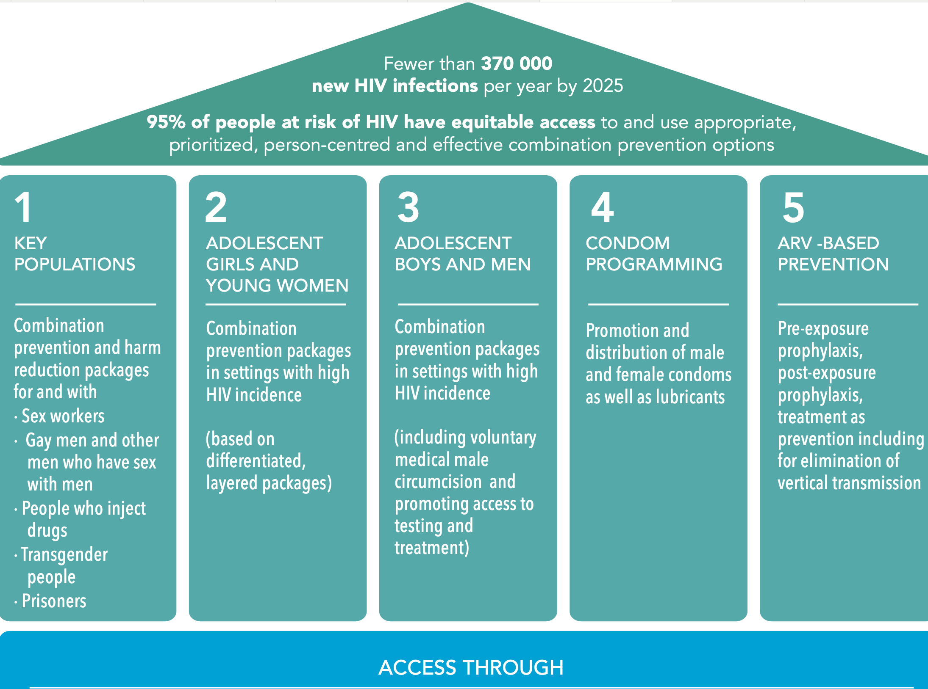

Slide 8
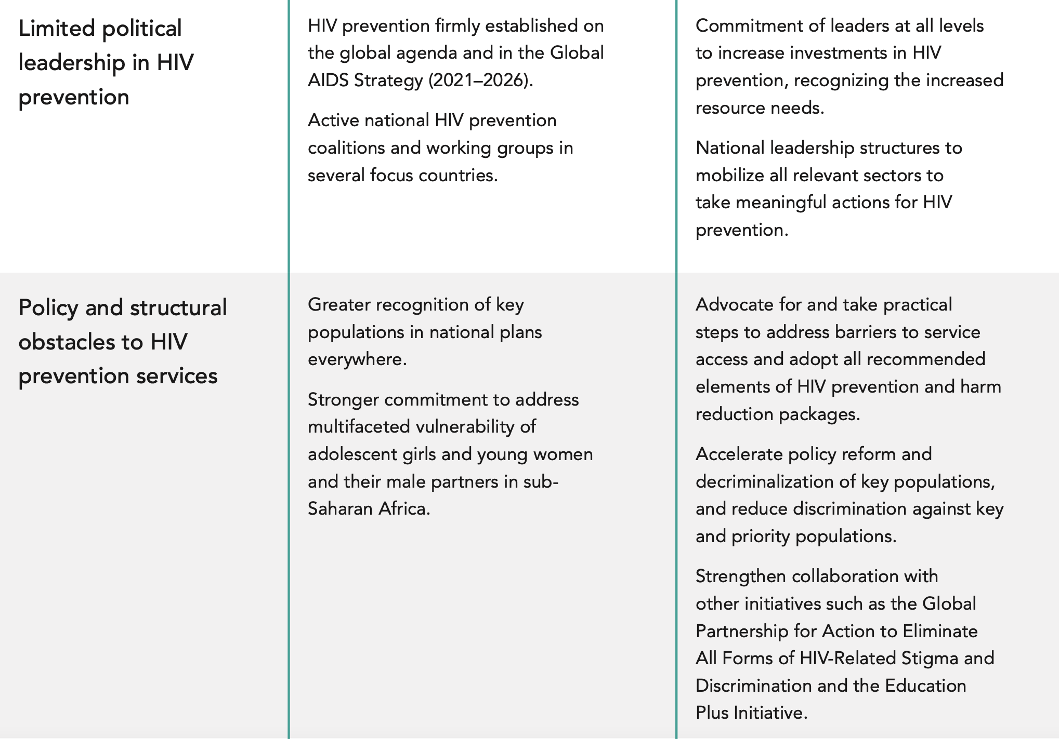

Slide 9
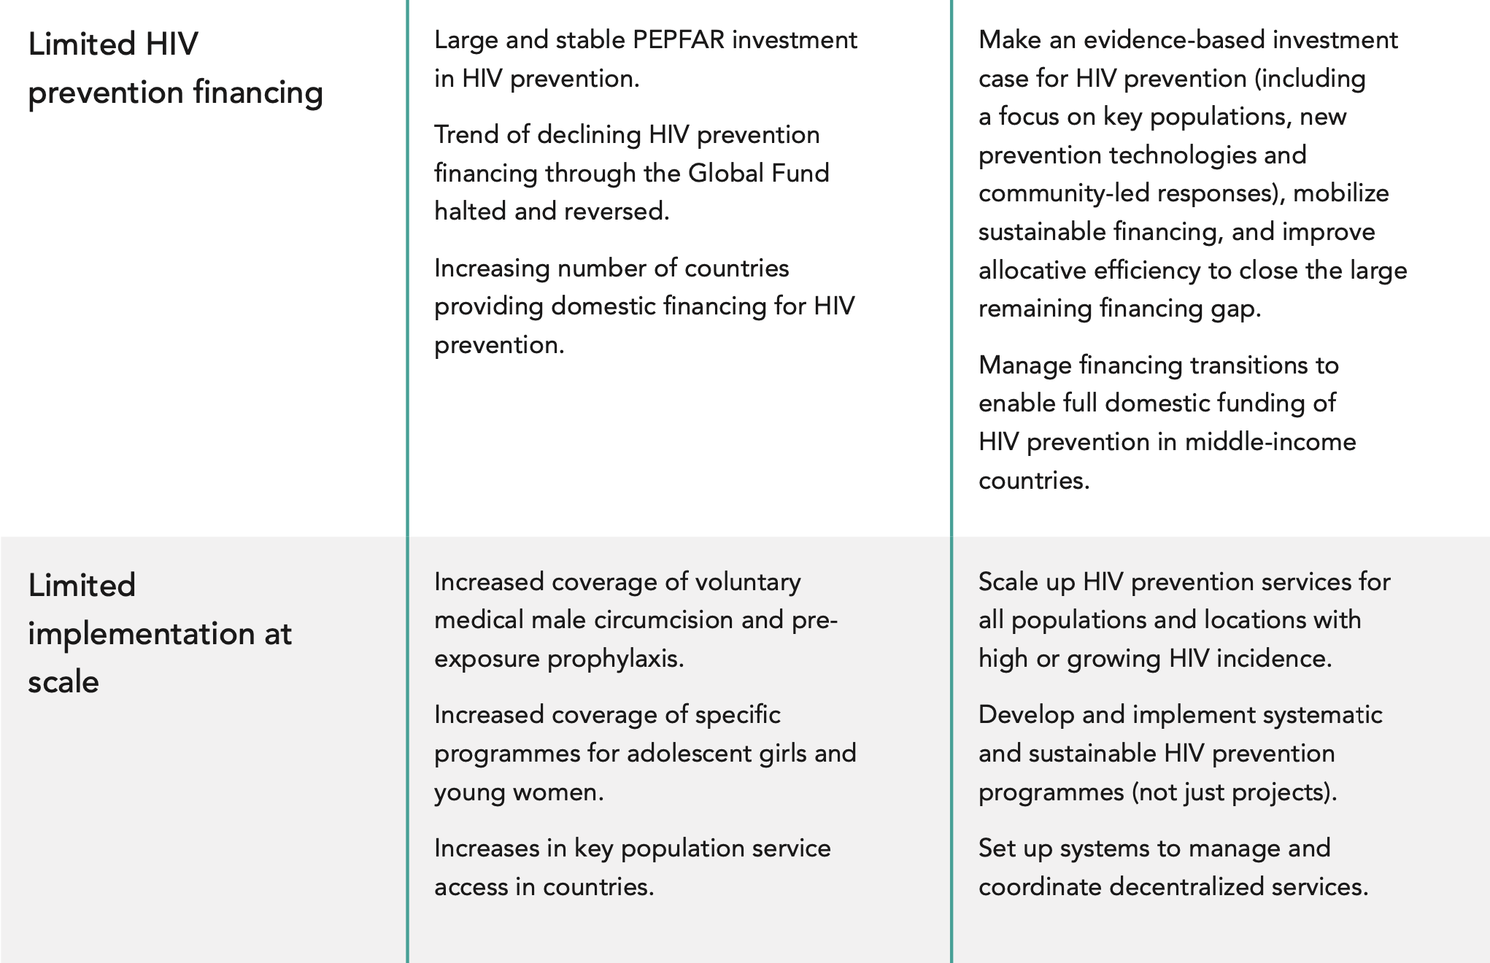

Slide 11
THANK YOU https://www.faithandcommunityinitiative.org

